Slide 1
ENDOCRINE PHYSIOLOGY
PROF. ABDULMAJEED AL-DREES

Slide 2
OBJECTIVES
By the end of this lecture, students should be able to describe :
Hormones
Definition
Chemical structure
Paracrine and autocrine
Secretion and clearance of hormones
Mechanism of action of hormones
Hormone receptors, down-regulation and up-regulation
Intracellular signaling
Second messenger mechanism (cAMP, IP₃)

Slide 3
GLANDS
Exocrine gland.
Endocrine gland.

Slide 4
What is hormone?.
Chemical substance secreted in a small amount from endocrine gland directly to the blood stream in response to stimulus to cause physiological responses at the target tissues.

Slide 5
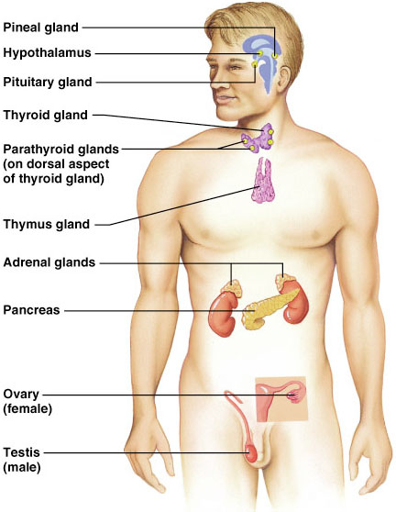
ENDOCRINE GLANDS

Slide 6
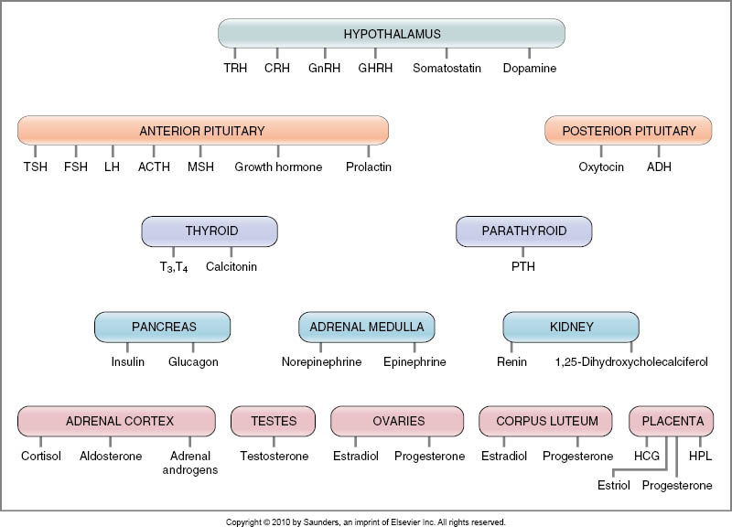

Slide 7
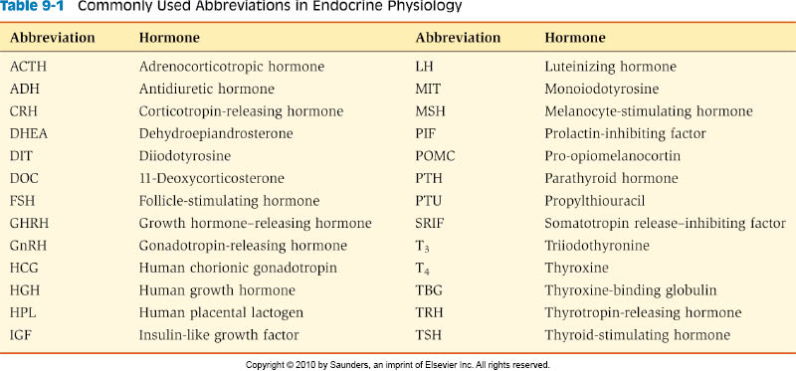

Slide 8
CHEMICAL CLASSIFICATION OF HORMONES
Peptides or proteins hormones.
Steroid hormones.
Amine hormones.

Slide 9
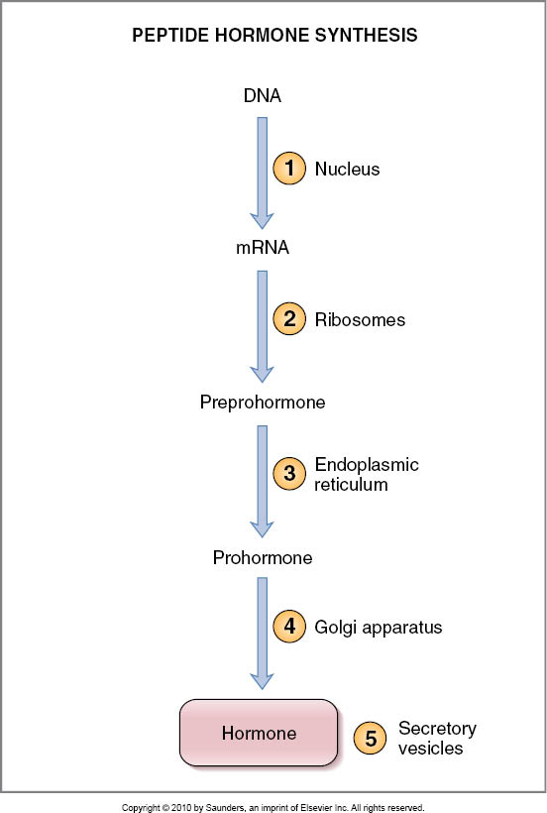
HORMONES SYNTHESIS

Slide 10
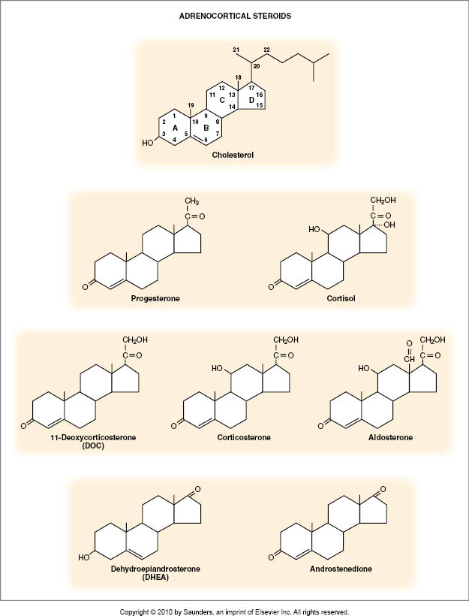
STEROIDS HORMONES

Slide 11
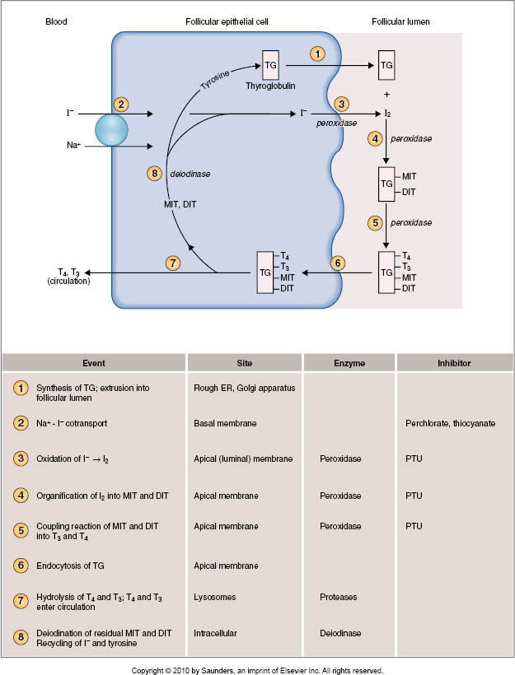
AMINE HORMONE

Slide 12
CLASSIFICATION OF STIMULI
Humoral Stimuli.
Neural Stimuli.
Hormonal Stimuli.

Slide 13
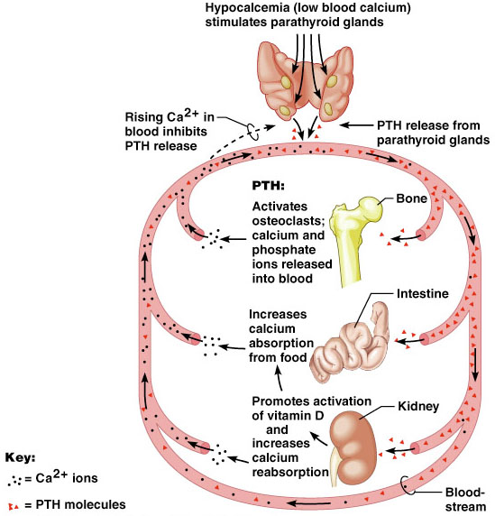
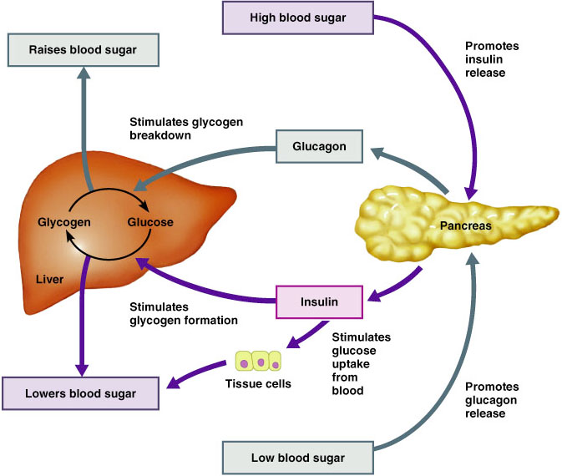
Humoral Stimuli
Secretion of hormones in direct response to changing in blood levels of ions and nutrients

Slide 14
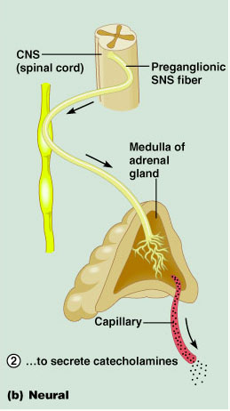
Neural Stimuli
Nerve fibers stimulate hormone release.

Slide 15
Hormonal Stimuli
Release of hormones in
response to hormones
produced by other endocrine
gland.

Slide 17
REGULATION OF HORMONE SECRETION
Neural mechanism.
Feedback mechanism.

Slide 18
NEURAL MECHANISM

Slide 19
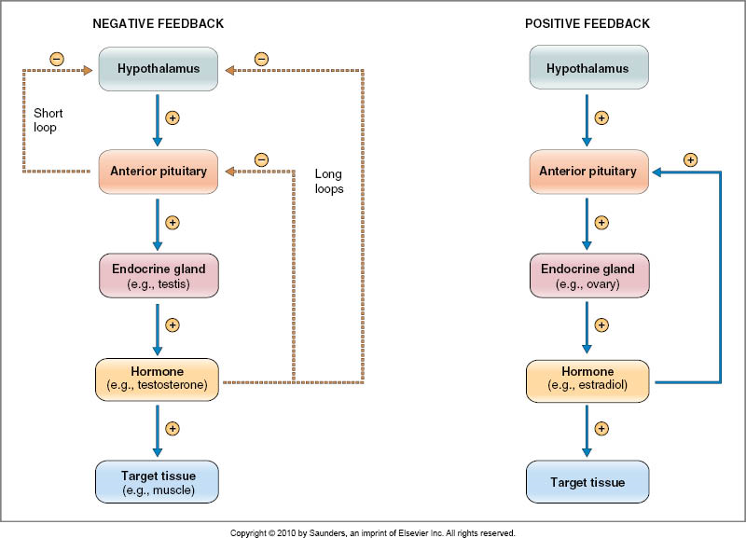
FEEDBACK MECHANISM

Slide 20
Autocrines – chemicals that exert their effects on the same cells that secrete them.
Paracrines – locally acting chemicals that affect cells other than those that secrete them.

Slide 22
TARGET TISSUE

Slide 23
MECHANISM OF ACTION
Hormone
Receptor
conformational changes
?????????
Action

Slide 24
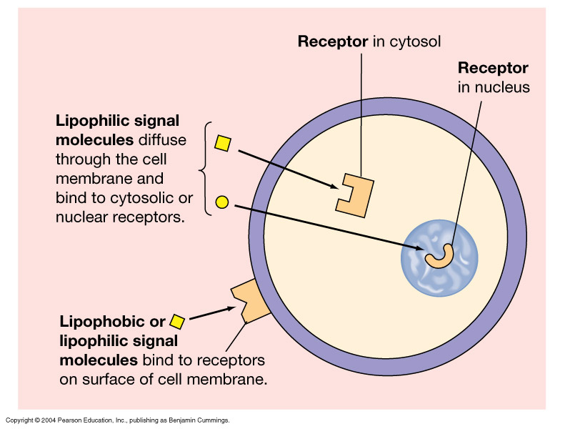
RECEPTOR LOCATIONS
Cytosolic or Nuclear
Lipophilic ligand enters cell
Often activates gene
Slower response
Cell membrane
Lipophobic ligand can't enter cell
Outer surface receptor
Fast response

Slide 25
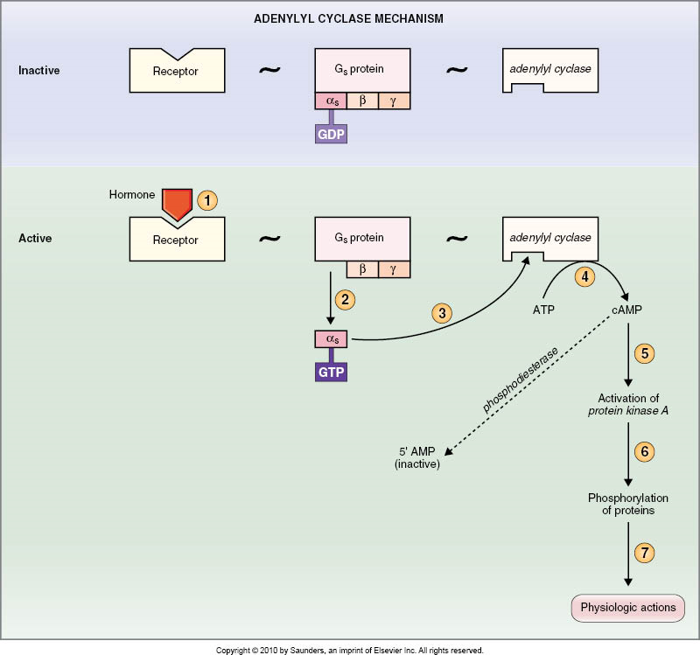
SECOND MESSENGER

Slide 26
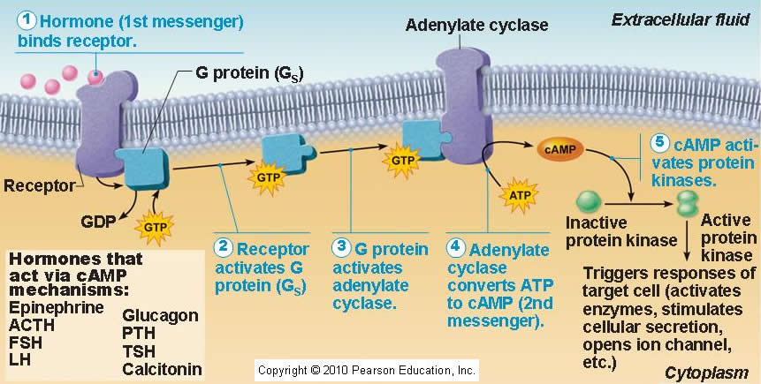

Slide 27
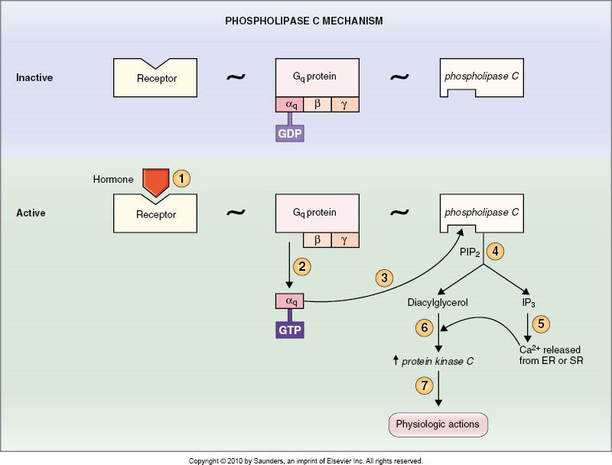

Slide 28
Tyrosine Kinase System
Activated tyrosine kinase phosphorylates signaling molecules
Induction of hormone/growth factor effects

Slide 29
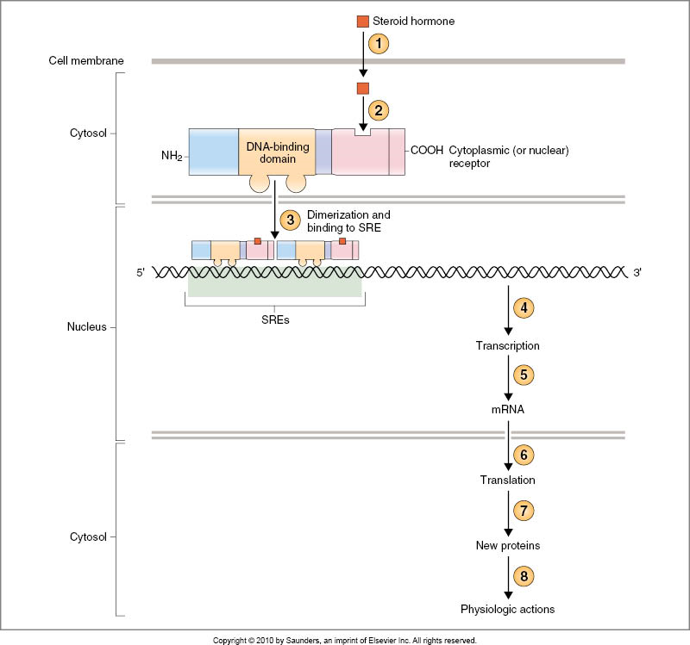
STEROID AND THYROID HORMONE MECHANISM

Slide 30
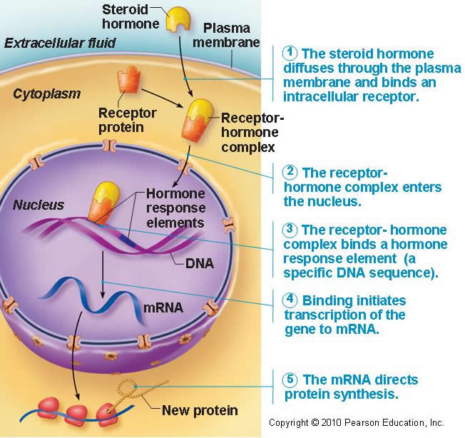

Slide 32
REGULATION OF HORMONE RECEPTORS
Dose-response relationship.
Sensitivity.
Number.
Affinity.

Slide 33
DOWN-REGULATION
Decrease synthesis.
Increase degradation.
Inactivation .
T3.

Slide 34
UP-REGULATION
Increase synthesis.
Decrease degradation.
Activation .
GH, prolactin.

Slide 35
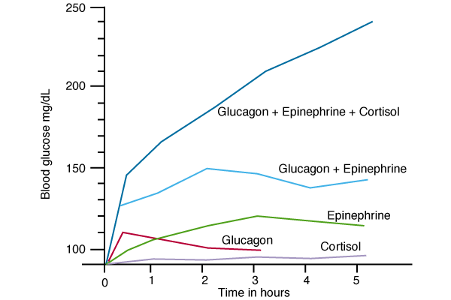
INTERACTION OF HORMONES AT TARGET CELLS
Permissiveness (Thyroid hormone have permissive effect on growth hormone action)
Synergism (glucagon, cortisol and epinephrine)
Antagonism (Glucagon /insulin)

Slide 36
HORMONE CONCENTRATIONS IN THE BLOOD
Concentrations of circulating hormone reflect:
Rate of release
Speed of inactivation and removal from the body
Hormones are removed from the blood by:
Degrading enzymes
The kidneys
Liver enzyme systems

Slide 37
Thank you

Slide 38
HYPOTHALAMIC-PITUITARY AXIS

Slide 39
OBJECTIVES
By the end of this lecture, students should be able to describe:
Structure of pituitary gland (hypophysis)
Anterior pituitary (adenohypophysis) cell types and hormones
Posterior pituitary (neurohypophysis) cell types and hormones
Control of pituitary gland by hypothalamus
Hypothalamo-hypophysial portal blood vessels (Hypothalamic releasing and inhibiting hormones and median eminence)
Hypothalamo-hypophysial tract
Feedback mechanisms: positive and negative feedback

Slide 40
HYPOTHALAMIC-PITUITARY AXIS
Coordinate.
Thyroid gland, adrenal gland, reproductive gland, control growth, milk production, osmoregulation.

Slide 41
HYPOTHALAMUS
Control pituitary gland secretion.
Composed of number of nerve cells.

Slide 42
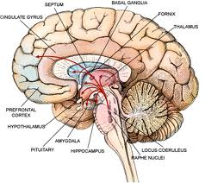

Slide 43
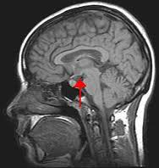

Slide 44
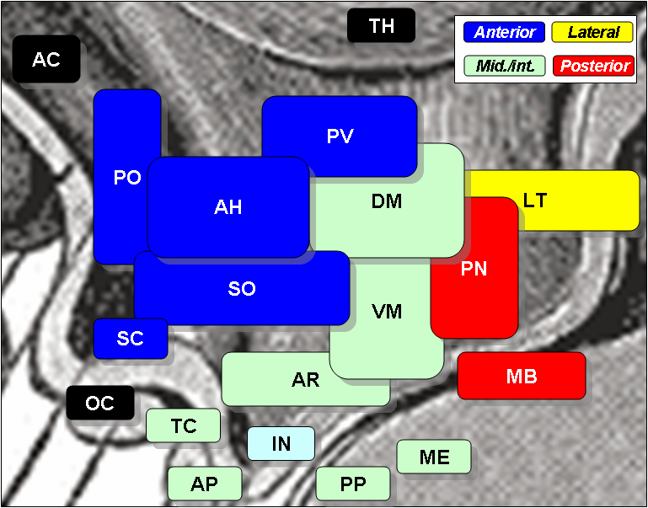
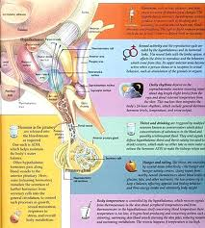

Slide 45
HORMONES
TRH.
CRH.
GnRH.
PIF.
GHRH.

Slide 47
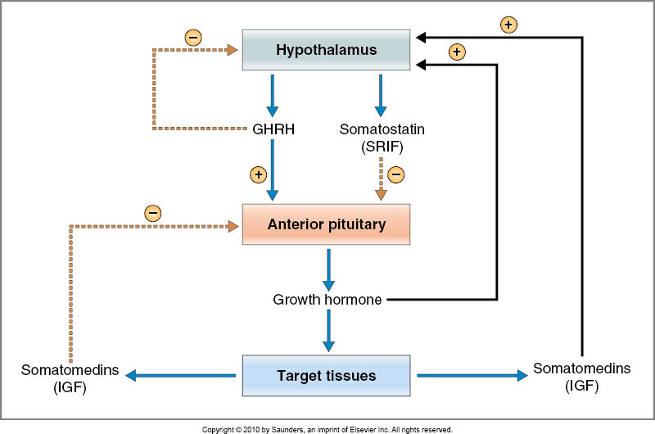
GHRH/GHIH(SRIF)
Stimulates release of growth hormone
Inhibits release of growth hormone

Slide 49
TRH

Slide 50
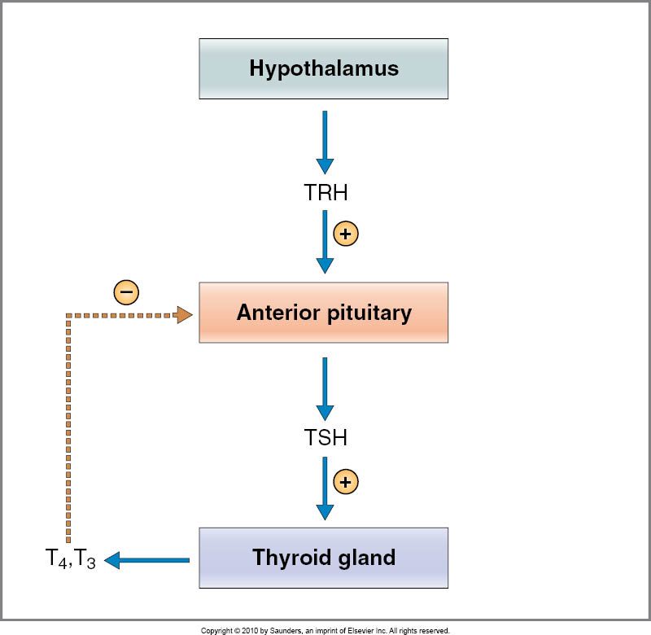

Slide 51
CRH

Slide 53
GnRH
Gonadotropin releasing hormone (GnRH) –
causes release of the 2 gonadotropic hormones:
Luteinizing (LH)
follicle-stimulating hormone FSH

Slide 54
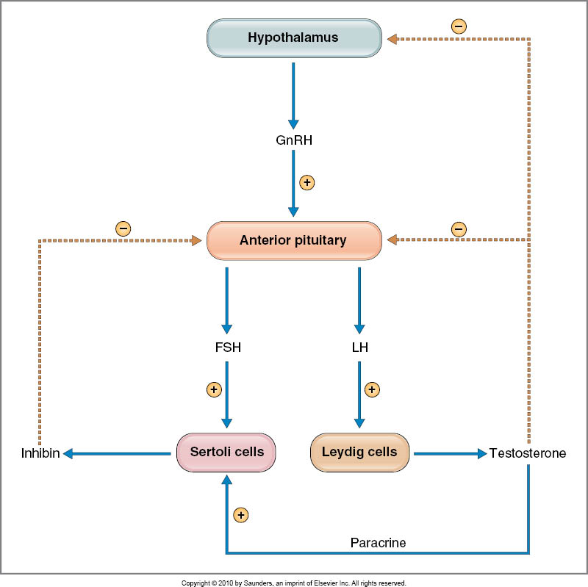

Slide 55
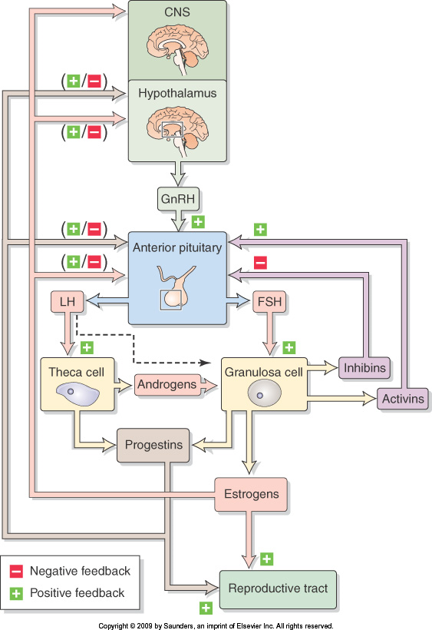

Slide 56
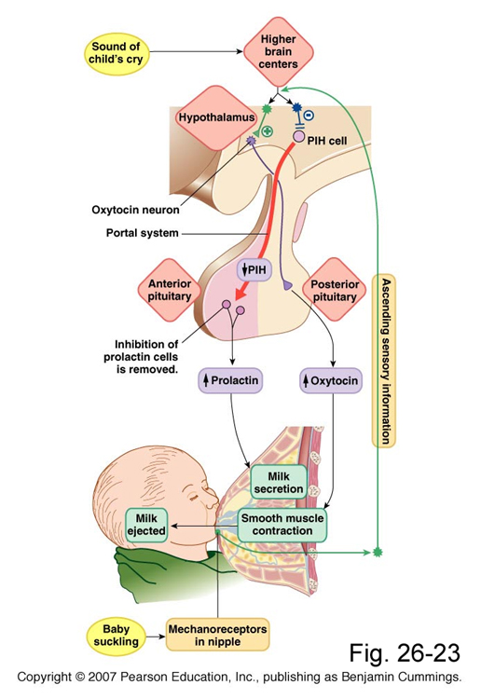
PIH
Prolactin inhibitory hormone (PIH) also known as Dopamine
Inhibits prolactin secretion

Slide 58
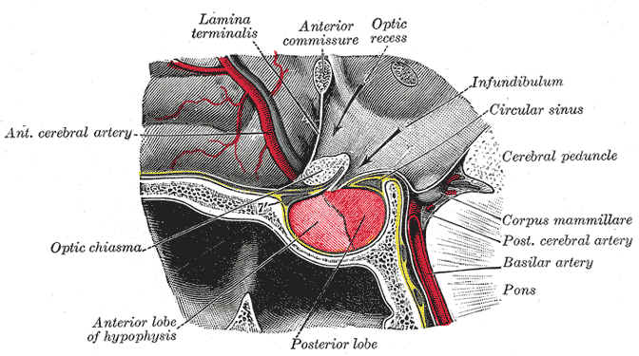
PITUITARY GLAND
Hypophysis.
1cm .
0.5-1 gram.

Slide 60
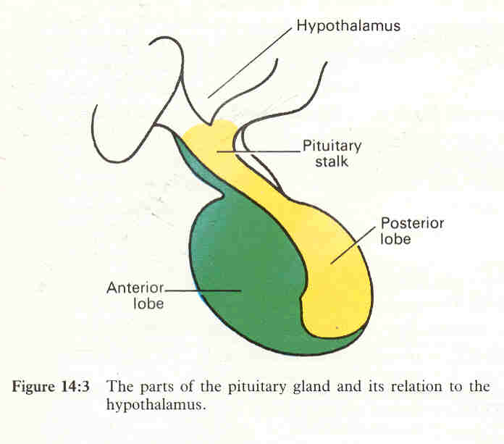

Slide 61
STRUCTURE
Anterior lobe (adenohypophysis).
Posterior lobe (neurohypophysis).
Infundibulum.

Slide 62
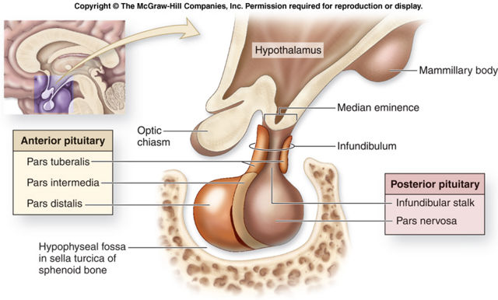

Slide 63
RELATIONSHIP OF THE HYPOTHALAMUS TO THE POSTERIOR PITUITARY
Collection of nerve axons +supporting cells.
1- Antidiuretic hormone (ADH).
Supraoptic nuclei.
2- Oxytocin.
Paraventricular nuclei.

Slide 64
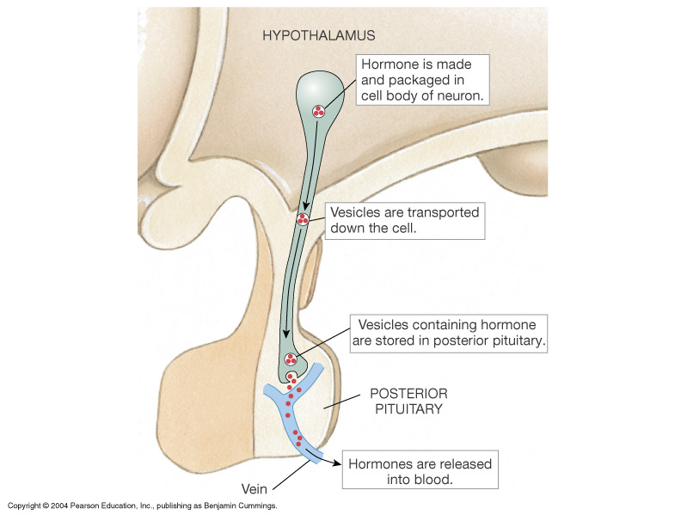

Slide 65
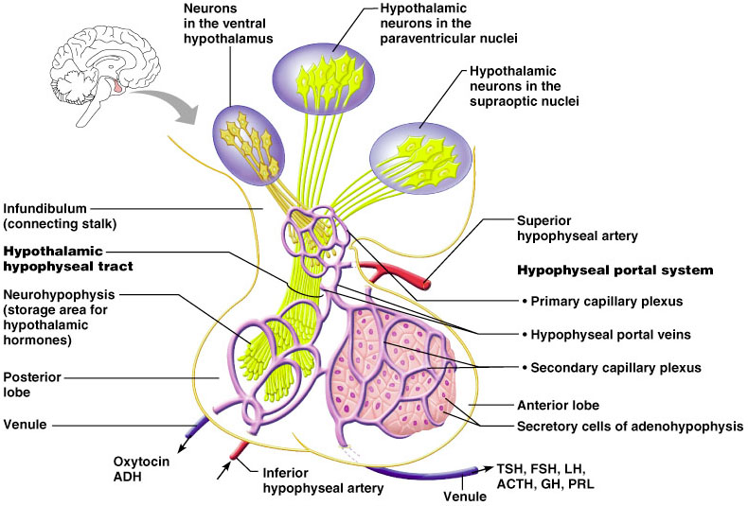
HYPOTHALAMO-NEURO HYPOPHYSIAL TRACT

Slide 66
RELATIONSHIP OF THE HYPOTHALAMUS TO THE ANTERIOR PITUITARY
collection of endocrine glands.
1- TSH
2- FSH
3- LH
4- GH
5- PROLACTIN
6- ACTH.

Slide 68
HYPOTHALAMIC-HYPOPHYSIAL PORTAL SYSTEM

Slide 69
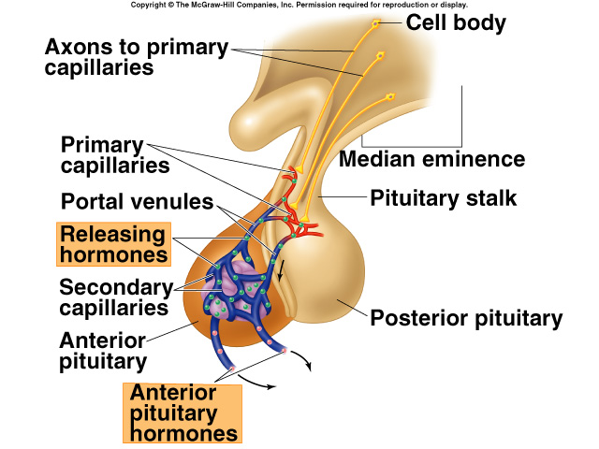

Slide 70
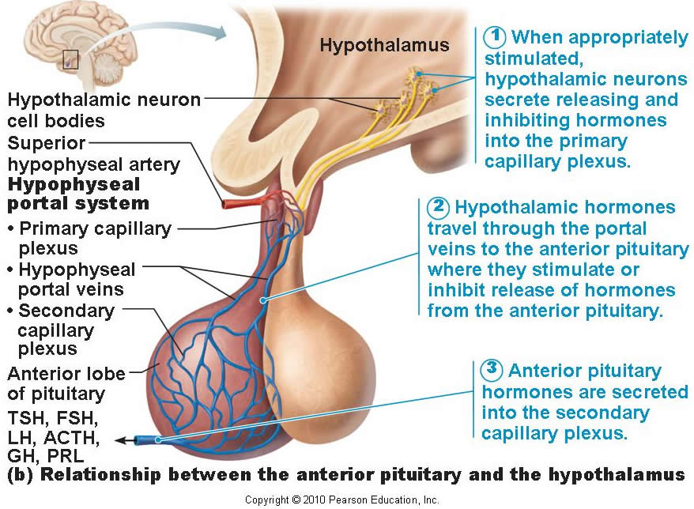

Slide 71
Both neural and endocrine.

Slide 72
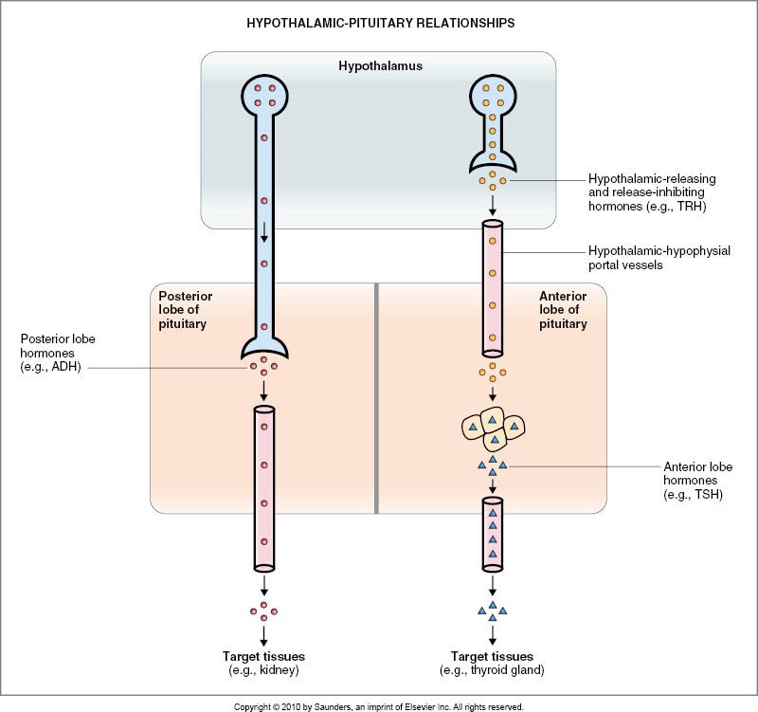

Slide 73
NEGATIVE FEEDBACK MECHANISM

Slide 74
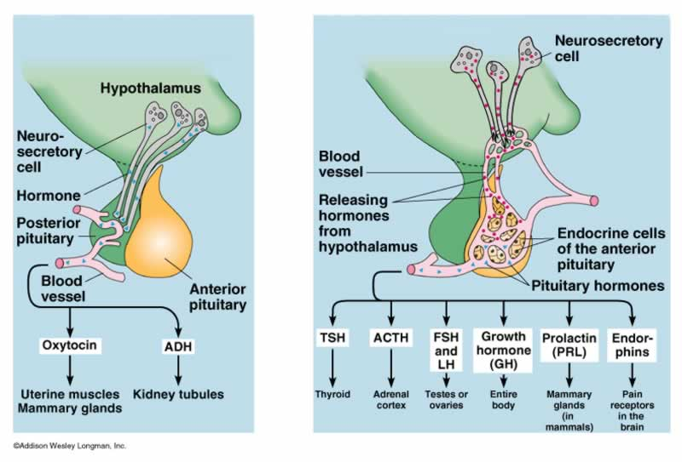

Slide 75
Thank you

