Slide 1
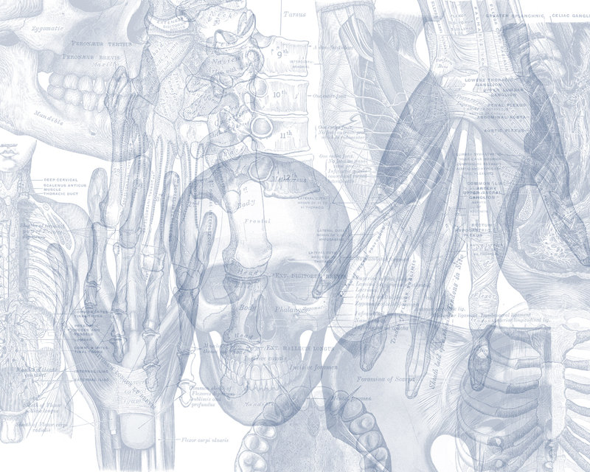
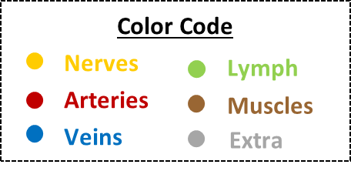
OSPE ENDOCRINE BLOCK

Slide 2
اللهم لا سهل إلا ما جعلته سهل وأنت تجعل الحزن إذا شئت سهل
Important Points
Don’t forget to mention right and left.
Read the questions carefully.
Make sure your write the FULL name of the structures with the correct spelling.
Example: IVC ✕→ Inferior Vena Cava ✓
Aorta ✕→ Abdominal aorta ✓
4. There is NO guarantee whether or not the exam will go out of this file.
ممكن يأشرون على أجزاء مو معلمه فراح نحط بيانات إضافية حاولوا تمرون عليها كلها
Good luck!

Slide 3
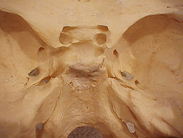
Pituitary gland
Identify:
Anterior and posterior clinoidal process of sella turcica.
Hypophyseal fossa (sella turcica)
1
2
Theory
The pituitary gland is located in middle cranial fossa and protected in sella turcica (hypophyseal fossa) of body of sphenoid.

Slide 4
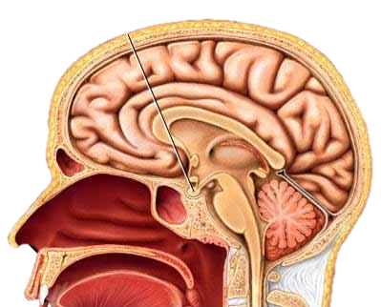
Relations Of Pituitary Gland
Identify:
Mamillary body (posteriorly)
Optic chiasma (anteriorly)
Sphenoidal air sinuses (inferior)
Body of sphenoid
Pituitary gland
hypothalamus
2
1
Theory
5
4
If pituitary gland became enlarged (e.g adenoma) it will cause pressure on optic chiasma and lead to bilateral temporal eye field blindness (bilateral hemianopia)
3

Slide 5
Relations Of Pituitary Gland
Important!
1
10
2
Identify:
Pituitary gland.
Diaphragma sellae (superior)
Sphenoidal air sinuses (inferior)
Cavernous sinuses (lateral)
Abducent nerve
Oculomotor nerve
Trochlear nerve
Ophthalmic nerve
Trigeminal (Maxillary) nerve
Internal carotid artery
6
7
8
5
9
3
4
Structures of lateral wall
Note: Ophthalmic and maxillary are both branches of the trigeminal nerve

Slide 6
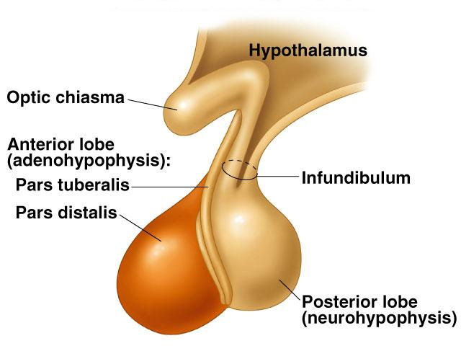
Divisions of Pituitary Gland
Identify:
Anterior lobe (Adenohypophysis)
Optic chiasma
Infundibulum
Posterior lobe (Neurohypophysis)
2
3
1
Theory
4
Subdivisions | Anterior Lobe | Posterior Lobe
 | Adenohypophysis Secretes hormones Vascular connection to hypothalamus by hypophyseal portal system (from superior hypophyseal artery) | Neurohypophysis Stores hormones Neural connection to hypothalamus by hypothalamo-hypophyseal tract from supraoptic and paraventricular nuclei.

Slide 7
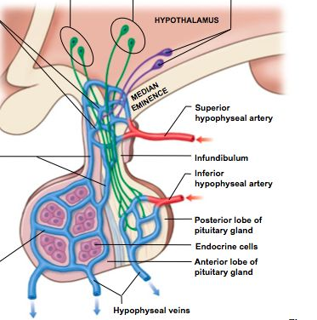
Blood Supply Of Pituitary Gland
Theory
Superior hypophyseal artery supplies infundibulum and anterior lobe. It also forms hypophyseal portal system.
Inferior hypophyseal artery supplies posterior lobe.
Superior and inferior hypophyseal arteries are branches of internal carotid artery.
Hypophyseal veins drain into cavernous sinuses.

Slide 8
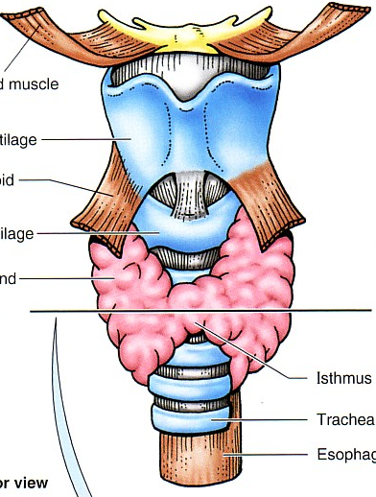
Hyoid bone
Identify:
Sternohyoid muscle
Thyroid cartilage
Sternothyroid muscle
Cricoid cartilage
Thyroid gland (lobe)
Isthmus of thyroid
Trachea
Esophagus
Thyrohyoid membrane
Cricothyroid ligament
9
1
2
3
10
4
5
6
7
8

Slide 9
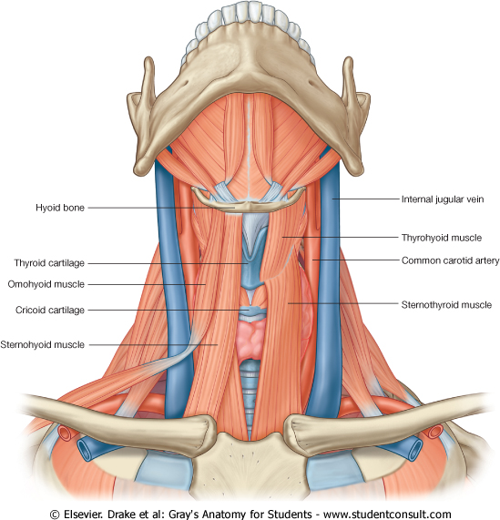
Relations Of Thyroid Gland
Theory
Relations
Anterolaterally |  | 1. Sternohyoid. 2. Sternothyroid 3. Superior belly of omohyoid 4. Sternomastoid (4S)
Posteriorly |  | Carotid sheath and its contents: 1- common carotid artery 2- internal carotid artery 3- internal jugular vein 4- vagus nerve (CN X)
Medially | Above | 1- Larynx 2- Pharynx
 | Below | 1- Trachea 2- Esophagus 3- Recurrent laryngeal nerve 4- Cricothyroid muscle 5- External laryngeal nerve
Trachea

Slide 10
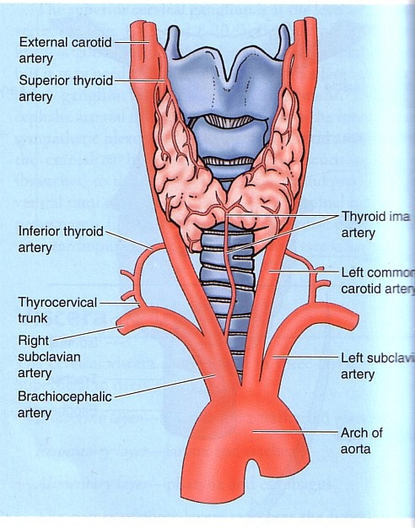
Arterial Supply Of Thyroid Gland
Thyroid cartilage
Isthmus of thyroid
Cricoid cartilage
Theory
Artery | Origin | Course
Superior thyroid artery | From the external carotid artery | It descends to the upper pole of the lobe, with the external laryngeal nerve.
Thyroidea ima artery | If present, it arises from aortic arch or from brachiocephalic artery. | It ascends in front of the trachea to reach the isthmus.
Inferior thyroid artery | From the thyrocervical trunk of 1st part of subclavian artery. | The recurrent laryngeal nerve crosses either in front or behind it.
Trachea

Slide 11
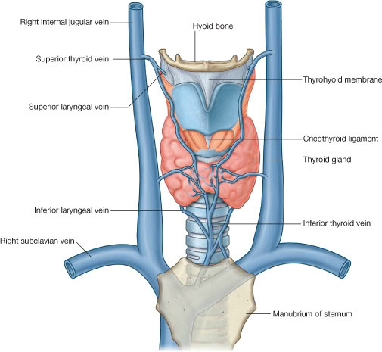
Veins of Thyroid Gland
Theory
Vein | Drains into
Superior thyroid vein | internal jugular vein
Middle thyroid vein
Inferior thyroid vein | left brachiocephalic vein
Brachiocephalic vein

Slide 12
Inferior thyroid artery
Thyroid cartilage
Thyrocervical trunk
Isthmus
Recurrent laryngeal nerve
Common carotid artery

Slide 13
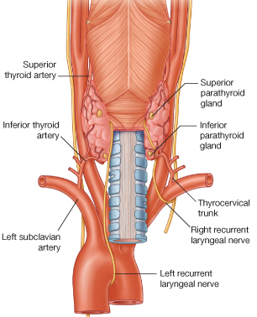
Vagus nerve
Recurrent laryngeal nerve

Slide 14
Clinical Points
Theory
When ligating thyroid arteries during thyroidectomy 2 nerves are at risk: external laryngeal nerve & recurrent laryngeal nerve.
Superior thyroid artery on each side is related to the external laryngeal nerve, which supplies the cricothyroid muscle. Damage to external laryngeal nerve results in an inability to tense the vocal folds and hoarseness.
Inferior thyroid artery is closely associated with the recurrent laryngeal nerve . Damage to recurrent laryngeal nerve results in impaired breathing & speech.
Relation to Recurrent laryngeal nerve:
Medially: Trachea
Laterally: common carotid artery
Superior: thyroid lobe

Slide 15
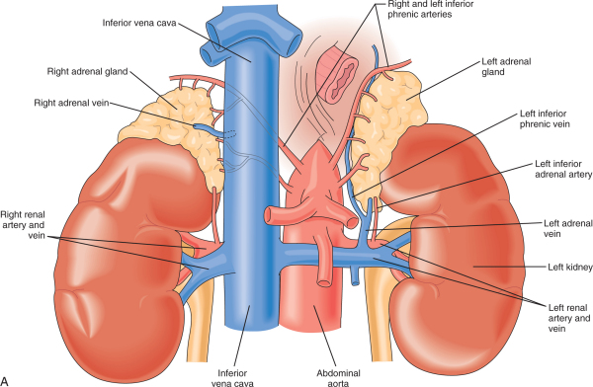
Adrenal (suprarenal) Glands
Theory
Theory
Right Gland
Notes |  | The right gland is pyramid shaped and caps the upper pole of the right kidney.
Relations | Anterior | Right lobe of liver Inferior vena cava
 | Posterior | Diaphragm
 | Medial | Celiac plexus and ganglia
Left Gland
Notes |  | The left gland is crescentic in shape and extends along the medial border of the left kidney from the upper pole to the hilus.
Relations | Anterior | Pancreas Lesser sac Stomach
 | Posterior | Diaphragm
 | Medial | Celiac plexus and ganglia

Slide 16
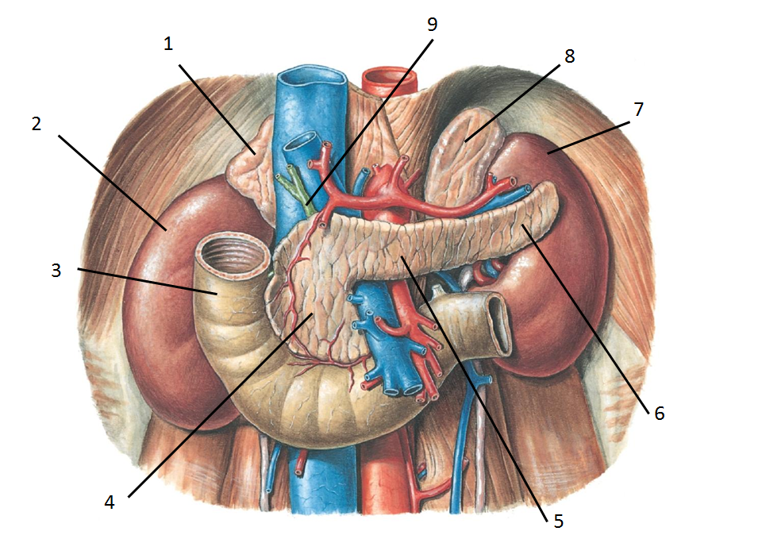
This slide was added by the female doctor
(the male doctor cancelled it)
Identify:
Right suprarenal gland
Right kidney
Duodenum
Head of pancreas
Neck of pancreas
Tail of pancreas
Left kidney
Left suprarenal gland
Common bile duct
Left Ureter
10

Slide 17
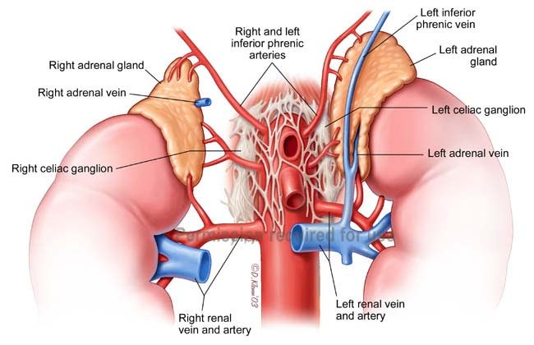
Adrenal (suprarenal) Glands
Theory
Supply
Arteries | Inferior phrenic → Superior suprarenal artery. Abdominal Aorta → Middle suprarenal artery. Renal artery → Inferior suprarenal artery.
Veins | A single vein emerges from the hilum of each gland and drains into: Inferior vena cava on the right & Renal vein on the left.
Nerves | Preganglionic sympathetic fibers derived from the splanchnic nerves. (Most of the nerves end in the medulla of the gland)
Lymphatics | The lymph drains into the lateral aortic nodes.

Slide 18
Done by:
Jawaher Abanumy
Khalid Aleedan
Mohammed Alyousef
Mohammed Ghandour
Practice Test
Extra Pictures For Practice
Feedback
Editing File
References:
1- Team 435
2- Greys Anatomy for Students
anatomyteam436@gmail.com
@anatomy436

