Slide 1
Biochemistry
Doctors slides
Important
Extra Information
Numbers Doctors notes
Editing file
A strong positive self-image is the best possible preparation for success.
- Joyce brothers
ENDOCRINE Block
Practical Sessions

Slide 2
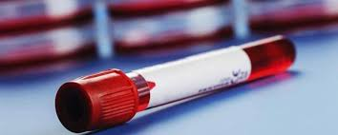
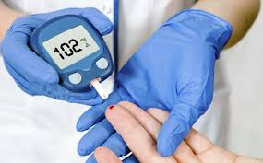
Outline
This file contains one lecture.
This work is done by students, so if there are any mistakes please inform us .
Lecture title :
  Blood glucose

Slide 3
Blood Glucose
Diabetes Mellitus: Common signs, symptoms and Lab results:

Slide 4
Comparison of Type 1 & Type 2 DM
Numbers here are important
 | Type 1 Diabetes | Type 2 Diabetes
Age of onset | Usually during childhood or puberty. | Frequently after age 35
Prevalence % | 10% of diagnosed diabetics. | 90% of diagnosed diabetics.
Defect or Deficiency | β cells are destroyed, eliminating insulin production . | Insulin resistance combined with inability of β cells to produce appropriate quantities of insulin.
Ketoacidosis¹ | Common. | rare
Plasma Insulin | Low to absent . | High early in disease; low in disease of long duration.
Treatment | Insulin is always necessary. | 1.Diet and exercise . 2. Oral hypoglycemic drugs. 3. +/- insulin, required ( not always depend on his/her condition)
1-Diabetic ketoacidosis is a serious complication of diabetes that occurs when your body produces high levels of blood acids called ketones. The condition develops when your body can't produce enough insulin.

Slide 5
Laboratory Tests For Glucose
Glucose laboratory tests
1. Fasting plasma glucose : | Is a measurement of plasma glucose after 12 hours of fasting (no caloric intake). Normal blood glucose range: 3.9 – 5.6 mmol/L (70–100 mg/dL ).
2. Oral Glucose tolerance Test (OGTT) & 2-hour post-prandial test | Serial measurement of plasma glucose before and after a specific amount of glucose given orally (75g glucose). Normal level: ( < 7.8 mmol\L ).
3. HEMOGLOBIN A1C measurement : | used to estimate glycemic control in the last 1-2 months & Recommended for the detection of type 2 DM. Normal level : 4 – 5.6 % .
4. Random Plasma Glucose Level : | ______________
5. HEMOGLOBIN A1C : | Hemoglobin A_{1C} (A_{1C} ) is produced due to non-enzymatic glycosylation of hemoglobin. It is used to estimate glycemic control in the last 1-2 months. Recommended for the detection of type 2 Diabetes Mellitus. HBA_{1C} and fasting plasma glucose are effective in diagnosing diabetes. Cut-off point of ≥ 6.5 % is used to diagnose diabetes.
Q: When does someone is said to have an impaired glucose tolerance (Pre-diabetes state) ? When fasting plasma glucose OR 2-hour postprandial glucose level is above normal but below diabetic level.

Slide 6
Criteria For Diagnosis of Diabetes Mellitus
Categories Of Increased Risk of DM & Diagnosis Of DM
Test performed/ - | Normal | Pre-diabetes | Diabetes
Fasting Plasma Glucose (FPG) | Less than 100 mg/dl | FPG or IFG ¹ : 100 - 125 mg\dl 5.6 - 6.9 mmol/L | (fasting= No caloric intake for at least 8hs) 126 mg\dl and over 7 mmol/L and over
2 hours post glucose on the 75-g OGTT | Less than 140 mg/dl | OGGT or IGT² [ 2 : 140 – 199 mg\dl 7.8 – 11.0 mmol/L [ | 200 mg\dl and over 11.1 mmol/L and over
HA_{1C} | Less than 5.7% | 5.7% - 6.4 % | 6.5% and over
Random Plasma Glucose Level | _____ | _____ | 200 mg/dl and over 11.1 mmol/L and over + signs and symptoms of hyperglycemia or hyperglycemic crisis
Ketone Bodies:
They produce by the liver and utilized for energy production by peripheral tissues . ( common in type I DM)
  Acetone (exhaled by lungs, gives characteristic smell in diabetic ketoacidosis patients).
  Acetoacetate.
  β-Hydroxybutyrate.
  Produced by the liver and utilized for energy production by peripheral tissues.
1- IFG: impaired fasting glucose
2- IGT: impaired glucose tolerance

Slide 7
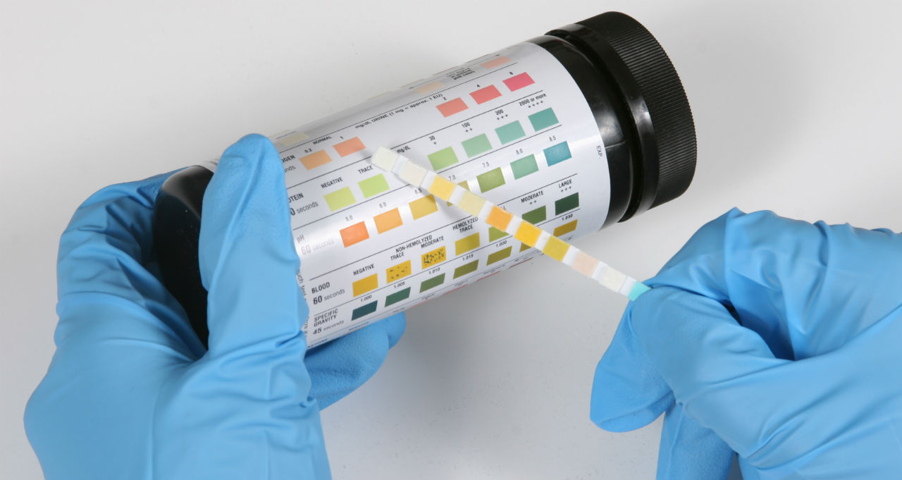

Urinalysis Using Dipstick
Note here is important
Principle:
Dipsticks are plastic strips impregnated with chemical reagents which react with specific substances in the urine to produce color-coded visual results.
They provide quick determination of pH, protein, glucose and ketones. The depth of color produced is proportional to the conc. of the substance in urine.
Color controls are provided against which the actual color produced by the urine sample can be compared “You must know how to compare color changes with the control charts.”
The reaction times of the impregnated chemicals are standardized.
Procedure :
Dip the dipstick in the urine sample provided.
Remove it immediately.
Wipe off excess urine, Keep strip horizontally.
Read the color produced within 30- 60 seconds or immediately
Do not read it after 60 sec. Color changes after 60 sec . Are of no significance.
5. Compare color changes with the control charts provided.
Notes:
Mind map by 432 biochemistry team

Slide 8
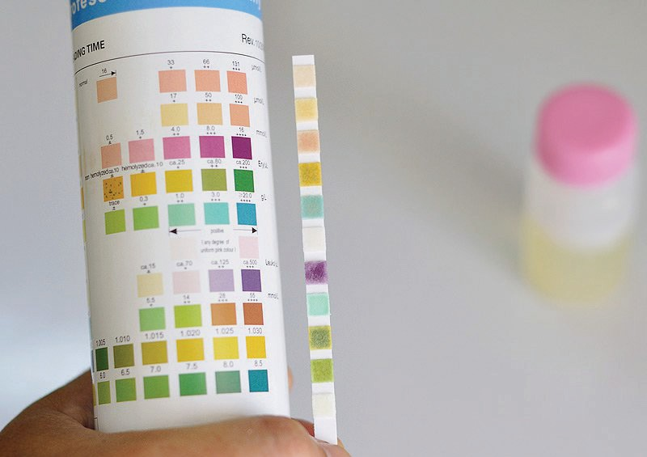
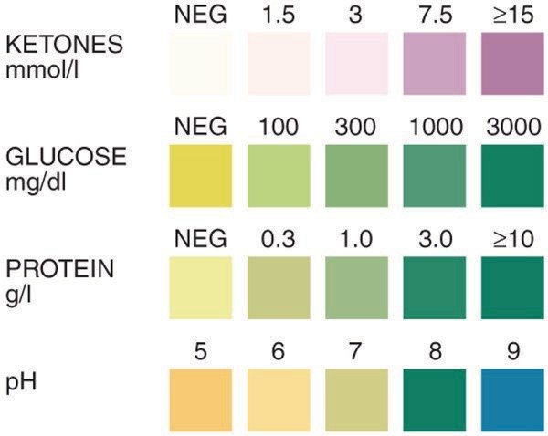
Principle of urine strep
The urine strip are impregnated with a variety of reagents that react with substances in the urine to produce color.
The intensity of color is proportional to concentration of the substance being detected.
1- Glucose : glucose oxidase enzyme on the strip react with glucose in urine to produce gluconic acid and hydrogen peroxide that reacts with peroxidase to produce bluish-green, greenish-brown, dark brown color.
2-Protein: Tetrabromophenol reacts with proteins to produce yellow-green, green, blue-green color.
3-Ketones: sodium nitroprusside react with ketones to produce pink , pink-purple color.
4-PH: bromothymol and methyl red indicators change color due to acidity or alkalinity of urine.

Slide 9
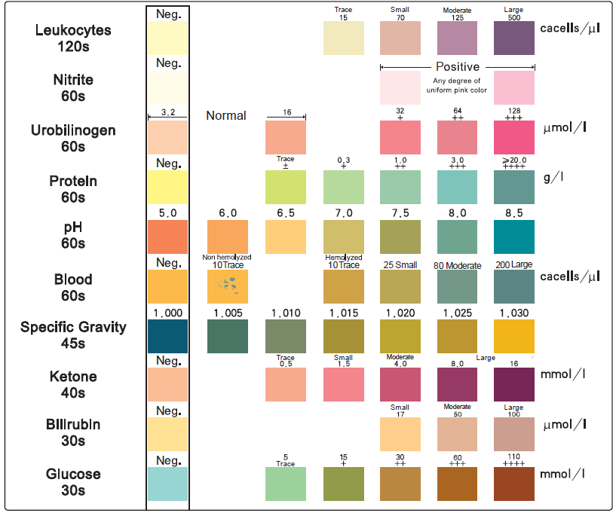

Changes In Urine Dipstick Observed In Diabetic Patients And Their Interpretation
Extra :
Physical examination
Parameter | Results |  | Interpretation | reasons
Appearance | Clear |  | Normal | ---------
Color | Colorless |  | Polyuria | Diabetes
Odor | Fruity (in case of Dka¹ ) |  | ↑ Ketogenesis | Diabetic ketoacidosis Starvation anxiety
Chemical parameters ”IMPORTANT”
Test | Results | Interpretation |  | reasons
Urine Glucose | + | Glucosuria |  | diabetes mellitus Fanconi Syndrome
Urine Protein | May be present (in case of nephropathy ) | Proteinuria |  | Chronic kidney disease Diabetes
Urine Ketones | + (In case of DKA) | ↑ Ketogenesis/ Ketonuria |  | Diabetic ketoacidosis Starvation
Urine PH | Acidic (in DKA) > 6 | Aciduria |  | Uncontrolled diabetes dehydration
*These results of diabetes patient*
You might get a picture similar to this in the exam , and be asked to fill the schedule based on comparing the urine dipstick test of patient with color control.
1-Diabetic ketoacidosis

Slide 10
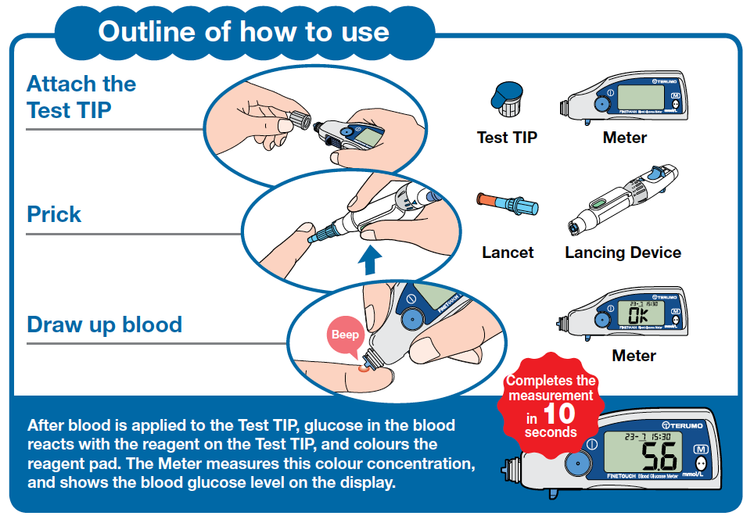

Measurement of Blood Glucose Level Using Glucometer
Note here is important
Instructions:
Attach the test tip to the glucometer as shown.
The meter will read “OK” indicating that it works properly.
Disinfect your fingertip using an alcohol swab.
Let it dry.
BIOHAZARD! The lancet in the lancing
device is for single use only. Discard it after use .* don’t reuse it again*
5. Prick the finger using the lancing device.
Draw up blood until the glucometer beeps.
Wait for 10 seconds until results are displayed.
Results can be read as mmol/L or mg/dL.
Interpret your results.

Slide 11
Benefits of Self-monitoring of Blood Glucose Level
”IMPORTANT”
It allows patients to detect their blood glucose levels without visiting a clinic .
It helps patients to immediately confirm hypo or hyperglycemia to avoid complications.
It facilitates patient education about diabetes and its management by giving them more self-care responsibilities .
It helps to promote wellbeing of patients .

Slide 12
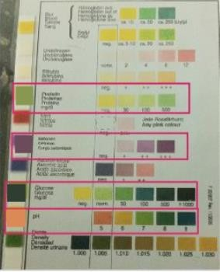
Test Your Self
Q1) What is your Interpretation of the patient’s results :
 | Patient A | Patient B | Patient C
FPG | 12 mmol/L | 6.5 mmol/L 1 | 10.2 mmol/L
Hb A1C | 10% | 6% | 9%
Serum ketones | 50 mg/dl | Negative | Negative
Urine Ketones | +++ | Negative | Negative
Urine Glucose | +++ | Negative | ++
Protein | +++ | Negative | +++
pH | 7.0 | 7.3 | 7.2

Slide 13
Test Your Self
The answer:
- Patient C:
1. High FPG “Hyperglycemia” and this indicates that the patient is diabetic
2. HbA1C is raised and shows his blood glucose level was uncontrolled “high” for the last 2 months.
3. The presence of glucose in urine “Glucosuria” which this also indicates the patient has high blood glucose level.
And the glucose filtration level is abnormally higher than the kidney threshold.
Patient A :
Very High FPG “Hyperglycemia” and this indicates that the patient is diabetic
HbA1C is raised which shows his blood glucose level was uncontrolled for the last 2 months, this confirms diabetes.
“Ketonemia” and “ketonuria” indicate that the patient has DKA.
“Glucosuria” indicates the glucose filtration level is abnormally higher than the kidney threshold.
The presence of protein in urine “proteinuria” is caused by nephropathy (complication of uncontrolled DM). Low pH of urine “Acidic urine” indicates metabolic acidosis due to increase production of ketone bodies
Patient B :
FPG is higher than normal BUT not diabetic “Pre-diabetic” and shows Increase risk of diabetes.
HbA1C is raised and shows his blood glucose level was uncontrolled “high” for the last 2 months.
The diagnosis is: Impaired Fasting Glucose “PreDiabetes”
The diagnosis is: Diabetes Mellitus with nephropathy .
The diagnosis is: Diabetes ketoacidosis.

Slide 14
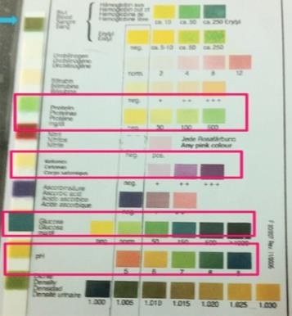
Test Your Self
Q1) A 50 year male came to the clinic with symptoms of dehydration, polyuria and polydipsia. A urine sample was taken from him with the following results:
 | Observation | Comment
Protein | +++ | Proteinuria
Glucose | +++ | Glucosuria
Ketone bodies | - | Normal
PH | 6 | Acidic
Q) What is the most likely diagnosis ?
  Diabetes mellitus.
Q) What is the reason of presence of protein in the urine sample ?
  Nephropathy.
N.B: You might be asked to fill the “comment” column.
Notes:
Case scenarios by 433 team

Slide 15
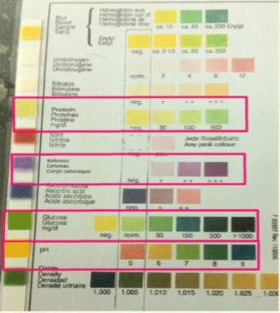
Test Your Self
Q1) A known diabetic was presented to the emergency room with symptom of confusion, weakness, fruity breath, nausea and vomiting, the picture showes the results of his urine dipstick test:
 | Observation | Comment
Color | Colorless | Polyuria
Odor | Fruity | Ketones
Protein | - | Normal
Glucose | +++ | Glucosuria
Ketone bodies | +++ | Ketonuria
PH | 6 | Acidic
Q) What is your most likely diagnosis ?
  Diabetic ketoacidosis.
Q) Name the three molecules of ketone bodies ?
  Acetoacetate .
  Acetone .
  β-Hydroxybutyrate.

Slide 16

Test Your Self
Q) 60 year old female presented with polyphagia, fatigue and blurred vision. She is retired since 13 years staying at home most of the time. Despite losing weight, her BMI is 33. She mentioned that she had to wake up during the night to urinate in the pas 3 weeks. She has no family history of diabetes. The general practitioner ordered a blood glucose tests and the results were as the following:
 | Result | Normal Range
OGTT | 231 mg\dl (12.8 mmol\L) | < 140 mg\ dl < 7.8 mmol\L
HA1c | 7.1 % | 4 – 5.6 %
Q1) What is the most likely diagnosis ?
  Diabetes mellitus type 2
Q2) What are the factors which predisposed her to such a condition ?
  1-Obesity. 2- Sedentary life style. 3- Aging .
Q3) Name two complications associated with her situation ?
  1.Retinopathy.
  2.Neuropathy.
Q4) What is the main underlying cause of her disease ?
  Insulin resistance.
آخر محاضرة بايوكيمستري عملي في سنوات العلوم الأساسية ☺
وداعا يا أصدقاء .. نتمنى لكم التوفيق فيما تبقى ❤️

