Slide 1
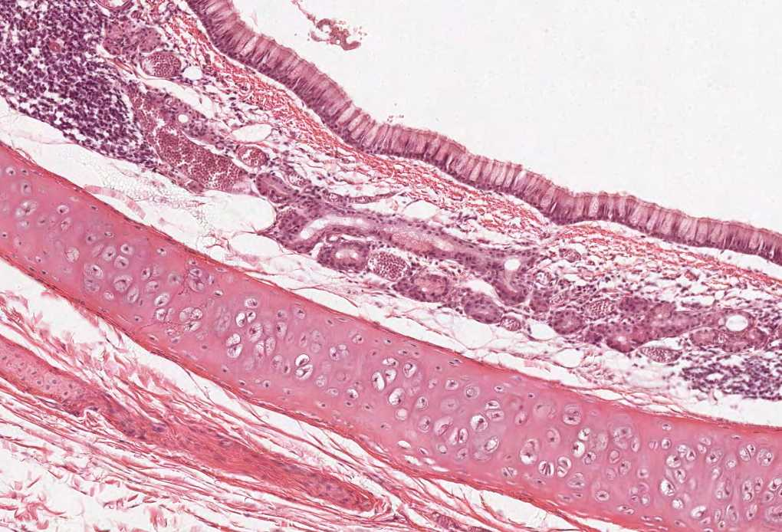
Practical Histology
Endocrine block

Slide 2
Things you need to know before the exam :
The pictures in the exam will be the same as the ones included in the slides.
Don’t try to take short cuts during the exam so avoid using abbreviations so you don’t lose marks.
Please keep in mind that this work is done by students , so if there are any mistakes please inform us.
This work is not by any means a reference.
Please study hard and don’t worry the exam will be easy!!

Slide 3
Thyroid gland
1- Identify the structure:
Thyroid follicle of Thyroid gland
2- Mention the lining epithelium:
Simple cuboidal epithelium
3- Mention the cells found in the thyroid glands
Follicular cells
Parafollicular cells It has a white cytoplasm
4- what is the type of capillaries found in the thyroid gland?
Fenestrated blood capillaries
5- Identify the structure marked by ‘D’ :
Acidophilic colloid material
D
B
A

Slide 4
Parathyroid gland
Adipocytes
1- Identify the structure:
Parathyroid gland
2- Mention the cells found in the parathyroid glands
Chief cells
Oxyphil cells

Slide 5
Adrenal gland
1-Identify the structure:
Adrenal gland
2- Identify A and B
Adrenal cortex
Adrenal medulla
3- Mention the cells found in B ( medulla )
Chromaffin cells
Sympathetic ganglion cells
A
B

Slide 6
Adrenal Cortex
A
1-Identify the structure:
Adrenal cortex
2- Identify A ,B and C
Zona glomerulosa
Zona fasciculata
Zona reticularis
B
C

Slide 7
Adrenal Gland-Cortex
Zona glomerulosa
Zona reticularis
Zona fasciculata

Slide 8
Adrenal medulla

Slide 9
Thank you & good luck
- Histology team
Team leaders:
Rana Barasain
Faisal Alrabaii

