Slide 1
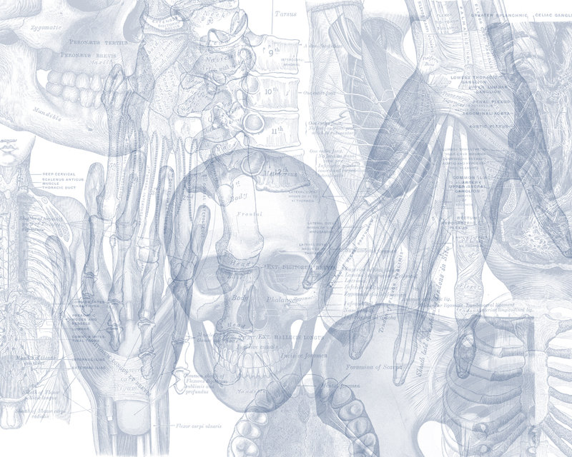
Anatomy of Pituitary Gland
Color Code
Important
Doctors Notes
Notes/Extra explanation
Please view our Editing File before studying this lecture to check for any changes.

Slide 2
Objectives
At the end of the lecture, students should be able to:
Describe the position of the pituitary gland.
List the structures related to the pituitary gland.
Differentiate between the lobes of the gland.
Describe the blood supply of pituitary gland & the hypophyseal portal system.

Slide 3
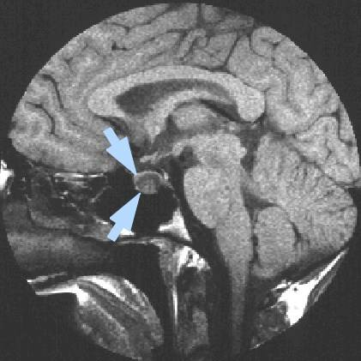
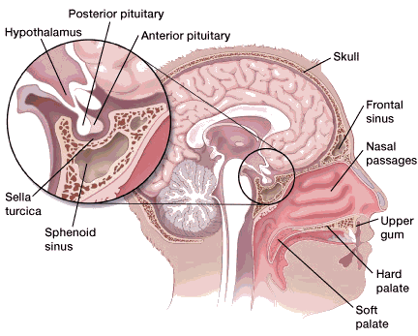
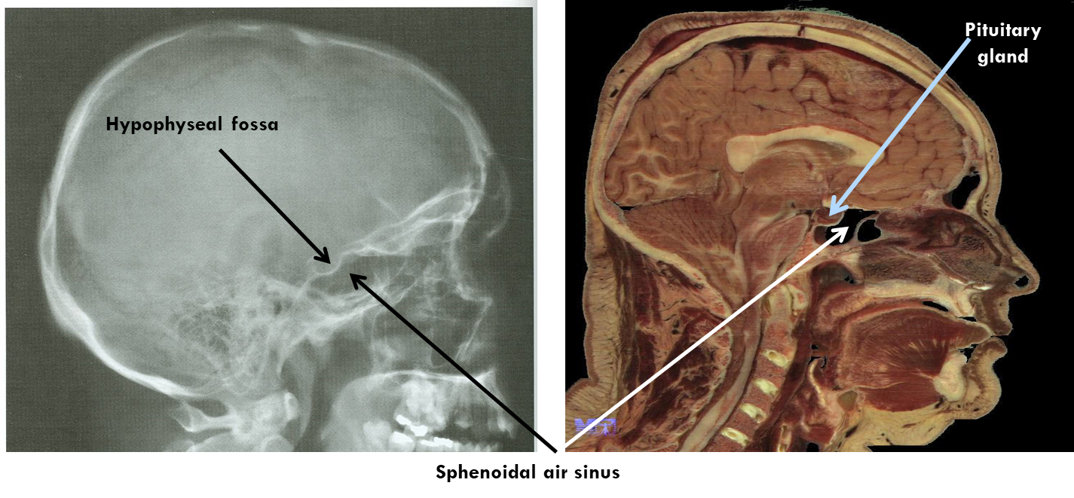
Pituitary Gland الغدة النخامية (also called Hypophysis Cerebri)
It is referred to as the master of endocrine glands.
It is a small oval structure 1 cm in diameter.
It doubles its size during pregnancy.
A women experiences changes in her hormone levels during menstruation (الحيض), pregnancy (الحمل), lactation (الرضاعة), and menopause (سن اليأس). But only the pituitary gland will only increase in size during pregnancy
X-RAY SKULL: LATERAL VIEW
SAGITTAL SECTION OF HEAD & NECK
Extra

Slide 4
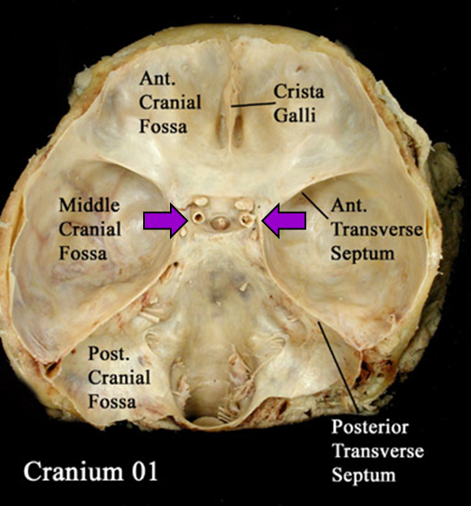
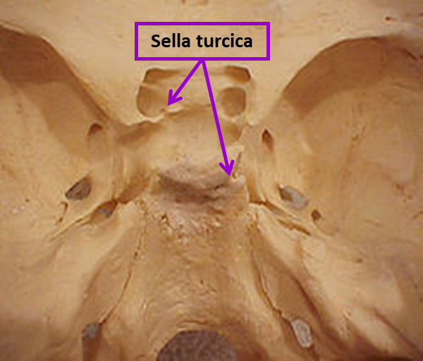
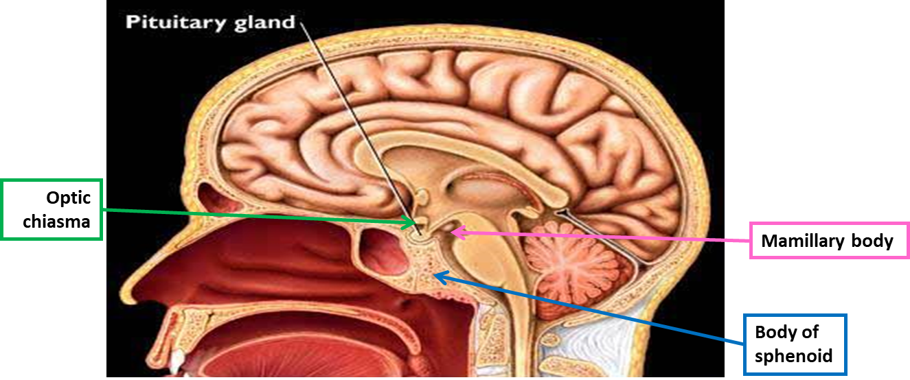
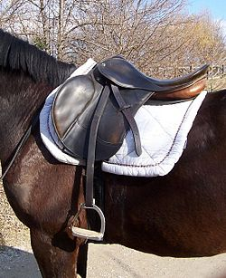
Pituitary Gland Position
It lies in the middle cranial fossa.
It is well protected in sella turcica* (hypophyseal fossa) of body of sphenoid
It lies between optic chiasma (anteriorly) & mamillary bodies** (posteriorly).
Clinical point:
Anterior to the pituitary gland is the optic chiasm, so if there was a tumor in the pituitary gland or it was enlarged this could press on the chiasm and disrupt the patients vision (loss of temporal field).
* سرج الحصان
** Part of hypothalamus

Slide 5
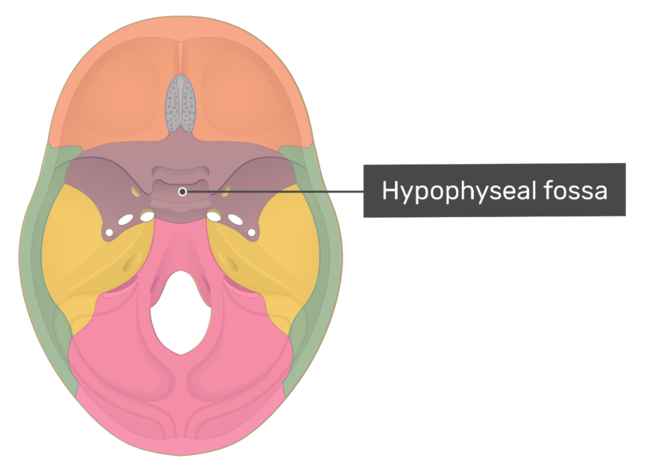
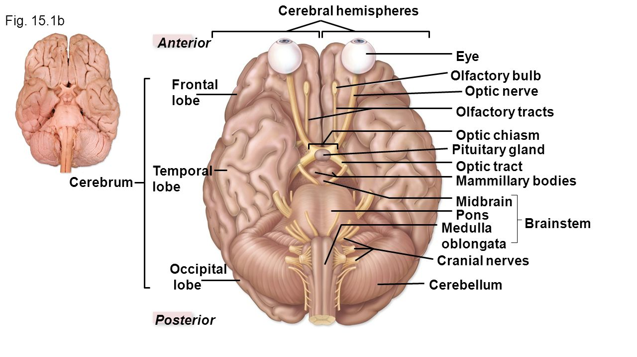
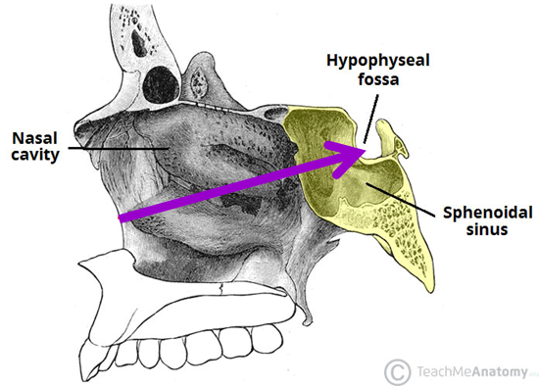
Extra Pictures
The purple part is the sphenoid bone
Hypophyseal fossa

Slide 6
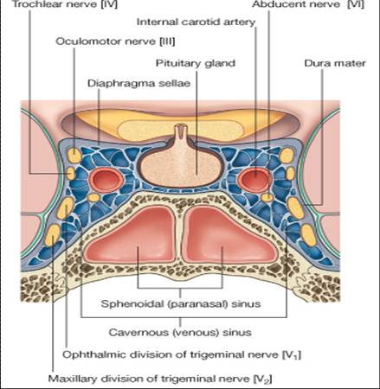
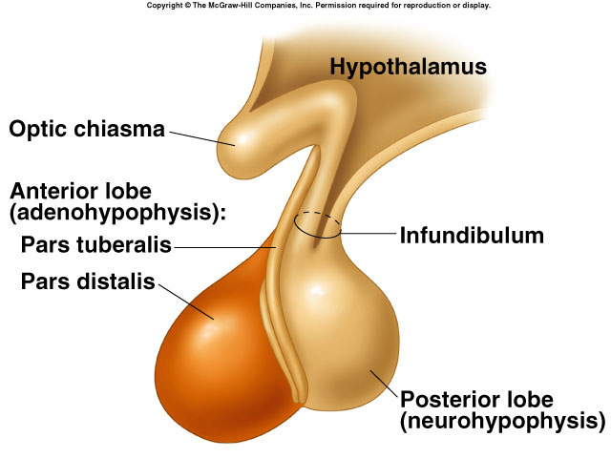
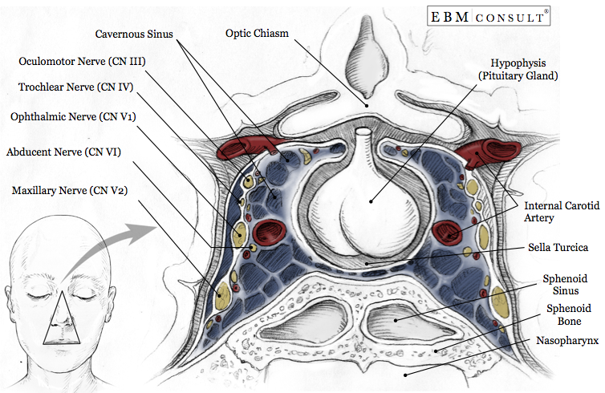
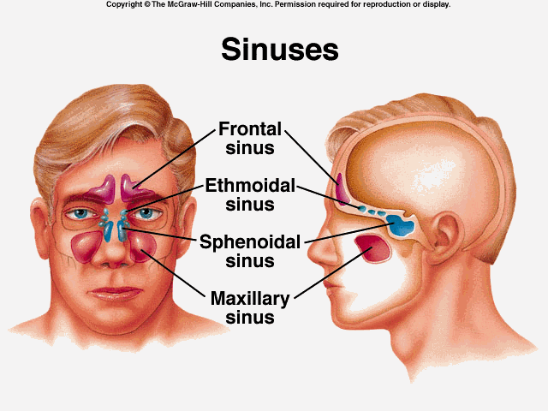
Pituitary Gland Important Relations
The relations are important
SUPERIOR: Diaphragma sellae: A fold of dura mater covers the pituitary gland & has an opening for passage of infundibulum (pituitary stalk) connecting the gland to hypothalamus.
INFERIOR: Sphenoidal air sinuses (recall from respiratory block)
LATERAL: Cavernous sinuses
Clinical point:
2 structures are present in the cavernous sinus: abducens nerve and the internal carotid artery.
So when a surgeon is working on the pituitary he must be careful not to injure the internal carotid artery (which passes through the cavernous sinus) because it supplies the brain and may lead to a stroke or coma.
Extra
Extra
Extra

Slide 7
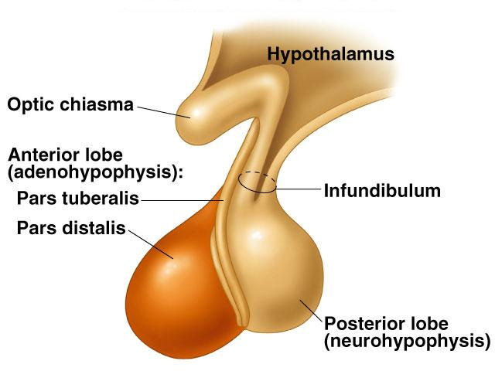
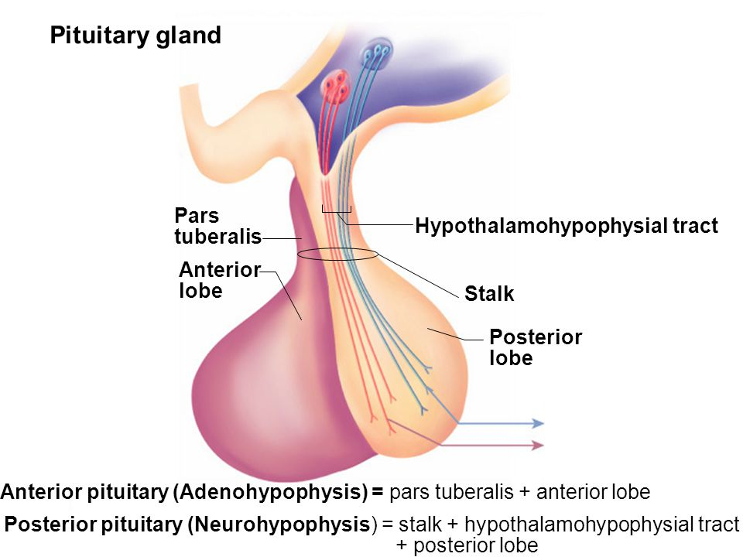
Pituitary Gland Subdivisions
Hypothalamo
-hypophyseal
tract
02:00
The gland is subdivided into:
Anterior Lobe (Adenohypophysis): it is the True gland, secretes hormones.
Posterior Lobe (Neurohypophysis): connected to hypothalamus through hypothalamo-hypophyseal tract (which passes through the stalk or infundibulum), stores hormones secreted by hypothalamic nuclei.
Extra

Slide 8
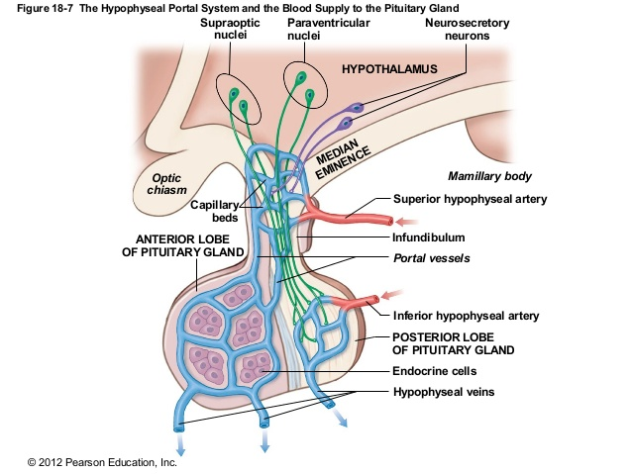
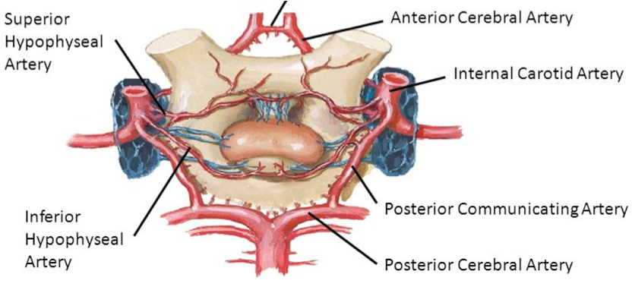
Pituitary Gland Blood supply
Arteries: superior & inferior hypophyseal arteries (branches from internal carotid artery).
Veins: hypophyseal veins drain into cavernous sinuses.
Remember when we studied the circle of willis we said it surrounded the optic chiasm and pituitary gland. Remember also that it was formed by the internal carotid and basilar arteries. So the circle of willis will give a branch (from the internal carotid) to the pituitary gland.
To remember the supply recall that the pituitary gland is also called hypophysis cerebri hence ‘hypophyseal’.
Extra

Slide 9
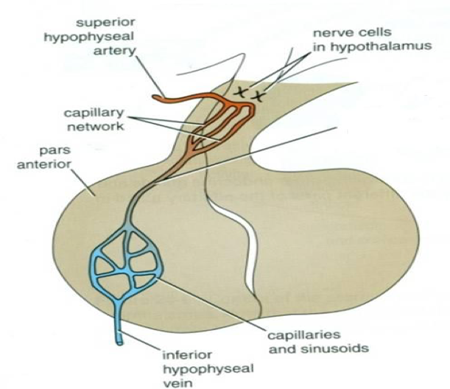
Pituitary Gland Distribution of Arteries
Superior Hypophyseal:
supplies infundibulum and anterior lobe
forms a capillary network from which vessels pass downward & form sinusoids into the anterior lobe of pituitary gland “hypophyseal portal system”.
(AKA: hypothalamo-hypophyseal portal vessel/ system)
Inferior Hypophyseal:
supplies posterior lobe of pituitary gland.
A portal system is a system of blood vessels between 2 capillary beds, just like the one in the liver. The difference between the portal system in the liver and the one in the pituitary gland is that here it started with an artery and contains hormone releasing factors while in the liver it is a vein and carries nutrients.
a hypothalamo-hypophyseal portal vessel

Slide 10
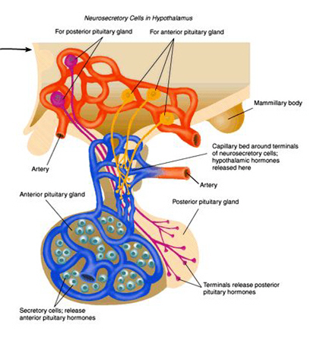
Pituitary Gland Lobes
مهمة
Explained further in physiology
Anterior Lobe (adenohypophysis)
Hormone releasing & inhibiting factors produced by hypothalamus use Hypophyseal Portal System of vessels to reach the Anterior lobe of pituitary gland
Posterior Lobe (neurohypophysis)
The Neurohypophysis receives a nerve supply from some of the hypothalamic nuclei (supraoptic & paraventricular)
The axons of these nuclei convey their neuro-secretion to the Posterior lobe of pituitary gland through Hypothalamo-Hypophyseal tract from where it passes into the blood stream.
Hypophyseal Portal System:
vascular connection between hypothalamus & anterior pituitary
Hypothalamo-Hypophyseal tract:
Neural connection between hypothalamus & posterior pituitary

Slide 11
SUMMARY
PITUITARY GLAND (HYPOPHYSIS CEREBRI)
master of endocrine glands. a small oval structure 1 cm in diameter. doubles its size during pregnancy. It lies in the middle cranial fossa. It is well protected in sella turcica (hypophyseal fossa) of body of sphenoid.
ARTERIES: Superior & Inferior hypophyseal arteries - Internal Carotid artery branches Superior hypophyseal: supplies infundibulum and the anterior lobe of pituitary gland (hypophyseal portal system). Inferior hypophyseal: supplies posterior lobe of pituitary gland | BLOOD SUPPLY | ANTERIOR : Optic chiasma POSTERIOR : Mamillary bodies SUPERIOR: Diaphragma sellae INFERIOR: Sphenoidal air sinuses LATERAL: Cavernous sinuses | IMPORTANT RELATIONS
VEINS: Hypophyseal veins drain into Cavernous Sinuses.
Anterior Lobe (Adenohypophysis): it is the True gland, Secretes hormones Hormone-releasing & inhibiting factors produced by hypothalamus use Hypophyseal Portal System of vessels to reach the Anterior lobe of pituitary gland. |  |  | SUBDIVISIONS OF PITUITARY GLAND
Posterior Lobe (Neurohypophysis): connected to hypothalamus through hypothalamo-hypophyseal tract, Stores hormones secreted. It receives a nerve supply from some of the hypothalamic nuclei (supraoptic & paraventricular) -The axons of these nuclei convey their neurosecretion to the Posterior lobe of pituitary gland through Hypothalamo-Hypophyseal tract from where it passes into the blood stream.

Slide 12
MCQs
1. Which part of the pituitary gland secret hormones ?
A- The posterior part B- Neurohypophysis part C- Adenohypophysis part
2. Inferior hypophyseal artery branch from which of the following ?
A- Internal carotid artery B- External carotid artery C- Posterior cerebral artery
3. Which of artery forms the hypophyseal portal system ?
A- Inferior hypophyseal B- Superior hypophyseal C- Internal carotid
4. Which of the following nuclei supply the neurohypophysis ?
A- Paraventricular B- Mammillary body C- Dentate
5. Which one of the following structures is superior to the pituitary gland?
A- Optic chiasma
B- Diaphragma sellae
C- Mammillary bodies
D- Sphenoidal air sinuses
6. Which one of the following venous sinuses drains hypophyseal veins?
A- Superior sagittal
B- Cavernous
C- Transverse
D- Sigmoid
7. Which of the following is posterior to the pituitary gland ?
A- Optic chiasma
B- Diaphragma sellae
C- Mammillary bodies
D- Sphenoidal air sinuses
Answers: 1. C, 2. A, 3. B, 4. A, 5. B, 6. B, 7. C

Slide 13
SAQ
Enumerate the relations of pituitary gland ?
Anteriorly: Optic Chiasm
Posteriorly: Mammillary Bodies
Superiorly: Diaphragma sellae
Inferiorly: Sphenoidal air sinuses
Laterally: Cavernous sinuses
2. In case of pituitary gland enlargement which structure lie anteriorly will be compressed?
The optic chiasm
When performing surgery on the pituitary gland which structure should the surgeon be most careful not to injure? And what may happen if he does injure it?
He should be careful not to injure the internal carotid artery. If it is severed it will decrease blood supply to the brain and result in a stroke or coma.

Slide 14
Leaders:
Nawaf AlKhudairy
Jawaher Abanumy
Members:
Alanoud Abuhaimed
Anwar Alajmi
Ghaida Alsaeed
Lama Alfawzan
Lama AlTamimi
Rawan AlWadee
Safa Al-Osaimi
Shatha Alghaihb
Wejdan alzaid
Feedback
References:
1- Girls’ & Boys’ Slides
2- Greys Anatomy for Students
3- TeachMeAnatomy.com
anatomyteam436@gmail.com
@anatomy436

