Slide 1
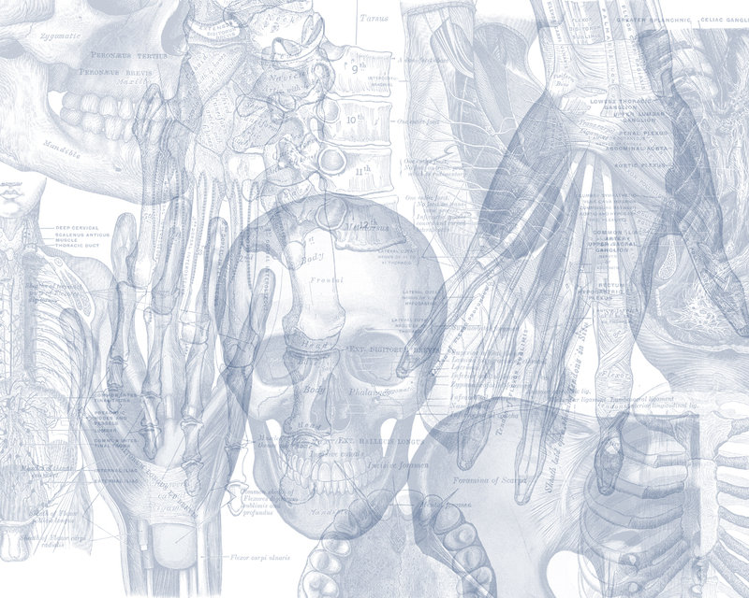
Thyroid and Parathyroid Glands
Color Code
Important
Doctors Notes
Notes/Extra explanation
Please view our Editing File before studying this lecture to check for any changes.

Slide 2
Objectives:
By the end of the lecture, you should be able to:
Describe the shape, position, relations and of the thyroid gland.
List the blood supply & lymphatic drainage of the thyroid gland.
List the nerves endanger with thyroidectomy operation.
Describe the shape, position, blood supply & lymphatic drainage of the parathyroid glands.
Describe briefly the development of the thyroid & parathyroid glands.
Describe the most common congenital anomalies of the thyroid gland.
These objectives (and their corresponding slides) will be covered by the Embryology team.

Slide 3
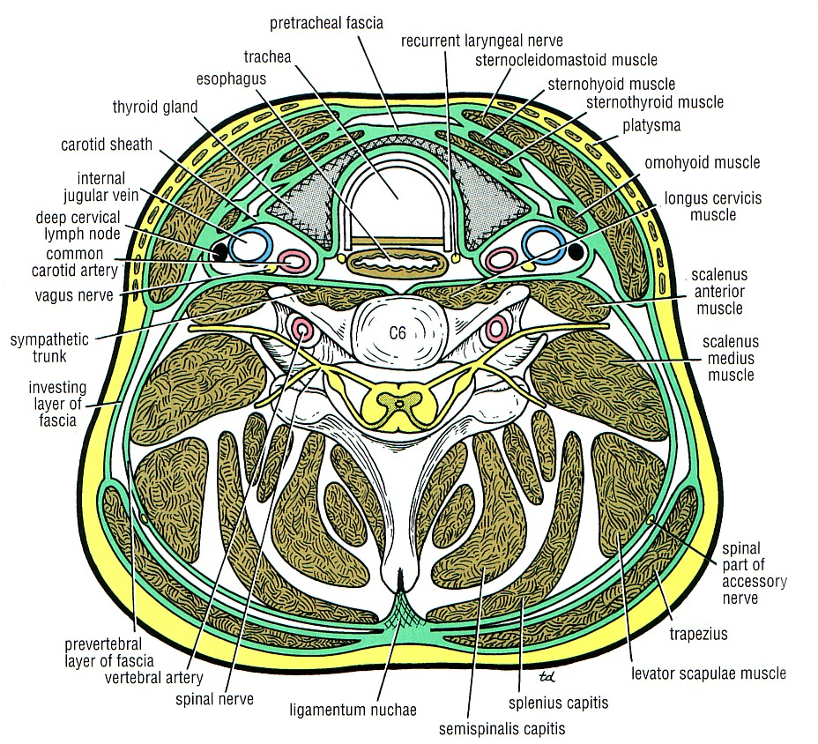
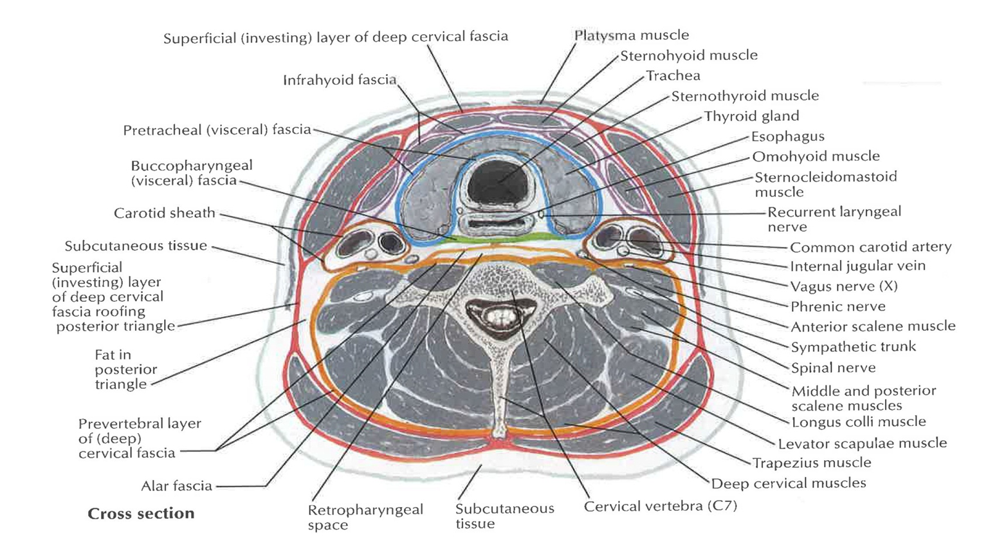
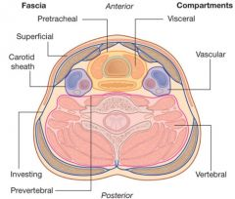
What are the parts of the deep cervical fascia of the neck?
It is divided mainly into 3 layers (or more):
Investing layer (covers neck completely).
Pretracheal layer (covers thyroid gland).
Prevertebral layer (surrounds vertebra and muscles).
Males’ slide: The carotid sheath is part of the deep cervical fascia of the neck
Investing (يغلف) layer: a thick layer that encircles the neck, and encloses the trapezius & sternocleidomastoid muscles.
Pretracheal layer: surrounds the thyroid, parathyroid glands, and encloses the infrahyoid muscles
Carotid sheath: it is a local condensation of the 3 layers and contains: the common & internal carotid arteries, the internal jugular vein, the vagus nerve, and the deep cervical lymph nodes
Extra
Extra

Slide 4
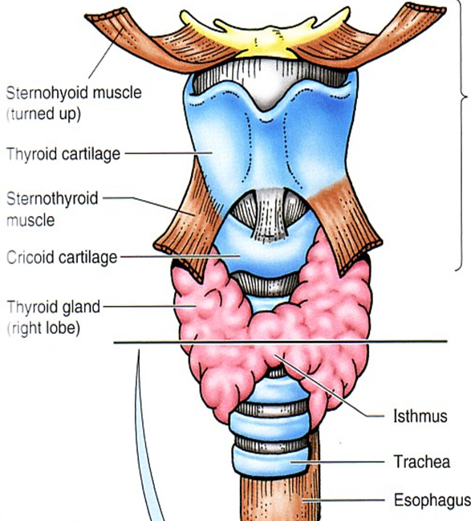
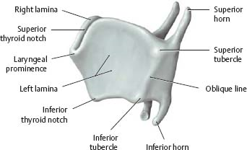
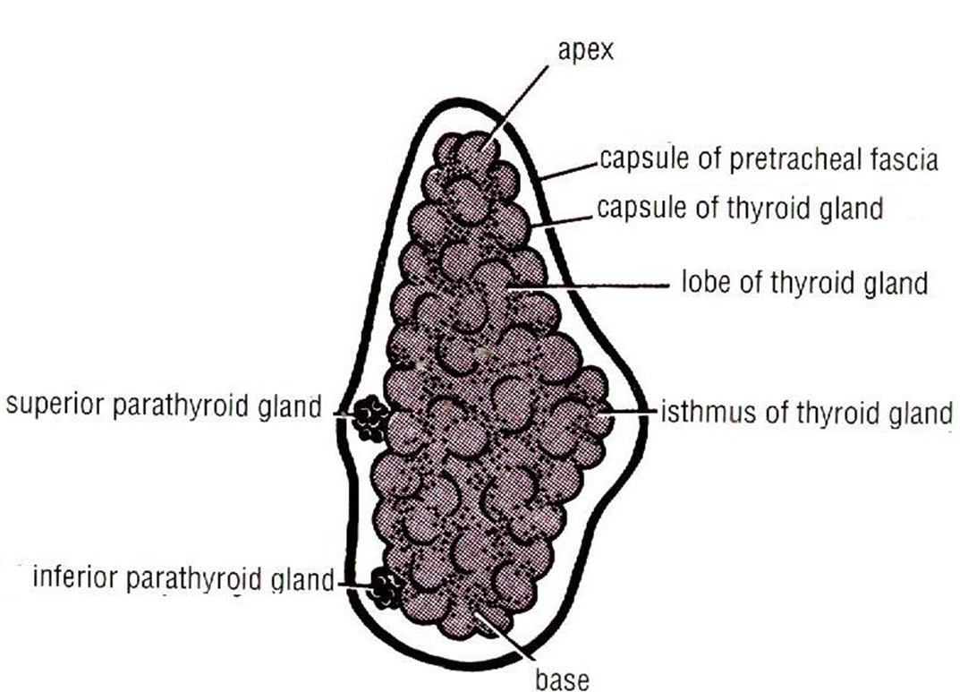
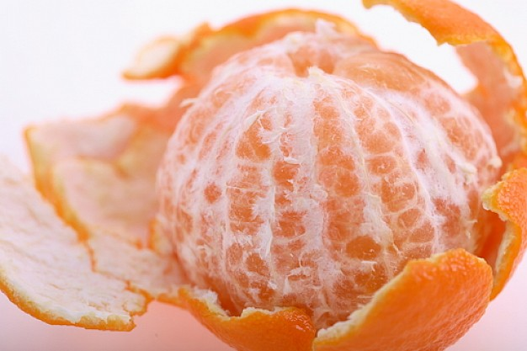
Thyroid gland (الغدة الدرقية )
Thyroid gland | A butterfly shaped endocrine gland.
 | Consists of right & left lobes.
 | Each lobe is pear- shaped, with its apex reaches up to the oblique line of thyroid cartilage.
 | Its base lies at the level of 4th or 5th tracheal rings^.
Isthmus** | The 2 lobes are connected to each other by a narrow isthmus.
 | The isthmus extends across the midline in front of the 2nd , 3rd, & 4th tracheal rings^.
Coverings | The gland is surrounded by a facial sheath derived from the pretracheal layer of the deep cervical fascia.
 | Inside the pretracheal facial capsule, there is another C.T (connective tissue) capsule.
 | So, it s surrounded by 2 membranes (زي البرتقال).
^ don’t be confused: tracheal rings NOT vertebra
Thyroid gland
(Right lobe)
Extra
Posterior
Anterior
Males’ slide: What is the clinical importance of the pretracheal layer? Either related to the spread of infection or to the movement of the gland during swallowing. Also helps in diagnosing a thyroid tumor.
Thyroid gland
capsule
**A narrow piece of tissue connecting two larger parts (اختناق)
Extra
fascia

Slide 5
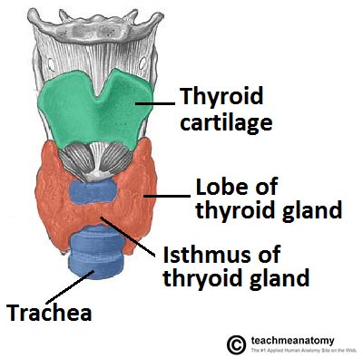
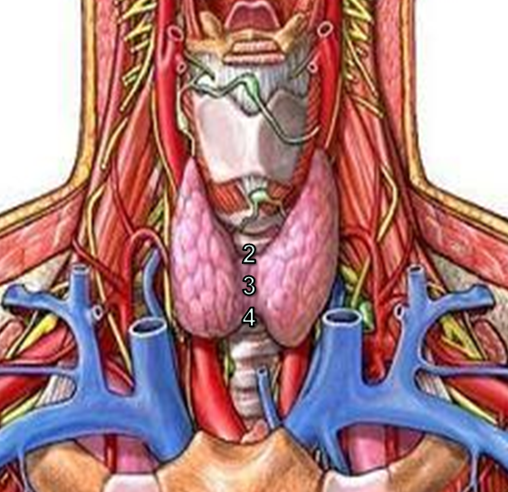
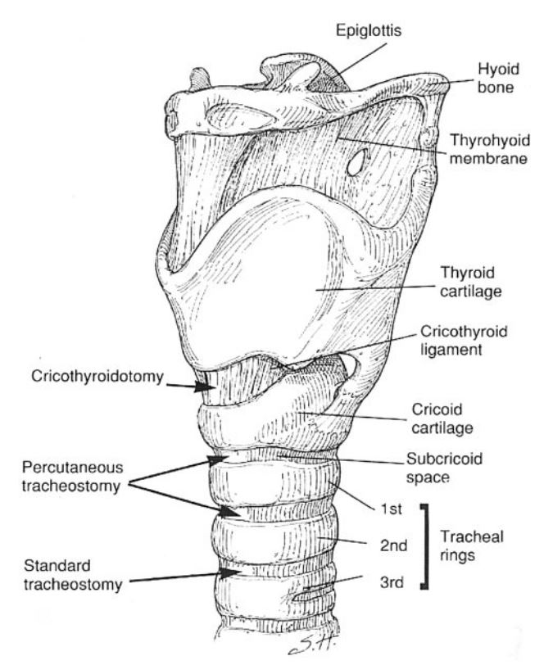
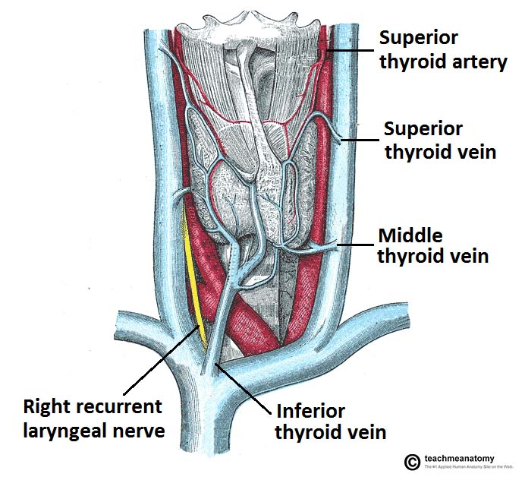
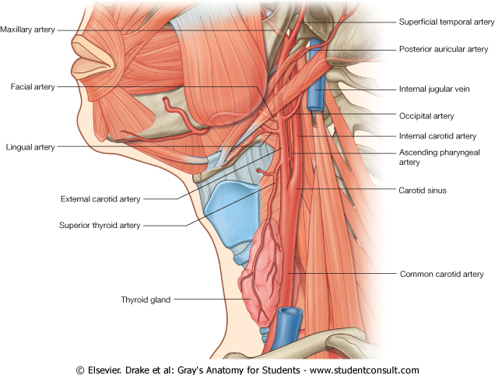
Extra
Extra
Extra

Slide 6
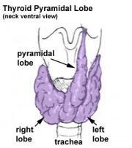
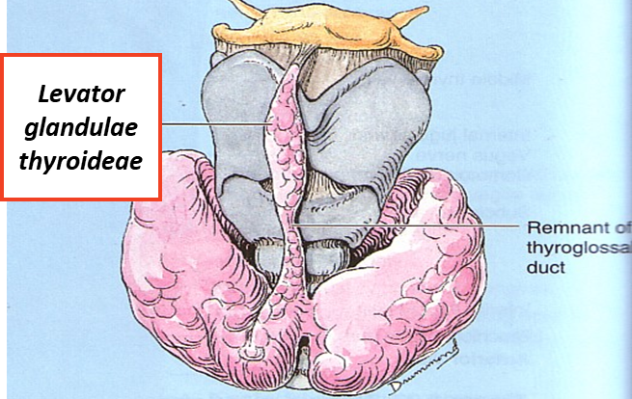
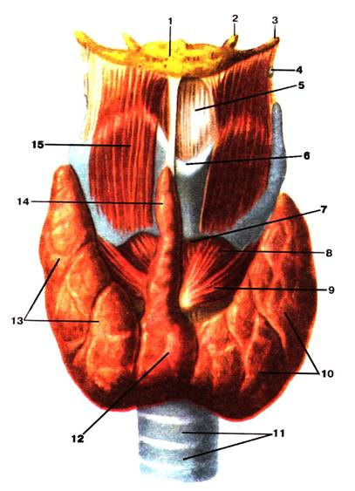
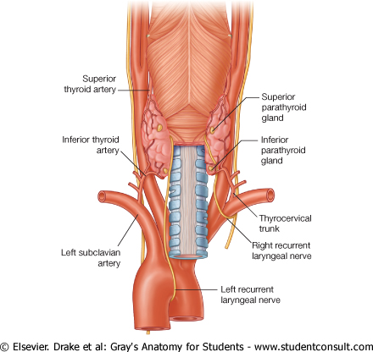
Thyroid gland
A 3rd small pyramidal lobe is often present which projects from the upper border of the isthmus slightly to left of middle line.
The Pyramidal lobe is connected to hyoid bone by a fibrous or muscular band called levator glandulae thyroideae.
This represents in 50% of people the fibrosed & obliterated thyroglossal duct.
Posterior border
The rounded posterior border is related to the superior & inferior Parathyroid glands.
It is also related to anastomosis between superior & inferior thyroid arteries.

Slide 7
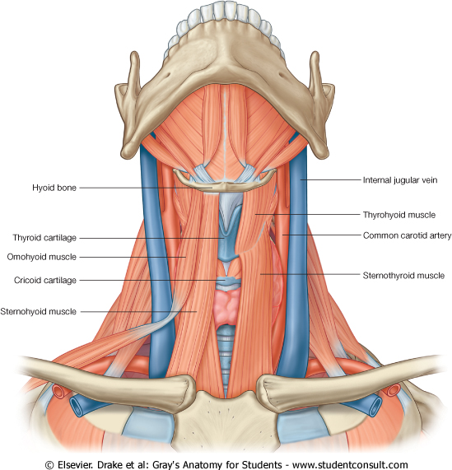
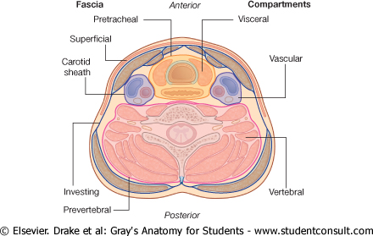
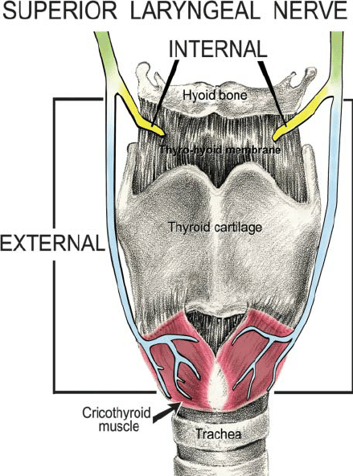
Thyroid gland
Relations
02:05
3
2
1
Extra
Anterolaterally (4s) | Posteriorly (or posterolaterally) | Medially
1. Sternohyoid. | Carotid sheath and its contents: the common carotid artery as well as the internal carotid artery (medial) internal jugular vein (lateral) the vagus nerve (CN X) (posterior) the deep cervical lymph nodes | Above | Below
 |  | 1- Larynx 2- Pharynx | 1- Trachea 2- Esophagus. 3- Recurrent laryngeal nerve in between trachea & esophagus. 4- Cricothyroid muscle**. 5- External laryngeal nerve.
2. Sternothyroid
3. Superior belly of omohyoid
4. Sternomastoid*
These 3 make up the strap muscles
*also called sternocleidomastoid
**the cricothyroid ms is supplied by the external laryngeal n.

Slide 8
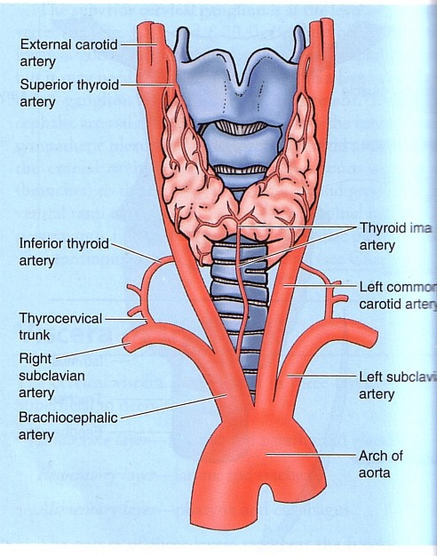
Thyroid gland
Arterial supply
The course is important
1-Superior thyroid artery .:
A branch of the external carotid artery. It descends to the upper pole of the gland, with the external laryngeal nerve (IMPORTANT)!. It runs along the upper border of the isthmus to anastomosis with that of the opposite side.
3-Inferior thyroid artery:
From thyrocervical trunk of the 1st part of the subclavian artery, Then it curves medially behind the carotid sheath.
It ascends upward behind the gland to the level of the Cricoid cartilage, C6.
Then it reaches the posterior aspect of the gland & descends downwards.
The recurrent laryngeal nerve crosses either in front or behind it.!
2- Thyroidea ima artery:
If present ( ), it arises from aortic arch or from the brachiocephalic artery. It ascends in front of the trachea to reach the isthmus.
مو موجودة عند كل الناس

Slide 9
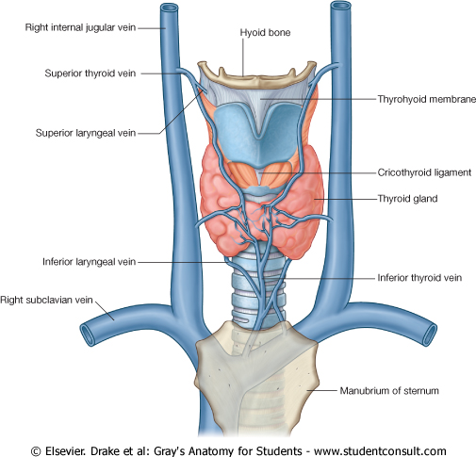
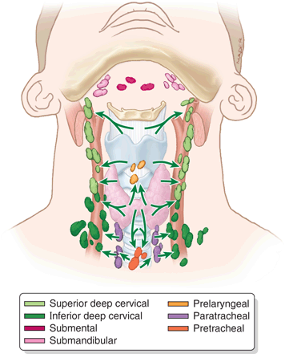
Thyroid gland
Supply
Vein | Tributary of :
Superior thyroid vein | internal jugular vein
Middle thyroid vein | internal jugular vein
Inferior thyroid vein | left brachiocephalic vein
Middle thyroid vein
Lymph Of the Thyroid Gland:
Deep cervical & paratracheal lymph nodes.
Innervation:
Sympathetic: cervical sympathetic trunk
Parasympathetic: branches of vagus nerve
Extra

Slide 10
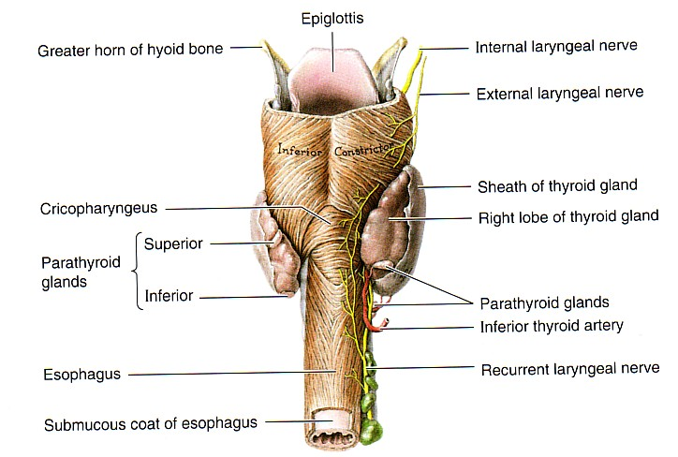
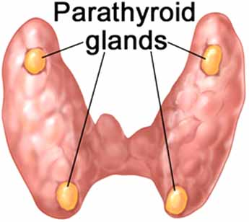
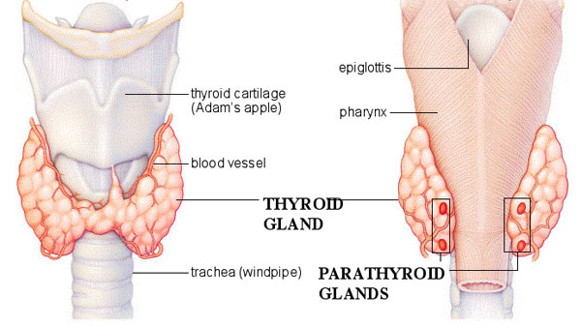
Parathyroid Gland (الغدة الجار درقية )
4 small ovoid* bodies, about 6 mm. long.
They lie within the facial capsule of the gland, (between the 2 membranes).
2 superior parathyroid has a constant position at the middle of the posterior border of the gland.
2 inferior parathyroid usually at the level of the inferior pole (قطب).
They lie within the thyroid tissue or sometimes outside the facial capsule.
The position is important
* بيضوي
Anterior
Posterior

Slide 11
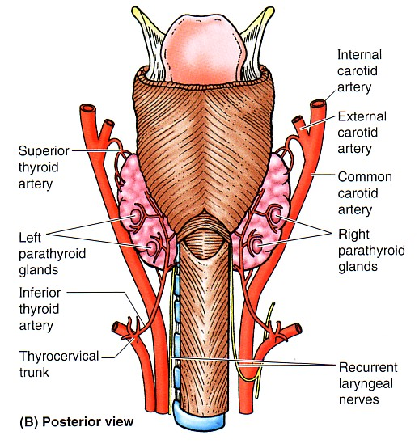
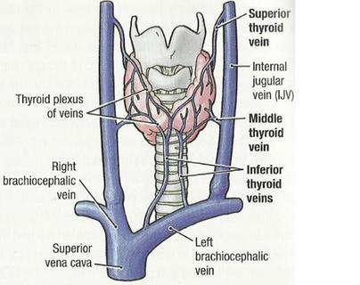
Parathyroid Gland Supply
They are supplied by superior & inferior thyroid arteries.
Their veins are drained to superior, middle and inferior thyroid veins.
Lymph nodes:
Deep cervical & paratracheal lymph nodes.
Nerve supply:
Sympathetic Trunk:
Superior & middle cervical sympathetic ganglia (vasomotor).
We have 3 cervical ganglia: superior, middle, and inferior.
The arterial, venous, and lymphatic supply are the same in both thyroid and parathyroid glands, only the nerve supply is different.

Slide 12
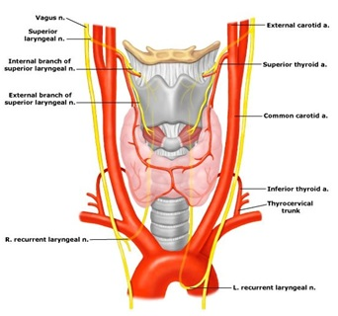
Clinical Notes
The external laryngeal nerve runs close to the superior thyroid artery before turning medially to supply the cricothyroid muscle. High ligation* of the superior thyroid artery during thyroidectomy places this nerve at risk of injury, so it should be ligated within the upper pole of the gland. Its lesion will cause horsiness of voice.
The inferior thyroid artery is closely associated with the recurrent laryngeal nerve**. This nerve can be found , in a triangle bounded laterally by the common carotid artery, medially by the trachea, and superiorly by the thyroid lobe.
The relationship of the recurrent laryngeal nerve and the inferior thyroid artery is highly variable in that the nerve can lie deep or superficial to the artery, or between the branches of the artery, and be different on either side of the neck.
Consideration of this nerve and its branches must be given during thyroidectomy.
NB. **RLN lesion may results in impaired breathing & speech.
Thyroid lobe
*(ربط) the surgical process of tying up an anatomical channel (as a blood vessel)
Thyroidectomy= surgical removal of all or part of the thyroid gland
Trachea
Common carotid artery
Superior thyroid artery → external laryngeal nerve → hoarseness of voice
Inferior thyroid artery → recurrent laryngeal nerve → impaired breathing and speech

Slide 13
SUMMARY
 | Thyroid Gland |  |  |  | Parathyroid Gland
Notes | Consists of 2 lobes, and each lobe has an apex and base (level of 4th or 5th tracheal rings) The 2 lobes are connected by a narrow isthmus which extends in front of 2nd , 3rd , and 4th tracheal rings. The gland is surrounded by a CT capsule and a pretracheal layer of deep cervical fascia. |  |  |  | 4 ovoid bodies lie within facial capsule between the 2 membranes
Relations | Anterolaterally | Posteriorly | Medially
 |  |  | Above | Below
 | Sternohyoid Sternothyroid Superior belly of omohyoid Sternomastoid | Carotid sheath & its contents | Larynx pharynx | Trachea Esophagus. Recurrent laryngeal nerve. Cricothyroid muscle. External laryngeal nerve.
Arterial | Superior, and inferior thyroid artery, and thyroidea ima artery |  |  |  | Superior and inferior thyroid artery
Venous | Superior, middle and inferior thyroid veins
Lymphatic | Deep cervical and paratracheal lymph nodes
Innervation | Sympathetic: cervical sympathetic trunk Parasympathetic: branches of vagus |  |  |  | Superior & middle cervical sympathetic ganglia
Nerves endangered during thyroidectomy →
Superior thyroid artery → external laryngeal nerve → hoarseness of voice
Inferior thyroid artery → recurrent laryngeal nerve → impaired breathing and speech

Slide 14
SAQs
MCQs
1- Which of the following arteries is crossed by the recurrent laryngeal?
A- superior thyroid
B- inferior thyroid
C- thyroidea ima artery
D- none of the above
2- Which on of the following is related to the thyroid gland medially but from above?
A- larynx
B- trachea
C- esophagus
D- sternohyoid
3- A surgeon is performing a thyroidectomy on a patient with graves disease and He accidentally ruptured the superior thyroid artery. which of the following nerves is the most susceptible to injury?
A- recurrent laryngeal
B- external laryngeal
C-phrenic nerve
D- none are susceptible
4- Which of the following is branch of the thyrocervical artery?
A-external carotid
B-thyroidea ima artery
C-superior thyroid
D-Inferior thyroid
5- Which of the following structures lies anterior to the thyroid lobe?
A- Inferior belly of omohyoid.
B- Internal jugular vein.
C- Vagus nerve.
D- Sternohyoid.
ANS: 1.B 2.A 3.B 4.D 5. D
Q1. What is the clinical importance of the pretracheal layer?
It is to determine whether the mass is in the thyroid or not
Q2. List the 3 veins that drain the thyroid gland and their tributaries.
Vein Tributary
Superior thyroid vein Internal jugular vein
Middle thyroid vein internal jugular vein
Inferior thyroid vein left brachiocephalic vein

Slide 15
Leaders:
Nawaf AlKhudairy
Jawaher Abanumy
Members:
Abdulmalik alhadlaq
Abdulrahman almalki
Abdulmohsen alghanam
Abdulmohsen alkhalaf
Abdullah jammah
Abdulrahman alrajhi
Feedback
References:
1- Girls’ & Boys’ Slides
2- Greys Anatomy for Students
3- TeachMeAnatomy.com
anatomyteam436@gmail.com
@anatomy436

