Slide 1
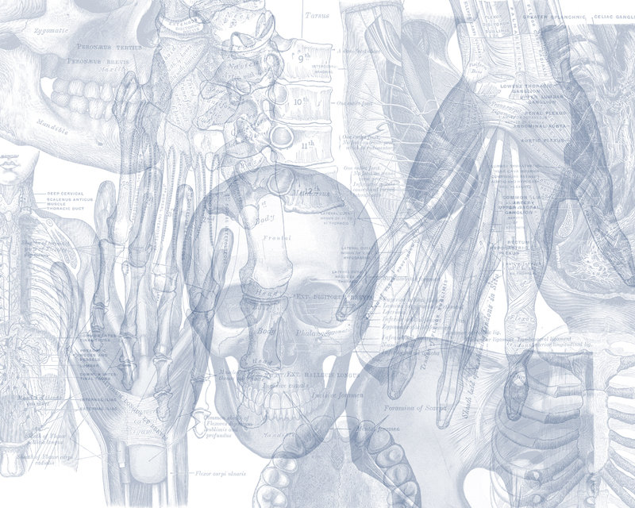
Anatomy of Adrenal Glands
Color Code
Important
Doctors Notes
Notes/Extra explanation
Please view our Editing File before studying this lecture to check for any changes.

Slide 2
Objectives
At the end of the lecture, the students should be able to describe the:
Location, shape and relations of the right and left adrenal glands.
Blood supply, lymphatic drainage and nerve supply of right and left adrenal glands
Parts of adrenal glands and function of each part.
Development of adrenal gland and common anomalies.
This objective (and its corresponding slides) will be covered by the Embryology team.

Slide 3
Suprarenal gland (also called adrenal gland:الغدة الكظرية )
The suprarenal (adrenal) gland is a component of the hypothalamic-pituitary-suprarenal axis also called “stressed axis “ that is responsible for coordinating stress response and metabolism.
They are yellowish retroperitoneal* organs that lie on the upper poles of the kidneys, At the level of the last thoracic vertebra (T12) The kidney extends from T12 to L3.
* retroperitoneal: lying posterior to the peritoneum (covers it anteriorly only)

Slide 4
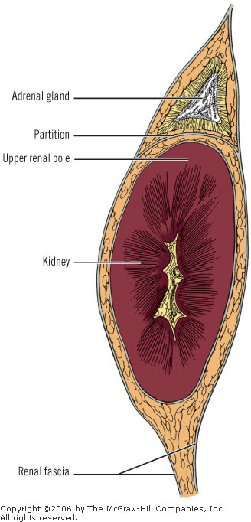
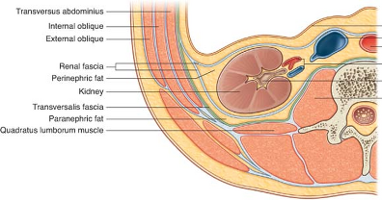
Suprarenal gland (also called adrenal gland:الغدة الكظرية )
Each gland has an outer yellow cortex and an inner dark brown medulla.
The suprarenal gland is enclosed within the renal fascia with the kidney but in a separate compartment, that allow the two organs to be separated easily during surgery*.
It is separated from the kidney by the perirenal fat**
Extra
*يعني الجراح لما يشتغل على الكلى ما راح يأثرعلى الغدة والعكس صحيح لان كل وحد في حجرة منفصله
**recall the kidney is covered by 4 layers: capsule, perirenal fat, renal fascia, pararenal fat.
Extra

Slide 5
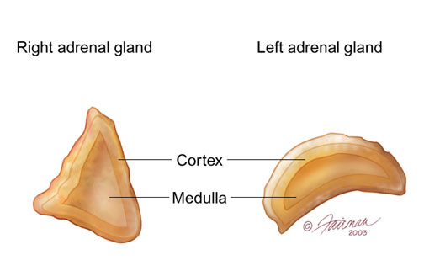
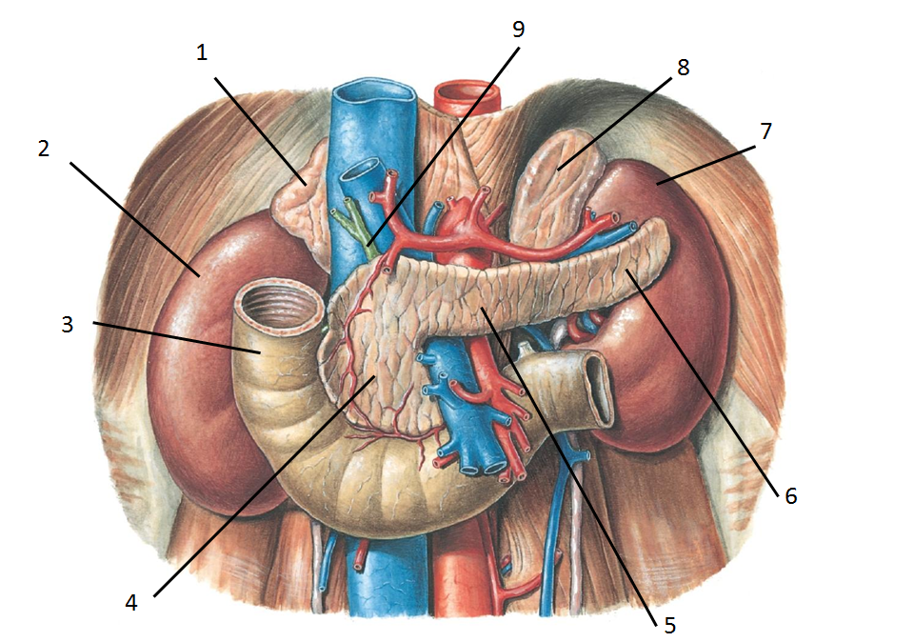
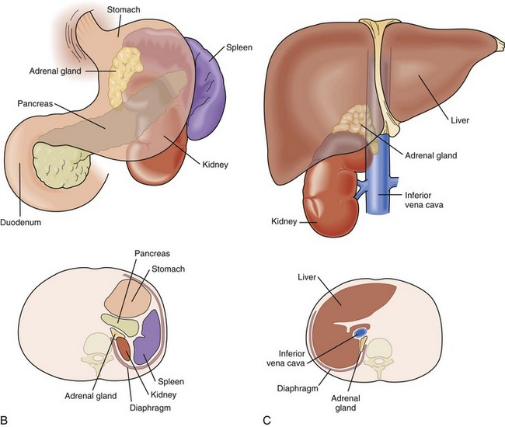
Right and Left Suprarenal Glands
*The relations are always important.
Anatomy = relations.
 |  | Right Suprarenal Gland | Left Suprarenal Gland
Shape |  | pyramidal (or triangular) shape | crescentic (هلالي) or semilunar shape
Location |  | Caps* the upper pole of the right kidney. So it is at the level of T12 * صايره زي القبعه فوق الكليه | Extends along the medial border of the left kidney from the upper pole to the hilus. Its level is from T12 to L2
Relations* | Anterior | Right lobe of liver Inferior vena cava | Pancreas Lesser sac Stomach
 | Posterior | Diaphragm | Diaphragm
 | Medial | Celiac plexus and ganglia | Celiac plexus and ganglia
Extra
It is a part of the stomach bed
A really nice picture showing the relations →

Slide 6
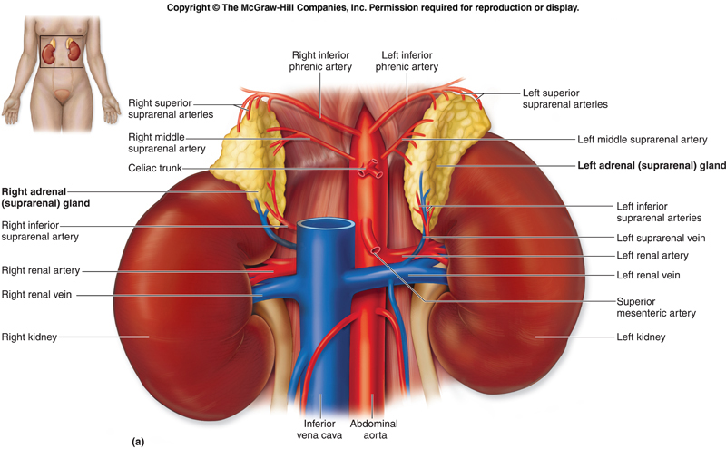
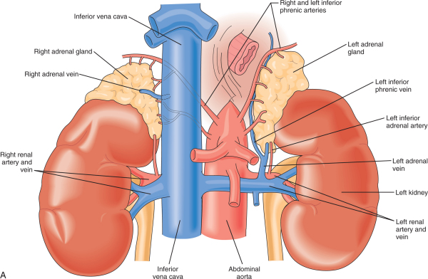
Suprarenal Glands: Supply
Arterial blood supply: IMPORTANT
The arteries supplying each gland are three in number:
Superior suprarenal from inferior phrenic artery.
Middle suprarenal from abdominal aorta
Inferior suprarenal from renal artery.
Venous Drainage: IMPORTANT (right vs left)
A single vein (adrenal vein) emerges from the hilum of each gland and drains into :
the inferior vena cava (directly) on the right side and
the left renal vein (then to the IVC) on the left side.
Right adrenal vein → inferior vena cava
Left adrenal vein → left renal vein → inferior vena cava
The inferior phrenic and renal arteries are branches of the abdominal aorta.
The inferior phrenic is paired on each side and supplies the diaphragm mainly.
On the left side the renal vein receives left suprarenal vein and left gonadal vein.
While on the right side the right suprarenal and right gonadal immediately drain into inferior vena cava

Slide 7
Suprarenal Glands:
Supply
Nerve supply
Preganglionic sympathetic fibers derived from the splanchnic nerves supply the glands
Most of the nerves (postganglionic) end in the medulla of the gland.
Lymph Drainage
The lymph drains into the lateral aortic* lymph nodes.
*Also called paraaortic or lumbar lymph nodes.

Slide 8
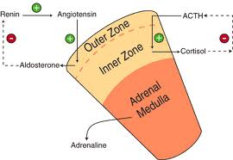
Suprarenal Glands
Function
The Cortex of the suprarenal glands secretes hormones that include: related to metabolism
Mineral corticoids, which are concerned with the control of fluid and electrolyte balance
Glucocorticoids, which are concerned with the control of the metabolism of carbohydrates, fats, and proteins
Small amounts of Sex hormones, which probably play a role in the prepubertal development of the sex organs.
The Medulla (related to stress) of the suprarenal glands secretes the catecholamines: epinephrine and norepinephrine

Slide 9
SUMMARY
Adrenal gland
retroperitoneal. At the level of the last thoracic vertebra (T12). Enclosed within the renal fascia.
 | Right suprarenal gland |  | Left suprarenal gland
Shape | Pyramidal |  | Crescentic
Location | Caps upper pole of the right kidney |  | Along the medial border from upper pole to hilus
Relation | Anterior | right lobe of liver IVC | Pancreas Lesser sac Stomach
 | Posterior | diaphragm
 | inferior | celiac plexus & ganglia
Blood supply | Superior suprarenal from inferior phrenic artery. Middle suprarenal from abdominal aorta Inferior suprarenal from renal artery.
Lymph drainage | Lateral aortic lymph nodes.
Venous drainage | Right adrenal vein drain into IVC |  | Left adrenal vein drain into left renal artery
Nerve supply | Preganglionic sympathetic fibers from splanchnic nerve

Slide 10
MCQ
1. The hypothalamic-­‐pituitary-­‐ suprarenal axis is responsible for :
Control stress
Control stress and metabolism
Control lipid digestion
Control metabolism
2. The suprarenal gland is :
Greenish retroperitoneal
Reddish retroperitoneal
Brown retroperitoneal
Yellowish retroperitoneal
3. The suprarenal gland is at the level of :
T11
T12
L1
L2
4. The supra renal gland is separated from the kidney by:
Adrenal fascia
Renal fascia
Peritoneal fat
Perirenal fat
5. The right supra renal gland is:
Square in shape
Circular in shape
Crescentic in shape
Pyramidal in shape
6. Which of the following is anterior to the Right supra renal :
Pancreas
Diaphragm
Celiac plexus
Inferior vena cava
7. Which of the following play a role in the prepubertal development of sex organs?
Mineral corticoids
Glucocorticoids
Sex hormones
8. Nerve fibers that are supplying the adrenal gland are :
Preganglionic sympathetic
Postganglionic sympathetic
Preganglionic parasympathetic
9. Superior suprarenal artery is a branch of?
Superior phrenic artery
Inferior phrenic artery
Abdominal aorta
10. A lesion in the left renal vein may affect which of the following vinous drainage :
Left suprarenal gland
Right suprarenal gland
Both

Slide 11
11. Lymphatic drainage of adrenal glands :
Lateral Aortic lymph nodes
Lumbar lymph nodes
both
Answers:
1:B, 2:D, 3:B, 4:D, 5:D, 6:D 7: C, 8: A, 9: B, 10: A, 11: C
SAQ
What is the vertebral levels of each suprarenal gland?
The right suprarenal gland: 12 thoracic
The left suprarenal gland: T12 – L2
Identify the relations of right suprarenal gland:-
Anterior : Right lobe of liver + inferior vena cava
Posterior : Diaphragm
Medial : celiac plexus and ganglia
Define the arterial supply of the adrenal glands, and the origin of each one :-
Three arteries
Superior suprarenal artery from inferior phrenic
Middle suprarenal artery from abdominal aorta
Inferior suprarenal artery from renal artery
Describe the Venous drainage of adrenal glands :-
Single vein in each gland, emerge from the hilum of each gland.
The right adrenal vein drains into the inferior vena cava
The left adrenal vein drains into the left renal vein

Slide 12
Leaders:
Nawaf AlKhudairy
Jawaher Abanumy
Members:
Allulu Alsulayhim
Ashwaq Almajed
Ameera Niazi
Dania Alkelabi
Do'aa abdulfattah
Muneerah Alzayed
Nourah Al Hogail
Nouf Aloqaili
Sarah Alshamrani
Feedback
References:
1- Girls’ & Boys’ Slides
2- Greys Anatomy for Students
3- TeachMeAnatomy.com
anatomyteam436@gmail.com
@anatomy436

