Slide 1
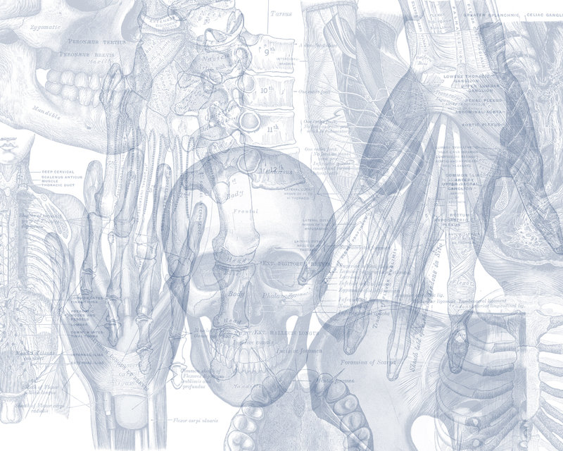
Anatomy of the Pancreas
Color Code
Important
Doctors Notes
Notes/Extra explanation
Please view our Editing File before studying this lecture to check for any changes.

Slide 2
Objectives
At the end of the lecture, the students should be able to describe the:
Describe the anatomical view of the pancreas regarding ; location, parts relations, ducts.
Arterial supply & Venous drainage.
Describe the nerve supply and lymph drainage.

Slide 3
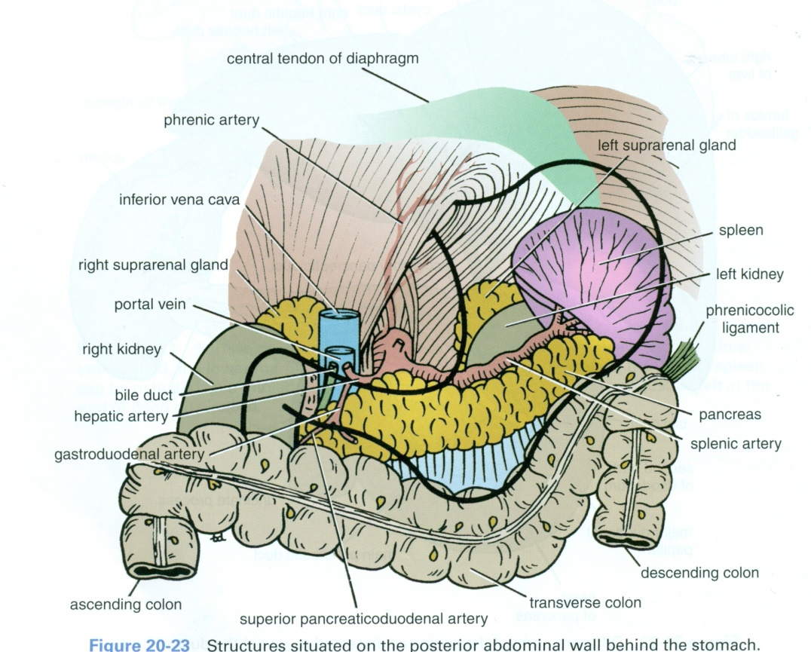
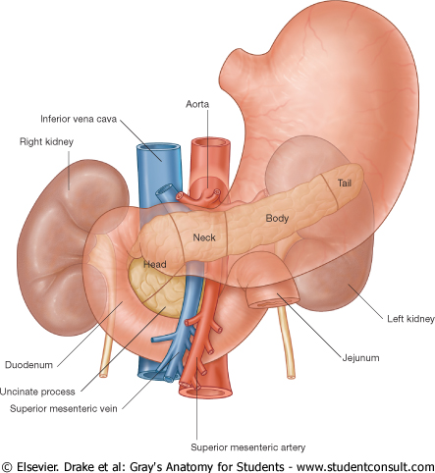
 | Pancreas
Introduction | It is an elongated soft pinkish structure (60-100) gram in weight & (6-10) inch in length Why is it Lobulated? Because it is surrounded by a fibrous tissue capsule from which septa pass into the gland and divide it into lobes. The lobes (فصوص) are divided into lobules (فصيصات). Lobulated structures are hard to manage during surgery.
Location | It is a Retro-Peritoneal* structure. It lies on the posterior abdominal wall in the: Epigastrium & Left upper quadrant of the abdomen. It extends in a transverse oblique direction at the transpyloric plane (1st lumbar vertebral) from the concavity of the duodenum on the right to the spleen on the left.
Parts | Head Neck Body Tail. Because of its oblique direction the tail is higher than the head (at T12).
L1 (transpyloric plane)
T12
*meaning it is only covered anteriorly by peritoneum and posteriorly it is fixed to the abdominal wall.

Slide 4
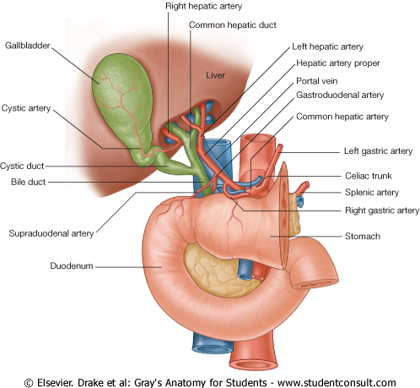
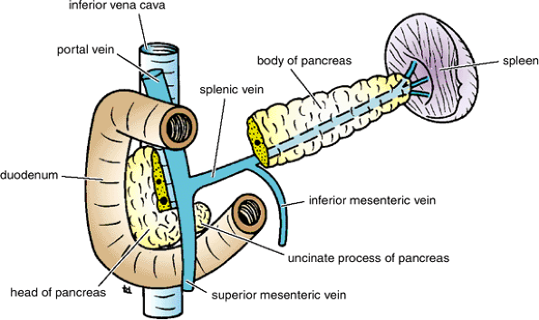
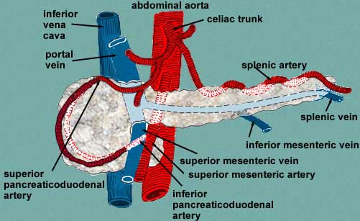
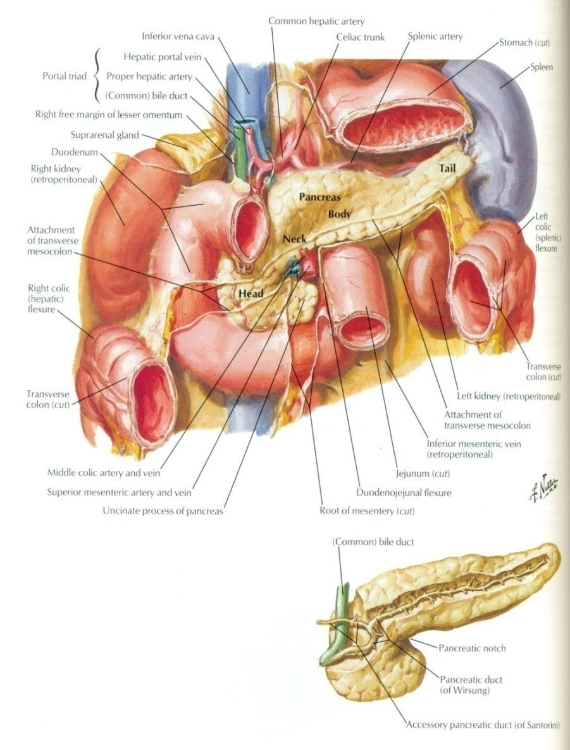
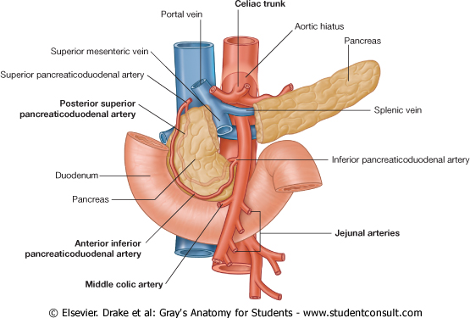
Part of Pancreas
Head | It is disc (قرص) shaped and lies within the concavity (c-shaped part) of the duodenum Related to the 2nd and 3rd portions of the duodenum. On the right, it emerges into the neck. On the left, it Includes Uncinate Process: ( an extension of the lower part of the head behind the superior mesenteric vessels so they descend in front of it) Structures Posterior to the Head: 1. Bile Duct runs downwards and may be embedded in it. (cancer of head will lead to obstructive jaundice) 2. IVC (inferior vena cava) runs upwards because its going to the heart.
Neck | It is the constricted portion connecting the head & body of pancreas It lies in front of (posterior relations): Aorta Origin of Superior Mesenteric artery the confluence (beginning) of the Portal Vein Its antero-superior surface supports the pylorus of the stomach The superior mesenteric vessels emerge from its inferior border*
Body | It runs upward and to the left. It is triangular in cross section. The Splenic Vein is embedded in its posterior surface. The Splenic Artery runs to the left (toward the spleen) along the upper border of the pancreas.
Tail | A narrow, short segment Ends within the splenic hilum. Lies in the Splenicorenal (also called lienorenal) ligament. Anteriorly, related to: splenic flexure of colon (also called left colic flexure). May be injured during splenectomy which will lead to acute pancreatitis.
Extra
*the superior mesenteric vessels start at L1 behind the neck then they will descend and go in front of the uncinate process

Slide 5
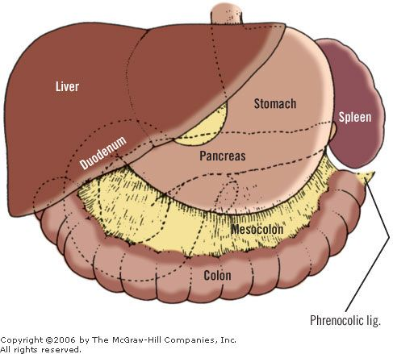
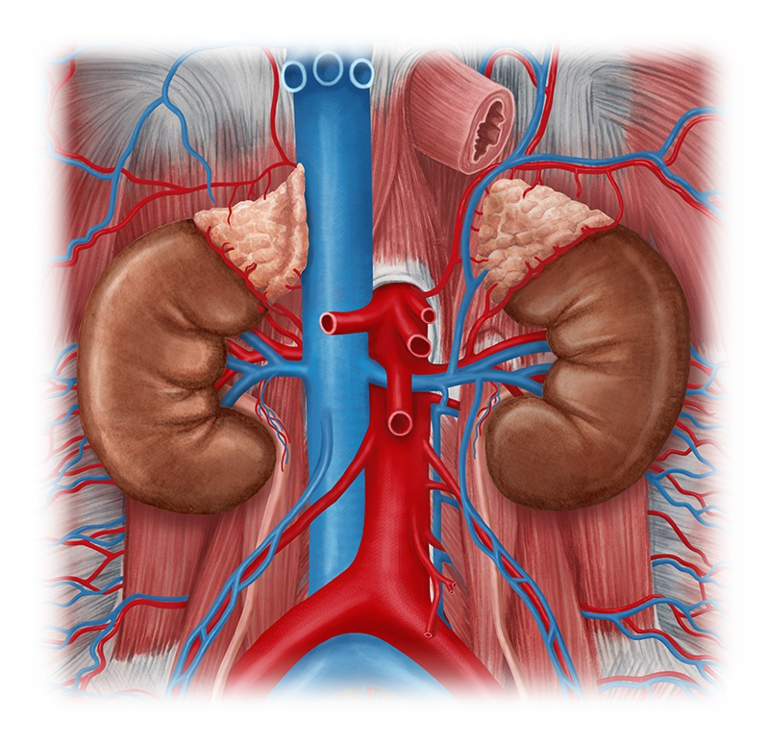
Relations of Pancreas
*Extra
*Extra
Anterior to (body & tail): | Posterior to (body & tail) :
Stomach separated from it by lesser sac | Left Psoas muscle
Transverse colon &transverse mesocolon | Left Adrenal gland
 | Left Renal vessels
 | Upper 1/3rd of Left kidney
 | Hilum of the spleen

Slide 6
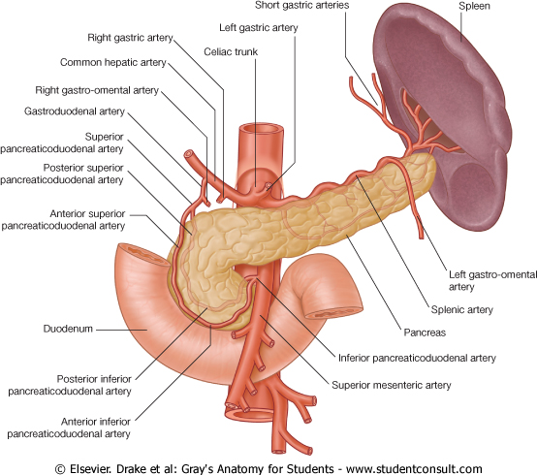
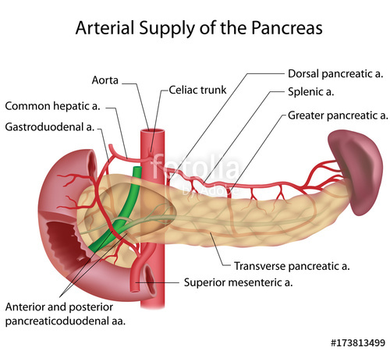
Arterial Supply Important to know
Supplied by:
Celiac trunk (foregut)
Superior mesenteric artery (midgut)
Splenic arteries (branch of celiac)
Head & Neck:
Celiac Trunk* → Common hepatic artery (also gives Right gastric and hepatic arteries) →Gastroduodenal →Superior pancreaticoduodenal .
Superior mesenteric → Inferior pancreaticoduodenal to head
Body and Tail:
Splenic artery: supplies the Body and Tail of pancreas by about 10 branches
*Extra
The inferior pancreaticoduodenal is a branch of superior mesenteric.
The superior pancreaticoduodenal is a branch of gastroduodenal which is a branch of common hepatic which is a branch of celiac trunk.
نفس الكلام بس بصيغة مختلفة
*Celiac trunk
1
Common hepatic artery
1
Gastroduodenal
Superior pancreaticoduodenal
3
2
3
2
Splenic
Left gastric
Right gastric
Hepatic

Slide 7
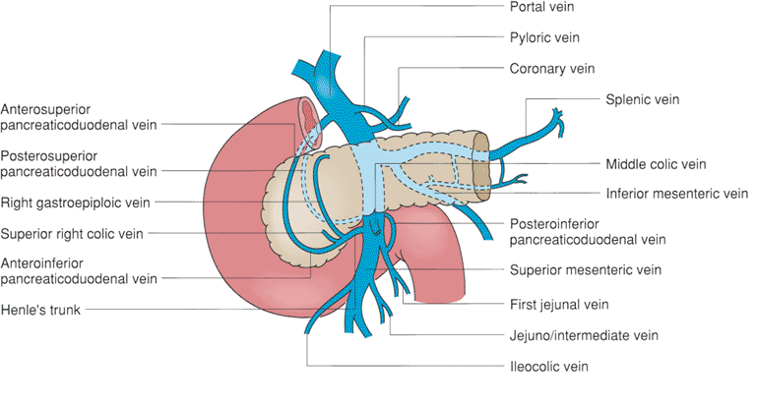
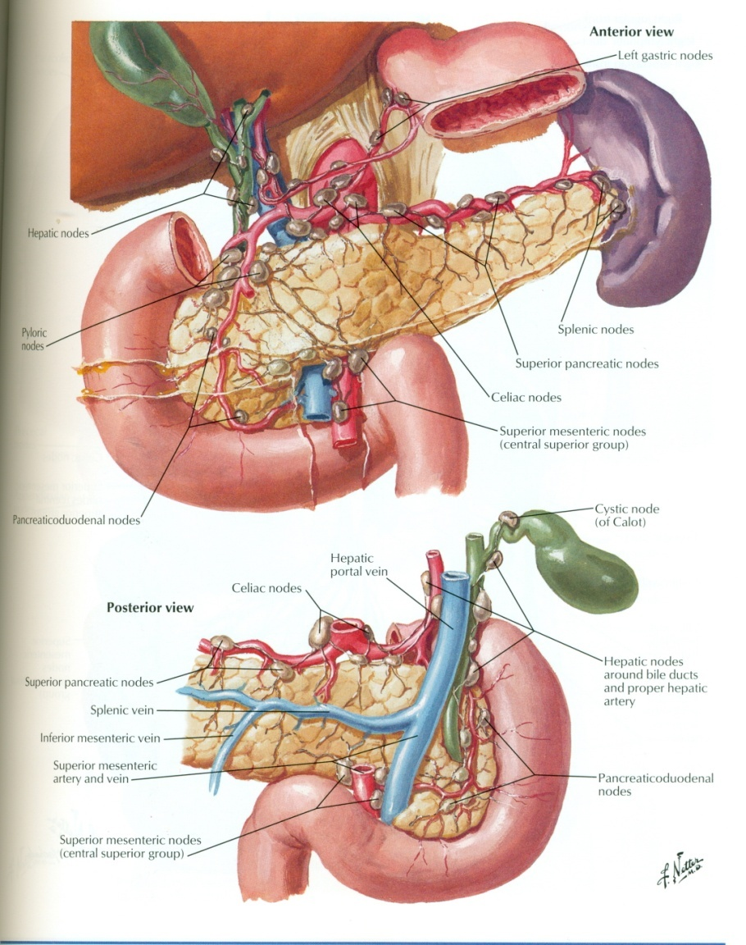
Venous drainage
Anterior and posterior arcades (the superior and inferior pancreaticoduodenal veins) drain head and the body,
Splenic vein drains the body and tail.
Ultimately, ends into Portal Vein by joining superior mesenteric.
Nerve supply
Sympathetic: from the splanchnic nerves , they have a predominantly inhibitory effect
Parasympathetic: from the Vagus, they stimulate both exocrine and endocrine secretions
Lymphatic drainage
Rich network drains into nodes along the upper border of the pancreas.
Ultimately the efferent vessels drain into the Celiac nodes.
Lymph vessels from the region of the Head pass to Superior Mesenteric nodes
Celiac nodes
Sup. Mesenteric nodes

Slide 8
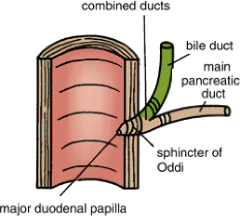
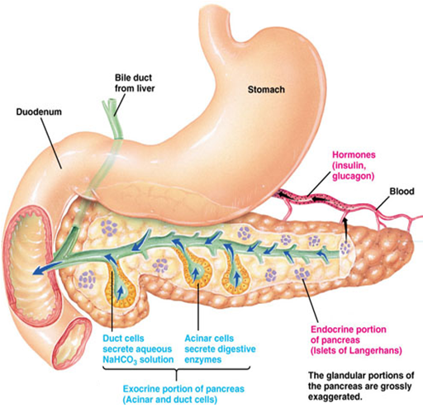
Pancreatic Ducts
Main Pancreatic duct :
Joins common bile duct & they open into a small hepatopancreatic ampulla in the duodenal wall (Ampulla of Vater) there is also sphincter of oddi which is a muscular valve.
The ampulla opens into the lumen of the duodenum (2nd part of posteromedial wall) through (Major Duodenal Papilla).
Accessory Pancreatic duct (of Santorini) :
Drains superior portion of the head.
It empties separately into 2nd portion of duodenum at (minor duodenal papilla) above the major papilla.
Functions
The pancreas is an exocrine and endocrine gland :
The Exocrine portion:
Small ducts arise from the lobules and enter the main pancreatic duct (which begins in the tail), and passes through the body and head where it meets the bile duct.
The Endocrine portion:
(Islets of Langerhans) produce insulin & glucagon.

Slide 9
 | Pancreas
Notes | Lobulated, Retro-Peritoneal organ located in Epigastrium & Left upper quadrant of the abdomen.
Parts | HEAD Related to the 2nd and 3rd portions of the duodenum on the right Includes uncinate process on the left (part extending to the left behind the superior mesenteric vessels) | NECK | BODY | TAIL Lies in the splenicorenal ligament
Levels | L1 (transpyloric plane) |  |  | T12
Relations | Posterior: Bile duct Inferior vena cava | Posterior: Aorta Origin of Superior Mesenteric artery Confluence of the Portal Vein Inferior border: Superior mesenteric vessels Antero-superior: pylorus of stomach | Posterior: Splenic vein Superior (upper border): Splenic artery | Anterior: Splenic flexure of colon
 |  |  | Anterior: Stomach separated by lesser sac Transverse colon & transverse mesocolon
 |  |  | Posterior Left psoas muscle, left adrenal gland, left renal vessels & upper 1/3rd of left kidney, hilum of the spleen.
Arterial | superior pancreatico-duodenal artery (celiac) and inferior pancreatico-duodenal artery (superior mesenteric) |  | splenic artery (celiac)
Venous | anterior and posterior arcades → superior mesenteric vein → portal vein |  | splenic vein → portal vein
Lymphatic | Superior mesenteric (drains head) and Celiac nodes
Innervation | Sympathetic: thoracic splanchnic nerves (inhibitory) Parasympathetic: vagus nerve (excitatory)
Duct | Main Duct (of Wirsung): Joins common bile duct & together they open into a small hepatopancreatic ampulla (Ampulla of Vater) Accessory Duct (of Santorini) drains superior portion of the head

Slide 10
MCQs
Q1- Which part of the pancreas is drained by the splenic vein?
A. Head
B. Body
C. Tail
D. both B&C
Q2- Which of the following is related posteriorly to the body of pancreas?
A. Splenic artery
B. Splenic vein
C. Stomach
D. Transverse colon
Q3- Tail of pancreas lies at the level of?
A. L3
B. T11
C. L1
D. T12
Q4- Which one of these arteries does NOT supply the neck of the pancreas ?
A. Celiac Trunk
B. Superior pancreatic duodenal
C. Splenic Artery
D. Superior mesenteric
Q5- The stomach is separated from the tail of pancreas anteriorly by which one of the following ?
A. Greater omentum
B. Lesser omentum
C. Greater sac
D. Lesser sac
Q6- The confluence (beginning) of the Portal Vein beg?
A. Body
B. Tail
C. Neck
D. Uncinate process
Answers: 1. D, 2. B, 3. D, 4. C, 5. D, 6. C

Slide 11
Leaders:
Nawaf AlKhudairy
Jawaher Abanumy
Members:
Hamad alkhudairy
Majed alzain
Mohammed habib
Talal alhoqail
Abdulaziz alsalman
Feedback
References:
1- Girls’ & Boys’ Slides
2- Greys Anatomy for Students
3- TeachMeAnatomy.com
anatomyteam436@gmail.com
@anatomy436

