Slide 1

Biochemistry
Editing file
General mechanisms
of hormone actions
The best project you will ever work on is YOU

Slide 2
By the end of this lecture, students should be able to:
Acquire the knowledge for general consequence of hormone-receptor interaction
Understand different mechanisms of action of hormones
Recognize the biomedical importance due to disturbance in the normal mechanisms of hormonal action
Reference : Buxton, Iain LO, and Dayue Duan. "Cyclic GMP/Protein Kinase G Phosphorylation of Smad3 Blocks Transforming Growth Factor-β–Induced Nuclear Smad Translocation." (2008): 151-153.‏‬

Slide 3
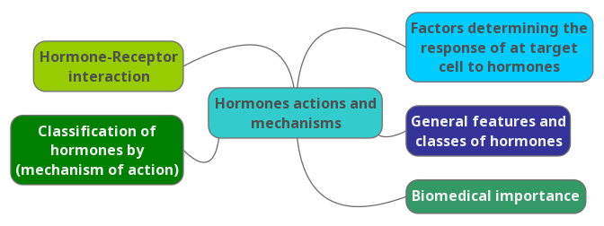
Overview

Slide 4
Background
Multicellular organisms depend in their survival on their adaptation¹ to a constantly changing environment
Intercellular communication is necessary for this adaptation to take place
Human body synthesizes many hormones that can act specifically on different cells of the body
More than one hormone can affect a given cell type²
Hormones can exert many different effects in one cell or in different cells³
A target is any cell in which the hormone (ligand) binds to its receptor⁴
Cell signaling : how do cells communicate with each other? Neurotransmitters , channels, the adjacent cells by molecular surface, hormones and impulses (electrical disturbances of cells)
1: Adaptation is the response of cells, no adaptation = cell death.
2: This means that one cell doesn’t have to be containing only one type of receptors for a specific hormones, it could have more.
3: This means that one hormone can act on different cells and exert different response. Example: Growth hormone binds to receptors on hepatocytes producing insulin like growth factors, and binds to receptors on muscle cells producing proteins.
4: A target cell : the cell you want to communicate to or the cell which has the receptor on. The receptors on the target cells could be on the surface of the cell or inside the cells (which is in the cytosol or the nucleus).

Slide 5
Factors determining the response of a target cell to a hormone
Some of the hormones are produced but they are inactive so they have to be converted to their active form.
The half life of the hormone is represented by how long the hormone is exposed to the target cell and it depends on wither the hormone soluble in the plasma or carried by other molecule
After the hormone-receptor complex is formed, to relay the message we need a second messengers , sometimes it only affect gene transcription by determining the promoter region (start point of transcription) and transcription factors which affect the response from the target cell
The 1st three steps are related to the hormone
The last 2 steps are related to the receptors that interact with the hormones

Slide 6
General features and classes of hormones
Stimulus
Group I hormones
Hormone receptor complex²
Gene transcription
Group II hormones
Second messenger¹
Transporters, channels
Protein translocation³
Protein modification
Gene transcription
Transporters, channels
Group I | Group II
الريسبتور داخل الخلية | الريسبتور على الممبرينز
Hormone release
Recognition
Hormone/receptor binding at the target cell
Signal generation
Effects
1: The hormone is the first messenger, and its receptor is present on the cell surface, the 2nd messenger is a mediator that picks up the message from the hormone and brings it inside the cell.
2: The receptor is usually intracellular
3: Translocation means movement of the protein.
RECALL from physiology ☺: the action of ADH on the protein aquaporin 2

Slide 7
General Features of Hormone Classes
Important slide
Group II | Group I
Polypeptides Glycoproteins Catecholamines | Steroids Thyroid Hs (T3 & T4) Calcitriol (vit.D), retinoids (vit.A) | Types
Hydrophilic | Lipophilic | Solubility
No | Yes and albumin is the usual carrier | Transport proteins Does it require or not?
Short (minutes) it moves freely in the blood and that makes it vulnerable to degradation | Long (hours – days) because they’re attached to plasma proteins so their clearance is harder | Plasma half-life
Plasma membrane (on the surface of the cell) | Intracellular (in cytosol or nucleus) | Receptor
cAMP, cGMP, Ca²⁺, metabolites of complex phosphoinositols, tyrosine kinase cascades | Receptor-hormone complex | Mediator

Slide 8
Classification of Hormones by Mechanism of Action
I. Hormones that bind to intracellular receptors (Steroid-Thyroid superfamily)
Steroid hormones
Thyroid Hormones
(T₃ & T₄)
Calcitriol
( active form of vitamin D, 1,25[OH]₂-D₃ )
Retinoic acid
Vitamin A

Slide 9
Mechanism of Action of Steroid-Thyroid Hormones
Steroid Hormones:
  Glucocorticoids
  Mineralocorticoids
  Sex hormones:
  Male sex hormones: Androgens
  Female sex hormones : Estrogens & Progestins
Thyroid Hormones (T₃ & T₄)
Calcitriol (1,25[OH]₂-D₃)
Retinoic acid
Explained in the next slide ☺

Slide 10

Dr. Sumbul’s explanation of the picture
شرحنا لكم الباثواي هنا
1
Follow the image ☺
1) You have your steroid hormone, because it’s lipophilic it can cross the plasma membrane and comes into the cytosol.
2 )In the cytosol, it binds to its receptor.
3) When it binds to the receptor, it becomes active and forms the steroid hormone-receptor complex which is the mediator here instead of a 2nd messenger.
4) The steroid hormone-receptor complex goes inside the nucleus.
5) In the nucleus, it binds to a sequence in the DNA called hormone receptor element (HRE) which is present in the promoter region of the genes.
6) After binding to HRE it increases gene transcription of that gene leading to increase synthesis of proteins (whatever protein that gene was coding for)
2
3
4
5
6

Slide 11
Classification of Hormones by Mechanism of Action continued …
You have to know the name of the hormone and the second messenger related to it
II. Hormones that bind to cell surface receptors
A. The second messenger is cAMP
Catecholamines
Catecholamines Anterior Pituitary: ACTH, FSH, LH & TSH
ADH (Renal V2-receptor)
(α₂- Adrenergic)
(β- Adrenergic)
Calcitonin & PTH
Glucagon
We have 2 receptors for ADH : V1: extra renal tissue V2: renal tissue (ADH uses cAMP when it acts on this receptor)
These hormones do not cross the cellular membrane, instead, they activate a 2nd messenger which works inside the cell

Slide 12
Cascade for formation of cAMP by cell-surface hormones:
Dr. Sumbul’s explanation ☺:
The receptor is a G-protein coupled receptor.
G-protein has 3 subunits: alpha, beta and gamma which are bond together.
Alpha has a site where GDP is bound, if GDP is present alpha is attached to beta and gamma. But if it’s replaced by GTP (by the action of a hormone), beta and gamma detach from alpha making it free and active which has a catalytic activity which then activates further molecules and proteins.
One of the enzymes that it activates is adenylyl cyclase which is also present in the membrane. This enzyme catalysis the conversion of ATP to cAMP.
So the first messenger was the hormone and the second messenger is cAMP.
شرحنا لكم الباثواي هنا

Slide 13
Actions of cAMP
1
cAMP activates protein kinase A.
Again, follow the image ☺:
Dr. Sumbul’s explanation:
1)Protein kinase A has 2 regulatory subunits and 2 catalytic subunits. The regulatory subunits cover the active sites of the catalytic subunits.
2)To make this enzyme active, you have to remover the regulatory subunit which can be done by cAMP.
3)Active catalytic subunits bind to protein substrates and phosphorylate them.
4)Phosphorylated proteins are translated to intracellular effect.
5)Protein phosphatase is the enzyme that stops the intracellular effect if we don’t need it anymore by dephosphorylating the proteins.
شرحنا لكم الباثواي هنا
2
3
4
5

Slide 14
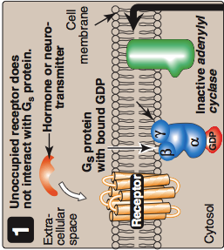
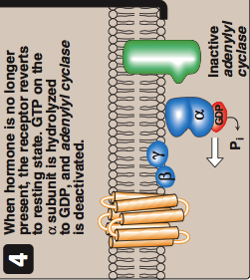
Abortion of Hormonal Stimulus
شرحنا لكم الباثواي هنا
Release of hormone from its receptor
(unbound receptor) after doing its job
2. Dephosphorylation of protein
substrate by phosphatase
3. Degradation of cAMP into AMP
by phosphodiesteras
4. Inactivation of protein kinase A
by a decrease of cAMP
as a result of its degradation to AMO
5. Hydrolysis of GTP into GDP, as we mentioned before, if GTP is not available, alpha subunit won’t be able to detach from beta and gamma subunits.
(alpha subunit has an intrinsic GTPase activities so it can hydrolyze GTP back to GDP)
6. Binding of α-subunit to βγ-subunits
7. Inactivation of adenylyl cyclase
Х

Slide 15
Classification of Hormones by Mechanism of Action continued …
Atrial Natriuretic Peptide (ANP)
II. Hormones that bind to cell surface receptors
B. The second messenger is cGMP
Atrial natriuretic peptide (ANP)
Nitric oxide
ANP is responsible for dilation
Stimulated by volume overload and cardiac muscle stretch.
It reduces the translation of collagen which is required for the fibrosis, so ANP reduces fibrosis
1- ANP binds to natriuretic peptide receptor (NPR.(
2-Direct activation of Gunaylate cyclase.
3-Activated GC converts GTP to cGMP.
4-Then cGMP exerts its function.
Explained in the next slide ☺

Slide 16
Dr. Sumbul’s explanation
I promise this is the last time in the lecture, follow the image ☺
1)ANP binds with NPR-A (natriuretic peptide receptor) which is associated with the enzyme Gunaylate cyclase.
2)GC converts GTP to cGMP which is very similar to Adenylyl cyclase.
3)cGMP activates the enzyme protein kinase G
**AN EASY MNEOMONIC TO REMEMBER THE DIFFERENCE ☺:
cAMP activates protein kinase A
cGMP activates protein kinase G**
4,5,6)Protein kinase G phosphorylates SMAD3.
Function of SMAD3: it binds with SMAD4 forming a heterodimer which goes inside the nucleus and affects the transcription of collagen genes leading to fibrosis.
BUT! If SMAD3 was phosphorylated (which is the action of protein kinase G) it cannot form a heterodimer with SMAD4 so it cannot go inside the cell, so there’s no formation of fibrosis.
As a summary:
Hormone: ANP
Receptor: NPR-A
Enzyme1: Gunaylate cyclase (converts GTP to cGMP)
Enzyme2: Protein kinase G (it phosphorylates SMAD3 so that it doesn’t go inside the nucleus)
شرحنا لكم الباثواي هنا

Slide 17
Classification of Hormones by Mechanism of Action continued …
II. Hormones that bind to cell surface receptors
C. The second messenger is calcium or phosphatidylinositol (or both)
Acetylcholine (muscarinic)
Catecholamines
(α₁- Adrenergic)
Angiotensin II
ADH (vasopressin): Extra-renal V1-receptor
Keep in mind, the receptors of ADH:
V1 : calcium or phosphatidylinositol
V2: cAMP

Slide 18
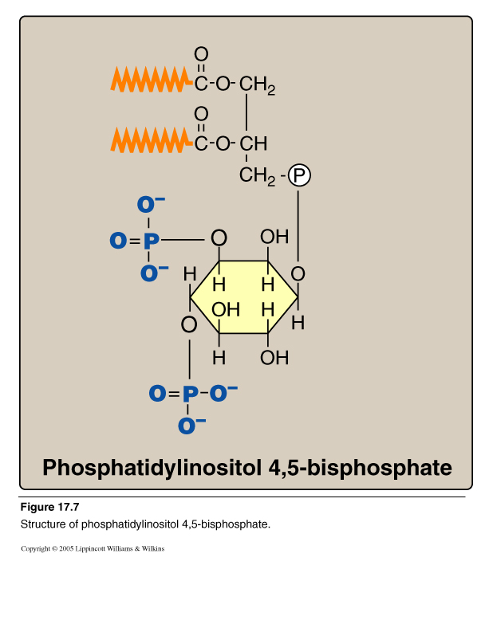
Calcium/Phosphatidylinositol System
Diacylglycerol
(DAG)
Inositol Trisphosphate
(IP₃)
Phospholipase C
What is Phosphatidylinositol ?
It is a membrane phospholipid.
It get phosphorylated to make different types of molecules : 1)Phosphatidylinositol Phosphate (PIP)
2)Phosphatidylinositol bisphosphate (PIP 2)
3)Phosphatidylinositol trisphosphate (IP3)
These different molecules are called phosphatidylinositol family and one of the members is phosphatidylinositol 4,5 bisphosphate
This molecule can be acted on by phospholipase c and that cleaves it to 2 molecules: DAG and IP3

Slide 19
Calcium/Phosphatidylinositol System
شرحنا لكم الباثواي هنا

Slide 20
Classification of Hormones by Mechanism of Action continued …
II. Hormones that bind to cell surface receptors
D. The second messenger is a tyrosine kinase cascade
GH & Prolactin
Insulin
Erythropoietin

Slide 21
Mechanism of Insulin action
Binding of insulin to the alpha-subunit leads to conformational changes that are transmitted to beta-subunit leads to Rapid auto-phosphorylation of tyrosine residues of the beta -subunits
Then phosphorylation of insulin receptor substrates (IRS) "a family of proteins" by tyrosine kinase and Activation of other protein kinases and phosphatases by IRS lead to Biological actions of insulin.
Insulin receptor is initially formed as a single dimer then by multiple steps it becomes 4 dimers forming a tetramer.
It is inactive when insulin is not attached.
Beta subunit has 2 domains:
1 is spanning the cellular membrane and the other is the intracellular domain (cytosolic domain) where it has kinase activity (tyrosine kinase) by phosphorylating tyrosine residues
*Tyrosine kinase has 2 activities:
1)Auto-phosphorylation
2)Further phosphorylation of other molecules called insulin receptor substrates
Recommended video .. Start from 2:00

Slide 22
Biologic Effects of Insulin
It increases
Glucose uptake
Glycogen synthesis
It decreases
Gluconeogenesis
Glycogenolysis
Protein synthesis
Fat synthesis
Lypolysis
What causes these effects?
Could be Altered gene expression

Slide 23
Biomedical Importance
Excessive (e.g., hyperthyroidism, Cushing), deficient (e.g., hypothyroidism, Addison), or inappropriate secretion (e.g., syndrome of inappropriate secretion of ADH “SIADH^{”1)} of hormones are major causes of diseases
Pharmacological treatment of these diseases depends on replacement of deficient hormone (hypo-) or use of drugs that interfere with the mechanism of action of the hormones (hyper- or inappropriate)
1: SIADH : too much ADH production leading to water retention which perceives as hyponatremia due to increased volume even if the levels of sodium are normal

Slide 24
Take home messages
Hormones are involved in responses to a stimulus, using a variety of signaling mechanisms to facilitate cellular adaptive responses.
Group I hormones are lipophilic, while group II are hydrophilic. Other differences exist between both groups.
Hormones can be classified according to their mechanism of action (specific examples of each category were discussed)
Biomedically, studying hormones’ actions in details helps to:
  understand consequences of abnormal hormone release-related diseases (excessive, deficient or inappropriate)
  design therapeutic approach for such diseases.

Slide 25
SUMMARY: Classification of Hormones by Mechanism of Action
I. Hormones that bind to intracellular receptors (Steroid-Thyroid superfamily):
Steroid Hormones: Glucocorticoids Mineralocorticoids Sex hormones: Male sex hormones: Androgens Female sex hormones: Estrogens & Progestins Thyroid Hormones (T3 & T4) Calcitriol (1,25[OH]2-D3) Retinoic acid |  | Mechanism :
 |  | 1- steroid hormone cross the plasma membrane into the cytosol 2- In the cytosol it binds to a a specific cytosolic or nuclear receptor and forms receptor ligand complex 3- the complex goes inside the nucleus and binds to HRE (hormone response element) which is a specific regulatory DNA sequences 4- this is causes increase of the transcription so the rate of the protein synthesize increases as well
II. Hormones that bind to cell surface receptors
A. The second messenger is cAMP | B. The second messenger is cGMP |  | C. The second messenger is calcium or phosphatidylinositol (or both) | D. The second messenger is a tyrosine kinase cascade
Catecholamines (α2- Adrenergic) Catecholamines (β- Adrenergic) Ant. Pituitary: ACTH, FSH, LH & TSH ADH (Renal V2-receptor) Calcitonin & PTH Glucagon | Atrial natriuretic peptide (ANP). Nitric oxide (NO). |  | Acetylcholine (muscarinic) Catecholamines (α1-Adrenergic)• Angiotensin II ADH (vasopressin): ExtrarenalV1-receptor | GH & Prolactin Insulin Erythropoietin
Mechanism :
Adenylyl cyclase = cAMP | Guanylate cyclase = cGMP |  | Phospholipase C = IP3 | Insulin receptor is a dimer that consists of 2 identical units. Each unit has: A- An alpha-chains: on the outside and create a binding site for insulin. B- A beta-chains: Spans the plasma membrane and its cytosolic domain is a tyrosine kinase.
1- Binding of ligand “Hormone” causes a conformational change in the receptor 2- Replacement of of the GDP of the Gprotein “α subunit” with GTP. 3- GTP-bound form of the alpha subunit dissociates from the beta and gamma subunits and move adenylyl cyclase “AC”, which is thereby activated. | 1- ANP binds to it’s receptor which is associated with the enzyme guanylate cyclase(GC) 2- GC converts GTP into cGMP 3- The cGMP activate the enzyme protein kinase G |  | 1- Hormone binds to G-protein coupled receptor. 2- Receptor Interacts with Gprotein Which releases GDP and binds with GTP. 3. 𝛼 subunit dissociates from βγ- subunits, and activates Phospholipase C. 4. Phospholipase cleaves phosphatidylinositol 4,5-bisphosphate to DAG and IP3 5. IP3 binds to a specific receptor on RER causing release of Ca. 6. Calcium and DAG synergistically activate protein kinase C . 7. Protein kinase C catalyzes protein phosphorylation.

Slide 26
Cont. Mechanism :
A. The second messenger is cAMP | B. The second messenger is cGMP | C. The second messenger is calcium or phosphatidylinositol (or both) | D. The second messenger is a tyrosine kinase cascade
Actions od cAMP | 4- Protein kinase G phosphorylate smad3 5- phosphorylated smad3 binds to smad4 producing heterodimer formation 6- it goes to the nucleus and affect the transcription of genes |  | 1- Binding of insulin to the alphasubunit 2- conformational changes that are transmitted to beta-subunit 3- Rapid autophosphorlation of tyrosine residues of the betasubunits 4- Then phosphorylation of insulin receptor substrates (IRS) "a family of proteins" by tyrosine kinase 5- Activation of other protein kinases and phosphatases by IRS 6- Biological actions of insulin
Protein kinase a has 2 regulatory subunits and 2 catalytic subunits They are arranged where regulatory subunits masking the active site of catalytic subunit to activate this enzyme active remove the regulatory surface . When cAMP comes and binds to the regulatory it become free
 |  |  | Biologic Effects of Insulin
 |  |  | Increase | Decrease
Abortion of Hormonal Stimulus |  |  | 1- Glucose up take 2- Glycogen synthesis 3- Protein synthesis 4- Fat synthesis | 1-Gluconeogenesis. 2-Glycogenolysis. 3-Lipolysis.
1.Release of hormone from its receptor (unbound receptor) 2. Dephosphorylation of protein substrate by phosphatase 3. Degradation of cAMP into AMP by phosphodiesteras 4. Inactivation of protein kinase A by a decrease of cAMP 5. Hydrolysis of GTP into GDP 6. Binding of α-subunit to βγ-subunits 7. Inactivation of adenylyl cyclase
 |  |  | Biomedical Importance
 |  |  | Excessive | Deficient
 |  |  | hyperthyroidism, Cushing | hypothyroidism, Addison), or inappropriate secretion (e.g., syndrome of inappropriate secretion of ADH “SIADH”)

Slide 27
QUIZ
Q1 : All the following statements about steroid hormones are true except ?
They are Lipophilic
They require carriers to transport them in circulation
Their receptors are intracellular
They require cyclic AMP as second messenger
Q2 : Glycogenoloysis is decreased by ?
Glucagon
Insulin
Epinephrine
cAMP
Q3 : When ADH binds to its extra renal V1 receptor , its second messenger will be ?
Ca/Phosphatidylininositol
cAMP
cGMP
Tyrosine kinase
Q4 : Which one of the following hormones uses tyrosine kinase cascade as a second messenger ?
Prolactin
ADH
Acetylcholine
Glutaminase
Q5 : Which one of the following is a biological effect of insulin ?
Increase gluconeogenesis
Decrease lypolysis
Increase glycogenolysis
Decrease glucose uptake
Q6 : Which one of the following is hydrophilic ?
Glucocorticoids
Progestin
Epinephrine
Retinoic acid

Slide 28
QUIZ
Q7 : Mention the elements that get increased by insulin ?
Glucose uptake , Glycogen synthesis , protein synthesis ,
Fat synthesis
Q8 : What’s factors determine the response of target cell to a hormone ?
The rate of synthesis & secretion of the hormones
The conversion of inactive forms of the hormone into the fully active form
The rate of hormone clearance from plasma (half-life & excretion)
The number, relative activity, and state of occupancy of the specific receptors 5. Post-receptor factors
Suggestions and recommendations
1) D 2) B 3) A 4) A 5) B 6) C

Slide 29
Leen altamimi
Heba Alnasser
Abdulrahman almalki
Talal altukhaim
Abdulrahman alrashed
Trad alwakeel

