Slide 1
Biochemistry
Thyroid Hormones and Thermogenesis

Slide 2
By the end of this lecture, the Second Year students will be able to:
Define glucose homeostasis and the metabolic processes involved
Differentiate between different phases of glucose homeostasis
Discuss the primary sources of energy and major organs utilizing glucose during the five phases of homeostasis
Understand the role of hormones in maintaining glucose homeostasis

Slide 3
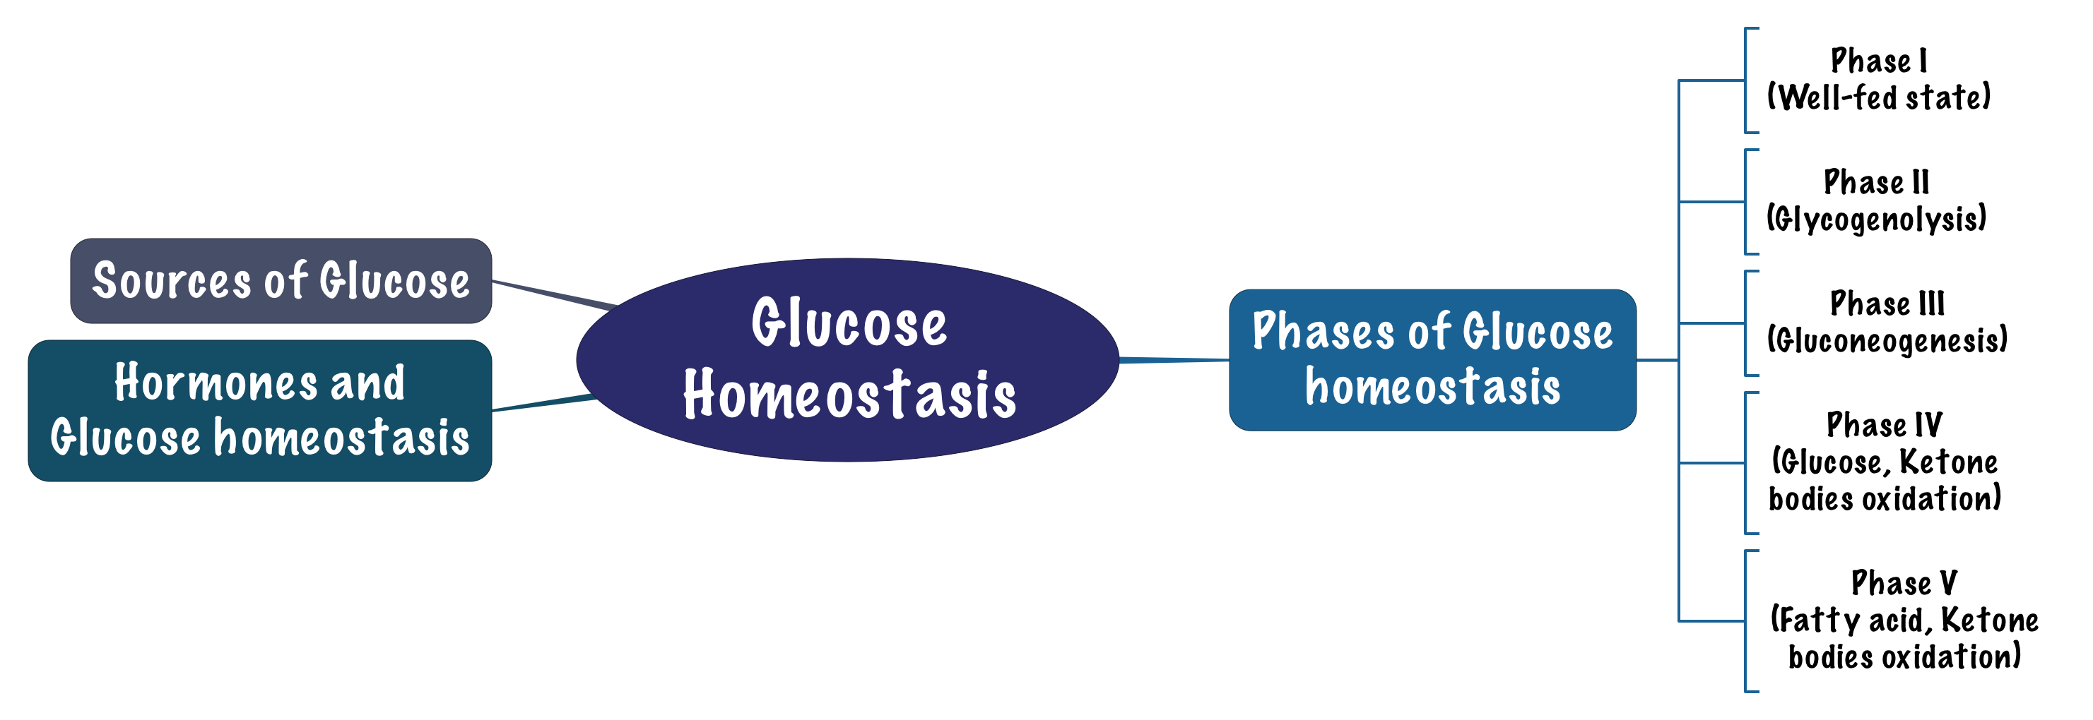
Overview

Slide 4
Glucose homeostasis
A process that:
  Controls glucose metabolism and
  Maintains normal blood glucose level in the body
Glucose is a major source of body’s energy
The liver plays a key role in maintaining blood glucose level
It is tightly controlled as the brain constantly needs glucose
Severe hypoglycemia can cause coma and death
Chronic hyperglycemia results in glycation of proteins, endothelial dysfunction and diabetes mellitus
Sources of glucose
Dietary sources: | Metabolic sources (via gluconeogenesis):
Dietary CHOs are digested to monosaccharides Starch provides glucose directly Fructose and galactose are converted to glucose in the liver | Glycerol, lactate, pyruvate, glucogenic amino acids why not glycogenolysis? Because glycogen is a polymer of glucose only, you’re not making new glucose you’re only bringing your own storage of glucose

Slide 5
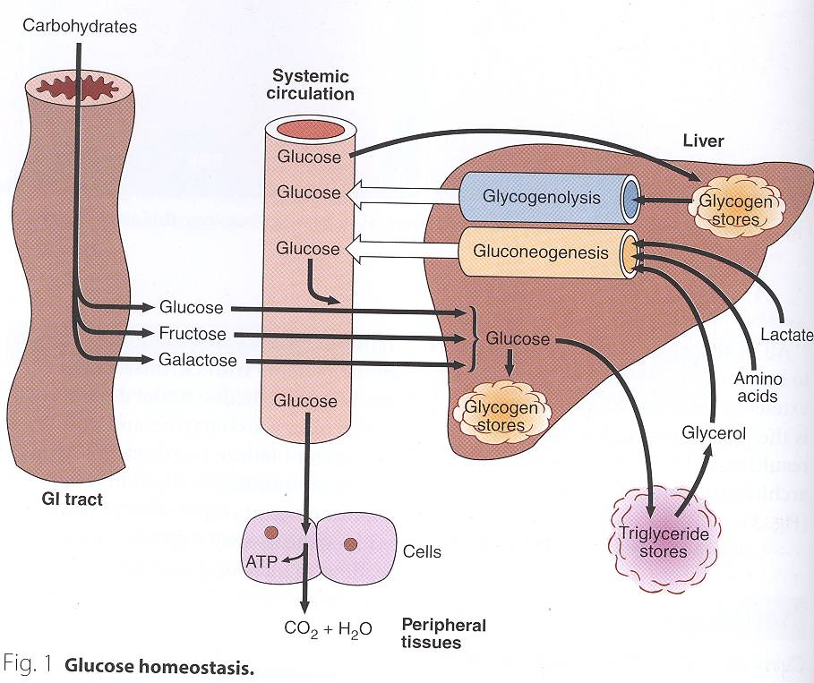
Glucose homeostasis
1: glucose, fructose and galactose are absorbed to the blood stream
2: Some of it goes to the peripheral tissue to be used as energy, and the remaining goes to the liver to convert fructose and galactose into glucose
3: Some of the glucose is used to make glycogen but as we said before it has a limit for glycogen formation, so excess amounts of glucose will be converted into fatty acids and triglycerides then sent to adipose tissue for storage, then when the adipose tissue breaks down fat it produces glycerol which goes back to the liver and forms glucose again (gluconeogenesis)
4: When blood glucose levels go down > glycogen is broken down (glycogenolysis) and we start forming glucose from amino acids and lactate from muscles
All the carbohydrate that comes from food (glucose-fructose-galactose) are stored in the liver as glycogen(glycogen stores).
-When the body needs glucose it converts glycogen stores back to glucose via Glycogenolysis + also via gluconeogenesis
*Cori cycle is the one that convert lactate into glucose

Slide 6
Phases of glucose homeostasis
Phase I (Well-fed state)
These phases are not separate from each other! It doesn't mean that one stops then the other starts.
Glucose is mainly supplied by dietary CHOs (Exogenous)
All body tissues use dietary glucose for energy in this phase
Liver removes about 70% of glucose load after a CHO meal
Some glucose is converted to glycogen for storage in the liver (glycogenesis)
Excess glucose is converted to fatty acids and triglycerides in the liver
  These are transported via VLDL (very low density lipoproteins) to adipose tissue for storage
Gluconeogenesis is inhibited in this phase
  Cori and glucose-alanine cycles are inhibited
  (both lactate and alanine are coming from the muscles)
So when we’re fasting during Ramadhan, what are we using for energy? We are NOT breaking down fat for energy, it’s only glycogen that is broken down because it’s used up to 24 hours, unless we reduce the intake of glucose so the storage will be less but still it needs more time to finish, or if we’re exercising so we’re consuming more energy, so it’s a wrong belief that we break down fat ☺

Slide 7
Phases of glucose homeostasis
Phase II (Glycogenolysis)
pre-fasting state.
Phase II starts during early fasting when dietary glucose supply is exhausted
Hepatic glycogenolysis (major) and gluconeogenesis (minor) maintain blood glucose level in this phase
Major sources of blood glucose in this phase:
  Glycogenolysis and gluconeogenesis
Phase III (Gluconeogenesis)
Phase III starts when glycogen stores in liver are exhausted (< 20 hours)
Duration of phase III depends on
  Feeding status
  Hepatic glycogen stores
  Physical activity
Hepatic gluconeogenesis from lactate, pyruvate, glycerol and alanine maintains blood glucose level
Major source of blood glucose in this phase:
  Gluconeogenesis

Slide 8
Phases of glucose homeostasis
Phase IV (Glucose and KB oxidation)
is a combination of glucose and fat
Phase II: major source of glucose is glycogen(liver stops using glucose at this phase because it can survive on fatty acids)
Phase III: major source of glucose is from Gluconeogenesis
phase IV: Gluconeogenesis at its maximum level so there is no glycogen here + at this phase the brain starts to use ketone bodies
Phase IV: the major source for brain is ketone bodies (glucose in minor)
Several days of fasting leads to phase IV
Gluconeogenesis starts to decrease
FA oxidation increases KB accumulation
KBs enter the brain and muscle for energy production
Brain uses both glucose and KB for energy

Slide 9
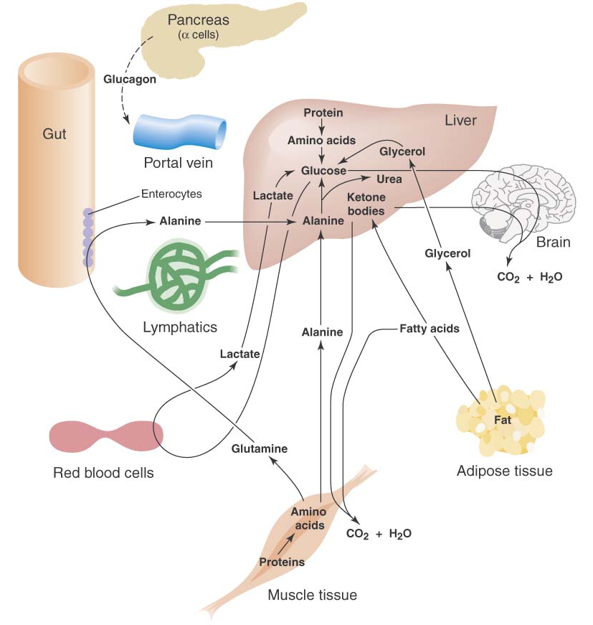
Phases of glucose homeostasis
Phase V (FA and KB oxidation)
Prolonged fasting leads to phase V
Less dependence on gluconeogenesis
All body tissues mainly use FA and KB oxidation for energy production
Gluconeogenesis somewhat maintains blood glucose level in this phase
High KB conc. and glucose levels inhibit proteolysis in muscle (conservation of muscle)
When all fat and KBs are used up
  Body uses muscle protein to maintain blood glucose level

Slide 10
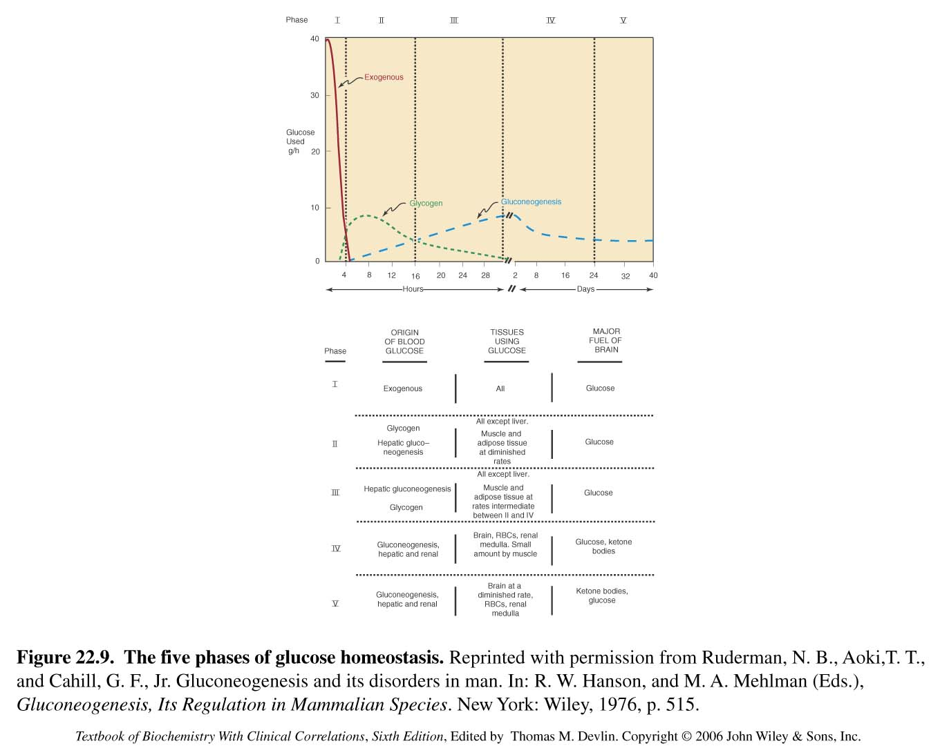
Phases of glucose homeostasis
This table shows you all the 5 phases and what is the origin of glucose in each one and the tissues that are using it as well as the major fuel for the brain
Ketone bodies are a byproduct of liver oxidation of fat, and these are :(acetone, acetoacetate and beta-hydroxybutarate) and they can be used as a source of energy

Slide 11
Phases of glucose homeostasis
During this study, they were seeing how the glucose is being maintained by the body and divided it into 5 phases (but these phases are not very well-demarcated even though they mention the beginning and the end of each phase it could be different from person to another but the pattern is the same):
Phase 1: starts from 0 after you get a meal and start starvation, the body will use glucose from the exogenous source
Phase 2: starts from 4-6 hours at the max, in this stage you start breaking down your glycogen storage to provide glucose
Phase 3: once you finish your glycogen storage you start gluconeogenesis by triglycerides to glycerol and some of the amino acids, the gluconeogenesis here is happening mainly by the LIVER.
Phase 4: you still make glucose by gluconeogenesis but in this stage your forming it by both the liver AND the kidney but the MAIN ORGAN IS THE KIDNEY, then when you’re breaking a lot of fatty acids they’re converted to ketone bodies. So in this phase you use limited amounts of glucose because you need it more in RBCs and brain, so majority of tissues will be using ketone bodies for their energy and the brain uses them as well after glucose finishes.
Phase 5: The person continues to use ketone bodies and by the end of this phase fatty acid stores are exhausted so we start breaking down proteins (so the function of your vital organs will be compromised) and if you continue starvation you die ☹☹

Slide 12
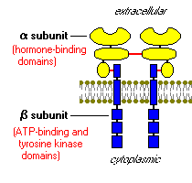
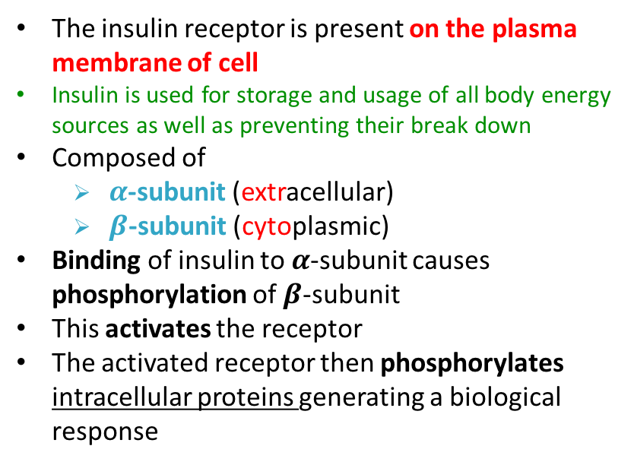
Hormones and glucose homeostasis
1- INSULIN (lowers blood glucose level)
Mechanism of action :
Plays a major role in glucose homeostasis
Synthesized by the b-cells of islets of Langerhans of pancreas
A small protein composed of two chains
Rise in blood glucose level stimulates insulin secretion “Hyperglycemia”
Promotes entry of glucose into cells
The insulin receptor is present on the plasma membrane of cell
Insulin is used for storage and usage of all body energy sources as well as preventing their break down
Composed of
  $α$-subunit (extracellular)
  $β$-subunit (cytoplasmic)
Binding of insulin to $α$-subunit causes phosphorylation of $β$-subunit
This activates the receptor
The activated receptor then phosphorylates intracellular proteins generating a biological response
Action :
Inhibits: | Stimulates:
Gluconeogenesis | Glucose uptake in muscle and adipose
Glycogenolysis | Glycolysis
Lipolysis | Glycogen synthesis
ketogenesis | Protein synthesis
proteolysis | Uptake of Ion (K+ and PO4)

Slide 13
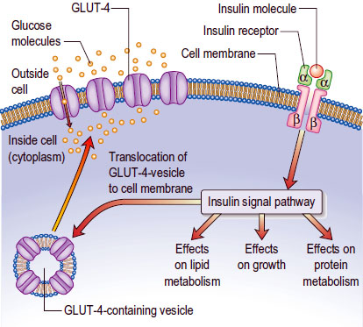
Hormones and glucose homeostasis
1- INSULIN (lowers blood glucose level)
Insulin and CHO metabolism
Promotes glucose uptake into cell:
Glucose is diffused into cells through hexose transporters such as GLUT4
GLUT4 is present in cytoplasmic vesicles
(they don’t go to the surface of the cell unless insulin is bound to its receptor and signals are sent to these vesicles)
Insulin binding to its receptor causes vesicles to diffuse into plasma membrane
GLUT4 is inserted into the membrane
Allowing glucose transport into the cell
Brain and liver have non-insulin dependent glucose transporter
Insulin deficiency causes diabetes mellitus
Hyperinsulinemia is due to insulin resistance in:
  Diabetes mellitus or
  Metabolic syndrome

Slide 14
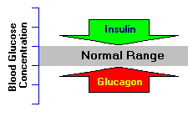
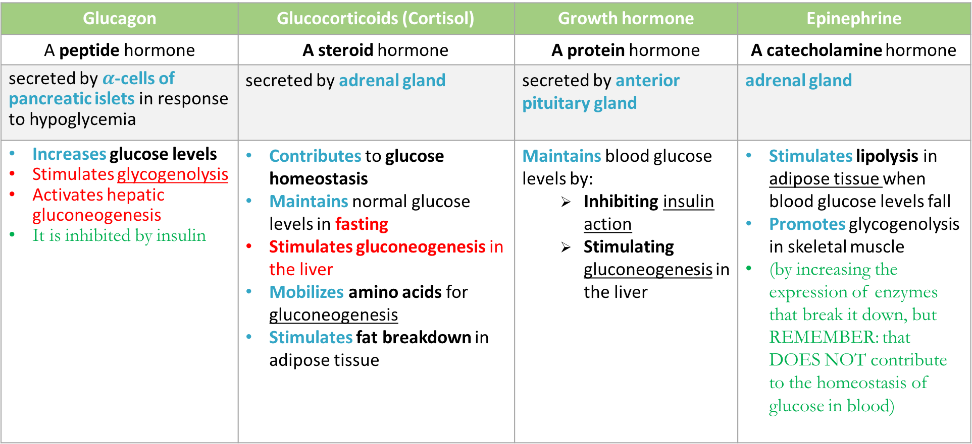
Hormones and glucose homeostasis
2-ANTAGONIZE insulin action
Glucagon | Glucocorticoids (Cortisol) | Growth hormone | Epinephrine
A peptide hormone | A steroid hormone | A protein hormone | A catecholamine hormone
secreted by $α$-cells of pancreatic islets in response to hypoglycemia | secreted by adrenal gland | secreted by anterior pituitary gland | adrenal gland
Increases glucose levels Stimulates glycogenolysis Activates hepatic gluconeogenesis It is inhibited by insulin | Contributes to glucose homeostasis Maintains normal glucose levels in fasting Stimulates gluconeogenesis in the liver Mobilizes amino acids for gluconeogenesis Stimulates fat breakdown in adipose tissue | Maintains blood glucose levels by: Inhibiting insulin action Stimulating gluconeogenesis in the liver | Stimulates lipolysis in adipose tissue when blood glucose levels fall Promotes glycogenolysis in skeletal muscle (by increasing the expression of enzymes that break it down, but REMEMBER: that DOES NOT contribute to the homeostasis of glucose in blood)

Slide 15
QUIZ
Q1 : Which one of the following is a complication of chronic hyperglycemia?
Liver failure
Kidney failure
Endothelial dysfunction
Nephropathy
Q2 : Excess glucose is converted in the liver during phase 1 into which of the following?
LDL
HDL
Glycogen
Fatty acids
Q3 : In which one of the following phases of glucose homeostasis is gluconeogenesis is inhibited?
I
II
III
IV
Q4 : Which one of the following is an action of insulin?
Increased Gluconeogenesis
Increased Glycogenolysis
Increased Lipolysis
Increased Glycogenesis
Q5 : Which one of the following is correct about GLUT 4?
It’s present in Golgi apparatus
It allows glucose transport into the cell
It’s insulin dependent in the liver and brain
Insulin causes inhibition of GLUT4
Q6 : Which one of the following cells secret Glucagon?
Alpha
Beta
Gamma
Delta

Slide 16
QUIZ
C) Name the 5 phases of glucose homeostasis and their main physiological event/function.
Phase I: Glycogenesis , inhibition of gluconeogenesis, Cori & glucose-alanine cycles
Phase II: Glycogenolysis and Gluconeogenesis.
Phase III: Gluconeogenesis from lactate, pyruvate, glycerol& alanine
Phase IV: Fatty acid oxidation leads to increased ketone body accumulation
Phase V: All body tissues use Fatty acids and ketone bodies oxidation for energy production. When FA and KBs are used up, proteolysis starts.
D) What does the duration of phase III depend on?
Feeding status
Hepatic glycogen stores
Physical activity
Q7 : The previous medical student girl came to your office, to make sure of the SAQ questions she answered in her endocrine block.
And because you are erudite (ضليع) in endocrinology you will answer all of them.
A) Name 4 hormones that antagonize insulin action?
Glucagon
Cortisol
Growth hormone
Epinephrine
B) How does the growth hormone contribute in maintaining blood glucose?
Inhibiting insulin action
Stimulating gluconeogenesis in the liver
Suggestions and recommendations
1) C 2) D 3) A 4) D 5) B 6) A

Slide 17
Hosam alkhathlan
Faris alnafisah
Abdulaziz alhusaini
Abdulrahman alrashed
Mohannad alzahrani

