Slide 1

Biochemistry
Editing file
Thyroid Hormones and Thermogenesis
One day you’ll be person between the patient and his grief.
Please study well ..

Slide 2
By the end of this lecture, the Second Year students will be able to:
Describe the types and biosynthesis of thyroid hormones
Discuss the thyroid hormone actions
Understand the regulation of thyroid hormones
List and interpret the thyroid function tests
Define goiter and differentiate between hypo and hyperthyroidism
Discuss the role of thyroid hormone in thermogenesis

Slide 3
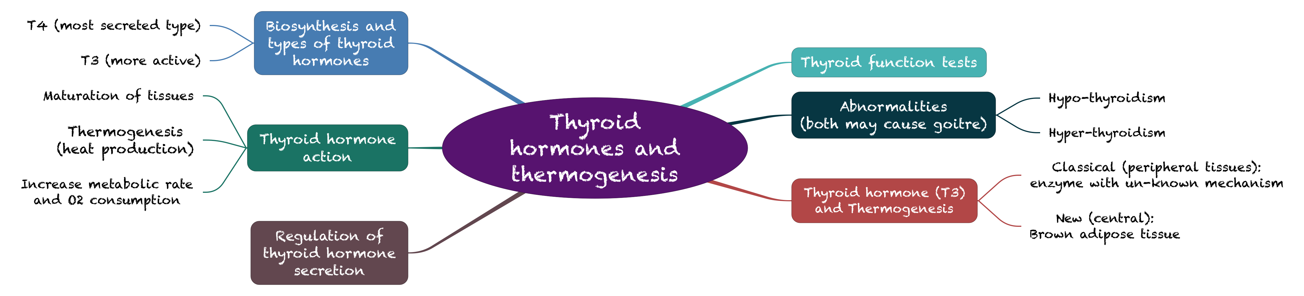
Overview

Slide 4
Types and Biosynthesis of Thyroid Hormones:
Biosynthesis :
Thyroglobulin is synthesized by follicular cells then released in the lumen.
Iodide (comes from the circulation) is oxidized by thyroid peroxidase in the lumen to form Iodine then ,this Iodine binds to tyrosine residues of thyroglobulin to form MIT (Mono-iodotyrosine) and DIT (Di-iodotyrosine) this process is catalyzed by thyroid peroxidase enzyme and it's called (Iodination), after that MIT & DIT get coupled to form T3 & T4 (MIT+DIT=T3 | DIT+DIT=T4).
1-Synthesized
  Synthesized in the thyroid gland by:
  Binding to thyroglobulin protein.
    Iodination and coupling of two tyrosine molecules.
After forming T3 & T4 the thyroglobulin will go back to follicular cells, TSH will stimulate follicular cells to Endocytose Thyroglobulin that is attached (T4, T3, MIT & DIT) to degrade thyroglobulin by lysosomes and we will be left with T4 & T3 which go to the circulation.
MIT & DIT are degraded to go back to the lumen.
يشرح لك طريقة تكوين الثايرويد هرمون بمراحله في اللومين:
1-تكوين ثايروجلوبيلين (الي راح يساعد على تصنيع الهرمون)
2-عمل الثايرويد بيروكسيديز على:
أ-يمسك الايودايد ويسوي له اوكسديشن ويتحول الى ايودين ويرتبط مع التايروزين الي تعتبر جزء من الثايروجلوبلين
ب-يعمل على ربط المكونات الناتجة من هذا الارتباط في تكوين الهرمونات
3-بعد تكوين الهرمونات يرجع الثايروجلوبلين الى الفلوكلير سيلز ويتم تكسيره (بحيث ما يصنع بشكل زائد).

Slide 5
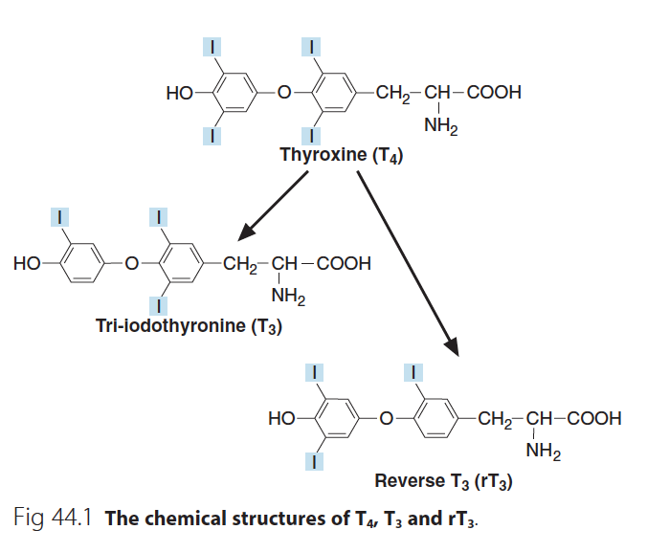
Types and Biosynthesis of Thyroid Hormones
Biosynthesis :
2-Secretion
Thyroid gland mostly secretes T4.
deiodinase
3- Deiodination
Peripheral tissues (liver, kidney, etc.) de-iodinate T4 to T3.
Deiodination is catalyzed by deiodinase enzyme.
T4 can be metabolized to rT3 (inactive form).
T3 & rT3 differ in the position of the iodine (structure)
But they have the same formula.
Pic: Note the difference in the position of Iodine.
T3 is the most active biological form, less active form is T4 and then the inactive form rT3

Slide 6
Types and Biosynthesis of Thyroid Hormones
Types :
Thyroxine (T4) AKA: tetra-iodothyronin. Number 4 stands for the number of iodine ions. (90%) | Tri-iodothyronine (T3) (10%)
Most of T₄ is transported in plasma as protein-bound : Thyroxin binding globulin (TBG)-bound (70%). Don’t confuse between thyroglobulin and TBG. Albumin-bound (25%). Transthyretin (pre-albumin)-bound (5%). | T₃ is a more biologically active form.
The unbound (free) form of T₄ and T₃ are biologically active. whatever is free is the functional form of hormones
The percentage of:
- Free T4 = 0.05%
Bound T4 = 99.95%
- Free T3 = 0.5%
Bound T3 = 99.5%

Slide 7
Thyroid hormone action:
  Plays an essential role in maturation of all body tissues.
  Involved in thermogenesis and metabolic regulation.
  Increases cellular oxygen consumption and stimulates the metabolic rate.
  Affects the rate of protein, carbohydrate and lipid metabolism.
2 Main functions:-
Affects the Metabolism.
Affects Body temperature (Thermogenesis).
Clinical evidence of the wide spectrum of thyroid hormone action:
Case | Consequences
Untreated congenital hypothyroidism: | permanent brain damage. If untreated within the FIRST 3 months, but if you treated it before 3 months you won't see that much of effects. This tells you that thyroid hormones are required for the normal brain development.
Hypothyroid children have: | Delayed skeletal maturation short stature. (Thyroid hormones Essential for bone maturation) Delayed puberty.
Hypothyroid patients have high serum cholesterol due to: This tells you that thyroid hormones need for lipids metabolism and not only proteins and carbs | Down regulation of LDL receptors on liver cells. Failure of sterol excretion via the gut.

Slide 8
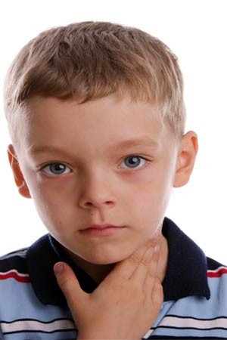

Clinical evidence of the wide spectrum of thyroid hormone action:
*hypothyroidism affects the cholesterol level (accumulate in the body and leads to atherosclerosis)
*LDL are particles that carry triglycerides and cholesterol from the liver to the tissue
-So basically they supply triglycerides and cholesterol to your tissues (tissues have receptors for these LDL particles)
-What if you have thyroid deficiency? These receptors will be inactive → less cholesterol uptake by the cells→ cholesterol will accumulate in the serum

Slide 9
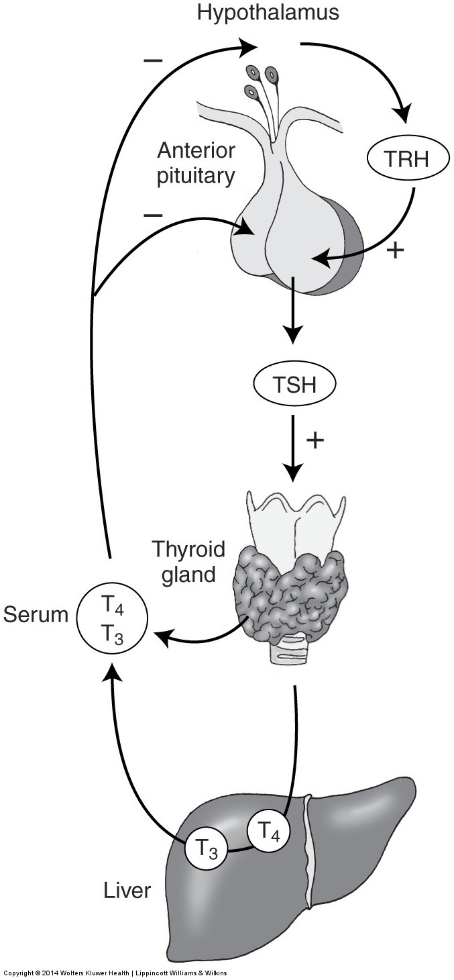
Regulation of Thyroid Hormone Secretion:
The hypothalamic-pituitary-thyroid axis regulates thyroid secretion:
The hypothalamus senses low levels of T3/T4 and releases thyrotropin releasing hormone (TRH).
TRH stimulates the pituitary to produce thyroid stimulating hormone (TSH).
TSH stimulates the thyroid to produce T₃/T₄ until levels return to normal.
Decrease the amount of Thyroid hormones and cold temp. both stimulate the hypothalamus to release TRH.
Controlling the release of Both TRH and TSH.
(when they become high) T₃/T₄ exert negative feedback control on the hypothalamus and pituitary.
High thyroid hormone levels:
  suppress TRH, TSH.
Low thyroid hormone levels:
  stimulate TRH, TSH to produce more hormone.

Slide 10
Thyroid Function Tests:
TSH measurement: | Total T₄ or free T₄: | Total T₃ or free T₃: | Antibodies:
The most preferred one because its level and the level of T4 & T3 are affecting each other. | - | Not measured unless suspecting hyperthyroidism especially when there is no increase in T4 | هاشميتو: انتيبوديز تثبط من عمل الهرمون المثبط عشانه ياكل كثير هاش براون
Assessment of thyroid function. | Assessment of thyroid function. | Useful for assessing hyperthyroidism in which rise in T₃ is independent of T₄ . | Diagnosis and monitoring of autoimmune thyroid disease:
Highly sensitive test (detects very low conc.). | Monitors thyroid treatment (both anti-thyroid and thyroid replacement treatment). | In some patients only T₃ rises (T₄ is normal): T₃ toxicosis. | Hashimoto’s thyroiditis (antibodies against TSH receptors that suppress thyroid secretion). Other: Anti-thyroid peroxidase Ab & Anti-thyroglobulin Ab.
If there is small change in the level of T4&T3 (even within the normal range), It will lead to significant change in TSH level, but when TSH level change, it won’t much affect in the T4&T3. | TSH may take up to 8 weeks to adjust to new level during treatment. During this time there will be possibility to hypothyroid very fast so you have to measure T4. | For earlier identification of thyrotoxicosis. | Graves’ disease (antibodies against TSH receptors that stimulate thyroid secretion). انتي بوديز تثبط من عمل الهرمون المحفز فتدخله القبر (جريف)

Slide 11
Thyroid Function Tests:
  We don’t measure the total T4 or T3 because total refers to both bounded and unbounded form of hormones.
  The bounded form is bounded to proteins which their levels can be changed (EX: During pregnancy, TBG will increase) which will affect the accuracy of the test. (Total will be high while Free will be in the normal level)

Slide 12
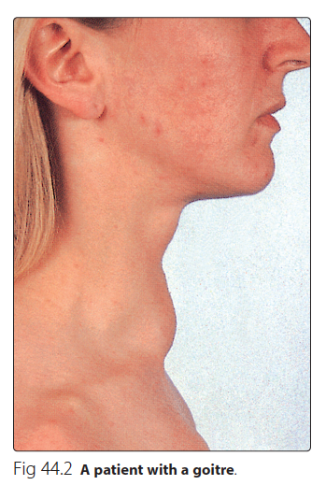
Goitre, Hypo and Hyperthyroidism
Goitre (Enlarged thyroid gland) may be associated with:
Hypofunction
Hyperfunction
Normal thyroid hormone conc. (euthyroid)
Causes:
Iodine, selenium deficiency
Hashimoto’s thyroiditis
Graves’ disease (hyperthyroidism)
Congenital hypothyroidism / thyroid cancer
Most common cause
Iodine: required for the synthesis of thyroid hormones.
Selenium: co-factor for the synthesis. if selenium is deficient → deficiency of the thyroid hormone

Slide 13
Hypothyroidism
Deficiency of thyroid hormones
Type | Primary hypothyroidism: Failure of thyroid gland (Elevated TSH, deficiency of thyroid hormones) | Secondary hypothyroidism: Failure of the pituitary gland to secrete TSH (rare) Failure of the hypothalamic-pituitary-thyroid axis
Causes | 1-Hashimoto’s thyroiditis. 2-Radioiodine or surgical treatment of hyperthyroidism. 3-Drug effects. 4-TSH deficiency. 5-Severe iodine deficiency. 6- Congenital defects in thyroid synthesis / thyroid resistance.
Clinical features | Tiredness / cold intolerance Most common / weight gain / dry skin.
Treatment | Replacement therapy with levothyroxine (T₄).
Non-Thyroidal illness
In some diseases, the normal regulation of TSH, T₃ and T₄ secretion and metabolism is disturbed.
Most of T₄ is converted to rT₃ (inactive).
Causing thyroid hormone deficiency.
Secretion of T₄ and T₃ is decreased.

Slide 14
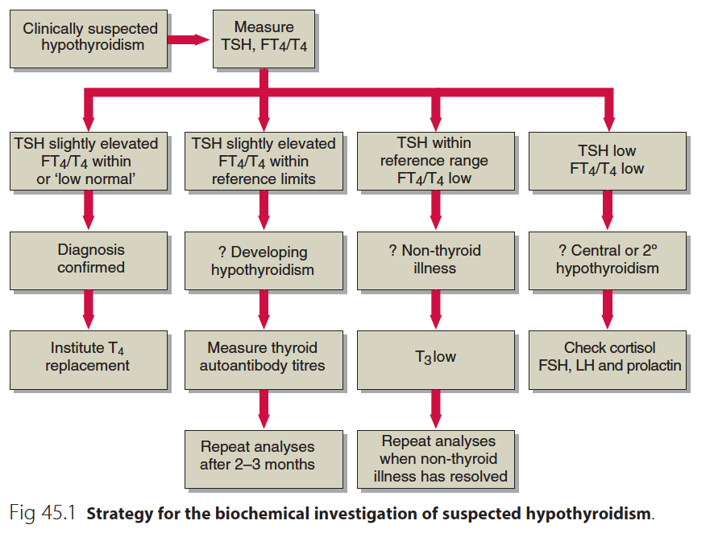
Biochemical investigation of suspected Hypothyroidism
1 | 2 | 3 | 4
TSH | Elevated | Elevated | Within reference range | Low
FT4\T4 | Within or low normal | Within reference | Low | Low
diagnosis | Conformed hypo-thyroidism | Developing hypo-thyroidism | Non-thyroid illness with the patient who critically ill ex. in ICU | 2^{ry} or central hypo-thyroidism
Further | Institute T4 Replacement | 1-measure thyroid autoantibody titers. 2-Repeat analyses after 2-3 months | 1- T3 test if low Repeat analyses when non-thyroid illness has resolved (Transist condition) | Check cortisol FSH,LH and prolactin
You can’t be sure because patient has symptoms of hypothyroidism, so he maybe developing it
At that moment, check for antibodies and if present repeat the test but don’t start treating because T4 levels is normal.

Slide 15
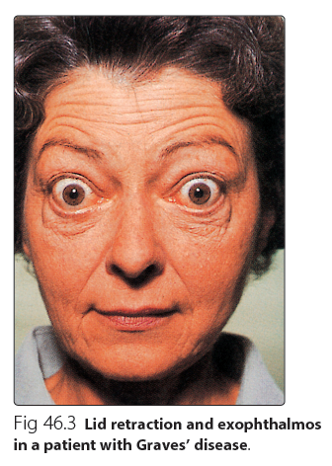
Hyperthyroidism
Hyperstimulation of thyroid gland by pituitary gland.
Hypersecretion of thyroid hormones.
Tissues are exposed to high levels of thyroid hormones (thyrotoxicosis).
Causes:
  Graves’ disease.
  Toxic multinodular goitre.
  Thyroid adenoma.
  Thyroiditis.
  Excessive intake of iodine / iodine drugs.
  Excessive intake of T₄ and T₃ .
Cause of Exophthalmos: the auto anti-bodies may attack some of orbital muscles of the eye which will cause inflammation and edema that will lead to Exophthalmos
  Graves’ disease (Most common)
Most common cause of hyperthyroidism
An autoimmune disease
Due to antibodies against TSH receptors on thyroid gland
The antibodies mimic the action of pituitary hormone Causing hypersecretion of thyroid hormone

Slide 16
Hyperthyroidism
Clinical features Opposite to Hypo-thyroidism | Weight loss with normal appetite. Sweating / heat intolerance. Fatigue. Palpitation / agitation, tremor. Thyroid hormones affects sympathetic system greatly. Angina, heart failure. Thyroid hormones affects Ca metabolism which affects heart muscle. Diarrhea. or frequent bowel movements Eyelid retraction and lid lag.
Diagnosis | Suppressed / undetectable TSH level. Raised thyroid hormones levels. Confirms primary hyperthyroidism. Free T₄ and TSH are (not total T4) first-line tests for diagnosis of thyroid dysfunction.
Problems in diagnosis | Total serum T₄ varies due to changes in binding protein levels. High estrogens in pregnancy increase TBG synthesis. Total T₄ will be high, free T₄ will be normal. Congenital TBG deficiency can also influence the results.
Treatment | Antithyroid drugs: carbimazole, propylthiouracil. Radioiodine: sodium ¹³¹I inhibits T₄/T₃ synthesis. it’s For the older patient but younger we won’t exposer them to radiation so the line of treatment depends on age. Surgery: thyroidectomy.
The antibodies act like the TSH exactly

Slide 17
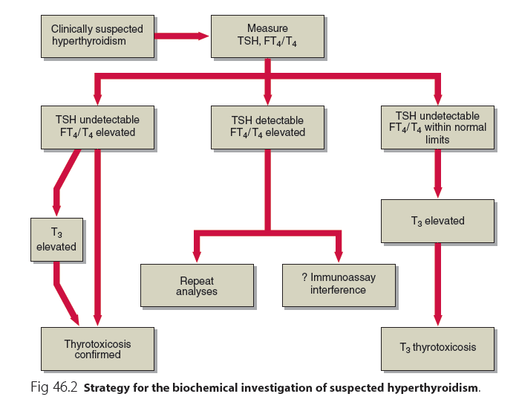
Biochemical investigation of suspected Hyperthyroidism
1 | 2 | 3
TSH | Undetectable | Detectable | Undetectable
FT4\T4 | Elevated | Elevated | Within normal limits
Further | T3 Levels | Repeat analyses Immunoassay interference | T3 Levels
Diagnosis | If T3 elevated = Thyrotoxicosis conformed | - | If T3 elevated = T3 Thyrotoxicosis

Slide 18
Thermogenesis (Heat production)
Recall : The amount of energy released when 1 NADH transfer it’s electrons to the O2 it produce 52 kcal. And the amount needed to make 1 ATP is 22 kcal. (which means we have a lot of energy that’s produced as extra).
- ATP synthesis and breakdown produce heat.
- ATP breakdown : is very efficient process and there is no much release of heat (No much Extra energy).
- ATP synthesis : is not very efficient process (produce a lot of Extra energy) and it releases more of energy as heat.
Humans are homeothermic (keep constant body temp.).
Tightly controlled temperature homeostasis.
Thermogenesis is important in regulation of the metabolism:
*it increases metabolism
*it increases metabolism by increasing cellular oxygen consumption.
Q/ by which process does the thyroid hormone increase cellular oxygen consumption?
A/ Respiratory chain (it increases the respiratory chain)
Thermogenesis is of two types
Obligatory normal physical activities | Facultative
Heat production due to basal metabolic rate | On-demand extra heat production from metabolic activity in brown adipose tissue, skeletal muscle, etc.
- | Facultative thermogenesis in brown adipose tissue (mainly in children, has a lot of mitochondria so, it has ability to synthesize a lot of ATP) is stimulated by sympathetic nervous system
Brown fat: special form of fat that generates heat, it is rich in sympathetic nerve endings and vessels so, its metabolic activity and development is regulated by norepinephrine, it is normally located in the axillary, subscapular, and interscapular regions.

Slide 19
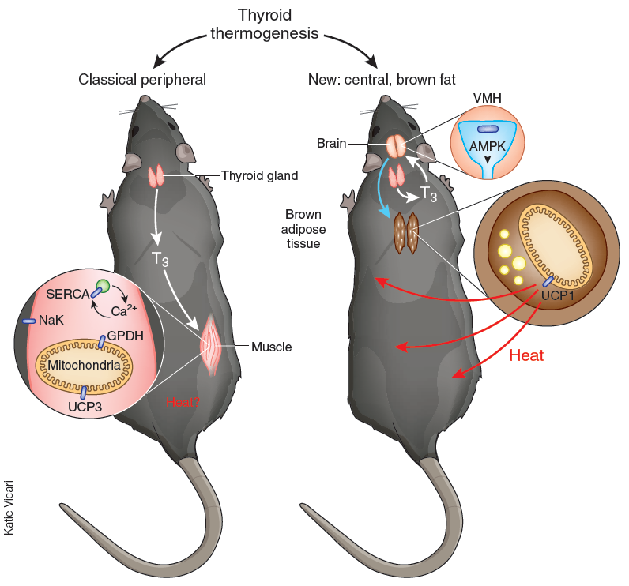
Thyroid Hormone and Thermogenesis
Two Concepts of Thyroid Thermogenesis
1. Classical:
peripheral
2. New : Central
brown fat
Thyroid hormone (T₃)
It effect Body tissue cells
(muscle, liver)
It directly effects the Hypothalamus
Activates certain
Enzymes by an
unknown mechanism
which increase basic metabolic rate
(EX: NA/K ATPase etc.)
Activates brown
adipose tissue
Increased
body energy
expenditure
Thyroid hormone will affects the hypothalamus where it will inactivate enzyme called AMPK , inactivation of this enzyme will stimulate signals that travel to brown adipose tissues and stimulate the synthesis of UCP1. (see the video in the next slide to know what is the role of UCP1 in thermogenesis).
THERMOGENESIS

Slide 20

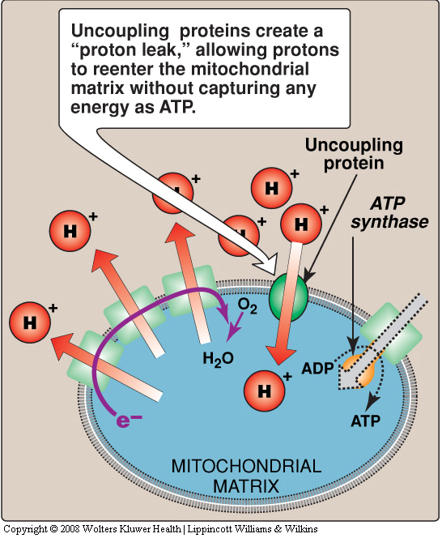
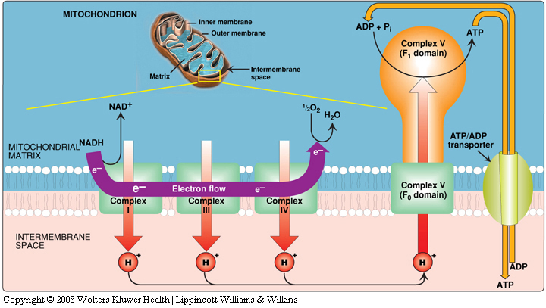
Thyroid Hormone and Thermogenesis
Brown Fat Thermogenesis
2:55
Thyroid hormone plays essential roles in thermogenesis.
It upregulates body temperature set by the brain.
It acts centrally on the hypothalamus that controls brown adipose tissue for thermogenesis.
UCP forms leaks in mitochondrial inner membrane allowing protons to fall back into the matrix and energy will be released as heat (non-shivering thermogenesis).
In respiratory chain, some protons reenter the mitochondrial matrix thru uncoupling proteins (UCPs) without ATP synthesis
These protons are released as heat
Thyroid hormone regulates mitochondrial UCPs
Examples:
UCP1 in brown adipose tissue
UCP3 in muscle, other tissues

Slide 21
Summary

Slide 22
Summary
Thyroid hormones | T3&T4&rT3 “ most active to least active”
Synthesis | tyroid gland
Transported in Blood | 1-bounded to : TBP 70% Albumin 25% Pre-albumin 5% 2- free ‘’active form’’
At peripheral tissue | de-iodinate T4 to T3 or rT3 by deiodinase enzymes
Function | 1-maturation of all body tissues 2-thermogenesis 3-increase O2 concamtion &metabolic rate
Regulation | T3/T4exert negative feedback control on the hypothalamus and pituitary
Function test | 1-TSH : thyroid function 2- Total T4 or free T4: thyroid function&monitoring 3-Total T3 or free T3 :T3 Toxicosis & early detection thyrotoxicosis 4- Antibodies:Hashimoto’s thyroiditis & graves
Thermogenesis | Tightly controlled temperature homeostasis 1- obligatory : heat production due to due to basal metabolic rate 2-Facultative : On-demand extra heat production from metabolic activity in brown adipose tissue, skeletal muscle
Thyroid thermogenesis | Thyroid hormone regulates mitochondrial UCPs , These protons are released as heat 1-new ‘’central’’ : act on hypothalamus by activation of brown adipose tissue ( UCP1) 2-classical ‘’pripheral ‘’: act on muscles and liver by activation of enzyme by unkown mechanism ( UCP3)

Slide 23
QUIZ
Q1 : Which one of the following cases is associated with permanent brain damage?
Untreated congenital Hypothyroidism
Genetic Hypothyroidism in children
Hashimoto’s thyroiditis
Goiter
Q2 : 78 year old patient known to have longstanding hypothyroidism came to your clinic one day, which of the following diseases do you expect him to have an increased risk of getting ?
Emphysema
Myocardial Infarction
Asthma
Irritable bowel syndrome
Q3 : Which one of the following is the most likely cause of hyperthyroidism ?
Thyroid adenoma
Graves’ disease
Thyroiditis
Excessive intake of T4 and T3
Q4 : Which one of the following proteins is responsible for transportation of the largest amount of Thyroxine ?
Albumin
Selenium
Transthyretin
TBG
Q5 : Which one of the following is considered a first line test
in TFT ?
TSH measurement
Total T4
Total T3
TRH measurement
Q6 : Which one of the following is the major cause of hypothyroidism?
Hashimoto’s thyroiditis
Graves’ disease
TSH deficiency
Severe iodine deficiency

Slide 24
QUIZ
Q7 : 9 year old boy came to your clinic with his mother.
She says that she is worried about him because he is too hot when she touches his forehead and that he is much thinner than his fellow students at school. She also complains of his enlarged neck and how she has to tailor him a thobe with a wider collar.
A) List 3 diseases that may cause Hyperthyroidism.
Thyroiditis, Graves’ disease, Toxic multinodular goiter, Thyroid adenoma, Excessive intake of iodine/ iodine drugs
B) List 3 other clinical features that are associated with hyperthyroidism.
Sweating
Fatigue
Palpitation
Diarrhea
Eyelid retraction
C) What is the possible treatment ? Explain why.
Anti-thyroidal drugs like: Carbimazole and propylthiouracil.
Because this patient is young.
D) Let’s say this patient is 90 years old, Would the treatment be different ?
Yes, we would treat him with Radioiodine and we might consider subtotal thyroidectomy.
Suggestions and recommendations
1) A 2) B 3) B 4) D 5) A 6) A

Slide 25
Saleh altwaijri
Mohannad alzahrani
Abdulaziz alhusaini
Maha alghamdi
Haneen alsubki
Rana Barsain
Shatha Alghaihb

