Slide 1

Biochemistry
Editing file
Vitamin D, Rickets
and Osteoporosis
One day you’ll be person between the patient and his grief.
Please study well ..

Slide 2
By the end of this lecture, the students should be able to:
Understand the functions, metabolism and regulation of vitamin D
Discuss the role of vitamin D in calcium homeostasis
Identify the types and causes of rickets
Correlate vitamin D and calcium deficiency in osteoporosis
Identify biomarkers used for the diagnosis and follow up of osteoporosis
Lippincott’s Biochemistry 6th Edition
Clinical Biochemistry: An illustrated colour text 4th Edition by Allan Gaw (Churchill Livingstone)
Wheater, G. et al. The clinical utility of bone marker measurements in osteoporosis. J. Trans. Med. 2013, 11: 201-214.

Slide 3
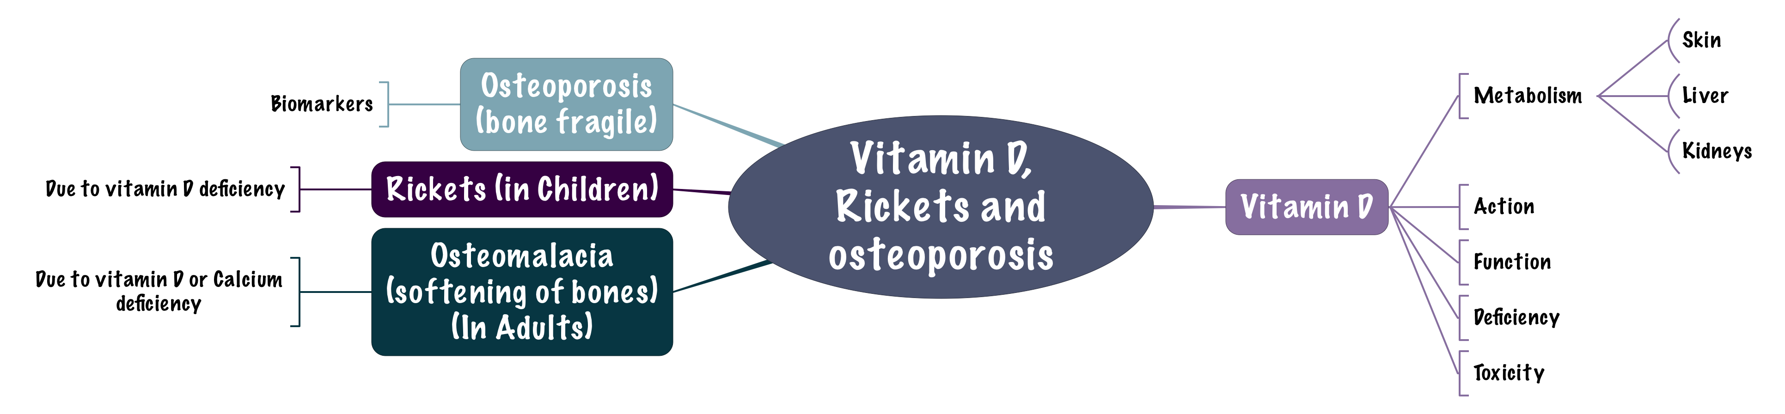
Overview

Slide 4
Vitamin D
2 vitamins that we consider as hormones: (Steroid in type)
1- Vitamin D. 2- Vitamin A. Why?
Recall: hormones are chemical messengers released from endocrine cells and circulating in the blood and work to accomplish intercellular interactions.
And since they are steroid hormones they diffuse into the cellular membrane and they bind to their receptors inside the cell and then go to the nucleus to binds with hormone-response element (HRE) (which is a specific sequence in the DNA) to affect the transcription of multiple types of genes نفس ما درسنا بالميد
It considered a steroid hormone
1-Cholecalciferol (vitamin D3):
The biologically active form is
is synthesized in the skin by the sunlight (UV) (UV type B- rays)
1,25-dihydroxycholecalciferol (calcitriol)
2-Ergocalciferol (vitamin D2) is derived from
D3, D2 are also available
Ergosterol in plants
as supplement

Slide 5
Vitamin D distribution
Dietary sources:
Ergocalciferol (vitamin D2) found in plants.
Cholecalciferol (vitamin D3) found in animal tissue.
Endogenous vitamin precursor:
7-Dehydrocholesterol is converted to vitamin D3 in the dermis and epidermis exposed to UV in sunlight.
Daily requirement (IU/day):
Adults: 600
Children: 400
Elderly: 800
Upper limit of intake: 4000
So it is either from the diet or exposure
D2 and D3 both can be converted into its biologically active form which is 1,25-dihydroxycalciferol.
يعني هو الريدي يبكون موجود داخل الجسم ولما يتعرض للشمس يتحول لـD3
High doses (10,000 IU for weeks or months) can lead to toxicity.
Hypercalcemia and deposition of calcium in arteries and kidneys.

Slide 6
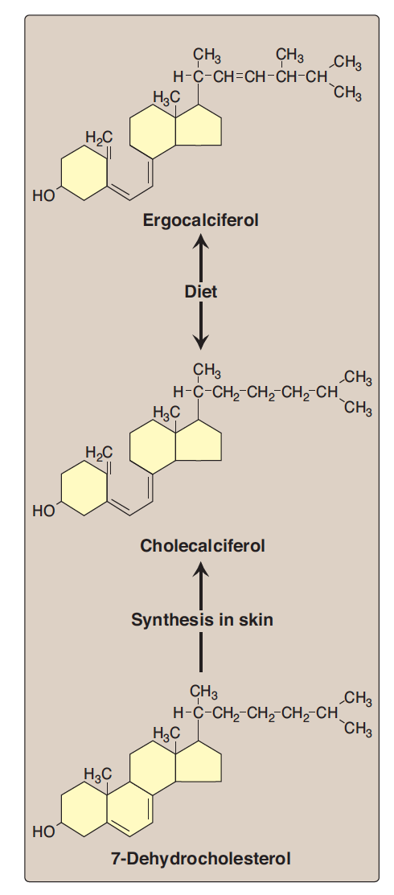
Sources of Vitamin D
After your skin exposed to sun UV light it convert 7-Dehydrocholestrol (which is already synthesized in your body) into Cholecalciferol (D3).
Another form is from the plants (Ergocalciferol) also the body can convert it into Cholecalciferol.
Cholecalciferol still need to be modified by the addition of 2 hydroxyl groups, the first one in the first carbon and the second one at 25th carbon and, then you can get the biologically active form which is Calcitriol.
Cholesterol is the precursor of cholecalciferol
2
1

Slide 7
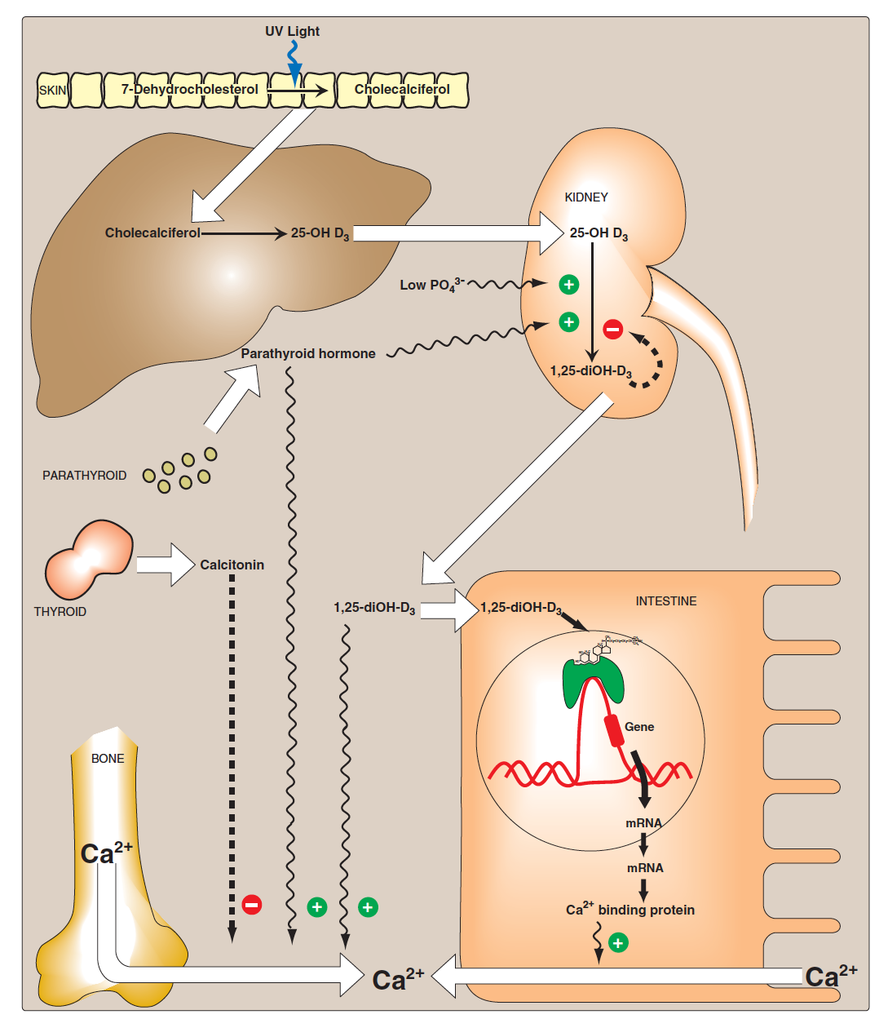
Metabolism of vitamin D
Follow the numbers pleases :
1. In the skin you synthesize Cholecalciferol from 7-Dehydrocholesterol (which is already in your body) when it exposed to sun UV light.
2. then it will go to the liver, because the liver has the enzyme (25- hydroxylase) to add the hydroxyl group in the 25th Carbon, so it becomes 25-hydroxycolecalciferol, this form is the most abundant form in the plasma and this is the storage form and the form we check in vitamin D blood test.
3. After that it will go to the kidney which have the enzyme (1alpha-hydroxylase) which will add a hydroxyl group to the first Carbon to get the final form which is 1,25-dihydroxycholecalceferol which is the final functional form of vitamin D and the form which will be released from the kidney to the circulation.
1
2
3

Slide 8

Summery of Vitamin D metabolism
storage form.
most abundant form.
form we check in vitamin D blood test.
Ergocalciferol (Vit.D2) (from plants)
Converted
By body
into:
Liver
25- Hydroxylase
(+OH in 25th C)
7-Dehydrocholesterol
Cholecalciferol (Vit. D3)
25-hydroxyColecalciferol
Sun UV light
Skin
(1-ɑ-hydroxylase)
(+OH in 1st C)
1,25-dihydroxyColecalciferol (Calcitriol) (Active form of Vit.D)
25-hydroxyColecalciferol
Kidney

Slide 9
Actions of vitamin D
1,25 diOH- D3 has a lot of effects, one of the them are intestinal cells it helps in the absorption of Ca, it does it by going to intestinal cells and affects gene expressions of some of the proteins which includes Ca+2 or cab binding protein and this helps in the absorption of ca2 from the intestine to the bloodstream (which will increase the Ca+2 ions in the plasma)
Decrease in Ca causes the release of parathyroid hormone, which activates 1-alpha hydroxylase which will increase the functional form of vitamin D (1,25-diOH-D3) that can increase Ca concentration, So 1,25 diOH-D3 and PTH cause increase in Ca level.
Calcitonin: cause decrease in Ca level
Q: What will stimulate 1,25-diOH-D3 synthesis?
A: PTH and low PO4
Q: What will inhibit 1,25-diOH-D3 synthesis?
A: 1,25-diOH-D3 itself by –ve feedback

Slide 10
Vitamin D metabolism
- We always measure 25-hydroxycholecalciferol
BUT if the patient has Renal problem then we measure 1,25-dihydroxycholecalciferol, Why? Because in this case the 25-hydroxycholecalciferol will not reflect your functional or active Vit.D amount, due to the problem in the kidney.
- Why we don’t’ measure both from the beginning?
because 1,25-dihydroxycholecalciferol measurement is expensive and complicated so we don’t do it for all patients.
In skin:
In liver:
Cholecalciferol (Vitamin D3) is derived from 7-dehydrocholesterol by the sunlight
Cholecalciferol is converted to 25-hydroxycholecalciferol (calcidiol) by the enzyme 25-hydroxylase
In kidneys:
• The 1-ɑ-hydroxylase enzyme converts 25-hydroxycholecalciferol to 1,25-dihydroxycholecalciferol (biologically active).
• Active vitamin D is transported in blood by gc-globulin protein
Gc-protein or vitamin D binding protein(other name).

Slide 11
Vitamin D regulation and calcium homeostasis
Vitamin D synthesis is tightly regulated by plasma levels of phosphate and calcium.
Activity of 1-ɑ-hydroxylase in kidneys is: (Point of regulation)
Directly increased due to low plasma phosphate.
Indirectly increased via parathyroid hormone (PTH) due to low plasma calcium.
PTH increases vitamin D synthesis in kidneys.
Vitamin D has essential role in calcium homeostasis.
Calcium homeostasis is maintained by parathyroid hormone (PTH) and calcitonin.
Function of calcitonin: When Ca plasma levels is increased it stimulates calcitonin to be released and decreases the activity of osteoclasts (cells responsible for bone resorption), so it inhibits bone resorption then it doesn't lead to furthermore production of calcium.
Recall:
PTH: comes from para thyroid gland
Calcitonin: comes from thyroid gland

Slide 12
Vitamin D action
Vitamin D action is typical of steroid hormones.
It binds to intracellular receptor proteins.
The receptor complex interacts with target DNA in cell nucleus.
This stimulates or represses gene expression.

Slide 13
Vitamin D functions
Regulates plasma levels of calcium and phosphate.
Promotes intestinal absorption of calcium and phosphate.
Stimulates synthesis of calcium-binding protein for intestinal calcium uptake.
Minimizes loss of calcium by the kidneys.
Mobilizes calcium and phosphate from bone to maintain plasma levels.
It can increase bone mineralization and formation by acting upon osteoblasts
By increasing calcium reabsorption from the kidney.
By acting on the osteoclasts to mobilize the Ca and PO4 from the bone to maintain plasma levels.

Slide 14
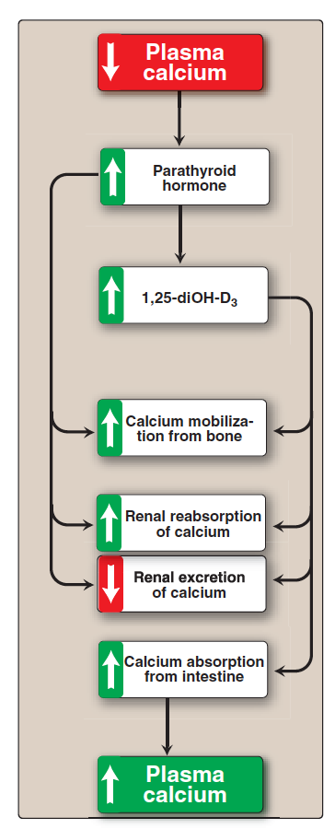
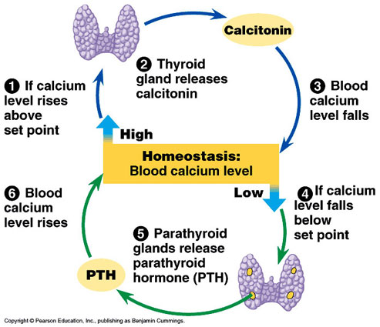
Vitamin D response to low plasma calcium
So vitamin D helps the intestinal cells to absorb of calcium via increasing the synthesis of Ca- binding protein (by stimulation of gene expression in that responsible for this protein synthesis), this protein will enhance Ca absorption from intestine (see image in slide 9).
So the enzyme 1-alpha-hydroxylase is actually regulated by calcium. How? When you have low plasma levels of calcium It causes the release of parathyroid hormone (so low Ca is a stimulus for PTH) and what PTH is released it goes and activates the enzyme 1alpha-hydroxylase and therefore 1alpha-hydroxylase increase the synthesis of the functional form of vitamin D that can go again and increase calcium level concentration by PTH.
Intestine are only affected by vitamin D and not by PTH.

Slide 15
Vitamin D deficiency
Deficiency most common worldwide.
High prevalence in Saudi Arabia due to:
Low dietary intake.
Insufficient exposure to Sun.
Circulating level of >75 nmol/L is required for beneficial health effects.
Lifestyle (eg. clothing esp. in women)
Actually we have 3 categories for measurements:
Below 50= Vitamin D deficiency.
Between 50 – 75 =. Vitamin D insufficiency.
Above 75 = Vitamin D sufficiency.

Slide 16
Nutritional Rickets
A disease in children causing net demineralization of bone.
With continued formation of collagen matrix of bone.
Incomplete bone mineralization.
Bones become soft and pliable.
Causes skeletal deformities including bowed legs.
Patients have low serum levels of vitamin D.
(Osteomalacia: demineralization of bones in adults, due to nutritional deficiency of vitamin D)
Here we are talking about bone development.
If the bone is not getting mineralized properly it becomes weak.
Mainly in Rickets not in osteomalacia.
The Bone starts from a healthy bone.
But when the bone is being remodeled it doesn't have proper mineralization.

Slide 17
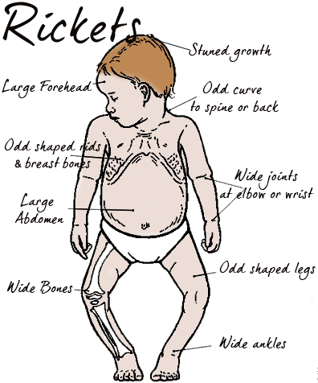
Rickets

Slide 18
Rickets
Rickets has 2 causes:
1- Vitamin D deficiency.
2- Genetic defect leading to vitamin D deficiency.
1. Vitamin D deficiency because of:
Poor nutrition
Insufficient exposure to sunlight
Renal osteodystrophy (causes decreased synthesis of active vitamin D in kidneys).
Hypoparathyroidism (hypocalcemia)
Causes
Leading to insufficient hydroxylation of the storage form of vitamin D into the functional form.
2. Inherited rickets
Rare types of rickets due to genetic disorders
Causing vitamin D deficiency mainly because of genetic defects in:
Vitamin D synthesis
Vitamin D receptor (no hormone action), This type is much more prevalent.
Vitamin D-dependent rickets (types 1 and 2)

Slide 19
Diagnosis and treatment of Rickets
Measuring serum levels of:
25-hydroxycholecalciferol Low
Treatment:
Vitamin D and calcium supplementation
PTH
Calcium
Phosphate
Alkaline phosphatase
We studied it in GIT block as one of the tests done in liver function tests and was not specific in the case of the liver, but it has an isotype specific for bones (high levels indicates problem in the bones) because it is produced by the osteoblast.

Slide 20
Osteoporosis
Reduction in bone mass per unit volume
Bone matrix composition is normal but it is reduced
Post-menopausal women lose more bone mass than men (primary osteoporosis)
Increases fragility of bones
Increases susceptibility to fractures
So rickets the quality of bone is defected, while in osteoporosis the quality is good but the problem is in bone density and amount of matrix (no problem in mineralization but there is loss or reduction in bone mass).

Slide 21
Osteoporosis
Secondary osteoporosis may be caused by:
Drugs e.g. asthma drugs
Immobilization
Smoking
Alcohol
Cushing’s syndrome
Gonadal failure
Hyperthyroidism, Thyroid hormones affect the synthesis of collagen & osteoblast activity.
GI disease
Primary osteoporosis: is that happen in Post-menopausal women and we don’t know the exact mechanism.
Most of these causes are somehow related to vitamin D deficiency (or improper absorption)

Slide 22
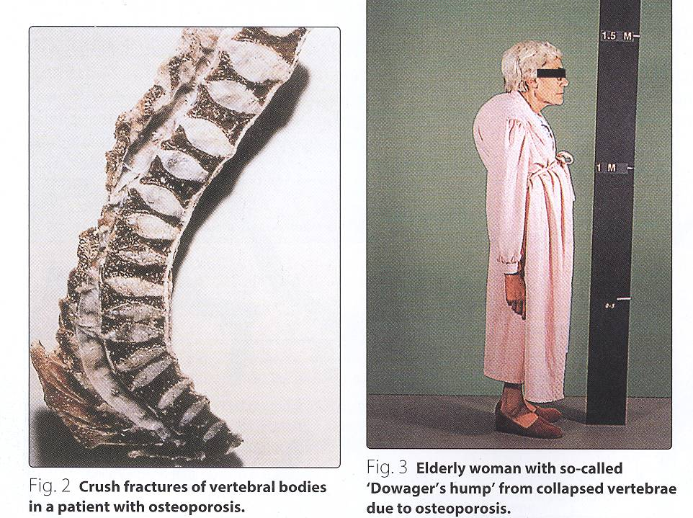
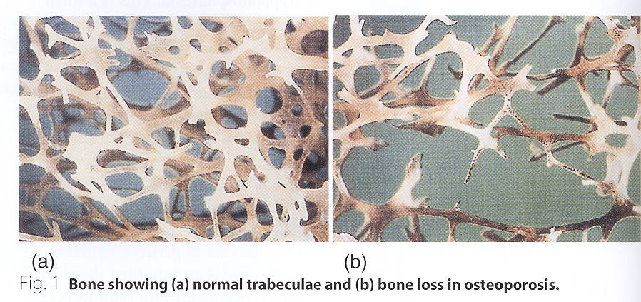
Osteoporosis

Slide 23
Diagnosis of osteoporosis
WHO standard: Serial measurement of bone mineral density.
Biochemical tests (calcium, phosphate, vitamin D) alone cannot diagnose or monitor primary osteoporosis
The test results overlap in healthy subjects and patients with osteoporosis
Secondary osteoporosis (due to other causes) can be diagnosed by biochemical tests
DEXA scan: is a technique where the bone density is measure.
It measures the amount of ca per square cm of the bone comparing it to what should it there for 30 year individual

Slide 24
Biomarkers of osteoporosis
Bone formation markers
Produced by osteoblasts during bone formation
Bone-specific alkaline phosphatase
Present in osteoblast plasma membranes
Involved in bone remodeling process
Released during bone formation and resorption (bone turnover)
Short half-life of few minutes
Helps osteoblasts in bone formation
A Non-specific marker
Its isoenzymes are widely distributed in other tissues
P1NP (Procollagen type-1 amino-terminal propeptide)
Produced by osteoblasts
Involved in the process of type 1 collagen formation
Blood levels are highly responsive to osteoporosis progression and treatment
Blood levels are influenced by Vitamin K status and renal function.
The isoenzymes also interfere with the assay
Shows good assay precision
Stable at room temperature
Osteocalcin
Osteocalcin
Recall from GI: It is related to vitamin K when they carboxylate blood coagulation factors to maturate them.
P1NP (Procollagen type-1 amino-terminal propeptide)
Involved in type 1 collagen synthesis.
So when there is bone synthesis the P1NP levels will be elevated.

Slide 25
Biomarkers of osteoporosis
CTX-1 (Carboxy-terminal cross-linked telopeptides of type 1 collagen)
A component of type-1 collagen
Released from type-1 collagen during bone resorption
Blood and urine levels are highly responsive to post-resorptive treatment
Levels vary largely by circadian variation
Bone resorption markers
In the osteoclasts.
So when there is osteoclastic activity its levels will be elevated (during resorption)
So the blood samples has to be taken at the same time (morning or afternoon)

Slide 26
Treatment and prevention of osteoporosis
Treatment
In confirmed cases of osteoporosis
  - Treatment options are unsatisfactory
Oral calcium, estrogens, fluoride therapy may be beneficial
Bisphosphonates inhibit bone resorption that slows down bone loss
Prevention
Prevention from childhood is important.
Good diet and exercise prevent osteoporosis later.
Hormone replacement therapy in menopause may prevent osteoporosis.

Slide 27
Take home messages
Overview of vitamin D metabolism and regulation.
Importance of vitamin D functions.
Vitamin D deficiency is common in populations.
Rickets and osteomalacia are due to vitamin D deficiency.
Various biochemical markers clinically important for assessment of osteoporosis.

Slide 28
QUIZ
Q1 : Which one of the following is correct in Vit.D deficiency?
Associated with sufficient exposure to sun
Has nothing to do with a human’s lifestyle
It’s related to vaccinations during childhood
Associated with loss of calcium from the kidneys
Q2 : 22 year old smoker, came to the E.R. with a bone fracture. His brother mentioned that he has been inactive for the past few years because of med school and that he also had a fracture 2 months ago when playing football with his high school friends.
Which one of the following is most probably the cause of his fracture?
Osteomalacia
Hypothyroidism
Osteoporosis
Crohn’s disease
Q3 : Which one of the following is the most common cause of rickets?
Nutritional
Inherited
Q4 : Which one of the following is the active form of Vit.D?
25-Hydroxycholecalciferol
Calcitriol
7-dehydrocholestrerol
Cholecalciferol
Q5 : Which one of the following is a protein responsible for transportation of the active form of Vit.D in the blood?
Albumin
GC-Globulin
Membrane transport protein
Rhodopsin
Q6 : 12 year old boy, his monthly intake of Vit.D is 9000 IU.
Which one of the following is correct about him?
His daily intake is deficient by 100 IU
His daily intake is excessive by 100 IU
His daily intake is deficient by 150 IU
His daily intake is excessive by 150 IU

Slide 29
QUIZ
Q7 : 6 year old boy came to your clinic with his older sister who is a medical student.
She says that she is worried about him because his legs have been bent slightly.
But because she wants to make sure you’re a good doctor, she asked you a few questions.
A) Can you tell me what activates Vit.D?
Low Phosphate, Low Calcium & High Parathyroid hormone
B) Mention 3 clinical features that are associated with rickets.
Soft pliable bones
Bowed legs
Low serum levels of vitamin D
C) How is rickets diagnosed?
By measuring levels of: 25-Hydroxycholecalciferol, PTH, Calcium, Phosphate and Alkaline phosphatase.
D) What is the possible treatment ?
Vit.D and calcium supplementation.
Suggestions and recommendations
1) D 2) C 3) A 4) B 5) B 6) A

Slide 30
Faris alnafisah
Abdulaziz alhusaini
Saad alrushud
Mohannad alzahrani

