Slide 1

Biochemistry
Editing file
Biochemistry of
Cushing Syndrome
The expert in anything was once a beginner

Slide 2
By the end of this lecture, the students should be able to know:
To identify different causes of Cushing’s syndrome
To understand the diagnostic algorithm for Cushing’s syndrome
To understand the interpretation of laboratory and radiological tests of Cushing’s syndrome
Dr. Rana:
Don’t memorize Numbers or procedures
Normal ranges will be given in exam ☺

Slide 3
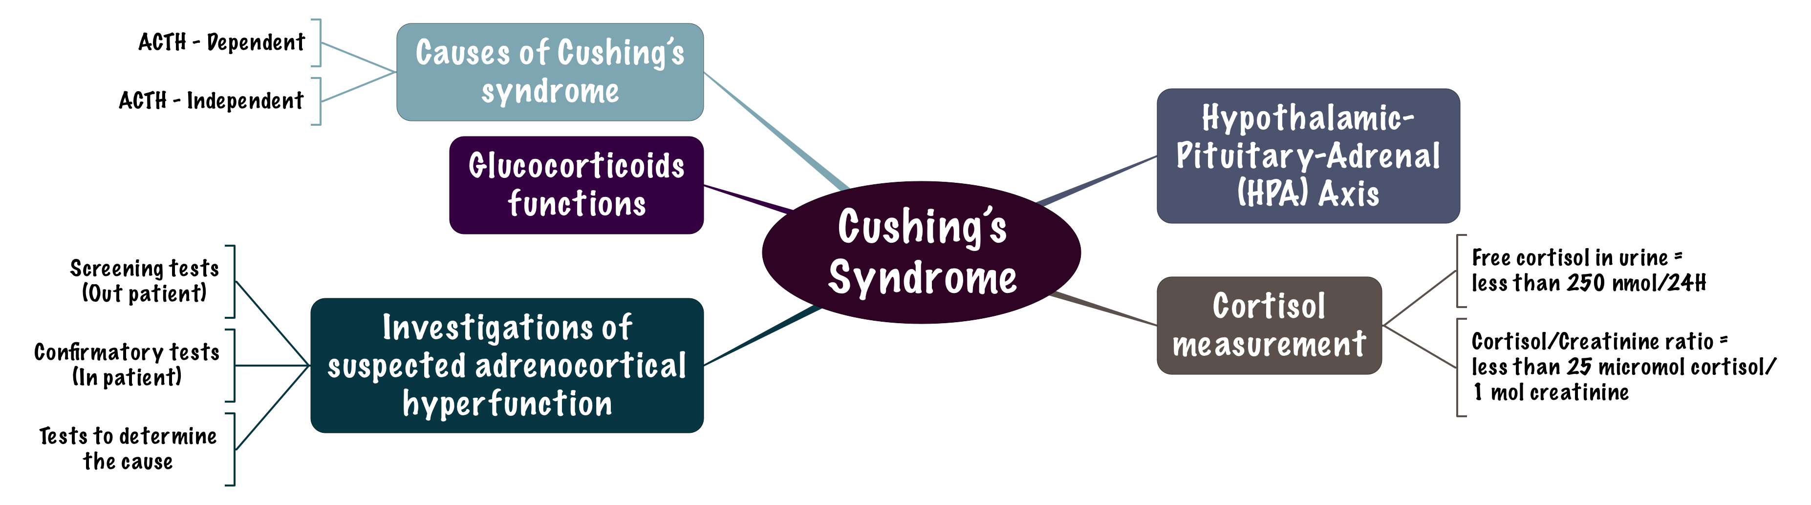
Overview

Slide 4
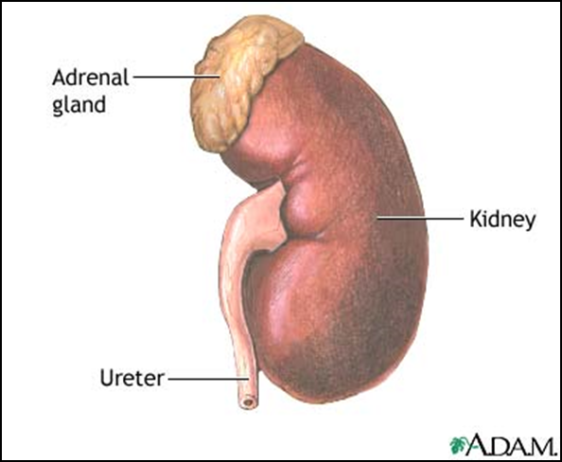
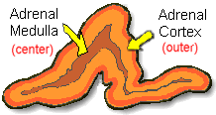
Adrenal gland
“ to understand better”
Anatomy | Histology
The adrenal gland is situated on the anteriosuperior aspect of the kidney | The adrenal gland consists of two distinct tissues of different embryological origin, the outer cortex and inner medulla.

Slide 5
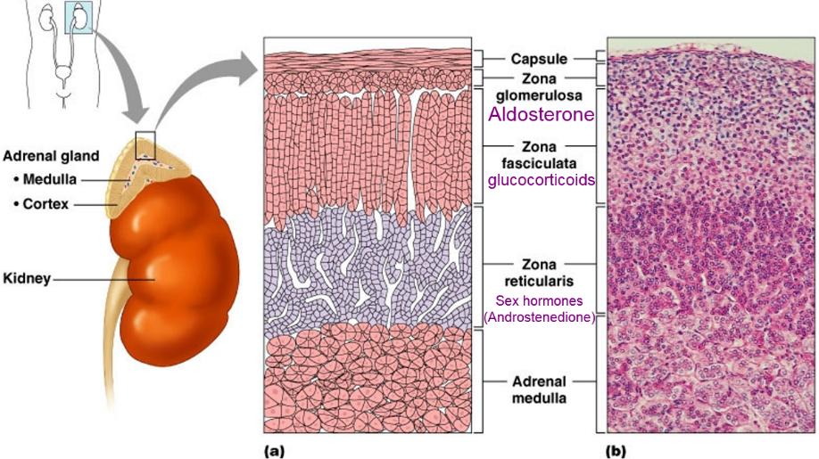
Adrenal cortex zones based on cell type and function
“ to understand better”
  The outermost zone
  Secrete aldosterone (the principal mineralocorticoid).
Zona Glomerulosa
  Secrete glucocorticoids – mainly cortisol (95%)
Zona Fasciculata
  Secrete Sex hormones, Mainly androgens
Zona Reticularis
From outer to inner: GFR

Slide 6
Steroid Hormone Synthesis
- Just know that Cholesterol (27C) is the precursor of 6 hormones:
Aldosterone.
Cortisol (21C).
Testosterone (Sex hormones)
- concern only with this pathway, and we shouldn't be worried about the enzymes
Cholesterol (27C)
Pregnenolone (21C)
3-β-Hydroxysteroid dehydrogenase
Progesterone (21C)
21-α-Hydroxylase
17-α-Hydroxylase
11-Deoxycorticosterone (21C)
17-α-Hydroxyprogesterone (21C)
11- β -Hydroxylase
21-α-Hydroxylase
Corticosterone
11-Deoxycortisol (21C)
Androstenedione (19C)
11- β -Hydroxylase
Aldosterone (21C)
Cortisol (21C)
Testosterone (19C)
Peripheral Tissues
cortisol is fat soluble and needs carrier in blood
Estradiol (18C)

Slide 7
Hypothalamic-Pituitary-Adrenal (HPA) Axis
If someone is taking exogenous cortisol drugs and want to stop the drug, it has to be stopped gradually, because the exogenous cortisol will result in –ve feedback on hypothalamus & pituitary which will lead to stopping their normal secretion so, we have to give them chance to secrete their hormones again.
The hypothalamus secretes corticotropin-releasing hormone (CRH) which stimulates the anterior pituitary gland to synthesis and release ACTH.
ACTH acts on the zona fasiculata cells → release of glucocorticoids (Cortisol).
Hypothalamus > release CRH > ACTH release > stimulates zona fasciculata > produce glucocorticoids
Regulation of ACTH and Cortisol Secretion:
1. Negative feedback control: | ACTH release from the anterior pituitary is stimulated by hypothalamic secretion of corticotrophin releasing hormone (CRH). CRH → ↑ ACTH → ↑[Cortisol] ↑[Cortisol] or synthetic steroid suppress CRH & ACTH secretion
2. Stress: (e.g. major surgery, emotional stress) | Stress → ↑ CRH & ACTH → ↑ Cortisol
3. The diurnal rhythm of plasma cortisol: | Highest Cortisol level in the morning ( 8 - 9 AM). Lowest Cortisol level in the late afternoon and evening ( 8 - 9 PM ).

Slide 8
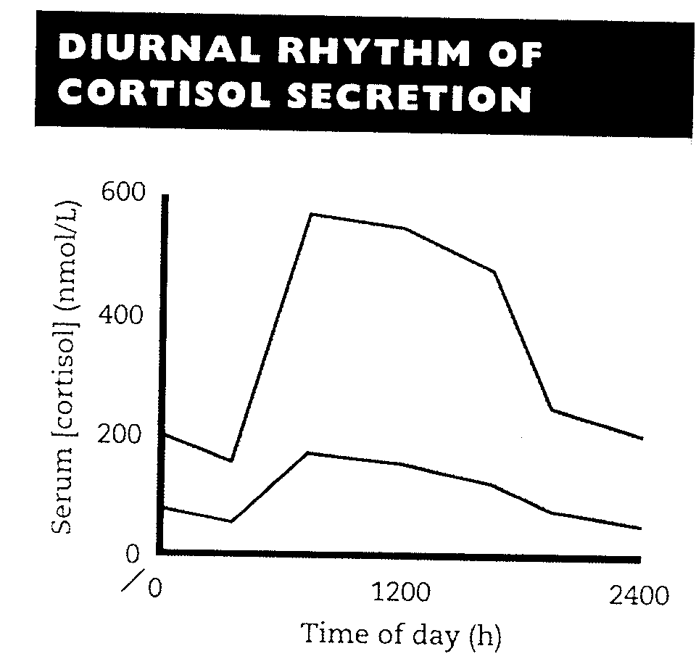
Hypothalamic-Pituitary-Adrenal (HPA) Axis
The diurnal rhythm of cortisol secretion; the area between the curves represents values that lie within the reference range
It’s either protein bound and unbound
In the circulation, glucocorticoids are mainly protein-bound (about 90%), chiefly to cortisol-binding globulin (CBG or transcortin).
The biologically active fraction of cortisol in plasma is the free (unbound) component. (10% unbound and it is the active form)
Plasma [CBG] :
Free cortisol features:
Excreted in urine
Acts on tissue
Goes through hepatic metabolism
Increases | Decreases
Pregnancy and estrogen treatment (e.g. oral contraceptives) | Hypoproteinemic states (nephrotic syndrome) proteins filtrated by the kidney

Slide 9
Cortisol and ACTH measurements
This slide is for reading only
Serum [cortisol] and plasma [ACTH]:
Serum measurement is preferred for cortisol and Plasma for ACTH.
Samples must be collected (without venous stasis to avoid stress, which increase cortisol secretion) between 8 a.m. and 9 a.m. and between 10 p.m. and 12 p.m. because of the diurnal rhythm. (Cortisol secretion is constant in the these periods)
Temporary ↑ in these hormones may be observed as a response to emotional stress,
بسبب خوف من الإبر والمستشفى مثلًا
10% of cortisol is excreted in urine and this is what we measure.
Most patient don’t have compliance for UFC (because they have to collect urine for 24 hours otherwise it will not give us accurate result) so we do Cortisol/creatinine Which depend only in one urine sample.

Slide 10
Cortisol and ACTH measurements
Cortisol
Metabolically inactive compound
Urinary excretion (conjugated metabolite)
Urinary cortisol excretion :
By liver
If someone came sweating or fasting he’ll have concentrated urine:
↑cortisol ↑creatinine ↓volume
The result of cortisol/volume is false high
If someone drank a lot of water he’ll have diluted urine:
↓cortisol ↓creatinine ↑volume
The result of cortisol/volume is false low
So, to have an accurate result we do Cortisol/creatinine
A small amount of cortisol is excreted unchanged in the urine (UFC).
In normal individuals:
  Urinary free cortisol (UFC) is < 250 nmol/24 h.
  Cortisol / Creatinine ratio in an early morning specimen of urine is
  < 25 μmol cortisol / mol creatinine.
الارقام اللي بالأحمر تحفظ

Slide 11
CAUSES OF ADRENOCORTICAL HYPERFUNCTION: CUSHING’S SYNDROME
ACTH - dependent : | 1. ↑ Pituitary ACTH 70% (Cushing's disease) 2. Ectopic ACTH by neoplasms 10%.
ACTH - independent : | 1. Adrenal tumor 20% (adenoma or carcinoma) 2. Glucocorticoid therapy. (eg.contraceptives)
The most common.
This is the only case in which we call it “Disease” instead of “Syndrome”.
Ectopic Neoplasm: Neoplastic cells release ACTH
Causes of elevated serum cortisol concentrations:
1. Increased cortisol secretion: | Cushing's syndrome
 | Exercise
 | Stress, Anxiety, Depression
 | Obesity
 | Alcohol abuse
 | Chronic renal failure
2. Increased cortisol binding globulin (CBG) | Congenital
 | Estrogen therapy
 | Pregnancy
True Cushing's syndrome
pseudo-Cushing's syndrome
الكورتيزول الموجود في السيرم يزيد يا اما بزيادة الافراز من الأساس او بزيادة نسبة CBG وكل واحد منهم له أسبابه الموضحة في الجدول

Slide 12
Glucocorticoid functions
Glucocorticoids have widespread metabolic effects on carbohydrate, fat and protein metabolism.
Upon binding to its target, CORTISOL enhances metabolism in several ways:
Liver
Cortisol is an insulin antagonist and has a weak mineralocorticoid action
↑ Amino acid uptake and degradation
adipose tissue
↑ Lipolysis through breakdown of fat .
↑ Ketogenesis.
↑ Gluconeogenesis → production of glucose from newly-released amino acids and lipids
muscles
↑ proteolysis and amino acid release
  Conserving glucose: by inhibiting uptake into muscle and fat cells.

Slide 13
Cushing’s Syndrome
It comes as case scenarios
Symptoms
Signs
1. Weight gain: trunk and face with sparing of the limbs (central obesity).
2. Buffalo’s hump*.
3. Moon face.
4. Excessive sweating.
5. Atrophy of the skin and mucous membranes.
6. Purple striae* on the trunk and legs.
7. Proximal muscle weakness (hips, shoulders).
8. Hirsuitism*
9. The excess cortisol may also affect other endocrine systems: ↓libido, amenorrhoea and infertility.
10. Patients frequently suffer various psychological disturbances ranging from euphoria to frank psychosis.
1. Loss of diurnal rhythm of cortisol and ACTH.
2. Hypertension (due to the aldosterone - like effects).
3. Hyperglycemia or diabetes due to insulin resistance.
4. Hypokalemic alkalosis. (aldosterone)
5. ↑protein metabolism.
6. Impaired immunity.
* Buffalo hump, is extra fat around the neck and upper part of the back
* purple lesions, which can appear anywhere on the body, but are most likely to appear in places where larger amounts of fat are stored
*Hirsuitism is a condition of unwanted, male-pattern hair growth in women

Slide 14
Investigations of suspected adrenocortical hyperfunction
A. Screening tests (out-patient): | to assess the clinical diagnosis of adrenocortical hyperfunction.
B. Confirmatory tests (in-patient): | to confirm or exclude the provisional diagnosis. (to Distinguish between Pseudo Cushing and real Cushing syndrome)
C. Tests to determine the cause: to ascertain: | (a) The site of the pathological lesion (adrenal cortex, pituitary or elsewhere?)
 | (b) The nature of the pathological lesion. (Malignant or benign)
These tests are all used together : the first one to know whether the patient has cushing’s disease or not then the second to know the type of the disease then the third
If patient complains of Obesity, depression, fatigue slow & hirsutism
Our differential diagnosis going to be:
Cushing syndrome, Depression, Polycystic ovarian syndrome or hypothyroidism . The screening test is used to tell weather the cause is the Cushing syndrome or not
Cushing syndrome patient usually come to clinics
Addison’s disease patient usually come to ER (life-threatening)

Slide 15
A. Screening tests:
* Dexamethasone: Synthetic Cortisol
Effective screening tests need to be sensitive but do not have to be highly specific.
It includes:
1. Low-dose dexamethasone* (DXM) suppression test (DST): (Overnight suppression test). DXM → ↓ CRH → ↓ ACTH → ↓ cortisol
2. 24-hour urinary free cortisol
Low dose of DXMاذا اعطيناه بعني الزبدة
Normal person = Suppression of cortisol
Cushing syndrome= NO suppression
لو ماصار سبرشن ندخل البيشنت المستشفى ونسوي confirmatory test
Details are explained below
1. Low-dose DST: (outpatient procedure)
Procedure “Not important” | - 1 mg DXM administered at 11-12 PM the night before attending the clinic. - serum cortisol is measured at 8-9 AM.
Result | Cortisol < 50 nmol/L (suppression)→ exclude hypercortisolnemia (Cushing Syndrome)
Precautions | Drugs that induce hepatic microsomal enzymes (Phenobarbitone &phenytoin) → ↑ DXM metabolism and ↓ DXM blood level to achieve CRH suppression (false diagnosis of Cushing).

Slide 16
A. Screening tests: …. Cont’D
2. 24- hour urinary free cortisol:
Disadvantage | incomplete collection of urine → a false-negative result.
Result | Cortisol < 250 nmol/day → exclude Cushing Syndrome.
An alternative is to determine the urinary cortisol | creatinine ratio on an early morning specimen
Interpretation of screening tests
The screening tests serve to | distinguish simple non-endocrine obesity from obesity due to Cushing's syndrome.
Pseudo-Cushing's syndrome | Depressed or extremely anxious patients Severe intercurrent illness Alcoholism
Confirmatory tests (in-patient basis) are required to rule out pseudo-Cushing's syndrome

Slide 17
B. Confirmatory tests: (Inpatient)
Insulin-induced hypoglycemia :
To distinguish true Cushing's syndrome from pseudo-Cushing’s syndrome
To test the integrity of the hypothalamic-pituitary-adrenal (HPA) axis.
Contraindicated in: epilepsy or heart disease.
  Hypoglycemia →↑ CRH →↑ ACTH →↑ cortisol
Pseudo-Cushing and true Cushing عشان نفرق بين
نعطي البيشنت انسولين, لو هو ماعنده كوشنق
hypoglycemia الكورتزول بيرتفع عشان يعدل
But if he has cushing = No further increase in cortisol (NO response)
  True Cushing patients:
  No response to hypoglycemia, (or not significant)
  Pseudo-Cushing patients show abnormal diurnal rhythm of S. cortisol, but, with Insulin-induced hypoglycemia → ↑ CRH, ACTH and cortisol blood levels

Slide 18
Insulin hypoglycemia test …. Cont’d
Procedure:
Insulin I.V. (0.15 U/kg) to lower blood glucose to 2.2 mmol/L or less .
Samples for simultaneous measurement of serum glucose and cortisol levels are taken basally (before insulin injection) and at 30, 45, 60 and 90 min after I.V. insulin injection.
Failure to achieve a glucose level of 2.2 mmol/L invalidates the test and should be repeated with increment in step of 0.05U/kg. (NO need to know about it)
For reading
Interpretation of the results
Normally | Basal serum cortisol: at least 145 nmol/L At 60 - 90 minutes: the level > 425 nmol/L
Patients with Cushing's syndrome | Whatever the cause, do not respond normally to insulin-induced hypoglycemia. High basal serum cortisol than normal . At 60 - 90 minutes: no increase in S. cortisol, despite the production of an adequate degree of hypoglycemia.

Slide 19
C. Tests used to determine the cause of Cushing's syndrome:
To differentiate ACTH-dependant from ACTH-independent:
Plasma ACTH (Diurnal rhythm)
The difference in ACTH levels in Cushing disease and Ectopic tumor due to:
Neoplastic cells are so many and there is NO control in ACTH releasing at all.
While in Cushing Disease (problem in Pituitary) there have to be some –ve feedback (may be very small but it will affect the level that will prevent it from Jumping to sky-high level).
Plasma [ACTH]:
Undetectable = 0 | ↑↑ ACTH = little bit high | ↑ ↑↑ ↑ ACTH = very high
Functional adrenal tumor → confirmed by an abdominal CT scan to detect an adrenal mass. | Cushing's disease (pituitary-dependent). | Ectopic (non-endocrine) origin of ACTH.
Because of –ve feedback

Slide 20
C. Tests used to determine the cause … Cont’d :
2. To distinguish between ACTH-dependent causes (Pitutary Vs Lung):
    High-dose DST.
    CRH stimulation test
Pituitary Adenoma (Cushing’s disease)
Low dose DXM → No Response (No suppression)
High dose DXM → Starts to respond (starts to suppress)
2 (a) High-dose DST
Suppression | is defined as a fall to less than 50 % of basal value
It is used to distinguish Cushing's disease from ectopic ACTH secretion. 2 mg dexamethasone six-hourly (every 6 hours) for 48 hours to suppress cortisol secretion. Basal (pre-dexamethasone) serum cortisol or 24-hour urine free cortisol is compared with the results at the end of the 48-hour period. About 90 % of patients with Cushing's disease show suppression of cortisol output. In contrast, only 10% of patients with ectopic ACTH production (or with adrenal tumors) show suppression.
High dose of DSTيعني باخصار اذا اعطينا البيشنت :
Cushing disease: SUPRRESSION of cortisol (90%)
Ectopic: NO suppression of cortisol (90%)

Slide 21
C. Tests used to determine the cause … Cont’d :
2 (b) CRH stimulation test:
Procedure: “Not important”
Measures the ACTH and cortisol levels basally and 60 minutes after injection of 100 µg CRH
In Cushing's disease: High-dose dexamethasone suppression test + the CRH test =100% sensitivity and specificity.
يعني هنا نكون تأكدنا ان المريض عنده كوشنق دزيز
Because the pituitary is the only one that directly affected CRH
Ectopic ACTH & adrenal tumors | Cushing's disease
No response | ↑ ACTH & cortisol above basal at 60 min.
False-positive responses are unusual | 10% of patients fail to respond

Slide 22
C. Tests used to determine the cause … Cont’d :
3. Radiological tests:
MRI of pituitary and ultrasound or CT of adrenals
3. Radiological Investigations:
  Other blood tests :
  - commonly performed for patients suspected to have Cushing’s syndrome are:
CT scanning of the adrenal glands/ Lungs
MRI of the pituitary gland
Full blood count
Blood glucose
Blood electrolytes and pH
Renal function tests
Liver function tests

Slide 23
Cushing’s Syndrome
For diagnosis we use
Cushing syndrome (hyperfunctioning): suppression tests.
Adrenocortical hypofunctioning: stimulation tests.

Slide 24
Adrenal Hyperfunction (Summary of Biochemical Tests):
This table is Important
Test | Cushing’s disease | Adrenal tumor | Ectopic ACTH secreting tumor
S. cortisol | ↑ | ↑ | ↑
Low dose DST | Not suppressed | Not suppressed | Not suppressed
Urinary cortisol | ↑ | ↑ | ↑
Diurnal rhythm | Lost | Lost | Lost
Insulin-induced hypoglycemia | No response | No response | No response
Plasma [ACTH] | Normal or ↑ | Not detectable | ↑ ↑ ↑
High dose DST | suppressed | Not suppressed | Not suppressed
CRH test | ↑ | No response | No response

Slide 25
Case study
58 years old man was admitted with weight loss and respiratory distress. He had increased pigmentation and BP was 140/80.
Lab tests :
Urea 8.6 (2.5-7 mmol/L)
Sodium 144 (135-145 mmol/L)
Potassium 2.0 (3.5-4.5 mmol/L)
Cortisol 1650 (150-550 nmol/L)
Post overnight DXM1530 (<50nmol/L)
Further investigation revealed the following:
DXM suppression test Basal after 48 h after 48h
0.5 mg qid 2.0 mg qid
Serum cortisol 1350 1420 1100 No suppression
8 am 22.00 pm
Plasma ACTH (ng/L) 220 180 Ref. range: 7-51
CRH showed flat response for cortisol and ACTH.
Diagnosis : Ectopic ACTH
Loss of diurnal rhythm
Flat response: no response

Slide 26
Take Home Message
Disorders of the adrenals are uncommon.
Sensitive screening tests for adrenocortical functions are important.
Additional confirmatory tests are required to establish the diagnosis and rule out pseudo-Cushing.
Other biochemical tests and radiological investigation are required to determine the cause of Cushing’s syndrome.

Slide 27
Summary
Regulation of ACTH and Cortisol Secretion | 1- - Negative feedback CRH→ ↑ ACTH ↑ [Cortisol] | CAUSES OF ADRENOCORTICAL HYPERFUNCTION: CUSHING’S SYNDROME
 | 2- stress ↑CRH & ACTH→ ↑ Cortisol | ACTH – dependent 1. ↑Pituitary ACTH 70% (Cushing's disease). 2. Ectopic ACTH by neoplasms 10%. 3. ACTH therapy. | ACTH – independent 1-Adrenal tumor 20% (adenoma or carcinoma) 2. Glucocorticoid therapy.
 | 3- The diurnal rhythm of plasma cortisol ↑ Cortisol level in the morning, ↓ Cortisol level in the late afternoon and evening
Glucocorticoid Functions | In the muscles : Cortisol ↑ proteolysis and amino acid release
 | In the adipose : tissue: Cortisol ↑ Lipolysis through breakdown of fat
 | In the liver : Cortisol is an insulin antagonist and has a weak mineralocorticoid action 1- ↑ Gluconeogenesis 2- ↑Amino acid uptake and degradation 3- ↑ Ketogenesis.
Cushing’s Syndrome | Symptoms 1- Weight gain: (central obesity) 2- Moon face 3- Excessive sweating 4- Purple striae on the trunk and legs 5- Proximal muscle weakness (hips, shoulders)
 | Signs 1- Loss of diurnal rhythm of cortisol and ACTH. 2- Hypertension 3- Hyperglycemia. 4- Hypokalemic alkalosis 5- protein metabolism. 6- Impaired immunity

Slide 28
Summary

Slide 29
QUIZ
Q1 : Which of the following tests is used as a confirmatory test for Cushing’s syndrome of ectopic origin?
Low Dose Dexamethasone
High Dose Dexamethasone
Induced Hyperglycemia
Urinary Cortisol
Q2 : 29 year old female patient, came to the clinic with a history of increased facial hair over the past year.
Her husband mentioned that she is having mood swings and her face seems to have become round. They also mentioned that they are not very financially capable. Which of the following tests would you order to confirm your diagnosis of Cushing’s Syndrome ?
Insulin Induced Hypoglycemia
CRH Suppression
CBC + MRI + CT + Blood Glucose + LFT + Ultrasound
Low Dose Dexamethasone
Q3 : Which one of the following is correct in a patient with an ectopic ACTH secreting tumor?
Low dose dexamethasone suppresses cortisol secretion.
The tumor’s ACTH secretion is more sensitive to Negative feedback.
High dose dexamethasone shows no suppression of cortisol.
MRI shows enlarged pituitary gland.
Q4 : In case of insulin induced hypoglycemia in a patient with Pseudo Cushing, which of the following is false?
Increased Serum CRH.
Increased Serum ACTH
Increased Serum Cortisol
Increased Serum Aldosterone.
Q5 : Which of the following describes true Cushing’s disease?
Increased Serum cortisol with Normal Plasma ACTH
No response to Hypoglycemia & sky high Plasma ACTH
No response to CRH test & Increased Urinary cortisol
Increased serum cortisol & suppression upon CRH test administration.
Q6 : 7 year old girl, came with her parents in the clinic for a routine visit. Their chief complain was that she is not able to sleep well for the past 3 months.
Which of the following tests would you order to know what is wrong with her?
Insulin induced hypoglycemia
CRH stimulation
Urinary cortisol
High dose dexamethasone

Slide 30
QUIZ
Q7 : 38 year old woman, admitted with hyperglycemia and increased serum cortisol.
There was no response upon inducing hypoglycemia with insulin and the plasma ACTH was normal
Upon administration with high dose of DST the serum cortisol was suppressed.
Which of the following is a correct diagnosis?
Adrenal tumor
Cushing’s Disease
Primary adrenal insufficiency
Pseudo-Cushing
Q8 : 29 year old male patient, came to the clinic with a history of increased facial hair over the past year, and purple striae on his abdomen.
Lab results revealed cortisol level to be 780nmol/L ( Normal is 150-550). Plasma ACTH was 1200 (normal is 7-51)
There was no hypoglycemia upon insulin induction, High dose DST showed no response & CRH test also showed no response.
Which of the following might be the correct diagnosis?
Secondary adrenal insufficiency
Pseudo-Cushing
Ectopic ACTH secreting tumor
Cushing’s disease
Q9 : 41 year old male patient, came to the clinic with a history of increased facial hair over the past year, and purple striae on his abdomen.
Lab results revealed cortisol level to be 650nmol/L ( Normal is 150-550). Plasma ACTH was 3 (normal is 7-51). There was no hypoglycemia upon insulin induction, High dose DST showed no response & CRH test also showed no response.
Which of the following might be the correct diagnosis? ?
Adrenal tumor
Cushing’s Disease
Primary adrenal insufficiency
Pseudo-Cushing
Q11 : 70 Year old female, came to the clinic with complains of abnormal sleeping times.
Upon administration of insulin, her CRH, ACTH & cortisol levels all increased.
Which of the following is a correct diagnosis?
Adrenal tumor
Cushing’s Disease
Primary adrenal insufficiency
Pseudo-Cushing

Slide 31
QUIZ
Q12 : 55 year old female came to your clinic.
She says that she came because she has been feeling depressed lately. She also mentioned that she loves to drink alcohol a lot these days.
A) Mention 3 causes of Pseudo-Cushing.
Alcoholism, Severe illness, Depression
B) Mention the test used to differentiate between Pseudo and true Cushing’s Syndrome and what type is it ?
Insulin induced hypoglycemia, it is a confirmatory test.
C) Are there any contraindications to this test?
Yes, it can’t be used for patients with epilepsy or heart diseases
D) What is plasma ACTH used for?
It’s used as a test to differentiate between causes of Cushing’s syndrome for example: Cushing’s disease, Ectopic ACTH secreting tumors & Functional adrenal tumors.
Suggestions and recommendations
B 2) A 3) C 4) D 5) A 6) C 7) B 9) C 10) A 11) D

Slide 32
Trad alwakeel
Talal alhuqail
Abdulaziz alhusaini
Abdullatif alabdullatif
Abdulrahman alrashed
Bushra quqandi
Ashwaq almajed
Rehab alenezi

