Slide 1

Biochemistry
Biochemistry of Obesity: Role of Hormones
Editing file
The best view comes after the hardest climb

Slide 2
By the end of this lecture, the students should be able to know:
Define and characterize obesity in terms of BMI and risk factors
Compare the anatomic and biochemical differences in fat deposition
Understand the role of adipocytes in fat storage and release of hormones
Discuss the hormonal control of obesity by leptin, adiponectin and other hormones
Discuss the management and treatment options for obesity

Slide 3
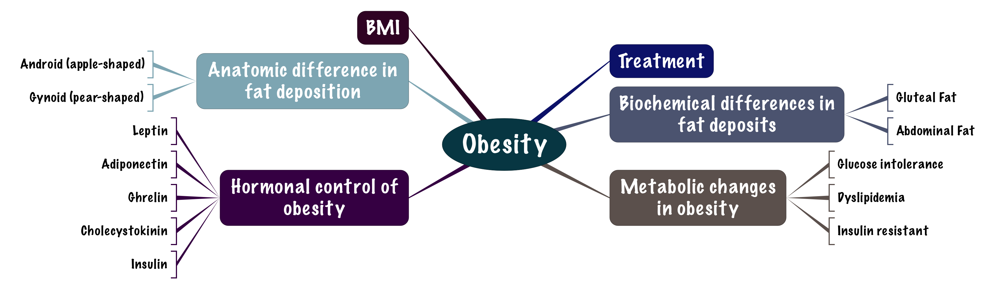
Overview
This lecture contains too many notes but it’s all super easy and understandable and most of it already known ..

Slide 4
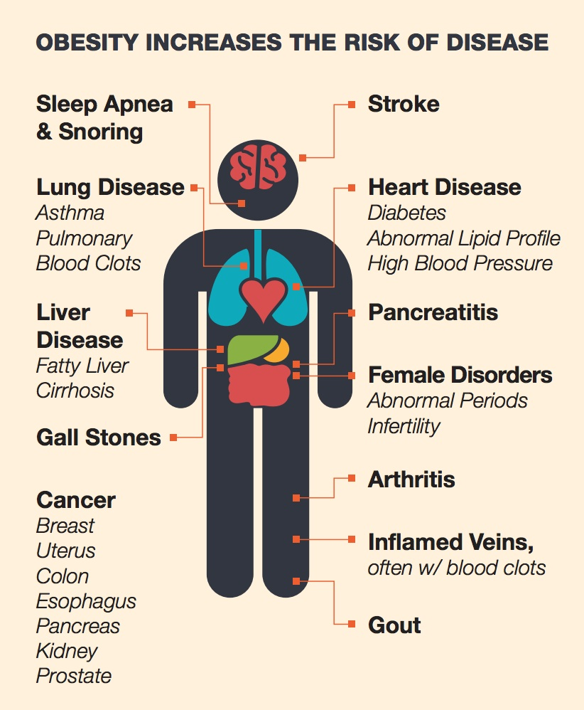
Obesity
A disorder of body weight regulatory systems.
Causes accumulation of excess body fat >20% of normal body weight.
Is overweight same as obesity? obesity is more than overweight. Obese is when you cross the line of being overweight.
It should be fat accumulation and not muscle mass and it must be > 20% of the normal weight .
What do we mean by body weight regulatory system? The body has it’s own regulatory system that controls a person’s body so if a person has been maintaining a certain weight the body tries to go to it’s memory and it becomes as a set point for it’s body and if there is a transient point like: you have a set weight of 50KG and then you’re stressed during the exam there is a chance that you’re not eating well so you’re starting loss weight in the end of the exams you have lost some weight but then as your exam finish and you’re relieved you’re start eating normally again then your body comes to it’s original weight. You’re on vacation your weight increase but then it comes to it’s normal weight, as the change goes off. But when that regulatory system is not able to bring back your weight back to it’s normal so, we’ve problem that causes obesity.
Obesity is associated with a high risk of:
    Diabetes mellitus.
    Hypercholesterolemia.
    High plasma triglycerides.
    Hypertension.
    Heart disease.
    Cancer.
    Gallstones, arthritis, gout.
    Mortality.

Slide 5
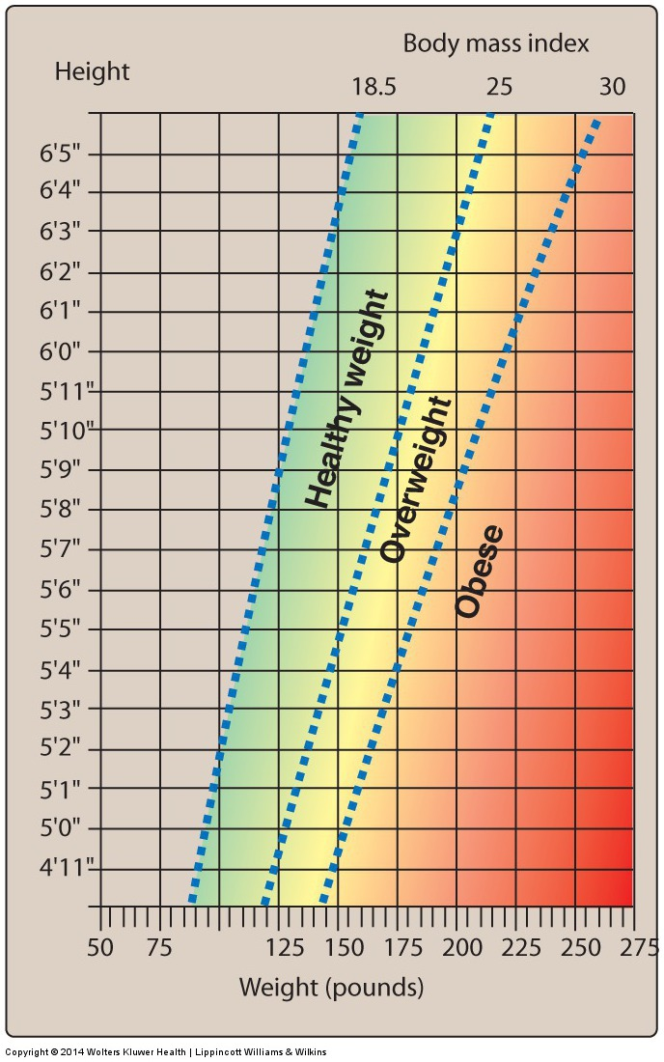
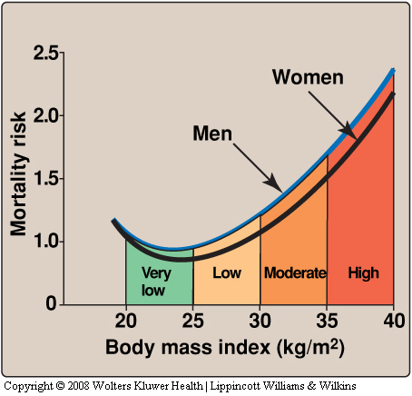
Body Mass Index (BMI)
BMI is an indirect measure of obesity.
Correlates height, weight and amount of body fat in an individual.
High BMI is associated with increased mortality risk.
 | BMI | GRADE
UNDER WEIGHT | < 18.5
NORMAL | 18.5-24.9
OVER WEIGHT | 25.0-29.9
OBESE | 30.0-34.9 | I
OBESE | 35.0-39.9 | II
HIGHLY OBESE | > 40 | III
How did we comes to these numbers and rates. We actually did the research and found how the correlation of the body weight. How the body correlate with pre mature death. The reason of death shouldn’t be accident so a natural pre-mature death so we have the weight and the height and it shows the BMI. If it’s in the range of 18.5 to 25 it’s a health range, we don’t have the graft here but it’s in Lippincott's it shows the curve. So you have the rate of premature death on the Y axis and you have the BMI on the X axis so if the BMI is lower than normal the mortality rate increases if the BMI in the health range it’s the minimum mortality rate. And as the BMI increases the mortality rate increase. To have the least mortality rate your BMI should be in healthy range.
BMI is and indirect measure of obesity:
Because muscular people have high BMI number because a muscle is much heaver than fat, so it sometimes gives a false positive that the person is obese.
When we talk about obesity and overweight we have to have certain measures to be able to differentiate the different people. There are different ways some people measure the waist circumference some people do a waist to hip ratio and one of the most generalized accepted and used ways are body mass index. What is BMI it’s the weight in KG divided by the square of height in meters.

Slide 6
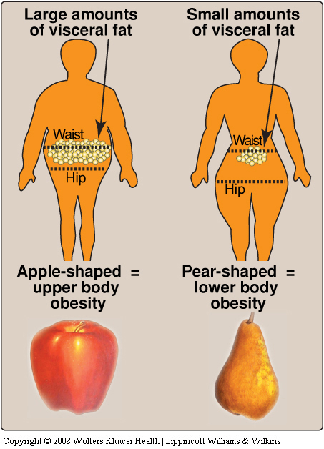
Anatomic differences in fat deposition
Health risks depend on the pattern of fat deposition.
If the fat accumulate, when we see people Everybody has a different body type but we can put them into 2 categories in the sense of how the fat is deposited in the body. If we look to the most of females body the fat is accumulated in the hip region (pear shaped body) and for the males in the abdominal region (apple shaped body) or central body deposition, which is more dangerous than the first type.
Android
Gynoid
  “apple-shaped,” or upper body obesity.
  Excess body fat deposited in the central abdominal area.
  Associated with risk of hypertension, insulin resistance, diabetes, dyslipidemia, and coronary heart disease.
      “pear-shaped,” or lower body obesity.
      Fat deposited around the hips or gluteal region.
      Associated risks are lower.
It’s risks are lower because the different regions of fat deposit it’s biochemical differ. The fat that is located under the skin it’s subcutaneous fat (it’s just stored under the skin). The fat present in the abdominal area which is the fat around the digestive system it’s the visceral omental fat, And this fat is much more dangerous because it’s much more metabolically active than the gluteal femoral region fat.

Slide 7
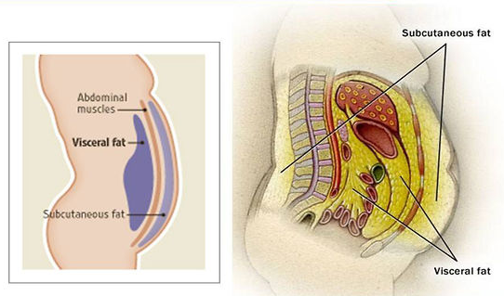
Fat Deposits
Different fat depots in the body
Subcutaneous Fat | Visceral Fat
The fat stored just under the skin in the abdominal and gluteal-femoral region. Constitutes 80-90% of the total fat in the body. | Composed of omental and mesenteric fat present in close association with digestive tract. Visceral fat is hard to lose compared to subcutaneous fat.
There is biochemical difference. So, by experience if you have seen obese people there is female has the same level of obesity and a male and both start exercising would you see a difference in their weight loss? Males loss weight faster. Because they have more muscles than fat. So even if they don’t exercise and they depend only on diet they will loss fat why? Because the male accumulate the fat in the abdominal region while the female accumulate in the gluteal region. The abdominal fat is much more metabolically active and the gluteal fat is much more slow this region it takes the fat stores it and leave it’s more difficult to loss the fat in this region (the gluteal region). Although the abdominal fat is dangerous and associated with pathological causes but it’s also has a positive things to be lost much easier.
Biochemical differences in fat deposits
Abdominal Fat | Gluteal Fat
Smaller cell | Larger cells
More responsive to hormones (both visceral and subcutaneous) | Less responsive to hormones
Release substances via portal vein to liver affect it and cause dyslipidaemia and considered as high association with insulin resistance, That’s why the abdominal fat is more dangerous because it release substances via portal vein to liver because this fat when it releases fatty acids and other things and the hormones everything goes to the liver so, it can cause insulin resistance and diabetes and dyslipidemia. Whether the gluteal fat what ever it releases it goes to the circulation it doesn’t go directly to affect the liver. | Release substances to circulation with no effect on the liver

Slide 8
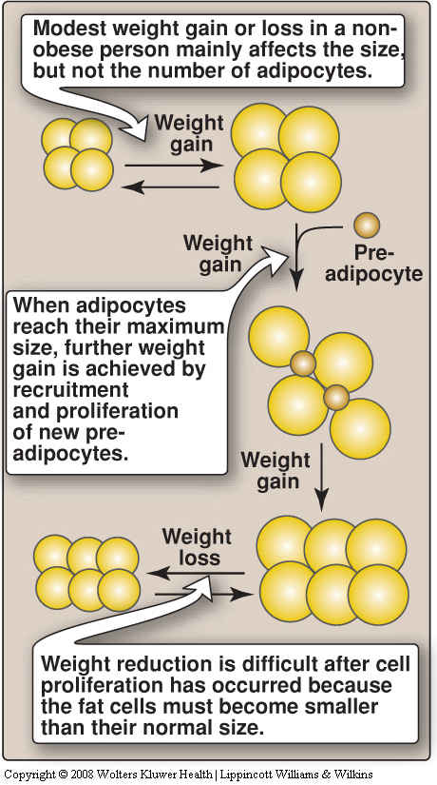
Adipocytes
  Triacylglycerols are deposited in adipocytes (fat cells) which can increase in size up to a limit.
Prolonged overnutrition stimulates
Pre-adipocytes in adipose tissue
Increases adipocyte number
Proliferation / differentiation into mature fat cells
It is hard to lose weight when the fat cells increase in number. So abdominal fat cells are smaller cells, and gluteal fat cells are large and they have more capacity to store fat, but abdominal fat is more responsive than the subcutaneous fat and the fat present in the gluteal region is subcutaneous and therefore is less responsive.
  Thus obesity is due to a combination of increased fat cell size (hypertrophy) and number (hyperplasia).
Fat cells, once gained, are never lost.
  Reduction in weight causes adipocytes to reduce in size.

Slide 9
Explanation
When you eat too much all the excess fat will be stored in the adipocytes, these adipocytes they have a size where they can store up to limit. What happens after that –if the person continue in over eating- : The adipocytes will recruits the pre-adipocytes (the stem cells) and they differentiate into adipocytes
So we have 2 things:
increase in size
increase in number.
The amount od fat that is coming to the adipose tissue is so much that the tissue is overwhelmed and it cannot store in the adipocytes then this fat spells over and become what we know as ectopic fat around your organs.
If a person is morbidly obese so, he has higher number and bigger adepocytes size then he starts losing weight There will be decrease the size of adipocytes only but the number stays the same.
if a person lost too much this person is on the douply abnormal state because now to achieve that normal weight which that person had done he’s still has the big number of his adipocytes but to reduce BMI range the size of adipocytes decreases .
The moment they get any fat they will increase in size again.
Simple extra explanation:
Increased size of adipose tissue increases the production of new mature adipose tissue to help in fat storage (increased number), so when the individual loses weight there is higher normal of fat cells which are smaller than normal and has higher susceptibility to store fat to restore their normal size so because of their increased number the person will gain weight and become obese again.

Slide 10
Factor Contributing To Obesity
Genetic: familial tendency.
Sex: women more susceptible .
Activity: lack of physical activity.
Psychogenic: emotional deprivation/depression.
Alcohol: problem drinking.
Smoking
(cessation of smoking actually!!) after they quit it they start to taste the food better and eat more.
Drugs: e.g. tricyclic derivatives.
The genetic to prove it. They did an experiment the parents was obese and they had twins one of them raised with an obese parents and the other twin raised with lean parents, results showed that both twins were obese because of genetic causes. But genetic factors can be modified, if a person has a genetic obesity which is a predisposing factor he/she can modified his/her life style and prevent being obese.
Other causes:
Stress.
Some diseases like: hypothyroidism.
Cushing’s.
The life style and eating habits
Ectopic Fat
  Excessive calories that cannot be stored in adipose tissue “spill over” into other tissues such as muscle and liver.
It is called “ectopic fat” that is strongly associated with insulin resistance.

Slide 11
Causes of weight Gain
Energy imbalance: | Calories consumed not equal to calories used. Calories consumed higher than used, which makes fat accumulate in the body overtime. Over a long period of time.
combination of several factors: | Individual behavior. Social interaction. When you go out for a walk with your friends or go to resturant, it will contribute to your life style. Environmental factors. e.g. hot weather (decrease physical activities) Genetics.
Hypothalamus: | Control center for hunger and satiety.
Endocrine disorder: Adipose tissue it self is an endocrine organ | Hormonal imbalance.
More in and less out = weight gain.

Slide 12
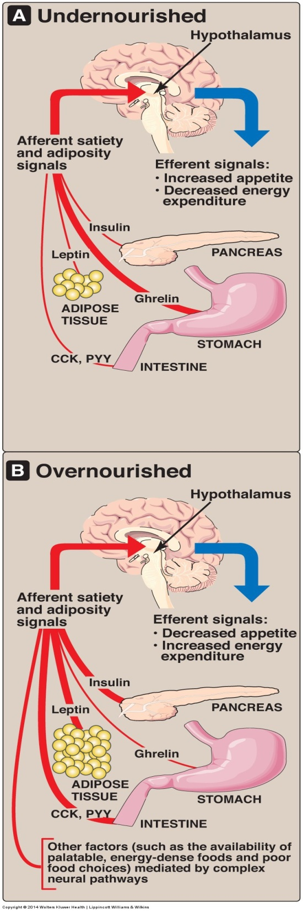
Hormonal control
Appetite is influenced by:
  Afferent neural signals, circulating hormones, and metabolites.
    These signals cause the release of hypothalamic peptides and activate efferent neural signals.
  Adipocytes also function as endocrine cells.
    They release many regulatory molecules: Leptin, Adiponectin, Resistin.
There are signals that is going to your brain that control your feeling of your satiety or hunger. If the person is undernourished your stomach will increase the secretion of hormone (ghrelin) and other signals coming from the gut like CCK, PYY or the one coming from the adipose tissue which is leptin or insulin they will be low they go and tell the hypothalamus that the state of the body is undernuorishing and the hypothalamus will send signals that will increase the appetite and then you will feel hungery to eat. When the person is overnourished all of the hormones except the ghrelin (insulin – leptin – CCK – PYY ) go and tell the hypothalamus that the person is fed and not hungry, so the hypothalamus will send the signals that decreases appetite (satiety) and the energy expenditure.

Slide 13
Leptin
Leptin Resistance
A protein or peptide hormone produced by adipocytes that is required to keep the body weight under control.
    Signals the brain about fat store levels.
    More fat in the body = more leptin secretion. So leptin tells the brain that body is will fed and induces satiety, decreases appetite and increases energy expenditure.
Regulates the amount of body fat by:
    Controlling appetite and energy expenditure.
Leptin secretion:
    Suppressed in starvation (depletion of fat stores).
    Enhanced in well-fed state (expansion of fat stores).
Leptin causes overweight mice to lose weight and maintain weight loss but not in humans.
Leptin increases metabolic rate and decreases appetite in humans.
  Plasma leptin level in obese humans is usually normal for their fat mass
Resistance to leptin has been found in obese humans.
Mechanism? The receptor for leptin in the hypothalamus is produced by db gene and mutation in the db gene causes leptin resistance in mice
Leptin resistance may have some role in human obesity:
      Dieting decreases leptin levels. Loss of fat stimulates leptin levels to go up and increases appetite and reduces metabolism.
      Reducing metabolism, stimulating appetite.

Slide 14
Adiponectin
A protein hormone exclusively and abundantly secreted by adipocytes .
  Adiponectin levels are inversely correlated with body fat percentage and parallels with HDL levels the good cholesterol (the good guy =P).
Low levels are seen in metabolic syndrome and diabetes mellitus.
Effect :
So, the fatty acids that present in the plasma it promotes the uptake of that and the glucose by tissues & that it’s basically improving the glucose tolerance and insulin resistance .
  Promotes uptake and oxidation of fatty acids and glucose by muscle and liver.
Blocks the synthesis of fatty acids and gluconeogenesis by hepatocytes.
Net effect is to increases insulin sensitivity / improve glucose tolerance.
(adiponectin regulates your fat metabolism and glucose metabolism so when it decreases the metabolism will be affected)

Slide 15
Other Hormones
GHRELIN | CHOLECYSTOKININ | INSULIN
A peptide hormone secreted by stomach. Right away before your meal time | Peptides | -
Secretion increases just before meals and drops after meals. Peaks and drops | released from the gut after a meal. | -
Stimulates appetite: It tells the body that you need to eat الام الحنون =( increases food intake. Decreases energy expenditure and fat catabolism. | Sends satiety signals to the brain. | Promotes metabolism
Levels of ghrelin in dieters are higher after weight loss. The body steps up ghrelin production in response to weight loss. The higher the weight loss, the higher the ghrelin levels. When you loose large amount of weight in a very short time there will be an imbalance signals by your body which increases your ghrelin levels because the body is not adapted with the new weight with excess ghrelin you eat, and your weight returns rapidly | - | -
    Dyslipidemia.
    Glucose intolerance.
    Insulin resistance.
Metabolic Changes in Obesity
Adipocytes send signals that cause abnormal metabolic changes such as:

Slide 16
Treatment options
Benefits of weight loss in obesity
  Physical Activity combined with healthy diet decreases level of obesity Reduces risk of heart disease and diabetes
Dieting:
    Use of low-calorie diet
    Restriction of excessive energy intake
    Lower blood pressure.
    Decreased serum triacylglycerols.
    Lower blood glucose levels.
    Increase in HDL levels.
    Decreased mortality.
    Beneficial changes in BMR.
    Decreased energy requirement.
    Slow weight loss is more stable.
The first thing to do is the modifying life style because if we go directly to the surgery or drugs without modifying the life style he will gain the weight again.
DRUGS | SURGERY
Orlistat. A pancreatic and gastric lipase inhibitor. Decreases the breakdown of dietary fat. Causes fatty stool because it will not let the body to digest and absorb fat. | Surgical procedures are designed to reduce food consumption in patients with BMI >40 the last option Used when other treatment options fail Many clinics tell the patient to lose 5% of his weight before treatment because they want to make sure that he will modify his life style after the treatment. Has multiple types: sleeve, bypass, ect..
Lorcaserin. Promotes satiety.
Tell the patient to eat healthy food not high calories food.
BMR = Basal metabolic rate

Slide 17
Summary
Definition | A disorder of body weight regulatory system . Accumulation of body fat >20%.
Risk factors | Diabetes Hypocholesteremia High plasma Triglycerols Hypertension Heart disease Cancer Gallstones , arthritis , gout Mortality
Causes | Energy imbalance Individual behavior , Environmental factors , Genetics Hypothalamus (Controls satiety and hunger) Endocrine disorders (Hormonal imbalance)
Factors Contributing | Genetic (Familial tendency) Sex (Women are susceptible ) Activity (Lack of physical activity) Psychogenic (Emotional deprivation ) Alcohol (Problem drinking) Smoking (Cessation of smoking) Drugs (Tricyclic derivatives)
Anatomic Differences in fat deposition:
Android Obesity | Gynoid obesity
Apple shaped , central , upper bpdy obesity . | Pear shaped , or lower body obesity
In the Abdominal area | Around the gluteal and hips region
Most common in men | Most common in women

Slide 18
Summary
Fat deposits
Subcutaneous fat | Visceral fat
Fat stored under the skin in abdominal and gluteal region Constituets 80-90% of total fat in body | Composed of omental and mesenteric fat present in close association with digestive system
Leptin | Adiponectin | Others
Keeps body weight under control . Signals brain about fat level stores . Controls appetite and energy expenditure . Leptin resistance is due to db gene mutation and has been found in obesed humans . | Promotes the uptake and oxidation of fatty acids and glucose by muscles and liver . Blocks synthesis of fatty acids and gluconeogenesis by hepatocytes . Net effect increases the sensitivity to insulin and improve glucose tolerance | Ghrelin : Secretes between meals , stimulates apetite . The higher the weight loss the higher the ghrelin levels CCK: satiety signals to brain Insulin : promotes metabolisim
Treatment options Physical activity combones with healthy diet Drugs (Orlistat, Lorcaserin) Surgery
Biochemical differences in fat deposition
Abdominal fat | Gluteal fat
Smaller cells | Large cells
More responsive to hormones (both visceral and subcutaneous ) | Less responsive to hormones .
Release substances bia portal vein to liver | Release substances to circulation with no effect on liver

Slide 19
QUIZ
Q1 : Which one of the following choices is associated with insulin resistance?
Abdominal fat
Gluteal fat
Ectopic fat
Subcutaneous fat
Q2 : 18 year old overweight teenager, came to your clinic complaining of inability to lose weight even though he tried dieting, he suggested that you do a sleeve for him.
But since you’re a good doctor and understand the complications, you refused and gave him a therapy that would cause him to lose weight.
Which of the followings hormones when increased , causes weight loss?
Ghrelin
Leptin
Resistin
Adiponectin
Q3 : Which one of the following is expected to be in high levels after weight loss?
Q4 : Which one of the following is correct about Leptin?
Increases insulin sensitivity
Secretion suppressed in starvation
Secretion suppressed in expansion of fat stores
Causes thin mice to become overweight
Q5 : Which one of the following choices defines obesity?
Fat cell hypertrophy
Fat cell hyperplasia
Fat cell deposition
A+B
Q6 : Which one of the following is the function of Adiponectin?
Blocks synthesis of fatty acids
Decreases insulin sensitivity
Decreases glucose tolerance
Inversely correlated with HDL levels
Ghrelin
Leptin
Resistin
Adiponectin

Slide 20
QUIZ
Q7 : 21 year old girl came to your clinic because her medical student friend insisted you are the best endocrinologist on earth. (same girl in previous SAQs)
She says that she is worried about her body image because she is a bit overweight & unable to lose weight.
She came to ask you questions about how she can lose weight and how her current state of body affects her.
A) Can you tell me 3 disease associated with obesity?
Diabetes mellitus
Hypercholesterolemia
High plasma triglycerides
Hypertension
Heart disease
Cancer
Gallstones, arthritis, gout
B) Tell me 3 hormones involved in appetite .
Leptin
Ghrelin
Cholecystokinin
C) What are the metabolic changes in obesity and what is responsible for them?
Dyslipidemia
Glucose intolerance
Insulin resistance
  Adipocytes send signals that cause these abnormal metabolic changes.
D) What is the possible treatment for my current weight?
Physical activity combined with a healthy diet.
E) Tell me 2 drugs that can be used for losing weight & how do they work?
Orlistat: Pancreatic and gastric lipase inhibitor → decreases the breakdown of dietary fat
Lorcaserin: promotes satiety
Suggestions and recommendations
1) C 2) B 3) A 4) B 5) D 6) A

Slide 21
Saud alshnaifi
Abdulrahman alrashed
Abdulaziz algarmoushi Abdulaziz alhusaini
Haifa bin taleb
Hanin alsubki
Hanin bashaikh

