Slide 1

Biochemistry
Editing file
Metabolic Changes in Diabetes Mellitus
Don't Stop when you are Tired. Stop When You are Done.
- Unknown

Slide 2
By the end of this lecture, the student should be able to understand:
1-The differences between type 1 and type2 DM
2-The natural course of type 1 and type 2 DM
3-The diagnostic criteria for DM
4-The metabolic changes in DM including: increase of hepatic glucose output, decrease of glucose uptake,
and inter-organ relationship in T1DM and T2DM
5-The mechanisms of diabetic complications.

Slide 3
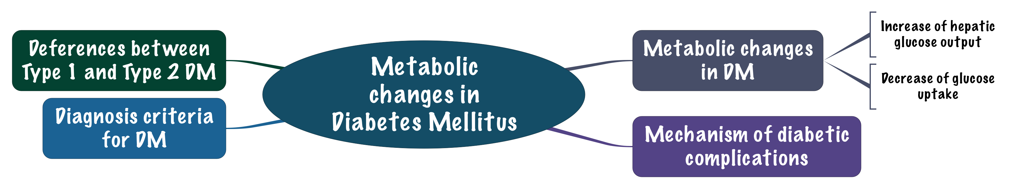
Overview

Slide 4
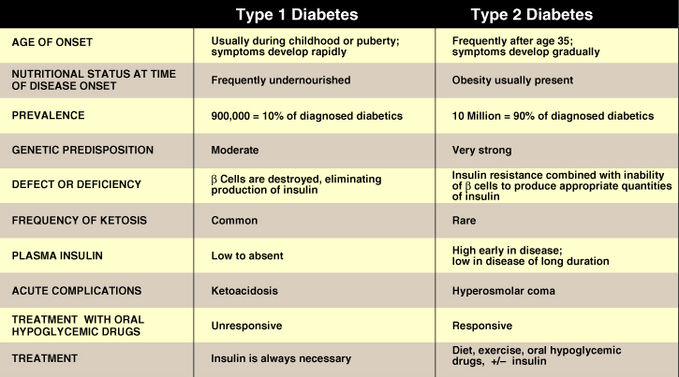
Comparison of type 1 and type 2 DM
Definition of diabetes:
1-Diabetes is an endocrine disease or a problem due to absolute or relative deficiency of insulin.
2-It is a combination of chronic diseases with underline hyperglycaemia because there are chronic complications associated with diabetes but the main feature is hyperglycaemia
Usually people don’t know that they have type 2 and they discover it by coincidence
In the beginning of type 2 the level of insulin will be high because of compensatory mechanism, but after longer duration the level will goes down because of dysfunctional beta cells, While in type 1 it will absent from the beginning Because of beta cells destruction.
Hyperosmolar hyperglycemic state = Coma

Slide 5
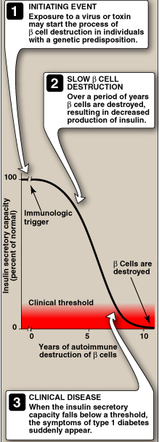
Natural course of T1DM
these people are genetically redisposed to autoimmune disease.
they has to be an initiating even like viral infection (immunologic trigger) and this trigger cause T-cell infiltration into islets of Langerhans and they start to attack beta cells which called Insulitis.
Then the insulin level will decreases gradually but you will not see any symptoms because this level is still sufficient to maintain glucose level.
After when 80%-90% of beta cells have died then you will able to see the clinical symptoms, and when the symptoms appears the progression will be fast.
So, if you see the clinical symptoms that's mean the remaining insulin secretory capacity is only 10%-20% (the clinical threshold).
We call it absolute insulin deficiency because it doesn’t produce insulin at all.

Slide 6
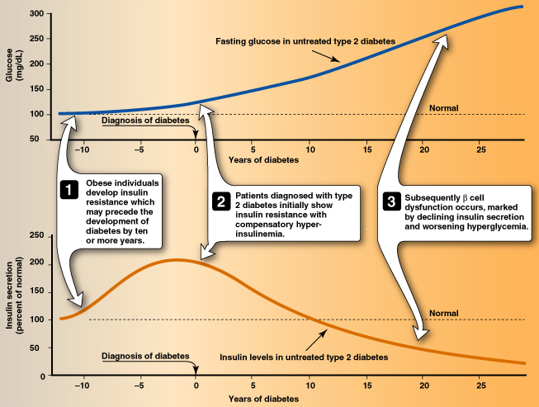
Progression of T2DM
To maintain this high glucose level in insulin resistance patients the body needs more insulin as compensation.
after time the insulin will not be sufficient to control the glucose level and it will raise up at this time you will diagnose type 2 DM.
If you not treat the patient the high level of glucose will start act as a toxic and it will cause dysfunction of beta cells, that will reduce the level of insulin, But even when the disease progressed there will be some amount of insulin production, and this small amount of insulin is enough to stop Ketone bodies formation, that's why diabetes ketoacidosis is not a complication of type 2 DM.
10 years before the diagnosis

Slide 7
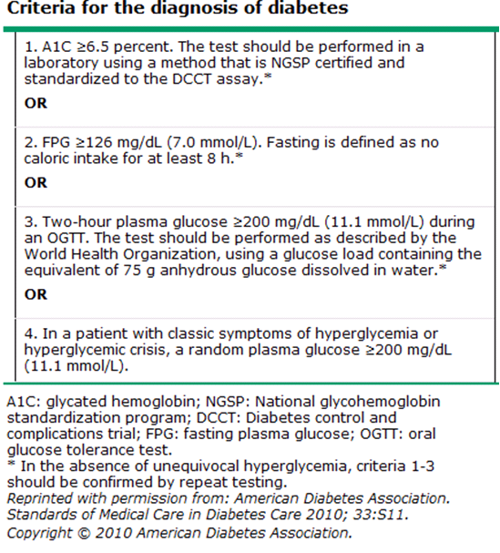
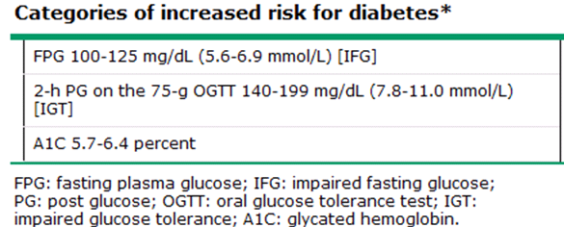
Criteria for Diagnosis of DM
(Pre-diabetic)
These people can delay the disease onset by modifying their life style.
American Diabetes Association (ADA), 2016

Slide 8
HEMOGLOBIN A1C & Metabolic Effects of Diabetes Mellitus
Hemoglobin A1C :
is the result of non enzymatic covalent glycosylation of hemoglobin. | Hemoglobin A1C:
It is used to estimate glycemic control in the last 1-2 months. Because the life span of RBCs. A1C and fasting plasma glucose (FPG) were found to be similarly effective in diagnosing diabetes. But to monitor the progression of the disease or treatment A1C is more effective, because it tells you about what happened in long prided of time. | Used for
A1C cut-off point of ≥6.5 % is used to diagnose diabetes. A1C values also correlate with the prevalence of retinopathy Assays for A1C has to be standardized according to the National Glycohemoglobin Standardization Program (NGSP). Recently, A1C is recommended for the detection of T2DM. | notes

Slide 9
Metabolic Effects of Diabetes Mellitus
Metabolic Effects of Diabetes Mellitus :
  Absolute or relative insulin deficiency → absolute as in T1DM(complete lack of insulin activity),relative as in T2DM(about 10% of insulin activity is conserved .
  ↓ Glucose uptake (by muscle & adipose tissue)
  ↑ Glucose production (from liver). By gluconeogenesis

Slide 10
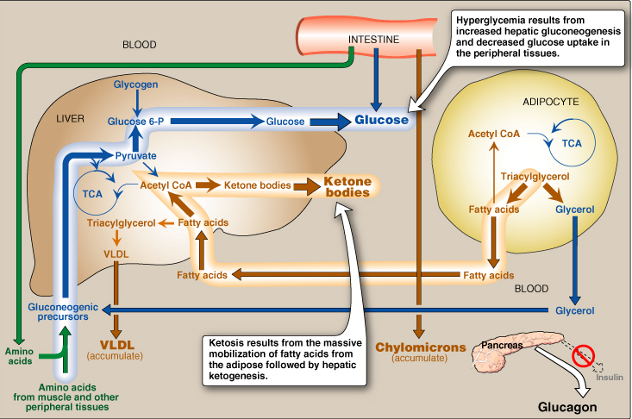
Intertissue Relationship in T1DM
1- When you eat normally insulin will be secreted but in type 1 DM There is no insulin secretion, instead of insulin glucagon will secreted.
2- the amino acid will be gluconeogenic precursors (they will be used in gluconeogenesis).
3- you will have a lot of glucose from food and gluconeogenesis.
4- in this situation and because of there is No uptake of glucose due to lack of insulin your adipocyte will break down TAGs into glycerol (which used in gluconeogenesis), and fatty acid.
5- the fatty acid will goes into liver where they synthesize Ketone bodies, also they participate in the production of VLDL. So the excess amount fatty acids will cause excessive Ketone bodies formation which called Ketosis.
- So you will have Hyperglycemia, dyslipidemia and Ketosis in type 1 diabetes.
by insulin-sensitiveGLUT-4 of adipose tissue and muscle
3
4
5
1
2

Slide 11
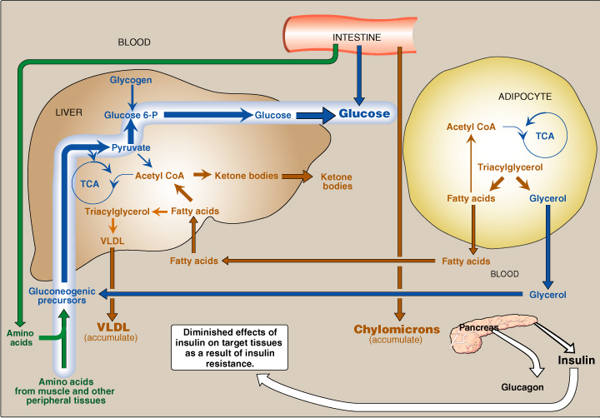
Intertissue Relationship in T2DM
The same mechanism in type 2 BUT, because we have some insulin releasing that will uptake a little amount of glucose inside the muscles and adipose tissues, and that’s why the amount of fatty acid that produced here is not so much as the type 1 DM, And that’s why type 2 DM patients are obese while type 1 are not!!
There is Ketone bodies formation but will not cause Ketosis because their amount is not very high

Slide 12
Major Metabolic changes in DM
Absolute or relative insulin deficiency
Multiple metabolic effects
CHO metabolism
↓ Glucose uptake by certain tissues (adipose tissue & sk. muscle)
↑ Glycogenolysis
↑ Gluconeogenesis
Lipid metabolism
↑ Lipolysis
↑ Fatty acid oxidation
↑ Production of Ketone bodies (in liver). Much worse in type 1.
Protein metabolism
↓ Protein synthesis
↑ Protein degradation

Slide 13
Mechanisms of Increase Hepatic Glucose Output & Decrease of Peripheral Glucose Uptake:
Mechanisms of Increase Hepatic Glucose Output
Mechanisms of Decrease of Peripheral Glucose Uptake
↓ Insulin
Muscle
Adipose Tissue
↓ Inhibitory effect on glucagon secretion
↓ Insulin
↓ Insulin
↑Glucagon
Glucose & amino acid uptake.
↑ Protein breakdown.
↓ Glucose uptake
↑Plasma glucose
↑Gluconeogenesis & glycogenolysis
(Liver)
↑Plasma glucose
↑Plasma amino acids
↑Plasma glucose

Slide 14
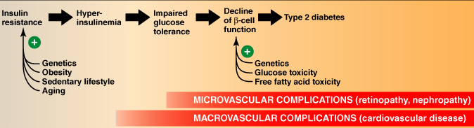
Mechanisms of Diabetic Complications
Typical Progression of T2DM
And nephropathy

Slide 15
General Mechanisms for Diabetic Microvascular Complications
General Mechanisms for Diabetic Microvascular Complications:
  In chronic hyperglycemia :
    ↑ Advanced Glycation End products (AGEs) of essential cellular proteins → cellular defects protein get glycated Like hemoglobin A1C and these glycated proteins may cause inflammation
    ↑Intracellular sorbitol → ↑ cell osmolality → cellular swelling. Alcoholic form of glucose, which is osmotically active so it brings the fluids inside the cells and causes cellular swelling
    ↑ Reactive Oxygen Species (ROS) → oxidative stress → cell damage
1. Advanced Glycosylation End Products (AGEs):
AGEs may cross link with collagen > microvascular complications
Chronic hyperglycemia
non-enzymatic combination between excess glucose & amino acids in proteins
formation of AGEs
The interaction between AGEs and their receptor (RAGE) may generate reactive oxygen species (ROS) > Inflammation

Slide 16
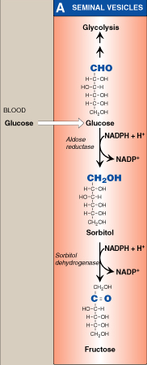
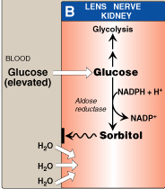
General Mechanisms for Diabetic Microvascular Complications
Pathway of sorbitol production
Sorbitol Formation & Metabolism
2. Polyol pathway:
    Glucose is metabolized to sorbitol within the cells by aldose reductase
    The role of sorbitol in the pathogenesis of diabetic complications is uncertain. Hypotheses are:
    During sorbitol production, consumption of NADPH → oxidative stress.
    Sorbitol accumulation:
    Increase the intracellular osmotic pressure → osmotic drag of fluid from extracellular space → cell swelling
    Alteration in the activity of PKC (Protein kinase C) → altered VEGF (Vascular Endothelial Growth Factor) activity→ altered vascular permeability
Some tissues like ovaries can convert sorbitol into Fructose because they have sorbitol dehydrogenase, but most of the tissues don’t have this enzymes
Conversion of Sorbitol into Fructose

Slide 17
Microvascular Complications :
3.Diabetic Nephropathy: | 2.Diabetic Neuropathy: | 1.Diabetic Retinopathy:
Occurs in both type 1 & type 2 DM The earliest clinical finding of diabetic nephropathy is microalbuminuria: (the persistent excretion of small amounts of albumin (30-300 mg per day) into the urine) Microalbuminuria is an important predictor of progression to proteinuria: (the persistent excretion of >300 mg albumin per day into the urine) Once proteinuria appears, there is a steady ↓ in the glomerular filtration rate (GFR) Finally, end-stage renal disease occurs | Loss of both myelinated and unmyelinated nerve fibers. Occurs in both type 1 & type 2 DM It correlates with the duration of DM & with glycemic control | A progressive microvascular complication of DM, affecting the retina of the eye A major cause of morbidity in DM (→blindness) Its prevalence ↑ with increasing duration and severity also of disease in both type 1 & 2 DM After 20 years of the disease: - Is present in almost all T1DM - Is present in 50 – 80% of T2DM
Sequence of Events in Diabetic Nephropathy
End-stage renal disease
Microalbuminuria
Glomerular hyperfiltration
Proteinuria & ↓GFR

Slide 18
Summary
CHO metabolism
↓ Glucose uptake by certain tissues (adipose tissue & muscle)
↑ Glycogenolysis
↑ Gluconeogenesis
↑ Glucose production (liver)
Criteria for Diagnosis of DM
 | Increased risk for diabetes | Diabetes mellitus
FPG | 100-125 mg/dl 5.6-6.9 mmol/L | = or >126 mg = or >7 mmol/L
2-h PG on the 75g OGTT | 140-199 mg/dl 7.8-11 mmol/L | = or >200 mg = or > 11.1 mmol/L
HbA1C | 5.7-6.4 % | > 6.5 %
Lipid metabolism
↑ Lipolysis
↑ Fatty acid oxidation
↑ Production of Ketone bodies
Protein metabolism
↓ Protein synthesis
↑ Protein degradation
Major Metabolic changes in DM
Hemoglobin A1C (A1C) is the result of non enzymatic covalent glycosylation of hemoglobin
It is used to estimate glycemic control in the last 1-2 months
Recently, A1C is recommended for the detection of T2DM
A1C and fasting plasma glucose (FPG) were found to be similarly effective in diagnosing diabetes.
A1C cut-off point of >6.5 % is used to diagnose diabetes.
A1C values also correlate with the prevalence of retinopathy
Assays for A1C has to be standardized according to the National Glycohemoglobin Standardization Program (NGSP)
HEMOGLOBIN A1C

Slide 19
QUIZ
Q1 : Which one of the following metabolic changes is correct in Diabetes Mellitus?
Increased Protein synthesis
Increased Protein degradation
Increased Glucose Uptake
Decreased Protein degradation
Q2 : Which one of the following may cross link with AGEs?
Glucose
Proteins
Keratin
Collagen
Q3 : Which one of the following is a complication of sorbitol accumulation?
Decreased gluconeogenesis
Retinopathy
Alteration of vascular permeability
Insulin resistance
Q4 : Which one of the following is the earliest clinical finding of diabetic nephropathy?
Nephrotic syndrome
Microalbuminuria
Glucosuria
Proteinuria
Q5 : Microalbuminuria progresses into which of the following?
Nephritic syndrome
Pyelonephritis
Glucosuria
Decreased GFR
Q6 : Which one of the following is a macrovascular complication?
Nephropathy
Retinopathy
Cardiovascular diseases
Neuropathy

Slide 20
QUIZ
Q7 : 2 year old boy came to your clinic with his parents.
They say that he has been needing a lot of diapers changed lately because of his frequent passing.
The mother also noticed that there is a strong fruity smell coming from his urine.
A) How can glucose hepatic output increase in diabetes mellitus ?
Decrease in insulin leads to decreased inhibition of glucagon secretion which in turn increases glucagon levels, causing a negative feedback of increased gluconeogenesis and glycogenolysis in the liver
Thus leading to increased plasma glucose.
B) Mention 3 complications that are associated with diabetes mellitus.
Diabetic Nephropathy
Diabetic Neuropathy
Diabetic Retinopathy
C) What are the factors that induce insulin resistance?
Genetics
Obesity
Sedentary lifestyle
Aging
D) How are Advanced glycosylation end products (AGEs) formed?
Chronic hyperglycemia leads to non-enzymetic combination between excess glucose and amino acids which leads to formation of AGEs
Suggestions and recommendations
1) B 2) D 3) C 4) B 5) D 6) C

Slide 21
Saleh altwaijri
Abdulrahman almalki
Abdulaziz alhusaini
Abdulrahman alrashed
Mohannad alzahrani
Jawaher Alkhayal
Ameerah Nyazi
Bushra Quqandi

