Slide 1
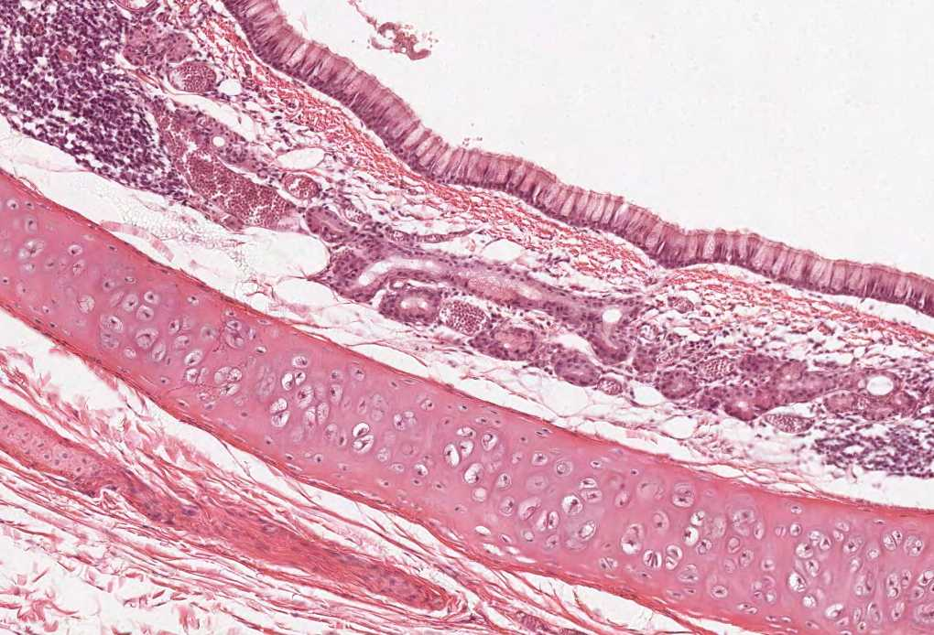
Pituitary Gland
Color index:
Slides.. Important ..Notes ..Extra..

Slide 2
Objectives:
By the end of this lecture, the student should be able to describe:
The microscopic structure of the different parts of the pituitary gland in correlation with their functions.
The hypophyseal portal circulation; components and significance.

Slide 3
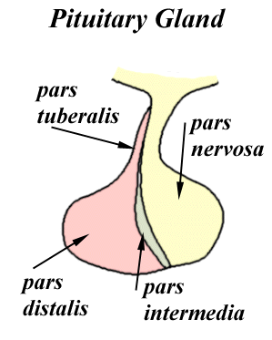
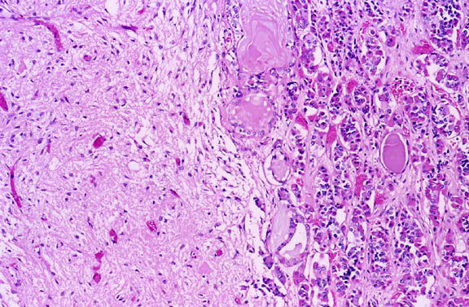
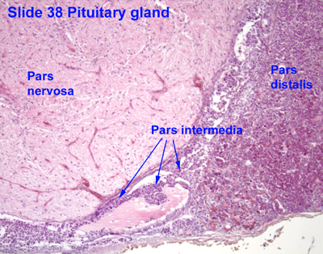
Pituitary Gland Components
(B) NEUROHYPOPHYSIS CEREBRI: Neurohypophysis is developed embryologically from the nervous tissue of the brain, but IT DOESN’T CONTAIN NEURONS (VERY IMPORTANT) | ADENOHYPOPHYSIS CEREBRI: “Adeno” from adenohypophysis refers to an endocrine gland derived from epithelial cells
1- Median eminence 2- Infundibulum: Neural (Infundibular) Stalk (stem) 3- Pars Nervosa | 1- Pars Distalis (pars anterior) 2- Pars Tuberalis 3- Pars Intermedia
Only in Boys slide and in ME objectives
Blood supply:
1- R & L Superior hypophoseal arteries:
To median eminence and neural stalk
Hypophoseal portal system: Carries neurohormones from median eminence to adenohypophysis.
Primary capillary plexus of fenestrated capillaries
To hypophoseal portal veins (or venules)
To 2ry capillary plexus of capillaries in adenohypophysis.
2- R & L Inferior hypophoseal arteries:
To pars nervosa, they don’t participate in the hypophoseal portal circulation.
The pituitary gland is supplied by fenestrated blood capillaries, and they are rich here because they carry hormones to the circulation

Slide 4
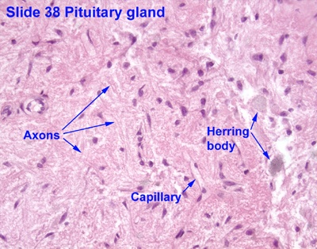
Posterior Lobe: PARS NERVOSA
Contents:
Unmyelinated axons of secretory neurons situated in supraoptic & paraventricular nuclei (i.e. Axons of hypothalamo-hypophyseal tract). *-cell bodies are in the hypothalamus and their axons form tract Function: Storage & release of: Vasopressin (ADH) by supraoptic nuclei Oxytocin by paraventricular nuclei Oxytocin hormone is responsible for contraction during labor and lactation (pushing of the milk from mamillary glands)
2. Fenestrated blood capillaries
3. HERRING BODIES: Are distentions of the axons in pars nervosa. Representing accumulation of neurosecretory granules at axon termini and along the length of the axons in pars nervosa. Herring bodies = dilated terminal end of the axons
4. Pitucytes: glial-like cells in pars nervosa. Structure: Have numerous cytoplasmic processes. Functions: Support the axons of the pars nervosa.
N.B. No secretory or neuronal cells in pars nervosa.
IT IS EXTREMELY IMPORTANT to know that pars nervosa DOES NOT contain neuronal cells

Slide 5
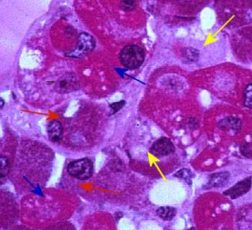
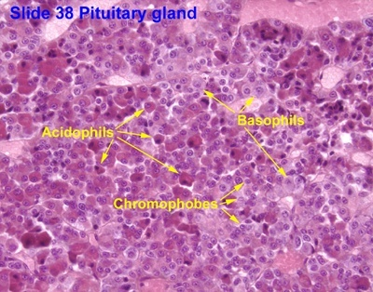
Anterior Lobe: PARS DISTALIS نشبه البارس ديستاليس بكيس مليان كور واحنا نبي نفرق بين هذي الكور، الكور هي السيلز والتفرقة تكون بالصبغة
Contents:
Parenchymal cells - Types
(2) Chromophobes: | Chromophils:
may represent : 1- stem cells. 2- degranulated chromophils. 3- degenerated cells. Chromophobes are cells that dislike staining, they represent 52% of the cells in Pars distalis | b- Basophils: 1- Thyrotrophs (TSH Cells) TSH stands for thyroid stimulating hormone 2- Gonadotrophs (Gonadotropic cells) (FSH, LH) LH stands for luteinizing hormone 3- Corticotrophs (ACTH cells) Corticotrophs are responsible for the production of cortisol but not directly, it stimulates glands in the adrenal cortex to produce it | a- Acidophils: We differentiate between the cells of acidophils by immunohistochemistry and electron microscope 1- Somatotrophs (GH cells) 2- Mammotrophs (Prolactin cells): Increase during lactation. formation of milk)
Blue arrow: acidophils Red arrow: basophils Yellow arrow: chromophobes

Slide 6
MCQs
1\Pars Distalis is one of the components of:
A-Neurohypophysis cerebri.
B-Adenohypophysis cerebri.
C-Both A&B.
4\which cell type of the following is considered Acidophils:
A- Corticotrophs.
B-Mammotrophs.
c-Thyrotrophs.
2\Inferior hypophyseal Arteries supplies:
A-pars nervosa.
B-Neural stalk.
C-Median eminence of hypothalamus.
5\Which cell type of the following secretes growth hormone:
A-Gonadotrophs.
B-Corticotrophs.
C-Somatotrophs.
3\The Storage & release of Vasopressin is one of the functions of:
A-Unmyelinated axons of secretory neurons.
B-Herring bodies.
C-Pitucytes.
1-b
2-a
3-a
4-b
5-c

Slide 7
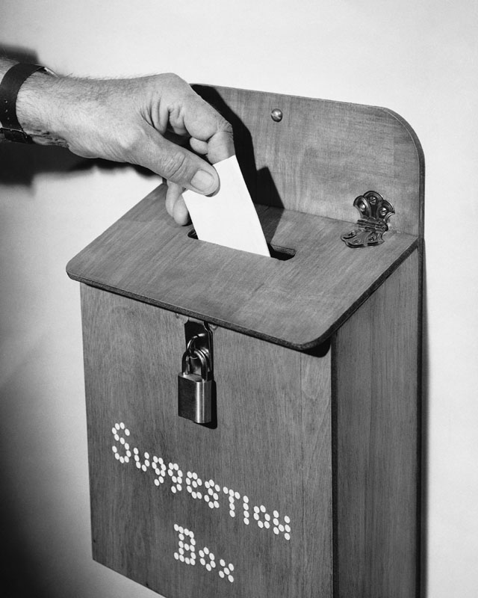
Thank you & good luck
- Histology team
Done by:
Amal AlQarni
Allulu Alsulayhim
Do’aa Walid
Shahad AlAnzan
We’am Babaier
Team leaders:
Rana Barasain
Faisal Alrabaii
References:
Females’ and Males’ slides.
Doctors’ notes

