Slide 1
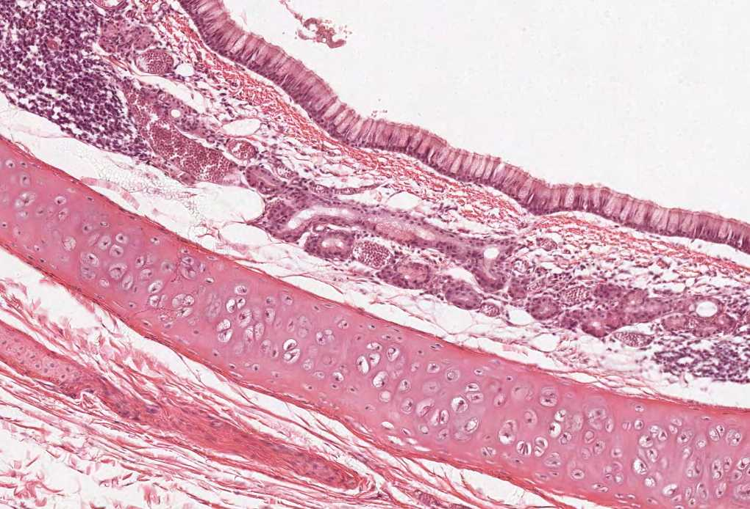
THYROID & PARATHYROID GLANDS
Color index:
Slides.. Important ..Notes ..Extra..

Slide 2
Objectives:
By the end of this lecture, the student should be able to:
Describe the histological structure of thyroid & parathyroid glands.
Identify and correlate between the different endocrine cells in thyroid gland and their functions.
Describe the functional structure of parathyroid cells

Slide 3
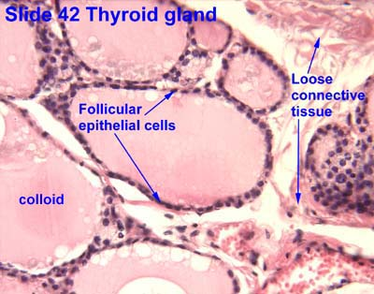
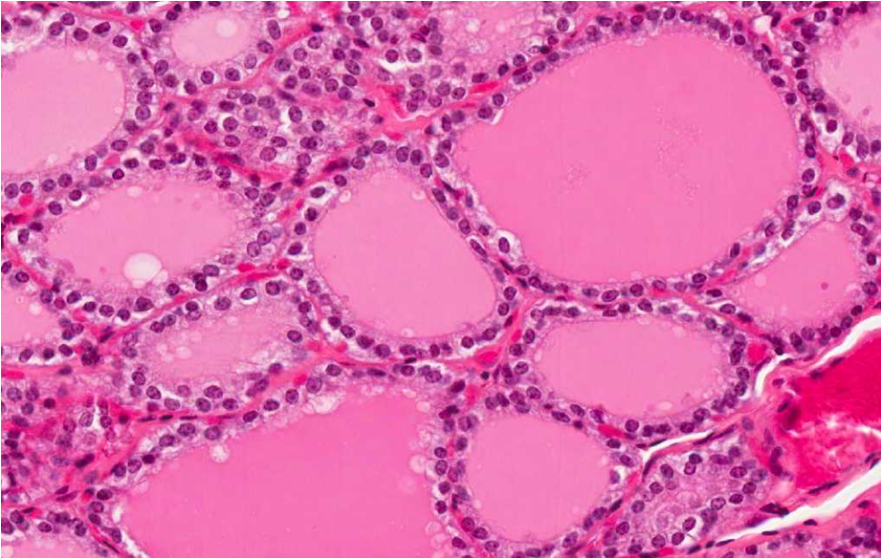
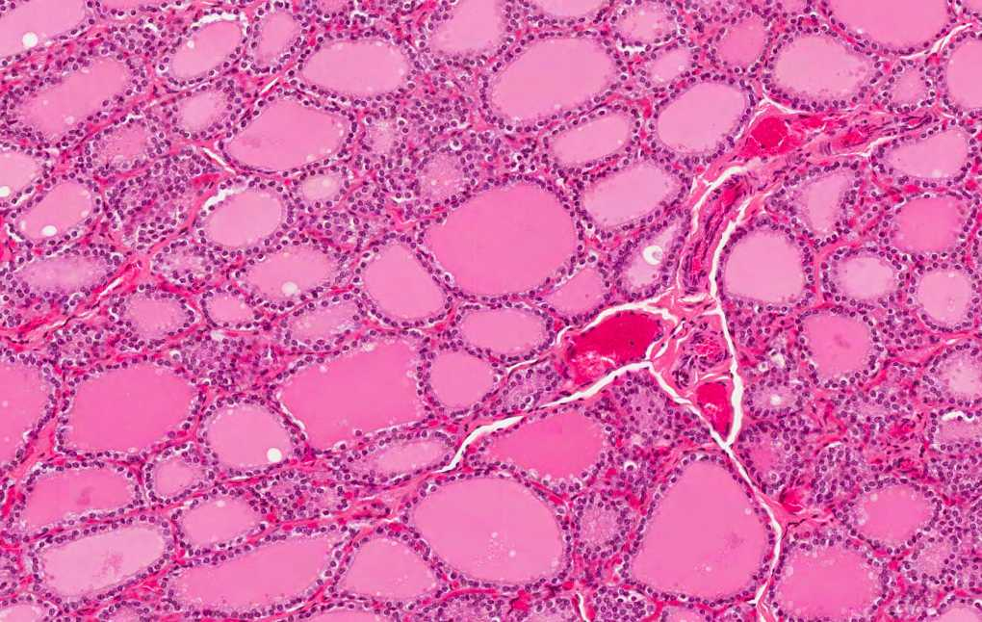
THYROID GLAND
Stroma
1- Capsule: dense irregular collagenous C.T.
Parenchyma
Are the structural and functional units of the thyroid gland. (synthesis of protein)
3- Reticular fibers:
Thin C.T., composed mostly of reticular fibers with rich capillary plexus* surrounds each thyroid follicle (separation)
2- Septa: (Interlobular septa)
L/M:
1- Simple cuboidal epithelium:
N.B. Each follicle is surrounded by thin basal lamina. To separate the epithelium from the C.T.
2- Colloid: central colloid-filled lumen. (gel like material - highly vascular - without blood capillaries nor cells)
b- Parafollicular cells.(Minor, larger)
a- Follicular cells. (Major . Small)
Parafollicular cells
Follicular cells
Colloid
*They are fenestrated blood capillaries

Slide 4
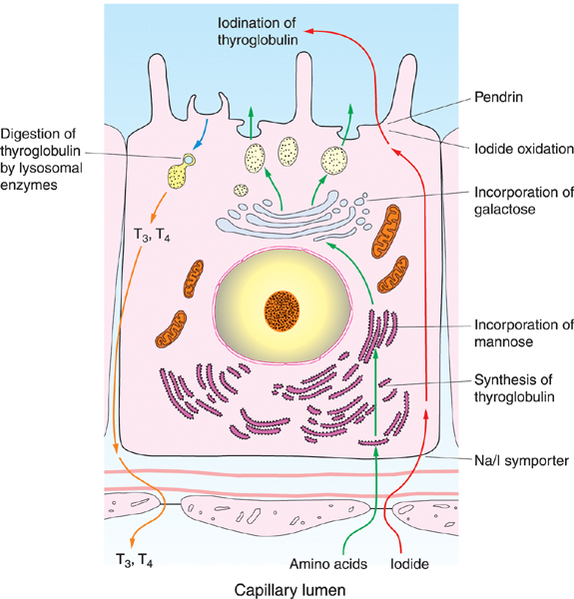
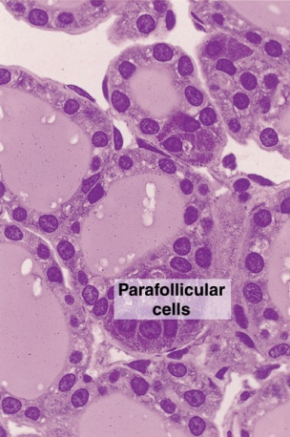
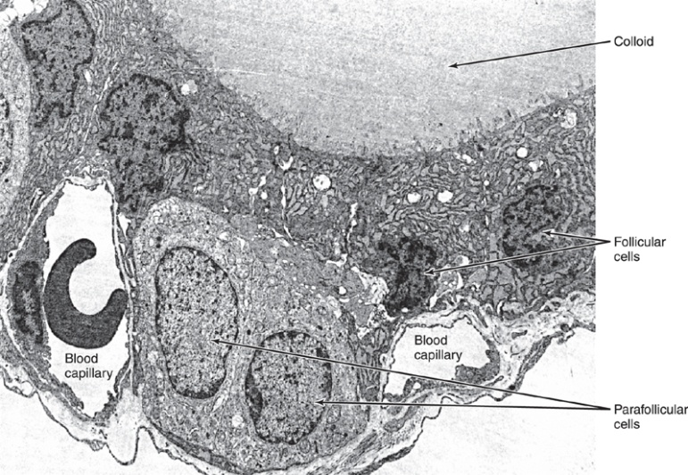
1- FOLLICULAR (PRINCIPAL) CELLS
Function:
Synthesis of
thyroid hormones (T4 & T3).
Electron microscope | Light microscope
Mitochondria. RER Supranuclear Golgi Complex. Numerous apically-located lysosomes. (lysosomes are needed to free the T3&T4 from thyroglobulin) Numerous dispersed small vesicles: - contain newly formed thyroglobulin. - Numerous apical short microvilli. (for the endocytosis of colloid) | Simple cuboidal cells Round nucleus with prominent nucleoli. Basophilic cytoplasm. Apical surface reaches the lumen of the thyroid follicle.

Slide 5
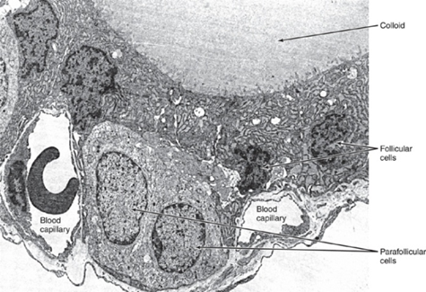
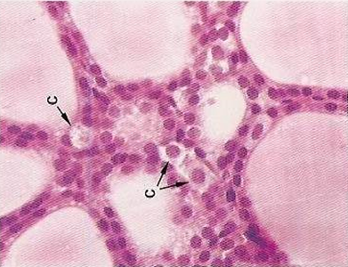
2- PARAFOLLICULAR CELLS (CLEAR CELLS) (C-CELLS)
Light microscope | Electron microscope
Pale-stained cells (Clear Cells). Clear cytoplasm. Found singly or in clusters in between the follicular cells. Unlike follicular cells, their apices do not reach the lumen of the lumen of the follicle. Are larger than follicular cells (2-3 times). Represent only 0.1% of the epithelial follicular cells. Have a round nucleus. | Mitochondria. Rough endoplasmic reticulum (RER) (moderate). Well-developed Golgi. Moderate as in less than follicular cells.
Function: Secrete calcitonin. it works with parathyroid hormone to balance the level of Ca⁺⁺ in the blood

Slide 6
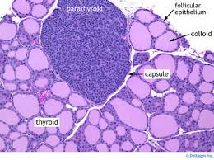
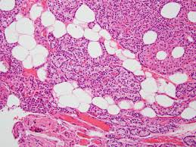
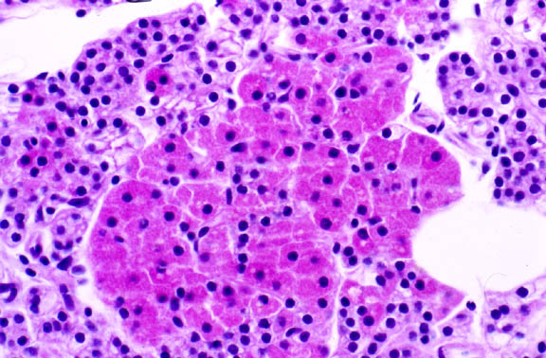
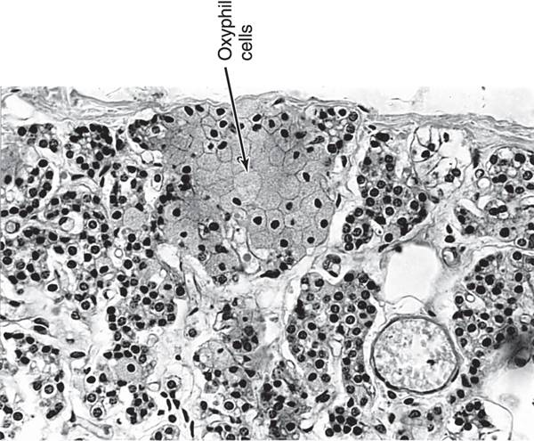
PARATHYROID GLANDS
They are 4 glands on the posterior surface of the thyroid gland.
A. Stroma of parathyroid gland: |  | B. Parenchyma of Parathyroid gland:
1. Capsule: | Each gland has its thin capsule. | Formed of cords or clusters of epithelial cells (chief cells & oxyphil cell) with blood capillaries in between. These cells are surrounded by reticular fibers.
2. Septa: | Thin | 1. Chief cells: Main functioning cells | Are slightly eosinophilic. Rich in rER. They secrete parathyroid hormone (increase blood calcium level) The only type of cell in newborn
3. Reticular C.T. | C.T. stroma in older adults often contains many adipose cells. Adipose cells may increase as you get older | 2. Oxyphil cells: Oxy: pink or red | They are arranged in groups or clusters or as isolated cells. They are deep eosinophilic (acidophilic). They have more numerous mitochondria. They are less numerous but larger than chief cells. They are of unknown function. N.B. They may be inactivated chief cells. Appear at puberty and it is claimed as the degenerative form of chief cell
Adipose cells:
Parenchyma of Parathyroid gland:

Slide 7
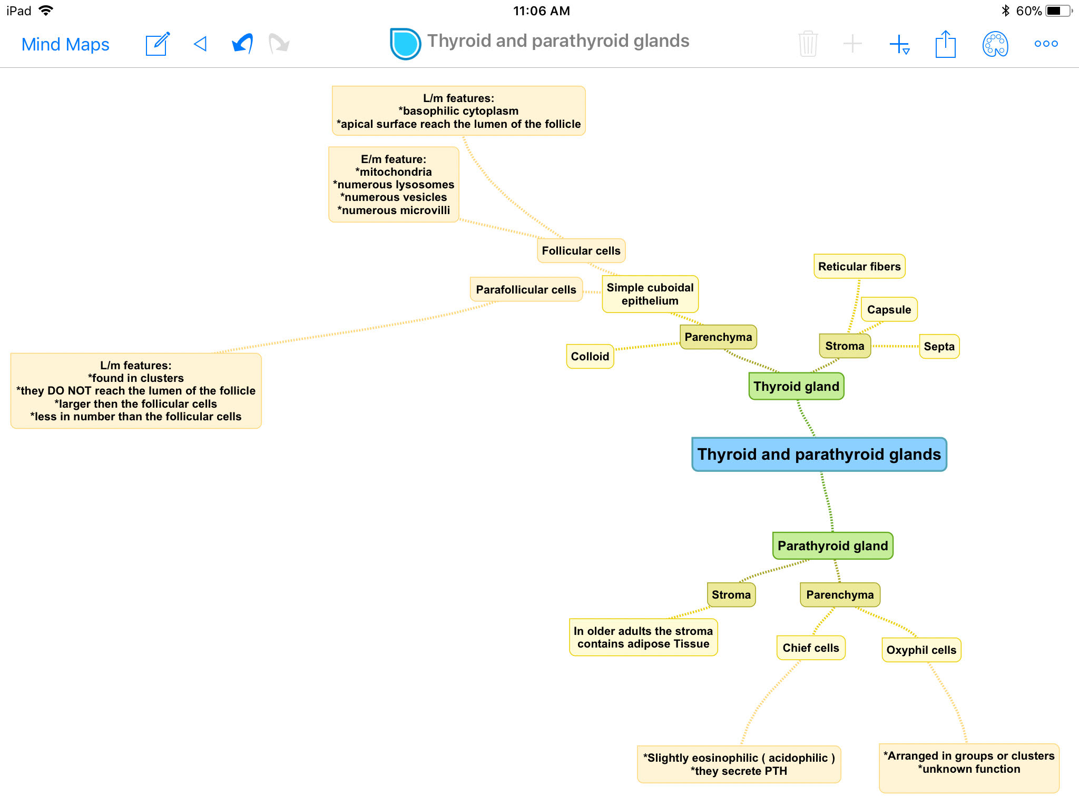

Slide 8
MCQs
1) T4&T3 are synthesized by which cell?
A-Follicular cell B-Para follicular cell
C-Chief cell D-Oxyphil cell
2) C-cells (clear cells) secrete which hormone?
A-TSH B-T4
C-Calcitonin D-ADH
3) Parathyroid hormone is synthesized from?
A-Oxyphil cells B-Chief cells
C-Follicular cells D-Parafollicular cells
4) Which cells of the following their apical surface reach the lumen of the thyroid follicle?
A-Parafollicular cells B-Chief cells
D-Oxyphil cells D-Follicular cells
5) Oxyphil cell is deep eosinophilic?
A- true B-False
6) Calcitonin increases blood calcium level?
A-true b-False
1-A
2-C
3-B
4-D
5-A
6-B

Slide 9
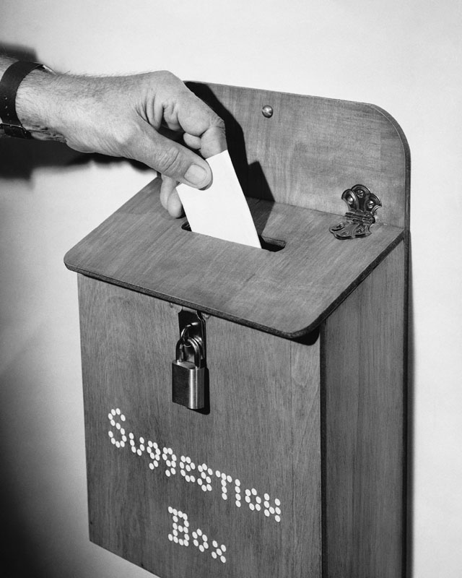
Thank you & good luck
- Histology team
Done by:
Ahmed Badahdah
Mutasem Alhasani
Omar Turkistani
Nawaf Aldarweesh
Mohammed Khojah
Team leaders:
Rana Barasain
Faisal Alrabaii
References:
Females’ and Males’ slides.
Doctors’ notes

