Slide 1
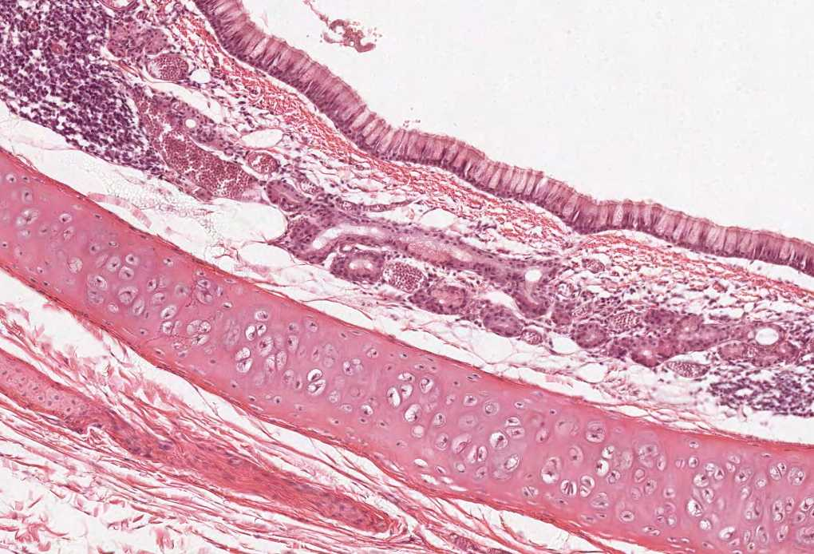
Adrenal Gland
Color index:
Slides.. Important ..Notes ..Extra..

Slide 2
Objectives :
By the end of this lecture, the student should be able to describe:
Differentiate between adrenal cortex and medulla.
Identify the histological features of each cortical zone and its cells.
Identify the histological features of the medullary cells

Slide 3
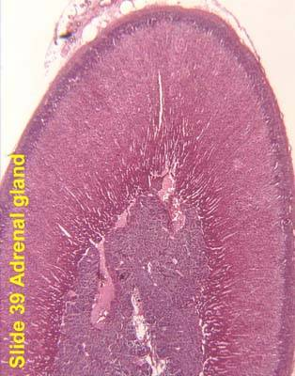
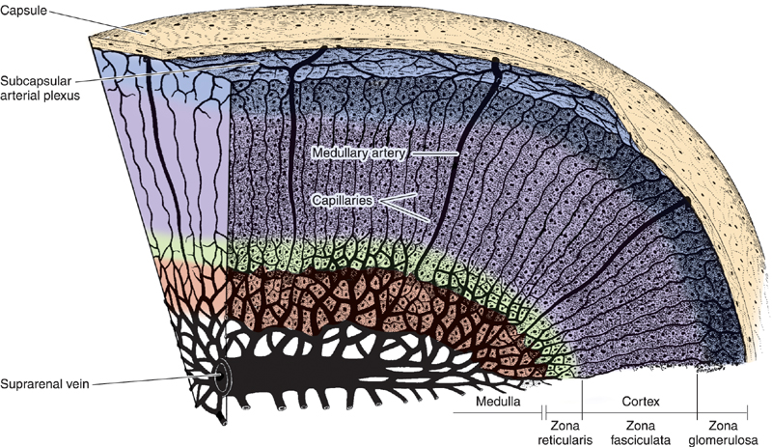
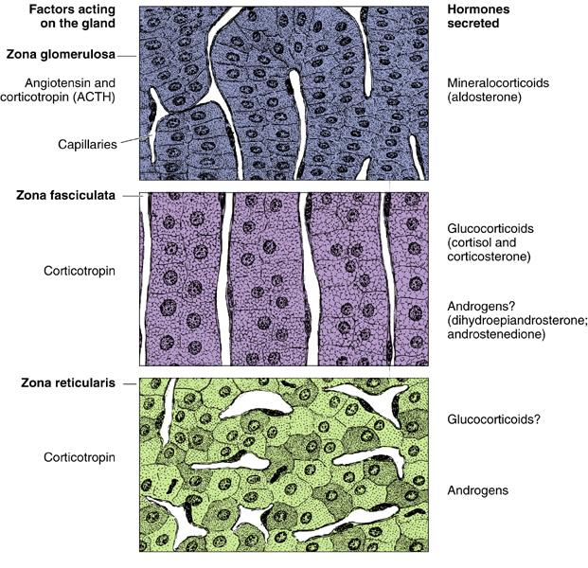
Adrenal gland
is formed of
Stroma
Parenchyma
that is divided into:
I. Cortex
that is composed
of:
II. Medulla
A-Zona glomerulosa.
B-Zona fasciculata.
C-Zona reticularis.
All adrenal gland hormones are steroids in origin.
Mnemonic: GFR which is the flow rate of filtered fluid through the kidney.
Follicular cells
Colloid

Slide 4
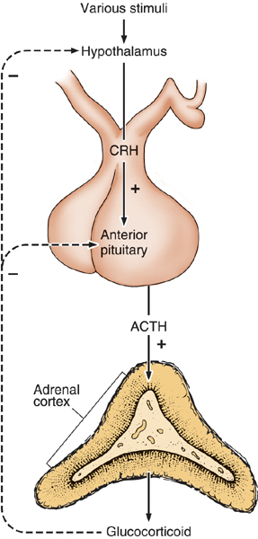
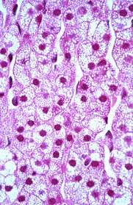
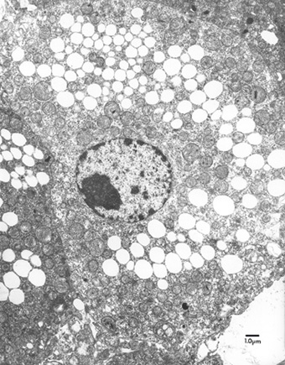
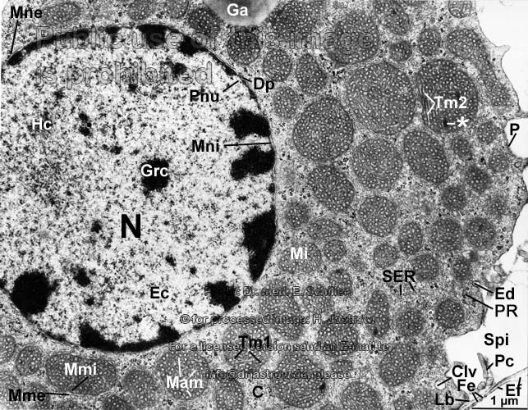
Adrenal cortex
*We can differentiate between the layers by the cell arrangement.
1. Zona Glomerulosa: | 2. Zona Fasciculata (Spongiocytes): | 3. Zona Reticularis:
Is formed of clusters of small columnar cells that are rich in SER and mitochondria for steroid synthesis. Produces Mineralocorticoids e.g. Aldosterone Hormone; {Reabsorb all the remaining sodium, and passively the chloride, from the lumen of the distal renal tubules into the renal interstitium. In addition, potassium and hydrogen ions are actively secreted into the lumen). | It is the intermediate and the largest layer of the cortex. Formed of columns of large polyhedral cells that are separated by longitudinal sinusoidal capillaries. Its cells are rich in: Lipids so they appear empty in sections (spongiocytes). Mitochondria ( with tubular cristae), SER and lipofuscin pigments. Its cells secrete Glucocorticoids. It is regulated by ACTH of pituitary. Fasciculata = column They look like air bubbles with spaces for blood capillaries. | It is the innermost layer of adrenal cortex. It is formed of anastomosing cords of deep acidophilic cells. With no specific arrangement. acidophilic compared to fasiculata Its cells contains few lipofuscin and lipid droplets. The cells secrete Androgens. Androgens are higher in males because they’re secreted by testes as well.
Spongiocytes
Zona Reticularis:
E/M of spongiocytes.

Slide 5
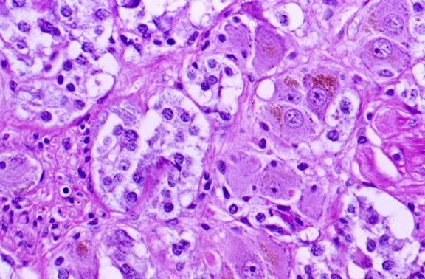
Adrenal Medulla
It is the central portion of the adrenal gland.
It is completely invested with adrenal cortex
(there is no CT. septa between cortex and medulla)
When sympathetic activity increases > cortisol level increases
It contains:
2. Sympathetic ganglion cells: | 1.Chromaffin cells (Pheochromocytes):
Relay on chromaffin cells. | Contains granules of catecholamine as that of sympathetic nervous system. They produce epinephrine and norepinephrine. They stain deep brown with chromic salts. Basophilic High amount of RER for synthesis of tyrosine to make catecholeamine
NEURONS IN ADRENAL MEDULLA

Slide 6
EXTRA

Slide 7
MCQs
1\Which one of following layers Produce mineralocorticoids:
A-Zona reticularis.
B-Zona glomerulosa.
C-Zona Fasciculata.
4\Chromaffin cells produce:
A-glucocorticoids.
B-epinephrine.
c-acetylcholine.
2\the largest layer of the cortex:
A-Zona Fasciculata.
B-Zona glomerulosa.
C-Zona reticularis.
5\Medulla of adrenal gland is:
A-the peripheral portion of the adrenal gland.
B-the outermost portion of the adrenal gland.
C-the central portion of the adrenal gland.
3\The cells secrete androgen in which of following layers:
A-Zona reticularis.
B-Zona glomerulosa.
C-Zona Fasciculata.
1-b
2-a
3-a
4-b
5-c

Slide 8
Thank you & good luck
- Histology team
Done by:
Amal AlGarni
Duaa Walid
Heba AlNasser
Shahad AlAnzan
We’am Babaier
Team leaders:
Rana Barasain
Faisal Alrabaii
References:
Females’ and Males’ slides.
Doctors’ notes

