Slide 1
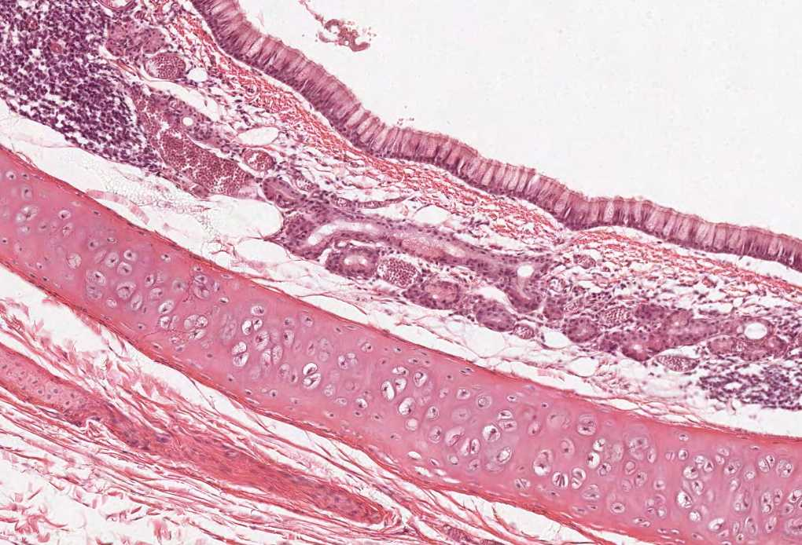
PANCREAS
Color index:
Slides.. Important ..Notes ..Extra..

Slide 2
Objectives :
By the end of this lecture, the student should be able to describe:
The endocrine part of the pancreas within the exocrine part.
The histological features of the cells of islet of Langerhans.
The function of different cells of islets of Langerhans.

Slide 3
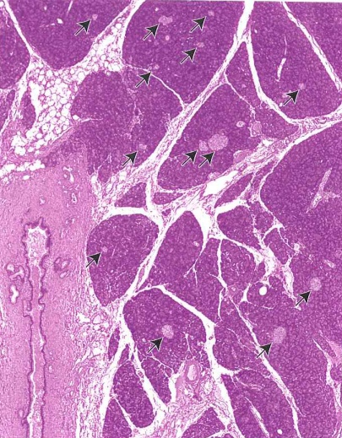
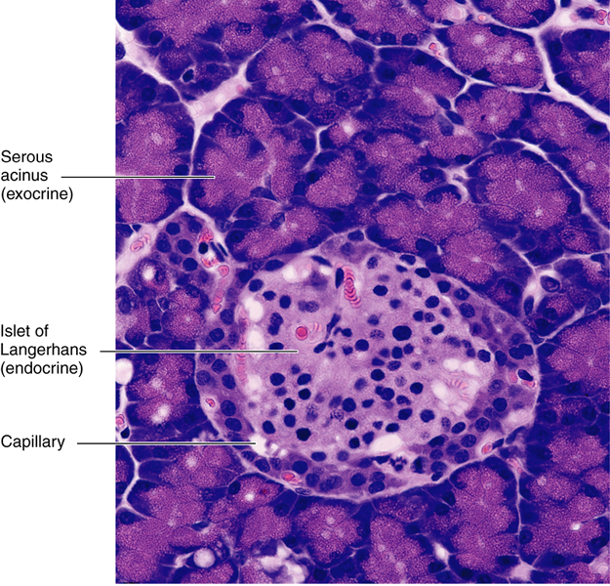
Endocrine Pancreas
Islets (island) of Langerhans:
Pale-staining spherical vascular collections of endocrine cells, scattered among the acini.
Richly vascularized by fenestrated capillaries
Most numerous in the tail of pancreas.
1 million islets in human pancreas.
Doesn’t have capsule but Each islet is surrounded and supported by reticular fibers.
Cells of the Islets: 5 types of cells in each islet
β (B) cells: | secrete insulin.
α (A) cells: | secrete glucagon.
δ (D) cells: | secrete somatostatin.
G cells: | secrete gastrin.
PP cells: also called F cells | secrete pancreatic polypeptide.
Cannot be differentiated from one another by routine stains, but we can use Immunohistochemistry & E/M for differentiation
جزر باهتة في بحر غامق

Slide 4
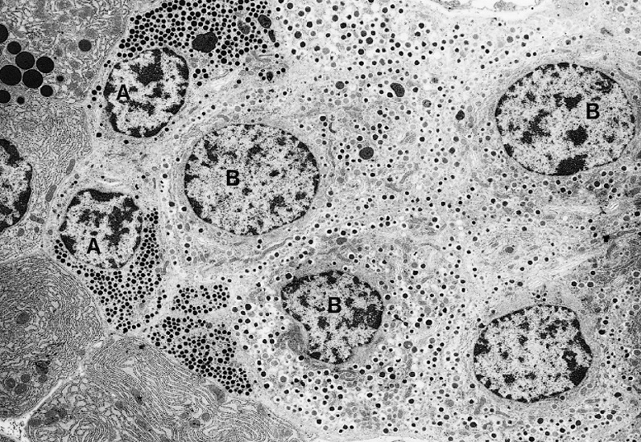
Endocrine Pancreas: Cells of the Islets
β (B) cells:
Constitute 70% of islet cells.
α (A) cells:
Constitute 15-20%.
δ (D) cells:
Constitute 5-10% of islet cells.
G cells:
Constitute 1% of islet cells.
PP cells:
Concentrated in islet center.
Function: secrete insulin which ↓ blood sugar.
Concentrated in islet periphery.
Granules are much more numerous, more tightly packed, smaller, and denser than those of β cells.
Function: secrete glucagon which ↑ blood sugar.
Scattered (doesn’t have a certain distribution ) throughout the islet.
Granules are less dense than those of β and α cells.
Function: secrete somatostatin which ↓ release of hormones from endocrine pancreas and enzymes from exocrine pancreas.
Scattered throughout the islet.
Function: secrete gastrin which ↑ production of HCl by parietal cells of the stomach.
Constitute 1% of islet cells.
Scattered throughout the islet.
Function: secrete pancreatic polypeptide which ↓ exocrine secretions of pancreas.

Slide 5
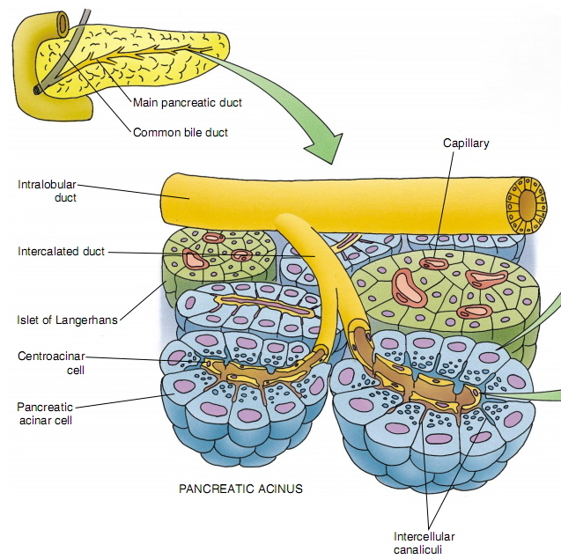
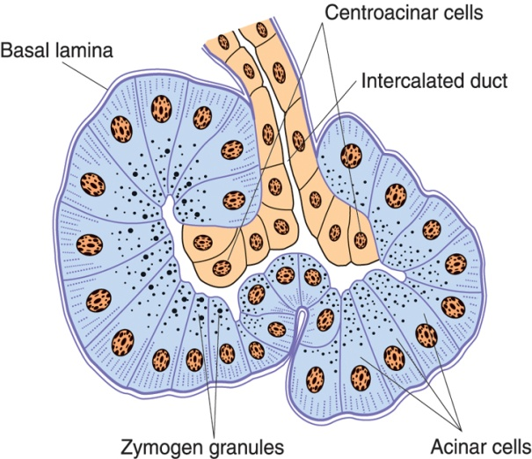
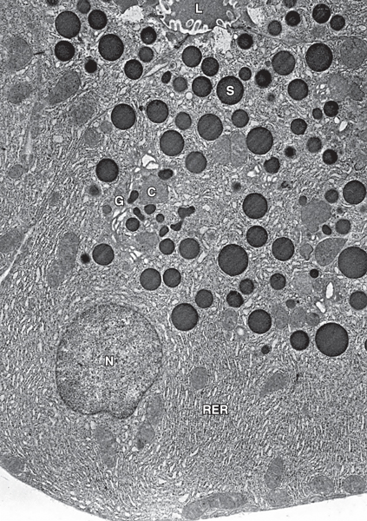
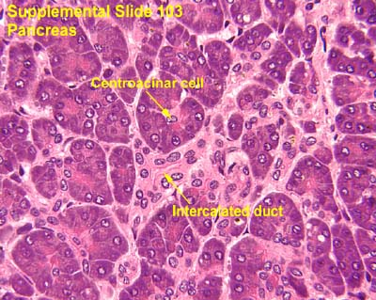
Exocrine Pancreas
Stroma: Capsule, septa & reticular fibers.
Parenchyma: Pancreas is a mixed gland:
Pancreatic Acini: | Duct System:
They are serous acini: secreting a thin fluid rich in digestive pancreatic enzymes. The Acinar cells: rosette shape Pyramidal in shape. Nuclei are basal. Cytoplasm: Basal part Basophilic (due to abundant rER) to secrete proteins Apical part Acidophilic (due to secretory granules). No Myoepithelial Cells around the acini. | Centroacinar cells: simple cuboidal Their nuclei appear in the center of the acini. They represent the beginning of the ducts. First ductal cells, have serous secretions like parotid. Intercalated ducts (low cuboidal). Intralobular ducts (NOT prominent). Interlobular ducts. Inter = between Main pancreatic duct.
Exocrine part (acini & ducts): produces digestive pancreatic enzymes. | Endocrine part (islets of Langerhans): produces hormones.

Slide 6
MCQs
1) Islets of Langerhans are most numerous in which part of the following?
A-Tail B-Head
C-Neck D-Body
2)Which cell of the following is the most numerous in islets of Langerhans?
A- A cell B- B cell
C- D cell D- PP cell
3)Which cell of the following is found in periphery of the islets?
A- A cell B- B cell
C- D cell D- PP cell
4)islets of Langerhans contain fenestrated capillaries?
A-True B-False
5) What is the function of PP cell ?
A- Decrease endocrine and exocrine part
B-Increase exocrine part
C-Decrease exocrine part
D-increase both part
6)Which cell is present in 5-10% of islets of Langerhans?
A- A cell B- B cell
C- D cell D- PP cell
1-A
2-B
3-A
4-A
5-C
6-C

Slide 7
Thank you & good luck
- Histology team
Done by:
Ahmed Badahdah
Mutasem Alhasani
Omar Turkistani
Nawaf Aldarweesh
Mohammed Khojah
Team leaders:
Rana Barasain
Faisal Alrabaii
References:
Females’ and Males’ slides.
Doctors’ notes

