Slide 1
Endocrine Block
Lecture one
The Immune System and Endocrine Disorders
Objectives:
To recognize that many endocrine disorders are organ-specific autoimmune diseases.
To understand the mechanisms of damage which take place at endocrine glands and their consequences.
To know the important examples of autoimmunity which affect different endocrine glands and the pathogenesis of these disorders.
Important.
Extra notes.
Doctor's notes

Slide 2
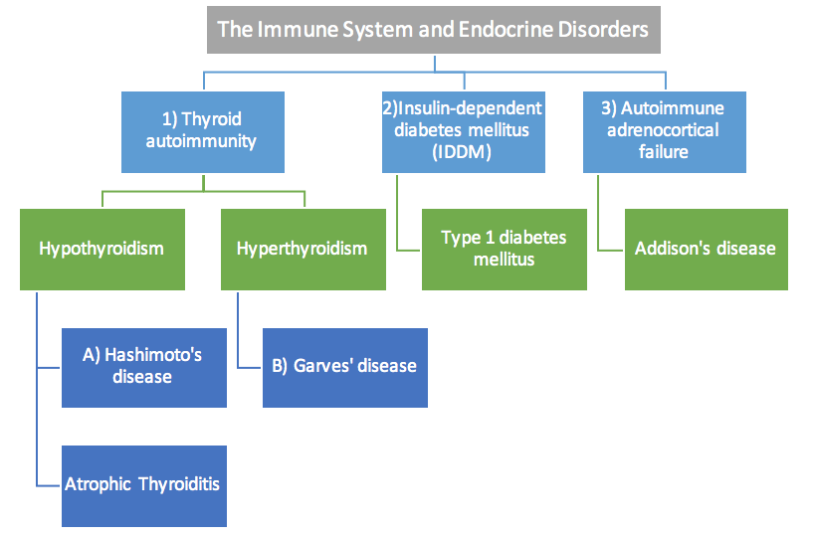
Overview of the lecture:
Introduction
Many endocrine disorders are organ-specific autoimmune diseases.
organ-specific autoimmune diseases :
- the immune response is directed to a target antigen unique to a single organ.
- the manifestations are largely limited to that organ.
The damage may be directly mediated by: (could be either one or both of them)
Humoral (Antibodies) Immunity: the antibodies may overstimulate or block the normal function of the target organ
Cell-mediated Immunity (CMI).
Examples of Autoimmune endocrine diseases:
Limited to the function of the organ
Thyroid
Pancreas
Adrenal
Gonads
Pituitary
Hashimoto’s disease:
Type I diabetes.
Addison’s disease:
Autoimmune oophoritis:
Lymphocytic hypophysitis:
Primary myxoedema:
Graves’ disease:
Autoimmune orchitis:
inflammation of the ovaries.
Testicular pain involving swelling, inflammation and infection.
Autoantibodies against thyroid peroxidase.
Atrophy of the thyroid.
Autoantibodies against Thyroid Stimulating Hormone receptor (TSH-R)
Chronic endocrine disorder; adrenal glands produce insufficient steroid hormones.
Low production of one or more hormones by the pituitary gland due to autoantibodies and autoimmunity.

Slide 3
1) Thyroid autoimmunity
Thyroid autoimmunity
Hypothyroidism
Hyperthyroidism
Hashimoto’s disease.
Atrophic thyroiditis.
Graves’ disease.
Autoimmunity is strongly associated with hypersensitivity type Tissue damage = 2 (cellular antigen) ,3 (soluble antigen)
Why are females more susceptible to autoimmune diseases? Hormones and genetics .
A) Hashimoto’s Thyroiditis / Chronic Lymphocytic Thyroiditis:
Male: Female ratio is 1:3, Frequently seen in middle-aged women.
Associated with HLA II,
Predisposing effect: DR4 (DRB1*04-DQB1*03-DQA1*03).(more likely to get the disease) .
Protective role: DR13 (DRB1*13-DQB1*06-DQA1*01) (less likely to get the disease) .
There will be symptoms of hypothyroidism.
Individuals produce auto-antibodies and sensitized TH1 cells specific
for thyroid antigens (Both Antibody mediated cellular mediated at the same time):
Anti-thyroid peroxidase and anti-thyroglobulin antibodies.
The DTH (Delayed Type (IV) Hypersensitivity) response is characterized by:
An intense infiltration of the thyroid gland by lymphocytes, macrophages, and plasma cells, which form lymphocytic follicles and germinal centers.
The ensuing inflammatory response causes:
A goiter or visible enlargement of the thyroid gland. (a physiological response to hypothyroidism) .
Formation of antibodies to thyroid proteins (thyroid peroxidase and thyroglobulin) both of which are involved in the uptake of iodine.
normal thyroid gland showing a follicle lined by cuboidal follicular epithelial cells
Hashimoto’s thyroiditis showing intense lymphocyte infiltration.
*Subtypes are not important
Pathogenesis
Clinical Features
Fatigue. Cold intolerance.
loss of energy. Mental slowing.
Enlarged thyroid. Weight gain.
Binding of the auto-antibodies to these proteins.
interferes with iodine uptake
and leads to
decreased production of thyroid hormones.
hypothyroidism
*We highly recommend you to watch the videos next to hashimoto’s, graves’, type I DM and Addison’s

Slide 4
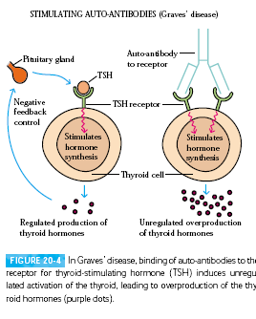
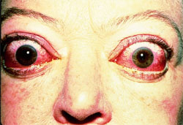
1) Thyroid autoimmunity
Less common than Hashimoto’s disease.
Male: Female ratio up to 1:7.
Associated with HLA class II protective effect for DR7 (DRB1*07-DQB1*02-DQA1*02).
Physiology of thyroid
The production of thyroid hormones is carefully regulated by thyroid-stimulating hormone (TSH), which is produced by the pituitary gland.
Binding of TSH to a receptor on thyroid cells activates adenylate cyclase and stimulates the synthesis of two thyroid hormones, thyroxine and triiodothyronine.
Clinical Features of Graves’ disease:
• Agitation, sleep disturbance.
• Sweating, palpitations.
• Muscle weakness.
• Weight loss despite increased appetite.
• Goiter.
• Tremor.
• Ophthalmopathy*.
*exophthalmos
B) Graves’ Disease
Associated with HLA class II Predisposing
effect for DR3 (DRB1*03-DQB1*02-DQA1*05)
*Subtypes are not important
In Graves’ disease auto-antibodies bind the
receptor for TSH and mimic the normal action
of TSH, activating adenylate cyclase and resulting
in production of the thyroid hormones.*no –ve feedback,
Continuous production
Unlike TSH, the autoantibodies are not regulated
and consequently they overstimulate the thyroid.
For this reason these auto-antibodies are called
long-acting thyroid-stimulating (LATS) antibodies.

Slide 5
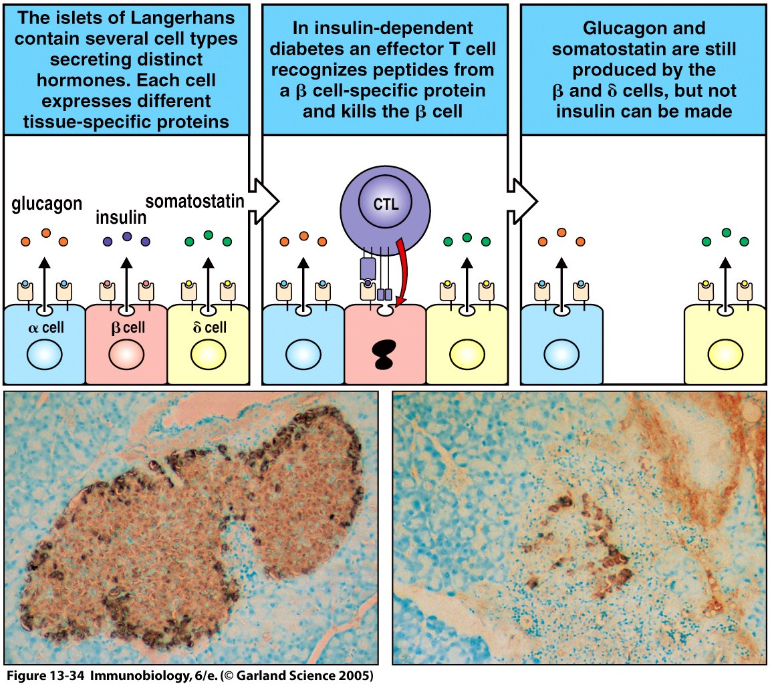
2) Insulin-dependent diabetes mellitus (IDDM)
IDDM is an example of type IV hypersensitivity.
Autoreactive T-cells invade the pancreatic islets and destroy the insulin-secreting beta cells.
Macrophages become activated at the site. This is frequently referred to as insulitis. (Cell-mediated DTH response)
As a result: decreased production of insulin and consequently increased level of blood glucose.
Type 1 Diabetes Mellitus:
Pathogenesis:
Three mechanisms are responsible for the islet cell destruction:
Genetic susceptibility (HLA-DQ alleles).
Autoimmunity.
Environmental factors.( Infections: Coxsackie virus* , Echovirus* ) *under research
Type I insulin- dependent diabetes
* pancreatic beta-cell autoreactive T cells (DTH & CTL) and autoantibodies.
Improper expression of Class II MHC on Non-antigen presenting cells
The most likely scenario is that viruses cause mild beta cell injury, which is followed by an autoimmune reaction against altered beta cells in persons with HLA-linked susceptibility.
Type 1 IDDM patients (aprox.10%) are prone to other autoimmune disorder
Beta cells improperly express of class 2 ( remember that beta cells aren’t APCs, so it’s abnormal), cell antigens in beta cells then will be presented. T-cells (TH1) will come and attack the beta cells.
What makes beta cells express abnormal class II MHC?
Macrophages, produced IFN-γ which upregulates Class II MHC expression.
IFN-γ produced might be triggered by the viral infection

Slide 6
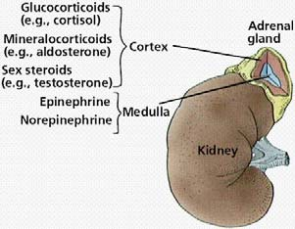
3) Autoimmune adrenocortical failure
Named as Addison’s disease, is a prototypical organ–specific autoimmune disorder.
It develops as a consequence of autoimmune destruction of steroid-producing cells in the adrenal gland.
A major autoantigen is 21-hydroxylase ( 21OH ) important.
which is involved in the biosynthesis of cortisol and aldosterone in the adrenal cortex .
Zona Glomerulosa: Mineralocorticoids Epinephrine
Zona Fasiculata: Glucocorticoids
Zona Reticularis: Androgens
Medulla
Addison’s disease
Genetics | Symptoms & physical finding in primary adrenal insufficiency | Etiology
Female: Male ratio: 4:1 Susceptibility genes: HLA-DR3 and/or DR4 - The most strongly associated DRB1*04 allele is (DRB1*04:04)*. *subtypes | Weakness Hyperpigmentation Weight loss Hypotension Poor appetite Weak pulses Confusion Shock. | (autoimmune disease)* 2. Infections . 3. Hemorrhage, 4. Tumors. 5. Use of drugs (anticoagulants). *main one
T cell-mediated injury is likely to be central to pathogenesis.
Adrenal Autoantibodies may have a pathogenic role, as yet unclear , or could arise secondary to T cell-mediated tissue damage.

Slide 7
Quiz
1- Atrophy of the thyroid is a feature of which of the following diseases? a) Hashimoto’s disease b) Addison’s disease c) Primary myxoedema d) Graves’ disease 2- in which disease the auto-antibodies interferes with iodine uptake ? a) Hashimoto’s disease b) Addison’s disease c) Primary myxoedema d) Graves’ disease 3- Hashimoto’s Thyroiditis is an example of which type of hypersensitivity ? a) l b) ll c) lll d) IV 4- the protective role in Chronic Lymphocytic Thyroiditis is : a) DR4 b) DR3 c) DR 13 d) DR7 5- long-acting thyroid-stimulating (LATS) antibodies. Are present in which of the following ? a) Hashimoto’s disease b) Addison’s disease c) Primary myxoedema d) Graves’ disease 6- in Insulin-dependent diabetes mellitus Autoreactive T-cells invade the pancreatic islets and destroy which pancreatic cells ? a) alpha b) beta c) gamma 7 – in Addison's disease the major autoantigen is : a) thyroid peroxidase b) TSH receptors c) 21-hydroxylase (21OH ) d) beta cells
1-C
2-A
3-D
4-C
5-D
6-B
7-C

Slide 8
Contact us
Email: Immunology436@gmail.com
Twitter: Immunology436
Team Leaders
Ghada Alhadlaq Basel almeflh
Team members
Abdulmajeed alammar
Abdulmajeed almutairi
Basel alanazi
Moayed ahmed

