Slide 1




LECTURE: Candidiasis
Editing File
Important
Doctor’s notes
Extra explanation
"لا حول ولا قوة إلا بالله العلي العظيم" وتقال هذه الجملة إذا داهم الإنسان أمر عظيم لا يستطيعه ، أو يصعب عليه القيام به .

Slide 2
OBJECTIVES:
Acquire the basic knowledge about Candida as a pathogen
know the main infections caused by Candida species
Identify the clinical settings of such infections
Know the laboratory diagnosis, and treatment of these infections.

Slide 3
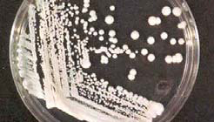
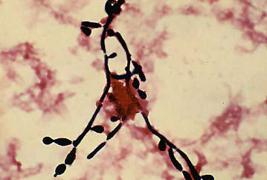
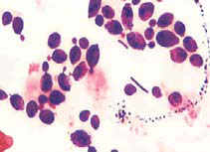
Candida (the organism):
Features | Candida is a unicellular yeast fungus It is imperfect* reproducing by budding**
Morphology | Microscopy: Budding yeast cells, and Pseudohyphae. Culture: Creamy colony, fast growing on Sabouraud Dextrose agar (SDA), Blood agar (48 hr)***
species | There are many species of Candida (>150) The common species are: Candida albicans, C.parapsilosis, C.tropicalis, C.glabrata, C.krusei.
Human commensal (normal flora) | Oral cavity - Skin - Gastrointestinal tract - Genitourinary tracts
Budding : if there is any weakness at the wall of the yeast cell --> there will be pouching ( out growth at that side )--> it will continue until the daughter cells are completely formed , the daughter cell could :
1-detach from the mother cell
2- or become elongated and make Pseudohyphae
*Means :the sexual stage is unknown
**Asexual
***fast growing comparing with molds

Slide 4
Candidiasis (the disease):
Definition:
  Any infection caused by any species of the yeast fungus Candida.
  The most common invasive fungal infections in immunocompromised patients
  4th most common cause of nosocomial (hospital acquired) blood stream infection
It is considered opportunistic infection:
Clinical – Spectrum of disease
Transmission of Opportunistic Fungi:
a) Alteration in:
Immunity - Normal physiology - Normal flora
b) Damage in the barriers
Mostly endogenously because it’s a normal flora
a) ENDOGENOUS:
Colonization precedes infection
Antibiotic suppression of normal flora, fungal overgrowth
b) EXOGENOUS:

Slide 5
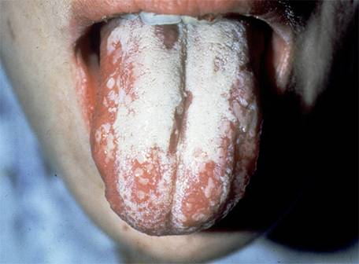
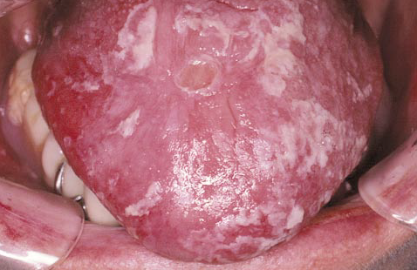
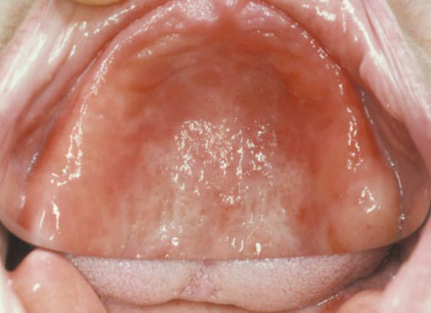
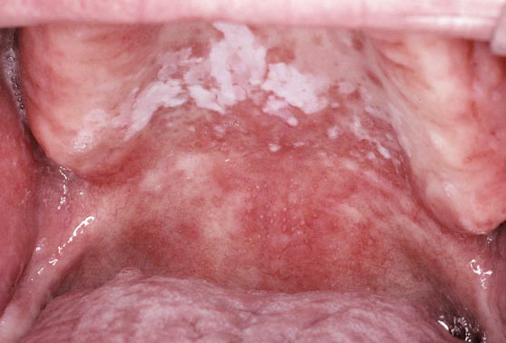
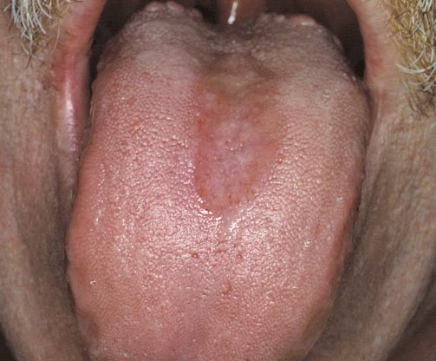
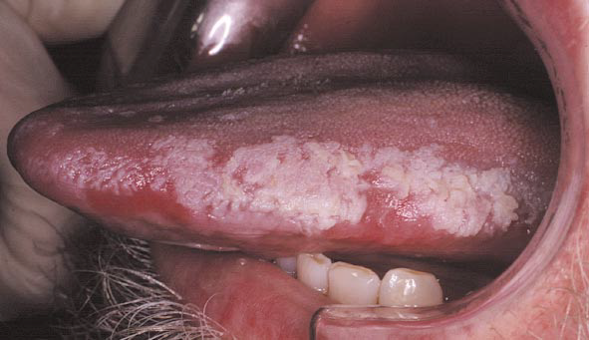
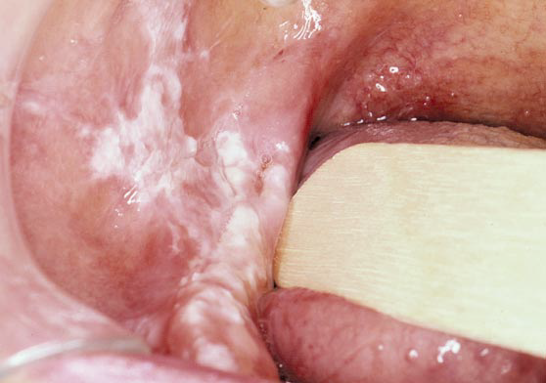
Candida – Clinical (superficial)
1) Mucous membrane infections
a) Oral Thrush “oropharyngeal” | White or grey Pseudomembranous patches on oral surfaces especially tongue with underlying erythema. Common in neonates, infants, elderly In immunocompromised host, e.g. AIDS.
b) Vaginitis (Vulvovaginitis) | Common in pregnancy, diabetics, use of contraceptives. Thick (white) discharge, itching irritation and burning . Lesion appear as white patches on vaginal mucosa.
b) Esophagitis | White patches on mucous membranes
Forms of Oral candidiasis:
Oral thrush
pseudomembranous form
erythematous form
Painful hyperplastic Candida of the lateral tongue
Hyperplastic candidiasis, that was mistaken for leukoplakia
pseudomembranous-erythematous form.
Painful, depapillation of the tongue dorsum.

Slide 6
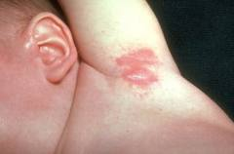
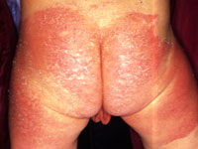
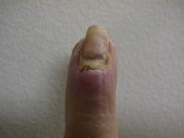
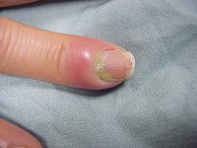
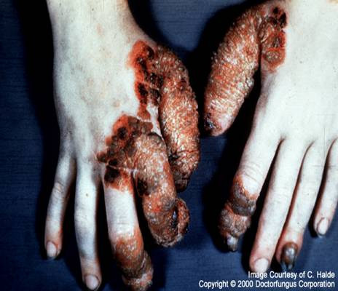
Candida – Clinical (superficial)
2) Cutaneous infections
Intertriginous¹ candidiasis: | Infections of skin folds eg. axilla, buttock, toe web, under breast. Erythematous lesion, dry or moist or whitish accompanied by itching and burning.
Nail infections: (pain - nail discoloration) | Onychomycosis (infection of nails) Discolored, hard, dislodge. Paronychia (infection of skin around nail bed)
Diaper rash
Chronic mucotaneous candidiasis | children with T-cell abnormality. recurrent persistent superficial infection (non-invasive) mostly caused by failure of T-cell immunity against candida. Most common cause: Candida albicans (in children).
Intertriginous candidiasis
Diaper rash
Onychomycosis
Paronychia
Chronic mucocutaneous candidiasis
¹ in between

Slide 7
Candida – Clinical (systemic)
Urinary tract infection
Candidemia (presence of candida in the blood; hematogenous spread to other organs)
Disseminated (systemic, invasive) infection :Endophthalmitis (eye) - Liver and spleen – Kidneys – Skin – Brain – Lungs - Bone
Pulmonary Candidiasis
Primary pneumonia is less common and could be a result of Aspiration Secondary pneumonia commonly seen with hematogenous candisiasis especially in: Immunocompromised patients
Diagnosis | Isolation of Candida from sputum, BAL bronchioalveolar lavage is not always significant because it is normal flora in the mouth so the sample may be contaminated. So we have to correlate with: Clinical features – Radiology - Other Lab investigations But if we find candida in a normally sterile site (CSF, blood) then we consider it as significant.
Candidemia :Candida is the fourth most common in causing nosocomial* bloodstream infections (BSI)
Transmission: | Increased colonization (endogenous or exogenous factors) Damage in host barriers by catheters, trauma, surgery Immunosuppression (transplant patient, AIDs) Central venous catheters (CVC)
Disseminated candidiasis | (involvement of any organ): Septic shock – Meningitis - Ocular involvement (retinitis)
clinical manifestation | Fever could be the only clinical manifestation
*hospital acquired

Slide 8
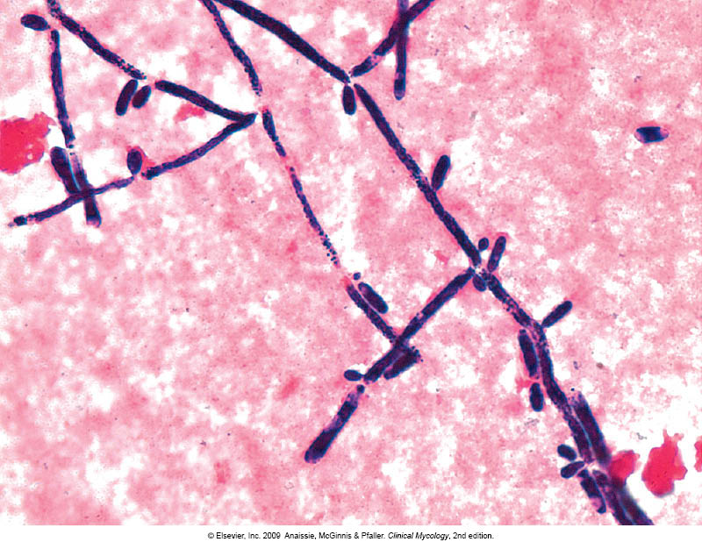
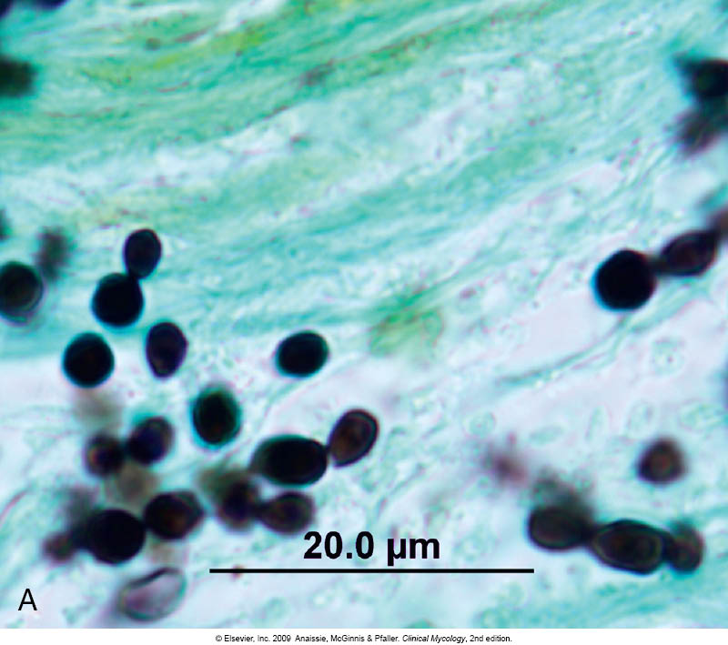
Candidiasis – Laboratory diagnosis
Specimen: | depend on site of infection we decide what sample to take: Swabs, Urine, Blood, Respiratory specimens, CSF, Blood
1. Direct microscopy : | What stains do we use? Gram stain, KOH, Giemsa, GMS, or PAS stained smears. What do we see? Budding yeast cells and pseudohyphae will be seen in stained smear or KOH
2. Culture: | Media: SDA (Sabouraud Dextrose Agar ) & Blood agar at 37oC, Creamy moist colonies in 24 - 48 hours.
3. Blood culture: | In case of Candidemia , it is not blood agar . We take blood sample from the patient and we put it in a bottle then in a machine
4. Serology: Patient serum | Test for Antigen , e.g. Mannan antigen using ELISA | Test for Antibodies
5. PCR:

Slide 9
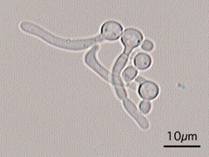
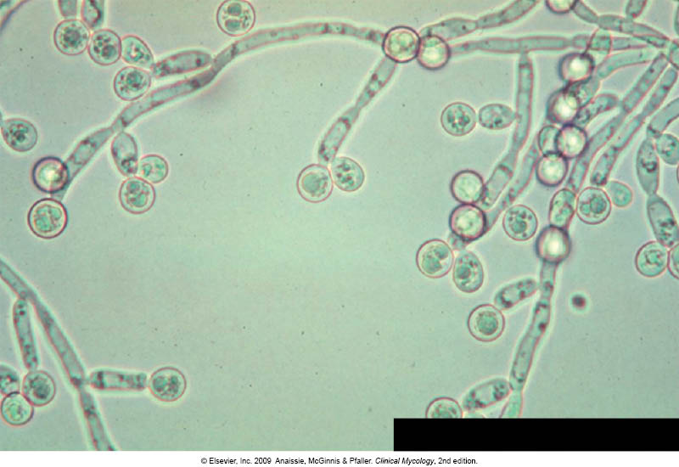
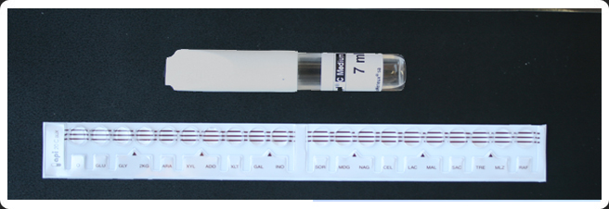
Candidiasis – Laboratory diagnosis (Laboratory identification of Yeast)
After identification we do susceptibility test in case of 1- sample from sterile body site or 2- recurrent infection
Because C. albicans is the most common species to cause infection
The following tests are used to identify C. albicans:
  Germ tube test : Formation of germ tube when cultured in serum at 37ᵒC in incubator for 2-4 hours
  2. Chlamydospore production in corn meal Agar
  Resistance to 500 μg/ml Cycloheximide
If these 3 are positive this yeast is C.albicans
لازم كل الثلاثة يطلعون بوزيتف
If negative, then it could be any other yeast:
Use Carbohydrate assimilations and fermentation . ( not used because it takes 72 hours for results )
Commercial kits available for this like: API 20C, API 32C
Culture on Chromogenic Media (CHROMagar™ Candida) gives different color for each species
Germ tube test No constriction while pseudo hyphy has constriction so there is continuation between the mother and the daughter / it is the initial stage of formation of true hyphy
Chlamydospores of C. albicans in CMA
Rounded and thickened wall could be terminal or intercalary =in between
Carbohydrates assimilation test , API 20C

Slide 10
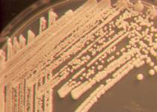
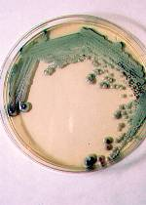
Candida species:
Candida albicans
Sabouraud Dextrose Agar
Morphology: | Creamy white yeast, may be dull, dry irregular and heaped up, glabrous and tough
Chromagar
Morphology: | producing green pigmented colonies on specially designed medium to speciate certain yeasts based on color they produce

Slide 11
Candidiasis- Treatment
Oropharyngeal: | Topical Nystatin suspension, Clotrimazole troches ,Miconazole, Fluconazole suspension. Systemic treatment in Immunocompromised patients
Vaginitis: | Miconazole, Clotrimazole, Fluconazole
Systemic treatment: | Fluconazole, Voriconazole, Caspofungin ( drug of choice ), Amphotericin B
Candidemia: | Treat for 14 days after last negative culture and resolution of signs and symptoms Remove catheters, if possible
Antifungal susceptibility testing in not done routinely in the microbiology lab, It is done in the following cases:
  For fungi isolated from sterile samples
  If the patient is not responding to treatment
  In case of recurrent infections
Points to consider:
  C. glabrata can be less susceptible or resistant to fluconazole
  C. krusei is resistant to fluconazole

Slide 12
SUMMARY:
Candidiasis:
Thrush (oropharyngeal)
Esophagitis
Cutaneous infections
Paronychia (skin around nail bed)
Vaginitis
Onychomycosis (nails)
Diaper rash
Chronic mucotaneous candidiasis (T-cell abnormality)
Urinary tract infections
Candidemia
Disseminated (systemic, invasive) infection
Endophthalmitis (eye)
Liver and spleen
Kidneys
Skin
Brain
Lungs (pulomnary candidiasis)
Bone
Mucos membrane infections
Laboratory diagnosis: Specimen depends on site of infection.
  Direct microscopy: (gram stain, KOH, Giemsa, GMS, or PAS stained)
  Culture: (SDA + blood agar)
  Blood culture
  Serology: Antigens > ELISA, and Antibodies
  PCR
Identification: (all positive > candida albicans)
  Germ tube test
  Chlamydospore production in corn meal Agar
  Resistance to Cycloheximide
All negative > any other yeast: use CHO assimilations and fermentation, culture on chromogenic media

Slide 13
QUIZ:
What is the most common type of candida?
a. Albicans
b. Parapsilosis
c. Tropicalis
d. Krusei
2.What is the most common route of transmission?
a. IV line
b. catheter
c. surgery
d. Use of broad spectrum antibiotics
3. Overweight patient comes in complaining of pain and burning sensation in his axillary region. What is the most likely diagnosis?
a. chronic mucocutanous candidasis
b. Interiginous Candidasis
c. Nail bed infection
d. diaper rash
4. 27 year old male comes into the clinic. He has white and red patches on his tongue and oral surfaces. You suspect its oropharyneal candidasis. What does the patient most likely have as a risk factor?
a. viral inefction
b. AIDs
c. he’s healthy
d. on antibiotics
5. Which method is not used to confirm a diagnosis of pulmonary candidasis?
a. isolation from sputum
b. clinical features
c. Radiology
d. other lab testing
6. How to confirm that the species is candida albicans?
a. SDA media stain culture
b. germ tube
c. chlamydospore
d. all the above
Answers: 1. a 2. d 3. b 4. b 5. a 6. d

Slide 14






THANK YOU FOR CHECKING OUR WORK, BEST OF LUCK!
Hamad Alkhudhairy
Shrooq Alsomali
Reem Alshathri
Ghada Alskait
Jawaher Abanumy
Shoag Alahmari
Heba Alnasser
Najd Altheeb
Doctors slides

