Slide 1
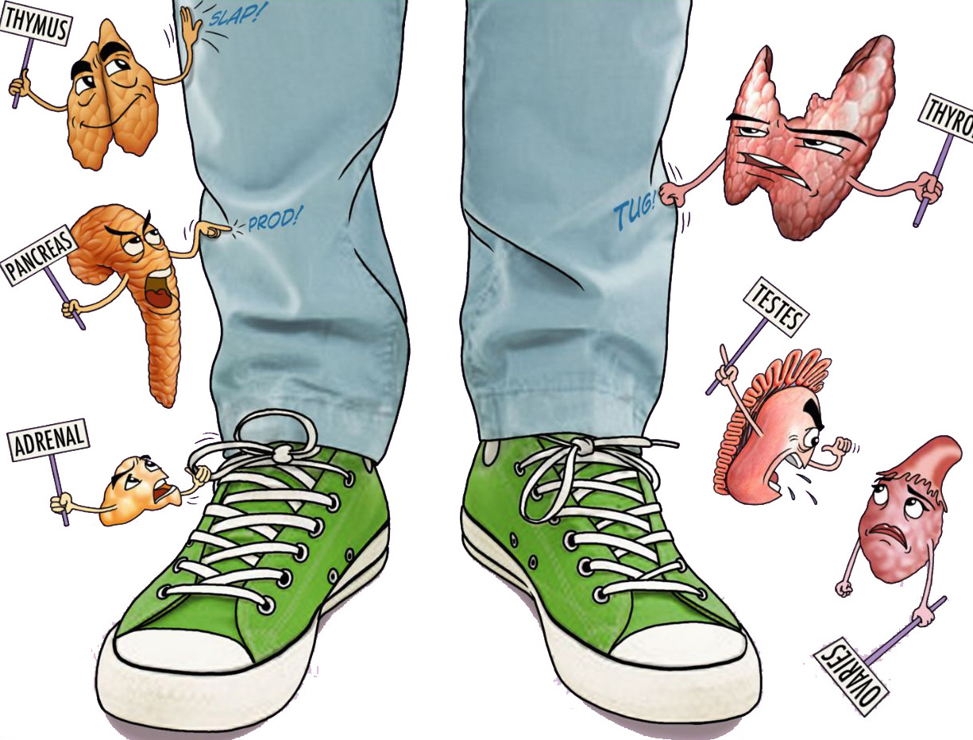
Thyroid Nodules and Neoplasms
Objectives:
Know the definition of a solitary nodule in the thyroid
Recognize the differential diagnosis of a solitary thyroid nodule
Understand the classification , pathology and behaviour of thyroid carcinoma
• Black: Doctors’ slides. • Red: Important! • Light Green: Doctors’ notes • Grey: Extra. • Italic black: New terminology.

Slide 2
Thyroid nodules :
Several clinical criteria provide a clue to the nature of a given thyroid nodule:
Solitary nodules, in general, are more likely to be neoplastic than are multiple nodules. (Solitary nodules are the opposite of multiple nodules, they are more suspicious whether benign or malignant)
Nodules in males are more likely to be neoplastic than are those in females.(Because females have other thyroid conditions)
Nodules in younger patients are more likely to be neoplastic than are those in older patients. (Not for sure just to help you think in a way for diagnosis)
A history of radiation treatment to the head and neck region is associated with an increased incidence of thyroid malignancy. (People with history of radiation have a higher risk to develop malignancy)
Nodules that take up radioactive iodine in imaging studies (hot nodules-active, takes up iodine) are more likely to be benign than malignant. (Malignancies are usually not functioning-cold nodules)
Ultimately, it is the morphologic evaluation of a given thyroid nodule by fine needle aspiration(FNA-to distinguish between benign and malignant but doesn’t distinguish between malignancies ”Adenoma and carcinoma), combined with histologic study of surgically resected thyroid parenchyma, that provides the most definitive information about its nature.(The first steps of thyroid mass evaluation is examination, radioactive iodine, ultrasound. When a mass is detected, we move to FNA then finally surgery depending on clinical situation and diagnosis of FNA)
Classification:
Non-Neoplastic | Neoplastic
Dominant nodule in multinodular goiter (Some follicles are distended forming colloidal cysts) Simple cysts Foci of thyroiditis | Adenoma Carcinoma

Slide 3
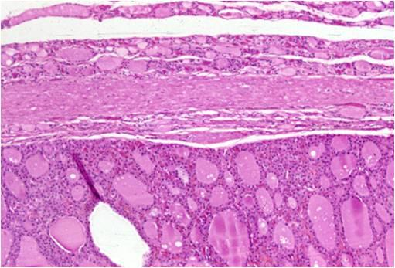
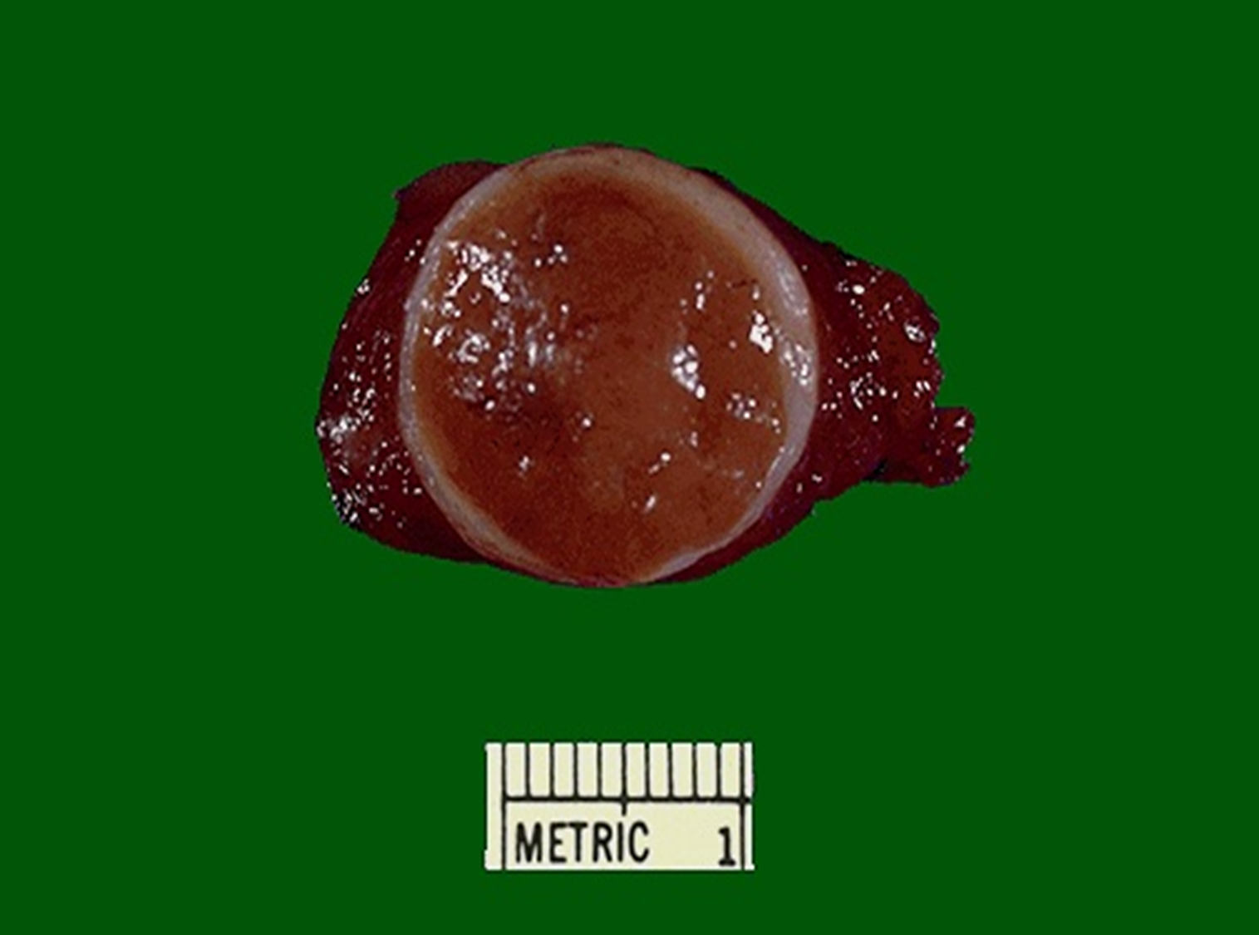
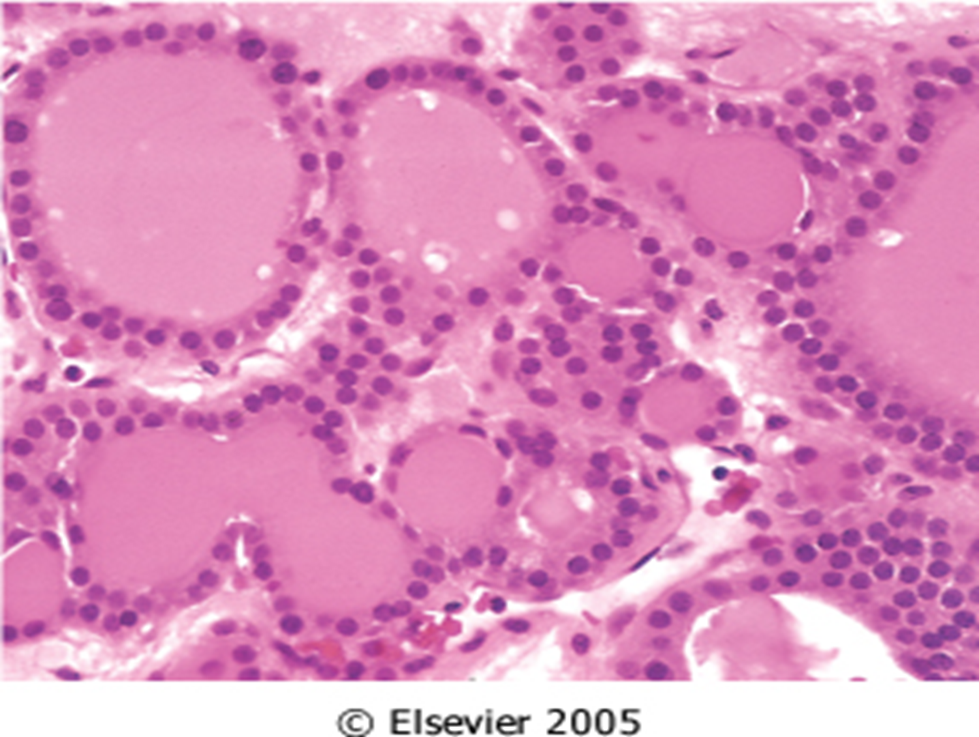
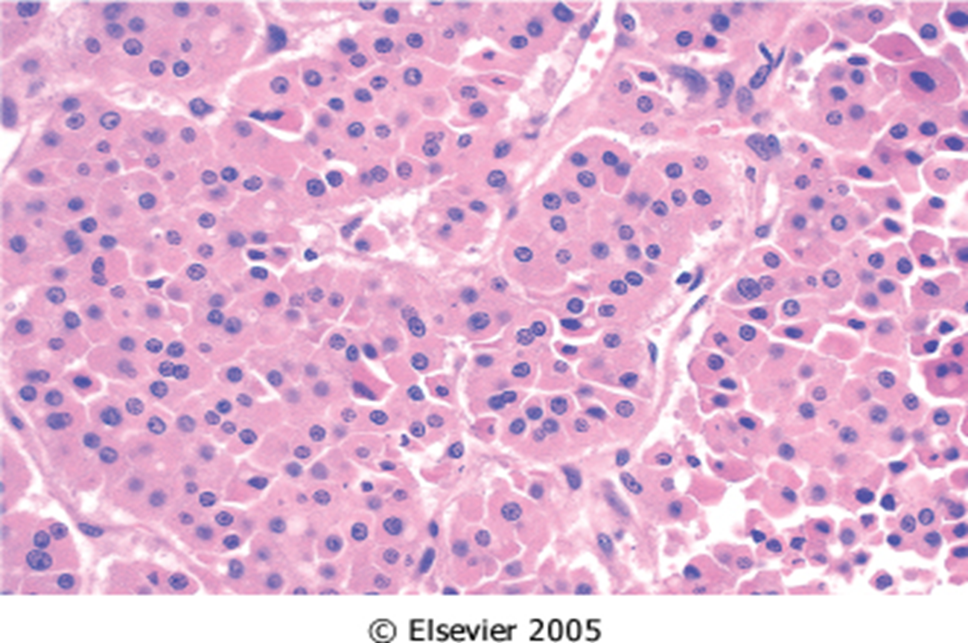
Adenoma:
Adenomas of the thyroid are benign neoplasms derived from follicular epithelium.
Follicular adenomas usually are solitary (single/one).
On clinical and morphologic grounds, they may be difficult to distinguish from a dominant nodule in multinodular goiter, or from follicular carcinomas. The definitive diagnosis of thyroid adenoma can be made only by histological examination of excising the whole mass because we need the capsule to differentiate. ( In FNA, we can only differentiate between adenoma and hyperplastic nodule in multinodular goiter)
In general, follicular adenomas are not forerunnersيتحول to carcinomas. (We cannot tell if its adenoma or carcinoma unless the thyroid gland is excised)
The typical thyroid adenoma is a solitary, spherical lesion that compresses the adjacent non-neoplastic thyroid.
The neoplastic cells are demarcated from the adjacent parenchyma by a well-defined, intact capsule .
These features are important in making the distinction from multinodular goiters, which contain multiple nodules on their cut surface , do not demonstrate compression of the adjacent thyroid parenchyma, and lack a well-formed capsule.
On microscopic examination, the constituent cells are arranged in uniform follicles that contain colloid . (Protrusion of follicular epithelium out of the capsule indicate carcinoma-invasion)
Occasionally, the neoplastic cells acquire brightly eosinophilic granular cytoplasm (Hürthle / oxyphil cell change). ITS JUST A MORPHOLOGICAL VARIANT THAT HELPS IN DIAGNOSING .
The clinical presentation and behavior of a Hürthle cell adenoma are no different from those of a conventional adenoma.
Careful evaluation of the integrity of the capsule is critical in distinguishing follicular adenomas from follicular carcinomas, which demonstrate capsular and/or vascular invasion (The main criteria of differentiation) . Again, The definitive diagnosis of thyroid adenoma can be made only by histological examination of excising the whole mass.

Slide 4
On radionuclide scanning, adenomas appear as Cold nodules (usually not functioning) relative to the adjacent normal thyroid gland.
Essential techniques used in the preoperative evaluation of suspected adenomas are ultrasonography and fine needle aspiration biopsy.
Suspected adenomas of the thyroid are removed surgically to exclude malignancy. (Adenomas can either be hot or cold nodules)
Thyroid adenomas carry an excellent prognosis and do not recur or metastasize.
Carcinomas : (Are always cold nodules)
Carcinomas of the thyroid : 1.5% of all cancers.
The major risk factor predisposing to thyroid cancer is exposure to ionizing radiation(Environmental Factors).
Majority of thyroid carcinomas associated with previous exposure to ionizing radiation.
Most often between the ages of 25 and 50.
Solitary or multifocal lesions.
Carcinomas¹ | Incidence | Gene mutation (pathogenisis)
Papillary Thyroid Carcinomas (If papillae is seen, we have to exclude the possibility of papillary carcinoma so if its not a carcinoma, its obviously an adenoma) | > 85% of cases | Rearrangements of the tyrosine kinase receptors RET or NTRK1 or activating point mutations in BRAF. The incidence of papillary carcinoma has increased markedly in the last 30 years.
Follicular Thyroid Carcinomas | 05% to 15% of cases | Mutations in the RAS family of oncogenes.
Medullary Thyroid Carcinomas | 5% of cases | Familial medullary thyroid carcinomas occur in multiple endocrine neoplasia type 2 (MEN-2). RET protooncogene mutation.
Anaplastic Carcinomas | < 5% of cases | Inactivating point mutations in the p53 tumor suppressor gene are rare in well-differentiated thyroid carcinomas but common in anaplastic tumors.
(1) Other tumors of the thyroid are lymphoma, metastases and sarcoma

Slide 5
Usually metastasize and the most common site are lymph nodes. Oftenly, the first presentation is cervical lymphadenopathy. So we must suspect PTC. By FNA we can detect it and this type is called metastatic papillary thyroid carcinoma .
Papillary thyroid carcinomas (PTC ):
General features
* The most common form of thyroid cancer(%85) . * May occur at any age. (even in children) * Associated with previous exposure to ionizing radiation . * Nonfunctional (no hormones production = cold nodules =they do not take up radioactive iodine) Indolent course = slow growing ))* They are indolent lesions
Histopathology
fibrovascular هلاق papillary stricture | * Papillary architecture ( finger like projections.(this case with fibrovascular cores
pink spot : invagination of eosinophilic cytoplasm | (pseudoinclusion): Invagination of the cytoplasm may give the appearance of intranuclear inclusion كأن السايتوبلازم داخل جوا النيوكليس. بس مو حقيقة داخل بس مع transverse cut طلع كذا
psammoma | * psammoma bodies :Concentrically calcified structures (often present )
* The nuclei of papillary carcinoma cells: (they have unique features of nuclei, which make the NFA sufficient for diagnosis)
carton character | * (Orphan Annie eye nucleus) : very finely dispersed chromatin, with an optically clear appearance, giving rise to the designation ground glass
 | * Grooves : grooved nuclei
Unlike follicular carcinoma which disseminates hematogenously , papillary carcinomas are metastasizing into cervical lymph node (lymphatic metastasis). |  | Metastasis
they manifest most often as a painless mass in the neck, either within the thyroid or as metastasis in a cervical lymph node. |  | manifestations
*the diagnosis of papillary carcinoma is based on nuclear features even in the absence of a papillary architecture. * So, preoperative diagnosis usually can be established by fine-needle aspiration. |  | Diagnosis

Slide 6
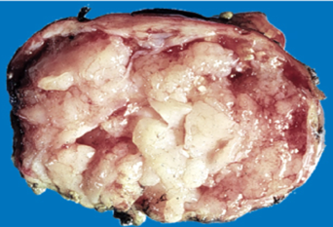
There are over a dozen variants of papillary thyroid carcinoma, but the most common is one composed predominantly or exclusively of follicles (follicular variant of papillary thyroid carcinoma “ absence of papillary structures , but presence of unique nuclear features” ). | Variation
:Prognosis of PTC is dependent on several factors including * Age : (in general, the prognosis is less favorable among patients older than 40 years). *stage : the presence of extra-thyroidal extension, and presence of distant metastases | Prognosis associated with 10-year survival rates in excess of 95%.
un-encapsulated , infiltrative and may be multifocal . | Gross appearance
It is true that it metastasize but its not an aggressive tumor so it has a good prognosis depending on age and stage (it depends more on the stage).
Treatment: patient undergo thyroidectomy and remove lymph nodes if there was metastases. But if not, the lymph nodes will not be removed.
There are two variants:
Classical: papillary variant depend on papillary structures
Follicular variants: exclusive follicles depend on the presence of nuclear features such as(orphan annie eye nucleus, psammoma bodies, pseudo-inclusions and grooves). So it is called follicular variant of papillary thyroid carcinoma
Not all PTC have the same histopathology(nuclear features), we must look at it at a higher magnification.

Slide 7
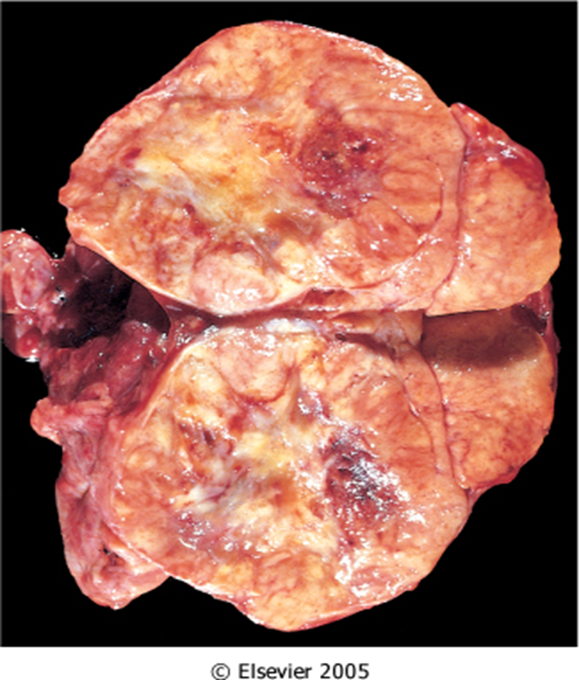
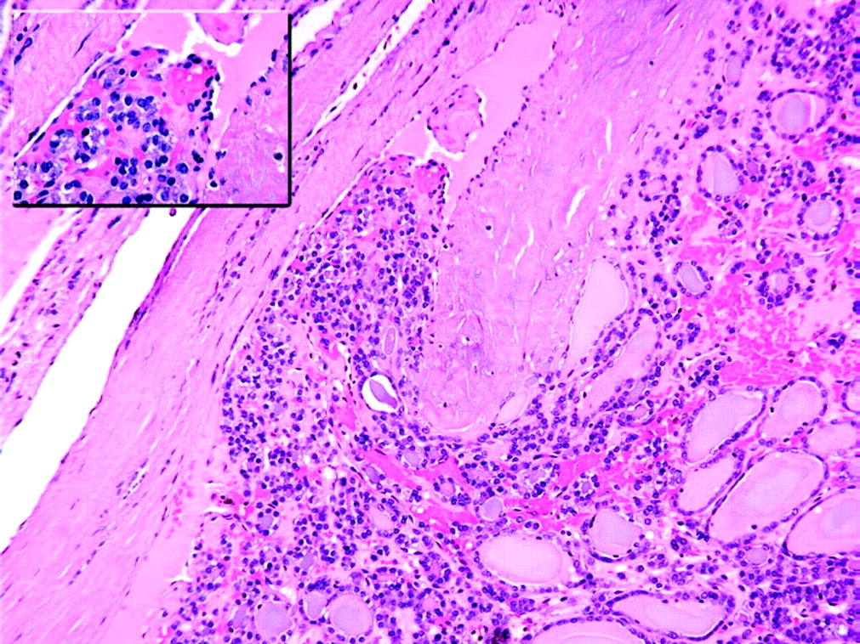
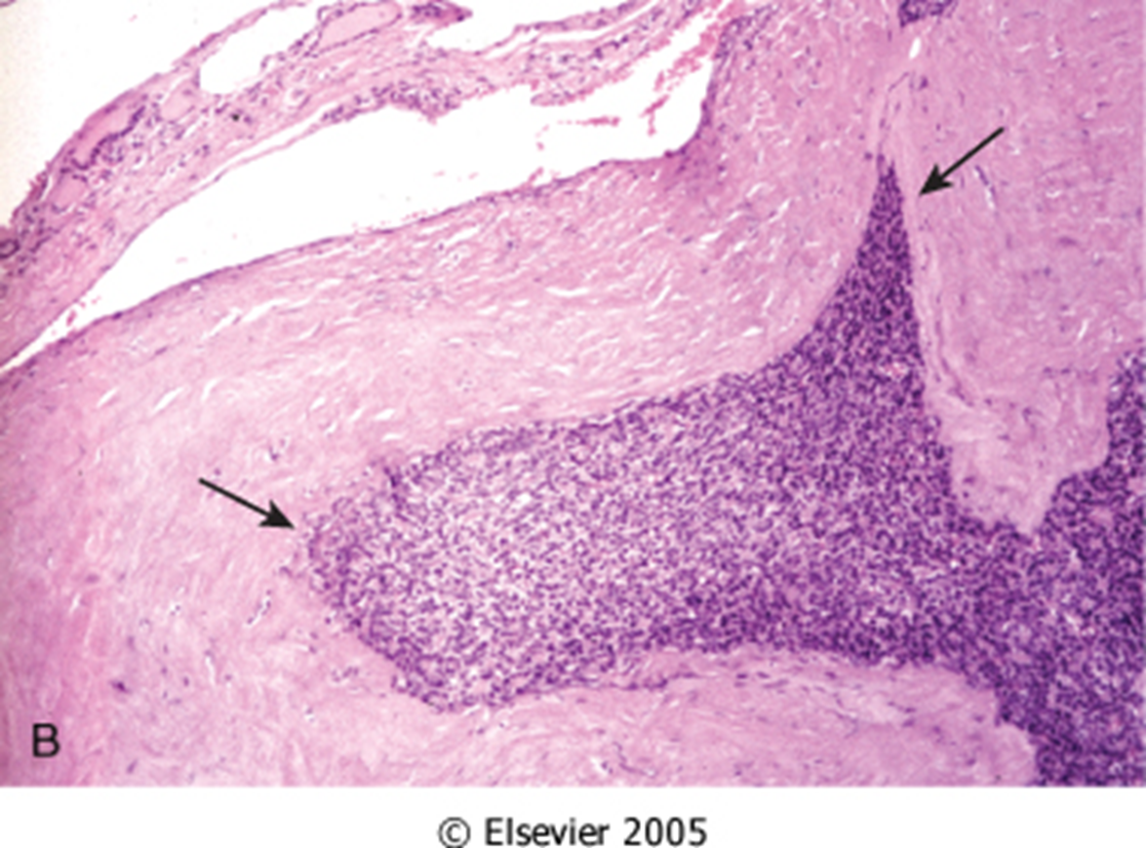
Follicular carcinoma
5% to 15% of primary thyroid cancers.
More common in women (3 : 1)
Peak incidence between 40 and 60 years.
More frequent in areas with dietary iodine deficiency
Follicular carcinomas manifest most frequently as solitary cold thyroid nodules.
These neoplasms tend to metastasize through the bloodstream to the lungs, bone, and liver.
Minimally invasive(well encapsulated: only focal break-through or focal vascular invasion), 10 year survival rate 90%.
Widely invasive carcinoma (scattered capsule and tumor), 10 year survival rate less than 50%.
Morphology
On microscopic examination, most follicular carcinomas are composed of fairly uniform cells forming small follicles, reminiscent of normal thyroid.(Depend on capsular and/or vascular invasion) (Here it is more crowded with absence of nuclear features looks like the normal thyroid gland)
Follicular carcinomas may be:
1- Widely invasive, infiltrating the thyroid parenchyma and extrathyroidal soft tissues.
2- Minimally invasive, are sharply demarcated lesions that may be impossible to distinguish from follicular adenomas on gross examination. This distinction requires extensive histologic sampling of the tumor capsule–thyroid interface, to exclude capsular and/or vascular invasion

Slide 8
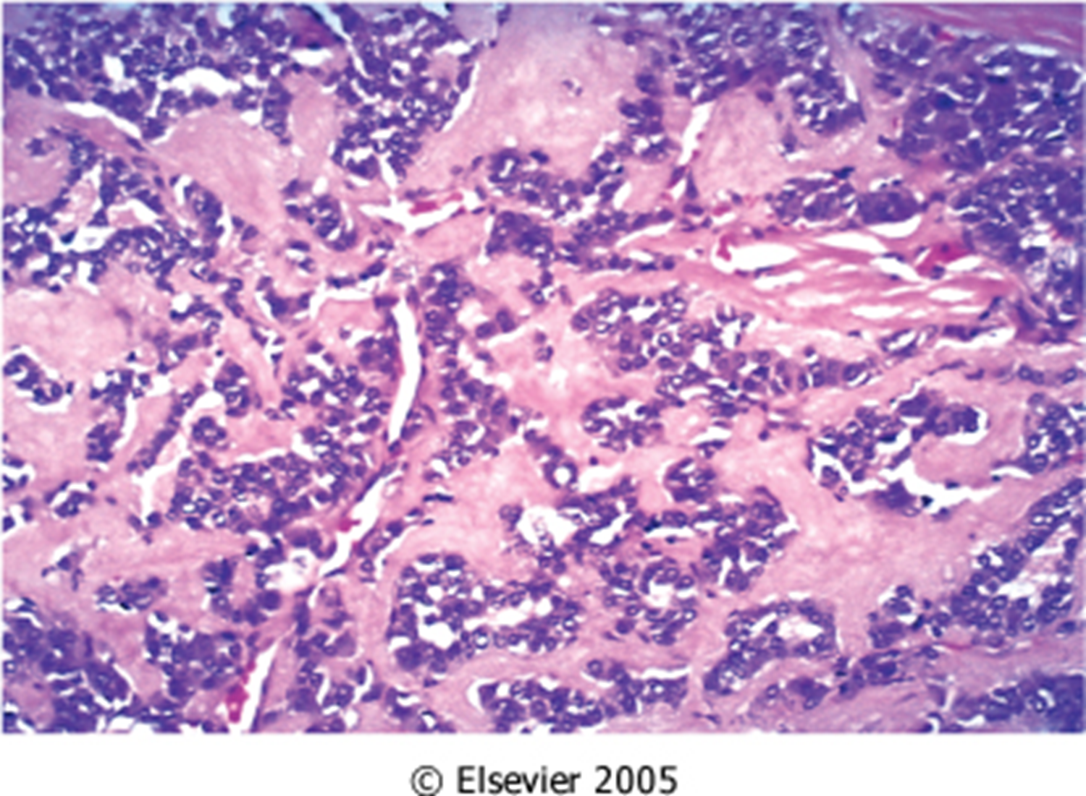
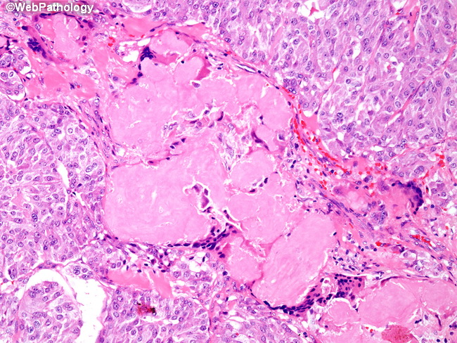
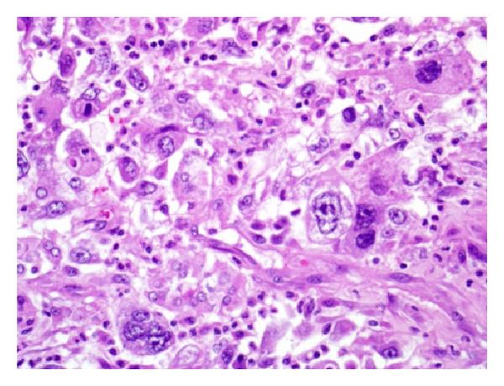
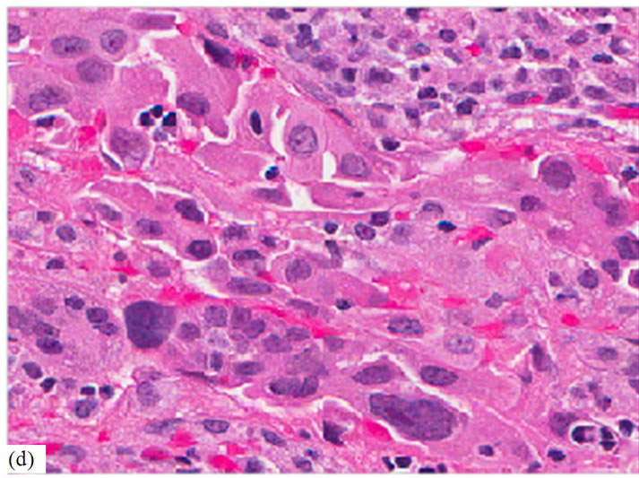
 | General info | Morphology
Medullary carcinoma MEN syndrome has two types: Type 1: associated with pituitary, para-thyroid and pancreas Type 2: associated with medullary carcinoma | Medullary carcinomas of the thyroid are neuroendocrine neoplasms made up of cells that are a combination of hormone-producing endocrine cells and nerve cells derived from the parafollicular cells, or C cells, of the thyroid. Medullary carcinomas, similar to normal C cells, secrete calcitonin, the measurement of which plays an important role in the diagnosis and postoperative follow-up of patients. About 70% of tumors arise sporadically No family history. The remainder occurs in the setting of MEN syndrome 2A or 2B (30%) or as Familial tumors without an associated MEN syndrome (familial medullary thyroid carcinoma, or FMTC). | Polygonal to spindle cells Amyloid deposition (congo-red stain) aggregates of proteins that become folded into a shape that allows many copies of that protein to stick together forming fibrils Bilaterality. Both loops Multicentricity (multifocal) having multiple centers of origin Necrosis Hemorrhage
Anaplastic Carcinomas | Anaplastic carcinomas of the thyroid are undifferentiated tumors of the thyroid follicular epithelium. Can be arising from a more differentiated carcinoma (papillary) These tumors starts differentiated then becomes undifferentiated resulting in anaplastic carcinomas (Cells are highly pleomorphic) Lethal (100%) (Poor prognosis) Older age group > 65 year | Highly anaplastic cells: (1) large, pleomorphic giant cells, including occasional osteoclast-like multinucleated giant cells (2) spindle cells with a sarcomatous appearance neoplastic cells resembling embryonic connective tissue. (3) mixed spindle and giant cells (4) small cells
EM: Neuro-secretory granules are also an important feature for diagnosis

Slide 9
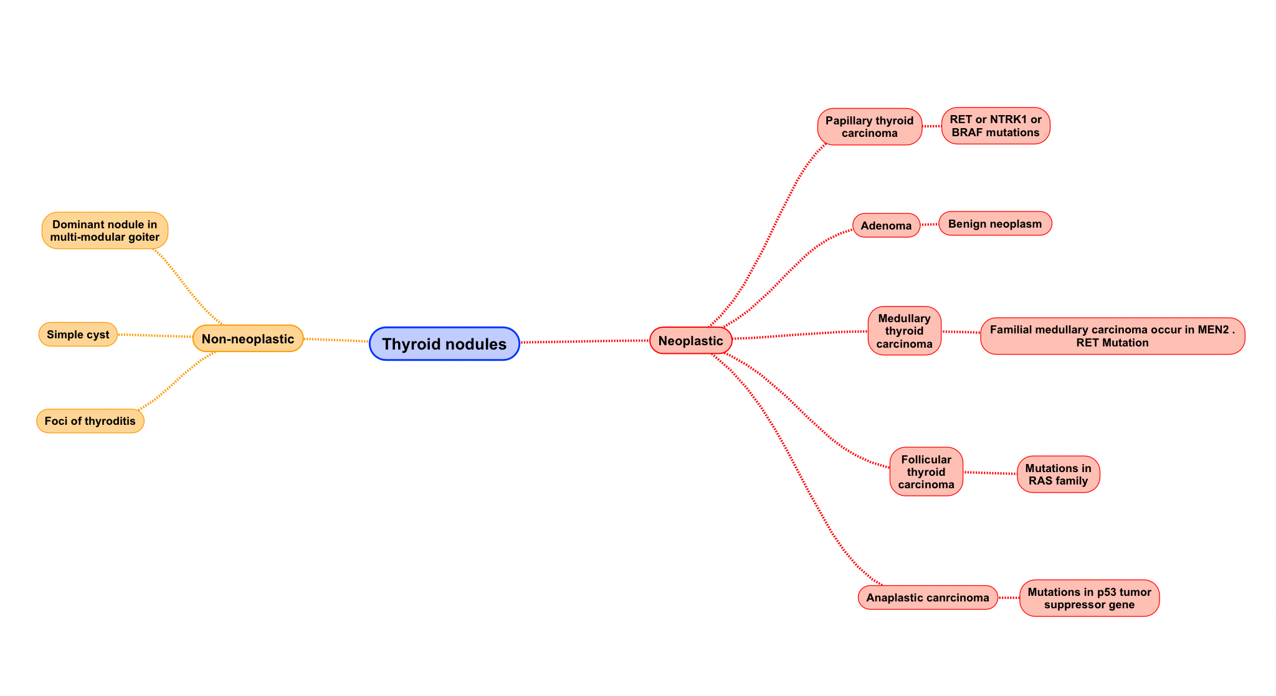
Robbin’s Corner :

Slide 10
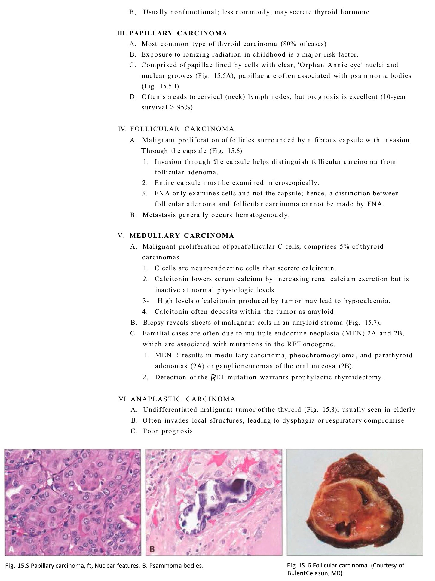

Slide 11
Questions
Q1: the measurement of calcitonin plays an important role in the diagnosis and postoperative follow-up of patients in which kind of tumors?
MC
Anaplastic carcinomas
Follicular carcinoma
PTC
Ans: A
Q2: Amyloid is stained by?
H&E
Indian ink
Congo red
Kinyouns-cold stain
Ans: C
Q3: Anaplastic cells can have?
pleomorphicgiant cells, sarcomatous appearance, larg cells.
sarcomatous appearance , giant cells and amyloid.
spindle cells with a sarcomatous appearance and small cells
Polygonal to spindle cells, , pleomorphicgiant cells and small cells
Ans: C

Slide 12
Q4:“Multiple nodules” are more likely to be neoplastic.
True
False
Q5:Hot nodules are more likely to be benign than malignant.
True
False
Ans:A
Q6:Foci of thyroiditis are considered as:
Neoplastic Nodules
Non-neoplastic Nodules
Adenoma
None of the above
Ans :B
Ans:B
Q7:Examination of a mass taken from a patient’s thyroid showed multiple nodules, they are NOT compressing adjacent thyroid parenchyma, capsule is not well-formed. What is the most likely diagnosis?
a)Thyroid adenoma
b)Multinodular goiter
c)Thyroid follicular carcinoma
Ans:b

Slide 13
Q8:What it’s the type of carcinoma that has RAS gene mutation?
Papillary thyroid carcinoma.
Follicular thyroid carcinoma.
Medullary thyroid carcinomas
Anaplastic carcinoma.
Ans:B
Q9: which one of the flowing consider as
one of nuclear feature in PTU ?
psammoma bodies
Hurthle cell
Grooved nuclei
Ans:c

Slide 14
حسبي الله لا إله إلَّا هو عليه توكلت وهو رب العرش العظيم.
الأعضاء
لمى التميمي
فاطمة الطاسان
دعاء وليد
رنيم الغامدي
ابتسام المطيري
مها الغامدي
ريما الشايع
بشرى قوقندي
جواهر الخيال
القادة
حنين السبكي
عبدالله أبو عمارة
Editing File
Email: pathology436@gmail.com Twitter: @pathology436
References: Doctor’s slides + notes, Robbins basic pathology 10th edition.

