Slide 1
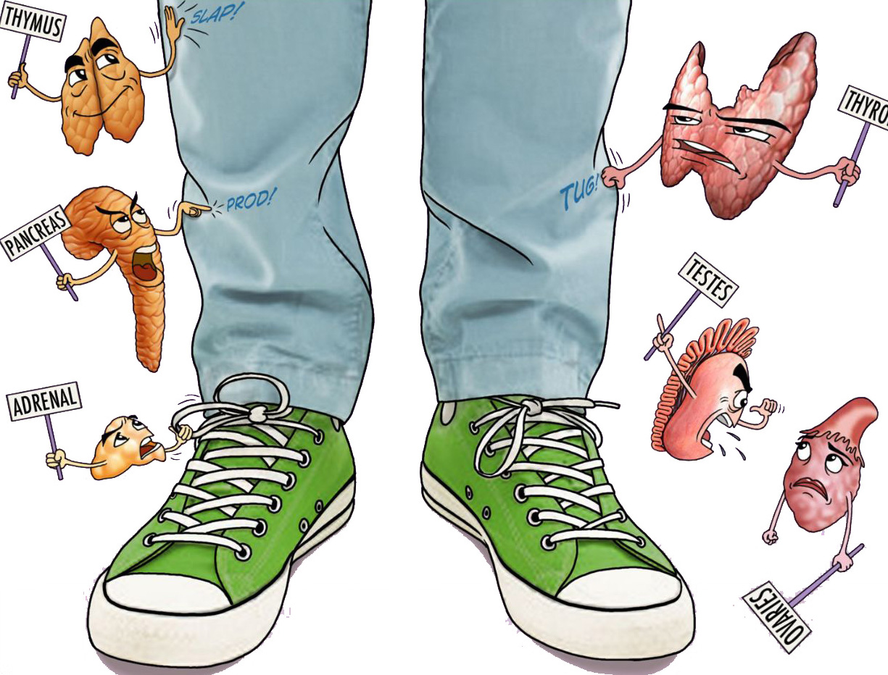



Adrenal gland
Objectives:
Understand the structure and function of adrenal glands.
Know the disorders that can cause hypo or hyper function of the adrenal cortex.
Understand the histopathological features and of both medullary (pheochromocytoma) and adrenocortical neoplasms.
• Black: Doctors’ slides. • Red: Important! • Light Green: Doctors’ notes • Grey: Extra. • Italic black: New terminology.

Slide 2
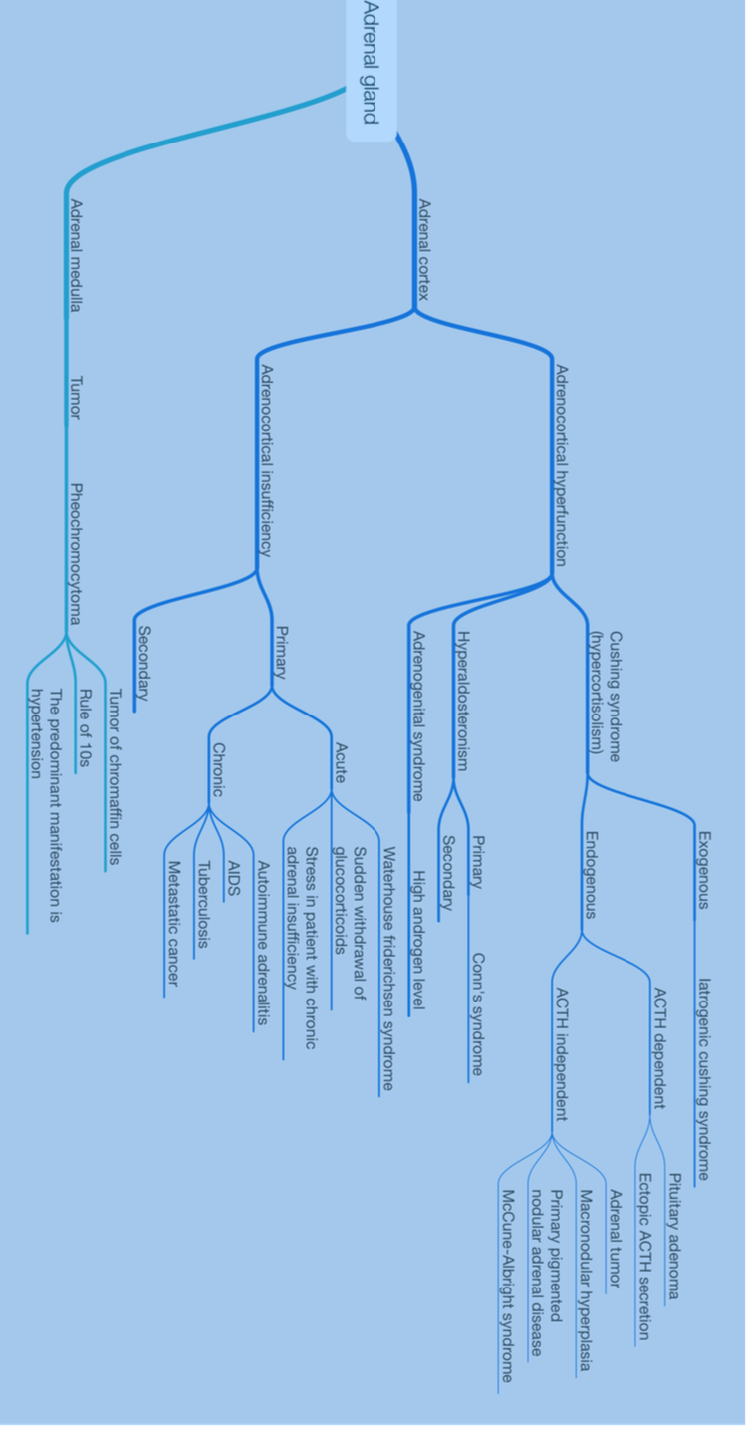
Lecture Overview
Picture taken from 435 pathology team

Slide 3
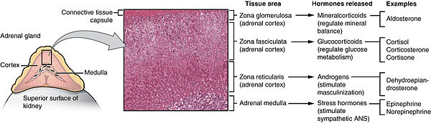
Adrenal Glands
The adrenal glands are paired endocrine organs consisting of both cortex and medulla
Three layers in the cortex:
Zona glomerulosa
Zona reticularis abuts the medulla.
Intervening is the broad zona fasciculata (75%) of the total cortex
Three types of steroids that are secreted from adrenal cortex :
(1) Glucocorticoids (principally cortisol) zona fasciculata
(2) Mineralocorticoids (aldosterone) zona glomerulosa
(3) Sex steroids (estrogens and androgens) zona reticularis.
. The adrenal medulla is composed of chromaffin cells, which synthesize and secrete catecholamines, mainly epinephrine.

Slide 4
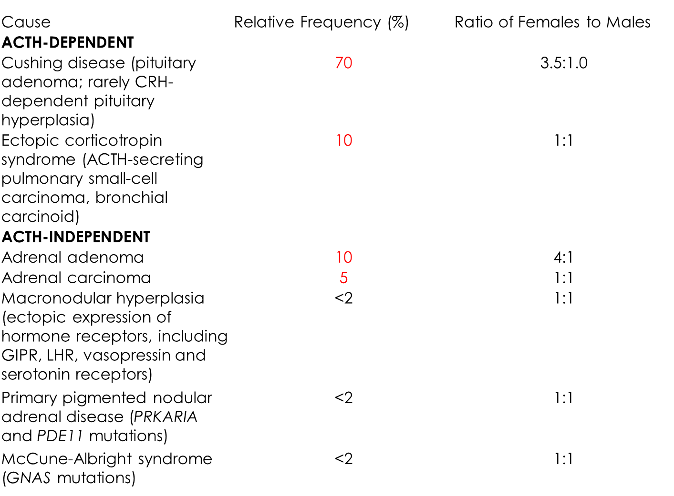
ADRENOCORTICAL HYPERFUNCTION
There are Three basic types of corticosteroids in adrenal cortex (glucocorticoids, mineralocorticoids, and sex steroids)so, there are Three distinctive hyper-adrenal clinical syndromes:
(1) Cushing syndrome, characterized by increased cortisol
(2) Hyperaldosteronism, characterized by increased aldosterone
(3) Adrenogenital or virilizing syndromes caused by an excess of androgens
(Cushing Syndrome)
The causes of Cushing syndrome are broadly divided into
(1)exogenous (2)endogenous causes.
The vast majority of cases of Cushing syndrome are the result of the administration of exogenous glucocorticoids (“iatrogenic” Cushing syndrome). Exogenous >E.g. medication
The endogenous causes can:
ACTH dependent (1-Pituitary Adenoma 2-Ectopic Corticotropin (Either Small cell carcinoma or carcinoid ! NOT SQUAMOUS CARCINOMA!!)
ACTH independent (Follow the table, most common are Adrenal adenoma or carcinoma)

Slide 5
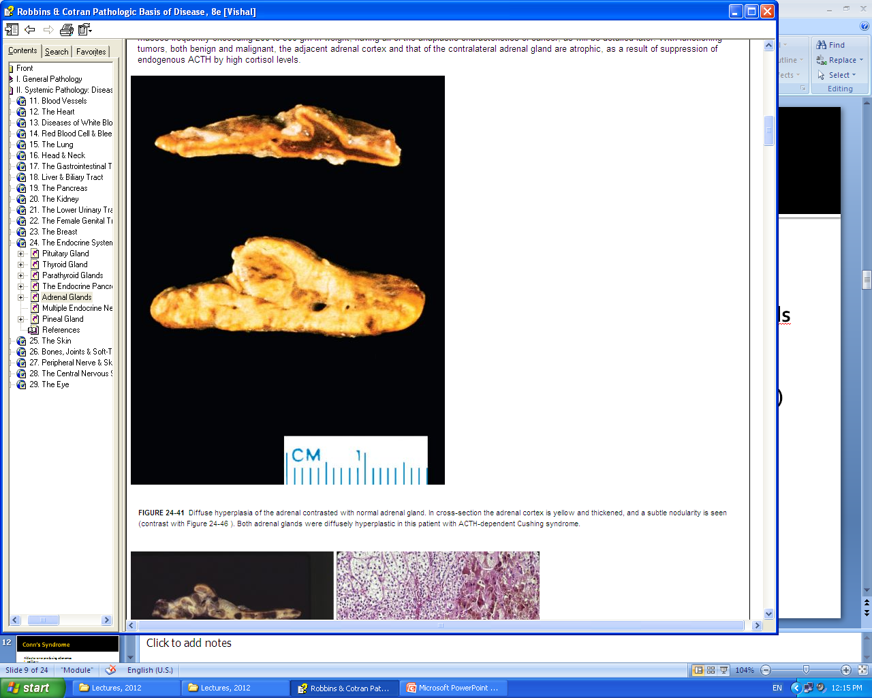
Morphology of Adrenocortical hyperfunction
One of the following abnormalities:
Diffuse hyperplasia: individuals with ACTH-dependent Cushing syndrome(Because the adrenal is getting too much ACTH that it becomes very big and undergo hyperplasia )
Cortical atrophy : results from exogenous glucocorticoids adjust level of cortisol.) When you take cortisol from an exogenous source like tablets for example , you will have increased blood cortisol which will cause feed back inhibition , and the pituitary with not secrete ACTH anymore , so your adrenals will be sleeping all that time > atrophy)
Macronodular (less than 3cm), or micronodular(1-3mm) hyperplasia
Adenoma or carcinoma
Diffuse hyperplasia .
”Normally the coertex is thin , as you see in the picture above”

Slide 6
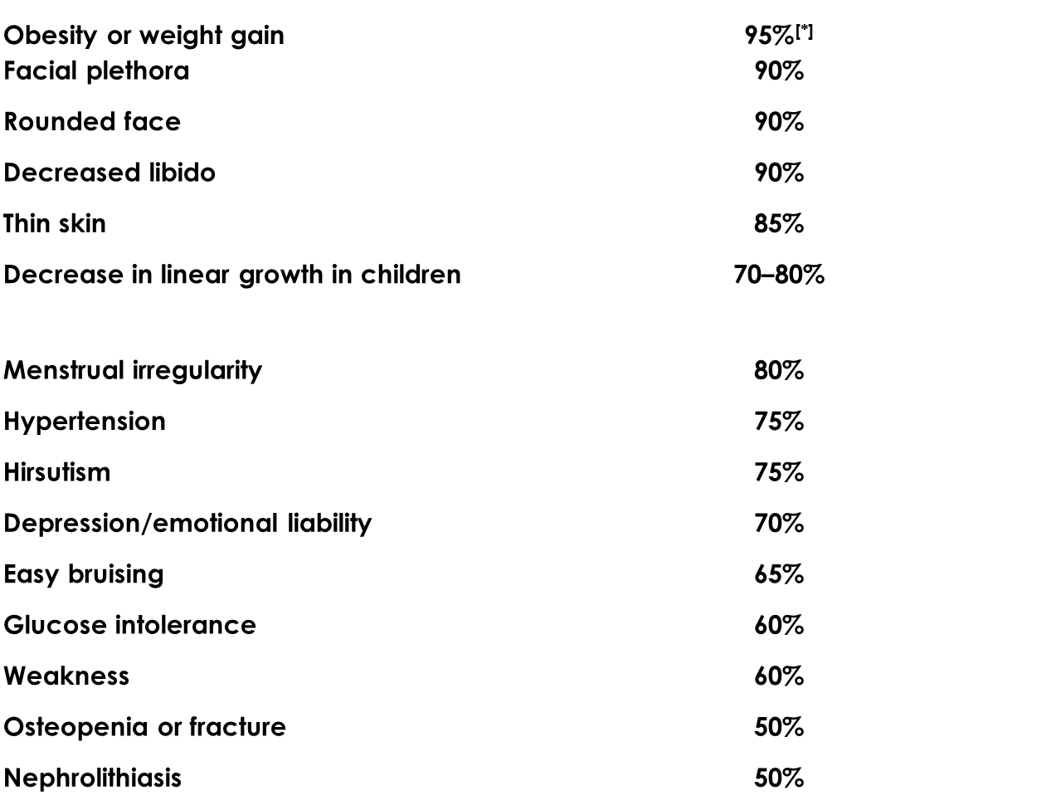
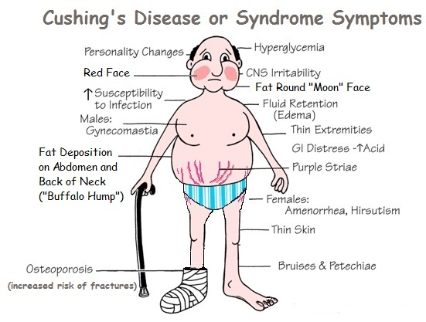
Clinical Features of Cushing Syndrome:
hypertension and weight gain.
truncal obesity, “moon face”and accumulation of fat in the posterior neck and back (“buffalo hump”). (Re-distribution of fat from the gluteal and hip region to the abdominal area and behind the neck)
proximal limb weakness.(increased cortisol level > increased catabolic effect of proteins > all proteins go out from their stores “like in muscles” to the blood , thus causes muscle weakness” )
Glucocorticoids induce gluconeogenesis and inhibit the uptake of glucose by cells, with resultant hyperglycemia,glucosuria, and polydipsia, mimicking diabetes mellitus
Thin skin and fragile, and easily bruised; cutaneous striae .(Due to the increased catabolic effect of proteins > all protiens go out from their stores to blood > one of proteins store is collagen in skin > so skin becomes very fragile > Any increase in weight will cause it to strech”Puprle striae” or any minor trauma will cause bruises)
Osteoporosis ( Due to Depletion of proteins from its stores, because bones are a main source of proteins and collagen too) with consequent increased susceptibility to fractions.
increased risk for a variety of infections.(Increase cortisol causes decreased immunity )
hirsutism and menstrual abnormalities. (Due to increased androgens level )
mental disturbances, including mood swings, depression, and frank psychosis.
Extra-adrenal Cushing syndrome caused by pituitary or ectopic ACTH secretion usually is associated with increased skin pigmentation secondary to melanocyte-stimulating activity in the ACTH precursor molecule.

Slide 7
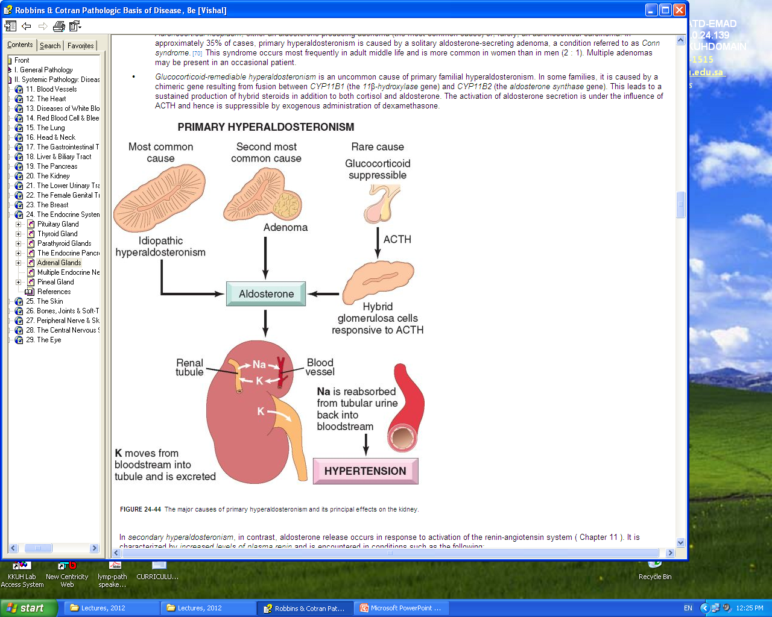
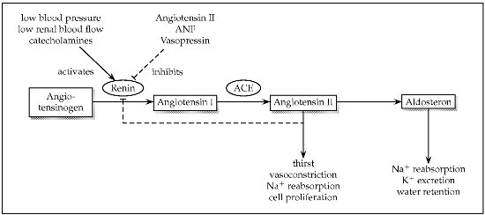
Hyperaldosteronism: Excess aldosterone secretion
There are two types:
Primary aldosteronism (autonomous overproduction of aldosterone) with resultant suppression of the renin-angiotensin system and decreased plasma renin activity.
Secondary hyperaldosteronism, in contrast, aldosterone release occurs in response to activation of the renin-angiotensin system (Ex:Either to renal stenosis or Hypovolemia )
Primary Aldosteronisim causes :
Bilateral idiopathic hyperaldosteronism, characterized by bilateral nodular hyperplasia of the adrenal glands. This mechanism is the most common underlying cause of primary hyperaldosteronism, accounting for about 60% of cases. The pathogenesis is unclear.
Adrenocortical neoplasm, either an aldosterone-producing adenoma or rarely, an adrenocortical carcinoma. In approximately 35% of cases, primary hyperaldosteronism is caused by a solitary aldosterone-secreting adenoma, a condition referred to as Conn syndrome.
Rarely, familial hyperaldosteronism may result from a genetic defect that leads to overactivity of the aldosterone synthase gene, CYP11B2.

Slide 8
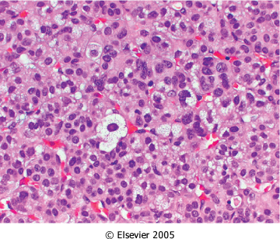
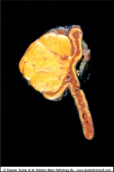
Clinical features:
Presents with hypertension.(due to increase in sodium reabsorption in distal convoluted tubule)
Primary hyperaldosteronism may be the most common cause of secondary hypertension (i.e., hypertension secondary to an identifiable cause).
Aldosterone promotes sodium reabsorption.
Hypokalemia results from renal potassium wasting. it can cause a variety of neuromuscular manifestations, including:
weakness, paresthesias and visual disturbances.
Aldosterone-producing adenomas Morphology:
Solitary
Small (<2 cm in diameter)
Well-circumscribed lesions left > right Thirties and forties(In contrast to carcinomas )
Women more often than in men
Buried within the gland and do not produce visible enlargement
Bright yellow on cut section
Aldosterone producing adenomas , You can see focal neuclear Atypia (Bening neoplasm) .

Slide 9
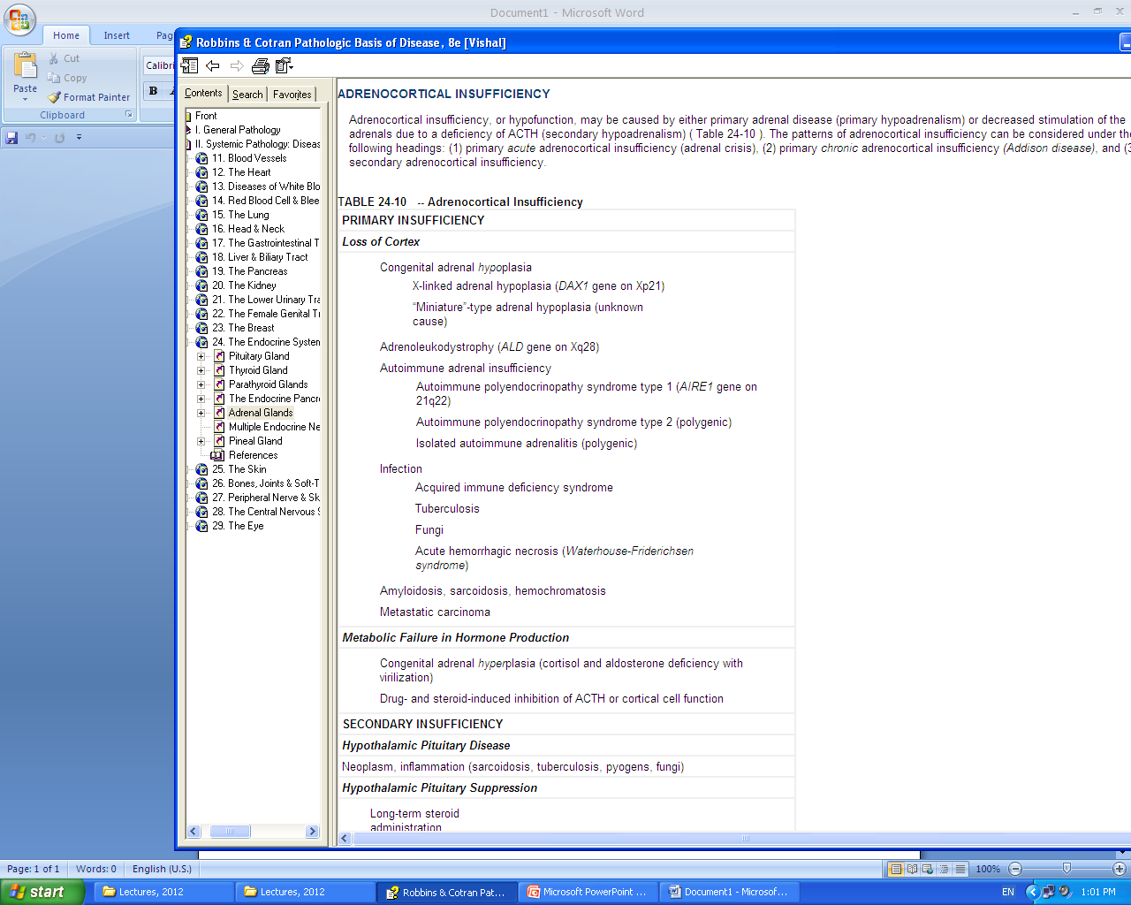
Hypersecretion of sex steroids:
The adrenal cortex can secrete excess androgens in either of two settings:
adrenocortical neoplasms (usually virializing carcinomas)
congenital adrenal hyperplasia (CAH).
CAH consists of a group of autosomal recessive disorders characterized by defects in steroid biosynthesis, usually cortisol; the most common subtype is caused by deficiency of the enzyme 21-hydroxylase.
Reduction in cortisol production causes a compensatory increase in ACTH secretion, which in turn stimulates androgen production.
Androgens have virilizing effects, including masculinization in females (ambiguous genitalia, oligomenorrhea, hirsutism), ¹precocious puberty in males.
Adrenocortical Insufficiency:
Caused by either primary adrenal disease (Primary hypoadrenalisim)
decreased stimulation of the adrenals due to a deficiency of ACTH (secondary hypoadrenalism)
Doctor said infections are important
1:Having developed certain abilities or characteristics at an earlier age than is usual or expected

Slide 10
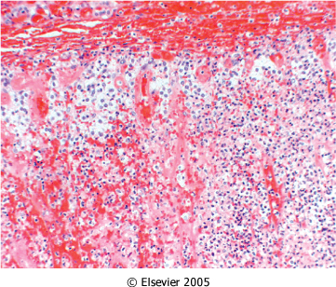
Continue adrenocortical insufficiency :
Three patterns of adrenocortical insufficiency
Primary acute adrenocortical insufficiency (adrenal crisis)
Primary chronic adrenocortical insufficiency(Addison disease)
Secondary adrenocortical insufficiency
Primary Acute :
hemorrhage
Waterhouse-Friderichsen syndrome. At autopsy, the adrenals were grossly hemorrhagic and shrunken; microscopically, little residual cortical architecture is discernible. Autoimmune adrenalitis

Slide 11
Waterhouse-Friderichsen syndrome is classically associated with Neisseria meningitidis septicemia but can also be caused by other organisms, including Pseudomonas spp., pneumococci, and Haemophilus influenzae.
The pathogenesis of the Waterhouse-Friderichsen syndrome remains unclear but probably involves endotoxin-induced vascular injury with associated disseminated intravascular coagulation.
( First you get infected with the bacteria ”BACTEREMIA” >Septicemia “Which is severe bacteremia”> reaches the adrenal glands > Causes hemorrhage of the adrenals due to the vascular injury caused by the bacteria” > Failure of adrenals )

Slide 12
Chronic Adrenocortical Insufficiency: (Addison Disease)
uncommon disorder resulting from progressive destruction of the adrenal cortex.
More than 90% of all cases are attributable to one of four disorders:
autoimmune adrenalitis (Most common, Autoimmune destruction of steroid producing cells and auto-antibodies)
tuberculosis
the acquired immune deficiency syndrome (AIDS)
metastatic cancer
Clinical features:
Gastrointestinal disturbances are common and include anorexia, nausea, vomiting, weight loss, and diarrhea.
In patients with primary adrenal disease, increased levels of ACTH precursor hormone stimulate melanocytes, with resultant hyperpigmentation of the skin and mucosal surfaces.(e.g: in lips)
Decreased mineralocorticoid (aldosterone) activity in patients with primary adrenal insufficiency results in potassium retention and sodium loss, with consequent hyperkalemia, hyponatremia, volume depletion, and hypotension, whereas secondary hypoadrenalism is characterized by deficient cortisol and androgen output but normal or near-normal aldosterone synthesis.
Hypoglycemia occasionally may occur.
Stresses such as infections, trauma, or surgical procedures in affected patients may precipitate an acute adrenal crisis, manifested by intractable vomiting, abdominal pain, hypotension, coma, and vascular collapse. Death follows rapidly unless corticosteroids are replaced immediately.

Slide 13
Morphology
Primary autoimmune adrenalitis is characterized by irregularly shrunken glands, which may be exceedingly difficult to identify within the suprarenal adipose tissue.
On histologic examination, the cortex contains only scattered residual cortical cells in a collapsed network of connective tissue. A variable lymphoid infiltrate is present in the cortex and may extend into the subjacent medulla
In tuberculosis or fungal diseases, the adrenal architecture may be effaced by a granulomatous inflammatory reaction identical to that encountered in other sites of infection.

Slide 14
ADRENOCORTICAL NEOPLASMS:
While functional adenomas are most commonly associated with hyperaldosteronism and with Cushing syndrome, a virializing neoplasm (Androngens)is more likely to be a carcinoma.
Not all adrenocortical neoplasms, however, elaborate steroid hormones.
Determination of whether a cortical neoplasm is functional or not is based on clinical evaluation and measurement of the hormone or its metabolites in the laboratory.
Most cortical adenomas do not cause hyperfunction and usually are encountered as incidental findings at the time of autopsy or during abdominal imaging for an unrelated cause.
On cut surface, adenomas usually are yellow to yellow-brown, owing to the presence of lipid within the neoplastic cells . As a general rule they are small, averaging 1 to 2 cm in diameter.
On microscopic examination, adenomas are composed of cells similar to those populating the normal adrenal cortex. The nuclei tend to be small, although some degree of pleomorphism may be encountered even in benign lesions (endocrine atypia). The cytoplasm of the neoplastic cells ranges from eosinophilic to vacuolated, depending on their lipid content; mitotic activity generally is inconspicuous².
Adrenocortical carcinomas
are rare neoplasms that may occur at any age, including in childhood.
Two rare inherited causes of adrenal cortical carcinomas are Li-Fraumeni syndrome and Beckwith-Wiedemann syndrome .
In most cases, adrenocortical carcinomas are large, invasive lesions that efface the native adrenal gland.
On cut surface, adrenocortical carcinomas typically are variegated³, poorly demarcated lesions containing areas of necrosis, hemorrhage, and cystic change
You can see anaplastic cells with prominent nuclei and mitosis
2:Not clearly visible
3:Not Homogeneous

Slide 15
Pheochromocytoma
Pheochromocytomas(chromaffin cells ) secret catecholamines
Similar to aldosterone-secreting adenomas, give rise to surgically correctable forms of hypertension.
“Pheochromocytomas are uncommon neoplasms composed of chromaffin cells, which synthesize and release catecholamines and in some instances peptide hormones. These tumors are important because they (similar to aldosterone-secreting adenomas) give rise to surgically correctable forms of hypertension. Although only about 0.1% to 0.3% of hypertensive patients have an underlying pheochromocytoma, the hypertension can be fatal when the pheochromocytoma goes unrecognized. Occasionally, one of these tumors produces other steroids or peptides and so may be associated with Cushing syndrome or some other endocrinopathy.”
"rule of 10s":
10% of pheochromocytomas arise in association with one of several familial are syndromes MEN-2A and MEN-2B syndromes.
10% of pheochromocytomas extra-adrenal.
10% of nonfamilial adrenal pheochromocytomas are bilateral; this figure may rise to 70% in cases that are associated with familial syndromes.
10% of adrenal pheochromocytomas are biologically malignant
10% of adrenal pheochromocytomas in childhood

Slide 16
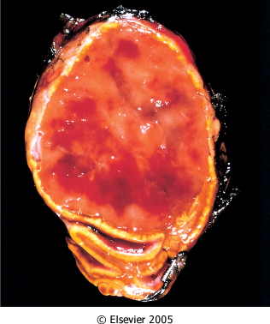
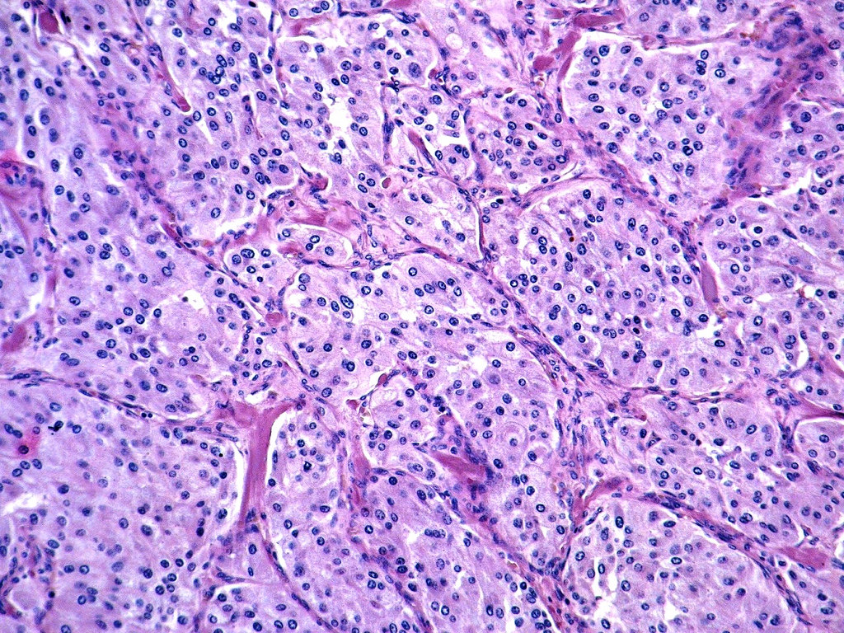
Pheochromocytoma can be manifisted in those disease :
Von Hippel-Lindau disease
Von Recklinghausen’s Neurofibromatosis (Type1)
Gross:
range in size from small, circumscribed lesions confined to the adrenal to large, hemorrhagic masses weighing several kilograms. On cut surface, smaller pheochromocytomas are yellow-tan.
Morphology:
polygonal to spindle-shaped chromaffin cells and their supporting cells, compartmentalized into small nests, or Zellballen⁴, by a rich vascular network
The cytoplasm of the neoplastic cells often has a finely granular appearance
Electron microscopy reveals variable numbers of membrane-bound, electron-dense granules
The nuclei of the neoplastic cells are often quite pleomorphic. Both capsular and vascular invasion may be encountered in benign lesions, and the mere presence of mitotic figures does not imply malignancy. Therefore, the definitive diagnosis of malignancy in pheochromocytomas is based exclusively on the presence of metastases. These may involve regional lymph nodes as well as more distant sites, including liver, lung, and bone.
4:Zell (means cell in germany) and ballen (means ball) so it’s packed like balls in the cell.

Slide 17
Clinical features:
The predominant clinical manifestation of pheochromocytoma is hypertension.
The characteristic presentation with a hypertensive episode is one of abrupt elevation in blood pressure, associated with tachycardia, palpitations, headache, sweating, tremor, and a sense of apprehension.
increased risk of myocardial ischemia, heart failure, renal injury, and stroke (cerebrovascular accident).
Sudden cardiac death may occur, probably secondary to catecholamine-induced myocardial irritability and ventricular arrhythmias.
The laboratory diagnosis of pheochromocytoma is based on demonstration of increased urinary excretion of free catecholamines and their metabolites, such as vanillylmandelic acid and metanephrines

Slide 18
Summary

Slide 19
Questions
1- Virializing syndromes are caused by which of the following?
Increased cortisol.
Hyperaldosteronism.
Excess androgens.
Decreased Cortisol.
ANS: C
2- Which of the following is the most common cause of Cushing syndrome?
Intake of corticoids.
Pituitary adenoma.
Adrenal adenoma.
Ectopic corticotropin syndrome.
ANS: A
3- A 35-year old gentleman presented with obesity, facial plethora and decreased libido was found to have a shrunken adrenal cortex. Which of the following is the most likely cause?
Pituitary adenoma.
Adrenal adenoma.
Ectopic corticotropin syndrome.
Intake of corticoids.
ANS: D
4- Which of the following is the commonest cause of secondary hypertension?
Hyperaldosteronism.
Cushing disease.
Excess androgens.
Low aldosterone.
ANS: A
5- Zellballen refers to which of the following?
Small nests of chromaffin cells.
Small nests of cortical cells.
Small nuclei without pleomorphism.
Large nuclei with pleomorphism.
ANS: A
6- A patient with an adrenal medullary mass was diagnosed with malignant pheochromocytoma. Which of the following caused the pathologist to diagnose it as malignant?
Mitotic figures.
Vascular invasion.
Capsular invasion.
Metastases.
ANS: D

Slide 20
Robbins basic pathology 9th
In many instances the responsible ectopic tumor of ACTH secreting tumor is small cell carcinoma of the lung .
In cushing syndrome , exogenous glucocorticoids ,suppresses endogenous ACTH results in bilateral cortical atrophy
Diffuse hyperplasia is found in patients with ACTH dependent cushing syndrome.
Early manifestation's of cushing syndrome include hypertension and weight gain
Hypercortisolism causes selective atrophy of fast-twitch (type II) myofibers, with resultant decreased muscle mass and proximal limb weakness.
A characteristic feature of aldosterone-producing adenomas is the presence of eosinophilic, laminated cytoplasmic inclusions , know as spironolactone bodies.
The clinical hallmark of hyperaldosteronism is hypertension.
In all cases of CAH , the adrenals are hyperplastic bilaterally.
Pearson's with chronic adrenocortical insufficiency may develop an acute crisis after any stress that taxes their limited physiological reserve .
Massive adrenal hemorrhage may destroy enough of the adrenal cortex to cause acute adrenocortical insufficiency.
In tuberculosis or fungal disease, the adrenal architecture may be effected by a granulomatous inflammatory reaction identical to that encountered in other sites of infection.
Metastatic carcinoma , the adrenals are enlarged , and their normal architecture is obscured by the infiltrating neoplasm.
Hyperpigmentation is not seen in patients with secondary adrenocortical insufficiency.

Slide 21

حسبي الله لا إله إلَّا هو عليه توكلت وهو رب العرش العظيم.
الأعضاء
طلال العنزي
عبدالمجيد العمار
محمد اليوسف
خالد العيدان
صقر التميمي
القادة
حنين السبكي
عبدالله أبو عمارة
Editing File
Email: pathology436@gmail.com Twitter: @pathology436
References: Doctor’s slides + notes, Robbins basic pathology 10th edition.

