Slide 1
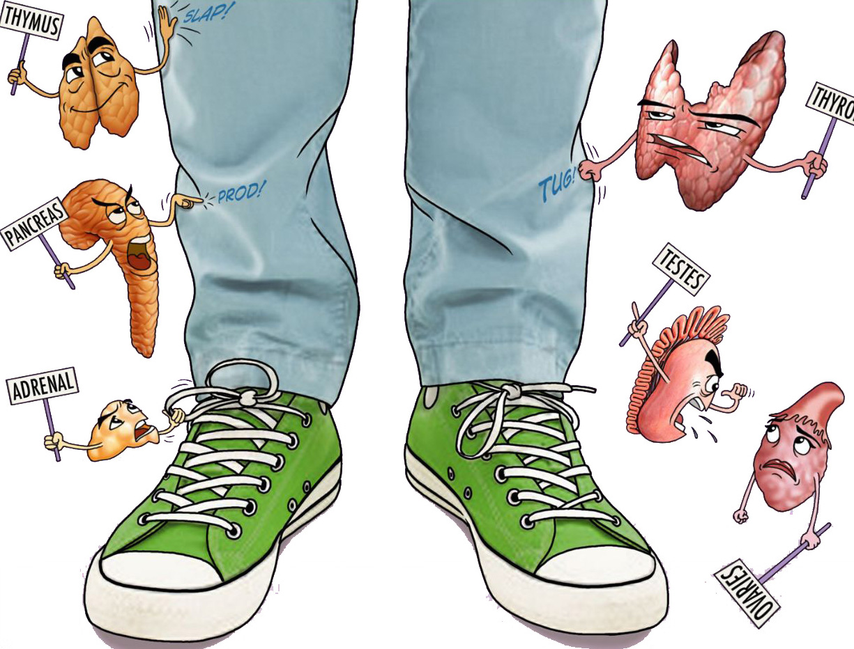


Diabetes Mellitus
Objectives:
Understand the structure of pancreas and have a basic understandidng of its function
Understand the pathogenesis and major histopathalogical changes seen in diabetes mellitus type 1 and type 2
Recognize the major complications of diabetes mellitus
• Black: Doctors’ slides. • Red: Important! • Light Green: Doctors’ notes • Grey: Extra. • Italic black: New terminology.

Slide 2
The endocrine pancreas
Islets of Langerhans, contain four major cell types.
β cell | secretes insulin decrease blood sugar
α cell | secretes glucagon increase blood sugar
δ cells | contain somatostatin
PP (pancreatic polypeptide) | unique pancreatic polypeptide.
Enterochromaffin | VIP, that exerts several gastrointestinal effects, such as stimulation of secretion of gastric and intestinal enzymes.
Diabetes Mellitus (DM)
Diabetes mellitus is not a single disease entity but rather a group of metabolic disorders sharing the common underlying feature of hyperglycemia.
Hyperglycemia in diabetes results from defects in insulin secretion (cell resistance/ insulin deficiency), insulin action (insulin-resistant), or most commonly, both.
Diabetes is the leading cause of end-stage renal disease, adult-onset blindness, and nontraumatic lower extremity amputations
Prediabetes, defined as elevated blood sugar that does not reach the criterion accepted for an outright diagnosis of diabetes ; persons with prediabetes have an elevated risk for development of frank¹ diabetes.
Blood glucose level should be tightly regulated by insulin and glucagon.
insulin is an anabolic hormone; main effect on: skeletal muscles, adipose tissue, liver (gluconeogenesis) no action on brain.
GH, Glucagon are catabolic hormones.
1: Is the precursor stage before DM in which not all of the symptoms required to diagnose diabetes are present, but blood sugar is abnormally high

Slide 3
Diagnosis of DM:
Normal blood glucose levels 70 to 120 mg/dL.
The diagnosis of diabetes is established by elevation of blood glucose by any one of three criteria:
Test | Blood Glucose level indicate DM
Random (at anytime) blood glucose concentration | > 200 mg/dL, with classical signs and symptoms (like increasing weight, Polydipsia , polyuria).
fasting glucose concentration (Minimum 8hrs) | ≥126 mg/dL on more than one occasion(It is done on more than one occasion to avoid false dx).
oral glucose tolerance test (OGTT)² | >200 mg/dL after 2hrs. From administering a standard carbohydrate load (75 g of glucose) repeat to assure diagnosis
Those who have Pre-diabetes (Impaired glucose tolerance will show the following results) :
Fasting Glucose | 110-125 mg/dL
OGTT | 140-199 mg/dL
people with impaired glucose tolerance (prediabetes) have a significant risk for progression to overt (Visible) diabetes over time.
Boarder line or grey zone; higher tendency to develop diabetes
2: A glucose tolerance test measures how well your body’s cells are able to absorb glucose, or sugar, after you ingest a given amount of sugar.

Slide 4
Classification of DM: you have to know the genes of MODY

Slide 5
Type 1 diabetes
is characterized by an absolute deficiency of insulin secretion caused by pancreatic beta cell destruction, usually resulting from an autoimmune attack. Accounts for approximately 10% of all cases.
Pathogenesis:
-Type 1 diabetes is an autoimmune disease in which islet destruction is caused primarily by immune effector cells reacting against endogenous beta cell antigens.
-The classic manifestations of the disease occur late in its course, after more than 90% of the beta cells have been destroyed.
-The fundamental immune abnormality in type 1 diabetes is a failure of self-tolerance in T cells.
-Autoantibodies against a variety of beta cell antigens, are detected in the blood of 70% to 80% of patients.
-90% and 95% of white patients with type 1 diabetes have HLA-DR3, or DR4.
-Environmental factors, especially infections, may be involved too.
Type 2 diabetes
is caused by a combination of peripheral resistance to insulin action and an inadequate compensatory response of insulin secretion by the pancreatic beta cells (relative insulin deficiency). Accounts for approximately 80% to 90% of all cases..
Pathogenesis:
-Type 2 diabetes is a prototypical complex multifactorial disease .
-Environmental factors such as sedentary life style and dietary habits .
-Genetic factors are also involved in the pathogenesis
-Recent Large-scale genome-wide association studies , have identified more than a dozen susceptibility loci called “diabetogenic “ genes The
two defects that characterize type 2 diabetes are :
1-Decreased ability of peripheral tissues to respond to insulin (INSULIN RESISTANCE )
2-Beta cells dysfunction that is manifested as inadequate insulin secretion in the face of insulin resistance and hyperglycemia .
starts with peripheral resistance despite normal insulin level → progressive loss of beta-cells function

Slide 6
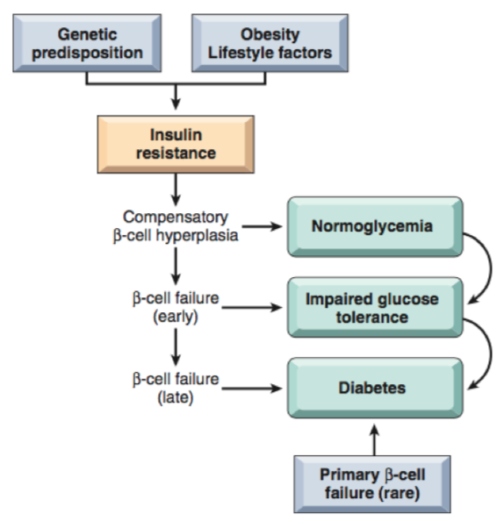
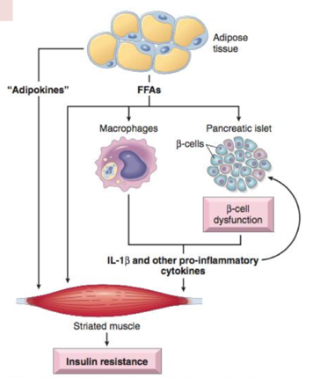
Obesity and insulin resistance:
Insulin resistance is defined as the failure of target tissue to respond normally to insulin . It leads to decreased uptake of glucose in muscles .
Picture1 : multifactorial components leads to insulin resistance , then B-cells tries to compensate by rising the production of insulin (hyperplasia) until it returns the glucose blood level to normal . After a while , B-cells are tired of producing so much insulin , so they start to secrete less insulin and here we will have (Impaired glucose tolerance) . When the B-cells stops completely from secreting insulin (Failure) we will get diabetes .

Slide 7
Monogenic Forms of Diabetes
Resembles type 2 DM, but occurs in young age group.
Type 1 and type 2 diabetes are genetically complex ,no single-gene defect (mutation) can account for predisposition to these entities.
By contrast, monogenic forms of diabetes are uncommon examples of the diabetic phenotype occurring as a result of loss-of-function mutations within a single gene.
The largest subgroup of patients in this category traditionally was designated as having maturity-onset diabetes of the young (MODY) because of its superficial resemblance to type 2 diabetes and its occurrence in younger patients.
MODY can be the result of inactivating mutations in one of six genes.
MODY is caused by genetics defects in Beta cell function, due to mutations in:
Hepatocyte Nuclear Factor 4α gene | HNF4A | MODY-1
Glucokinase gene | GCK | MODY-2
Hepatocyte Nuclear Factor 1α gene | HNF1A | MODY-3
Pancreatic and duodenal hemobox 1 gene | PDX1 | MODY-4
Hepatocyte Nuclear Factor 1β gene | HNF1B | MODY-5
Neurogenic differentiation factor 1 gene | NEUROD1 | MODY-6

Slide 8
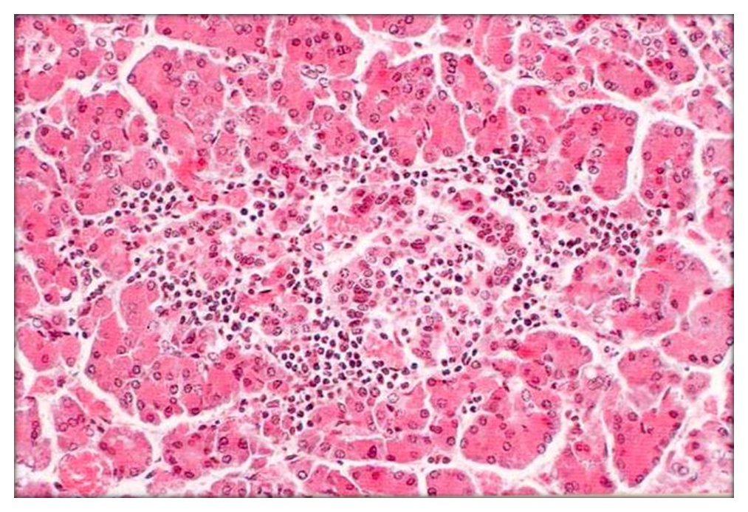
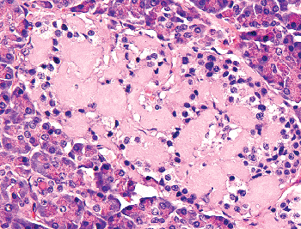
Morphology
Lesions in the pancreas are inconstant (not significant)and rarely of diagnostic value. we don’t take pancreas biopsy for diagnosing diabetes, Diagnosis is by biochemical tests.
One or more of the following alterations may be present:
In Type1 DM:
Reduction in the number and size of islets. This change most often is seen in Type1 DM.
Insulitis: Leukocytic infiltration of the islets, which are principally composed of mononuclear cells (lymphocytes and macrophages). It is typically more in Type1 DM.
In Type2 DM:
Amyloid replacement of islets in long-standing type 2 diabetes, appearing as deposition of pink, amorphous material. At advanced stages fibrosis also may be observed.
Insulitis
Type1 DM
Amyloidosis
Type2 DM

Slide 9
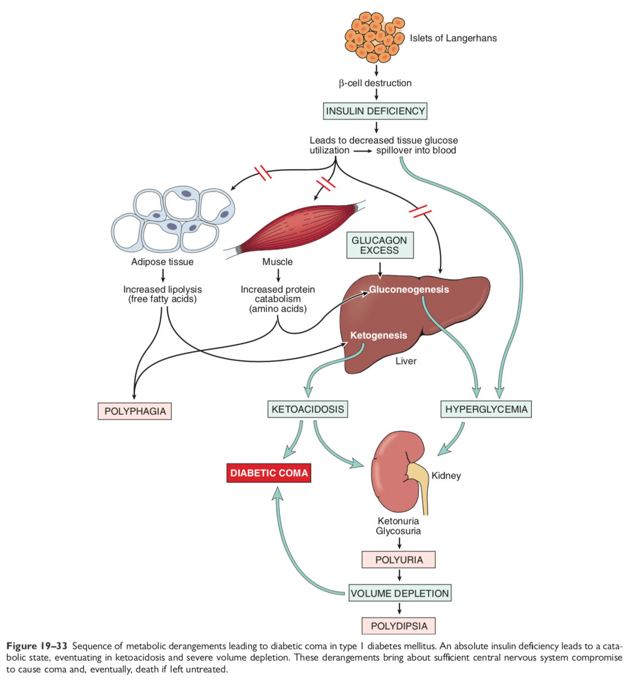
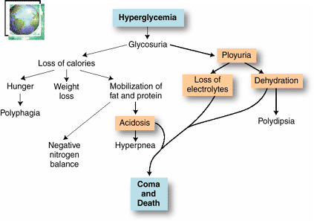
Clinical Manifistations:
Polyuria:when glucose levels are so high that glucose is excreted in the urine. Water follows the glucose concentration passively, leading to abnormally high urine output.
Polyghagia: glucose from the blood cannot enter the cells - due to either a lack of insulin or insulin resistance - so the body can't convert the food you eat into energy. This lack of energy causes an increase in hunger.
Weight loss: insufficient insulin prevents the body from getting glucose from the blood into the body's cells to use as energy. When this occurs, the body starts burning fat and muscle for energy, causing a reduction in overall body weight.

Slide 10
Clinical manifistations
DM type 1 :
the classic triad of diabetes:
Polyuria
Polydipsia
Polyphagia
Despite the increased appetite, catabolic effects prevail, resulting in weight loss and muscle weakness.
In patients with type 1 diabetes, deviations from normal dietary intake, unusual physical activity, infection, or any other forms of stress may rapidly influence the metabolic balance, predisposing the affected person to diabetic ketoacidosis³.
The plasma glucose usually is in the range of 500 to 700 mg/dL
The marked hyperglycemia causes an osmotic diuresis and dehydration characteristic of the ketoacidotic state.
Type 2 DM:
May manifest with
polyuria
polydipsia
But unlike in type 1 diabetes, patients often are older than 40 years and frequently are obese.
In the decompensated state, patients with type 2 diabetes may develop hyperosmolar nonketotic coma. This syndrome is engendered by severe dehydration resulting from sustained osmotic diuresis and urinary fluid loss due to chronic hyperglycemia.
Typically, the affected person is an elderly diabetic who is disabled by a stroke or an infection and is unable to maintain adequate water intake.
Why in type 1 diabetes patients may develop DKA , while in type 2 they don’t ?
Because in Type 1 DM we dont have any insulin , so the cells are not receiving any glucose . Our body then has to convert fat into ketone bodies to supply the cells with inurjy , and the left amount of ketone bodies will be accumulated in blood and cause it to be acidic . Unlike type 2 diabetes where you have ”RELATIVE” amount of insulin .
3:Without enough insulin, your body begins to break down fat as fuel. This process produces a buildup of acids in the bloodstream called ketones, eventually leading to diabetic ketoacidosis if untreated.

Slide 11
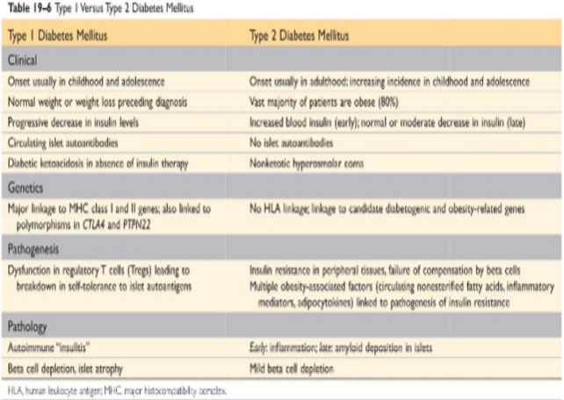
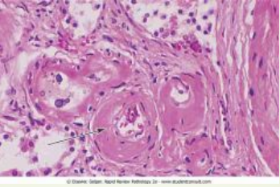
Diabetic complications
Macrovascular disease
The hallmark of diabetic macrovascular disease is accelerated atherosclerosis affecting the aorta and large and medium-sized arteries.
Myocardial infarction, caused by atherosclerosis of the coronary arteries is the most common cause of death in diabetics
Gangrene of the lower extremities, as a result of advanced vascular disease (diabetic foot)
The larger renal arteries also are subject to severe atherosclerosis, but the most damaging effect of diabetes on the kidneys is exerted at the level of the glomeruli and the microcirculation
Hyaline arteriolosclerosis, the vascular lesion associated with hypertension , is both more prevalent and more severe in diabetics than in nondiabetics ´ It takes the form of an amorphous, hyaline thickening of the wall of the arterioles, which causes narrowing of the lumen

Slide 12
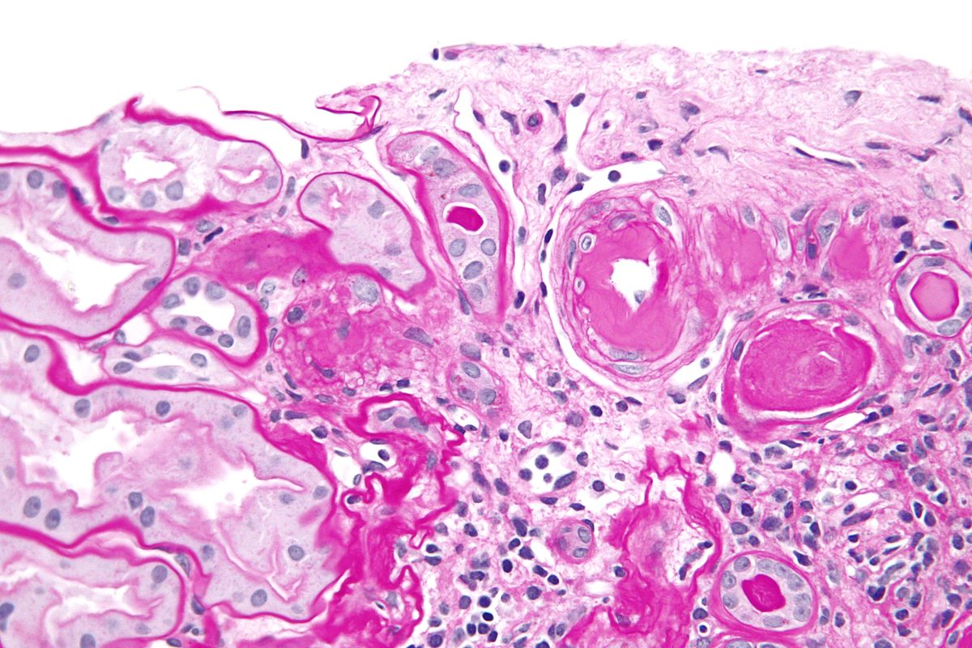
Microangiopathy⁴
One of the most consistent morphologic features of diabetes is diffuse thickening of basement membranes. The thickening is most evident in the capillaries of the skin, skeletal muscle, retina, renal glomeruli, and renal medulla.
the basal lamina separating parenchymal or endothelial cells from the surrounding tissue is markedly thickened by concentric layers of hyaline material composed predominantly of type IV collagen . Of note, despite the increase in the thickness of basement membranes, diabetic capillaries are more leaky than normal to plasma proteins.
The microangiopathy underlies the development of diabetic nephropathy, retinopathy, and some forms of neuropathy.
PAS stain (periodic acid-schiff –PAS-)
4:excess glucose in blood will cause non-enzymatic combination between glucose and proteins and formation of something called “Advanced Glycosylation End products “ . Those AGEs will cross link with collagen and cause the microvascular complications .

Slide 13
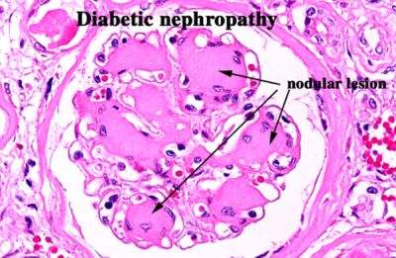
Nephropathy
Renal failure is second only to myocardial infarction as a cause of death from this disease.
Three lesions are encountered:
glomerular lesions
renal vascular lesions, principally arteriolosclerosis
pyelonephritis, including necrotizing papillitis.
The most important glomerular lesions are capillary basement membrane thickening, diffuse mesangial sclerosis, and nodular glomerulosclerosis.
The glomerular capillary basement membranes are thickened along their entire length.
Diffuse mesangial sclerosis (hyaline fibrosis) consists of a diffuse increase in mesangial matrix along with mesangial cell . When glomerulosclerosis becomes marked, patients manifest the nephrotic syndrome, characterized by proteinuria, hypoalbuminemia, and edema.
Nodular glomerulosclerosis : ball-like deposits of a laminated matrix situated in the periphery of the glomerulus . These nodules are PAS-positive . This distinctive change has been called the Kimmelstiel-Wilson lesion.
Nodular glomerulosclerosis is encountered in approximately 15% to 30% of persons with long-term diabetes. It is essentially pathognomonic of diabetes.
Both the diffuse and the nodular forms of glomerulosclerosis induce sufficient ischemia to cause scarring of the kidneys, manifested by a finely granular-appearing cortical surface

Slide 14
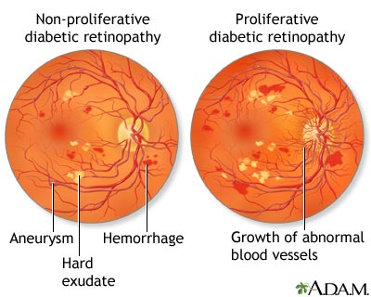
Occular Complications of Diabetes
The ocular involvement may take the form of retinopathy, cataract formation, or glaucoma. Retinopathy⁷, the most common pattern .
The lesion in the retina takes two forms:
nonproliferative (background) retinopathy: (related to the endothelial dysfunction)
Haemorrhages (due to the leaky basement-membrane), retinal exudates (cotton wool spots⁵), microaneurysms, edema, thickening of the retinal capillaries (microangiopathy).
The microaneurysms are discrete saccular dilations of retinal choroidal capillaries that appear through the ophthalmoscope as small red dots.
proliferative retinopathy:
It is a process of neovascularization⁶ and fibrosis.
This lesion leads to serious consequences, including blindness, especially if it involves the macula and retinal detachment
5:Cotton wool spots are an abnormal finding on funduscopic exam of the retina of the eye. They appear as fluffy white patches on the retina.
6: Neovascularization is the natural formation of new blood vessels (neo- + vascular + -ization).
7: People with diabetes can have an eye disease called diabetic retinopathy. This is when high blood sugar levels cause damage to blood vessels in the Retina. These blood vessels can swell and leak. Or they can close, stopping blood from passing through. Sometimes abnormal new blood vessels grow on the retina. All of these changes can steal your vision.

Slide 15
Diabetic Neuropathy: may be sensory or autonomic
The central and peripheral nervous systems are not spared by diabetes.
The most frequent pattern of involvement is that of a peripheral, symmetric neuropathy of the lower extremities affecting both motor and sensory function, particularly the latter.
Other forms include autonomic neuropathy, which produces disturbances in bowel and bladder function and diabetic mononeuropathy, which may manifest as sudden footdrop or wristdrop.
Microvasculopathy involving the small blood vessels of nerves contributes to the disorder.
In a person with diabetic neuropathy, a trivial
infection in a toe may be the first event in a long succession of complications (gangrene, bacteremia, pneumonia) that may ultimately lead to death
Both hand and legs are affected “gloves and stocking” mostly starts with the lower limbs.
diagnosed with a pin-prick test.
Infections:
Diabetic patients have an enhanced susceptibility to infections of the skin, as well as to tuberculosis, pneumonia, and pyelonephritis.
Such infections cause about 5% of diabetes-related deaths.
Bacterial and Fungal Infections Occur in Diabetic Hyperglycemia if Poorly Controlled.
Renal papillary necrosis may be a devastating complication of bladder infection.
Mucormycosis: A dangerous infectious complication of poorly controlled diabetes is often fatal fungal infection tends to originate in the nasopharynx or paranasal sinuses and spreads rapidly to the orbit and brain.

Slide 16
Gestational diabetes the infant is large in size, early delivery is recommended
Diabetes Occurring During Pregnancy
May Put both Mother and Fetus at risk
Develops in only a few percent of seemingly healthy women during pregnancy.
It may continue after parturition in a small proportion of these patients.
These women highly susceptible to overt T2DM later in life.

Slide 17
Robbins Corner:
Summary on Pathogenesis and Long-Term Complications of Diabetes Mellitus:
Type 1 diabetes is an autoimmune disease characterized by progressive destruction of islet beta cells, leading to absolute insulin deficiency. Both autoreactive T cells and autoantibodies are involved.
Type 2 diabetes is caused by insulin resistance and beta cell dysfunction, resulting in relative insulin deficiency. Autoimmunity is not involved.
Obesity has an important relationship with insulin resistance (and hence type 2 diabetes), probably mediated by cytokines released from adipose tissues (adipocytokines). Other players in the adipo-insulin axisinclude FFAs (which may cause lipotoxicity) and the PPARγreceptor, which modulates adipocytokine levels.
Monogenic forms of diabetes are uncommon and are caused by single-gene defects that result in primary beta cell dysfunction (e.g., glucokinase mutation) or lead to abnormalities of insulin–insulin receptor signaling (e.g., insulin receptor gene mutations).
The long-term complications of diabetes are similar in both types and affect mainly blood vessels, and the kidneys, nerves and eyes. The development of these complications is attributed to three underlying mechanisms: formation of AGEs, activation of PKC, and disturbances in polyol pathways leading to oxidative stress.

Slide 18
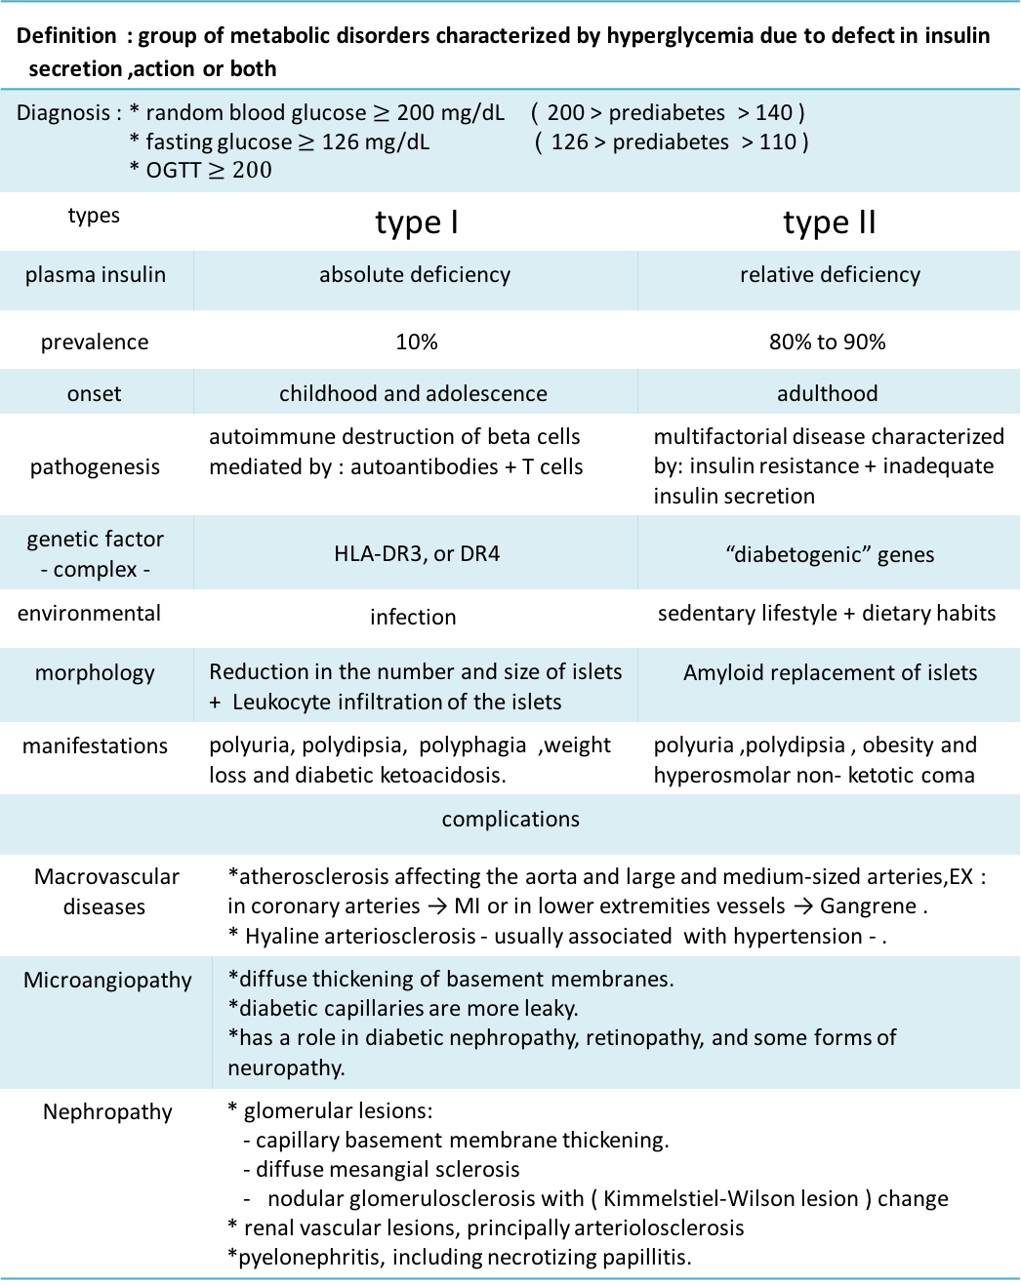
summary
Definition : group of metabolic disorders characterized by hyperglycemia due to defect in insulin secretion ,action or both
prediabetes > 140 ) 200 > ) Diagnosis : * random blood glucose $≥\text{200 }\text{mg}\text{/}\text{dL}$ prediabetes > 110 ) 126 > ) * fasting glucose $≥$ 126 mg/dL * OGTT $≥200$
type II | type I |  | types
relative deficiency | absolute deficiency |  | plasma insulin
80% to 90% | 10% |  | prevalence
adulthood | childhood and adolescence |  | onset
multifactorial disease characterized by: insulin resistance + inadequate insulin secretion | autoimmune destruction of beta cells mediated by : autoantibodies + T cells |  | pathogenesis
“diabetogenic” genes | HLA-DR3, or DR4 |  | genetic factor - complex -
sedentary lifestyle + dietary habits | infection |  | environmental
Amyloid replacement of islets | Reduction in the number and size of islets + Leukocyte infiltration of the islets |  | morphology
polyuria ,polydipsia , obesity and hyperosmolar non- ketotic coma | polyuria, polydipsia, polyphagia ,weight loss and diabetic ketoacidosis. |  | manifestations
complications
*atherosclerosis affecting the aorta and large and medium-sized arteries,EX : in coronary arteries → MI or in lower extremities vessels → Gangrene . * Hyaline arteriosclerosis - usually associated with hypertension - . |  | Macrovascular diseases
*diffuse thickening of basement membranes. *diabetic capillaries are more leaky. *has a role in diabetic nephropathy, retinopathy, and some forms of neuropathy. |  | Microangiopathy
* glomerular lesions: - capillary basement membrane thickening. - diffuse mesangial sclerosis - nodular glomerulosclerosis with ( Kimmelstiel-Wilson lesion ) change * renal vascular lesions, principally arteriolosclerosis *pyelonephritis, including necrotizing papillitis. |  | Nephropathy

Slide 19
Proliferative retinopathy | Nonproliferative retinopathy |  | ocular: *retinopathy *cataract *glaucoma
neovascularization and fibrosis → retinal detachment → blindness | -hemorrhages, -retinal exudates (cotton wool spots), microaneurysms (small red dots by ophthalmoscope) , -edema, -thickening of the retinal capillaries (microangiopathy).
autonomic nerves | motor and sensory nerves |  | Neuropathy
disturbances in bowel and bladder function | peripheral, symmetric neuropathy of the lower extremities
*Renal papillary necrosis as a complication of bladder infection *Mucormycosis |  |  | infection (bacteria or fungi)
Gestational diabetes |  | MODY
*During Pregnancy *both Mother and Fetus at risk *Develops in only a few percent of seemingly healthy women during pregnancy *may continue after parturition *These women highly susceptible to overt T2DM later in life |  | *loss-of-function mutations within a single gene. *resembles type 2 diabetes. *occurrence in younger patients

Slide 20
Questions
Q1: an 18 year-old male, previously healthy, came to the general practitioner with 1 month history of polydipsia and polyuria. No long-term medications are used. Random blood glucose concentration is 300 mg/dL. What is the most likely diagnosis?
Type 1 DM
Type 2 DM
Maturity-onset Diabetes of the Young (MODY)
Ans:C
Q2: For patient in the previous Q ,what is the most likely genetic mutation he will have?
RAS
MEN2
Hepatocyte Nuclear Factor 1α gene
Ans:C
Q3: Khalid, a 68 year-old civil engineer. BMI: 35, he has a history of poorly controlled DM over the last 20 years. 2 days ago he died of a stroke affected the brainstem. What is suspected to see in pancreatic islets of Langerhans :
Beta cells destruction by autoantibodies
Insulitis
Islets replaced by Amyloid pink amorphous material
Ans:C
Q4: Which of the following is right in DM?
Single disease due to hyperglycemia
Delta cells are hypofunctioning.
Cuased by decrease in insulin action
The patient could develope hypotention
Ans:C

Slide 21
Q5: What are the genes involved in developing diabetes type 1?
HLA-DR3.
HLA-DR4.
HLA-DR7.
A & B.
Ans:D
Q6: What are the defects recognized in diabetes type 2?
Insulin resistance.
Destruction of Beta cells by autoantibodies.
Beta cells dysfunction.
A & C
Ans:D
Q7:What is primary cause of diabetic complication including retinopathy , nephropathy and peripheral neuropathy:
Low immunity
Microangiopathy
Atheroma
Systemic disturbances
Ans:B
Q8:What is the most frequent pattern of involvement in neuropathy?
Peripheral symmetric neuropathy
Peripheral asymmetric neuropathy
Mononeuropathy
Autonomic neuropathy
Ans:A

Slide 22

حسبي الله لا إله إلَّا هو عليه توكلت وهو رب العرش العظيم.
الأعضاء
نوف العماري
ابتسام المطيري
فاطمة الطاسان
جواهر الخيال
أمل القرني
أميرة نيازي
دعاء وليد
رنيم الغامدي
لمى التميمي
ريما الشايع
القادة
حنين السبكي
عبدالله أبو عمارة
Editing File
Email: pathology436@gmail.com Twitter: @pathology436
References: Doctor’s slides + notes, Robbins basic pathology 10th edition.

