Slide 1

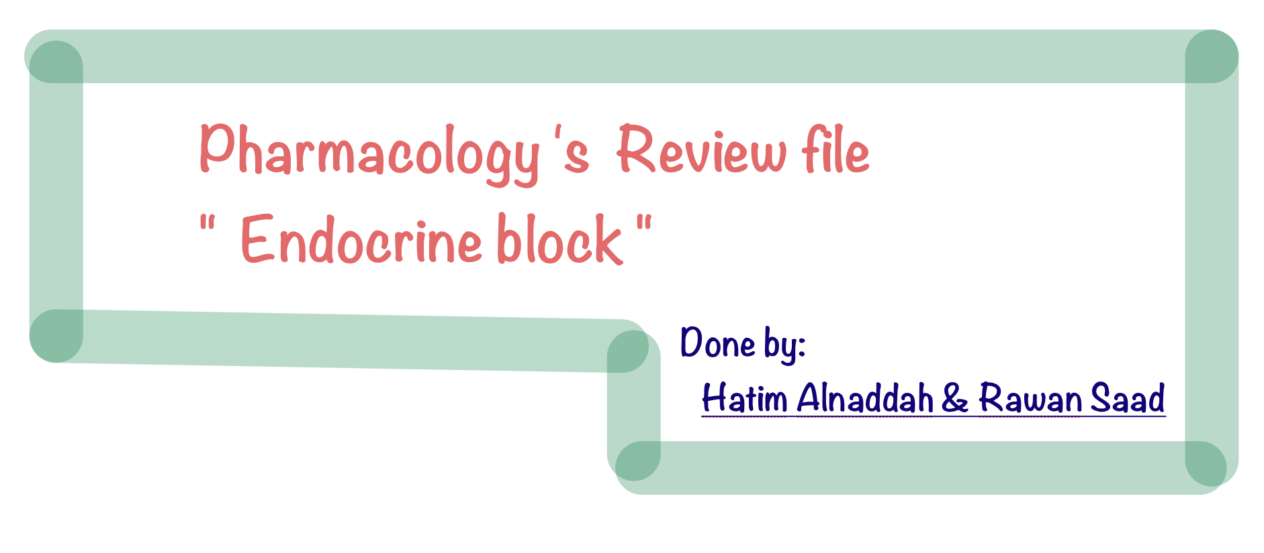

Slide 2





Summary of (Hyperthyroidism &Hypothyroidism)
***
***
***
***
***
***
***
***
***
***
***

Slide 3
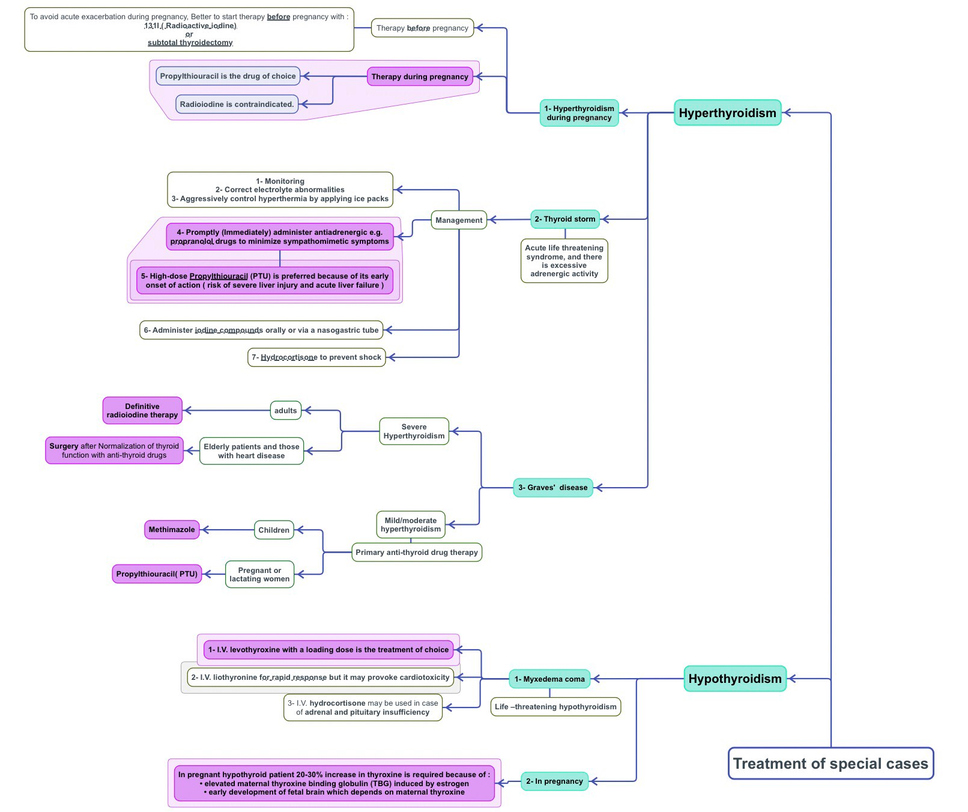





***
***
***
***
***

Slide 4

Q1: Patient with which one of the following drugs is need to be assessed with the thyroid function test frequently ?
A- Lithium. for Hypo B- Amiodarone. for both Hyper & Hypo. C-Both of them
Q2: Which one of the following describe the main mechanism of action of propylthiouracil ?
A- Block the Conversion T3 into T4 in the peripheral.
B- Destroys the parenchymal cells of thyroid gland by beta rays. C- Inhibit the peroxidase enzyme centrally in thyroid gland.
Q3: What is the drug of choice in treatment of hyperthyroidism in pregnant women ?
A-Methimazole. B- Propylthiouracil. C- Propranolol.
Q4: Why propylthiouracil is drug of choice in treatment of hyperthyroidism in pregnancy ?
A- It does Crosses placenta because it hydrophobic. B- It is highly protein bound.
C-It has low incidence of delayed hypothyroidism.
Q5: Which one of the following is recommended to be used before thyroidectomy to decrease the possibility of bleeding from thyroid vessels ?
A- Thioamides. B- Radioactive iodine. C-Lugol's solution or (KI).
Q6: Which one of the following describe the mechanism of action of radioactive iodine ?
A- Decrease both vascularity & size of thyroid gland by inhibiting the mitosis. B- Destroys the parenchymal cells of thyroid gland by beta rays.
C- Inhibit the peroxidase enzyme centrally in thyroid gland.
Q7:Which one of the following line of treatment of hyperthyroidism acting
by destruction of thyroid’s parenchyma due to
emission of β rays ?
A- Thioamides. B- Radioactive iodine. C- Lugol's solution
Q8:Which one of the following line of treatment of hyperthyroidism may safe the life of patient especially if he has tachycardia and sever palpitation a long with her hyperthyroidism ?
A- Thioamides. B- Radioactive iodine. C- β-blockers.
Q9: Patient who had hyperthyroidism and used anti-thyroid drug, he suddenly developed thyroid storm which is emergency situation. He had sever palpitation and other excessive adrenergic activity. Which one of the following is considered as
essential first step to be given in like this condition ?
A-Methimazole. B- Radioactive iodine. C- propranolol.
Contraindicated in asthmatic patient.
Q10: A 42 years old female came to the clinic and complain of weakness & fatigue and lack of energy and weight gain. Also she mentioned that she has cold intolerance and her hairs started to be brittle. The physician request the thyroid function test and the result shows there is markedly decreased in the level of both T3 & T4. Which drug of the following is the drug of choice in her case for long life thereby ?
A- Liothyronine. B- Levothyroxine. C- Liotrix.
Q11: Which drug can be used in emergency case due to its rapid of onset and its potent eﬀect ?
A- Liothyronine.
Q12:Which drugs of the following is
B- Levothyroxine. C- Liotrix.
highly contraindicated in patient with cardiac disease due to its cardiotoxicity ?
A- Liothyronine. B- Levothyroxine. C- Liotrix.
Q13: Which drugs of the following is acting by mimicking the natural hormonal secretion of thyroid gland?
A- Liothyronine. B- Levothyroxine. C- Liotrix.
Q14: Why is it essential to increase the dose up to 30% in women with hypothyroidism during pregnancy ?
A- The elevated estrogen induced the thyroxine binding globulin.
B- The maternal thyroxine is essential for development of fetal brain.
C- Both of them.
Q15: 56 years old Patient who is diagnosed with hypothyroidism with weight gain, cold intolerance, fatigue and lack of energy and brittle nails. The doctor prescribed 0.46 mg tablets of drug as treatment. Three day later, his symptoms completely changed to the opposite. He develop tremor, heat intolerance, weight loss and clubbing of the fingers. What is the underlying cause behind this condition?
A- he develops Iodism and overdose of iodine. B- he develops secondary hyperthyroidism.
C- he develops overdose of levothyroxine.

Slide 5

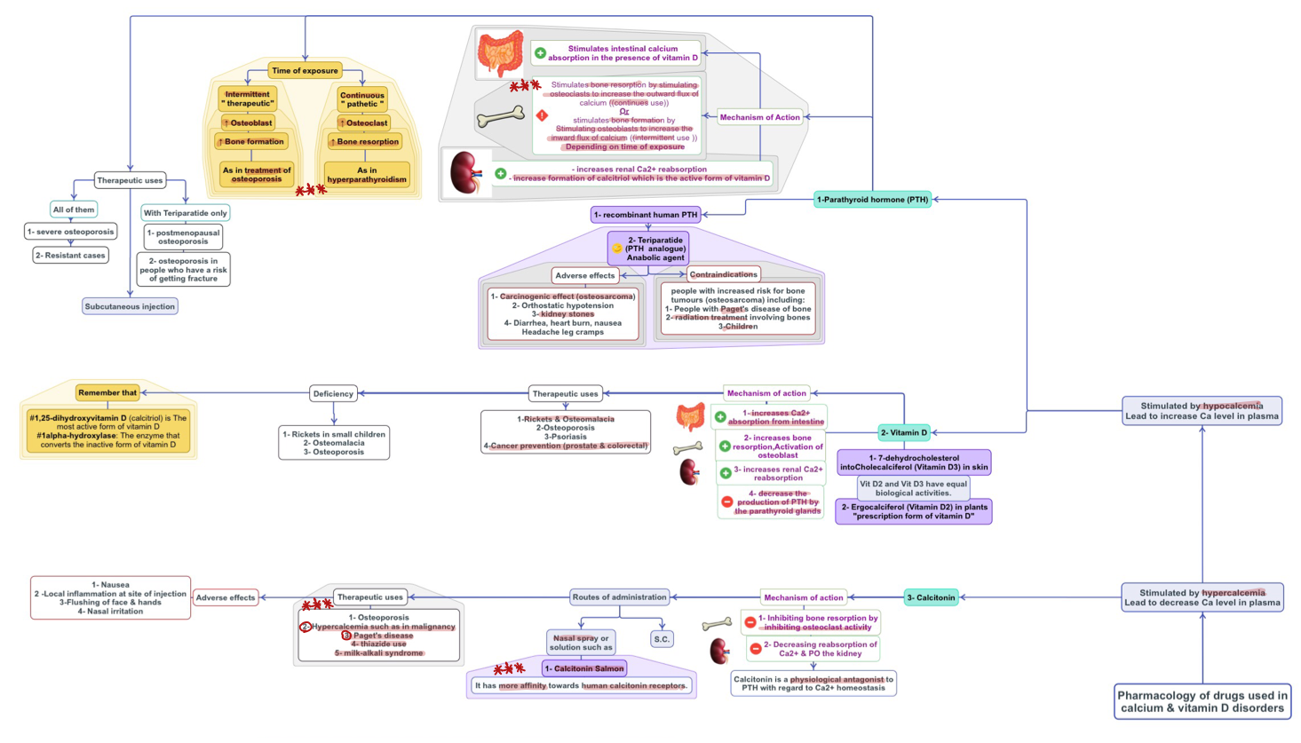
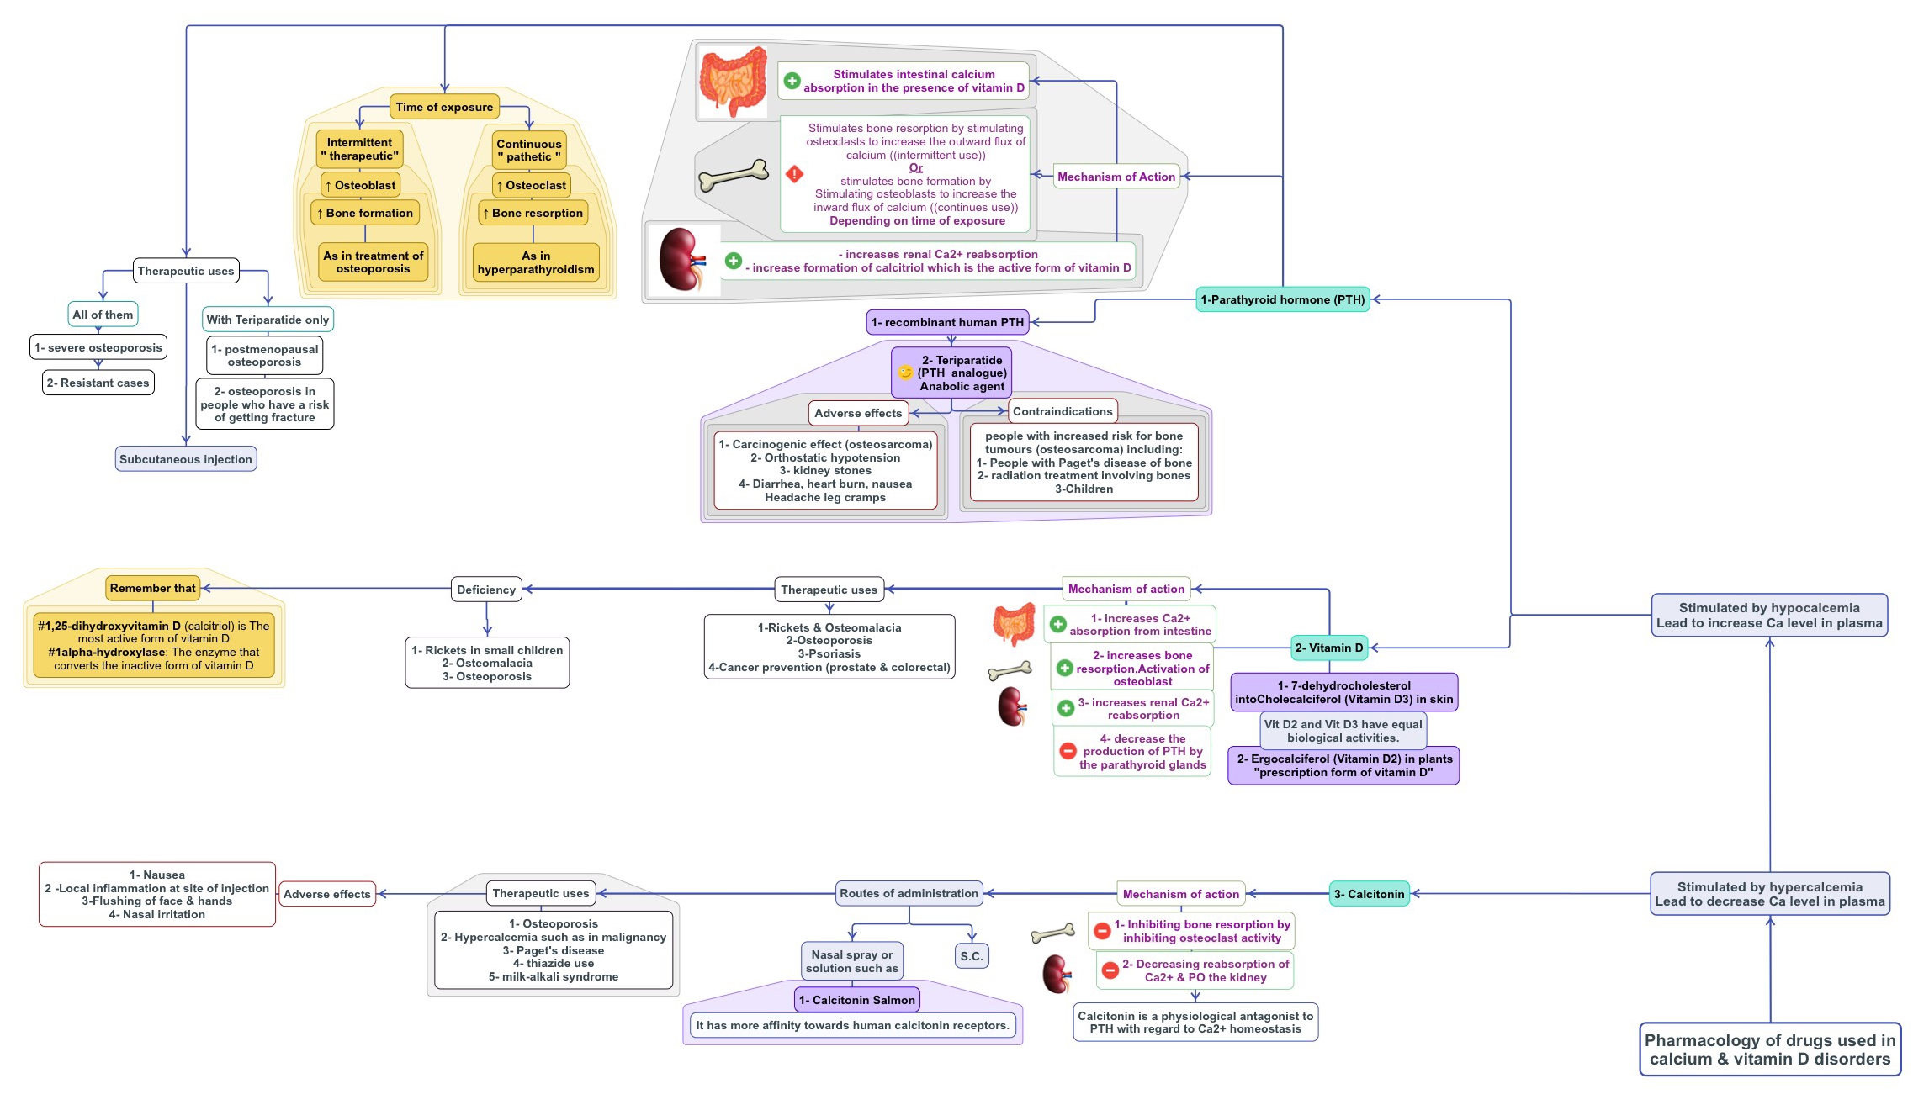




Summary of (Calcium and Vitamin D)

Slide 6
Q1: What is the
A- Hypercalcemia.
stimulus for parathyroid hormones
to be secreted from parathyroid gland ?
B- Hypocalcaemia.
C- Low phosphate concentration in plasma.
Q2: What is the
stimulus for calcitonin hormones
to be secreted from thyroid gland ?
A- Hypercalcemia. B- Hypocalcaemia.
C- High phosphate concentration in plasma.
Q3: Which one of the following
methods is preferred to be used in
case of PTH & Teriparatide
to treat osteoporosis
?
A- Continuous. B- intermittent. C- Both of them.
Q4: Which one of the following increase the rate of bone resorption ?
A- Continues administration of Teriparatide. B- Intermitted administration of PTH.
C- Both of them.
Q5: Which one of the following is shown carcinogenic eﬀect in animal experimentation and increase the risk of osteosarcoma ?
A- Chronic exposure to PTH. B- continuous administration Teriparatide. C- Vitamin D toxicity.
Q6: Which one of the following is recommended in people with Paget's disease ?
A- Vitamin D. B- Teriparatide. C- Calcitonin
Q7: Which one of the following should be avoided in people with Paget's disease ?
A- Vitamin D. B- Teriparatide. C- Calcitonin.
Q8: Which one of the following may lead to develop renal stone ?
A- Vitamin D. B- Teriparatide. C- Calcitonin.
Q9: Hypertensive patient who is on hydrochlorothiazide as diuretic, which one of the following to maintain normal plasma level of calcium ?
A- PTH. B- Teriparatide. C- Calcitonin.
Q10: Orthostatic hypotension is one of adverse eﬀect of which one of the following treatment?
A- PTH. B- Teriparatide. C- Calcitonin.
is recommended
in his case
Q11: Patient with peptic ulcers was treated by giving a lot of milk and absorbable alkaline which caused
metabolic
alkalosis and electrolytes disturbance, which one of the following can be used to correct his plasma level of
calcium
?
A- PTH. B- Teriparatide. C- Calcitonin.
Q12:Which one has more aﬃnity towards human calcitonin receptors ?
A- Recombinant human calcitonin. B- Calcitonin Salmon. C- Synthesized calcitonin.
Q13: 5 years old child who has Rickets, which one of the following can be helpful to be given to him ?
A- Teriparatide. B- Vitamin D. C- Calcitonin.
Q14: Which one of the following has shown protective eﬀect against colorectal cancer ?
A- Teriparatide. B- Vitamin D. C- Calcitonin.

Slide 7

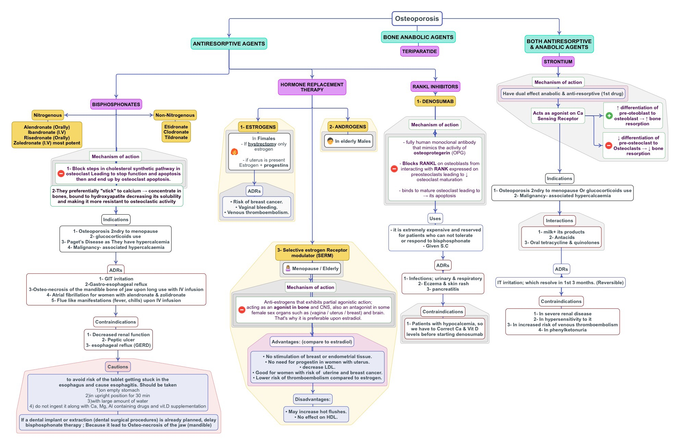


Summary of (Osteoporosis )

Slide 8


Q1: 52 years old female. Three years ago she has diagnosed with uterine cancer. She had a surgery to remove the entire
uterus. Now she develop primary osteoporosis. Which one of the following drug can be used in her case ?
A. Estrogen. B. Progesterone. C. Both of them
Q2: Which one of the following anti-osteoporotic Drugs should be products?
A. RANKL inhibitors. B. Strontium. C. SERM
avoided
to be
taken
along
with milk
containing
Q3: Which route of administration of bisphosphonate is recommended in patient with
A. Orally. B. Inhalation. C. Intravenously.
esophagitis
to treat osteoporosis ?
Q4: A 70-year-old female who is being started on ibandronate once monthly for the treatment of osteoporosis. Which of the following is important to communicate to this patient?
Take this medication with orange juice to increase absorption.
Avoid to take this medication along with milk or other calcium containing substance.
Remain upright for at least 60 minutes after taking this medication.
Both B & C .
Q5: Which one of the following drugs may
induce osteonecrosis of jaw bone
in clinical practice ?
A. Raloxifene. B. strontium ranelate. C. Risedronate.
Q6: Which one of the following is the strongest
drugs to treat the osteoporosis ?
C. Denosumab.
A. Risedronate. B. strontium ranelate.
Q7: Which one of the following is the
major class predominantly
used to treat osteoporosis clinically ?
A. Bisphosphonates. B. RANKL inhibitors.
C. Estrogen Analogues
Q8: Which one of the following drugs is the
best choice to treat osteoporosis in women in clinical practice
?
A. Estrogen analogue. B. Progesterone analogue. C. Raloxifene.
Q9: 49 years old female is diagnosed with pelvic inflammatory disease and she has
,
which one of the following is the drugs of choice to treat postmenopausal
high risk to develop uterine cancer
osteoporosis
?
A. Estrogen analogue. B. Progesterone analogue. C. Raloxifene.
Q10: A 78-year-old woman with known osteoporosis presents to her primary care physician for follow- up. She is amanaged with alendronate. Physical examination reveals a woman with a height of 5 ft 3 in and weight of 143 lb. The most likely eﬀects on bone would be which of the following?
A- Increased osteoblastic bone resorption B- Inhibition of cholesterol biosynthesis
C- Inhibition of osteoclastic apoptosis D- Inhibition of osteocyte activation
Q11: Which one of the following osteoclast ?
A. Risedronate.
act by mimicking the activity of osteoprotegerin
and prevent the maturation of
B. strontium ranelate. C. Denosumab.
Q12: Which one of the following is
highly contraindicated
to be given to patient with
hypocalcemia
?
A. Alendronate. B. Raloxifene.
C. Denosumab.
Q13: Which one of the following is contraindicated
to be used in patient with phenylketonuria
to treat osteoporosis ?
A. Risedronate.
B. strontium ranelate.
C. Denosumab.
Q14: All of the following are
adverse eﬀects of estrogen
analogue as a drug except :
A. Vaginal bleeding. B. Breast cancer. C. Change in blood coagulation.
D. delay postmenopausal age.
Q15: Which one of the following treatment of osteoporosis ?
A. Raloxifene.
act by mimicking the action of calcium on its sensing receptors
and have
dual action
in
B. strontium ranelate. C. Denosumab.

Slide 9

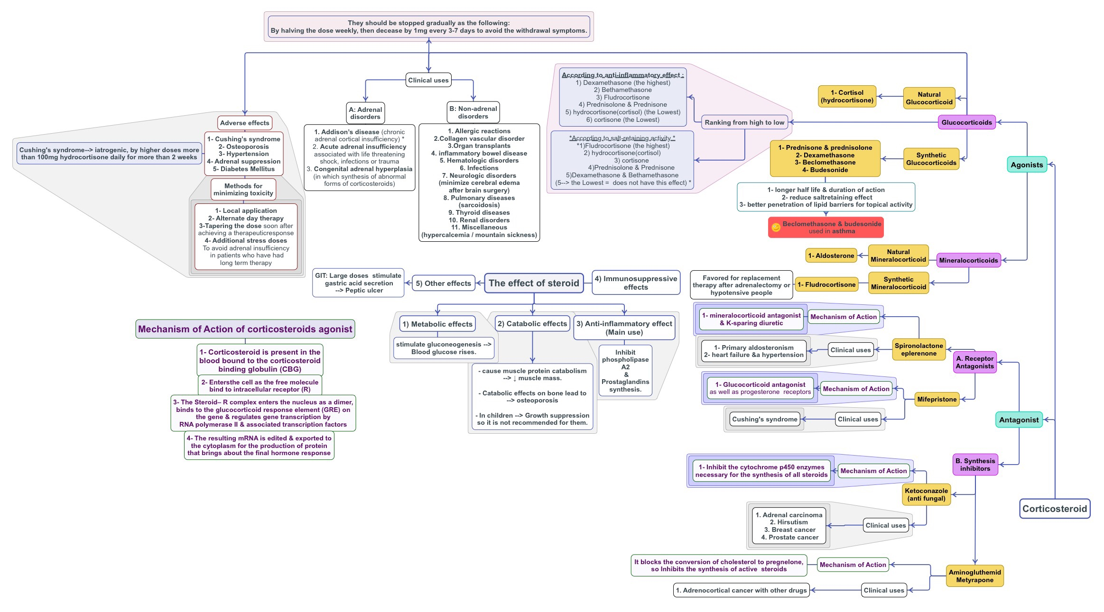






Summary of (Cortticosteroids )

Slide 10
Q1: Which one of the following Drugs can be used to treat patient with
A. Dexamethasone. B. Mifepristone. C. Spironolactone
Cushing's disease
?
Q2: Which one of the following is one of most common side eﬀect of steroid therapy ?
A. Induced Adrenal tumor. B. Weight loss. C. Osteoporosis
Q3: Which one of the following is the main mechanism in which
glucocorticoids
act as
anti-inflammatory drugs
?
Block the action of cytokines and chemokine.
Inhibit phospholipase A2 and prostaglandin synthesis.
Inhibit the migration of neutrophils and leukocytes.
Q4:Which corticosteroids possess the highest mineralocorticoid function ?
A. Hydrocortisone. B. Fluprednisolone. C. Fludrocortisone.
Q5: Corticosteroids are useful in the treatment of all of the following disorders except:
A. Addison disease. B. Allergic rhinitis. C. Cushing syndrome. D. Inflammatory bowel disease.
Q6: Osteoporosis is a major adverse eﬀect caused by the glucocorticoids. It is due to their ability to:
A. Increase the excretion of calcium. B. Inhibit absorption of calcium. C. Decrease collagen synthesis.
Q7: A child's with severe asthma is being treated with high doses of inhaled corticosteroids. Which of the following
adverse eﬀects
is of particular concern?
B. Hirsutism.
A. Hypoglycemia.
C. Growth suppression.
Q8: The diagnosis of congenital adrenal hyperplasia (CAH) is confirmedin a child. This condition can be eﬀectively treated by Administering :
A. Glucocorticoid.
B. Androgen antagonist. C. ketoconazole
Q9: A patient with
Addison disease
is being treated with hydrocortisone but is still having problems with
dehydration and
hyponatremia
. Which of the following drugs would be best to add to the patient’s therapy?
A. Dexamethasone.
B. Fludrocortisone. C. Prednisone.
Q10: Which one of the following synthetic steroid shows predominantly anti-inflammatory eﬀect
and possess the
lowest
salt retaining eﬀect ?
A. Hydrocortisone. B. Prednisone.
Q11: Comparing to Cortisol/Hydrocortisone, the synthetic glucocorticoids are
C. Dexamethasone.
preferred
to be used due to :
A. Rapid onset of action. B. Mineralocorticoid eﬀect. C. Better penetration of lipid barrier.
Q12: 49 years old patient who is on cortisol thereby for 2 years. He is going to major surgery after systemic infection. How can his doctor adjust the dose of cortisol before surgery ?
Tapering the dose before the surgery to the half.
Give him the drug daily instead of alternate day thereby.
Give him additional stress dose before the surgery.
Q13: Which is contraindicated in a patient with
A. Aldosterone. B. Ketoconazole.
hyperkalemia
?
.
Q14: Which one of the following drugs
A. Aldosterone.
C. Spironolactone
act by inhibiting the synthesis of corticosteroids
?
B. Ketoconazole.
C. Spironolactone

Slide 11

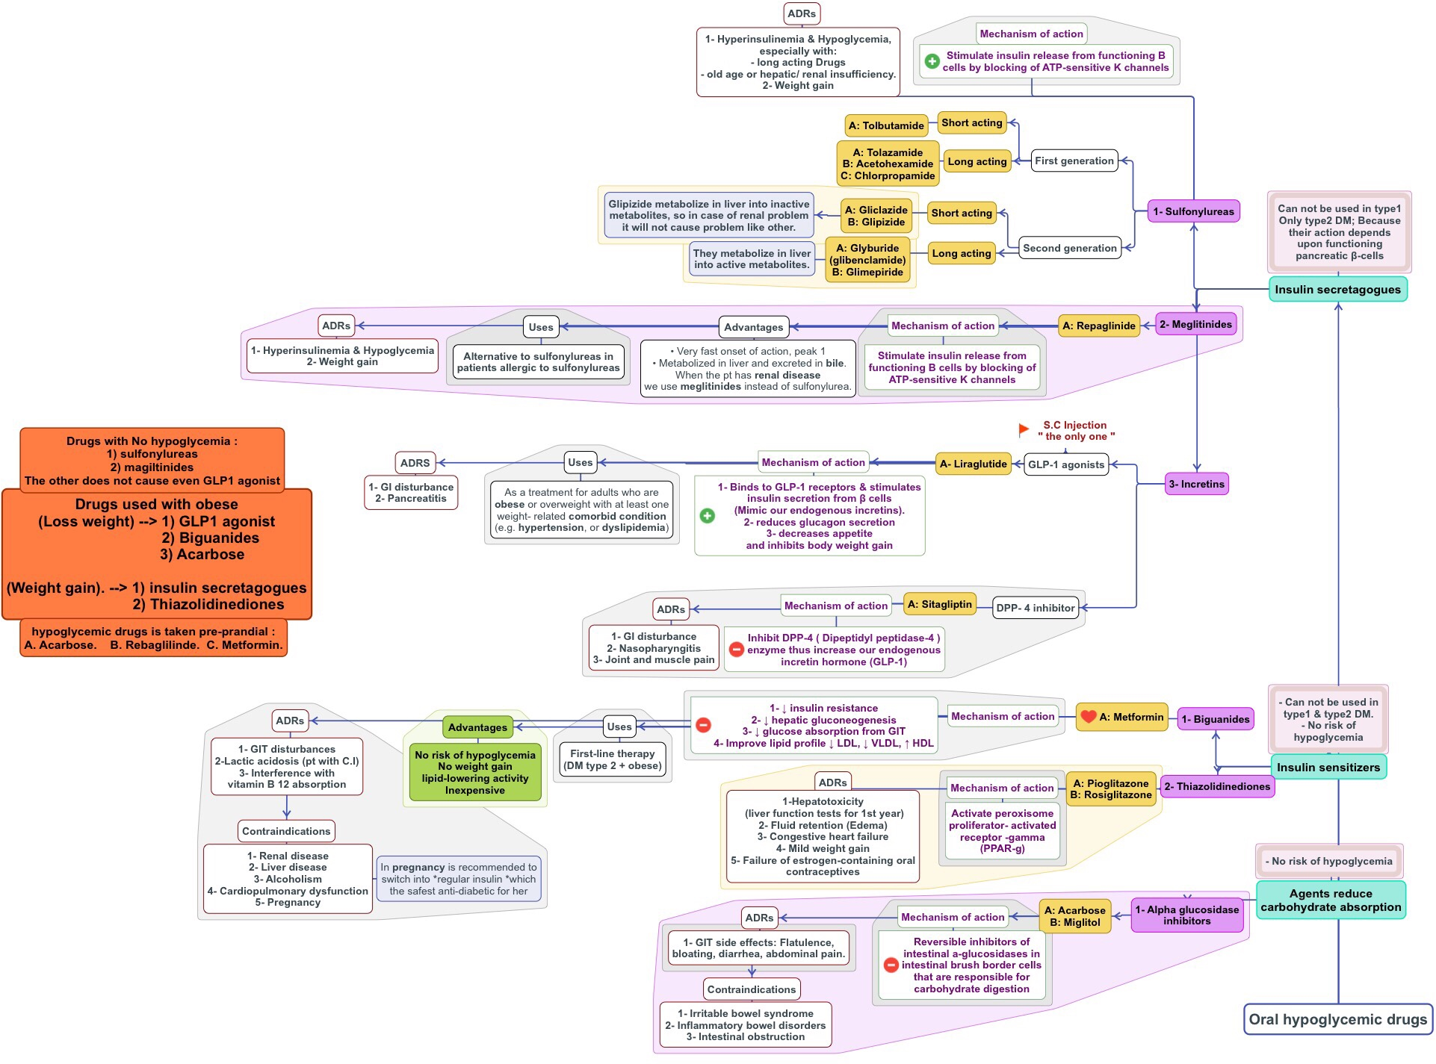




Summary of (Oral hypoglycemic drugs)

Slide 12
Q1: Which one of the following oral hypoglycemic drugs can be
A. Glyburide. B. Repaglinide. C. Metformin.
used in case of
D. Glimepiride.
diabetic
patient with
renal disease
?
Q2: All of the following hypoglycemic drugs can be used as treatment for both type 1&2 diabetes , EXCEPT :
A. Acarbose. B. Pioglitazone. C. Metformin. D. Liraglutide.
Q3: Sulfonylureas and Meglitinides act as insulin secretagogues mainly by which one of the following mechanism?
Opening the ATP dependent K+ channels.
Blocking the ATP dependent K+ channels.
Opening the voltage-dependent Ca2+ channels.
Blocking the voltage-dependent Ca2+ channels.
Q4: which one of the following describe the
A- inhibit the gluconeogenesis by the liver B- it inhibit alpha glucosidase in intestine C- maintain high level of incretin in plasma.
mechanism
of
Pilogiltazone
as anti diabetic drug ?
D- activate the PPAR gamma
Q5: Newly patient who was prediabetes, he is diagnosed now with type 2 diabetes. The medical history relieves that he
can not tolerance Sulfasalazine or
sulfamethoxazole. Which one of the following drugs can be safe to be used in his
case ? A. glibenclamide.
B. Repaglinide. C. Glipizide. D. Glyburide.
Q6: Which one of the following hypoglycemic drugs would be least likely to cause hypoglycemia ?
A. Glimepiride. B. Glyburide. C . Repaglinide. D . Dulaglutide.
Q7: which one of the following hypoglycemic drugs is taken pre-prandial ?
A. Acarbose. B. Rebaglilinde. C. Metformin. D . All of them.
Q8: Which one of the following hypoglycemic drugs is taken by injection once a wake
A. Liraglutide. B. Sitagliptin. C . Repaglinide. D. Both A & B .
rather than orally ?
Q9: Sulfonylureas are class of oral diabetes drugs which excreted mainly by kidney in urine. Which one of these drugs
has the least risk to develop hypoglycemia in patient with renal insuﬃciency ?
A. glibenclamide. B. Glimepiride. C. Glipizide. D. Glyburide
Q10: Which of the following drugs for diabetes would be LEAST likely to cause weight gain?
A. Metformin. B. Liraglutide. C. Pioglitazone. D. Both A & B.
Q11: 37 years old male who is obese and has diagnosed as prediabetes. His blood glucose and lipid
is significantly
high. He failed to loss his weight with diet and exercise. Which one of the following drugs is case?
A. Sitagliptin. B. Metformin. C . Repaglinide. D. Both A & C .
first line of treatment
in his
Q12: A 32 years old male who is diabetic. He did not tell his doctor that he drinks alcohol almost daily. The doctor
prescribed metformin for him. Which one of the following adverse eﬀect
could be seen in this patient ?
.
A. pancreatitis. B. urinary tract infections. C. Liver cirrhosis. D. Lactic acidosis
Q13: A 64-year-old woman with a history of type 2 diabetes is diagnosed with heart failure. Which of the following medications would be a poor choice for controlling her diabetes?
A. Sitagliptin . B. Glyburide. C. Repaglinide. D. Pioglitazone.
Q14: 21 years old female, her family have history of diabetes type2. She did oral glucose tolerance test. And the result was 156mg/dl which mean she is a prediabetes. Which one of the following can be used alone in this early stage to control her blood glucose level ?
A. Dulaglutide. B. Rebaglilinde. C. Acarbose. D. All of them.
Q15: Which one of the following hypoglycemic drugs is preferable to be used in diabetic patient who is obese or hypertensive or even with high lipid profile ?
A. Liraglutide. B. Metformin. C . Repaglinide. D. Both A & B
Q16: Which one of the following anti-diabetic drug may interference with vitamin B12 absorption
A. Liraglutide. B. Metformin. C . Repaglinide. D. glibenclamide.
if it use for long term ?
Q17: Which one of the following describe the
A- inhibit the gluconeogenesis by the liver B- it inhibit alpha glucosidase in intestine
mechanism of Sitagliptin as anti diabetic drug ?
C- maintain high level of incretin in plasma. D- activate the PPAR gamma.

Slide 13

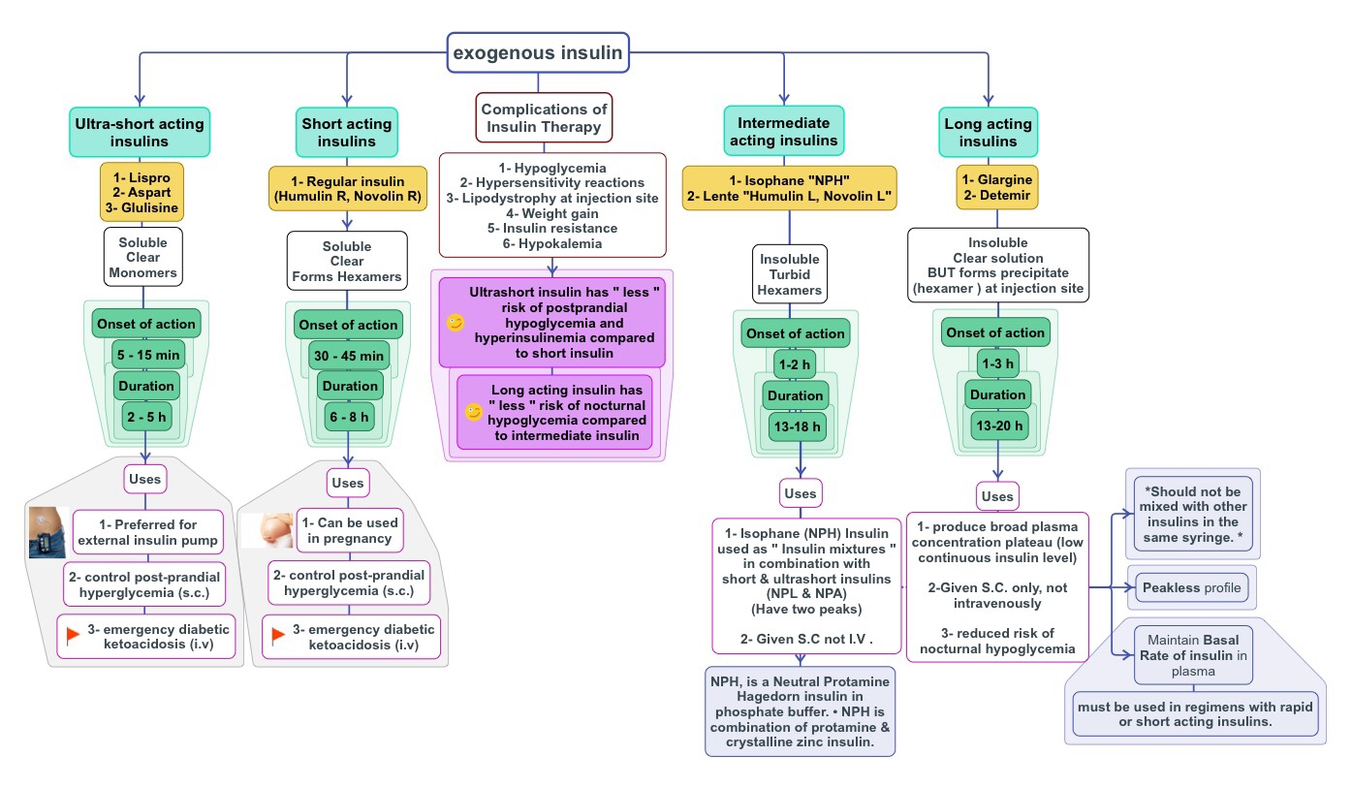
Summary of (Exogenous Insulin)

Slide 14
Q1: The
main route of administration of insulin
is :
A. Intravenous. B- Subcutaneous. C- Intramuscular. D. Orally.
Q2: Which one of the following preparation of insulin can be given
Intravenously
?
A. Insulin glargine. B. Humulin Lente. C. NPH insulin. D. Humulin regular
Q3 : In invitation, which preparation of insulin is recommended to be taken with diabetic patient
before eating ?
to reduce the waiting time
A. Insulin aspart. B. Insulin glargine. C. NPH insulin. D. Regular insulin.
Q4: Which one of following preparation of insulin is preferable to be used in
pregnant women
?
A. Insulin aspart. B. Insulin glargine. C. NPH insulin. D. Regular insulin.
Q5: Which one of the following preparation of insulin has lowest risk to develop hypoglycemia ?
A. Insulin aspart. B. Humulin Lente. C. NPH insulin. D. Regular insulin.
Q6: Which one of the following preparation of insulin has two peaks ?
A. NPH insulin. B. Humulin Lente. C. NPL insulin. D. Humulin regular.
Q7: All of the following mimic the prandial mealtime insulin release EXCEPT:
A. Insulin aspart. B. Humulin regular. C. NPL insulin. D. Insulin detemir.
Q8: Which one of the following preparation of insulin should not be mixed with other form of insulin in the same syringes ?
A. Insulin aspart. B. Insulin glargine. C. NPH insulin. D. Regular insulin.
Q9: Which one of the following preparation of insulin is recommended to reduce the incidence of nocturnal hypoglycemia
and maintain a baseline insulin thereby
?
C. NPH insulin. D. Regular insulin.
A. Insulin aspart. B. Insulin glargine.
Q10: Which one of the following preparation of insulin has lowest risk to develop hypoglycemia ?
A. Insulin glargine. B. Humulin Lente. C. NPH insulin.
Q11: Diabetic patient who is going to increase his physical activity and exercise to loss some kilograms. doctor adjust his insulin dose according to that ?
A. By doubling the dose. B. by reducing the dose. C. by adding one of oral hypoglycemic drugs.
Q12: Which one of the following preparation of insulin can be used in case of ketoacidosis ?
How
can the
A. Insulin aspart. B. Insulin lispro. C. Humulin regular. D. all of them.

Slide 15

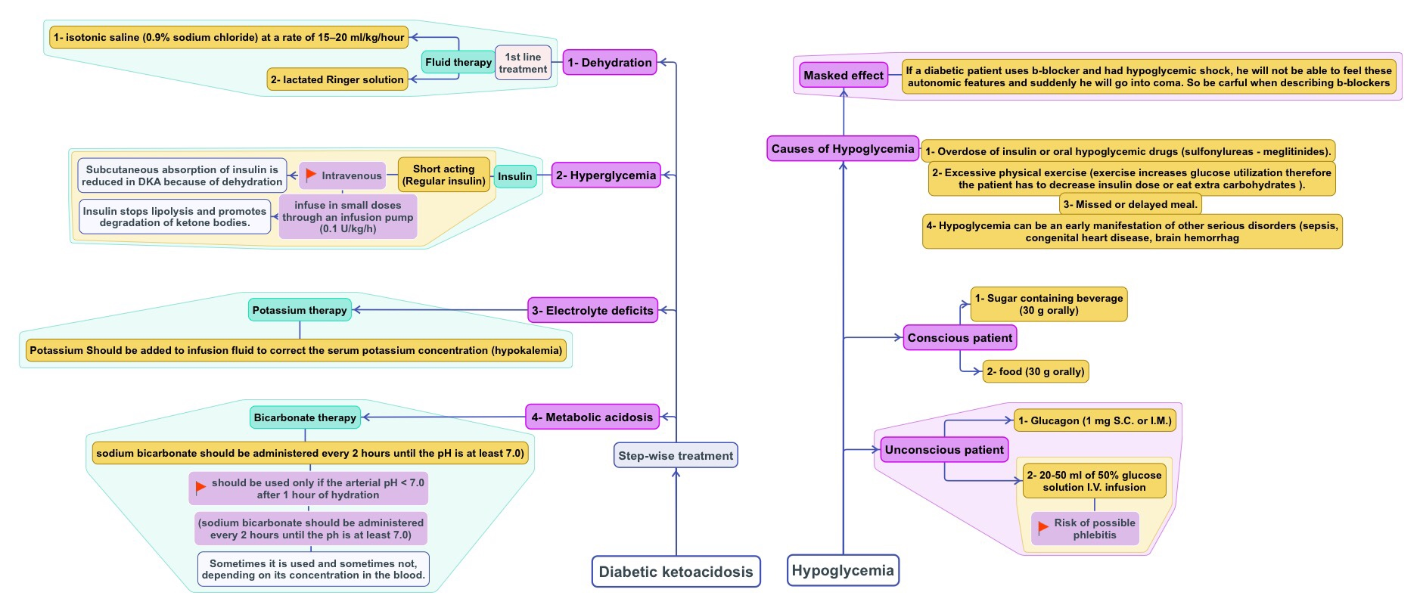


Summary of (Ketoacidosis & Hypoglycemia)
Q1: Which one of the following is considered as initial step in treatment of ketoacidosis ?
A. 0.9% sodium chloride. B. Regular insulin. C. Potassium replacement. D. sodium bicarbonate
Q2: Which one of the following steps can be skipped sometimes in case of ketoacidosis management ?
A. 0.9% sodium chloride. B. Regular insulin. C. Potassium replacement. D. sodium bicarbonate
Q3 : Which one of the following preparation is commonly use to treat ketoacidosis in clinical practice ?
A. I.V Insulin lispro. B. S.C Insulin glargine. C. I.V Regular insulin. D. I.V NPH insulin.
Q4: In which dose the regular insulin is given intravenous infusion ?
A. 0.01 U/kg/h. B. 0.05 U/kg/h. C. 0.1 U/kg/h. D. 0.2 U/kg/h.
Q5: 10 years old child came to ER with fruity breath, he was with hot and dry skin, his mother said that his child tend to be thirsty all the time. The biochemical investigation shows (Blood glucose level : 267 mg/dl, Arterial PH : 7.37, dehydration with ketonuria) . How can we mange his case ?
Isotonic saline + Humulin regular + Potassium replacement + Sodium bicarbonate.
0.9 % sodium chloride + Humulin Lente + Potassium replacement + Sodium bicarbonate.
Isotonic saline + Humulin regular + Potassium replacement.
0.9 % sodium chloride + Humulin regular + Sodium bicarbonate.
Q6: 58 years old male who fall down due to hypoglycemic coma
. How can be treated In this situation?
A. By giving him orange juice. B. By giving him I.V regular Insulin.
.
D. All of them.
Q7: Which one of the following insulin preparations should be
A) A. Glulisine. B. Humulin regular. C. Novolin regular.
C. By giving him I.M Glucagon
avoided
in diabetic ketoacidosis?
D. Glargine Insulin.

