Slide 1
4: Drugs Used in Osteoporosis
Objectives
Revise the composition, regulation & the remodeling stages of bone turnover.
Recognize the interlinks of osteoblastic & osteoclastic function.
Relate changes to the development of osteoporosis.
Classify drugs according to their replacement, antiresorptive or anabolic mechanism of action.
Detail the pharmacology of such group of drugs & their clinical utility in combating osteoporosis.
Color index
Extra information and further explanation
Important
Doctors’ notes
Drugs names
Mnemonics
Kindly check the editing file before studying this document

Slide 2
To Understand
Osteoporosis
Osteo: is Latin for “bone” Porosis: means “porous or full of holes” “Osteoporosis” means bones that are full of holes”
Osteoporosis is the silent disease
Healthy bone
Bone is living tissue, which is constantly being broken down and rebuilt, a process called remodeling.
Bone is renewed like skin, hair and nails.
Types of bone (you can skip it)
cortical
Trabecular
”cancellous”
is hard, compact, dense bone(example: long bones of arms and legs)
is spongy, porous and flexible bone (example: end of the wrist, hip and the spine), this type of bone more susceptible for osteoporosis bc they already have low density
The two steps are in a state of equilibrium.
Any process that disrupts this balance by increasing bone resorption relative to formation results in osteoporosis.
$↑$ Resorption = $↑$holes = osteoporosis
BONE “Remodeling”
It includes:
Resorption-removes old, dead or damaged bone which done by osteoclast cells.
Formation-replaces old bone with new bone which done by osteoblast cells.
Bone remodeling
Cells called osteoclasts (think “C” for cutting of bone) seek out old bone or damaged bone tissue and destroy it, leaving small spaces (resorption)
OSTEOCLASTS-PHASE 1
OSTEOBLASTS-PHASE 2
Cells called osteoblasts (think “B” for builder) use minerals like calcium, phosphorus, and vitamin D to fill in the spaces with new bone (formation)

Slide 3
To Understand
Steps to build healthy bone
Calcium & vitamin D
Limit Caffeine & Alcohol¹
Exercise
Don’t Smoke
Less use of glucocorticoids²
You build bone until about age 30
Bone composed of 2 types of tissues (you can skip it)
Inorganic: 65% of mass + Consists of crystaline calcium phosphate salts (hydroxyapatite: stable crystal inside the bones).
Organic: 35% of mass + Consists of; osteoblasts, osteoclasts and osteocytes.
Bone cells
Bone Forming Cells:
Osteogenic cells: mesenchymal in origin & are found on all bone surfaces
Osteoblasts: forms osteoid framework & help in its mineralization.
Bone Resorptive Cell:
Osteoclasts → Reside in pits (resorption bays) that form by eaten bone surface. Secretes lysosomal enzymes (collagenase & metalloproteinase) + hydrochloric → dissolve bone matrix.
¹ alcohol can inhibit absorption of some nutrient (including Ca)
² Glucocorticoids are bad for bone health, it will breakdown the collage in bone matrix (bc collage is protein, and as you know from physiology glucocorticoids ‘cortisol’ breakdown protein)

Slide 4
To Understand
NORMALLY: bones continuously form & resorb
BONE REMODELING is Under control of systemic hormones, body mineral contents & local autocrine paracrine secretions (Cytokines, Growth Factors, PGs) . It is meant to maintain calcium homeostasis & to renew bone in repair of microdamage & microcracks
RANKL and OPG³
الصورة مختلفة عن الموجودة بالسلايد، هذي الصورة أفضل وأرتب
PTH binds to receptors on the adjacent osteoblasts, causes releasing of osteoprotegerin ligand (OPGL), or RANK ligand. OPGL activates receptors on preosteoclast cells, causing them to differentiate into osteoclasts (maturation). The osteoclasts release enzymes and acids that promote bone resorption.
Osteoblasts also produce osteoprotegerin (OPG), a cytokine which inhibits bone resorption. OPG bind to OPGL and preventing OPGL from interacting with its receptor, thereby inhibiting differentiation of preosteoclasts into mature osteoclasts that resorb bone.
³ The Important to know from this illustration is: RANK will make osteoclast mature and OPG will bind with RANK receptors and inhibit RANK effect

Slide 5
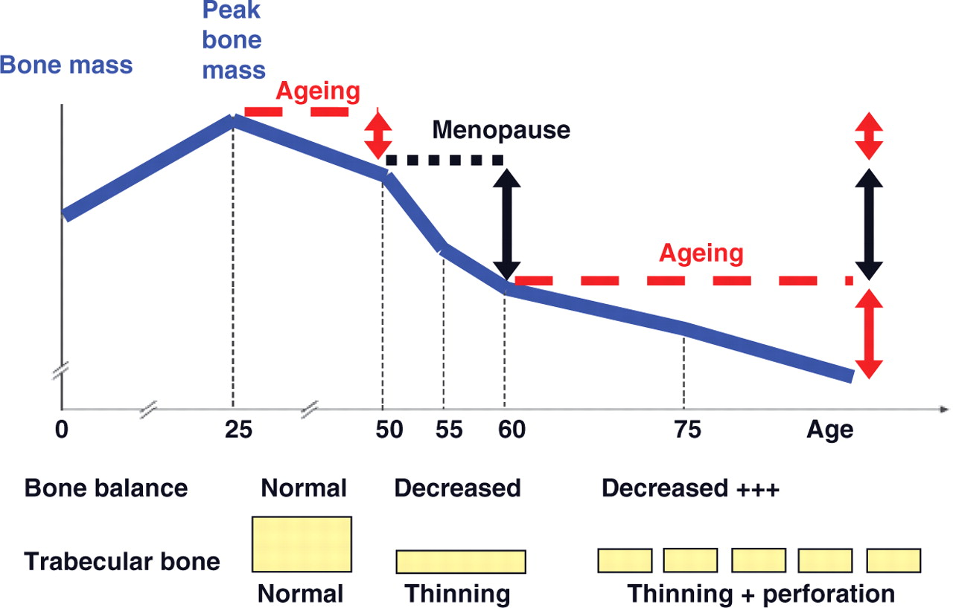
Osteoporosis
Definition: A complex of endocrinological disorders of bone and mineral metabolism (bone resorption > formation).
It’ll lead to low bone mass + disruption of bone architecture + reduced bone strength and increased risk of fractures.
Potentially modifiable under our control | Non-modifiable Not under our control
Current cigarette smoker. Diet low on calcium or Vit.D. Glucocorticoids anticonvulsants. Excessive alcohol intake. Sedentary lifestyle (lacking the physical activity and movements) Body weight. Environmental risks. | Personal history of fracture 1st degree relative has a history of fractures Race (Caucasian or Asian) Elder people Poor health Dementia Hormonal disorders (E.g. hypothyroidism). Neoplastic disorders Metabolic abnormalities
BONE LOSS & AGING: The first 5-15 years after menopause a woman can lose approximately 25 - 30 % of trabecular bone & approximately 10 – 15 % of cortical bone
Aging → decline in bone density. Menopause → great decline in bone density
Bone loss often occurs without symptoms or warning signs
Inadequate gonadal hormone production is a major cause of osteoporosis in men & women. Estrogen replacement therapy at menopause is a well-established means of prevention.
Notes:
The point of this pic is to know that the bone remodeling require long time.
From birth through adolescence, new bone is built faster than old bone is removed
In mid-life, depending on lifestyle and other factors, bone removal can achieve a balance with bone formation
After menopause, bone removal may accelerate due to a decrease in estrogen

Slide 6
Overview
Treatment of osteoporosis
Used to enhance the strength by the formation of fluorapatite. It is considered only when trabecular bone is decrease in presence of normal cortical bones
Replace what is missing
( Ca , Vit D , Na, fluoride )
Bisphosphonates
RANKL inhibitors (Denosumab)
Strontium
Anti-Resorptive Agents⁴
Androgen Analogues
Estrogen Analogues
SERMS (Raloxifene)
Calcitonin
PTH (Teriparatide)
PTH: Natural
Teriparatide: synthetic form. Common to cause malignancy.
It’s secreted in case of hypocalcemia
Reset back the balance of remodeling
Bone Anabolic Agents⁴
Strontium
⁴ Antiresorptive: acts on osteoclasts , Bone anabolic: acts on osteoblast

Slide 7
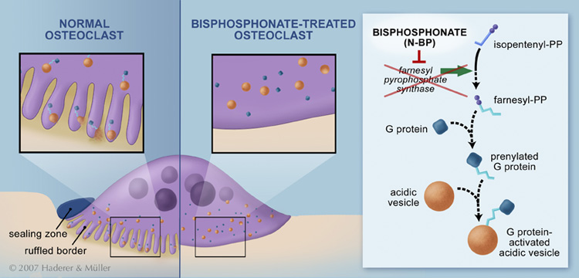
Bisphosphonates
Non-Nitrogenous
Nitrogenous
Etidronate
Alendronate (orally)
Clodronate
Ibandronate (IV)
Tildronate
Risedronate (orally)
Zoledronate (IV)
Very potent
Bisphosphonates (Most commonly used)
Mechanism Of Action | Are compounds that have two phosphonate (PO₃) groups. Are structurally similar to pyrophosphate (component of bone matrix) They preferentially "stick" to calcium → concentrate in bones, bound to hydroxyapatite, decreasing its solubility and making it more resistant to osteoclastic activity ’prevent osteoclasts from working’. (predominant mechanism) They prevent bone resorption by inhibiting osteoclast function. Their relative potencies for osteoclast inhibition is the most with 3rd generation “Zoledronate” BLOCK STEPS IN CHOLESTROL SYNTHETIC PATHWAY IN OSTEOCLAST that act as signaling molecules responsible for the osteoclastic hydrolytic & phagocytic activity → Stop function → apoptosis (increased death of osteoclast)
Normal mature osteoclast has ruffled border to increase the surface are for releasing its enzyme
Bisphosphonates will remove the ruffled border (immature osteoclast)

Slide 8
Anti-Resorptive Agents
Bisphosphonates (Most commonly used)
M.O.A | How do they inhibit osteoclasts? It is taken up by osteoclast then blocks steps in cholesterol synthetic pathway within osteoclast then and end up by osteoclast apoptosis.
P.K | Poorly abs (< 10%), food impair absorption more so must be given on an empty stomach. infused IV. t_{½}: 1 hr. Half of absorbed drug accumulates in bones, remainder → excreted unchanged in urine. (dose is adjusted in patients with renal impairment) In bone it is retained for months, depending on bone turnover.
Uses | Osteoporosis, 2ndry to menopause, glucocorticoids,.. Paget’s Disease (They have hypercalcemia & we need the ca⁺² to be deposited in bones). Malignancy- associated hypercalcemia
Dosing | Once weekly, or on two consecutive days each month Should be taken in upright position (to avoid esophagitis). Separate 4 hrs before giving Ca, Mg, Al containing drugs Note : calcium and vit.D supplementation given during bisphosphonate therapy don’t ingest it along with bisphosphonate, give a gap as mentioned above, why? Because bisphosphonate will inhibit the absorption of Ca and vitamin D
ADRs | GIT irritation; nausea, vomiting, gastritis , ulceration, esophagitis, to avoid: give large amount of water to avoid risk of the tablet getting stuck in the esophagus Gastro-esophageal reflux + ulcerations, to avoid: give on empty stomach while sitting in upright for 30 min Flue like manifestations (fever, chills) upon IV infusion (in high dose) Osteo-necrosis of the jaw [ mandible > jaw ] more upon long use with IV infusion preparation usually after dental surgical procedures. If a dental implant or extraction is already planned, delay bisphosphonate therapy for a few months until healing of the jaw is complete Atrial fibrillation > women with alendronate & zolidronate
C.I | Decreased renal function because it’s excreted in the kidney Peptic ulcer / esophageal reflux

Slide 9
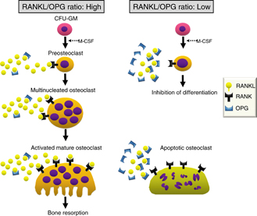
Anti-Resorptive Agents
RANKL Inhibitors (Denosumab) “still under investigation”
Mechanism Of Action | It is a fully human MOA (a human monoclonal antibody) that mimics the activity of osteoprotegerin (OPG). It binds to RANKL, expressed by osteoblasts → Block RANKL from interacting with RANK expressed on preosteoclasts → decrease Osteoclastogenesis ( no mature osteoclasts). It binds also to mature osteoclast → increase its apoptosis, So net effect: decrease bone resorption RANKL binds to its receptor RANK on the surface of precursor and mature osteoclasts, and stimulates these cells to mature and resorb bone. OPG, which competes with RANK for binding to RANKL, is the physiological inhibitor of RANKL. Denosumab binds with high affinity to RANKL, mimicking the effect of OPG.
Uses | It is extremely expensive and reserved for patients who can not tolerate or respond to bisphosphonate
P.K | Administered Subcutaneously every 6 month
ADRs | Infections: urinary & respiratory (Due to the immunological nature of the drug). Eczema & skin rash (Due to the immunological nature of the drug). Pancreatitis
C.I | In patients with hypocalcemia, bc Densosumab decreases serum calcium conc ( Correct Ca & Vit D levels before starting denosumab), why we give Ca? will basically denosumab inhibit osteoclast which regulate Ca level in the blood, so if osteoclast inhibited the Ca level in the blood will be low
$↑$ RANK = $↑$ maturation & activation of osteoclast = $↑$ resorption.
OPG = physiological antagonist that bind to RANK and inhibit it from binding to its receptor.
مثل ما شرحنا قبل يساعد إنها تصبح خلايا ناضجة، لكن ممكن نثبط عملية النضوج من خلال ، هذا الدوا يشتغل مثل شغل
osteoclast
RANK
OPG
OPG

Slide 10
Anti-Resorptive Agents + Bone Anabolic Agents
Strontium “strontium ranelate”
Mechanism Of Action | Sr²⁺, is a divalent cation, resembling Ca²⁺ in atomic & ionic properties. It is orally active as distrontium 1st drug to possess “ dual or double action “ i.e has both anabolic & anti-resorptive effects resulting in a rebalance of bone turnover in favor of bone formation. Effect on Osteoblast: Since it is like Ca, it acts as agonist on Ca Sensing Receptor [CaSR] ; which is a GP coupled receptor that enhances differentiation of preoteoblast to osteoblast → increase bone formation It stimulate the expression of OPG → increase RANKL binding → -ve of osteo-clustogenesis → decrease bone resorption. Effect on Osteoclast: Acts as agonist on Ca Sensing Receptor [CaSP] → suppress differentiation of preoteoclast to osteoclast → increase osteoclast apoptosis → decrease bone resorption Click here to see a very helpful illustration
P.K | Orally with a modest bioavailability 25% Binds partially to plasma proteins and strongly to bones t_{½} 60 hrs Excreted mainly by the kidney
Uses | Osteoporosis, 2ndry to menopause, glucocorticoids, …. Malignancy- associated hypercalcaemia
C.I | In severe renal disease. In hypersensitivity to it In increased risk of venous thromboembolism (in immobile patients) In phenylketonuria is an inborn error of metabolism that results in $↓$metabolism of the amino acid phenylalanine.
Interactions | Food specially containing milk+ its products Antacids Oral tetracycline & quinolones chelate it
ADRs | GIT irritation; nausea, vomiting, headache, eczema. All resolve in 1st 3 months. (Reversible)
Precautions: 2hrs spacing, to avoid interaction

Slide 11
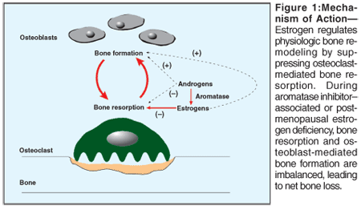
Anti-Resorptive Agents
Estrogen⁵ |  | Androgen
Indications | Estrogen in females & Androgen in males are essential for normal bone remodeling.
 | When to use Estrogen? If hysterectomy (the surgical removal of the uterus): use Estrogen only. If uterus is present: Estrogen + Progestins (progestins given to lower risk of cancer) As Hormonal replacement therapy (HRT): Menopausal symptoms SERMs (Selective Estrogen Receptor Modulator, e.g. Raloxifene): Menopause/Elderly. | Androgen: for elderly men. | Androgen: for elderly men.
M.O.A | Increase osteoclast apoptosis Inhibit osteoblast apoptosis Decrease Number & depth of resorption cavities Increase release of growth factors from osteoblasts Decrease release of inflammatory cytokines causing resorption
ADRs | As a HRT (estrogen): Risk of breast cancer. Vaginal bleeding. Venous thromboembolism.
⁵ Estrogen is neuro protective

Slide 12
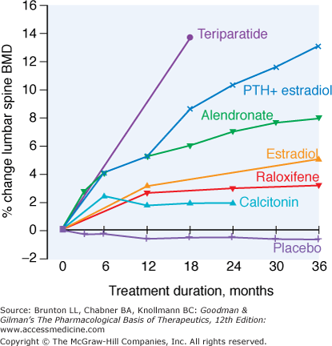
Anti-Resorptive Agents
SERMs (selective estrogen Receptor modulator) e.g. Raloxifene The only drug that have both anti-resorptive agent & bone anabolic effect
General info. | Raloxifene is the 1st selective estrogen Receptor modulator (SERM) for prevention and treatment of osteoporosis. Modulator: can be either agonist or antagonist.
M.O.A | Antiestrogens that exhibits partial agonistic action; acting as an agonist in bone & an antagonist in some female sex organs. The point from this table is to know that: Estradiol has ADRs on most of organs unlike Raloxifene (just little effect on CVS and bone)
Advantages | Increase bone density (2%) & decrease fracture risk (30%). No stimulation of breast or endometrial tissue. No need for progestin in women with uterus. decrease LDL. Good for women with risk of uterine and breast cancer. Lower risk of thromboembolism compared to estrogen.
Disadvantages | May increase hot flushes. No effect on HDL.
effect on the organ | Brain | Uterus | Vagina | Breast | Bone | CVS
Estradiol (estrogen analogues) | ++ | ++ | ++ | ++ | ++ | ++
Raloxifene | - | - | - | - | + | +
*
Relative efficacy of different therapeutic interventions on bone mineral density of the lumbar spine
* الدكتورة قالت غير مهمة وأنتوا غير مطالبين فيها

Slide 13
Summary
 | Bisphosphonate |  | RANKL inhibitors
Drugs | Non-nitrogenous | Nitogenous | Denosumab (still under investigation)
 | Etidronate, Tildronate, Clodronate | Alendronate, Risedronate, Ibandronate, Zoledronate
MOA | Structurally similar to pyrophosphate. Stick to calcium and concentrate in bones resulting in more resistant to osteoclastic activity. Block steps in cholesterol synthetic pathway in osteoclast that act as signaling molecules responsible osteoclastic hydrolytic & phagocytic activity →(stop function→apoptosis) |  | A fully human MOA that mimic the activity of osteoprotegrin (OPG) resulting in: Inhibition of osteoclast genesis. Promote osteoclast apoptosis.
P.K | Poorly absorbed, must be given on an empty stomach with a full glass of water. |  | Given subcutaneously every 6 months.
Indication | Osteoporosis secondary to Menopause. Glucocorticoids. Paget’s disease. Malignancy-associated hypercalcemia. |  | __________
ADRs | GI irritation. Gastro-esophageal reflux. Osteo-necrosis of the jaw. Atrial fibrillation in females with alendronate, zoledronate. Flu-like manifestation upon I.V infusion. |  | Increase risk of infections. Eczema and skin rash. Constipation. Cataract. Joint pain.
C.I | Impaired renal failure. Peptic ulcer. Esophageal reflux. |  | Patient with hypocalcemia.

Slide 14
Summary
 | Strontium | Estrogen and androgen | SERMs
Notes | Distrontium is the active form of strontium. | Essential hormones in bone remodeling. | Including Raloxifene.
MOA | Has both anabolic and anti-resorptive effects. On osteoclast: enhances differentiation of pre-osteoblast into osteoblast. On osteoclast: inhibiting differentiation of pre-osteoclast into osteoclast. | Increase osteoclast apoptosis. Inhibit osteoblast apoptosis. | Acts as: Estrogen agonist in bones. Estrogen antagonist in some female sex organs.
P.K | Partially bound to plasma proteins and strongly to bone. Excreted by kidney. | Females: If hysterectomy use estrogen only. Uterus is present use estrogen + progestin. Males: in elderly use androgen. | Advantages: Increase bone density. Decrease fracture risk. No stimulation of breast endometrium.
Indications | Osteoporosis secondary to: Menopause. Glucocorticoids. Malignancy-associated hypercalcemia. | __________ | First-line alternative for post-menopausal osteoporosis in women who are intolerant to bisphosphonate.
ADRs | GIT irritation that resolve after 3 months of drug withdrawal. | Vaginal bleeding. Risk of breast cancer. Thromboembolism | Increase flushes.
Interactions | Food containing milk. Antacids. Oral tetracycline and quinolones. | ____________ | ____________
C.I | In severe renal impairment. Sensitivity to Strontium. Thromboembolism. Phenylketonuria. | ____________ | ____________

Slide 15
MCQs
Q1: a 55-year-old female who has been diagnosed with postmenopausal osteoporosis. She has a past medical history of ethanol abuse, alcoholic liver disease, erosive esophagitis, and hypothyroidism. Which of the following would be the primary reason oral bisphosphonates should be used with caution in this patient?
A. Age. B. Erosive esophagitis. C. Liver disease. D. Thyroid disease.
Q2: Which one of the following is the major class predominantly used to treat osteoporosis clinically ?
A. Bisphosphonates. B. RANKL inhibitors. C. Estrogen Analogues
Q3: Which route of administration of bisphosphonate is recommended in patient with esophagitis to treat osteoporosis ?
Orally. B. Inhalation. C. Intravenously.
Q4: A 70-year-old female who is being started on ibandronate once monthly for the treatment of osteoporosis. Which of the following is important to communicate to this patient?
Take this medication with orange juice to increase absorption.
Avoid to take this medication along with milk or other calcium containing substance.
Remain upright for at least 60 minutes after taking this medication.
Both B & C .
Q5: Which of the following is correct regarding the pharmacokinetics of the bisphosphonates?
Bisphosphonates are well absorbed after oral administration.
Food or other medications greatly impair absorption of bisphosphonates.
Bisphosphonates are mainly metabolized via the cytochrome P450 system.
Calcium and vitamin D supplementation increase their absorption if taken along with them.
Q6:A 65-year-old female who has been diagnosed with postmenopausal osteoporosis. She has no history of fractures and no other pertinent medical conditions. Which of the following would be most appropriate for management of her osteoporosis?
A. Alendronate. B. Calcitonin. C. Denosumab.
Q7: Which one of the following drugs may induce osteonecrosis of jaw bone in clinical practice ?
A. Raloxifene. B. strontium ranelate. C. Risedronate.
Q8: Which one of the following is the strongest drugs to treat the osteoporosis ?
A. Risedronate. B. strontium ranelate. C. Denosumab.
Q9: Which one of the following drugs is the best choice to treat osteoporosis in women in clinical practice ?
A. Estrogen analogue. B. Progesterone analogue. C. Raloxifene.
Q10: 49 years old female is diagnosed with pelvic inflammatory disease and she has high risk to develop uterine cancer, which one of the following is the drugs of choice to treat postmenopausal osteoporosis ?
A. Estrogen analogue. B. Progesterone analogue. C. Raloxifene.
B
A
C
D
B
A
C
B
C
C

Slide 16
MCQs
Q11: Which one of the following act by mimicking the activity of osteoprotegerin and prevent the maturation of osteoclast ?
A. Risedronate. B. strontium ranelate. C. Denosumab.
Q12: Which one of the following is highly contraindicated to be given to patient with hypocalcemia ?
Alendronate. B. Raloxifene. C. Denosumab.
Q13: Which one of the following is contraindicated to be used in patient with phenylketonuria to treat osteoporosis ?
Risedronate. B. strontium ranelate. C. Denosumab.
Q14: All of the following are adverse effects of estrogen analogue as a drug except :
Vaginal bleeding. B. Breast cancer. C. Change in blood coagulation. D. delay postmenopausal age.
Q15: Which one of the following act by mimicking the action of calcium on its sensing receptors and have dual action in treatment of osteoporosis ?
Raloxifene. B. strontium ranelate. C. Denosumab.
Q16: Bisphosphonates thereby should be delayed for months after dental surgical procedures, why ?
Because they block the prostaglandin synthesis and be easy to get infection by Streptococcus sanguis.
Because they lead to osteonecrosis of mandible bone and delay the healing process.
Both of them.
Q17: The following is true of raloxifene except: *
A- It acts as an estrogen agonist in bone.
B- It exerts estrogen antagonistic action on endometrium.
C- It increases risk of developing breast cancer.
D- It can induce/aggravate menopausal hot flushes.
Q18: A 52-year-old postmenopausal patient has evidence of low bone mineral denisity. She and her physician are considering therapy with raloxifene or a combination of conjugated estrogens and medroxyprogesterone acetate. Which of the following patient characteristics is most likely to lead them to select raloxifene? *
A- Previous hysterectomy
B- Recurrent vaginitis
C- Troublesome hot flushes
D- Strong family history of breast cancer
Q19: A 78-year-old woman with known osteoporosis presents to her primary care physician for follow-up. She is managed with alendronate. Physical examination reveals a woman with a height of 5 ft 3 in and weight of 143 lb. The most likely effects on bone would be which of the following? *
A- Increased osteoblastic bone resorption
B- Inhibition of cholesterol biosynthesis
C- Inhibition of osteoclastic apoptosis
D- Inhibition of osteocyte activation
C
C
B
D
B
B
C
D
B
* Q17,18,19 were taken from pharmacology team 435

Slide 17
قادة فريق علم الأدوية :
- جومانا القحطاني - اللولو الصليهم
- فارس النفيسة
الشكر موصول لأعضاء الفريق المتميزين :
خالد العيسى
روان سعد القحطاني
أمل القرني
ريما البراك
لمى التميمي
References :
1- 436 Dr. Ishfaq’s slides and notes
2- 436 Dr. Alia’s notes
2- Guyton & Hall of Medical Physiology 12th Edition.
pharma436@outlook.com
@pharma436
Your feedback

