Slide 1
5: Pharmacology of corticosteroids
Objectives
Define and classify corticosteroids
To Compare Various Corticosteroids
Concept of mechanism of action and pharmacological effects of corticosteroids
Explain the clinical uses of corticosteroids
To discuss the adverse effect profile of corticosteroids
Color index
Extra information and further explanation
Important
Doctors’ notes
Drugs names
Mnemonics
Kindly check the editing file before studying this document

Slide 2
To Understand
Biosynthesis of adrenal hormones (only female’s slides)
*
**
* أهم شيء تعرفونه إن تصنيع الهرمونات يبدأ من الكولسترول
**the pharmacological preparation of cortisol is hydroxycortisol
Corticosteroids
Corticosteroids are steroid hormones produced by the adrenal cortex. They consist of two groups:
1- Glucocorticoids
They have important effects on intermediary metabolism, catabolism, immune responses, growth & inflammation.
2- Mineralocorticoids
They have salt-retaining activity which regulate Na & K reabsorption in the collecting tubules of the kidney.

Slide 3
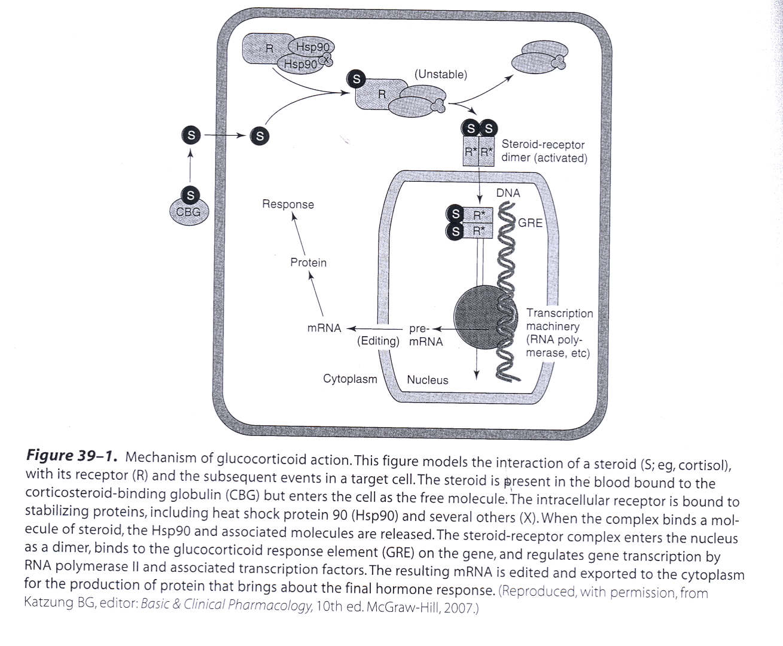
Introduction to corticosteroids
Mechanism of action:
Corticosteroid is present in the blood bound to the corticosteroid binding globulin (CBG) and enters the cell as the free molecule.
The intracellular receptor is bound to the stabilizing proteins, including heat shock protein 90 (Hsp90) and several others (X). When the complex binds a molecule of steroid, the Hsp90 and associated molecules are released.
The resulting mRNA is edited and exported to the cytoplasm for the production of protein that brings about the final hormone response.
The Steroid – receptor complex enters the nucleus as a dimer, binds to the glucocorticoid response element (GRE) on the gene, and regulates gene transcription by RNA polymerase2 and associated transcription factors.

Slide 4
Effects of steroids
1- Metabolic effects
Glucocorticoid stimulate gluconeogenesis, as a result: Blood glucose rises.
Insulin secretion is stimulated → Lipolysis and lipogenesis are stimulated. With a net increase of fat deposition in certain areas (e.g., the face (moon facies), shoulder and back (buffalo hump)
These effects occur when the patient is treated with 100 mg of hydrocortisone or > for longer than 2 weeks. (Female slides only)
2- Catabolic effects
Glucocorticoids cause muscle protein catabolism ( ↓ muscle mass ).
Lymphoid and connective tissue fat and skin undergo wasting (Fat wasting).
Catabolic effects on bone lead to osteoporosis
In children growth is inhibited, so it is not recommended for chronic use in children.
3- Immunosuppressive effects
Glucocorticoids inhibit cell mediated immunologic functions, especially dependent on lymphocytes & decrease interleukins secretion.
Glucocorticoids do not interfere with the development of normal acquired immunity (adaptive immunity which is against a specific pathogen) but delay rejection reactions in patients with organ transplants.
4- Anti-inflammatory effect (Main use)
Glucocorticoids have important inhibitory effects on the distribution and function of leukocytes (that is used for immune reaction).
Suppressive effect on the inflammatory cytokines & chemokines. (Female slides only)
These drugs increase neutrophils and decrease lymphocytes, eosinophils, basophils and monocytes.
Inhibit phospholipase A2 (Converts phospholipids into arachidonic acid and then it will produce prostaglandin and cytokines) & Prostaglandins synthesis.
The migration of leukocytes is also inhibited (male slides only)

Slide 5
Effects of steroids
5- Other effects
Glucocorticoids such as cortisol are required for normal renal excretion of water loads.
But if we use it for a long time it will affect:
CNS: When given in large doses these drugs may cause profound behavioral changes (first insomnia & euphoria or excitation then depression).
GIT: Large doses also stimulate gastric acid secretion and decrease resistance to ulcer formation.
Overview
Agonist
Antagonist²
Glucocorticoids¹
Mineralocorticoids
Spironolactone³
Mifepristone
Natural Glucocorticoids
synthetic Glucocorticoids
Aldosterone
(Fludrocortisone)
Ketoconazole
Cortisol (hydrocortisone)
Prednisone
Aminogluthemide⁴
Prednisolone
Metrapone⁴
Dexamethasone
Triamcinolone
Beclomethasone
Budesonide
¹ We use it if we have low glucocorticoids
² we use them If we have excess mineralocorticoids
³ Also used as diuretic
⁴ only in male’s slides

Slide 6
Effects of steroids
Some commonly used natural and synthetic corticosteroids for general use (click here to see the original pic)
Agent | Activity
 | Anti-inflammatory | Topical | Salt-retaining
Short-to-medium acting glucocorticoids
Hydrocortisone (cortisol) | 1 | 1 | 1
Cortisone | 0.8 | 0 | 0.8
Prednisone* | 4 | 0 | 0.3
Prednisolone* | 5 | 4 | 0.3
Long-acting glucocorticoids
Betamethasone* | 25-40 | 10 | 0
Dexamethasone* | 30 | 10 | 0
Mineralocorticoids
Fludrocotisone | 10 | 0 | 250
The salt retaining action is reduced in the new drugs which is better
new drugs has better anti-inflammatory effect than cortisol
اللي عليهم نجمة ركزت عليهم الدكتورة
Glucocorticoids
 | Natural Cortisol (hydrocortisone) | synthetic Glucocorticoids
Pharmacokinetics | Given orally, cortisol is well absorbed from GIT. غير مهم Cortisol in the plasma in 95% bound to CBG (corticosteroid binding globulin). It is metabolized by the liver and has short duration of action compared with the synthetic congeners. It diffuses poorly across normal skin and mucous membranes. | Their properties (compared with cortisol) include: Longer half life Longer duration of action. Reduce salt retaining effect Better penetration of lipid barriers for topical activity. Better pharmacokinetics than Natural Cortisol

Slide 7
Glucocorticoids
 | Natural Cortisol (hydrocortisone) | synthetic Glucocorticoids
General information | It’s the major natural glucocorticoid. The physiologic secretion of cortisol is regulated by adrenocorticotropic (ACTH) & secretion rate varies during the day (Circadian rhythm). Peaks in the morning and trough (declines) in midnight.
Uses |  | Beclomethasone & budesonide Have been developed for use in asthma and other condition in which good surface activity on mucous membrane or skin is needed and systemic effects are to be avoided. Rapidly penetrate the airway mucosa but have very short half lives after they enter the blood, so that systemic effects and toxicity are greatly reduced.
ADRs (toxicity) | The cortisol molecule also has a small but significant salt-retaining (mineralocorticoid) effect. This is an important cause of hypertension in patients with cortisol secreting adrenal tumor or a pituitary ACTH secreting tumor (Cushing's syndrome)
 | Cushing’s syndrome (iatrogenic, by higher doses more than 100mg hydrocortisone daily for more than 2 weeks characterized by moon shape face and buffalo hump) Increase growth of fine hair on face, thighs and trunk. Myopathy, muscle wasting, thinning of skin, Diabetes Mellitus (because of its effect on blood glucose levels). Osteoporosis and aseptic necrosis of the hip. (because of its catabolic effects on protiens) Wound healing impaired. In general patients treated with corticosteroids should be on high protein and potassium enriched diet Peptic ulcer Adrenal suppression (high cortisol leads to low ACTH levels by negative feedback therefore the body will depend on the drug instead of the natural cortisol secreted by the adrenal glands, so the gland will be atrophied) Acute psychosis, depression Sub-capsular cataracts (loss of lens transparency) Growth suppression Hypertension

Slide 8
Clinical uses of glucocorticoids
Adrenal disorders
Addison’s disease (chronic adrenal cortical insufficiency)
Acute adrenal insufficiency associated with life threatening shock, infections or trauma.
Congenital adrenal hyperplasia (in which synthesis of abnormal forms of corticosteroids are stimulated by ACTH).
Non-adrenal disorders⁵
Allergic reactions (e.g; bronchial asthma, angioneurotic edema -swelling in larynx and respiratory system-, drugs reactions, urticaria, allergic rhinitis)
Collagen vascular disorders: Auto-immune diseases against connective tissues (e.g; rheumatoid arthritis, systemic lupus erythematous, giant cell arteritis, poly myositis, mixed connective tissue syndrome)
Organ transplant: prevention and treatment of rejection- immunosuppression.
GIT disorders: inflammatory bowel disease, non-tropical sprue.
Hematologic disorders: leukemia, multiple myeloma, acquired hemolytic anemia, acute allergic purpura ‘auto-immune disease cause destruction in the RBCs’.
Infections: acute respiratory distress syndrome, sepsis -high immune cells release-
Neurologic disorders: to minimize cerebral edema after brain surgery, multiple sclerosis
Pulmonary disease: e.g; aspiration pneumonia, bronchial asthma, sarcoidosis accumulation of inflammatory cells inside the lungs and lymph
Thyroid diseases: malignant exophthalmos , subacute thyroiditis
Renal disorders: nephrotic syndrome
Miscellaneous: hypercalcemia to secrete Ca from the body, mountain sickness
⁵ all of these diseases are autoimmune diseases, and here we use glucocorticoids as anti-inflammatory drug

Slide 9
Methods for minimizing corticosteroid toxicity
1
Local application (e.g; aerosol for asthma)
2
Alternate day therapy (to reduce pituitary suppression) to induce feedback mechanisms يوم نستخدمه ويوم لا
3
Tapering the dose soon after achieving a therapeutic response.
4
To avoid adrenal insufficiency in patient who have had long term therapy, additional stress doses (high dose) may need to be given during serious illness or before major surgery (to avoid withdrawal symptoms)
Mineralocorticoids
Aldosterone (e.g. Fludrocortisone)
Notes | The major natural mineralocorticoid in human. Aldosterone is the main salt-retaining hormone, promotes Na reabsorption and therefore water reabsorption, K excretion, in the distal convoluted tubule & thus it is very important in the regulation of blood volume & blood pressure. Its secretion is regulated by ACTH & by the renin-angiotensin system. Aldosterone has short half life & little glucocorticoid activity
M.O.A | Same as that of glucocorticoids. Fludrocortisone: it is a mineralocorticoid has a long duration of action and significant glucocorticoid activity compared to aldosterone (only male slides)
Uses | Fludrocortisone is favored for replacement therapy after adrenalectomy & in other conditions in which mineralocorticoid therapy is needed. And can be given to hypotensive people to maintain normal Na and water levels.

Slide 10
Corticoids antagonist
 | Receptor antagonists |  | Synthesis inhibitors
 | Spironolactone , eplerenone⁶ | Mifepristone | Ketoconazole | ⁶Aminogluthemide , Metyrapone
Mechanism of action | antagonists of aldosterone at its receptor mineralocorticoid antagonist & K-sparing diuretic, it keeps the K in the body (only female slides) | A competitive inhibitor of glucocorticoid receptors as well as progesterone receptors | It inhibits the cytochrome p450 enzymes necessary for the synthesis of all steroids (synthesis inhibitor) | It blocks the conversion of cholesterol to pregnelone Inhibits the synthesis of all hormonally active steroids
Indications | used in the treatment of primary aldosteronism, -the problem in the adrenal gland- (only female slides) | useful in the treatment of Cushing's syndrome | * anti fungal * Used in a number of conditions in which reduced steroid level are desirable such as: Adrenal carcinoma Hirsutism Breast cancer Prostate cancer. | Adrenocortical cancer (steroid producing tumor) in conjuction with other drugs
 |  |  | Adrenal cancer, when surgical therapy is impractical or unsuccessful because of metastasis
⁶ only in male’s slides

Slide 11
Summary
Corticosteroids
MOA: | Corticosteroid is present in the blood bound to the corticosteroid binding globulin (CBG) and enters the cell as the free molecule The intracellular receptor is bound to the stabilizing proteins, including heat shock protein 90 (Hsp90) and several others (X). When the complex binds a molecule of steroid, the Hsp90 and associated molecules are released. The Steroid – receptor complex enters the nucleus as a dimer, binds to the glucocorticoid response element (GRE) on the gene, and regulates gene transcription by RNA polymerase2 and associated transcription factors. The resulting mRNA is edited and exported to the cytoplasm for the production of protein that brings about the final hormone response.
Effects of steroids : | Metabolic effects, Catabolic effects, Immunosuppressive effects Anti-inflammatory effect, CNS, GIT .
Glucocorticoids (Natural Cortisol (hydrocortisone), synthetic Glucocorticoids)
Beclomethasone & budesonide Have been developed for use in asthma, have very short half lives after they enter the blood, so that systemic effects and toxicity are greatly reduced.
ADRs effects |  | Cushing’s syndrome Increase growth of fine hair on face, thighs and trunk. Myopathy, muscle wasting, thinning of skin, Diabetes Mellitus Osteoporosis Growth suppression Hypertension
Clinical uses of glucocorticoids |  | Adrenal disorders (e.g. Addison’s disease, Congenital adrenal hyperplasia ) Non-adrenal disorders (e.g. Allergic reactions, Organ transplant, Hematologic disorders)
Mineralocorticoids
Aldosterone is the main salt-retaining hormone, promotes Na reabsorption. Fludrocortisone is favored for replacement therapy after adrenalectomy & in other conditions in which mineralocorticoid therapy is needed
Corticoids antagonist
Receptor antagonists (Spironolactone antagonists aldosterone, Mifepristone competitive inhibitor of glucocorticoid receptors) Synthesis inhibitors (Ketoconazole It inhibits the cytochrome p450 enzymes necessary for the synthesis of all steroids, Metrapone Inhibits the synthesis of all hormonally active steroids by blocking the conversion of cholesterol to pregnelone)

Slide 12
MCQs
Q1: Which one of the following is the most important therapeutic property of glucocorticoids in clinical practice ?
A. Metabolic effect. B. Immunosuppressant. C. Anti-inflammatory.
Q2; Which one of the following is the main mechanism in which glucocorticoids act as anti-inflammatory drugs ?
A. Block the action of cytokines and chemokines.
B. Inhibit phospholipase A2 and prostaglandin synthesis.
C. Inhibit the migration of neutrophils and leukocytes.
Q3: Which corticosteroids possess the highest mineralocorticoid function ?
A. Hydrocortisone. B. Fluprednisolone. C. Fludrocortisone.
Q4: Corticosteroids are useful in the treatment of all of the following disorders except:
Addison disease. B. Allergic rhinitis. C. Cushing syndrome. D. Inflammatory bowel disease.
Q5: All of the following adverse effects commonly occur with glucocorticoid therapy except:
Glaucoma. B. Increased risk of infection. C. Hypotension. D. Peripheral edema.
Q6: Osteoporosis is a major adverse effect caused by the glucocorticoids. It is due to their ability to:
A. Increase the excretion of calcium. B. Inhibit absorption of calcium. C. Decrease collagen synthesis.
Q7: A child with severe asthma is being treated with high doses of inhaled corticosteroids. Which of the following adverse effects is of particular concern?
Hypoglycemia. B. Hirsutism. C. Growth suppression.
Q8: The diagnosis of congenital adrenal hyperplasia (CAH) is confirmed in a child. This condition can be effectively treated by Administering :
A. Glucocorticoid. B. Androgen antagonist. C. ketoconazole to decrease cortisol synthesis.
Q9: A patient with Addison disease is being treated with hydrocortisone but is still having problems with dehydration and hyponatremia. Which of the following drugs would be best to add to the patient’s therapy?
Dexamethasone. B. Fludrocortisone. C. Prednisone.
Q10: A male patient is placed on a new medication and notes that his breasts have become enlarged and tender to the touch. Which medication is he most likely taking?**
Hydrocortisone. B. Spironolactone. C. Eplerenone.
C
B
C
C
C
B
C
A
B
B
** An adverse drug reaction to spironolactone is gynecomastia due to its effects on androgens and progesterone in the body. Eplerenone may be a suitable alternative if the patient is in need of an aldosterone antagonist but has a history of gynecomastia.

Slide 13
MCQs
Q11: Which corticosteroids possess the lowest salt retaining effect ?
Hydrocortisone. B. Prednisone. C. Dexamethasone.
Q12: Comparing to Cortisol/Hydrocortisone, the synthetic glucocorticoids are preferred to be used due to :
Rapid onset of action. B. Mineralocorticoid effect. C. Better penetration of lipid barrier.
Q13: Patients who are treated by Hydrocortisone, their diet should be rich in :
Carbohydrates & Na. B. Proteins & K. C. Fats & Cl.
Q14: 49 years old patient who is on cortisol thereby for 2 years. He is going to major surgery after systemic infection. How can his doctor adjust the dose of cortisol before surgery ?
Tapering the dose before the surgery to the half.
Give him the drug daily instead of alternate day thereby.
Give him additional stress dose before the surgery.
Q15: Which is contraindicated in a patient with hyperkalemia?
Aldosterone. B. Ketoconazole. C. Spironolactone.
Q16: Which one of the following synthetic steroid shows predominantly anti-inflammatory effect ?
Hydrocortisone. B. Prednisone. C. Dexamethasone.
Q17: Which one of the following drugs act by inhibiting the synthesis of corticosteroids ?
A. Aldosterone. B. Ketoconazole. C. Spironolactone.
Q18: All of the following are strategies to minimize the development of HPA axis suppression with corticosteroid therapy except***:
Alternate-day administration of therapy.
Using the lowest dose of corticosteroid that adequately controls symptoms.
Administration of two-thirds of the daily dose in the morning and one-third in the afternoon.
Q19: Which of the following patients would most likely have suppression of the HPA axis and require a slow taper of corticosteroid therapy****?
A patient taking 40 mg orally of prednisone daily for 7 days to treat an asthma exacerbation.
A patient taking 10 mg orally of prednisone daily for 3 months for rheumatoid arthritis.
A patient using beclomethasone nasal spray daily for 6 months for allergic rhinitis.
A patient receiving an intra-articular injection of methylprednisolone for osteoarthritis.
*** Administration of two-thirds of the dose in the morning and one-third in the afternoon is a strategy to mimic the normal diurnal variation of cortisol secretion. However, it is not a strategy to prevent suppression of the HPA axis. All of the other methods will help prevent the likelihood of suppression of the HPA axis.
**** Correct answer = B. Suppression of the HPA axis usually occurs with higher doses of corticosteroids when used for a duration of 2 weeks or more. Although the dose of prednisone is higher in the asthma patient, the duration of therapy is short, so the risk of HPA axis suppression is lower. The risk of HPA axis suppression is low with topical therapies like intranasal beclomethasone and with one-time joint injections.
C
C
B
C
C
C
B
C
B

Slide 14
قادة فريق علم الأدوية :
- جومانا القحطاني - اللولو الصليهم
- فارس النفيسة
الشكر موصول لأعضاء الفريق المتميزين :
روان سعد القحطاني
حنين باشيخ
ريم الشثري
ريما البراك
References :
1- 436 doctors slides and notes
2- 435 pharmacology teamwork
pharma436@outlook.com
@pharma436
Your feedback

