Slide 1
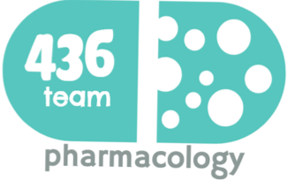
6: Uses of insulin in treatment of diabetes
objectives
Define diabetes and mention different types of diabetes
Differentiate between difference in treating type I and type II diabetes.
Understand mechanism of action, secretion, and actions of insulin. Describe different types of insulin analogues
Be able to recognize the difference in pharmacokinetic profile between different types of insulin analogues.
Know uses of different insulin analogues
Color index
extra information and further explanation
important
doctors notes
Drugs names
Mnemonics
Kindly check the editing file before studying this document

Slide 2
Diabetes mellitus
Definition: it is a chronic metabolic disorder characterized by high blood glucose level caused by relative or absolute deficiency of insulin.
complications: Cardiovascular problems (Micro- and macro-vascular disease, Renal failure (nephropathy),Blindness (retinopathy), Neuropathy, & risk of foot amputation.
Fasting glucose levels : (no food for 8 hours)
Normal : <100 mg/dl (5.6 mmol/l)
Prediabetes: 100-125 mg/dl (5.6-6.9 mmol/L)
Diabetes: >126 mg/dl (7 mmol/L) or 2h after a meal > 200 mg/dl (11.1 mmol/L).
 | Type I diabetes due to autoimmune or viral diseases | Type II diabetes due to genetic susceptibility and other factors (age, obesity)
Onset (age) | Usually during childhood or puberty | Usually over age 35 - 40
Type of onset | Abrupt | Gradual
Prevalence | 10-20% | 80-90 %
Genetic predisposition | Moderate | Very strong
Defects | β-cells are destroyed | β-cells produce inadequate quantity of insulin
Endogenous-insulin | - Absent - absolute deficiency of insulin secretion | Present (not enough)
Insulin -resistance | absent | Present (in peripheral tissues)
Nutritional status | Usually thin | Usually obese (Obesity is an important factor)
Ketosis | Frequent | Usually absent
Clinical symptoms | Polydipsia, polyphagia, polyuria, weight loss | Often asymptomatic
Related lipid abnormalities | Hypercholesterolemia frequent | Cholesterol & triglycerides often elevated
Treatment | Insulin injection | Oral hypoglycemic drugs ± insulin

Slide 3
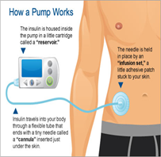
insulin
Receptors
Only on female
Present on cell membranes of most tissues.
Mainly in liver, muscle and adipose tissue.
Effects of insulin
Carbohydrate Metabolism: |  | Protein Metabolism:
↑glucose uptake & utilization by peripheral tissues ↑Glycogen synthesis (glycogen synthase) ↑Conversion of carbohydrate to fats. ↓Gluconeogenesis. ↓Glycogenolysis (liver) ↑Glycolysis (muscle). |  | Liver: | Muscle:
 |  | ↓ protein catabolism | ↑ amino acids uptake. ↑protein synthesis. ↑ glycogen synthesis (glycogenesis).
Fat Metabolism: |  | Potassium:
Liver: | Adipose Tissue: | ↑potassium uptake into cells.
↑ Lipogenesis. ↓Lipolysis →Inhibits conversion of fatty acids to keto acids. | ↑ Triglycerides storage. ↑Fatty acids synthesis. ↓Lipolysis.
Pharmacokinetics
Cannot be given orally
Insulin syringes (S.C. in arms, abdomen, thighs)
Portable pin injector (pre-filled).
Continuous S.C. infusion (insulin pump). Its advantages:
More convenient.
Eliminate multiple daily injection.
Programmed to deliver basal rate of insulin
Routs of administration: only in female slides
Intravenously (in a hyperglycemic emergency)
Under Clinical Trials: Inhaled aerosols, transdermal, intranasal
Degradation by:
Basal level of endogenous insulin is 5-15 µU/ml.
Half life of circulating insulin is 3-5 min
60% liver & 40% kidney (endogenous insulin)
60% kidney & 40% liver (exogenous insulin)

Slide 4
Insulin Analogues
Exogenous source: only in female slides
They have the same effect as human insulin but they can cause hypersensitivity reaction
لان التركيب مختلف.كانت
تستخدم قديماً.
Beef Insulin:
Differs from human insulin by 3 amino acids (antigenic).
Porcine Insulin :
Differs by one amino acid (antigenic)
Human insulin Analogues: only in female slides
Identical to human insulin but they increase the onset and the duration of action and decrease the absorption
Prepared by recombinant DNA techniques
Less immunogenic
Modifications of amino acid sequence of human insulin can change pharmacokinetics
Types of insulin preparations (Insulin Analogues):
A- Ultra-short (Rapid) | B- Short | C- Intermediate | D- Long
Lispro Aspart | Regular insulin | NPH (Isophane) Lent | Glargine Detemir
Very fast onset of action and short duration 10min | Fast onset of action and short duration 30min | Slow onset, intermediate duration of action (relative long duration) | Slow onset and long duration of action
Note: When rapid-acting insulins (e.g., lispro, aspart) are mixed with another insulin, the preparation should be used immediately
These types differ in pharmacokinetic properties mainly in :
Rate of Absorption (Onset of Action)
Duration of Action
These variations are due to : only in female slides
Change of amino acid sequence.
Size and composition of insulin crystals in preparations (monomers, dimers, hexamers).

Slide 5
Types of insulin preparations
(listen bro) you wanna lose weight (ultra fast)? Eat (asparagus)
Drug | A- Ultra-short (Rapid) Lispro, Aspart, Glulisine | B- Short (regular insulin) Humulin R, Novolin R
Physical characteristics | Clear solution at neutral pH | Clear solution at neutral pH + Soluble crystalline zinc insulin
Chemistry | Monomeric analogue (Do not aggregate or form dimers or hexamers) | Hexameric analogue
Route and time of admin | S.C. (5 -15 min) before meal I.V. in emergency | S.C. (30 – 45 min) before meal I.V. in emergency
Onset | 5 – 15 min ( S.C ) | 30 – 45 min ( S.C )
Peak level | 30 – 90 min | 2 – 4 hrs.
Duration | 3 – 5 hrs. (Shorter) | 6 – 8 hrs. (Longer)
Usual admin | 2 – 3 times/day Mimic the prandial mealtime insulin release skip the dose if the meal is skipped | 2 – 3 times/day with meal, skip the dose if the meal is skipped
Indications | Control of postprandial hyperglycemia (S.C) because they mimic the prandial mealtime insulin release. Emergency diabetic ketoacidosis (I.V) Preferred for external insulin pump (Lispro does not form hexamers عشان ما يسد المضخه) | Control of postprandial hyperglycemia (S.C) Emergency diabetic ketoacidosis (I.V) Can be used in pregnancy
Advantages of Insulin Lispro vs Regular Insulin. Insulin lispro has:
Rapid onset of action (due to rapid absorption) cuz patients will not wait long before they eat. Reduced risk of postprandial hypoglycemia and hyperinsulinemia (due to shorter duration of action, no more than 3-4 hrs regardless of dose).
When the duration is long → the risk for Hypoglycemia is higher

Slide 6
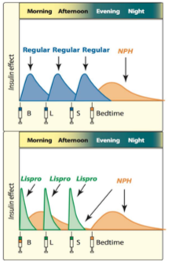
Con. Types of insulin preparations
C- Intermediate acting insulins
NPH نبهه
(lente) lentalsان العدس
يقعد بالمعده ويشبع لفترة متوسطة
 | 1- Isophane (NPH) insulin
M.O.A | NPH, is a Neutral Protamine Hagedorn insulin in phosphate buffer. NPH insulin is combination of protamine & crystalline zinc insulin (1:6 molecules). proteolysis release insulin.
P.K | Turbid suspension at neutral pH since its not clear → its not used in emergency Given S.C. only, not I.V. Can not be used in ketoacidosis or emergency Onset of action 1-2 h. Peak serum level 5-7 h. mimic the normal basal inulin release rate Duration of action 13-18 h
Insulin Mixtures | NPH/regular insulin – 75/25 , 70/30 , 50/50 (NPL= NPH / lispro) (NPA= NPH / aspart) NPL & NPA have the same duration as NPH Have two peaks. لما نخلط واحد قصير مع الطويل , الطويل عشان يغطي مستوى الأنسولين الطبيعي للجسم و القصير يعطي ال Spikes اللي وقت الاكل
Drug | 2- Lente insulin (Humulin L, Novolin L)
Characteristics | Mixture of: تقول الدكتوره التركيب مو معنا 30% semilente insulin (amorphousprecipitate of zinc insulin in acetate buffer) 70% ultralente insulin (poorly soluble crystal of zinc insulin) Turbid suspension at neutral pH Given S.C., not intravenously cuz its not clear Should not be mixed with insulin in the same syringe (in males slides)
P.K | Delayed onset of action (1-3 h) Peak serum level 4-8 h. o Duration of action 13-20 h. Lente and NPH insulins are equivalent in activity. Lente is not used in diabetic ketoacidosis or emergency.
*More explanation in the next page
Prandial and basal insulin replacement

Slide 7
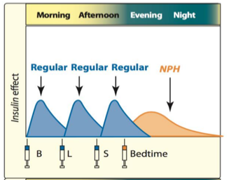
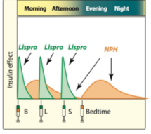
EXTRA explanation of Prandial and basal insulin replacement
special thanks to 435 team
1 |  | Before meals : diabetic patients takes short acting insulin which is regular insulin used to cover the daily need of the insulin after meals . Before sleeping : no need for strong and fast action because glucose levels before sleeping not high like after meals so, to avoid hypoglycemia and coma the patients takes instead of short acting insulin the insulin intermediate
2 | Figure 24.8 Examples of four regimens that provide both prandial and basal insulin replacement. B = breakfast; L = lunch; S = supper. NPH = neutral protamine Hagedorn. | Same idea but the short acting insulin is replaced with the ultra-short acting insulin which has a rapid effect As long as the body needs the insulin as a basal level between meals , the patients take double dose of the insulin intermediate to control the glucose level for the whole day not only before meals or sleeping time Q: why don’t patients take double dose of insulin intermediate with short acting insulin ? Because it has longer effect than ultra-short
Insulin mixture = intermediate + short acting insulin
Is a helpful drug to reduce the use of injections for the diabetic patients and provide a basal level of insulin during the day and once the patient eat a meal short acting insulin is ready Anyway diabetic patients supposed to check the blood glucose level frequently and don’t depend on drugs .

Slide 8
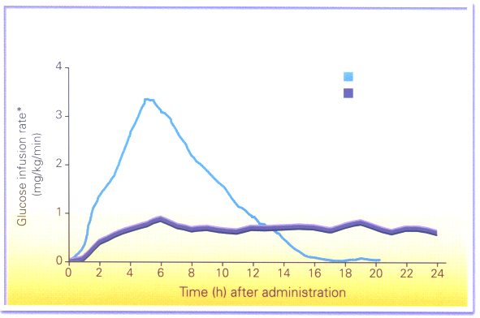
Con. Types of insulin preparations
D- Long acting insulins : Insulin glargine (lantus) , Insulin detemir (Levemir)
She is glaring (Glargine) at her for a long time because she admires (detemir) her
 | Insulin glargine (lantus)
M.O.A | Clear solution BUT forms precipitate (hexamer) at injection site. Due to change of PH from the syringe to the blood ( PH sensitive ) Slow onset of action 2 hr. absorbed less rapidly than NPH & Lente insulin. Given S.C. only, not intravenously Should not be mixed with other insulins in the same syringe. Due to the PH difference
P.K | Maximum effect after 4-5 h Prolonged duration of action (24 h). Once daily. Produce broad plasma concentration plateau (low continuous insulin level) Glargine must be used in regimens with rapid or short acting insulins.
Advantages | Advantages over intermediate-acting insulins: Constant circulating insulin over 24 hr , with no peak (peak-less profile) Produce flat prolonged hypoglycemic effect. (reduced risk of nocturnal hypoglycemia) →Safer than NPH & Lente insulins cuz it keeps a low continues release of insulin
NPH
Glargine
No risk of hypoglycemia because it keeps a low steady flow of insulin (basal rate)
and it has no peak

Slide 9
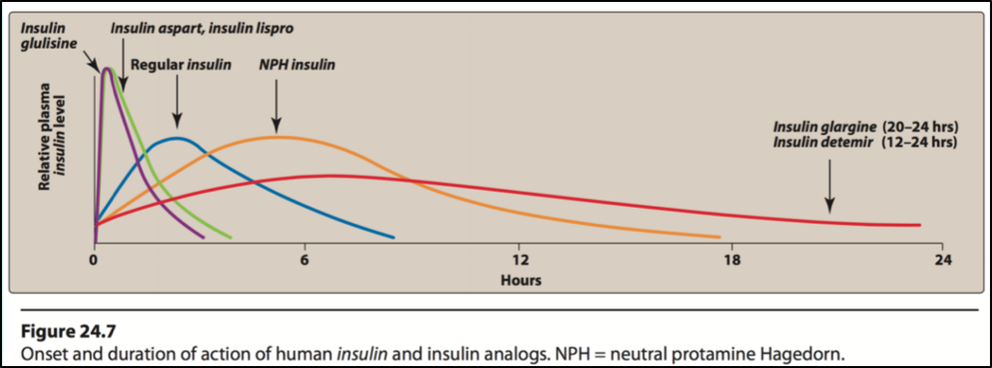
Insulin in general
Insulin analogues are used to treat type I diabetes.
 | Fast acting insulins (Lispro, Aspart) given S.C. or I.V., produce fast action, used to mimic postprandial insulin.
 | Short acting insulin (Regular insulin) given S.C. or I.V. produce rapid action, used to mimic postprandial insulin.
 | Intermediate acting insulin (lente, Isophane) produce slower action, than regular insulin, given S.C. not I.V.
 | Long acting insulins (glargine, detemir) produce constant circulating insulin over 24 hr with no peak (peakless profile), S.C. not I.V
Insulin dosing consideration only in female slides
Blood glucose monitoring is required in all patients receiving insulin.
Rotate injection sites within the same region.
Insulin should be stored in refrigerator and warm up to room temp before use.
Complications of insulin therapy
Hypoglycemia (life threatening occurs when blood glucose < 50 mg/dl.)
Hypersensitivity reactions.
Lipodystrophy at injection site
Weight gain (due to anabolic effects of insulin )
Insulin resistance.
Hypokalemia “cuz insulin causes the K uptake into the cells”
On males slides: Overdose of insulin/ Excessive (unusual) physical exercise / A meal is missed.
How it is treated?
1. Conscious patient: Oral glucose tablets, juice or honey.
2. Unconscious patient: 20-50 ml of 50% glucose solution I.V. infusion, OR Glucagon (1 mg S.C. or I.M.)

Slide 10
Summary
 | Lispro Aspart | Humulin R Novolin R | NPH | Lente | Glargine Detemir
Subclass | Ultra-short acting insulins | Short-acting insulins (Regular​) | Intermediate acting insulins |  | Long acting insulins
Onset | 5-15m | 30-45m | 1-2h | 1-3h | 2h
Duration | 3-5h | 6-8h | 13-18h | 13-20h | 24h
Peaks | 30-90m | 2-4h | 5-7h | 4-8h | Peakless
Route | S.C. at home I.V. in E.R. | S.C. at home I.V. in E.R. | S.C. |  | S.C.
Physical Ch. | Clear | Clear | Turbid |  | Clear but precipitate at site of injection
Chem. | Monomers | Hexamers | Combination |  | Hexamers
Indications | Postprandial hyperglycemia (S.C.) Diabetic ketoacidosis (I.V.) | Postprandial hyperglycemia (S.C.) Diabetic ketoacidosis (I.V.) | Combined with lispro, aspart or regular insulins. |  | Produce plasma conc. Plateau (low continuous insulin level). Used with rapid or short acting regimens
Notes | They are mixed with other insulins. Preferred for external insulin pump | Can be used in pregnancy | NOT​ used in emergency ie:​​ DKA |  | Should not be mixed with other insulins with the same syringe. Reduce risk of nocturnal hypoglycemia

Slide 11
MCQs
Q1: Which of the following statements is correct regarding insulin glargine?*
It is primarily used to control postprandial hyperglycemia.
It is a “peakless” insulin.
It should not be used in a regimen with insulin lispro or glulisine.
It may be administered intravenously in emergency cases.
Q2: a patient with type 2 diabetes who has a blood glucose of 400 mg/dL today at his office visit. The physician would like to give some insulin to bring the glucose down before he leaves the office. Which of the following would lower the glucose in the quickest manner in his case ? **
Insulin aspart. B. Insulin glargine. C. NPH insulin. D. Regular insulin.
Q3 : In invitation, which preparation of insulin is recommended to be taken with diabetic patient to reduce the waiting time before eating ?
A. Insulin aspart. B. Insulin glargine. C. NPH insulin. D. Regular insulin.
Q4: Which one of following preparation of insulin is preferable to be used in pregnant women ?
A. Insulin aspart. B. Insulin glargine. C. NPH insulin. D. Regular insulin.
Q5: Which one of the following preparation of insulin has lowest risk to develop hypoglycemia ?
Insulin aspart. B. Humulin Lente. C. NPH insulin. D. Regular insulin.
Q6: Which one of the following preparation of insulin has two peaks ?
A. NPH insulin. B. Humulin Lente. C. NPL insulin. D. Humulin regular.
Q7: All of the following mimic the prandial mealtime insulin release EXCEPT:
A. Insulin aspart. B. Humulin regular. C. NPL insulin. D. Insulin detemir.
* The prolonged duration is due to its low pH, which leads to precipitation at the injection site and resultant extended action.
* Although regular insulin can be used to bring the glucose down, its onset is not as quick as insulin aspart. The onset of regular insulin is about 30 to 60 minutes. Insulin aspart is a rapid-acting insulin that has an onset of action within 15 to 20 minutes.
B
A
A
D
A
C
D

Slide 12
MCQs
Q8: Which one of the following preparation of insulin should not be mixed with other form of insulin in the same syringes ?
A. Insulin aspart. B. Insulin glargine. C. NPH insulin. D. Regular insulin.
Q9: Which one of the following preparation of insulin is recommended to reduce the incidence of nocturnal hypoglycemia and maintain a baseline insulin thereby ?
A. Insulin aspart. B. Insulin glargine. C. NPH insulin. D. Regular insulin.
Q10: Which one of the following preparation of insulin has lowest risk to develop hypoglycemia ?
Insulin glargine. B. Humulin Lente. C. NPH insulin.
Q11: Diabetic patient who is going to increase his physical activity and exercise to loss some kilograms. How can the doctor adjust his insulin dose according to that ? *
By doubling the dose. B. by reducing the dose. C. by adding one of oral hypoglycemic drugs.
Q12: Which one of the following preparation of insulin can be used in case of ketoacidosis ?
A. Insulin aspart. B. Insulin lispro. C. Humulin regular. D. all of them.
Q13: The main route of administration of insulin is :
Intravenous. B- Subcutaneous. C- Intramuscular. D. Orally.
Q14: Which one of the following preparation of insulin can be given Intravenously ?
A. Insulin glargine. B. Humulin Lente. C. NPH insulin. D. Humulin regular
B
B
A
B
D
B
D
* Because during the exercise or physical activity we consume more glucose so to avoid hypoglycemia we have to reduce the dose of insulin.

Slide 13
قادة فريق علم الأدوية :
- جومانا القحطاني - اللولو الصليهم
- فارس النفيسة
الشكر موصول لأعضاء الفريق المتميزين :
عبد الرحمن الجريان
روان سعد القحطاني
لين التميمي
أثير الرشيد
لمى التميمي
References :
1- 436 doctors slides
2-435 team work
pharma436@outlook.com
@pharma436
Your feedback

