Slide 1
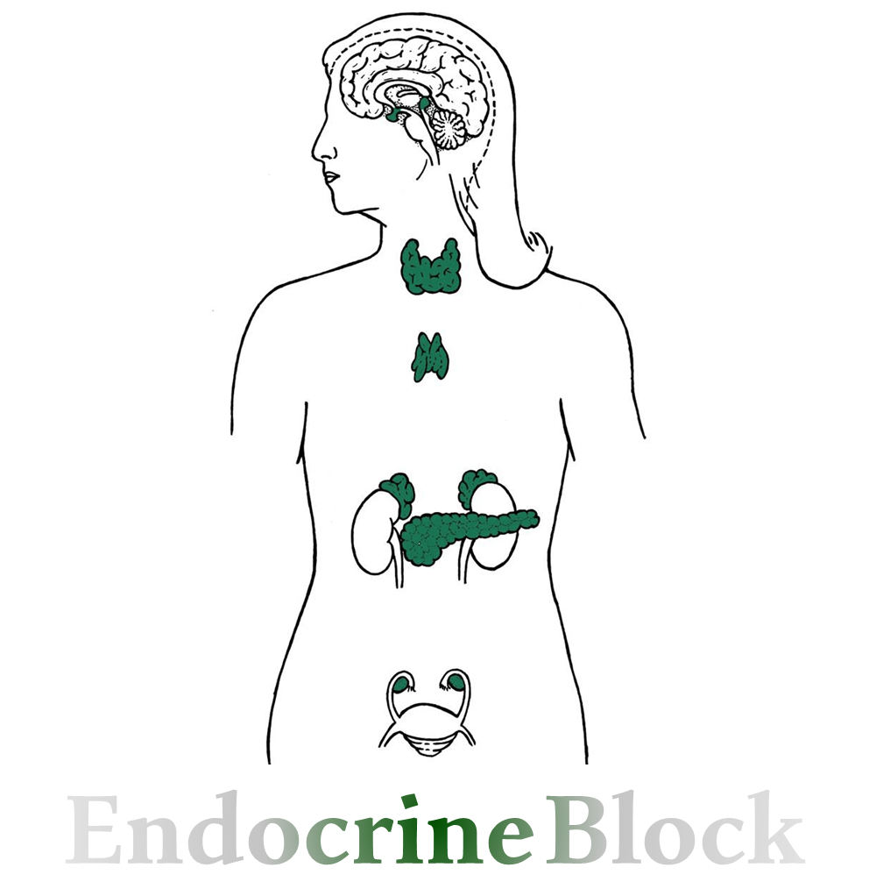
Text
Only in Females’ slide
Only in Males’ slides
Important
Numbers
Doctor notes
Extra Notes
المحاضرة مبنية بشكل أساسي على نوتات الدكتورز + قايتون ولندا، نظرا لأن السلايدات اغلبها صور !

Slide 2
Introduction to endocrine physiology
By the end of this lecture, students should be able to describe:
1. Hormones:
Exocrine gland vs Endocrine gland
Definition
Chemical structure
Paracrine, autocrine, Neuroendocrine & Endocrine hormones.
2. Secretion & clearance of hormones.
3. Mechanism of action of hormones:
Hormone receptors.
down-regulation & up-regulation.
Intracellular signaling.
Second messenger mechanism (cAMP, IP₃).

Slide 3
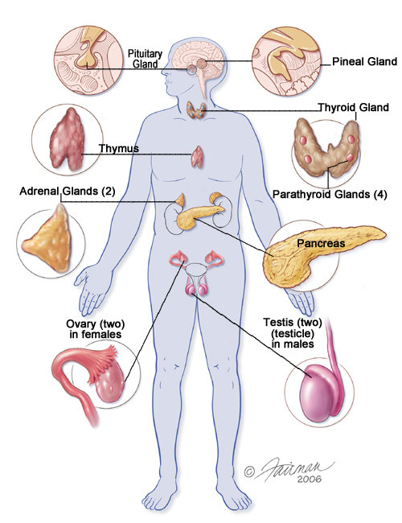
Overview of Glands
The differences are important
Overview of Glands
Types | Exocrine gland | Endocrine gland
Definition | Crine = Gland
 | Are glands that produce & secrete substances onto an epithelial surface by way of a duct. Or: Glands with cavity filled with secretions, secretions go through ducts to the final destination. | Are glands of the endocrine system that secrete their products (hormones) directly into the blood rather than through a duct (ductless). Or: it’s mainly group of cells that secrete hormones to the interstitial fluid, to the blood, to different targeted organs & cells.
Differences | Ducts Lumen. Surfaces | No Duct Chemical messengers Blood stream
Examples | Acrimal gland (tear ducts & glands near eyes). Mammary gland (breast milk). Eccrine sweat glands (perspiration or salty water release). Salivary glands (saliva consisting of fluid with digestive enzymes). Liver (bile, green-brown fluid that contains salts & digestion substances). | Pituitary gland. Pancreas. Ovaries. Testes. Thyroid gland. Parathyroid gland. Hypothalamus. Adrenal glands.
 | The pancreas & gonads produce both hormones & exocrine products (So considered as Endocrine & Exocrine organs).

Slide 4
Chemical messengers
The activities of cells, tissues & organs are coordinated by chemical messengers
Types | Definition | Example
Neurotransmitters | Guyton: Are released by axon terminals of neurons into the synaptic junctions & act locally to control nerve cell functions. Or: stimulated, first neuron will release & synthesize neurotransmitters that will travel along the axon & release them to produce it’s action. | Glutamate, Nitric oxide (NO). Acetylcholine (ACH).
Endocrine hormones | Guyton: Are released by glands or specialized cells into the circulating blood & influence the function of target cells at another location in the body. Or: cells release hormones to interstitial fluid, absorbed by blood to the targeted cells receptors, the hormones will act on the receptors & produce a response. | Erythropoietin. Renin.
Neuroendocrine hormones | Guyton: Are secreted by neurons into the circulating blood & influence the function of target cells at another location in the body. Or: nerve cells when stimulated it will synthesize hormones & travel through the axon to be directly released into the blood. | Specialized groups of neuroendocrine cells can be found in the hypothalamus.
Paracrines | Locally acting chemicals that affect cells other than those that secrete them. Guyton: Are secreted by cells into the extracellular fluid & affect neighboring target cells of a different type. Or: one group of cells will travel to interstitial fluid & affect the adjacent cells. | Growth factor. Clotting factors.
Autocrines | Chemicals that exert their effects on the same cells that secrete them. Guyton: Are secreted by cells into the extracellular fluid & affect the function of the same cells that produced them. Or: the cell itself produce chemicals that will affect the same cell. | -
Cytokines | Are peptides secreted by cells into the extracellular fluid & can function as autocrines, paracrines, or endocrine hormones. | Peptides: Interleukins. Lymphokines. Adipokines.
د: مهم تفهموا تعريف كل وحدة، مو بس تعداد، (حطينا لكم تعريف قايتون والدكتورة)، ولكن الدكتورة قالت اتّبعوا قايتون
The most important to know are Para & Autocrines

Slide 5
Hormones & Endocrinology
تعريف الهرمون جدا مهم، وهو لبّ المحاضرة، بحيث راح نمسك كل جزء من التعريف ونفصّل فيه!
Hormones & Endocrinology
Definition | Endocrinology: It is a study of homeostatic functions of HORMONES, that are released from endocrine glands distributed throughout the body. Hormones: Chemical substance¹ secreted in a small amount² from endocrine gland directly to the blood stream³ in response to stimulus⁴ to cause physiological responses at the target tissues⁵. (male slides) Or: Hormone is a chemical substance released by group of cells to contror the function of other type of cells.
Functions | The multiple hormones systems play a key role in regulating almost all body functions: Metabolism (Like thyroxin is responsible for energy & heat). Growth & development. Water & electrolyte balance. Reproduction (estrogen, testosterone). Behavior.
Types | Affect many different types of cells (e.g. Thyroxin, growth hormones & insulin).
 | Affect only specific target cells (eg. ACTH & estrogen).
¹= 3 main types: peptide/protein, steroid, or amine. ²= A mechanism control its secretion is to keep it within the normal range (avoid hypo or hyper secretion). ³= Hormones act on target tissue that is far away from the gland. On the other hand, paracrine acts on nearby tissues. Autocrine, secreted by & act on the same tissue eg; when the hormones secreted from a gland affects its own function. ⁴ = Humoral, neural & hormonal. ⁵= contain a specific receptor to a particular hormone.

Slide 6
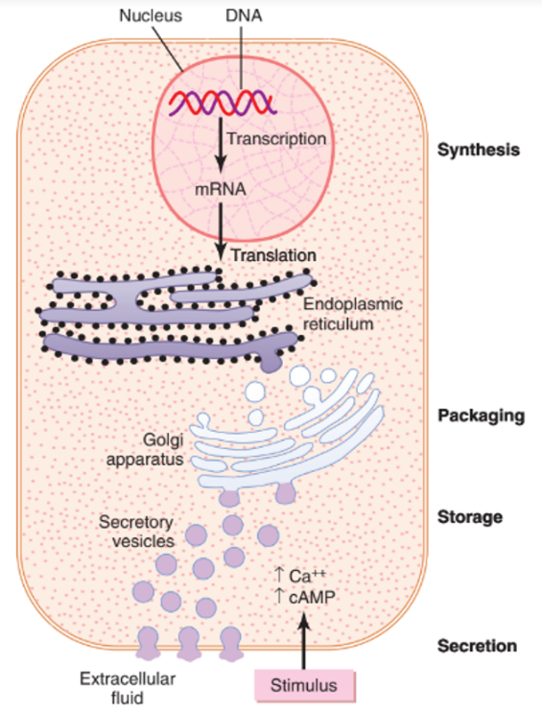
Chemical classification
1. Peptides or proteins hormones
Definition | Including hormones secreted by: The anterior & posterior pituitary gland. The pancreas (insulin & glucagon). The parathyroid gland (parathyroid hormone).
Synthesis
Important
ضروري تفهموا الميكانزيم هنا
^{Difference between} ^{protein and polypeptides:}
If the amino acids are more than 100 it’s called a protein if it’s less it’s called polypeptide.
Other Picture
1. Transcription: form mRNA from a section of the DNA.
2. Translation: translate the mRNA into a protein.
^{Inactive}
3. The initial protein formed by rough endoplasmic reticulum is larger than the active hormone & is called a preprohormone (synthesized as preprohormone).
(post- translational modification to prohormone → then hormone
^{Inactive}
4. The signal sequence of this large protein is cleaved in the endoplasmic reticulum to form a prohormone in the Golgi apparatus.
5. The prohormone is packaged in secretion granules along with proteolytic enzymes that cleave the prohormone into active hormone (stored in vesicles until needed).
^{Active form}
Guyton corner:
They are usually synthesized first as larger proteins that are not biologically active (preprohormones) & are cleaved to form smaller prohormones in the endoplasmic reticulum. These prohormones are then transferred to the Golgi apparatus for packaging into secretory vesicles. In this process, enzymes in the vesicles cleave the prohormones to produce smaller, biologically active hormones & inactive fragments. The vesicles are stored within the cytoplasm, & many are bound to the cell membrane until their secretion is needed. Secretion of the hormones (as well as the inactive fragments) occurs when the secretory vesicles fuse with the cell membrane & the granular contents are extruded into the interstitial fluid or directly into the blood stream by exocytosis.
Synthesis & secretion of peptide hormones. The stimulus for hormone secretion often involves changes in intracellular calcium or changes in cyclic adenosine monophosphate (cAMP) in the cell.

Slide 7
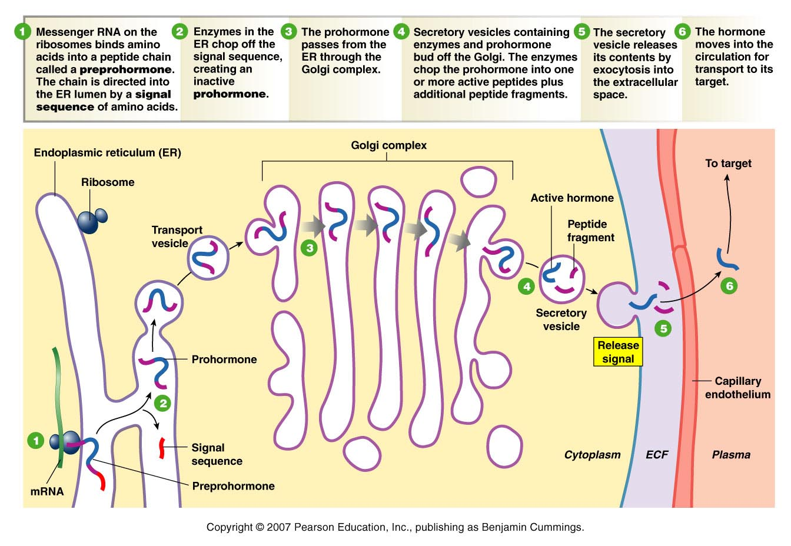
Doctors’ explanation
If you understood the previous slide, skip this one.
Protiens Synthesized from Rough Endoplasmic Reticulum, so the stimulus will stimulate transcription from DNA → mRNA → mRNA goes to the RER on the ribosomes (translation) → combining amino acids to produce a protein (at this stage it’s called Preprohormone & it’s attached to signal sequence).
When it’s detached from the signal sequence it’s then called Prohormone.
The prohormone is stored in a vesicle & to the Golgi complex. in the Golgi some gets activated (because it will combine it with enzymes that will cat part of it to activate it).
The vesicle coming out of the Golgi will have active hormone.
Protein hormones have the advantage of always being synthesized & stored, then secreted when needed (when stimulus act on cell, conformational changes happen & the vesicle gets attached to the membrane to be released by exocytosis).
After that it gets to the interstitial fluid → absorbed in blood & it will be DISSOLVED in the plasma because it’s hydrophilic.
Insulin synthesis:
Loop with S bonds → gets activated by removing a part of it.
C-peptide is used when measuring how much insulin is synthesized by the pancreas.
Because if a person had insulin shot, their blood wont have C-peptide.

Slide 8
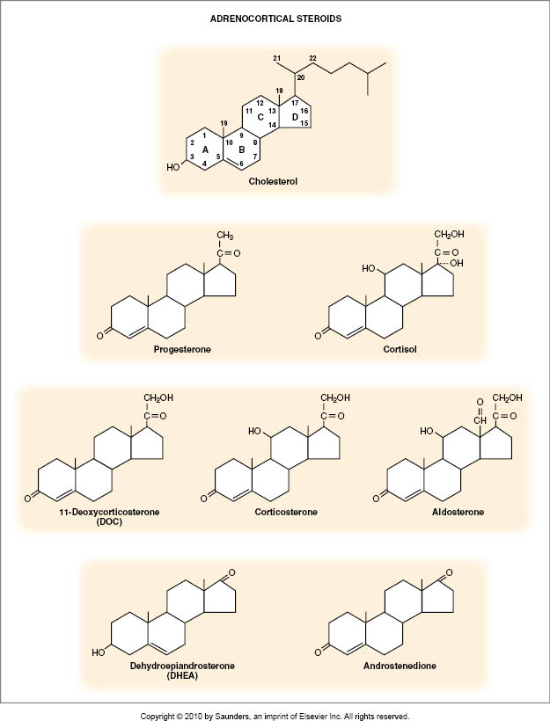
Chemical classification
2. Steroid hormones
Definition | Steroid hormones differs from protein hormones in ways of synthesis. Derived from Cholesterol (lipophilic). Cross membranes easily (no storage) because we have high levels of cholesterol so cells that produce steroid hormones can easily get it & because it crosses membranes. They are synthesized in demand (when needed) on Smooth endoplasmic reticulum, while protein hormones are synthesized & stored then released when needed. Because, steroid hormones are synthesized easily from cholesterol from blood on smooth endoplasmic reticulum. Usually Bound to Carrier proteins & it’s unsolvable in blood. Including hormones secreted by: The adrenal cortex (cortisol & aldosterone). The ovaries (estrogen & progesterone). The testes (testosterone) The placenta (estrogen & progesterone) (Placenta is a temporary gland).
Synthesis
The notes here are very imp
Common form & most important one
Guyton corner:
The chemical structure of steroid hormones is similar to that of cholesterol & in most instances hormones are synthesized from cholesterol. They are lipid soluble & consist of three cyclohexyl rings & one cyclopentyl ring combined into a single structure.
Although there is usually very little hormone storage in steroid-producing endocrine cells, large stores of cholesterol esters in cytoplasm vacuoles can be rapidly mobilized for steroid synthesis after a stimulus. Much of the cholesterol in steroid-producing cells comes from the plasma, but there is also de novo synthesis of cholesterol in steroid-producing cells.
Because the steroids are highly lipid soluble, once they are synthesized, they can simply diffuse across the cell membrane & enter the interstitial fluid & then the blood.
Chemical structures of several steroid hormones.

Slide 9
Chemical classification
3. Derivatives of the amino acid
Definition | 1. derivative from Tyrosine: Catecholamines (behave like peptide hormones) & Thyroid hormones (behave like steroid hormones). 2. derivative from Tryptophan: Melatonin.
Synthesis
Guyton corner:
The two groups of hormones derived from tyrosine, the thyroid & the adrenal medullary hormones, are formed by the actions of enzymes in the cytoplasmic compartments of the glandular cells. The thyroid hormones are synthesized & stored in the thyroid gland & incorporated into macromolecules of the protein thyroglobulin, which is stored in large follicles within the thyroid gland.
Hormone secretion occurs when the amines are split from thyroglobulin, and the free hormones are then released into the blood stream. After entering the blood, most of the thyroid hormones combine with plasma proteins, especially thyroxine-binding globulin, which slowly releases the hormones to the target tissues.
Epinephrine & norepinephrine are formed in the adrenal medulla, which normally secretes about four times more epinephrine than norepinephrine. Catecholamines are taken up into preformed vesicles & stored until secreted. Similar to the protein hormones stored in secretory granules, catecholamines are also released from adrenal medullary cells by exocytosis. Once the catecholamines enter the circulation, they can exist in the plasma in free form or in conjugation with other substances.

Slide 10
Regulation of hormone secretion by neural or feed back mechanism
Feedback mechanism (The level of the hormone will stimulate/inhibit its own release) | Negative feedback | Negative feedback means that some feature of hormone action, directly or indirectly, inhibits further secretion of the hormone. Release of hormone A stimulates the release of hormone B→Hormone B inhibits the release of hormone A. For example, LH from pituitary stimulates the testes to produce testosterone which in turn feeds back & inhibits LH secretion. Guyton Explanation: Negative Feedback Prevents Overactivity of Hormone Systems. Although the plasma concentrations of many hormones fluctuate in response to various stimuli that occur throughout the day, all hormones studied thus far appear to be closely controlled. In most instances, this control is exerted through negative feedback mechanisms that ensure a proper level of hormone activity at the target tissue. After a stimulus causes release of the hormone, conditions or products resulting from the action of the hormone tend to suppress its further release. In other words, the hormone has a negative feedback effect to prevent over secretion of the hormone or over activity at the target tissue. The controlled variable is sometimes not the secretory rate of the hormone but the degree of activity of the target tissue. Therefore, only when the target tissue activity rises to an appropriate level will feedback signals to the endocrine gland become powerful enough to slow further secretion of the hormone.
 | Positive feedback | Means that some feature of hormone action causes more secretion of the hormone. Release of hormone A stimulates the release of hormone B →Hormone B stimulates further release of hormone A. For examples: include LH stimulation of estrogen which stimulates LH surge at ovulation.
The notes here are very imp
هذه الجزئية عند الأولاد فقط في هذه المحاضرة لكنها عند البنات بالمحاضرة الثانية
Short loop: the feedback is directly on the chief gland secreting it.
Long loop: when the feed back is all the way back to the hypothalamus.
Ultra-short loop: the gland secretes hormone & that’ll directly act on it “autocrine”.
“Self- limiting”
Will stop further secretion
“Self- augmenting”
Hormone release will further increase its secretion.
E.g. oxytocin will cause uterus contraction & lead to cervix expansion which will further increase oxytocin release.

Slide 11
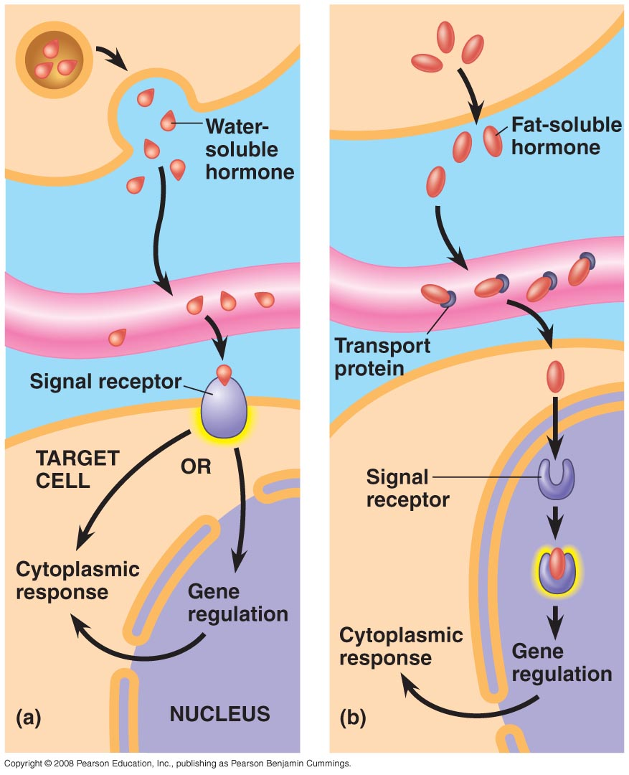
Transport of hormones
Only in Females’ Slides
Transport of hormones:
1. Water soluble hormones (hydrophilic):
(peptides & catecholamines) dissolved in Plasma.
2. Fat soluble hormones (hydrophobic):
(Steroids & thyroid hormones) transported bound to plasma proteins (90%), binding to proteins helps to:
Provide reservoirs (Reservoirs when bound to proteins so when the hormone is needed it can detach from the protein).
Slow hormones clearance.
Protein hormones dissolve in blood then move through openings in the endothelium to reach the targeted cell & attach to the receptor to produce action. Action of the protein hormones either direct on the cytoplasm or through the nucleus & produce gene regulation.
Steroid hormones are traveled in blood combined with protein & once it reaches the targeted cell it will be released from the protein to produce it’s action (needs to go through the nucleus to produce gene regulation). Takes long time to produce action.
If steroids is low in blood & we give external hormones the action will take a long time.

Slide 12
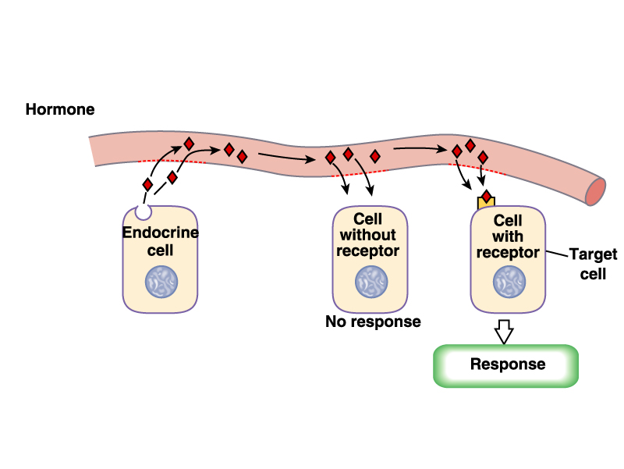
Mechanism of action of hormones & target tissue
Target tissue :Target cells refer to cells that contain specific receptors (binding sites) for
a particular hormone.
Imp: Each hormone has it’s own specific receptors on target cells, except in certain hormones.
Mechanism of action of hormones:
1. Hormone-receptor interaction
(1st messenger)
2. Enzyme activation
3. Release of the second messenger
4. Effects on cellular function

Slide 13
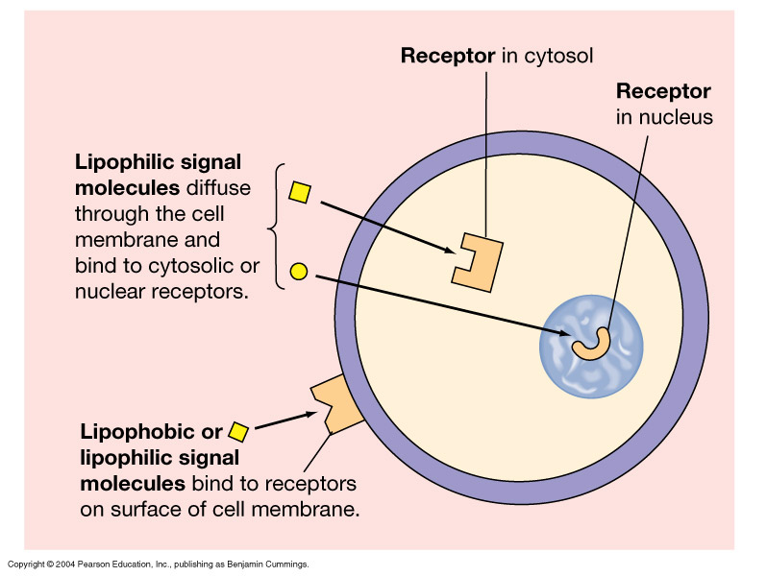
Hormone-receptor interaction (1st messenger)
Only in Females’ Slides
Receptor’s Location:
1. Cytosolic or Nuclear:
Lipophilic ligand enters cell.
Often activates gene.
Slower response (Due the time consuming transcription & translation processes).
Example:
In the cell cytoplasm (Steroids).
In the cell nucleus (thyroid hormones).
2. Cell membrane (surface):
Lipophobic ligand can't enter cell.
Outer surface receptor.
Fast response (The binding of the ligand to the receptor will cause a cascade of actions).
Example:
proteins, peptides & catecholamines.
Receptors:
Hormonal receptors are large proteins.
2000-100,000 receptors/cell.
Receptors are highly specific for a single hormone.

Slide 14
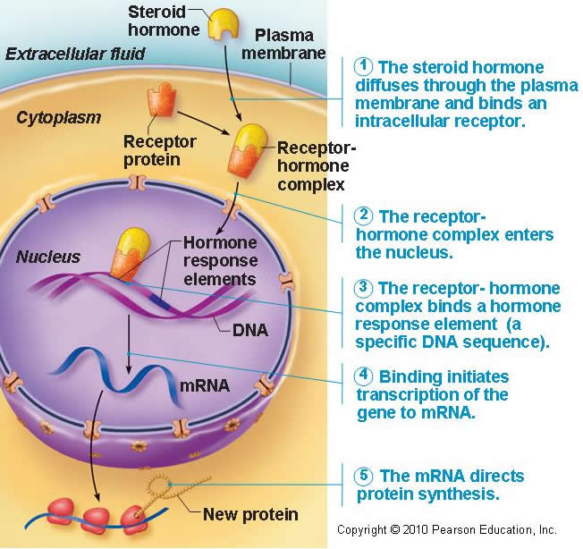
Mechanism of action In case of steroid & thyroid hormones
Other Picture
1. The steroids hormones diffuses through the plasma membrane & binds an intracellular receptor.
2. The receptor hormones complex enters the nucleus.
3. The receptor - hormones complex binds a hormone response element (a specific DNA sequence).
4. Binding initiates transcription of the gene to mRNA.
5. The mRNA directs the proteins synthesis.

Slide 15
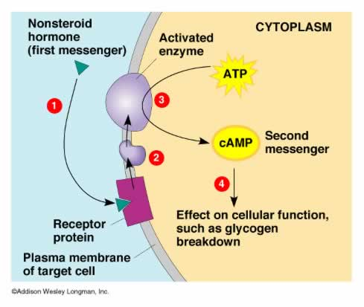
Mechanism of action In case of peptides & protein hormones
السلايد هذي هي الأساس لفهم السلايد الجاي!
^{1.} The hormone in the blood → finds it’s receptor on targeted cell & binds with the receptor → conformational changes in the receptor cells.
2. G-protein coupled receptors (has 3 subunits: alpha- beta- Gama) are combined with GDP.
3. When it gets activated it will release GDP & bind with GTP, the GTP has energy so it will dissociate the alpha subunit from the beta-Gama subunits, the alpha will go & activate a second enzyme (adenylyl cyclase) in the cell membrane (different enzymes). The activated enzyme will convert the ATP to cAMP.
4. The cAMP is the second messenger (this will activate protein kinase). The second messenger will produce the action in the cell.

Slide 16
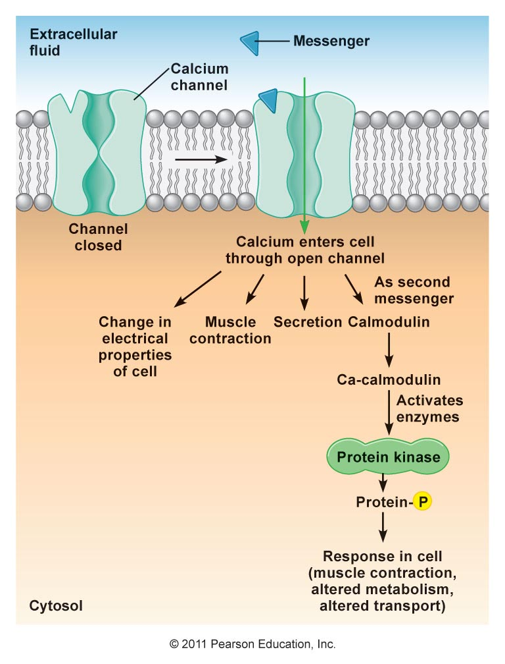
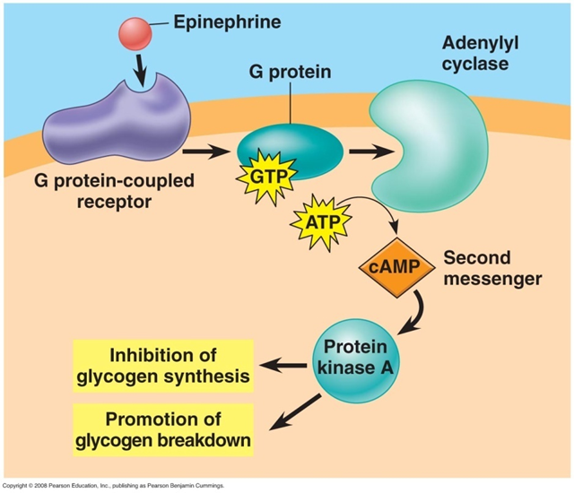
Cont. Mechanism of action In the case of peptide & catecholamine hormones
Second-messenger mechanisms include the following: | 1. Calcium-Calmodul | Guyton: Hormone-receptor interaction activates calcium channels in the plasma membrane, permitting calcium to enter cells. Calcium may also be mobilized from intercellular stores such as the Endoplasmic reticulum. The calcium ions bind with the protein calmodulin; this complex alters the activity of calcium-dependent enzymes & thus intercellular reactions. Or: Inactivated channel, when the first messenger combines to its receptor , it activates it (open the channel).Once the channel is open, a lot of calcium will go inside the cell (influx of calcium). This will cause changes in the electrical properties of the cell, muscle contraction or secretior. The second messenger is the Calmodulin, Calmodulin will combine with calcium → activates enzymes like protein kinase that will phosphorylate other proteins & the phosphorylated proteins will produce the action of the hormone
 | 2. Adenylyl Cyclase–cAMP | Guyton: Hormone (first messenger) binds to its receptor, which then binds to a G protein. The G protein is then activated as it binds GTP, displacing GDP. Activated G protein → activates the effector enzyme adenylate cyclase→ Adenylate cyclase generates cAMP (second messenger) from ATP cAMP activates protein kinases, which then cause cellular effects. Other Picture Another Picture
مهم تعرفوا كل نوع ايش الـsecond messenger الخاص فيه (مرتبة بالجدول سلايد)

Slide 17
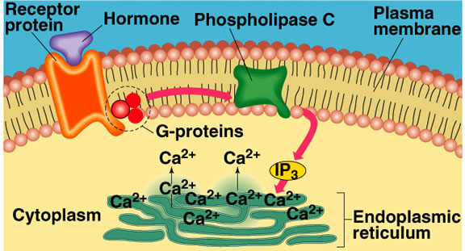
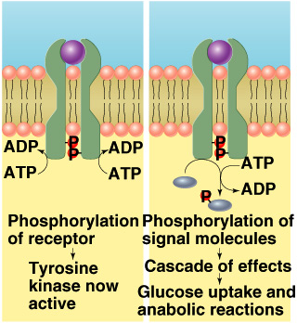
Cont. Mechanism of action In the case of peptide & catecholamine hormones
Second-messenger mechanisms include the following: | 3. Cell Membrane Phospholipid | Hormone binds to the receptor→ activates G protein. G protein activates a phospholipase enzyme. Phospholipase splits the phospholipid PIP2 into diacylglycerol (DAG) & IP3 (both act as second messengers). → DAG activates protein kinases. → IP3 triggers release of Ca2+ stores Ca2+ (third messenger) alters cellular responses. Other picture
 | 4. Tyrosine kinase (Enzyme-Linked Hormone Receptors) | Is used by insulin & many growth factors to cause cellular effects. Surface receptor is tyrosine kinase consists of 2 units that form active dimer when insulin binds Activated tyrosine kinase phosphorylates signaling molecules → Induction of hormone/growth factor effects. 2 parts which are identical, once it gets activated by the hormone it will come closer together, & there will be some changes like phosphorylation of part of the receptor inside the cell → phosphorylate other proteins inside cytoplasm, these phosphorylated proteins will open a channel for glucose & cause influx of glucose. Combine with it’s receptor in the cytoplasm> the complex of (hormone-receptor) will go through the nuclear membrane inside the nucleus & it has a specific target in the DNA, it will bind to the target on DNA & cause conformational changes & produce transcription → synthesis of messenger RNA that will leave the nucleus to the cytoplasm to the RER & produce action of the hormone. (a long process)
أهم شيء الـTyrosine
مهم تعرفوا كل نوع ايش الـsecond messenger الخاص فيه (مرتبة بالجدول سلايد18)

Slide 18
Mechanism of action of hormones
اللي بالأحمر مو معنا

Slide 19
Regulation of hormonal receptors
These receptors are not stable all the time, a lot of changes happen, the number of receptors will decrease by destruction & it will increase by synthesis & activation, & change according to the level of hormone in the blood.
Regulation of hormonal receptors
Dose-response relationship | Relative number of receptors on the target cell | The affinity of those receptors | The Sensitivity of those receptors
 | (Receptors does not remain constant): Inactivated or destroyed. Reactivated or manufactured. And they undergo: 1. Up-regulation: The hormone induces greater than normal formation of a receptor or intracellular signaling proteins. Lead to: Increase synthesis. Decrease degradation. Activation. GH, prolactin (For breast-milk synthesis; once it’s secreted the number of the receptors will increase, hence, increase the breast-milk production). 2. Down-regulation: (Used in case of primary hyperthyroidism; no negative feedback mechanism to regulate the hormone release. So, we down-regulate the receptor using one of these mechanisms). Increase hormone concentration leads to: 1. decrease in the number of active receptors & synthesis. 2. Increase degradation. 3. Inactivation. 4. T3. Most peptide hormones have pulsatile secretion⁶ which prevents downregulation.
 |  |  | The hormone concentration that will lead to 50% of the maximum response. It can be increased by: 1- Increasing receptors. 2- increase affinity of the receptors to ligand.
⁶=Pulsatile secretion: ‘like when it increases in the night & decrease in the day…”, it happens so that receptors wont have to be downregulated so this mechanism acts as protection for the receptors.

Slide 20
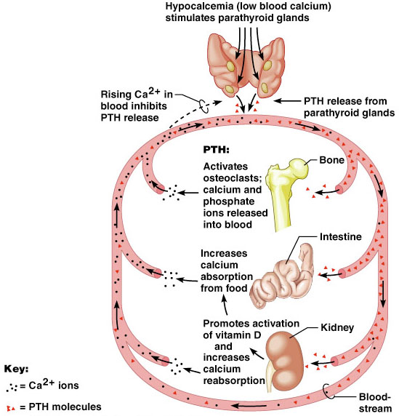
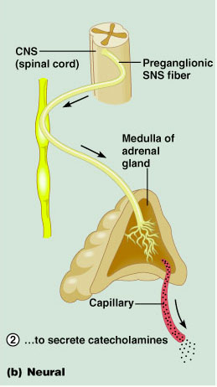
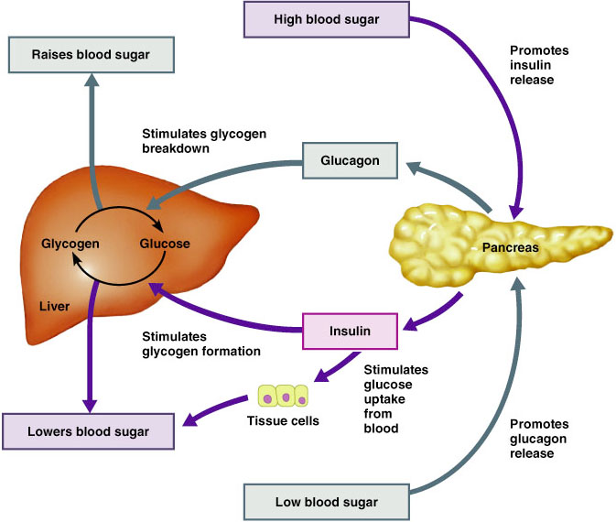
Hormones are synthesized & released in response to 3 stimuli:
Stimuli | 1. Humoral Stimuli | 2. Neural Stimuli | 3. Hormonal Stimuli
Definition | Secretion of hormones in direct response to changing in blood levels of ions & nutrients. Imp: Concentration of certain substances or change in ions gradient will Directly stimulate the release of a hormone. | Nerve fibers stimulate hormone release. | Release of hormones in response to hormones produced by other endocrine gland. A hormone will stimulate/inhibit the release of other hormones.
Example | Concentration of calcium ions in the blood: Declining blood Ca²⁺ concentration stimulates the parathyroid glands to secrete PTH (parathyroid hormone) then PTH causes Ca²⁺ concentrations to rise & the stimulus is removed. Another Example: ↑glucose blood level → insulin release. ↓glucose blood level → glucagon release. ↓Calcium → release of parathyroid hormone | Preganglionic sympathetic nervous system (SNS) fibers stimulate the adrenal medulla to secrete catecholamines. Fight or flight reflex: Release epinephrine or norepinephrine from adrenal gland. | TRH (thyroid releasing hormone) from hypothalamus will act on inferior pituitary gland to release TSH (thyroid stimulating hormone) that will stimulate the release of thyroxine from the thyroid gland.
The examples here are imp
Only in Males’ Slides
Check this picture (summary)

Slide 21
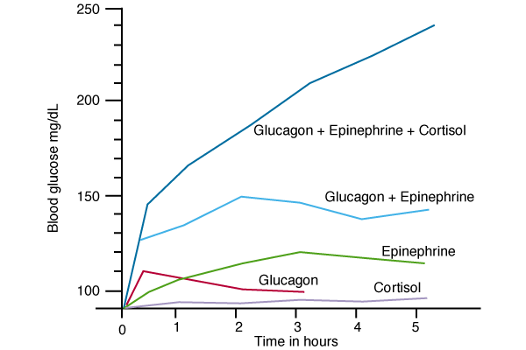
Hormone Interactions
Multiple hormones can affect a single target simultaneously
Interactions | 1. Synergism | 2. Permissiveness | 3. Antagonism
Definition | Combined action of hormones is more than just additive. Means: 2 hormones help each other. | One hormone allows another hormone to have its full effect Especially during growth. Means: 2 hormones, one hormone gives permission to another hormone to act. So, if a hormone is not produced the other hormone wont work. | Antagonistic hormones have opposing physiological actions. Hormone B diminishes the effect of hormone A. Means: one hormone antagonizing the action of another hormone.
Example | Blood glucose levels & synergistic effects of glucagon, cortisol & epinephrine. | Thyroid hormone have permissive effect on growth hormone action. Deficiency of thyroid hormone in infants leads to dwarfism. Thyroid hormone will promote the effect of growth hormone that will stimulate bone maturation & ossification (Thyroid H will only promote this process; the main effect is done only by the GH). | Glucagon antagonizes the action of insulin.
Each one of these hormones (in the pic) perform the same function & have the same effect but when they unite together the effect will be greater.
^{Strengthen each other.}
Not an additive effect (the product is larger than the actual components).
(اذا زميلكم أعطاني ١٠٪ من الشغل والزميل الثاني اعطاني ١٠٪ والثالث ١٠٪ المجموع مارح يصير ٣٠٪، بيصير ٥٠٪ لأن التأثير بيصير اكبر)

Slide 22
Clearance of hormones
Clearance of hormones:
Two factors control the concentration of a hormone in the blood: (Hormones have half-life that’s why we need them to be regularly synthesized).
The rate of its secretion (release).
The rate of its inactivation & removal (metabolic clearance).
Hormones are cleared by:
Metabolic destruction by tissues.
Binding with tissues.
Excretion by the liver into bile.
Excretion by the kidney into urine.
Clearance of protein bound hormones is slower than clearance of peptide hormones.
So if the rate of secretion is greater than the removal → high levels of the hormones in blood (same goes for the opposite → Low levels).
steroid hormones are slow because they are attached to proteins while peptide hormones are fast.

Slide 23
Summary
Chemical messengers
Neurotransmitters
Endocrine
Neuroendocrine
Paracrines
Autocrines
Cytokines
Endocrine glands | Methods of signaling
Pituitary | Endocrine signaling
Thyroid - Parathyroid | Paracrine signaling
Adrenal | Autocrine signaling
Pancreas | Synaptic signaling
Ovaries - Testes | Neuroendocrine signaling
How does a hormone reaches a target cell?
Endocrine cell
(Hormone)
Transmission
(Blood)
Target cell
(Receptor)

Slide 24
Summary
 | Proteins | Steroids | Amine
Examples | Anterior & posterior pituitary, pancreas & parathyroid hormones. | Adrenal cortex, ovarian & testicular hormones. | Thyroid hormones & catecholamines.
 | Preprohormaone → prohormon → hormone | - On demand synthesis. Lipophilic → Bound to carrier protein. | Derivatives of: a) Tryptophan (Melatonin). b) Tyrosine (Catecholamines & Thyroid hormones)
How does a hormone reaches a target cell?
Adynylate cyclase-cAMP
Synergism
Ex (Glucagon + Epinephrine)
Phospholipase C-IP3
Hormone
interactions
2nd Messenger
Permissiveness
Ex (GH & thyroid hormone)
Calcium calmodulin complex
Thyrosine kinase system
Antagonism
Ex (Glucagon & insulin)

Slide 25
Thank you for checking our work!
اعمل لترسم بسمة، اعمل لتمسح دمعة، اعمل و أنت تعلم أن الله لا يضيع أجر من أحسن عملا.
قادة الفريق:
ليــلـى مـذكور & مـحـمـد نـصـر
Please check our editing file to know if there are any additions, changes or corrections.
Examine yourself
خالص الشكر لأعضاء الفريق الكِرام:
لـمى التميمي
آمال الشيبي
بُشرى قوقندي
حنين باشيخ
2017-2018 Dr. Hanaa AlZamil’s Lecture & Notes.
2017-2018 Prof. Abdulmajeed Aldress’s Lecture& Notes.
Guyton & Hall of Medical Physiology 13th Edition.
Linda S. Costanzo 5th Edition.
Helpful physiology bocks.
Give us your feedback ☺
اللهم اني استودعتك ما حفظت وما قرأت وما فهمت، فرده لي وقت حاجتي إليه إنّك على كل شيءٍ قدير.

