Slide 1
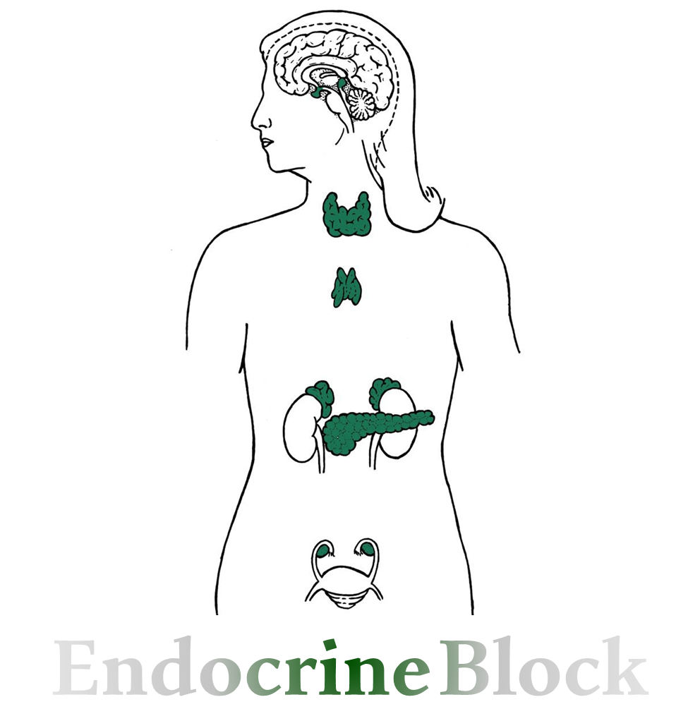
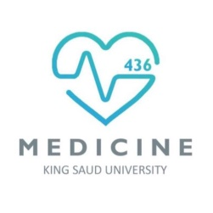
Text
Only in Females’ slide
Only in Males’ slides
Important
Numbers
Doctor notes
Extra Notes

Slide 2
Adrenal gland hormones
(Mineralocorticoids)
By the end of this lecture, students should be able to describe:
The cellular arrangements and functional components of the adrenal gland.
The hormones secreted by the medulla and cortex of the adrenal gland.
The synthesis of the adrenocortical steroids.
The physiological actions of aldosterone.
The regulation of aldosterone secretion.
The major stimuli for aldosterone secretion.

Slide 3
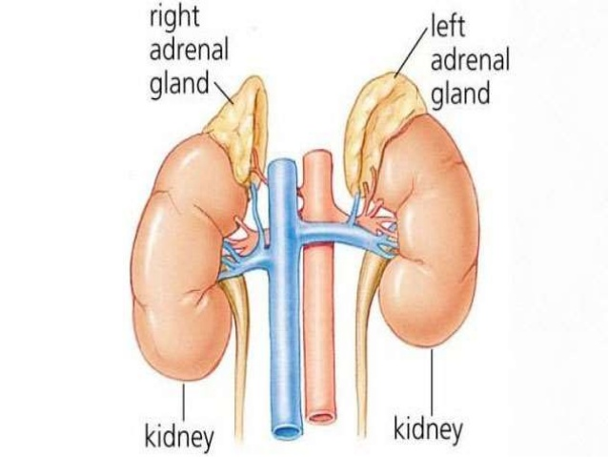
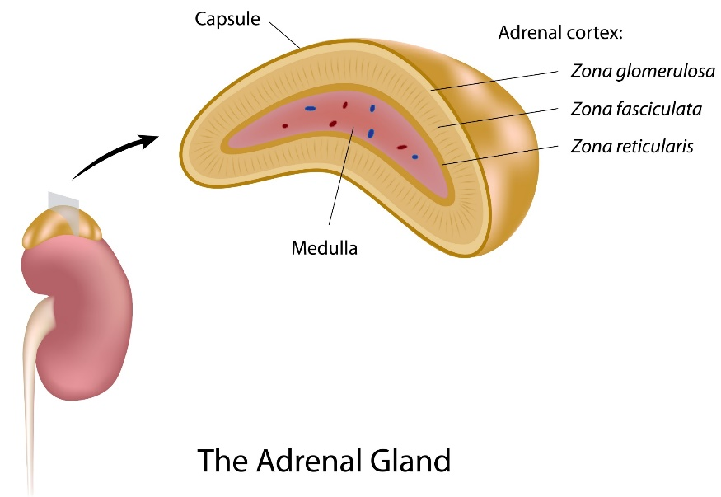
Adrenal (suprarenal) Glands
Suprarenal gland also called adrenal gland الغدة الكظرية
Location: Located at the superior pole of the both kidneys (paired).
Shape: Small, the right one is pyramid (triangle) in shape, while the left one is crescentic.
Weigh: each of which weighs 4 -10 g (according to Guyton).
Structurally and functionally they are two glands in one, divided into two morphologically & distinct regions:
Adrenal cortex: (80-90%) glandular tissue derived from embryonic mesoderm (the outer layer)
Adrenal medulla: (10-20%) formed from neural ectoderm, can be considered a modified sympathetic ganglion (the inner layer). (when ever sympathetic system is stimulated adrenal medulla is also stimulated).

Slide 4
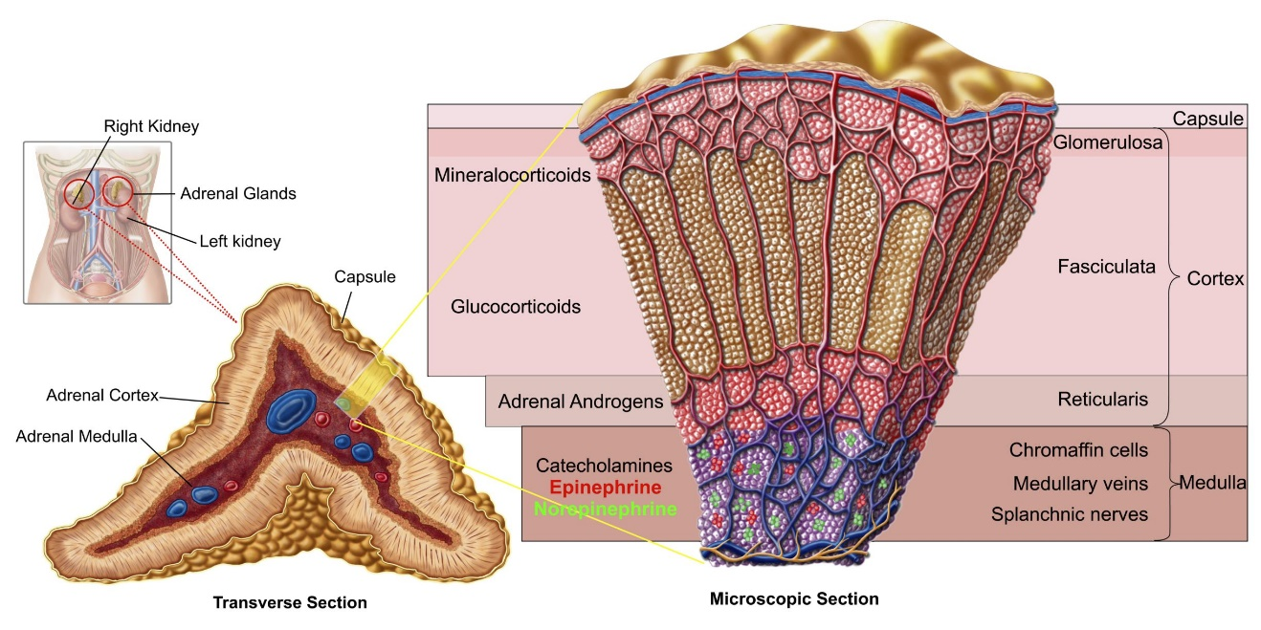
Functions of Adrenal (Suprarenal) Glands
Glomerulos → Mineralocorticoids
Fasciculate → Glucocorticoids
Reticularis → Gonadocorticoids
خذوا أول حرف من كل كلمة تصير GM FGRA (قم فجرا)
The Cortex of the suprarenal glands synthesizes and secretes steroid hormones (corticosteroids).
The Medulla is functionally related to the sympathetic nervous system, it secretes the catecholamines: epinephrine & norepinephrine in response to sympathetic stimulation.
Different corticosteroids are produced in each of the three layers.
Notes about hormones of adrenal cortex:
Cortisol is at 1000 fold higher concentrations than aldosterone.
Corticosterone → aldosterone.
Cortisol binds well to the mineralocorticoid receptor.
Region | Major hormone's group | Hormones
Zona Glomerulosa Bigger layer .. (salt) | Mineralocorticoids | Aldosterone Only produced by zone glomerulosa
Zona Fasciculate Sugar | Glucocorticoids From its name Glu…it plays a role in gluconeogenesis (cortisol) | Mainly: Cortisol (in humans), Corticosterone (in animals). In small amount: Androgens (Dehydroepiandrosterone DHEA & Androstenedione) & Estrogen.
Zona Reticularis | Gonadocorticoids | Mainly: Androgens (Dehydroepiandrosterone DHEA & Androstenedione). In small amount: Estrogen & Glucocorticoids.

Slide 5
Sympathetic Pathway of The Medulla
The pathway on the right shows when norepinephrine is secreted from the sympathetic neurons which then act on target cells at the point of release.
The pathway on the left shows the effect of the sympathetic nervous system on the adrenal medulla that mainly secrete epinephrine which act on distant target cells

Slide 6
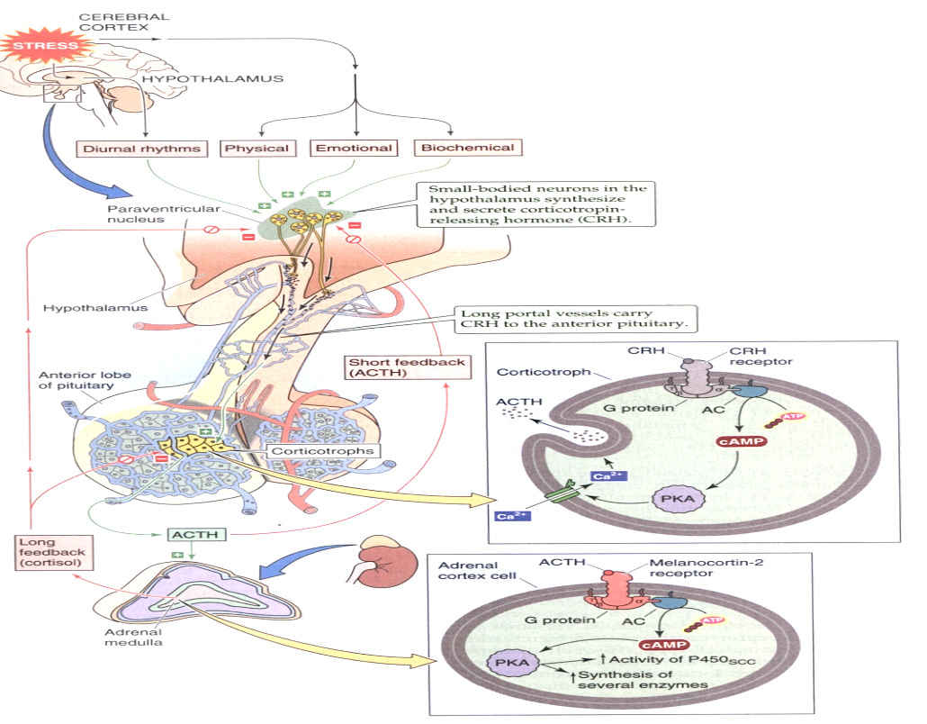
Hypothalamic Pituitary Axis
Stress stimulates the release of Corticotropin-releasing hormone (CRH) from the hypothalamus (paraventricular nucleus) which uses cAMP as a secondary messenger.
Adrenocorticotropic hormone (ACTH) is released from the corticotrophs, which uses cAMP as a secondary messenger as well.
ACTH causes an increase in cortisol and other adrenal hormones.
Cortisol regulates release of CRH and ACTH by long loop negative feedback mechanism while ACTH regulates the release of CRH by short loop.
Stress activate → CRH is produced by hypothalamus → ACTH (part of POMC big protein) from corticotrophes which is produced by Anterior pituitary gland → act mainly on zone faciculata to secrete glococorticoids little affect on aldosterone.

Slide 7
Steroid Hormones Structure
Cholesterol under the control of different enzymes in adrenal cortex is converted into cortisol and aldosterone, where in the ovary is converted into estradiol (estrogen).

Slide 8
Steroid Hormones Synthesis
Important
Steroids are derivatives of cholesterol.
Cholesterol is from the lipid droplets in cortical cells (cholesterol esters in Low-density lipoprotein LDL).
Removed cholesterol is replenished by cholesterol in LDL in blood or synthesized from acetate. Cholesterol in the blood binds to LDL proteins. There are receptors for these lipoproteins in the membranes of adrenocortical cells, the lipoprotein-cholesterol complex binds to the receptor and is transferred into the cell by endocytosis.
Steroidogenic Acute regulatory protein (StAR protein) transfers cholesterol to the inner membrane of the mitochondria (mutation in this protein causes accumulation of cholesterol in the cytoplasm). Once cholesterol is transferred to the mitochondria then steroid synthesis will start.
Steroid hormones are synthesized and secreted on demand (not stored).
The first step in the synthesis of all steroid hormones is conversion of cholesterol to pregnenolone by the enzyme cholesterol dismolase (also known as cholesterol side chain cleavage enzyme) (SCC enzyme).
Newly synthesized steroid hormones are rapidly secreted from the cell (cross the membrane easily).
Following secretion, all steroids bind to some extent to plasma proteins: CBG (corticosteroid binding globulin also called transcortin) and albumin.

Slide 9
Cont.
cholesterol
17 alpha hydroxylase
17 alpha hydroxylase
Pregnenolone
17 hydroxyPregnenolone
Dehydroepiandrosterone
اللي محتاجين تعرفوه (لهذه المحاضرة) للفيسيولوجي:
The first step in the synthesis of all steroid hormones is conversion of cholesterol to pregnenolone by the enzyme cholesterol dismolase.
الباقي مكرر في البايوكمستري
3 Beta dehydrogenase
3 Beta dehydrogenase
3 Beta dehydrogenase
17 alpha hydroxylase
17 alpha hydroxylase
Progesterone
17 hydroxyProgesterone
Androdtenedione
21 hydroxylase
21 hydroxylase
Deoxycorticos-terone
11 Deoxycortisol
Testosterone
11 Beta hydroxylase
11Beta hydroxylase
Aromatase
corticosterone
Cortisol
Oestradiol
5 alpha reductase
18 hydroxylase
18 hydroxyl-corticosterone
Aldosterone synthase
Dihydrotestosterone
Aldosterone

Slide 10
Hormones of Adrenal Cortex
Only in Females’ Slides
Hormone | Production Mg/Day | Concentration Ng/Ml | Activity Mineral | Activity Glucose
Aldosterone | 0.05 - 0.15 | 0.15 | 90% | -
Deoxy Corticosterone | 0.6 | 0.15 | 1/15 | -
Corticosterone | 1 - 4 | 2 - 4 | 1/50 | 4%
Cortisol | 8 - 25 | 40 - 180 | 1/400 | 95%
DHEA | 7 -15 | 5 | - | -

Slide 11
Genetic Defects in Adrenal Steroidogenesis
Congenital adrenal hyperplasia:
The gene that is responsible for aldosterone and cortisol are very close to each other so in some cases whenever for ex: ACTH is hyper released aldosterone will be also hyper release.
21-hydroxylase (P450c21) deficiency:
Result in cortisol, corticosterone, and aldosterone deficiency. (all synthesis will be shifted to androgen; will be released in high amounts)
Increased in ACTH lead to Adrenal hypertrophy & high amounts of androgen.
Virilization الترجّلof female (masculinization).
There is an enzyme block preventing the synthesis of all
mineralocorticoids & all glucocorticoids (e.g., deficiency of 21β
hydroxylase). Because of the block, steroid intermediates are
“shunted” toward androgen production & the increased adrenal
androgen levels cause masculinization.
Decrease in cortisol
Increase in ACTH
Result in adrenal hyperplasia

Slide 12
Action of Steroid Hormones
تكرار للمحاضرة الأولى ☺
1. Most hydrophobic steroids are bound to plasma protein carriers. Only unbounded hormones can diffuse into the target cell.
2. Steroids hormones receptors are in the cytoplasm or nucleus.
3. The receptor-hormone complex binds to DNA & activates or represses one or more genes.
4. Activated genes create new mRNA that moves back to the cytoplasm.
5. Translation produces new proteins for cell processes.
6. Some steroid hormones also bind to membrane receptors that use second messenger system to create rapid cellular responses.
Other Picture

Slide 13
Overview of Mineralocorticoids (Aldosterone)
A steroid hormone.
Essential for life.
The main mineralocorticoid produced by the adrenal gland.
Synthesis: Synthesized in zona glomerulosa Aldosterone exerts 90% of all the mineralocorticoid activity.
Target cells: are called “principal (P) cell”.
Bound: 60% of aldosterone bound to plasma protein, while 40% is free form.
Half life: 20 min.
Much of secreted aldosterone is metabolized by the liver & converted to tetrahydroglucuroind derivative.

Slide 14
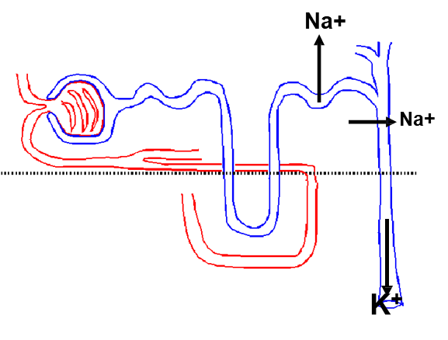
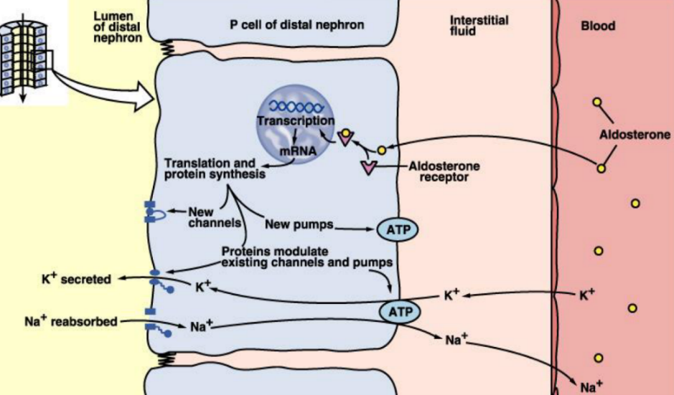
Actions of Aldosterone
Important
1. Renal Actions:
Binds to mineralocorticoid receptor (MR)
Aldosterone causes sodium to be conserved in the ECF while increasing potassium excretion in the urine.
Acts mainly on the cells of the cortical collecting ducts & distal tubules by increases renal tubular reabsorption of Na⁺ in the ECF & promote excretion of K⁺ and H⁺ in the urine By:
(it could cause metabolic alkalosis if there was excessive secretion)
Increase transcription (synthesis) of Na+ / K+ pump.
Increase the expression of apical Na+ channels and Na+ / K+ /Cl- cotransporter.
Na/K pump → synthesis of ATPase → increase protein channels → lead to more Na entering.
اهم شيْ تعرفونه انه يحفظ الـ ECF
Keep the minerals in balance
يحب الصوديوم والماء ويكره البوتاسيوم، بالتالي أي زيادة في البوتاسيوم ولو كانت لا تذكر تحرّك لي جيوش من الالدسترون!

Slide 15
Cont.
2. Circulatory Actions:
Increases ECF volume & Arterial Pressure.
If decreased: Na will be excreted in the urine and water will follow it → thus leading to
dehydration and fall of blood pressure.
3. Affects Na+ reabsorption by sweat, salivary and intestinal cells: Stimulates synthesis of more Na/K-ATPase pumps.

Slide 16
Secretion of Aldosterone
Important
Aldosterone secretion is stimulated by:
Decreasing blood volume or pressure (renin-angeotensin system) is the major stimulant.
Rising blood levels of K+.
Adrenocorticotropic hormone (ACTH).
Aldosterone levels fluctuate diurnally.
highest concentration being at 8 AM.
lowest at 11 PM, in parallel to cortisol rhythms.

Slide 17
Control of Aldosterone Secretion
الترتيب حسب الاهمية
Increases aldosterone secretion:
1. Plasma concentration of potassium & sodium:
directly influences the zona glomerulosa cells.
↑ K + concentration in the ECF (the most potent stimulus).
↓Na+ concentration in the ECF.
2. ACTH: (most important)
Directly influences the zona glomerulosa cells
causes small transient (diminished within several days) increases of aldosterone during stress
3. Stress, surgery
4. Renin-angiotensin mechanism:
Indirectly influences the zona glomerulosa cells.
The major stimulant.
Decreasing blood volume (Hypovolemia) or pressure (Hypotension) → Increased activity of the renin → angiotensin system increased levels of angiotensin II → stimulates aldosterone release (Explained in the 19th slide)
Both decrease in Na and increase in K will stimulate aldosterone secretion, but Why change in K is prior to change in Na ? K is found in a little amount in the ECF so any slightly change will cause a big affect while Na amount is too large it need a lot of decrease to cause the affect
Check this picture

Slide 18
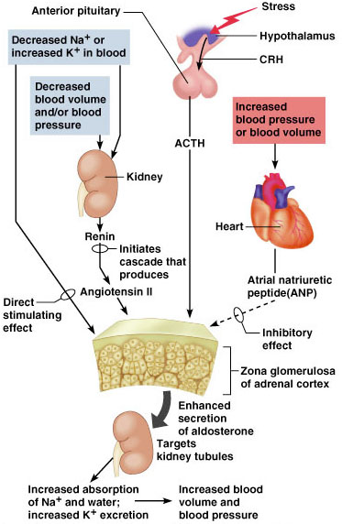
Cont.
Inhibits aldosterone secretion:
Atrial natriuretic peptide (ANP): inhibits activity of the zona glomerulosa.
Increase in Na.
Summary Of Aldosterone Regulation

Slide 19
Cont.
Only in Females’ Slides
Very important
Renin:
Is a enzyme released by the kidneys when the arterial pressure falls.
Renin is synthesized and stored in in the juxtaglomerular cells (JG cells) of the kidneys.
The JG cells are modified smooth muscle cells located in the walls of the afferent arterioles immediately proximal to the glomeruli.
Renin acts on another plasma protein (angiotensinogen in the liver), to release angiotensin I which is converted to angiotensin II (in the lungs).
Angiotensin 1 is converted to Angiotensin 2 by ACE “angiotensin converting enzyme”
Angiotensin II increases the blood pressure through:
Vasoconstriction occurs intensely in the arterioles & much less so in the veins. Constriction of the arterioles increases the total peripheral resistance, thereby raising the arterial pressure.
Decrease excretion of both salt and water by the kidneys. This slowly increases ECF volume, which then increases the arterial pressure during subsequent hours and days.
Angiotensin II acts on the zona glomerulosa to stimulate aldosterone synthesis.
Angiotensin II acts via increased intracellular cAMP to stimulate aldosterone synthesis.

Slide 20
Aldosterone Abnormalities
Important
Complete failure to secrete aldosterone leads to death, because of:
Dehydration → low blood volume → low blood pressure → death. (its an emergency)
Hyperaldosterone states (increase secretion of mineralocorticoids):
Contribute to hypertension associated with increased blood volume.
2ry hyperaldosteronism caused by extra adrenal cause such as( cirrhosis, ascites, nephrotic syndrome) excess renin secretion leading to high → aldosterone secretion. SO the main pathology is excess renin secretion leading to high → aldosterone secretion.
If we removed Zona glomerulosa what will happen? Hyponatremia لأن معد فيه شي يسحب الصوديوم مما يؤدي للوفاة
Primary Hyperaldosteronism (Conn’s Syndrome) | Secondary Hyperaldosteronism
↓ Plasma Renin | ↑ Plasma Renin

Slide 21
Hyperaldosterone States
Causes
1. primary:
adenoma or nodular hyperplasia of zona glomerulosa → secretes large amounts of aldosterone.
2. Secondary:
Left ventricular failure.
Cor pulmonale (alteration in the structure and function of the right ventricle (RV) of the heart caused by a primary disorder of the respiratory system).
Cirrhosis (is a late stage of scarring (fibrosis) of the liver).
Ascites (is the abnormal buildup of fluid in the abdomen).
Hyperreninism.
3. Apparent mineralocorticoid excess syndrome (AME) (cortisol binds MR).
Symptoms & Signs
Headache.
Hypokalemia causing muscle weakness & fatigue.
Hypernatremia.
Hypervolemia.
Metabolic alkalosis.
Nocturnal polyuria.
Hand cramping & temporary paralysis.
Frequent urination.
Increased thirst.
Tingling in fingers.
Heart palpitions.
Hypertension.

Slide 22
Primary Aldosteronism (Conn's Syndrome)
Only in Females’ Slides
Effect:
Hypokalemia & hypernatremia.
Hypertension.
Slight increase in ECF volume and blood volume.
Very slight increase in plasma sodium concentration.
Almost always, hypertension.
There are occasional periods of muscle paralysis caused by hypoglycemia.
Decreased plasma renin concentration (from feedback suppression of renin secretion caused by the → aldosterone) or by the excess ECF volume and arterial pressure (because the renin is acting as a feedback mechanism).
Nocturnal polyuria (excessive urination) & polydipsia (excessive thirst).
Increased tubular (intercalated cells) hydrogen ion secretion, with resultant mild alkalosis
Neuromuscular manifestations: weakness, paresthesia & intermittent paralysis.
Treatment:
Surgical removal for adenoma.
Spironolactone: a potassium-sparing diuretic that acts as an aldosterone antagonist.

Slide 23
Summary
Aldosterone:
Synthesized from cholesterol.
First and rate limiting step: conversion of cholesterol to pregnenolone by cholesterol dismutase
Secreted from adrenal cortex: zona glomerulosa.
Essential for life.
Mainly acts on principal cells in the collecting ducts and distal tubule.
Actions:
Renal: reabsorption of Na and water, secretion of K and H.
Circulatory: increases ECF volume and arterial pressure.
Sweat, salivary and intestinal cells: reabsorption of Na.
Control:
Increases K levels.
Decrease Na levels.
Renin release.
ACTH.
Stress.
Renin:
Released in hypotension or hypovolemia from juxtaglomerular cells.
Actions:
Vascular: vasoconstriction.
Kidney: decrease excretion of water and salts.
Adrenal cortex: increases synthesis of aldosterone.
Abnormalities:
Primary hyperaldosteronism (Conn’s disease):
Hypertension.
Hypokalemia.
Hypernatremia.
Low levels of plasma renin
Complete failure to secrete aldosterone: Death.
Summary Of Aldosterone Regulation

Slide 24
Thank you for checking our work!
اعمل لترسم بسمة، اعمل لتمسح دمعة، اعمل و أنت تعلم أن الله لا يضيع أجر من أحسن عملا.
قادة الفريق:
ليــلـى مـذكور & مـحـمـد نـصـر
Please check our editing file to know if there are any additions, changes or corrections.
Examine yourself
خالص الشكر لأعضاء الفريق الكِرام:
خالد القحطاني
فارس الجعفر
ماجد الزين
نواف الخضيري
لـمـى الـتـمـيـمـي
لـيـنـا الوكـيـل
جومانا القحطاني
نوف العماري
نورة المهيدب
2017-2018 Dr. Abeer AlGhumlas’s Lecture & Notes.
2017-2018 Dr. Khalid Al Regaiey’s Lecture& Notes.
Guyton & Hall of Medical Physiology 13th Edition.
Linda S. Costanzo 5th Edition.
Helpful physiology bocks.
Give us your feedback ☺
اللهم اني استودعتك ما حفظت وما قرأت وما فهمت، فرده لي وقت حاجتي إليه إنّك على كل شيءٍ قدير.

