Slide 1
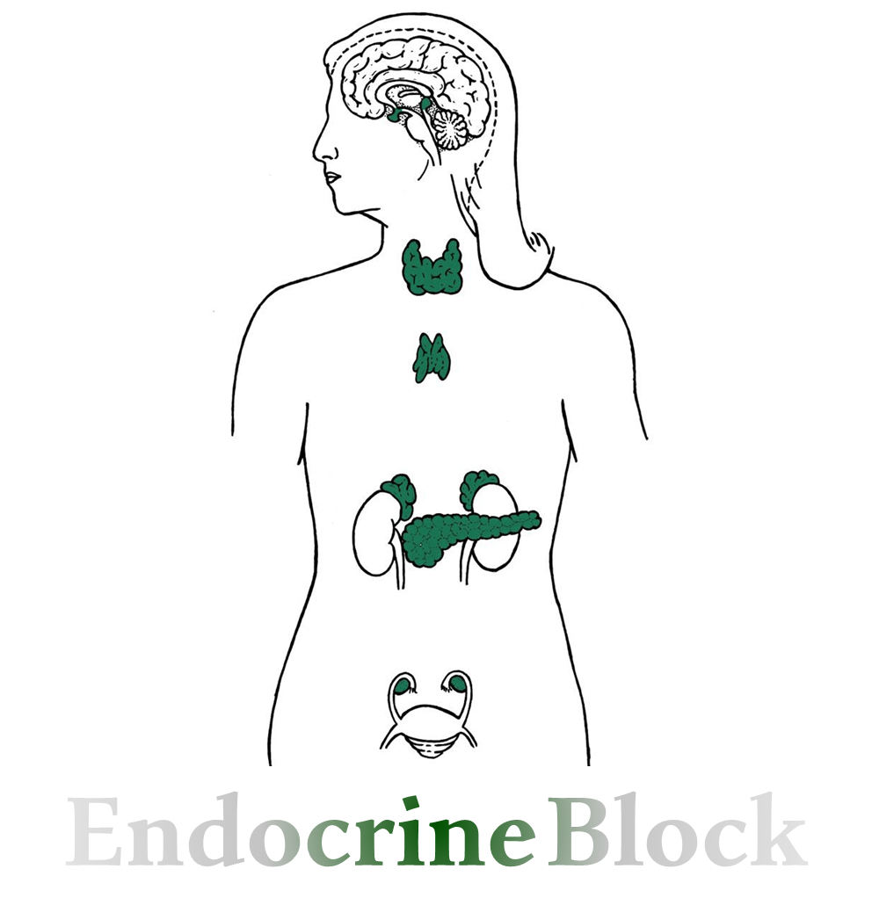
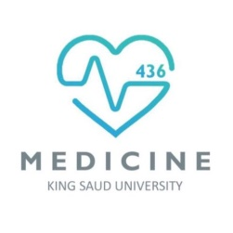
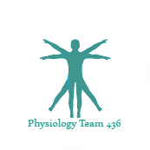
Text
Only in Females’ slide
Only in Males’ slides
Important
Numbers
Doctor notes
Extra Notes

Slide 2
Adrenal gland hormones
(Glucocorticoids)
By the end of this lecture, students should be able to describe:
Describe the metabolism and physiological effects of glucocorticoids.
Describe the mechanisms that regulate secretion of glucocorticoids
Describe the main features of the diseases caused by excess or deficiency of each of the hormones of the adrenal gland.

Slide 3
Adrenal Cortex: Glucocorticoids
Only in Females’ Slides
Main Glucocorticoid In Human
Cortisol
Corticosterone
Very potent.
Account for 95% of glucocorticoid activity.
Less potent than cortisol.
Account for about 4% of total glucocorticoid activity.
Cortisol: corticosterone produced in humans in a ratio of 10:1.

Slide 4
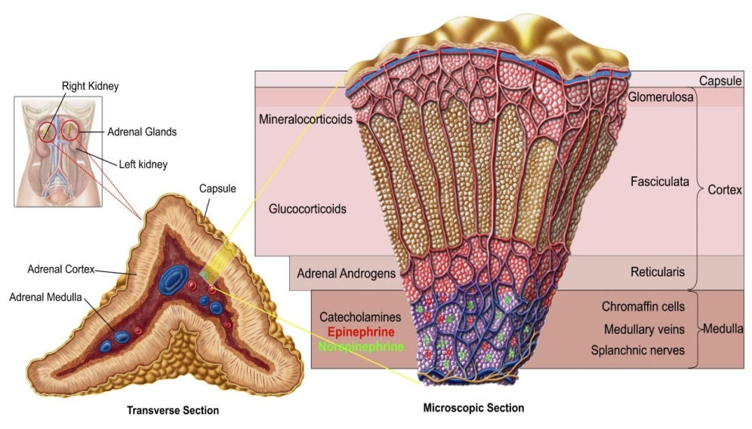
Overview Of Glucocorticoids (Cortisol)
Synthesis: Glucocorticoids produced by the fasciculata and reticularis layers of the adrenal cortex. (mainly fasciculata)
Target cells: most body tissues.
Bound: 90-95% of Glucocorticoids bound to CBG (corticosteroid binding globulin also called transcortin) and albumin, while 6% is free form which is active.
Half life: 60 - 90 min.
Metabolized in liver by reductases & conjugated to glucuronides and excreted via kidney.
Free cortisol is excreted into urine.
Glucocorticoids (cortisol) recognized early to increase plasma
glucose levels:
Mobilization of amino acids from proteins.
Enhance liver gluconeogenesis.
Explanation : Cortisol moves the amino acids from the muscles to the circulation, then the liver will uptake these amino acids in order to use it in gluconeogenesis.

Slide 5
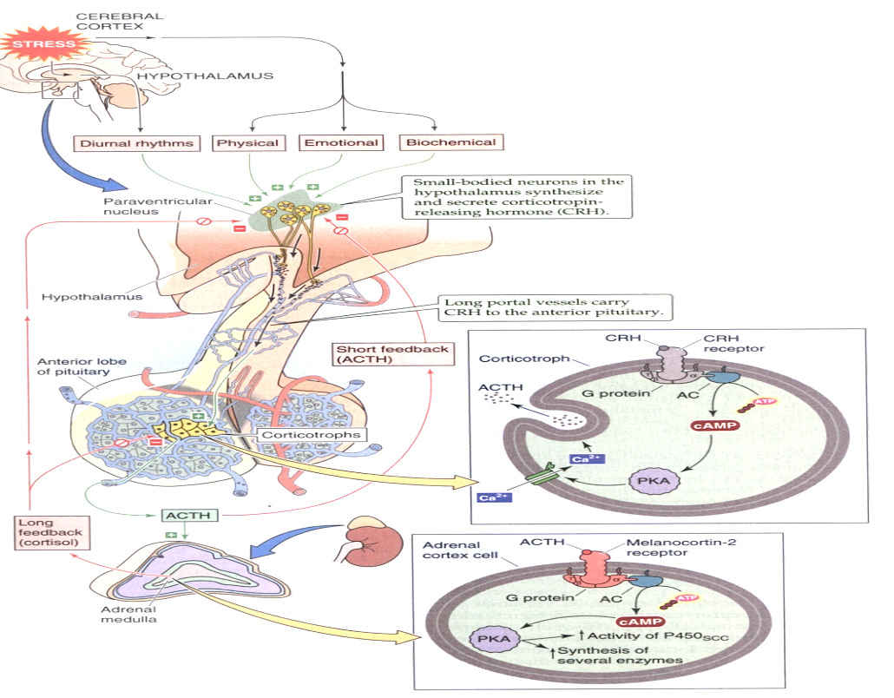
Hypothalamic Pituitary Axis
تكرار للمحاضرة السابقة
Stress stimulates the release of Corticotropin-releasing hormone (CRH) from the hypothalamus (paraventricular nucleus) which uses cAMP as a secondary messenger.
Adrenocorticotropic hormone (ACTH) is released from the corticotrophs, which uses cAMP as a secondary messenger as well.
ACTH causes an increase in cortisol and other adrenal hormones.
Cortisol regulates release of CRH and ACTH by long loop negative feedback mechanism while ACTH regulates the release of CRH by short loop.
Stress activate → CRH is produced by hypothalamus → ACTH (part of POMC big protein) from corticotrophes which is produced by Anterior pituitary gland → act mainly on zone faciculata to secrete glococorticoids little affect on aldosterone.

Slide 6
Circadian Rhythm of Cortisol Secretion
Important
The secretory rates of CRF (CRH) , ACTH, and cortisol:
High in the early morning: (increase by stresses)
The plasma cortisol level ranges between a high of about 20 µg/dl an hour before arising in the morning.
Low in the late afternoon and evening:
Low of about 5 µg/dl around midnight.
This effect results from a 24 hour cyclical alteration in the signals from the hypothalamus that cause cortisol secretion.
When a person changes daily sleeping habits, the cycle changes correspondingly. Therefore, measurements of blood cortisol levels are meaningful only when expressed in terms of the time in the cycle at which the measurements are made.
ﯾﻌﻨﻲ ﻟﻮ أحد ﯾﻨﺎم اﻟﺼﺒﺢ وﯾﺼﺤﻰ اﻟﻠﯿﻞ (قالب نومه) ﺑﯿﺘﻐﯿﺮ عنده ﺗﺮﻛﯿﺰ الكورتيزول وﯾﺼﯿﺮ ﻋﺎﻟﻲ ﺑﺎﻟﻠﯿﻞ.
Cortisol , highest in the early morning 8:00am , lowest at night 12:00pm. Why?
لأننا الصباح نكون في حالة من الـتوتر بسبب الدراسة، الزحمة، المواصلات... الخ، فـ من رحمة الله سبحانه وتعالى أن يقوينا بالكورتيزول للتغلب على التوتر.
ولكن الكورتيزول زيادته ضارة، لهذا بالليل عند النوم وانتهاء مسببات التوتر راح يقل.
لما يكون مستوى الكورتيزول pulsatilla نسميها Circadian rhythm.

Slide 7
Regulation of Cortisol Secretion
Stress stimulates CRH secretion by the hypothalamus, CRH is the major regulator of ACTH secretion.
(Mental stress can cause an equally rapid increase in ACTH secretion. This is believed to result from increased activity in the limbic system, especially in the region of the amygdala and hippocampus, both of which then transmit signals to hypothalamus which secrete CRH).
ADH is also a potent ACTH secretagogue. (a substance stimulate another substance secretion)
ACTH from anterior pituitary stimulates cortisol synthesis and secretion.
Cortisol has a direct negative feedback effect on both the hypothalamus (CRH) & anterior pituitary (ACTH). (Unlike androgens, which can’t suppress ACTH or CRH)
CRH and ACTH are secreted in pulses.
(which mean: CRH & ACTH are released in specific time during the day as all Hypothalamic hormones).

Slide 8
Actions of Glucocorticoids (on Metabolism)
Metabolic Response to Fasting:
Increase in gluconeogenesis from amino acids due to increased expression of the enzymes responsible of gluconeogenesis.
Mobilization of stored fat by activating hormone steroid lipase (HSL) and its use in β-oxidation and the production of ketone bodies.
Effect on Fat metabolism:
Lipolytic effect. (increase lipolysis)
Mobilization of fatty acid from adipose tissue.
Increase the concentration of free fatty acids in the blood.
Increase Their utilization for energy.
Effect on carbohydrate metabolism:
Stimulation of gluconeogenesis by the liver (rate increases 6 to 10 fold) due to:
Mobilizing and transporting the amino acids from extra hepatic tissues (muscles) to the liver.
Increase the enzyme’s activity that required to convert amino acids into glucose by activating the DNA transcription.
(Cortisol moves the amino acids from the muscles to the circulation, then the liver will uptake these amino acids in order to use it in gluconeogenesis)
Increase the glycogen synthesis and storage in liver cells.
Decrease the glucose utilization by the cells (by blocking GLUT-4 receptor) which will lead to Increase Glucose level in blood → “Adrenal Diabetes”.
Explanation: cortisol increase lipolysis in adipose tissue, then free fatty acids will be released into the circulation in order to utilize it to get energy.

Slide 9
Cont.
Effect on Protein metabolism:
Proteocatabolic effect in all body cells except the liver. (increase the catabolism of protein)
Mobilization of amino acids from non-hepatic tissues. (transporting amino acids from different tissue to the liver)
Decreased amino acids transport into extrahepatic tissues like: muscles & lymphatic tissues.
(decrease transporting the amino acids from liver to other tissues to use it in gluconeogenesis)
Increase Amino acid level in the blood.
Decreased protein synthesis & stores in all body except the liver. (decrease the anabolism of the protein)
It has Proteoanabolic (Anabolic) effect in the liver which is:
Glucocorticoids enhance the synthesis of liver proteins.
Glucocorticoids increase the plasma proteins. (because it has anabolic effect on liver cells)

Slide 10
Actions of Glucocorticoids (on Stress)
Stress include (trauma, infection, surgery, increase heat or cold, any debilitating disease like: Rheumatoid Arthritis & Schizophrenia).
Cortisol causes rapid mobilization of amino acids and free fatty acid (FFA) from their cellular stores, making them immediately available both for energy & synthesis of other compounds, including glucose, needed by the different tissues in the body.
Permissive Actions of Cortisol enhances the capacity of glucagon and catecholamines.
Increase BP & glycogen will prevents stress induced reaction from becoming excessive.
Without Glucocorticoids, the body cannot cope with even mild stressors.
نتعرض يوميا لأحداث صادمة أو تسبب التوتر، لكننا نتحمل غالبا. كيف يتحمل الإنسان؟ بسبب وجود الكورتيزول
Fat & glucose metabolism (Redistribution إعادة التوزيع of Fat, increase of glucose).
Maintenance of the vascular response to norepinephrine.
Effects on CNS.

Slide 11
Actions of Glucocorticoids (on Inflammation & Allergy)
Important
Damage to the tissues by trauma or infection almost always leads to inflammation.
Inflammation can be more damaging than the trauma or disease itself.
Attenuates fever mainly because cortisol reduces release of interleukin-1 from white blood cells.
Cortisol blocks the inflammatory response to Allergic reactions → prevent Anaphylactic shock → prevent death.
In pharmacological doses it have anti-allergic effects:
It decreases fibroblastic activity and local swelling.
Decrease phospholipase A2 which will Inhibit production of prostaglandins and leukotrines that mediate inflammation.
Inhibits collagenase from breaking down proteins.
Inhibits histamine release.

Slide 12
Anti-inflammatory Effects of Glucocorticoids
Glucocorticoids are used to alleviate inflammation (has anti-inflammatory effect) How?
1. Reduces all aspects of the inflammatory process:
By stabilization of the intracellular lysozomal membranes → more difficult for these membranes to rupture → less release of proteolytic enzymes that cause inflammation.
Inhibit production of prostaglandins and leukotrines that mediate inflammation via inhibiting phospholipase A2.
Reduces degree of vasodilatation → vasoconstriction.
Decrease permeability of capillary membranes. Therefore, reducing swelling.
Decreases migration of white blood cells.
Suppresses immune system.
Only in Females’ Slides
2. Block the early stages of the inflammation process before inflammation even begin.
3. If inflammation begun: It cause rapid resolution of the inflammation & increase rapidity of healing.
4. Resolution of inflammation.

Slide 13
Suppression of Immune System By Glucocorticoids & Effect of Glucocorticoids on RBCs
Important
Cortisol increases​ the RBCs count, platelets and neutrophils.
Decreases ​lymphocyte, eosinophils and basophils count.​
Administration of large doses of cortisol causes significant atrophy of lymphoid tissue throughout the body.
Suppresses lymphoid tissue systemically therefore decrease T cell and antibody production decreasing immunity. This decrease immunity effect of cortisol is useful during transplant operations in reducing organ rejection.
Suppression of Immune System By Glucocorticoids & effects on RBCs
Decrease immunity could be fatal in diseases such as tuberculosis.

Slide 14
Cont. Actions of Glucocorticoids
Effect on circulation:
Maintains body fluid volumes & vascular integrity.
Excrete water load: Cortisol levels vary with water intake.
Cortisol has mineralocorticoid effect:
Na+ reabsorption and K+ secretion.
Not as potent as aldosterone.
BP regulation & cardiovascular function: Sensitizes arterioles to action of noradrenaline (Permissive effect).
Decreased capillary permeability.
Maintins normal renal function.
Mineral metabolism:
Anti-vitamin D effect: reduces osteoblast differentiation.
That’s why chronic elevated cortisol level cause osteoporosis
Only in Males’ Slides
Effect on CNS:
Negative feedback control on release of ACTH.
Modulates perception & emotion.
Effect on Developmental:
Permissive regulation of fetal organ maturation.
Surfactant synthesis (phospholipid that maintains alveolar surface tension).
Inhibition of linear growth in children due to direct effects on bone & connective tissue.
Effect on GIT:
Increase HCL secretion → Increases the acidity → Might cause ulcers.

Slide 15
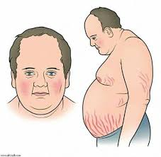
Glucocorticoids Abnormalities
Abnormalities
Increase secretion of corticosteroid
Decrease secretion of glucocorticoids
and mineralocorticoids
Cushing’s Syndrome
Addison's disease

Slide 16
Cushing's Syndrome
Cushing’s syndrome results from continued high glucocorticoid levels.
Patients’ ages are usually 30-60, the ratio between female and male is 4:1 (respectively).
Causes of Cushing's Syndrome
ACTH independent | ACTH dependent | Other causes
Could be due to: Adrenal adenoma or carcinoma. | Could be due to: 1. Adenomas of the anterior pituitary​ (​75-90%) → increase ACTH. When Cushing's syndrome is secondary to increased ACTH by the anterior pituitary = Cushing's disease. إيش الفرق بين الـCushing's syndrome و الـ Cushing's disease؟ الـ Cushing's syndrome ﻫﻮ ﻟﻔﻆ ﻋﺎم ﻟﻤﺠﻤﻮﻋﺔ كبيرة ﻣﻦ اﻷﻣﺮاض، الليﻛﻠﻬﺎ ﺗﺸﺘﺮك ﺑﻨﻔﺲ اﻟﺴﺒب المسبب لها وهو: (إفراز الكورتيزول ﺑﻜﻤﯿﺎت ﻛﺒﯿﺮة). الـ Cushing’s diseases هو مرض يندرج تحت الـ Cushing’s syndrome، ولكن سبب الزيادة في إفراز الكورتيزول هنا هو يعتمد ومرتبط بـ ACTH (ACTH Dependent) انتبهوا انه يكون syndrome بكل الحالات، إلا إذا كان بسبب ورم في الـPituitary راح يصير اسمه هنا disease. 2. Abnormal function of the hypothalamus​ → increase CRH. 3. Ectopic secretion of ACTH by a tumor elsewhere in the body, such as an abdominal or pulmonary carcinoma. | Pharmacologic: Cushing's syndrome may occur when large amounts of glucocorticoids are administered over prolonged periods for therapeutic purposes. E.G. Patients with chronic inflammation associated with diseases such as rheumatoid arthritis.

Slide 17
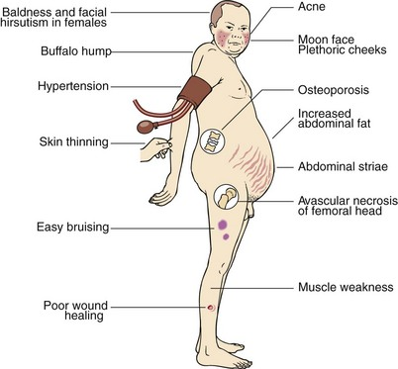
Diagnosis of Cushing's Syndrome
Only in Females’ Slides
How to differentiate between ACTH-dependent and ACTH-Independent Cushing's syndrome?
يعني كيف نفرق هل هو ناتج عن زيادة الـACTH الجاي من الـPituitary، أو من الأدرينال نفسها ؟
By administrating large doses of cortisol (dexamethasone).
ACTH-dependent:
In patients with $↑$ACTH $→$No suppression of ACTH secretion.
ACTH-Independent:
Patients with primary adrenal overproduction of cortisol (ACTH-independent) $→$ $↓$ Levels of ACTH.
كيف نشخص سبب المرض؟ عن طريق الـNegative feedback.
كيف؟ بإننا نعطي المريض كورتيزول صناعي (دكساميثازون).
1. إذا كان السبب من الـPituitary راح يزيد الكورتيزول ويعمل فيدباك لكن ماراح تستجيب الـPituitary فيستمر الACTH عالي.
2. في الحالة الثانية لما يكون برايمري بأنه يكون فيه إفراز فوق الطبيعي للكورتيزول ، الكورتيزول راح يسوي فيدباك ويمنع الـPituitary. هل راح تستجيب ولا لا؟
تستجيب بعكس الحالة الأولى! لأن الأدرينال طبيعية بالتالي راح توقف الACTH ويصير منخفض.
We recommend you to see the biochemistry Cushing’s syndrome lecture to more differentiate between ACTH-dependent and ACTH-independent.

Slide 18
Sign & Symptoms of Cushing's Syndrome
Important
Sign & Symptoms of Cushing's Syndrome
On Carbohydrate Metabolism | On Protein Metabolism | Abnormal Fat Redistribution
Chronic increase in Glucose level & gluconeogenesis → causing adrenal diabetes. May cause beta cells to die. Decrease glucose utilization by the tissues. | Decrease tissue proteins almost everywhere in the body (except liver). Protein loss from the muscles in particular causes severe weakness. Protein collagen fibers in the Subcutaneous (loss of CT). Loss of collagen will lead to sever osteoporosis. Thinning of the skin → Purple striae (purple stretch marks). What is the pathophysiology of striae? Breakdown of protein → Breakdown of collagen → striae. إذا نقص البروتين الموجود في البشرة راح تصير Thin فلو حصلت أي زيادة في الوزن راح تتمزق البشرة ويتكون الـ striae. | Central obesity: Mobilization of fat from the lower part of the body, with concomitant extra deposition of fat in the thoracic, upper abdominal regions, giving rise to a buffalo hump (truncal obesity). The appearance of the face described as a “moon face” (subcutaneous fat in cheeks and submandibular). وجهك زي القمر = Cushing’s Syndrome
80% of patients have hypertension (because of the mineralocorticoid effects of cortisol)
Treatment: based on cause. (Reducing corticosteroid use, Surgery, Radiotherapy, Medications)

Slide 19
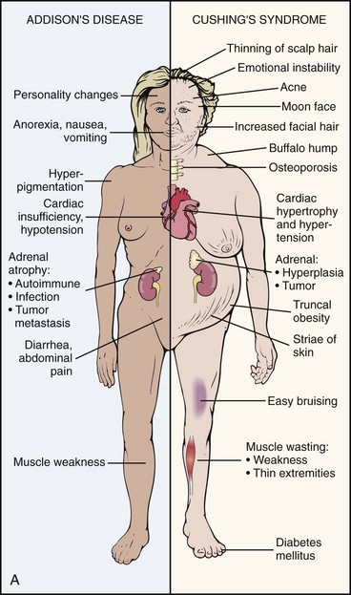
Addison's disease
Definition: Addison’s disease results from an inability of the adrenal cortices to produce sufficient adrenocortical hormones​, Auto deficiency of cortisol and aldosterone.
Causes of Adrenocortical insufficiency
Primary causes i.e. Addison’s disease | Autoimmune disease. Tumor. Infection. Hemorrhage. Metabolic failure. Ketoconazole (glucocorticoid antagonist activity).
Secondary causes | Hypopituitarism. Suppression by exogenous steroids.

Slide 20
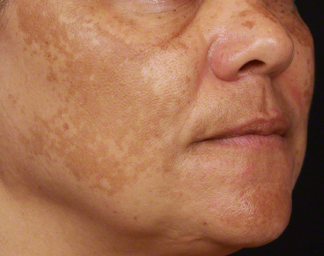
Clinical Manifestation of Addison’s Disease
Clinical Manifestation Of Addison’s Disease
Due to Mineralocorticoid Deficiency (absence of aldosterone) | Due to Glucocorticoid Deficiency | Due to ↑ ACTH | Other causes
The ​volume depletion​(Reduction in ECF volume) may be severe → Shock. ↑ Excretion of sodium and water. Tendency toward ​low blood pressure (Hypotension),​ which falls further when standing, making the patient feel ​dizzy​. Craving الرغبة الشديدةfor salt, salty foods and drinks. The person is allowed to eat large amounts of salt and drink large amounts of water to balance the increased urine output of salt and water. | Hypoglycemia (Reduced cortisol results in poor blood glucose regulation). General weakness and becoming easily tired (indicating that glucocorticoids are necessary to maintain other metabolic functions of the tissues in addition to energy metabolism) Fatigability. Anorexia (Decrease appetite) & ​weight loss. Cramps​ & pains in muscles. Nausea (Feeling sick and ​vomiting​ from time to time). Abdominal pains, diarrhea or constipation, which may come and go. | Darkened areas of skin (Generalized pigmentation​, but especially deposition in the palmar skin creases, nails and gums) because of ↑ ACTH will stimulate synthesis of melanin. | Women loss of axillary and pubic hair. Irregular or stopping menstrual periods. Adrenal crisis: asthenia, severe pains in the abdomen, vascular collapse. Patient cannot cope with stress.
Treatment: glucocorticoid replacement, mineralocorticoid replacement.

Slide 21
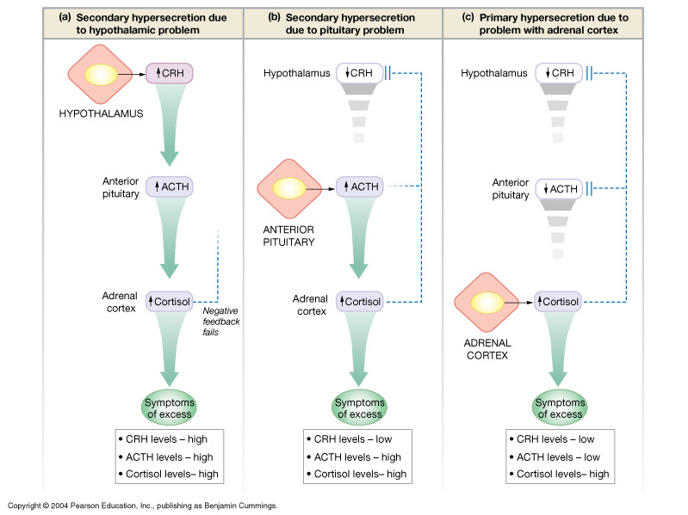
Primary & Secondary Hypersecretion Of Cortisol
Important

Slide 22
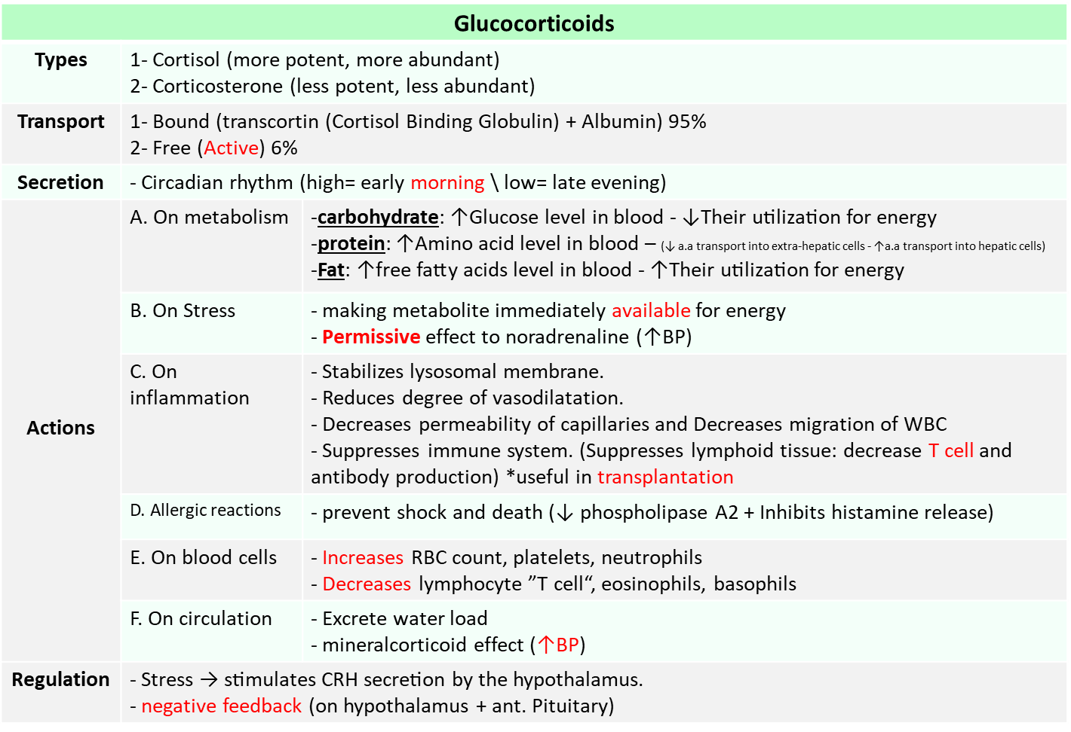
Summary
Very helpful Summary

Slide 23
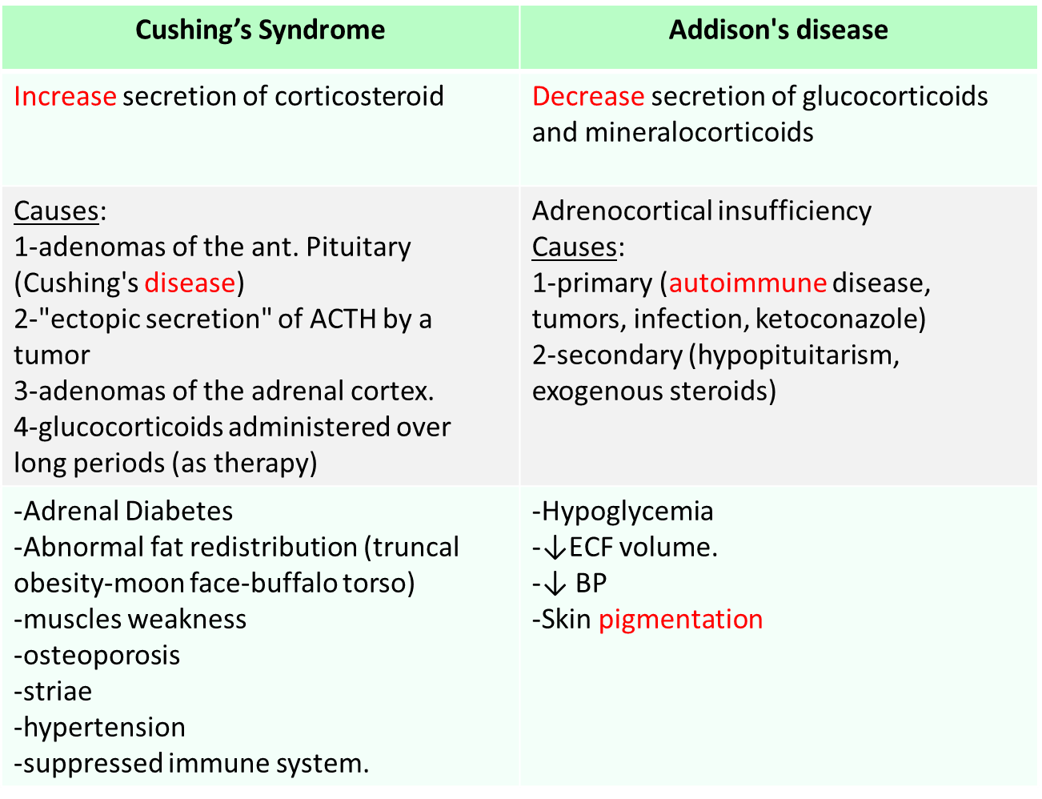
Summary
Very helpful Summary

Slide 24
Thank you for checking our work!
اعمل لترسم بسمة، اعمل لتمسح دمعة، اعمل و أنت تعلم أن الله لا يضيع أجر من أحسن عملا.
قادة الفريق:
ليــلـى مـذكور & مـحـمـد نـصـر
Please check our editing file to know if there are any additions, changes or corrections.
Examine yourself
خالص الشكر لأعضاء الفريق الكِرام:
حسان الشمري
حمد الخضيري
عبداللطيف العبداللطيف
فهد الفايز
ندى الدخيل
غادة المزروع
اللولو الصليهم
2017-2018 Dr. Abeer AlGhumlas’s Lecture & Notes.
2017-2018 Dr. Khalid Al Regaiey’s Lecture& Notes.
Guyton & Hall of Medical Physiology 13th Edition.
Linda S. Costanzo 5th Edition.
Helpful physiology bocks.
Give us your feedback ☺
اللهم اني استودعتك ما حفظت وما قرأت وما فهمت، فرده لي وقت حاجتي إليه إنّك على كل شيءٍ قدير.

