Slide 1
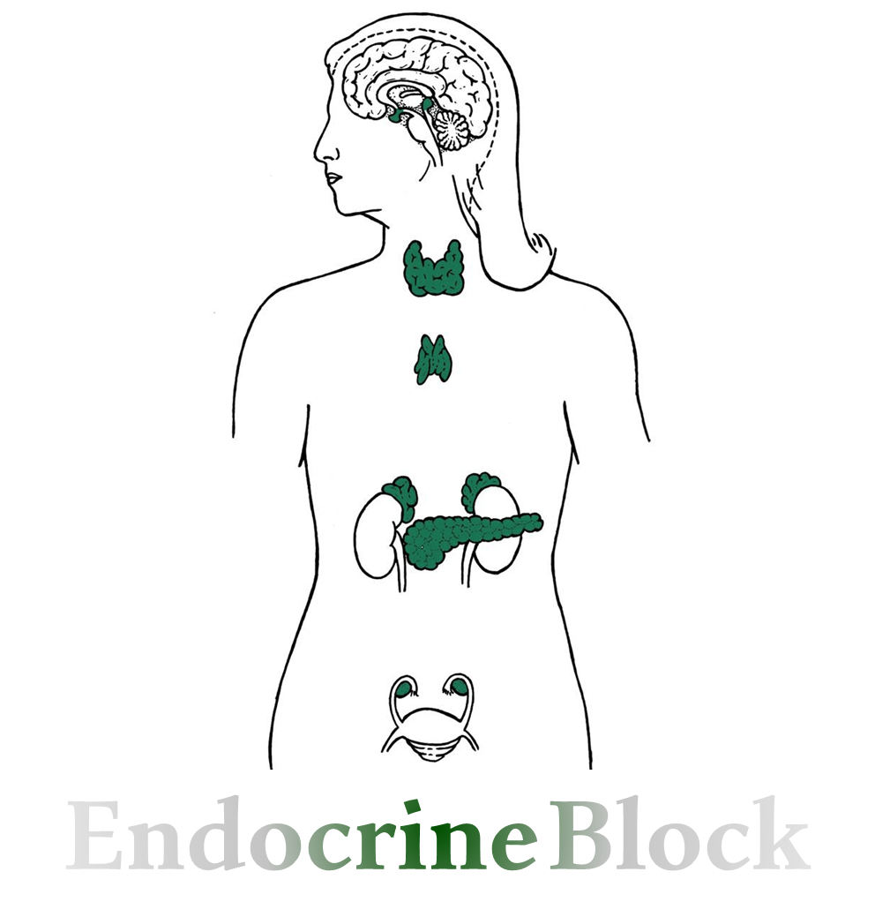
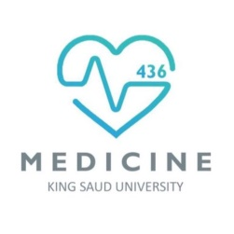
Text
Only in Females’ slide
Only in Males’ slides
Important
Numbers
Doctor notes
Extra Notes

Slide 2
Adrenal gland hormones
(Androgens)
By the end of this lecture, students should be able to describe:
Summarize the actions of adrenal androgens.

Slide 3
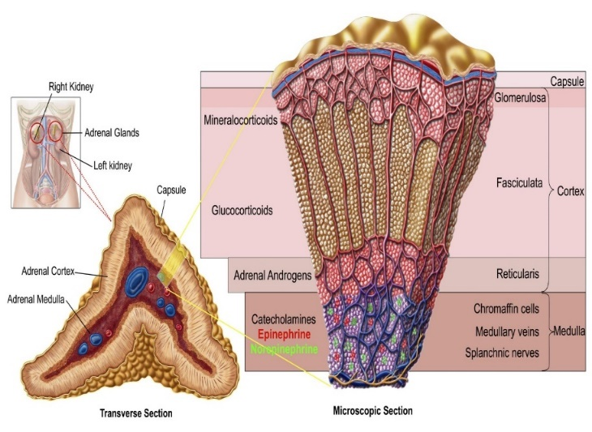
Overview Of Androgens
Definition: Androgens are the hormones that exert masculinizing ذكوريةeffects and they promote anabolism and growth.
Synthesis: The reticularis produces significant amounts of androgens, mostly dehydroepiandosterone (DHEA) and dehydroepiandosterone sulfate (DHEAS).
Target cells: General body cells
Hormone control: Control of secretion of adrenal androgens is by ACTH from the pituitary (There is no negative feedback effect of androgens on ACTH)
Androgens sources
(only in Females’ slides)
Testosterone
(Testis)
Adrenal androgens
(Adrenal Gland)
Cortex
The major active androgen.
Have less than 20% of testosterone activity.

Slide 4
Adrenal Cortex
Adrenal cortex
Male sex hormones
(Androgens)
Female sex hormones
Adrenal androgens includes:
Dehydroepiandrosterone (DHEA).
DHEA sulfate (DHEAS).
11β-hydroxyandrostenedione (11OHA).
11β-hydroxytestosterone (11OHT).
Androstenedione.
Androstenediol.
Estrogens
Progesterone
Estrogen for males is important for Ca homeostasis, deposition of fat and making wise decisions.

Slide 5
Cont.
The adrenal cortex in both sexes produces small amounts of sex hormone of the opposite sex. Additional small amounts of sex hormones come from nonadrenal sources.
Some testosterone in males is converted into estrogen by the enzyme aromatase found in adipose tissues.
In females, ovaries produce androgen as an intermediate step in estrogen production. Little of this androgen is released in the blood instead of being converted into estrogen (Testosterone in males is linked to aggressive behavior and selfishness)

Slide 6
Adrenal Androgens
Definition: Adrenal androgens have little androgenic activity, but they provide a pool of circulating precursor for peripheral conversion to more potent androgens (e.g. testosterone) and estrogens (e.g. estradiol).
1
Synthesis: Produced from Zona reticularis in small amounts (Adrenal Androgens not androgen) Its secretion is controlled by ACTH.
Adrenarche: the onset of adrenal androgens in humans is a gradual process that precedes the onset of puberty (6-7 years of age in girls and 7-8 years of age in boys).
Binding: (only in Males’ slides)
About 90% of adrenal androgens are bound to albumin, while 3% approximately is bound to sex hormone-binding globulin (SHBG).
DHEAS has high affinity to albumin with half-life 7-10 hours, while DHEA has low affinity with half-life15-30 minutes.
DHEA, DHEAS, and Androstenedione are converted to the potent androgens Testosterone and Dihydrotestosterone (DHT) in peripheral tissues (Mostly in adipose tissue, hair follicles and prostate).
Adrenarche: means the 1st sign of puberty 1st trace of androgens.
Menarche: means the 1st period in females.

Slide 7
Dehydroepiandosterone (DHEA) & Androstenedione
Only in Females’ Slides
Dehydroepiandosterone (DHEA):
It is the most abundant adrenal androgen with DHEAS.
DHEA is the primary precursor of natural estrogens.
Normally they exert very little masculinizing ذكوري effect (weak) when secreted in normal amount (mild effect in female).
Androstenedione:
An androgenic steroid produced by the testes, adrenal cortex, and ovaries.
Androstenediones are converted metabolically to testosterone and to estrogens in the fat and other peripheral tissues. It is an important source of estrogen in men and postmenopausal women.
Androstenedione were used as an athletic or body building supplement.

Slide 8
Steroid synthesis (steroidogenesis)
The notes here are imp
cholesterol
If there was a deficiency in the enzyme 21-hydroxylase which is responsible for the conversion of progesterone to deoxycorticosterone and 17-hydroxyprogesterone to 11-deoxycortisol there will be a deficiency in aldosterone + cortisol and shift to the pathway for production of androgens (this will lead to excessive amounts of androgens) its usually a congenital defect in the enzyme (Adrenogenital syndrome) and also can be a differential diagnosis for female patients with hirsutism.
17 alpha hydroxylase
17 alpha hydroxylase
Pregnenolone
17 hydroxyPregnenolone
Dehydroepiandrosterone
3 Beta dehydrogenase
3 Beta dehydrogenase
3 Beta dehydrogenase
17 alpha hydroxylase
17 alpha hydroxylase
Progesterone
17 hydroxyProgesterone
Androstenedione
21 hydroxylase
21 hydroxylase
Deoxycorticos-terone
11 Deoxycortisol
Testosterone
11 Beta hydroxylase
11Beta hydroxylase
Aromatase
corticosterone
Cortisol
Oestradiol
5 alpha reductase
Not all androgens will be converted to testosterone.
Some of them will be released in the circulation as:
Androstenediol & Androstenedion.
They are weaker than Testosterone but have androgenic effect.
18 hydroxylase
Aldosterone synthase
By an enzyme called Aldosterone synthase. This enzyme is only present in zona glomerulosa and this is why aldosterone is not synthesized in zone reticularis.
Dihydrotestosterone
18 hydroxyl-corticosterone
Aldosterone

Slide 9
Role Of Androgen (Effects) The androgens function as ​paracrine hormones
Only in Females’ Slides
In males’:
Spermatogenesis (it acts on Sertoli cells).
Inhibition of fat deposition.
Muscle mass زيادة بناء العضلات
Brain: Androgen levels have been implicated in the regulation of human aggression and libido.
Masculinization of the developing male fetus (including penis and scrotum formation).
In females’:
Growth of pubic and axillary hair.
Pubertal growth spurt. يساعد في البلوغ
Androgen have potential roles in relaxation of myometrium عضلات الرحم​ preventing premature uterine contractions in pregnancy.
Development and maintenance of female sex drive (libido).
Androgen from the adrenal gland in males is NOT important because it is secreted from testes.
But in females it is important.

Slide 10
Adrenogenital Syndrome
Definition: Excessive adrenal androgens secretion.
Causes:
1. Adrenocortical tumors. Adrenocortical tumor secretes excessive quantities of androgens that cause intense masculinizing effects throughout the body.
2. Congenital adrenal hyperplasia.
It is a familial disorder of adrenal steroid biosynthesis, inherited as autosomal recessive diseases.
Affect both boys and girls.
The defect is expressed as adrenal enzyme deficiency.
Most important enzyme deficiencies:
21 α-Hydroxylase (>80% of cases) → enzymes of the cortisol synthesis →Result in deficiency in both Aldosterone and cortisone.
11 β-Hydroxylase (5-10% of cases) → There will be deficiency in Cortisone but there will be excessive mineralocorticoid action (signs of Aldosteronemia)
17 α-Hydroxylase.
The enzyme deficiency causes reduction in end-products, accumulation of hormone precursors & increased ACTH production.
The clinical picture reflects the effects of:
Inadequate production of cortisol & aldosterone.
The increased production of androgens & steroid metabolites.
Treatment:
Glucocorticoids.

Slide 11
The 21 α-Hydroxylase Enzyme Pathway
Very important
الزبدة:
فيه إنزيم اسمه 21 α-Hydroxylase
هذا الإنزيم الألدسترون والكورتيزول ما يتصنّعون بدونه، بالتالي يتأثرون بأي تغيرات بالإنزيم.
بينما الأندروجين ما يحتاج هذا الإنزيم عشان يتصنّع، بالتالي ما يتأثر.
طيب احنا نعرف أن كل هذه الثلاثة هرمونات مصدرها الكوليسترول، فإذا تأثر الإنزيم وما تصنع عندي الدسترون وكورتيزول وين راح يروح الكوليسترول؟
كل الكوليسترول راح يتحول إلى اندروجين لأنه الوحيد اللي ما يتأثر بالإنزيم وبالتالي بيصير عندي فائض وزيادة اندروجين.
Patients with of 21-hydroxylase deficiency will have low aldosterone and cortisol and high levels of androgens.

Slide 12
Sign & symptoms (In Females’)
نقصد هنا الأعراض على النساء، مو فقط سلايدات البنات
Sign & symptoms (In Females’)
Before​ Birth (only in females’ slides) | After​ Birth
Pseudohermaphroditism خشونة كاذبة XX ​true female ​with ​external male genitalia. Cause:​ exposure of the mother to ​excessive androgens, before ​12 weeks​ in female fetus. | Virilization الترجّل Development of male characters in females. Increase bulk of muscles. Hoarseness بحة الصوت Masculine distribution of body hair & facial hair. Atrophy of the breast. Amenorrhea (is the absence of a menstrual period in a woman of reproductive age). Growth of a beard نمو اللحية A much deeper voice. Occasionally baldness الصلع Growth of the clitoris to resemble a penis.

Slide 13
Sign & symptoms (In Males’)
نقصد هنا الأعراض على الرجال، مو فقط سلايدات الأولاد
Sign & symptoms (In Males’)
In prepubertal (After birth) male | In the adult male (only in females’ slides)
The same characteristics ​as in the female plus​ rapid development of the male sexual organ​. Precocious puberty بلوغ مبكر Early appearance of male characters. Increase musculature. Development of external genitalia organ to adult size. No spermatogenesis هذي الخاصية اللي تفرق بين هالمرحلة ومرحلة الشباب Increased growth but shorter stature because of early closure of epiphyseal plates. | The virilizing characteristics of adrenogenital syndrome are usually ​obscured ​by the​ normal virilizing characteristics​ of the testosterone secreted by the testes, that’s why it is often​ difficult​ to make a diagnosis. However, the excretion of ​17-ketosteroids​ (derived from androgens) in urine may be 10 to 15 times more than normal, used in diagnosing the disease. المقصد من الكلام: ﺻﻌﺐ ﻧﻔﺮق بين اﻟﺼﻔﺎت اﻟﺬﻛﺮية الناتجة ﻋﻦ إفراز التيستستيرون ﻣﻦ اﻟﺨﺼﯿﺘﯿﻦ مثل اﻟﺮﺟﻞ اﻟﻄﺒﯿﻌﻲ وبين الناتجة ﻋﻦ زيادة وﻓﺮط إفراز اﻻﻧﺪروﺟﯿﻦ ﻣﻦ اﻻدرﯾﻨﺎل ﻛﻤﺎ ﻓﻲ اﻟﺸﺨﺺ اﻟﻐﯿﺮﻃﺒﯿﻌﻲ. فالشيء اللي يساعدنا نفرق ويساعدنا بالتشخيص وجود الـ17-ketosteroids في الـUrine بكمية أكثر من الطبيعي توصل الى 10-15 ضعف الطبيعي!

Slide 14
Thank you for checking our work!
اعمل لترسم بسمة، اعمل لتمسح دمعة، اعمل و أنت تعلم أن الله لا يضيع أجر من أحسن عملا.
قادة الفريق:
ليــلـى مـذكور & مـحـمـد نـصـر
Please check our editing file to know if there are any additions, changes or corrections.
Examine yourself
خالص الشكر لأعضاء الفريق الكِرام:
قيس المهيدب
نواف الخضيري
غادة السكيت
جومانا القحطاني
2017-2018 Dr. Abeer AlGhumlas’s Lecture & Notes.
2017-2018 Dr. Khalid Al Regaiey’s Lecture& Notes.
Guyton & Hall of Medical Physiology 13th Edition.
Linda S. Costanzo 5th Edition.
Helpful physiology bocks.
Give us your feedback ☺
اللهم اني استودعتك ما حفظت وما قرأت وما فهمت، فرده لي وقت حاجتي إليه إنّك على كل شيءٍ قدير.

