Slide 1
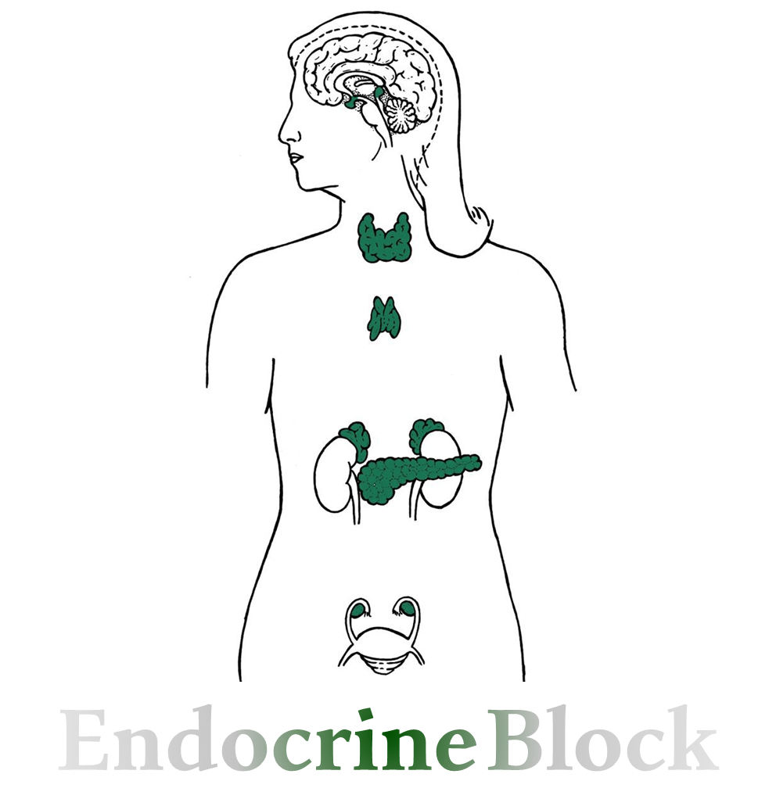
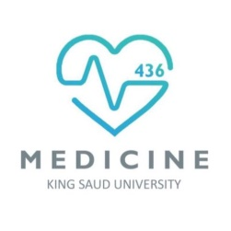
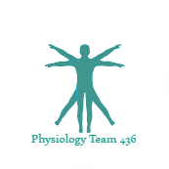
Text
Only in Females’ slide
Only in Males’ slides
Important
Numbers
Doctor notes
Extra Notes

Slide 2
Physiology of Adrenal Medulla and Pheochromocytoma
By the end of this lecture, students should be able to describe:
Summarize the actions of adrenal androgens.
Describe the causes and major manifestations of hyperadrenocorticism and Hypoadrenocorticism.
Describe circumstances in which catecholamines are released from the adrenal gland.
List the major actions of catecholamines.

Slide 3
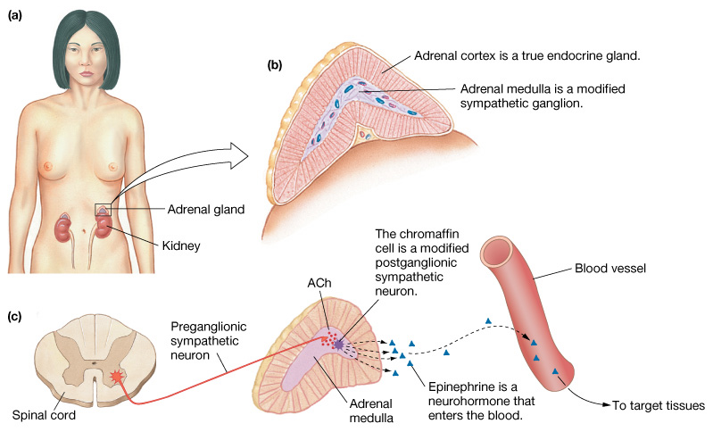
Overview of Adrenal Medulla
Adrenal medulla: (10-20%) formed from neural ectoderm.
The adrenal medulla is the inner part or core of each adrenal gland.
Innervated by cholinergic preganglionic sympathetic neurons.
In parasympathetic:
Preganglionic use Ach as its neurotransmitter and nicotinic cholinergic receptors.
Postganglionic use Ach as its neurotransmitter and muscarinic receptors
In sympathetic:
preganglionic use Ach as its neurotransmitter and nicotinic acetylcholine receptors.
postganglionic release norepinephrine, which activates adrenergic receptors that are present on the peripheral target tissues.

Slide 4
Sympathetic Pathway of The Medulla
The pathway on the right shows when norepinephrine is secreted from the sympathetic neurons which then act on target cells at the point of release.
The pathway on the left shows the effect of the sympathetic nervous system on the adrenal medulla that mainly secrete epinephrine which act on distant target cells
The most important thing we should know here is that:
Epinephrine acts on distant target cells (systemic effect).
While Norepinephrine acts on target cells where it is released (local effect).

Slide 5
Adrenal Medullary Hormones
The notes here are imp
Adrenal medulla secretes catecholamines:
Adrenaline (epinephrine).
Noradrenaline (norepinephrine).
Small amount of dopamine.
Its derived from the embryonic neural crest, simply modified neurons (Chromaffin cells, also pheochromocytes) in the adrenal medulla.
Secretion of these hormones causes: Blood to be diverted to the brain, heart, and skeletal muscle.
Its secretions are derived from tyrosine:
Tyrosine → Dopamine → Norepinephrine, high levels of cortisol that drain into the medulla from the adrenal cortex induce expression of the enzyme phenylethanolamine N-methyl transferase (PNMT), which converts norepinephrine to epinephrine.
Very important
Always remember that:
Dopamine beta hydroxylase (DBH) is an enzyme that catalyzed dopamine to norepinephrine.
Phenylethanolamine N-methyltransferase (PNMT) is an enzyme that converts norepinephrine (noradrenaline) to epinephrine (adrenaline).

Slide 6
Epinephrine & Norepinephrine
Very important
فيه سؤال من هنا
Epinephrine & Norepinephrine
Epinephrine (EP) | Norepinephrine (NP)
80% of adrenal medullary secretion. | 20% of adrenal medullary secretion.
Epinephrine is the more potent stimulator of the heart and metabolic activities. | Norepinephrine is more influential مؤثرon peripheral vasoconstriction and blood pressure.
Comes solely (alone not involving anyone or anything else) from chromaffin cells of the adrenal medulla. | Comes from Both from chromaffin cells of the adrenal medulla and postganglionic sympathetic nerves. This is because postganglionic sympathetic nerves cannot synthesize Epinephrine from its precursor Norepinephrine, because they lack the enzyme (PNMT) needed for conversion of Norepinephrine into Epinephrine.
Very important
Which has more affinity towards the receptors (alpha and beta)?
Epinephrine has similar affinity to 𝞪 & 𝛃 receptors.
Norepinephrine has greater affinity than epinephrine for the 𝞪 receptors.

Slide 7
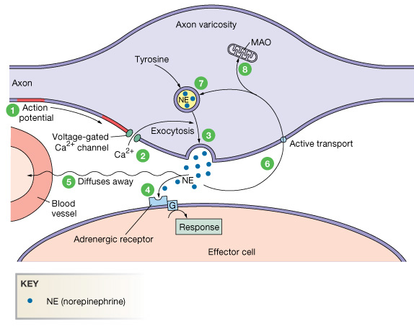
Mechanism of Norepinephrine Release & Recycling
Only in Males’ Slides
1. Action potential arrives at the varicosity.
2. Depolarization opens voltage-gated Ca²⁺ channels.
3. Ca²⁺ entry triggers exocytosis of synaptic vesicles.
4. Norepinephrine bind to adrenergic receptor on target.
5. Activity ceases when Norepinephrine diffuses away from the synapse.
6. Norepinephrine is transported back into the axon.
7. Norepinephrine can be taken back into synaptic vesicles for recycling.
8. Norepinephrine is metabolized by Monoaminoxidase (MAO).

Slide 8
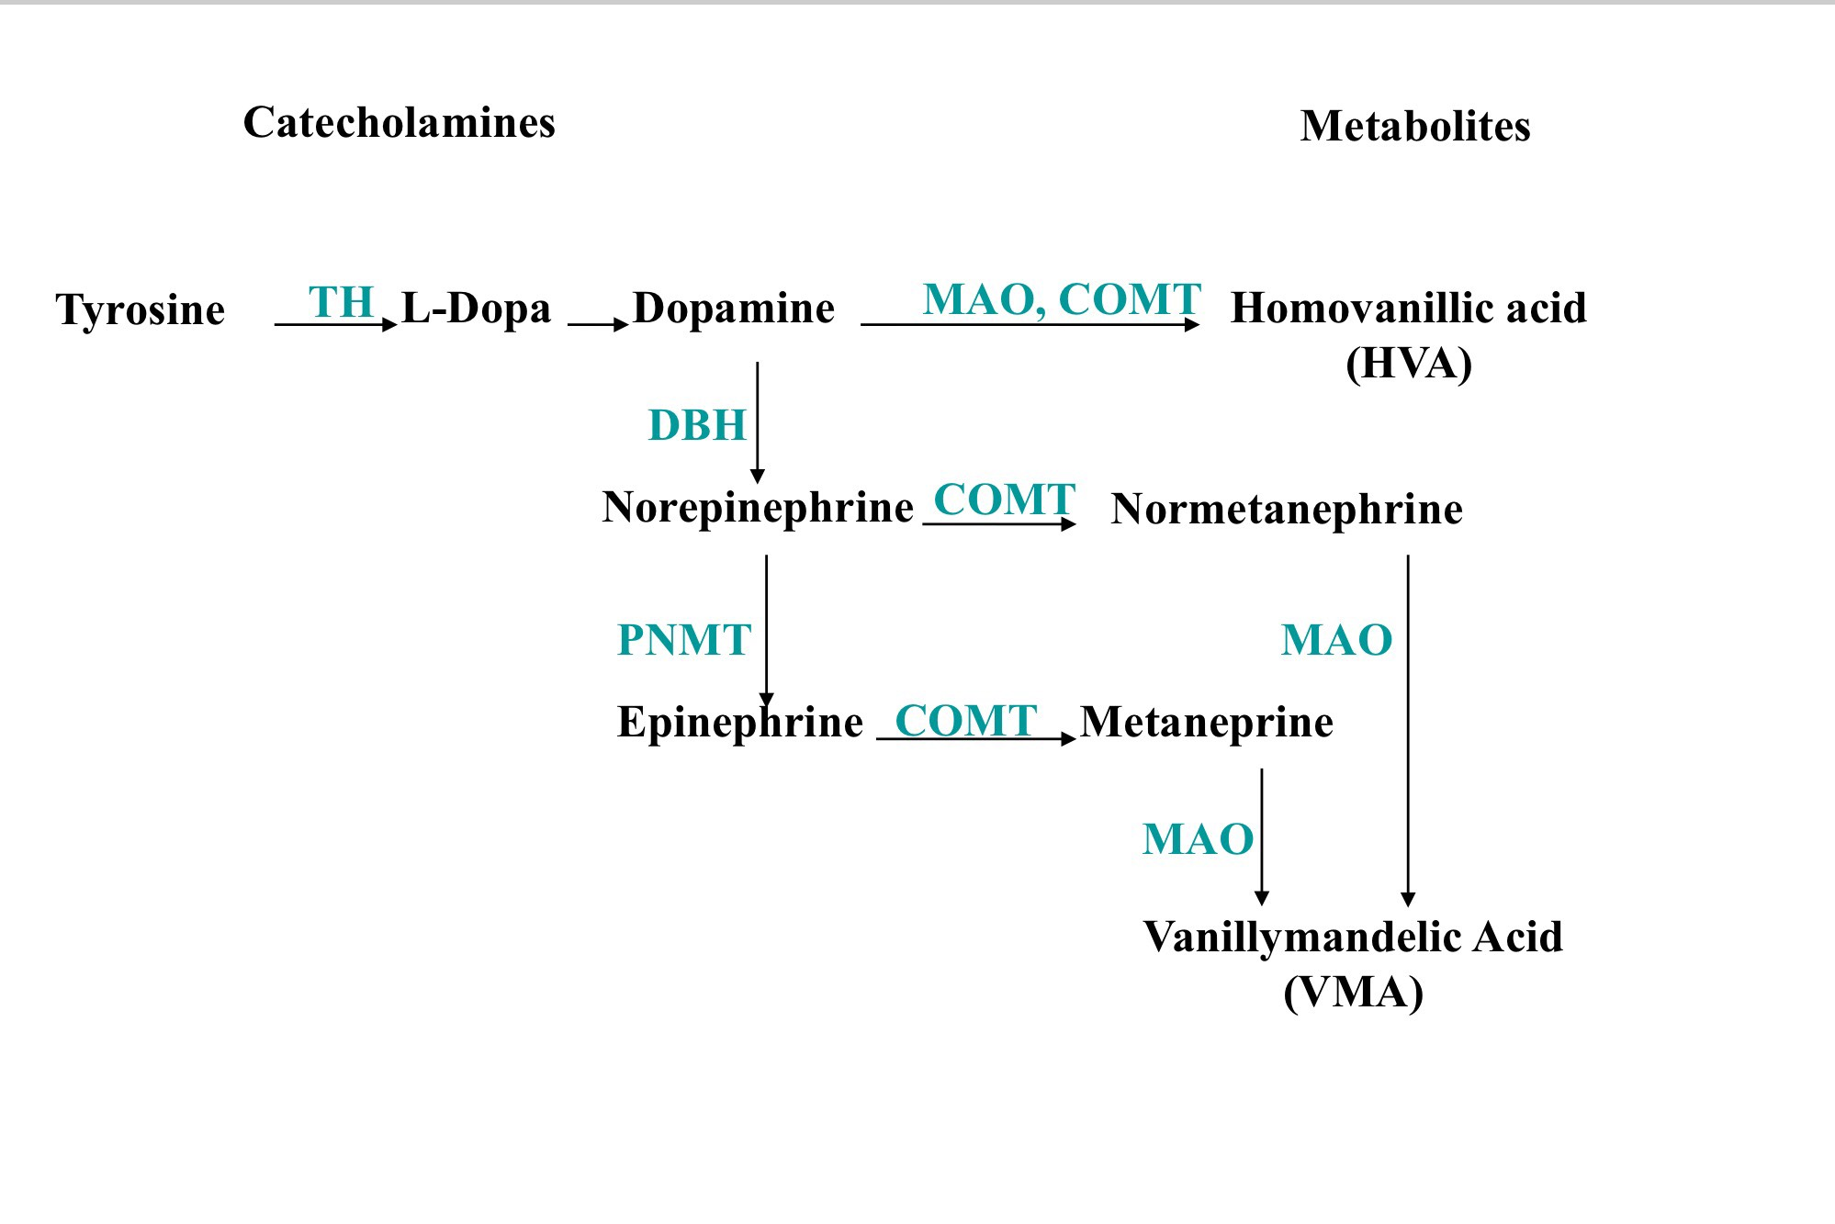
Metabolism of Catecholamines
Adrenal medulla secrete catecholamines (epinephrine and norepinephrine) and small amount of dopamine.
Dopamine after being catalyzed by DBH (dopamine beta hydroxylase) to norepinephrine, from here it can be released as it is or else the majority of it is converted to epinephrine.
High levels of cortisol that diffuses from adrenal cortex to medulla stimulates the Phenylethanolamine N-methyltransferase (PNMT) enzyme.
Two primary enzymes are used for the degradation of catecholamines:
Monoaminoxidase (MAO).
Catechol-o-methyltransferase (COMT).
Urinary Vanillylmandelic acid (VMA) and metanephrine are sometimes used clinically to assess the level of catecholamine production in a patient.
Phenylethanolamine N-methyltransferase (PNMT) is an enzyme found in the adrenal medulla that converts norepinephrine (noradrenaline) to epinephrine (adrenaline)
Only in Males’ Slides
The vanillylmandelic acid (VMA) and metanephrine become elevated in pheochromocytoma.

Slide 9
The Actions of Adrenal Medullary Hormones
Enhance the effects of the sympathetic nervous system.
Prepare the body for a stressful event. The response is known as the “fight or flight” response.
The overall effect is to ensure that all requirements for increased muscle activity are available. What are these effect?
Functions of catecholamines
Effect on carbohydrates Metabolism | Both of them can increase glycogenolysis and gluconeogenesis and decrease glycogenesis in liver and skeletal muscle; lead to hyperglycemia (increased blood glucose level). Catecholamine promote the release of glucose from liver and decrease its utilization by muscle. Epinephrine inhibits insulin secretion but promote glucagon secretion.
Effect on lipids metabolism | Both of them enhance the breakdown of triacylglycerol (TAG) in adipose tissue (lipolysis) Mobilization of free fatty acids (FFA). This cause increase in the free fatty acid in the circulation which are effectively utilized by the heart and muscle as fuel source.
Effect on physiological functions | Catecholamines increase cardiac output (heart rate), blood pressure (vasoconstriction of blood vessels) and oxygen consumption. To meet demands of skeletal and cardiac muscles Increase metabolic rate. They cause smooth muscle relaxation in bronchi, GIT and blood vessels supplying skeletal muscle.

Slide 10
Exercise As An Example of Adrenal Medulla Activation
Only in Males’ Slides
Exercise is similar to the “fight-or-flight” response but without the subjective element of fear
It involves a greater adreno-medullary response (i.e., endocrine role of epinephrine) than a sympathetic nervous response (i.e., neurotransmitter role of norepinephrine).
The overall goal of the sympatho-adrenal system during exercise is to meet the increased energy demands of skeletal and cardiac muscle while maintaining sufficient oxygen and glucose supply to the brain.

Slide 11
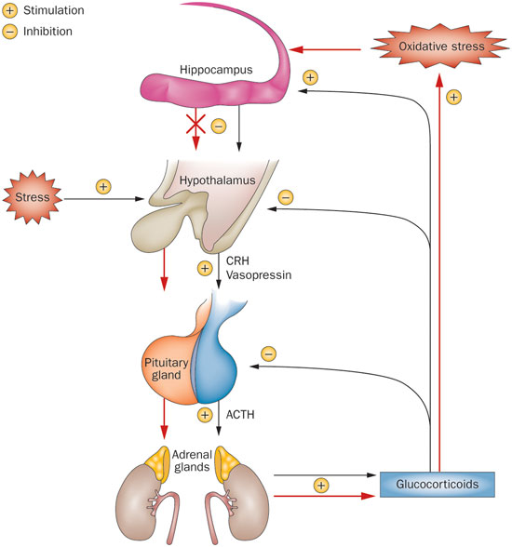
Control of Secretion of Adrenal Medullary Hormones
The adrenal medulla is innervated by the sympathetic nervous system.
Adrenal hormones are released from the medulla in response to signals from the sympathetic nervous system.
The sympathetic nervous system is activated in response to stress also know as the “fight or flight” response.
Stress can be physical (exercise), physiological (hypoglycemia, hemmorhage), or emotional.
Cortisol, when secreted from the adrenal cortex in response to stress, causes release of these hormones from the medulla.

Slide 12
Stress & The Adrenal Gland
Short term stress will stimulate adrenal medulla to release catecholamine.
Long term stress will stimulate adrenal cortex to release corticosteroid & mineralocorticoid.

Slide 13
Adrenergic Receptors
ما يحتاج تعرفون الريسيبتور
Receptor | Response | Target
α 1 Alpha 1 are located in smooth muscle cells in blood vessels, sphincters of gastrointestinal system and urinary bladder causing contraction of smooth muscles. | ↑ Glycogenosis | Heart
 | Constriction | Arterioles of skin
 |  | Arterioles of mucosa
 |  | Arterioles of skeletal muscle
 | ↑ Glycogenolysis & gluconeogenesis. ↑ Blood sugar | Liver & muscle
 | ↓ Sphincter contraction | Stomach & intestine
 | ↑ Sphincter contraction | Urinary bladder
 | ↑ Sweating | Skin
 | Contraction | Uterine
 | Contraction of radial muscles of iris Pupillary dilation | Eyes
α 2 | Platelet aggregation & vasoconstriction | Blood vessels
 | ↓ Insulin secretion | Pancreas

Slide 14
Cont.
ما يحتاج تعرفون الريسيبتور
Receptor | Response | Target
β 1 Beta 1 receptors are located in the heart by increasing contractility. | ↑ Frequency and rate of contraction ↑ Conduction ↑ Blood flow (dilation of coronary arteriole) | Heart
 | Dilation | Arterioles of skeletal muscle
 | ↑ Renin secretion | kidneys
 | ↑ Blood FFA and glycerol ↑ glycogenolysis & gluconeogenesis ↑ Blood sugar ↑ Lactate and pyruvate release | Liver & Muscle
 | ↓ Motility | Stomach and intestine
β 2 Beta 2 receptors are located in the smooth muscles causing relaxation of bronchial, stomach and intestinal smooth muscles. | Relaxation | Bronchial muscle
 | ↑ Glycogenolysis | Liver
 | Vasodilation | Blood vessels
β 3 Beta 3 are located in the adipose tissue causing lipolysis. | ↑ Lipolysis & ↑ brown fat thermogenesis | Fat

Slide 15
Pheochromocytoma
Originates from the chromaffin cells along the paravertebral sympathetic chain extending from pelvis to base of skull.
Pheochromocytoma is a relatively rare tumor of the adrenal medulla or of similar specialized cells outside of the adrenal glands.
About 10% of pheochromocytomas are malignant.
It can occur in combination with other tumors, conditions and in some familial (inherited) syndromes.
Associated with neurofibromatosis.
It can be life threatening if not recognized & not treated.
Most often occurs in middle age.
Most tumors secrete epinephrine, NE, and dopamine and can cause episodic hypertension.
Urinary Vanillylmandelic acid, VMA (a breakdown product of norepinephrine) and plasma catecholamine are elevated.
Appearance of the disease:
>95% are abdominal.
>90% in adrenal medulla.
80% occur unilateral.
Surgically correctable forms of hypertension.

Slide 16
Clinical Features
الأرقام بهذي السلايد مو معنا ☺
Headache, sweating, palpitation, anxiety, chest pain and a fast heartbeat (palpitation) are typical symptoms, usually in association with markedly high blood pressure.
Hypertension: often severe, occasionally malignant, and may be resistant to treatment with standard antihypertensive drugs.
Paroxysms or Crisis: frequent or sporadic, occurring at intervals as long as weeks or months. With time, the paroxysms (any sudden, violent outburst; a fit of violent action or emotion) usually increase in frequency, duration, and severity.
Classic triad: resistant hypertension, headache and sweating.
Increased metabolic rate, such as profuse غزيرsweating, glucose intolerance, and mild to moderate weight loss.
Sinus tachycardia, sinus bradycardia, supraventricular arrhythmias, and ventricular premature contractions have all been noted. Angina and acute myocardial infarction.
Sign and symptoms: of Pheochromocytoma:
Palpitation → 64%
Headache → 80%
Episodic sweating
Perspiration → 71%
Pallor → 42%

Slide 17
Diagnosis & Treatment
Diagnosis:
The diagnosis is established by the demonstration of:
Increased production of catecholamine (high plasma catecholamine).
Catecholamine metabolites (VMA): metanephrine and vanillylmandelic acid (VMA) in plasma and/or urine. The diagnosis can usually be made by the analysis of a single 24-h urine sample, provided the patient is hypertensive or symptomatic at the time of collection.
Imaging: CT & MRI.
Treatment: Laparoscopic Adrenalectomy.
Pre-operation:
Control of hypertension.
α blockers to prevent intraoperative hypertensive crisis due to tumor manipulation and release of catecholamine.
Fluid resuscitation to prevent circulatory collapse after removal of the catecholamine-secreting tumor.
(If you suddenly remove the catecholamine secreting tumors, blood vessels will relax and then hypo volume so you need to administrate IV fluid)
Case study:
James 35 years old complaining of headache, anxiety, palpitation and panic attacks.
So there is abnormality in adrenal gland but where exactly?
It is in the medulla. Classical trial of a condition called pheochromocytoma.

Slide 18
Questions Recommended by Females’ Doctor in The Interactive Session
Very important
1. How does the epinephrine which is secreted from the adrenal medulla differs in way of secretion from the other epinephrine secreted from other sources?
By the exocytosis to the ganglia.
2. epinephrine and norepinephrine considered as amino acid. If I give you a multiple choices what is the right answer?
Tyrosine
3. What is the difference in the structure between epinephrine and norepinephrine?
Epinephrine and Norepinephrine are the same except that epinephrine has a methyl group. Both Epinephrine and Norepinephrine are synthesized within adrenomedullary secretory cells and both are stored in Chromaffin Granules.
6. Norepinephrine binds to which receptors ?
α 1 & α 2.
β 1, β 2 & β 3.
4. Is there a difference in the affinity to the alpha receptor between epinephrine and norepinephrine?
Yes, norepinephrine has more affinity to alpha receptor.
5. What is the role of alpha 1 receptor on the blood vessels?
The alpha-1 (α1) adrenergic receptor is a G protein-coupled receptor (GPCR). Alpha 1 are located in smooth muscle cells in blood vessels, sphincters of gastrointestinal system and urinary bladder causing contraction of smooth muscles.
6. what is the mechanism by which epinephrine causes hyperglycemia?
Direct way: it will stimulate the gluconeogenesis in the liver.
Indirect way: it will stimulate the muscles to use energy and produce lactate which will go back to the liver to produce glucose.

Slide 19
Thank you for checking our work!
اعمل لترسم بسمة، اعمل لتمسح دمعة، اعمل و أنت تعلم أن الله لا يضيع أجر من أحسن عملا.
قادة الفريق:
ليــلـى مـذكور & مـحـمـد نـصـر
Please check our editing file to know if there are any additions, changes or corrections.
Examine yourself
خالص الشكر لأعضاء الفريق الكِرام:
باسل المفلح
عبدالرحمن الراشد
ماجد الزين
لـمـى الـتـمـيـمـي
لـيـن الـتـمـيمـي
2017-2018 Dr. Abeer AlGhumlas’s Lecture & Notes.
2017-2018 Dr. Khalid Al Regaiey’s Lecture& Notes.
Guyton & Hall of Medical Physiology 13th Edition.
Linda S. Costanzo 5th Edition.
Helpful physiology bocks.
Give us your feedback ☺
اللهم اني استودعتك ما حفظت وما قرأت وما فهمت، فرده لي وقت حاجتي إليه إنّك على كل شيءٍ قدير.

