Slide 1
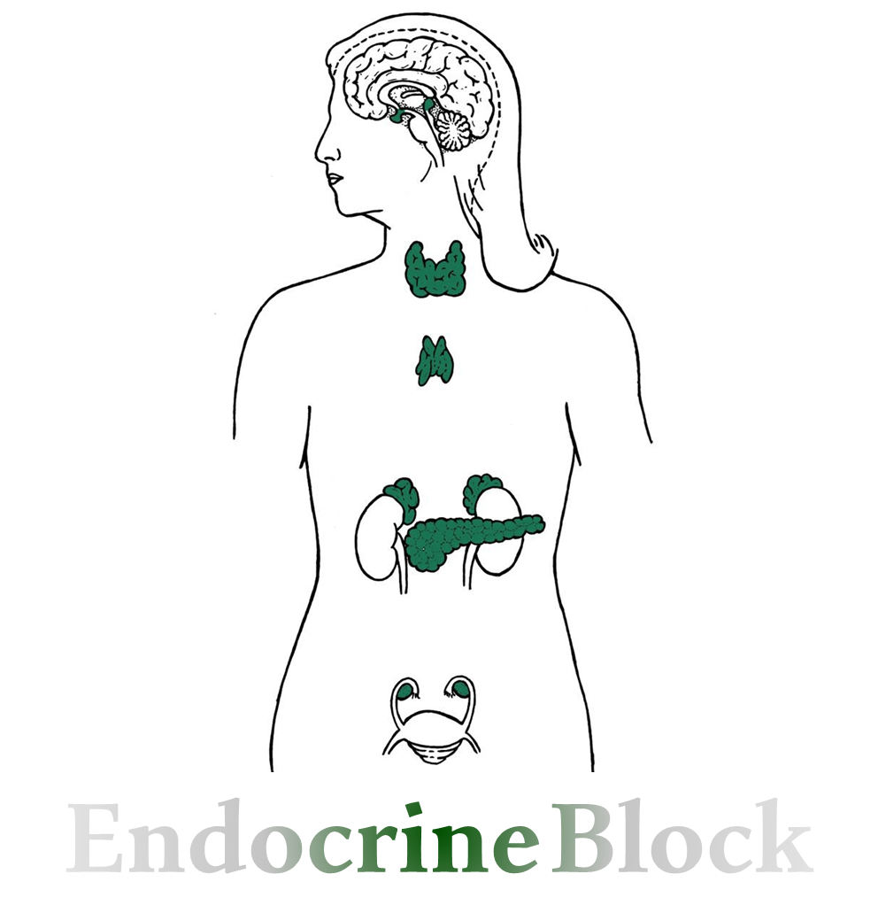
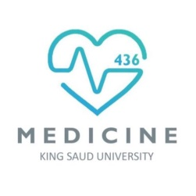
المحاضرة بسيطة وقليلة، الباقي ملخصات وشرح
Text
Only in Females’ slide
Only in Males’ slides
Important
Numbers
Doctor notes
Extra Notes

Slide 2
Pancreas, Insulin & Glucagon Synthesis.
By the end of this lecture, students should be able to describe:
Describe the cellular arrangements and functional components of the pancreas.
List the hormones secreted by the pancreas.
Outline the regulation of insulin secretion.
Describe the mechanism of action of insulin.
Describe actions of pancreatic Somatostatin.
Outline the physiological and biochemical actions of insulin.
Describe mechanism of action of glucagon.
Outline regulation of glucagon secretion.
Outline the physiological and biochemical actions of glucagon.
Outline the effects of other hyperglycemic hormones.

Slide 3
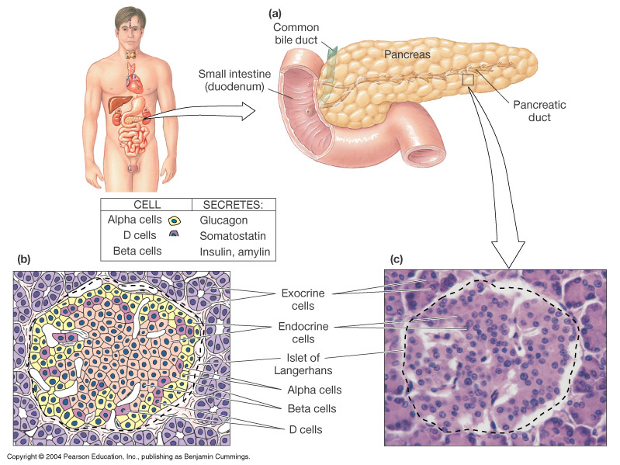
Introduction To Pancreas
Important
Shape: A triangular gland, which has both exocrine and endocrine cells.
Location: located behind the stomach (Strategic location).
Exocrine product: Acinar cells produce an enzyme-rich juice used for digestion.
Endocrine product: Pancreatic islets (islets of Langerhans) produce hormones involved in regulating fuel (CHO, fats & protein) storage and use.
Islets of Langerhans (1-2 million islets) (important)
Cells types | Secretion | Percentage
Beta (β) | Produce insulin | 70%
Alpha (α) | Produce glucagon | 20%
Delta (δ) | Produce somatostatin (Somatostatin always acts as inhibitor) | 5%
F (​gamma ​γ​ ​or PP cells)​ cells | Produce pancreatic polypeptide | 5%

Slide 4
Glucose Metabolism Terms
Gluconeogenesis: synthesis of glucose from non carbohydrate precursors, lactic acid, glycerol, amino acids. Liver cells synthesizes glucose when carbohydrates are depleted by gluconeogenesis.
Glycogenesis: formation of glycogen, glucose stored in liver and skeletal muscle as glycogen. Important energy reserve (In case of excess).
Glycogenolysis: breakdown of glycogen (polysaccharide) into glucose molecules (monosaccharide).
Glycolysis: the breakdown of glucose into pyruvate by cells for the production of ATP.

Slide 5
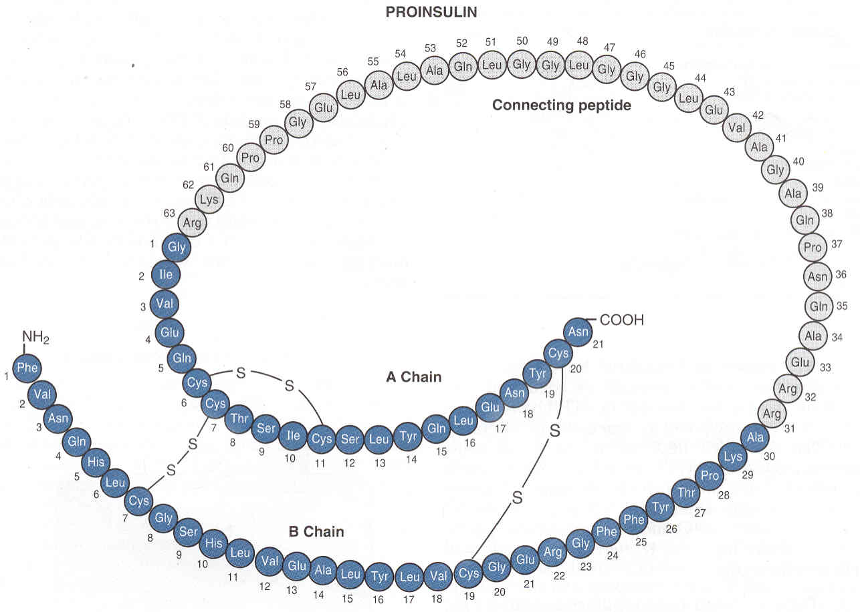
Overview & Structure of Insulin
يسمى هرمون الوفرة والكثرة ما يفرز وقت المجاعة، يفرز اذا عندي وفرة من المواد الغذائية (الجلوكوز، البروتين، الدهون) فيأخذها من الدم ويدخلها لخلايا كما يمنعها تطلع من الخلايا.
Hormone of nutrient abundance.
A protein hormone consisting of two amino acid chains linked by disulfide bonds.
Synthesized as part of proinsulin (86 AA) and then excised by enzymes, releasing functional insulin (51 AA) and C peptide (29 AA).
Half life: Has a plasma half-life of 5-6 minutes.
For your information

Slide 6
Dr. Manan’s Explanation

Slide 7
Insulin Synthesis
Important
Insulin synthesis is stimulated by glucose or feeding and decreased by fasting.
( When blood glucose level is elevated, Insulin synthesis is stimulated and insulin is secreted, while fasting (hypoglycemic condition) will inhibit insulin synthesis)
By negative feedback → reverse the direction of action whether it was increasing or decreasing ex: feeding, increase in blood sugar above normal range there is a sensor that gives signals to the hypothalamus which give orders to the organ in charge (pancreas) which activate the beta cells to produce insulin which is like a key for glucose to enter the cell → decrease in blood sugar to normal (most common in our body).
Positive feedback → support the action whether it was increasing or decreasing like oxytocin during labor, platelets aggregation; to stop bleeding.
Threshold of glucose-stimulated insulin secretion is 100 mg/dl.
(when glucose level is higher than 100mg/dl, pancreas will secrete insulin and vice versa)
Glucose rapidly increase the translation of the insulin mRNA and slowly increases transcription of the insulin gene.
In chromosome 11 in β cells:
DNA transcription into mRNA
mRNA is translated into Pre-proinsulin:
(signal peptide, A chain, B chain, and peptide C)
Pre-proinsulin is converted to proinsulin
Insulin is formed from proinsulin and Insulin is ready to be released
كيف يتصنع الأنسولين؟ أول شيء بيتصنع في خلية بيتا، وين بالضبط؟ بكروموسوم رقم 11.
يتصنع على شكل صيغة مبدئية (Pre-proinsulin)، الصيغة هذه تتكون من اربع سلاسل هم (Signal peptide, A chain, B chain & C peptide).
راح تدخل هذه الصيغة الأولية إلى (Endoplasmic reticulum) وبمجرد دخولها هنا راح تتكسر الـ (Signal peptide) و الـ (A & B chain) راح يرتبطون ببعض برابطة اسمها (disulfide bond) وهنا راح يصير اسمه (Proinsulin). بس احنا مو محتاجين الـProinsulin، محتاجين الأنسولين النشط، فكيف نطلعه؟
راح يروح الـProinsulin إلى الـ (Golgi apparatus) ومجرد دخولها هنا راح تتسكر الـ C peptide وهذا يعتبر الأنسولين النشط وبعدين تخزن في Vesicles وبعدين راح يصير لها Released.

Slide 8
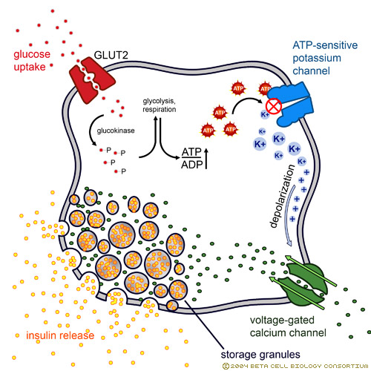
Insulin Secretion
Glucose is the primary stimulator of insulin secretion.
الجلوكوز هو اول محفز للأنسولين أنه يصير له secretion.
طيب كيف راح يدخل الجلوكوز إلى خلية البيتا مكان إفراز الأنسولين ويفرز لي الأنسولين؟
لما يصير عندي جلوكوز كثير بالدم، راح يجي عند الخلية بيتا ويدخل عن طريق ناقل اسمه GLUT 2.
عندي هنا إنزيم جدا مهم ويعتبر (Rate limiting step)، وبدونه العملية ماراح تتم لأننا ماراح نقدر نخلي الجلوكوز محبوس داخل الخلية، وراح يطلع علطول قبل يطلّع لي الأنسولين. الإنزيم هذا اسمه (Glucokinase).
بمجرد دخول الجلوكوز لداخل الخلية، راح يرتبط مع (Phosphate) ويصير عندي (Glucose 6 phosphate)، أول ما يتكون عندي كمية من الـ (Glucose 6 phosphate) راح يتكون عندي كمية من الـATP.
هذا الـATP راح يسكّر لي بوابة اسمها K gated channel، بالتالي البوتاسيوم ماراح يقدر يطلع لبرا وراح يتراكم بالداخل، وبما أن البوتاسيوم موجب الشحنة وتراكم بالداخل، بالتالي راح يزيد عندي شحنة الخلية الموجبة بالداخل.
زيادة هذه الشحنة الموجبة تسوي لي Depolarization، واحنا عارفين من قبل ان الـ Depolarization يفتح لي بوابة اسمها (Ca gated channel).
بمجرد فتح هذه البوابة راح تدخل كميات كبيرة من الكالسيوم لداخل الخلية وتعمل على تحفيز الأنسولين اللي تصنّع وتجمع في Visicles لوقت الحاجة أنه يخرج إلى خارج الخلية وإلى الدم.

Slide 9
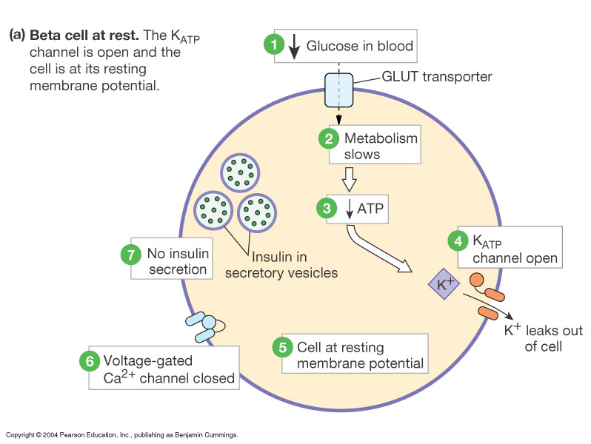
Cont.
Important
When Beta cells at rest:
When Beta cells at rest:
Decreased glucose in blood → decreased intracellular glucose → decreased metabolism → decreased ATP → K channels are open and K leaks out → Cells at resting membrane potential → Ca channels are closed → No Insulin secretion.
Beta Cells have GLUT2

Slide 10
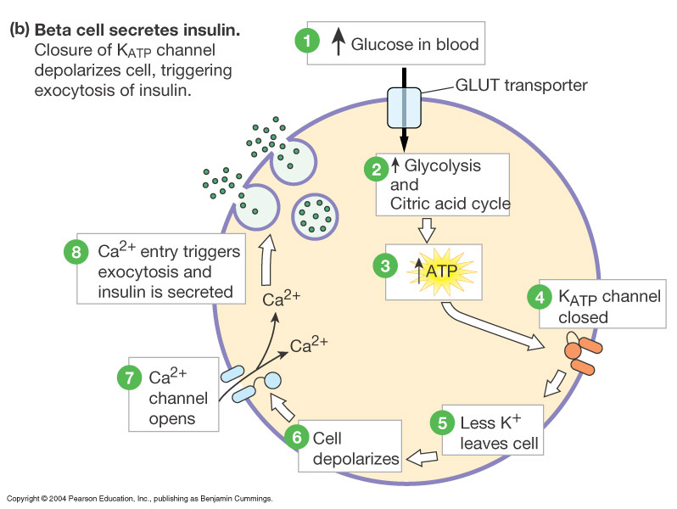
Cont.
Important
When Beta cells secrete Insulin:
When Beta cells secrete Insulin:
Increased glucose in blood → Increased intracellular glucose → Increased Glycolysis and Citric acid cycle → Increased ATP → K channels are closed so, less K leaves the cells → Cells depolarization → Ca channels will open → Ca entry will trigger the exocytosis of insulin vesicles → Insulin is released.

Slide 11
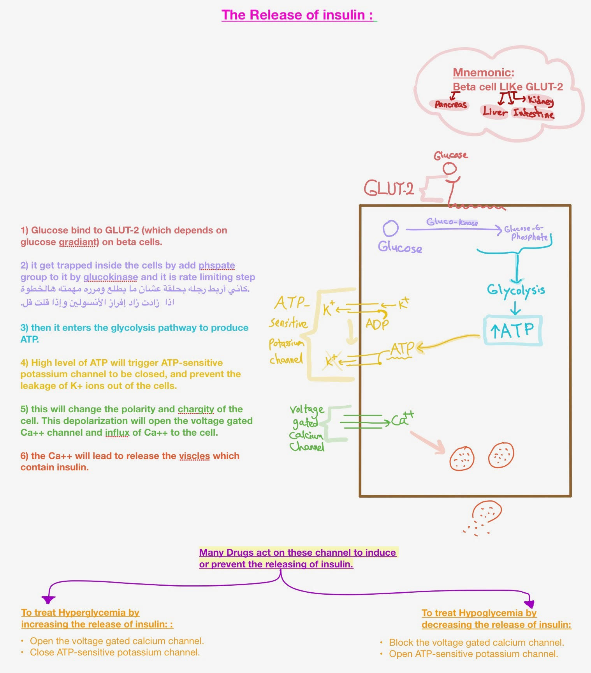
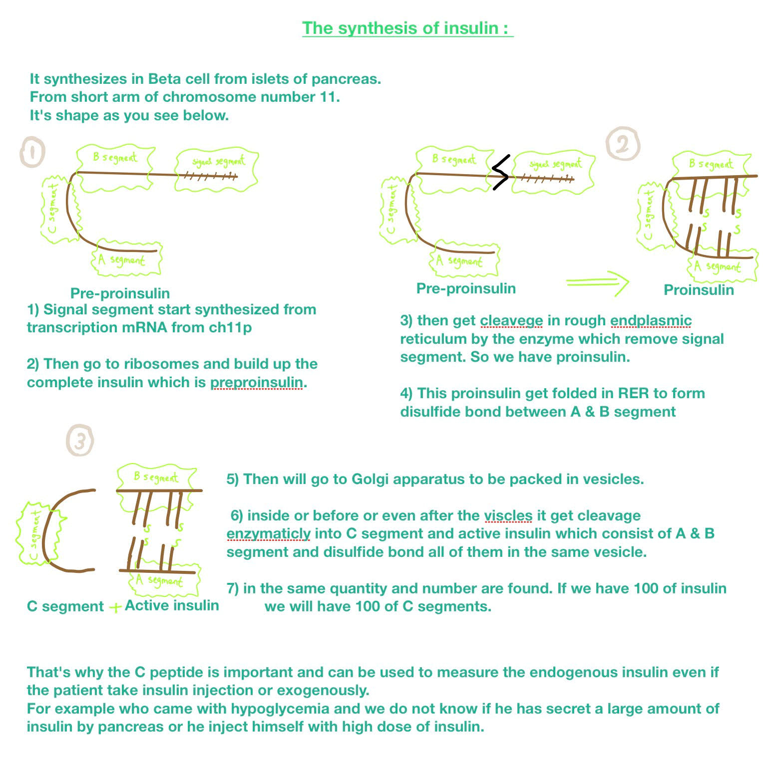
Dr. Manan’s Explanation

Slide 12
Factors Affecting Insulin Secretion
Stimulating factors | Inhibiting factors
Increased blood glucose (the most important) Increased blood free fatty acids Increased blood ketone bodies Increased blood amino acids الأمينو أسيد يرفع الأنسولين ولكن بنسبة قليلة، فمثلاً لو أكلنا بروتين لحاله ما راح يرفع الأنسولين بنسبة كبيرة، أما لو أكلت بروتين وجلوكوز بيحفزون إفراز كمية كبيرة من الأنسولين. Hormones*: Gastrin, Secretin & Glucagon (Glucagon will stimulate insulin, in contrast the insulin will inhibit glucagon). الجلوكاجون يحفز افراز الانسولين، بينما الانسولين ناكر جميل يقلل افراز الجلوكاجون Cholecystokinin (CCK) Gastric inhibitory peptide (GIP). Vasoactive intestinal peptide (VIP). Parasympathetic stimulation; acetylcholine (Ach) β-Adrenergic stimulation شخص اخذ جلوكوز عن طريف الفم وشخص آخر عن طريق الوريد، أيهم إفرازه للأنسولين أعلى؟ عن طريق الفم أعلى، لانه بيصير عندنا جلوكوز مرتفع + لانه بيحفز انزيمات من الجهاز الهضمي. | Decreased blood glucose (the most important) Decreased blood free fatty acids Decreased blood amino acids Hormones: Somatostatin Epinephrine (Alpha receptor) α-Adrenergic activity Sympathetic stimulation (sympathetic nervous system has two receptors: 1. Alpha which is inhibitory 2. Beta which is stimulatory. When it act on alpha receptor it inhibits insulin secretion but, when we block alpha receptor and it act on beta receptor it stimulate insulin release. However, beta cells have more alpha receptor which makes the end result of sympathetic nervous system (inhibition of insulin secretion).
*Some hormones, such as glucagon, glucose-dependent insulinotropic peptide (gastric inhibitory peptide), and acetylcholine, increase intracellular calcium levels through other signaling pathways and enhance the effect of glucose, although they don't have major effects on insulin secretion in the absence of glucose.
12

Slide 13
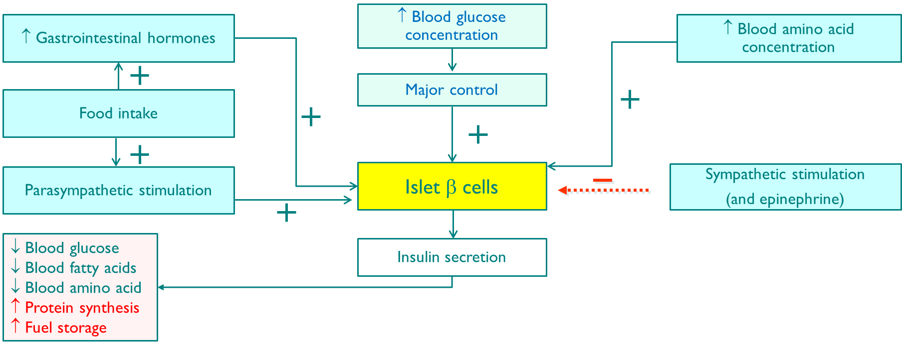
Cont.
تكرار للسلايد السابق
Excess: stored As nutrient in muscle, liver if there is too much it get stored in adipose tissue after that synthesis start and the more storage the more synthesis.
That’s why During exercise → decrease insulin synthesis; we are burning calories lead to increase insulin sensitivity so, no need for it + it decrease insulin resistance by cells that is caused by obesity.
What happen in obesity and the risk factor like smoking and not moving that number of receptor get decreased so, cell and receptor get resistance against the insulin after a while blood sugar + insulin both will be high with no affect so, pancreas gives up. So, exercise relief the pancreas.
This thing doesn’t depend on the weight, it depend on body composition (muscle, fat water).
If we increase our muscle percentage and replace our fat tissue with muscle tissue it will increase insulin sensitivity and increase metabolism rate and fat oxidation even if you are doing nothing.
Ex: If we gave 2 person the same meal with 800 kcal but one of them have more lean mass (muscle) than the other this person going to burn the calorie faster due to regular exercise.

Slide 14
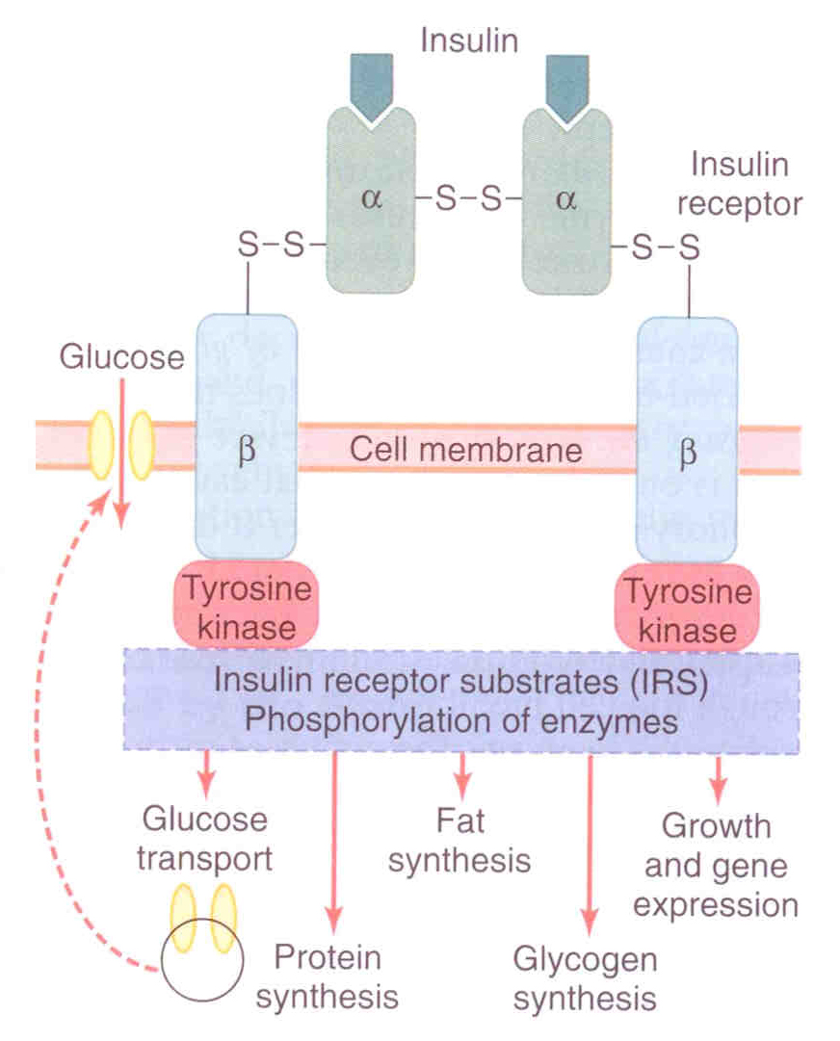
Insulin Receptor
The cascade is IMP
The insulin receptor is a transmembrane receptor.
Belongs to the large class of tyrosine kinase receptors.
Made of two alpha subunits and two beta subunits.
Insulin acts on its target cells, as described in the following steps:
كأنها باصات جوا الخليه ماتشتغل الا اذا جا الانسولين وأعطاها طاقة او بنزين
Will be sticky and attract any IRS to be phosphorylated, some of them will get activated and others will be inhibited
1. Insulin binds to the alpha-subunits.
2. Conformational change in the receptor.
3. Activation of tyrosine kinase in the beta-subunits.
Auto-phosphorylation
4. Beta-subunits autophosphorylation (in the presence of ATP).
5. Phosphorylation of other proteins or enzymes (e.g. Protein kinases).
The insulin like growth hormone, is very important in growth
6. Activation or inhibition of these proteins.
7. Produce the various metabolic actions of insulin (e.g. Fat synthesis).
Insulin is the master and manager of fuels in our body:
First: it will use the glucose by glycolysis.
Excess glucose will be stored as glycogen.
If there is even more, it will be converted into fat and protein and promote their synthesis.
It prevents the break down of glucose by glycogenolysis or produce more glucose by gluconeogenesis.
14

Slide 15
Glucose Transport System
Very Important
Glucose transport system
Transporters | Examples
GLUT1 | Placenta, Blood brain barrier, RBCs, Kidneys and Colon.
GLUT2 | β cells of Pancreas, Liver, Epithelial cells of small intestines and Kidneys.
GLUT 3 | Brain (insulin independent)((يدخله الجلوكوز دايركت مايحتاج انسولين, Placenta and Kidneys.
GLUT4 | Skeletal Muscles, Cardiac muscles and Adipose tissue. نسألكم بالاختبار: Which one is insulin-sensitive transporter? الجواب Glut4
GLUT5 | Jejunum and sperm.
15

Slide 16
Action of Insulin
Effect on adipose tissue | Effect on muscle | Effect on liver
Increase: Glucose Uptake (by increasing GLUT-4 availability). Glucose use. Glycolysis. Fatty acid synthesis. Alpha Glycerol phosphate synthesis. Triglyceride deposition. Esterification of fats. Lipoprotein lipase. K+ uptake. Decrease: Hormone sensitive lipase. Lipolysis. | Increase: Glucose Uptake (by increasing GLUT-4 availability). Glucose synthesis & use. Glycogenesis & Glycolysis. Amino acid uptake. Protein synthesis in ribosomes. Ketone uptake. K+ uptake. Decrease: Protein catabolism (proteolysis). Release of gluconeogenic amino acid. Glycogenolysis. | Increase: Protein synthesis. Lipid & very LDL synthesis. Glycogen synthesis. Glycolysis. Glycogenesis. Glucose Uptake (if blood glucose level is high) Glucose use. Decrease: Ketogenesis. Gluconeogenesis & Glycogenolysis. Urea cycle activity.
Insulin in general increases the cell growth. الأنسولين له دور مهم بالنمو لا تقل عن أهمية الـ growth hormone
16

Slide 17
Actions Classified By Duration
Actions classified by duration
Rapid (seconds) | Intermediate (minutes) | Delayed (hours)
Increase: transport of glucose into insulin sensitive cells (muscle adipose tissue). transport of amino acids into insulin sensitive cells. uptake of K+ into insulin sensitive cells. That’s why if you have patient with hyperkalemia you cant treat them with insulin injection to increase the potassium uptake by the cells and then give him/her glucose to avoid hypoglycemia, | Increase: Protein synthesis. Glycolytic enzymes and glycogen synthase. Decrease: protein degradation. phosphorylase and gluconeogenic enzymes. Inhibit the phosphatase enzyme which removes phosphate group from G-6-P and lead to leakage of glucose out of the cell. So, insulin prevents that by inhibiting this enzyme and delay glucose secretion from the cells. | Increase mRNAs for lipogenic and other enzymes.
17

Slide 18
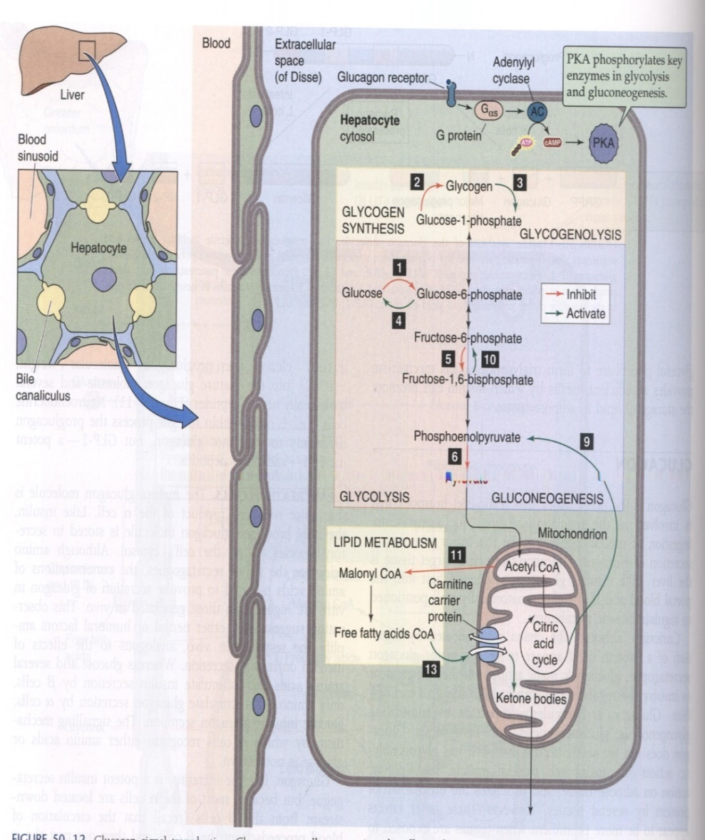
Overview & Synthesis of Glucagon
Overview:
A 29-amino-acid polypeptide hormone that is a potent hyperglycemic agent.
Produced by α cells in the pancreas.
Synthesis:
In chromosome 2 in α cells:
DNA transcription into mRNA
mRNA is translated into Pre-proglucagon
Pre-proglucagon is converted to Proglucagon
Glucagon is formed from proglucagon and glucagon is ready to be released

Slide 19
Factors Affecting Glucagon Secretion
Factors affecting insulin secretion
Stimulating factors | Inhibiting factors
1. Decrease blood glucose. 2. Increased blood amino acids (arginine, alanine). (The glucagon is secreted to stimulate the uptake of amino acids into the cells of the liver for gluconeogenesis) 3. Sympathetic nervous system stimulation. (beta receptors are more than alpha) 4. Stress. 5. Exercise. | Increase blood glucose Somatostatin. (Remember: it inhibit both insulin and glucagon) Insulin.
19

Slide 20
Glucagon Action on Cells
Its major target is liver.
It stimulates:
1. Glycogenolysis (the process of is the breakdown of glycogen into glucose)
2. Gluconeogenesis (is a metabolic pathway that results in the generation of glucose from non-carbohydrate carbon substrates such as amino acids)
3. Lipid oxidation (In the body lipid oxidation is important for several physiological reactions, for instance when utilizing fatty acids for the production of energy through β-oxidation).
(when lipids are fully oxidized they change to CO2 or partially to produce keto acids “ketone bodies”).
4. Release of glucose to the blood from liver cells.

Slide 21
The Regulation of Blood Glucose Concentrations ‘’ Summery of Both Insulin & Glucagon’’

Slide 22
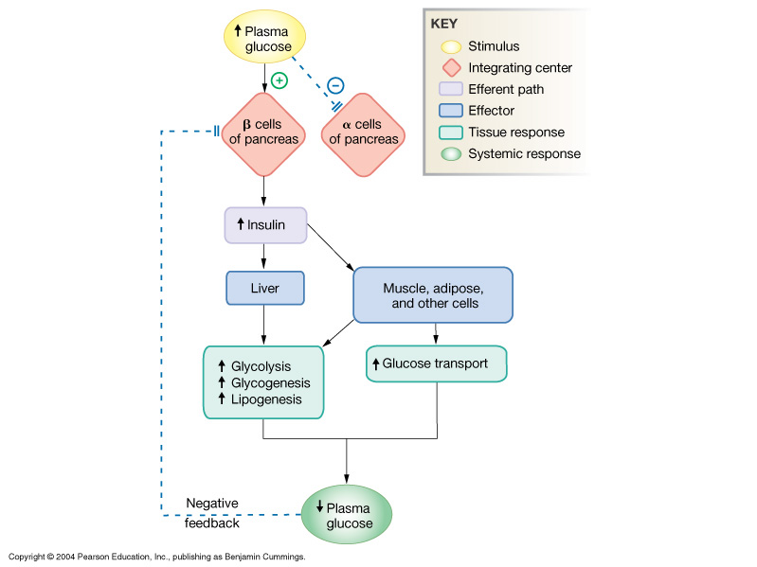
Summary of Insulin Action on Cells
Insulin is secreted from the beta cells of the pancreas in response to elevated blood glucose.
Effects muscle, adipose tissue and liver:
Increases glucose transport
Increases glycolysis
Increases glycogenesis
Increases lipogenesis
This then decreases blood glucose which in turn inhibit the release of insulin

Slide 23
Summary of Insulin (from slides)
Important
Insulin
Origin | Beta cells of pancreas
Chemical nature | 51-amino acid peptide
Biosynthesis | Typical peptide
Transport | Dissolved in plasma
Half life | 5 minutes
Factors affecting its release | Increased plasma glucose > 100 mg/dl Increased blood amino acids. GI hormones (feedforward reflax) (examples: Gastrin, CCK, Secretin etc…) Parasympathetic amplify (Increase & stimulate) & sympathetic inhibit.
Target cells | Liver, muscle, adipose tissues mainly. Brain, kidney, and intestine not insulin dependent.
Target receptor | Membrane receptor with tyrosine kinase pathway with insulin receptor substrate.
Whole body action | Decreases plasma glucose Increases transport of glucose into cells Increases metabolic use of glucose
Action at cellular level | Increases glycogen synthesis Increases aerobic metabolism of glucose Increases protein and triglyceride synthesis
23

Slide 24
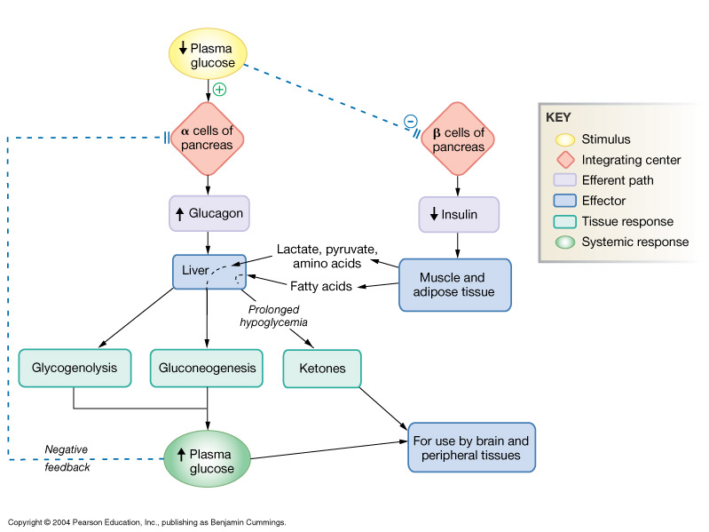
Summary of Glucagon Action on Cells
1st when the body plasma glucose level are below the normal range:
This will be detected by the pancreases especially the (alpha cells) which will secrete Glucagon to restore body’s normal glucose level by two mechanisms:
Glycogenolysis.
Gluconeogenesis.
The pancreases will also inhibit release of insulin to increase glucose level in the blood.
At the end, increased blood glucose level will inhibit the release of glucagon from pancreas. (-ve feedback)

Slide 25
Summary of Glucagon (from slides)
Important
Glucagon
Origin | Alpha cells of pancreas
Chemical nature | 29 -amino acid peptide
Biosynthesis | Typical peptide
Transport | Dissolved in plasma
Half life | 4-6 minutes
Factors affecting its release | Stimulated by plasma (glucose) <200 mg/dL, with maximum secretion below 50 mg/dL. Increase blood amino acids.
Target cells | Liver primary.
Target receptor/second messenger | G protein-coupled receptor linked to cAMP.
Whole body action | Increase plasma glucose by glycogenolysis & gluconeogenesis. Increases lipolysis leads to ketogenesis in liver.
Action at molecular level | Alters existing enzymes & stimulate synthesis of new enzymes.
Feedback regulation | Increase plasma (glucose) shuts off glucagon secretion.
Other information's | Member of secretion family along with VIP,GIP and GLP-1.
25

Slide 26
Summary of Glucagon
Summary
Pancreas
A triangular gland, which has both exocrine and endocrine cells, located behind the stomach
Endocrine cells | Exocrine cells
Islets of Langerhans produce hormones involved in regulating fuel storage and use. | Acinar cells produce an enzyme-rich juice used for digestion
Beta (β) cells produce insulin (60%) Alpha (α) cells produce glucagon (25%) Delta (δ) cells produce somatostatin (10%) F cells produce pancreatic polypeptide (5%)
26

Slide 27
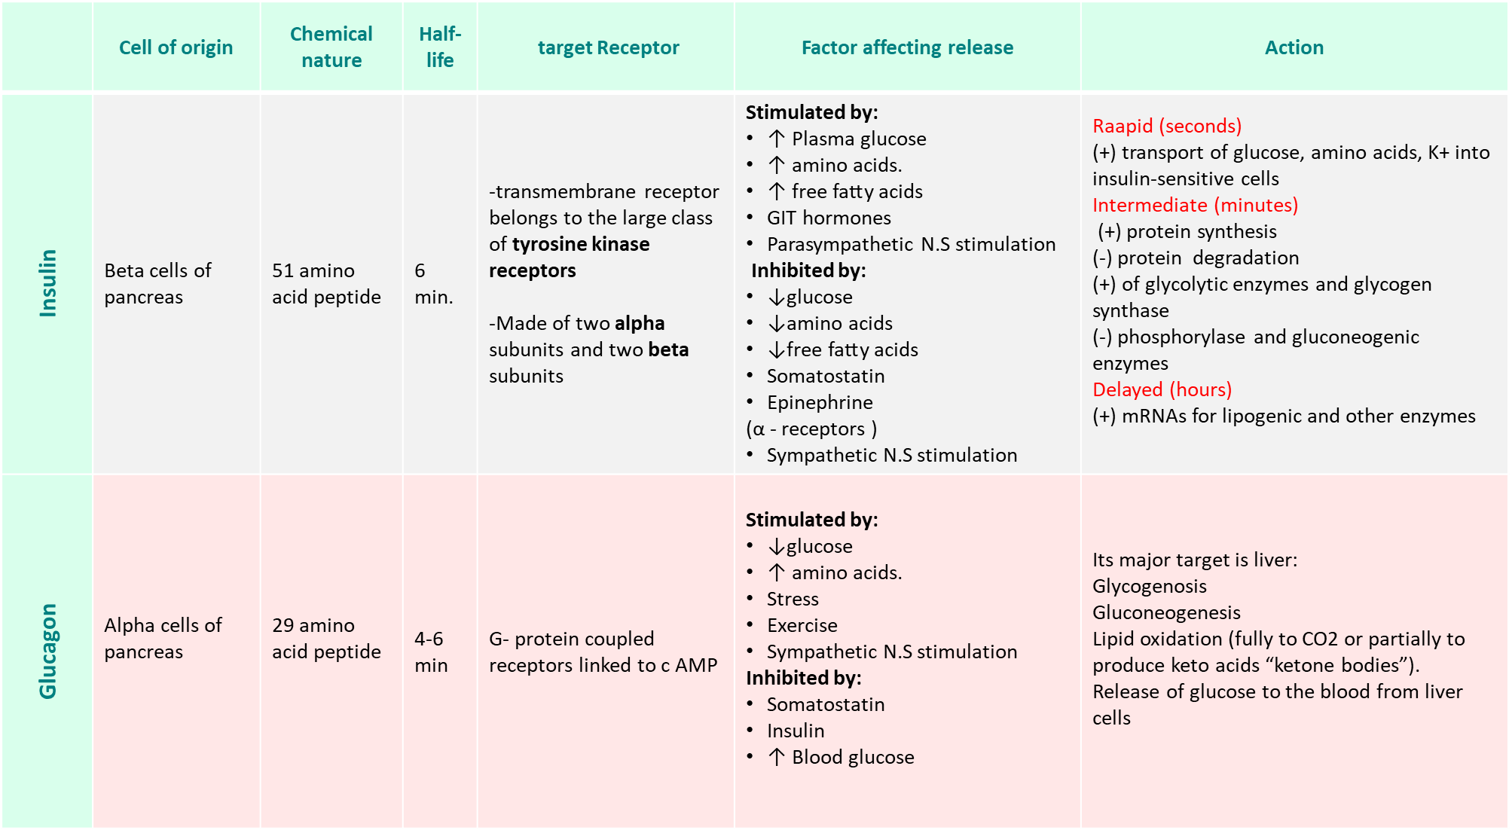
Summary of Glucagon
27

Slide 28
Thank you for checking our work!
اعمل لترسم بسمة، اعمل لتمسح دمعة، اعمل و أنت تعلم أن الله لا يضيع أجر من أحسن عملا.
قادة الفريق:
ليــلـى مـذكور & مـحـمـد نـصـر
Please check our editing file to know if there are any additions, changes or corrections.
Examine yourself
خالص الشكر لأعضاء الفريق الكِرام:
حسان الشمري
طلال الحقيل
فارس الجعفر
محمد المهوس
نواف الخضيري
لـمـى الـتـمـيـمـي
روان القحطاني
لينا الوكيل
وجدان الزيد
2017-2018 Dr. Manan Al Hakbany’s Lecture & Notes.
2017-2018 Dr. Ahmad Alsabeeh’s Lecture& Notes.
Guyton & Hall of Medical Physiology 13th Edition.
Linda S. Costanzo 5th Edition.
Helpful physiology bocks.
Give us your feedback ☺
اللهم اني استودعتك ما حفظت وما قرأت وما فهمت، فرده لي وقت حاجتي إليه إنّك على كل شيءٍ قدير.

