Slide 1
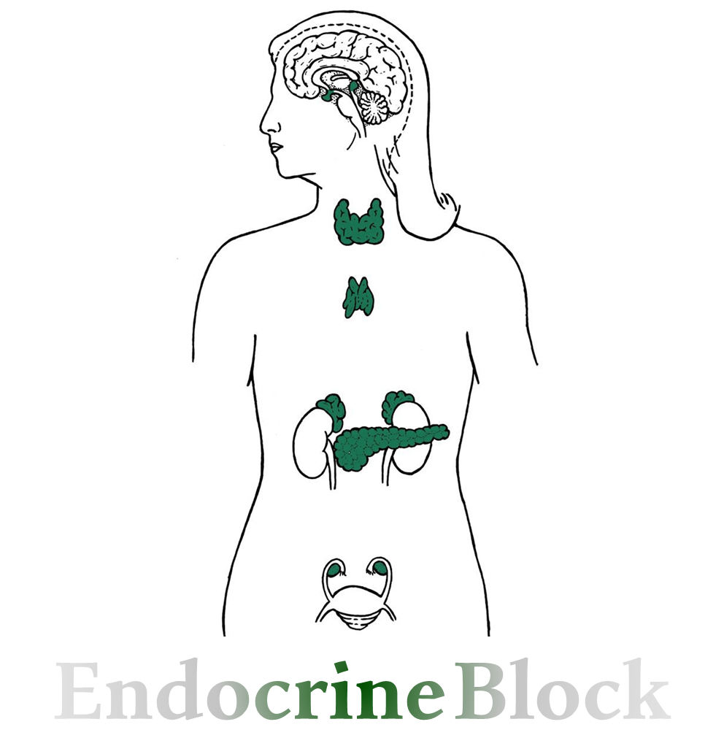
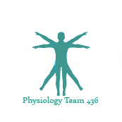
Text
Only in Females’ slide
Only in Males’ slides
Important
Numbers
Doctor notes
Extra Notes
المحاضرة مبنية بشكل أساسي على نوتات الدكتورز + قايتون ولندا، نظرا لأن السلايدات اغلبها صور !
المحاضرة بتكرر بالمحاضرة الجاية فاحرصوا تفهمون كل شيء☺

Slide 2
Hypothalamo-Pituitary axis and regulatory mechanisms
By the end of this lecture, students should be able to describe:
1. Structure of pituitary gland (hypophysis):
Anterior pituitary (adenohypophysis) cell types and hormones
Posterior pituitary (neurohypophysis) cell types and hormones
2. Control of pituitary gland by hypothalamus:
Hypothalamo-hypophysial portal blood vessels (Hypothalamic releasing and inhibiting hormones and median eminence).
Hypothalamo-hypophysial tract.
3. Feedback mechanisms: positive and negative feedback.

Slide 3
Hypothalamus
Hypothalamus is located at the base of the brain & Composed of number of nerve cells.
It is part of the limbic system, which controls the autonomic nervous system and the endocrine systems.
Control pituitary gland secretion by:
Secretes releasing hormones to cause the pituitary to release hormones.
Secretes inhibiting hormones to turn off secretion of pituitary hormones.
One of the most important functions of the hypothalamus is to link the nervous system to the endocrine system via the pituitary gland (hypophysis).
Hypothalamic-pituitary relationships:
The hypothalamus and pituitary gland function in a coordinated fashion to orchestrate many of the endocrine systems. The hypothalamic-pituitary unit regulates the functions of the thyroid, adrenal, and reproductive glands and also controls growth, milk production and ejection, & osmoregulation.
It is important to visualize the anatomic relationships between the hypothalamus and the pituitary because these relationships underlie the functional connections between the glands.
Hypothalamus and pituitary are responsible for the secretion of other glands.
There is a relation between:
hypothalamus/anterior lobe:,hypophyseal portal system.
hypothalamus/posterior lobe: hypothalamo-hypophyseal tract.

Slide 4
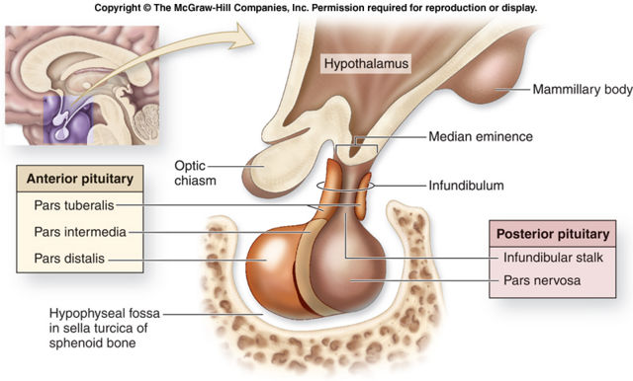
Pituitary Gland
Important
Pituitary Gland
Structure | Anterior lobe (Adenohypophysis) | Posterior lobe (Neurohypophysis) | Infundibulum
Histology | Originates from Rathke’s pouch (pharyngeal epithelium). | Originates from hypothalamus (glial-type cells) →neural tissue.
Structure of pituitary gland (relation to optic chiasm) It’s important to know that there is a relation between optic chiasm and anterior pituitary gland, any tumor in the anterior pituitary gland could affect optic chiasm, so it will affect the vision. | Pars tuberalis. Pars intermedia. Pars distalis. | Infundibular stalk. Pars nervosa
How to control of secretion | Hormonal secretion of hypothalamus. | Nervous signals from hypothalamus
Weight & dimeter | 0.5-1 gram & 1cm.

Slide 5
Relationship of the hypothalamus to the pituitary gland
Important
It is important to visualize the anatomic relationships between the hypothalamus and the pituitary because these relationships underlie the functional connections between the glands.
Relationship of the hypothalamus to the Anterior pituitary
Relationship of the hypothalamus to the posterior pituitary
Collection of endocrine glands:
TSH
FSH
LH
GH
Prolactin
ACTH.
When we do a blood test to asses
thyroid function, we can only detect the
TSH and T4, but we cannot detect TRH
b/c of it’s less amount and it also got
diffused. In addition, it didn't reach
the bloodstream.
Collection of nerve axons + supporting cells (Straight forward neural relationship).
Antidiuretic hormone (ADH) (vasopresson))→ For water regulation): Supraoptic nuclei.
2. Oxytocin → For production of milk &
contraction of uterus:
Paraventricular nuclei.
Hormones release from posterior
pituitary are synthesis in hypothalamus
and go all the way to posterior pituitary
through tract, and than release from
posterior pituitary into blood.

Slide 6
Anterior Pituitary (Adenohypophysis¹)
The notes here are imp
Special neurons in the hypothalamus synthesize and secrete the hypothalamic releasing and inhibitory hormones that control secretion of anterior pituitary.
Neurons send their nerve fibers to the median eminence (extension of hypothalamic tissue into the pituitary stalk).
There is NO direct neural contact to anterior pituitary.
Hormones are secreted to the tissue fluids, absorbed into the hypothalamic-hypophysial portal system and transported to the sinuses of the anterior pituitary (Anterior pituitary gland is connected to hypothalamus by portal system: “hypothalamic-hypophysial portal vessels²”).
Adenohypophyseal Hormones³:
Growth hormone (GH).
Thyroid-stimulating hormone (TSH).
Adrenocorticotropic hormone (ACTH).
Follicle-stimulating hormone (FSH).
Luteinizing hormone (LH) also known as lutropin.
Prolactin (PRL).
These six hormones Secreted from 5 types of cells are called trophes, Ex: somatotrphes & it regulate the activity
of other endocrine glands.
In addition, pro-opiomelanocortin (POMC): Has been isolated from the pituitary. Is enzymatically split into ACTH,
opiates, and melanocyte-stimulating hormone (MSH).
¹= Adenohypophysis = Epithelial cells secret a lot of different secretions.
²= portal system → Connection between two capillaries.
³= Anterior pituitary gland usually secret 6 hormones:
4 of them is known to stimulate other endocrine gland like prolactin stimulate the mammary gland. The only hormone which is acting on all body cell is growth hormone.

Slide 7
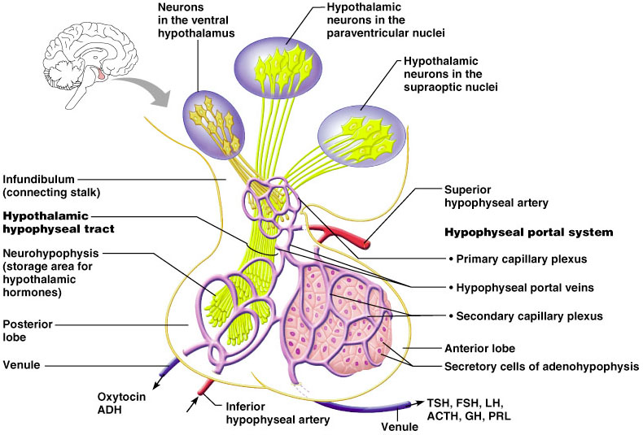
Hypothalamic-hypophysial portal system
The artery will branched and give this primary capillaries or plexus.
The end of the neurons “the yellow” will secret the hormones coming from hypothalamus in the interstitial fluid, & immediately it absorbed by primary plexus, the primary plexus will union with each other and give venules ”portal venules” which take the hormones to secondary capillary “which is sinusoid blood vesselsمنتشرة inside anterior pituitary” than finally the hormones of anterior pituitary will go to the circulation.

Slide 8
Anterior Pituitary (Adenohypophysis)
Anterior pituitary contains 5 cell types:
Cell: Somatotrops.
Hormone its secret: growth factor (GH)
40%
Cell: Corticotrops
Hormone its secret: Adrenocorticotropic hormone (ACTH)
20%
Cell: Thyrotropes
Hormone its secret: thyroid–stimulating hormone (TSH)
Cell: Gonadotropes.
Hormone its secret: luteinizing hormone &Follicle-stimulating hormone (LH & FSH)
Anterior pituitary gland contains 5 cell types
Cell: Lactotrops
Hormone its secret:
PRL

Slide 9
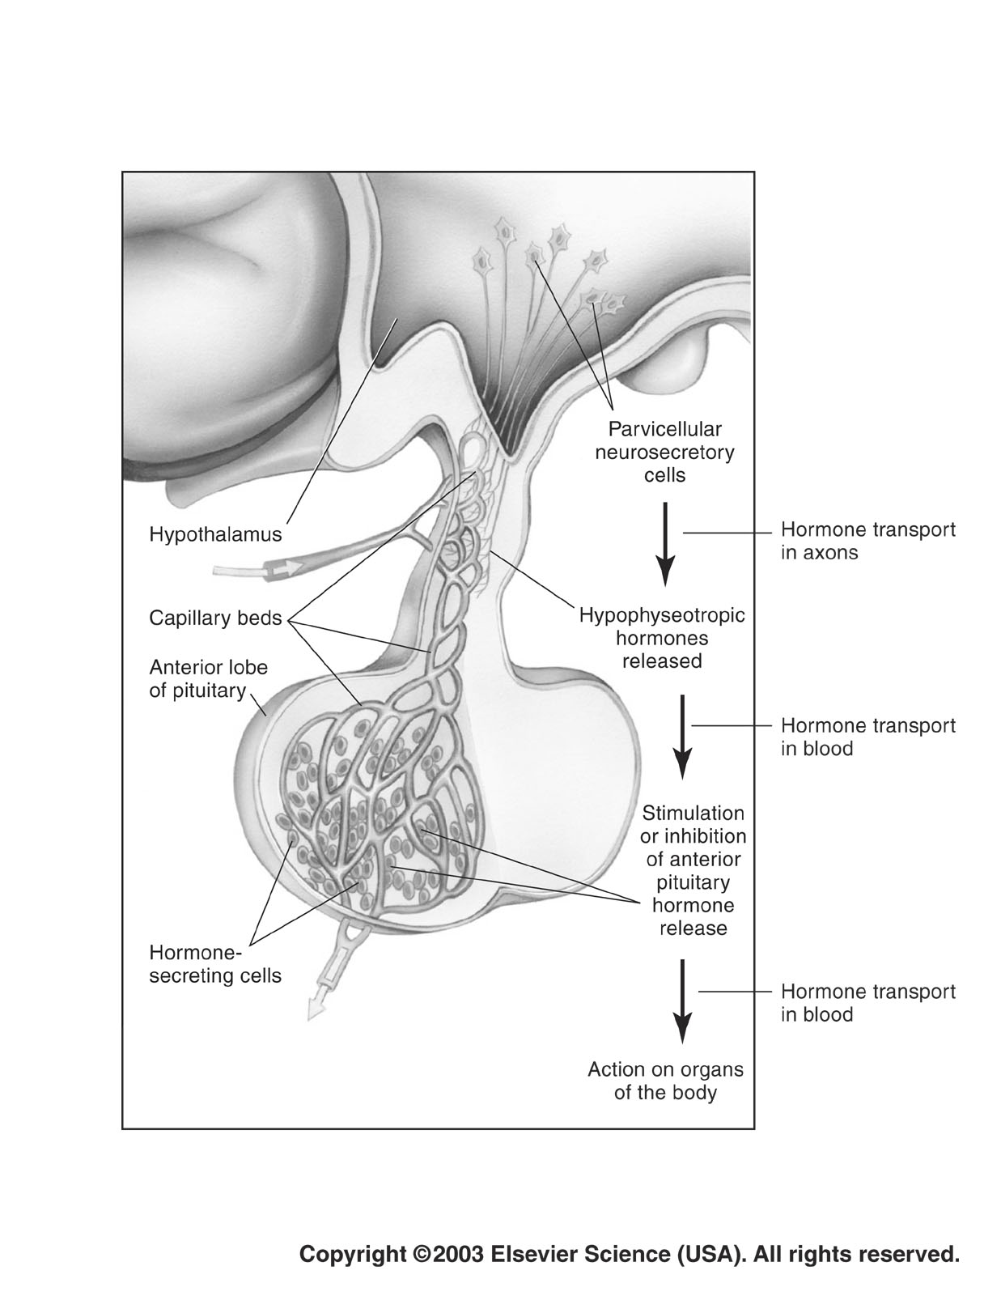
Control of anterior pituitary by hypothalamus (Hormonal control)
As we said before: There are two types of special neurons in the hypothalamus these have either:
Releasing hormones.
Inhibitory hormones.
These special neurons send their axon to the median eminence which is an extension of the hypothalamic tissue into the pituitary stalk.
The hormones secreted by these neurons will reach the anterior pituitary cells by a way of hypothalamic-hypophysial portal vessels.
Other picture
Relationship between hypothalamus/anterior pituatary:
Hypothalamus will release hormones and dump it in the median eminence. From there it will enter the following respectively:
- primary capillary plexus, hypophyseal portal vessel, secondary capillary plexus(anterior pituitary), hypophyseal veins. And finally enter the bloodstream.
The pituitary is connected to the hypothalamus by infundibulum (neural stalk).
Its protected by sella turcica of the body of sphenoid.
It lie between optic chiasma (anteriorly) and mammillary bodies (posteriorly).

Slide 10
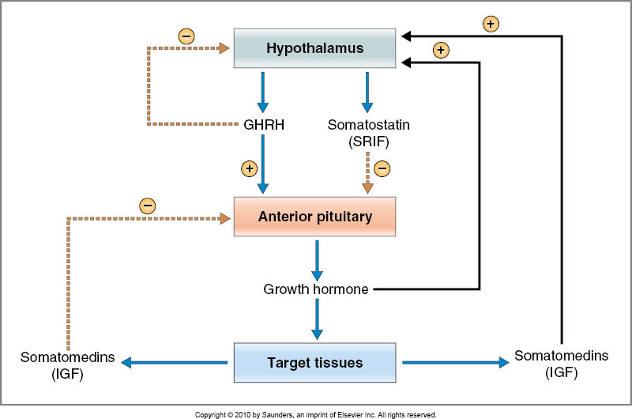
Hypothalamic releasing and inhibiting hormones
The notes here are imp
Hormones from the hypothalamus have the letter R that stands for releasing except for prolactin which is inhibiting.
GHRH & GHIH
Growth hormone releasing hormone (GHRH) | Growth hormone inhibiting hormone (GHIH) also called Somatostatin
GHRH it self stimulated by low blood glucose “hypoglycemia”. Stimulates release of growth hormone. It’s antagonize the action of insulin, act like glucagon. | GHIH it self stimulated by high blood glucose “hyperglycemia”. Inhibits release of growth hormone.
These two hormones have an antagonist action عشان كذا دائما نقول الأطفال ما ينفع يكثروا حلويات، لأنه إذا كان سكر الدم عالي هيكون في تثبيط لـ GH. الصيام يحفز GH relase؛ كيف؟ فترة الصيام يكون سكر الدم منخفض يالتالي يتحفز الGH.
GHRH and somatostatin will act on the anterior pituitary. One will stimulate and the other will inhibit the release of growth hormone.
These positive and negative processes will give a final outcome of inhibiting the hypothalamus where less growth hormone is released.

Slide 11
Cont. Hypothalamic releasing and inhibiting hormones
The notes here are imp
(TRH)
Thyrotropin-releasing hormone
Stimulates release of thyroid stimulating hormone (TSH)
Elevated T3,T4 will inhibit TRH & TSH
Not enough thyroid hormones will stimulate hypothalamus to secrete TRH which will secrete TSH that will go to the thyroid gland and stimulate the secretion of hormones.
If there was over stimulation on thyroid gland, this can cause a trophic effect (change in size)- goiter effect – abnormal enlargement of thyroid gland.

Slide 12
Cont. Hypothalamic releasing and inhibiting hormones
The notes here are imp
(CRH)
Corticotropin-releasing hormone
Stimulates release of adrenocorticotropin hormone (ACTH). This hormone stimulated when the level of cortisol decreased.
Elevated cortisol will inhibit release of CRH by hypothalamic neurosecretory cells and ACTH by anterior pituitary corticotrophs.
لازم تقولوا cortex

Slide 13
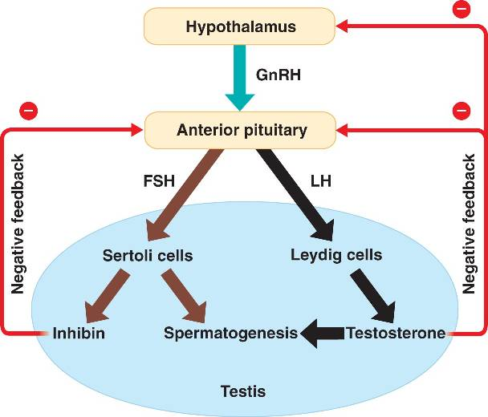
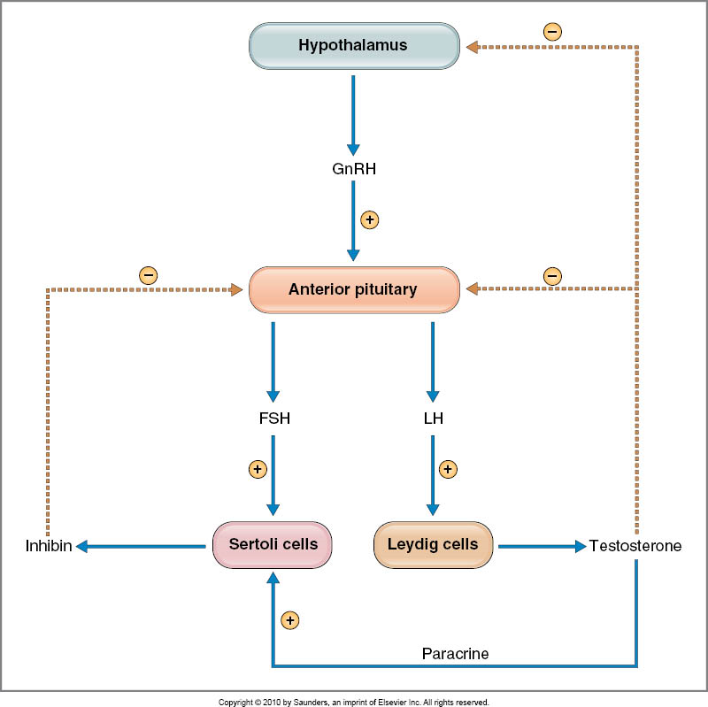
Cont. Hypothalamic releasing and inhibiting hormones
The notes here are imp
(GnRH)
Gonadotropin releasing hormone
causes release of the 2 gonadotropic hormones: Luteinizing (LH). follicle-stimulating hormone FSH.
Selectively inhibit release of FSH
LH and FSH In female will act on ovary and stimulate release of estrogen and progesterone, when their level elevated in blood they will do negative feedback.
But there is exception in day 12-14 the time of ovulation in the cycle when estrogen reach certain level and became high and stimulate hypothalamus to release more of LH which cause weakness in the membrane of follicle and rupture, this is a positive feedback mechanism.
In male, FSH & LH have different function. FSH cause growth to sperm ”spermatogenesis”, LH work in interstitial cells called leyding cells causes release of testosterone. When testosterone elevate it will cause negative feedback, also there is another hormones from sterol cells called inhibin causes negative feedback.

Slide 14
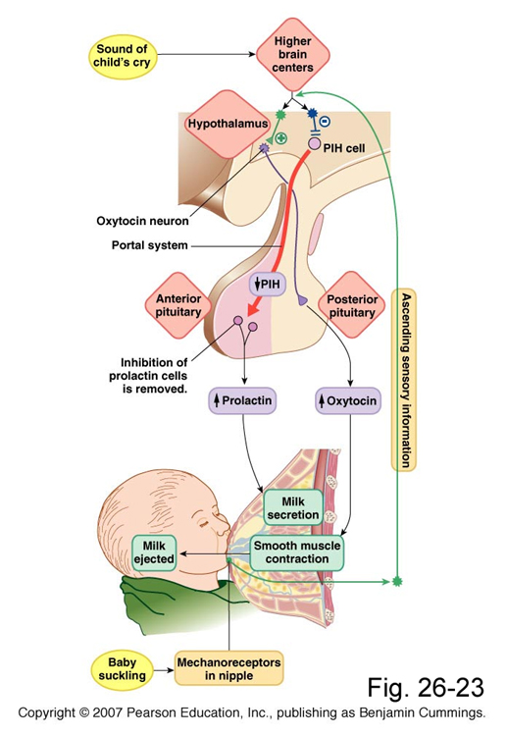
Cont. Hypothalamic releasing and inhibiting hormones
The notes here are imp
How prolactin release ? When there is sucking from baby to the nipple, the mechanoreceptors in nipple will send sensory neural impulses that reach the brain in hypothalamus, this impulse has two action:
1- inhibitory to cells that release PIH so the prolactin will release from anterior pituitary and go to breast to synthesis milk.
2- stimulation to release of Oxytocin from posterior pituitary. oxytocin work in myoepithelial cells around الحويصلات to eject the milk.
(PIH)
Prolactin inhibitory hormone also known as Dopamine
Inhibits prolactin secretion. The hormone that always make inhibition.
Notice the big arrow
Ascending sensory information to release more prolactin when the baby is sucking the nipple (mechanoreceptor in nipple).
The release of prolactin is inhibited by dopamine. Even though TRH is stimulated to release prolactin, dopamine inhibit the release b/c its much more stronger.
Only during lactation prolactin is released TRH is stimulated and PIF is inhibited.
بروكلاتين ما عنده هرمون محفز، فقط مثبِّط. ليه؟
لأننا ما نحتاج هذا الهرمون طول حياتنا، نحتاجه فقط لفترة محدودة، ( فترة ما بعد الولادة) لتحفيز الـbrest لإفراز الحليب.

Slide 15
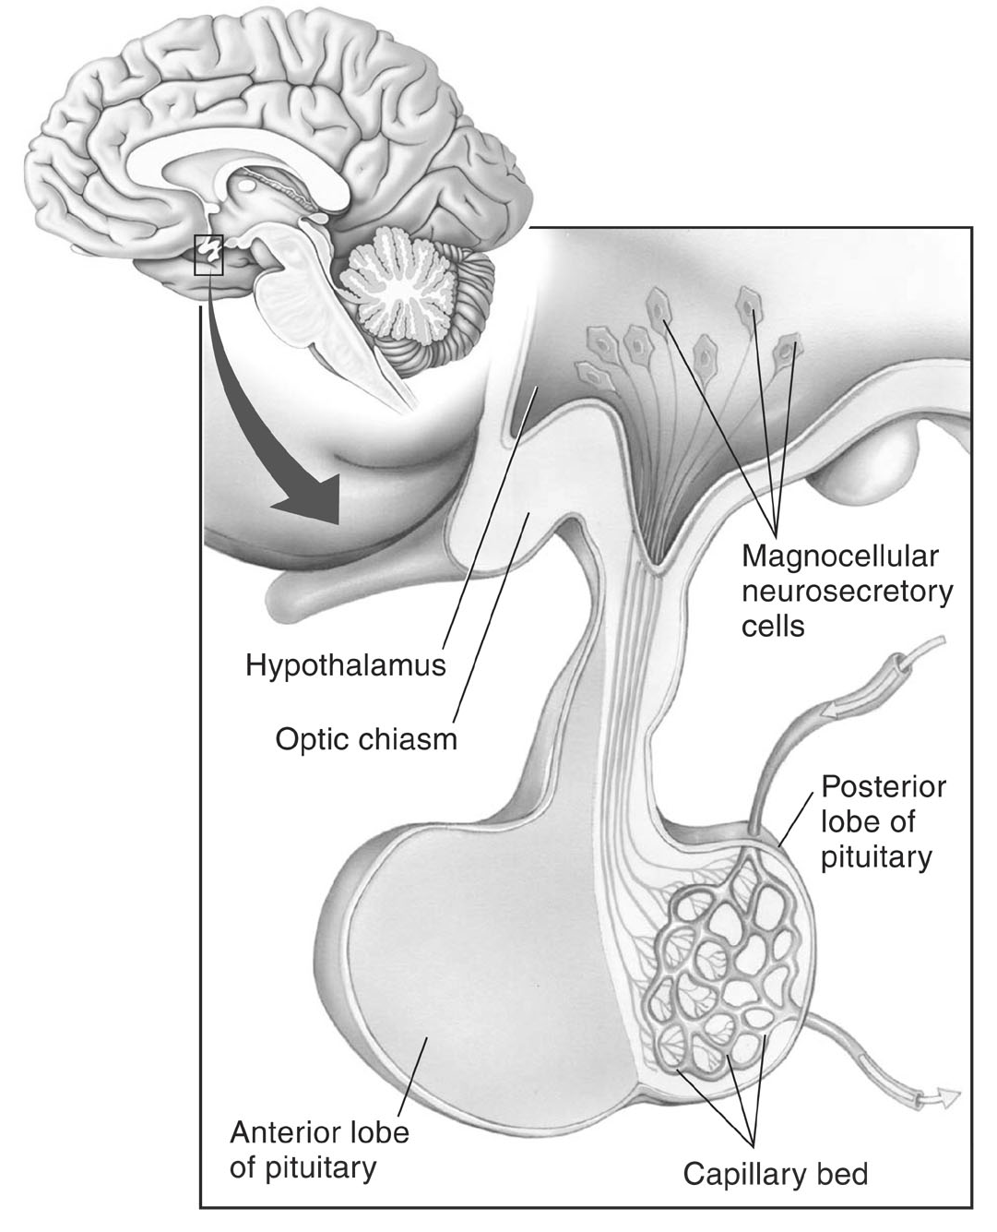
Control of posterior pituitary
Magnocellular neurons in paraventricular and supraoptic nuclei secrete oxytocin and vasopressin directly into capillaries in the posterior lobe.
Here there is no primary and secondary capillary, just one capillary in posterior pituitary.

Slide 16
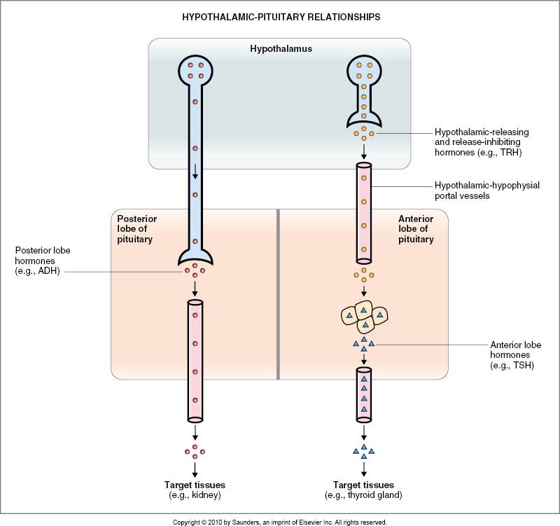
neural & endocrine (posterior & anterior)
Means the relationship between:
Hypothalamus/anterior pituitary: both neural and endocrine.
Hypothalamus /posterior pituitary: straight forward neural relationship.

Slide 17
Regulation of hormone secretion
Feedback mechanism (The level of the hormone will stimulate/inhibit its own release) | Negative feedback | negative feedback means that some feature of hormone action, directly or indirectly, inhibits further secretion of the hormone. Release of hormone A stimulates the release of hormone B→Hormone B inhibits the release of hormone A. for example, LH from pituitary stimulates the testes to produce testosterone which in turn feeds back and inhibits LH secretion. Guyton Explanation: Negative Feedback Prevents Overactivity of Hormone Systems. Although the plasma concentrations of many hormones fluctuate in response to various stimuli that occur throughout the day, all hormones studied thus far appear to be closely controlled. In most instances, this control is exerted through negative feedback mechanisms that ensure a proper level of hormone activity at the target tissue. After a stimulus causes release of the hormone, conditions or products resulting from the action of the hormone tend to suppress its further release. In other words, the hormone has a negative feedback effect to prevent over secretion of the hormone or over activity at the target tissue. The controlled variable is sometimes not the secretory rate of the hormone but the degree of activity of the target tissue. Therefore, only when the target tissue activity rises to an appropriate level will feedback signals to the endocrine gland become powerful enough to slow further secretion of the hormone.
 | Positive feedback | means that some feature of hormone action causes more secretion of the hormone. Release of hormone A stimulates the release of hormone B →Hormone B stimulates further release of hormone A. For examples: include LH stimulation of estrogen which stimulates LH surge at ovulation.
The notes here are imp
تكرار للمحاضرة الأولى
Short loop: the feedback is directly on the chief gland secreting it
Long loop: when the feed back is all the way back to the hypothalamus
Ultra-short loop: the gland secretes hormone and that’ll directly act on it “autocrine”
“Self- limiting”
Will stop further secretion
“Self- augmenting”
Hormone release will further increase its secretion
E.g. oxytocin will cause uterus contraction and lead to cervix expansion which will further increase oxytocin release

Slide 18
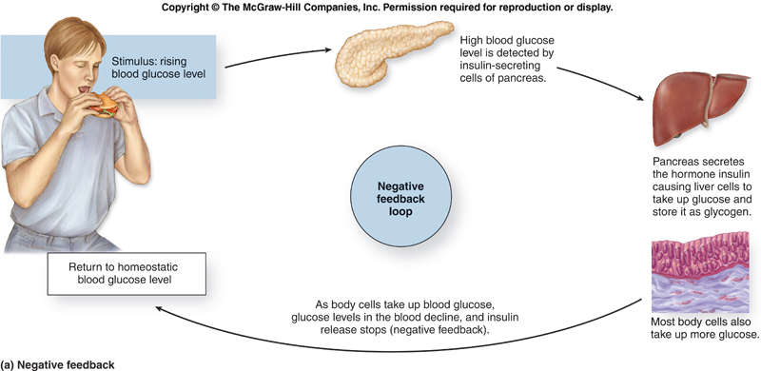
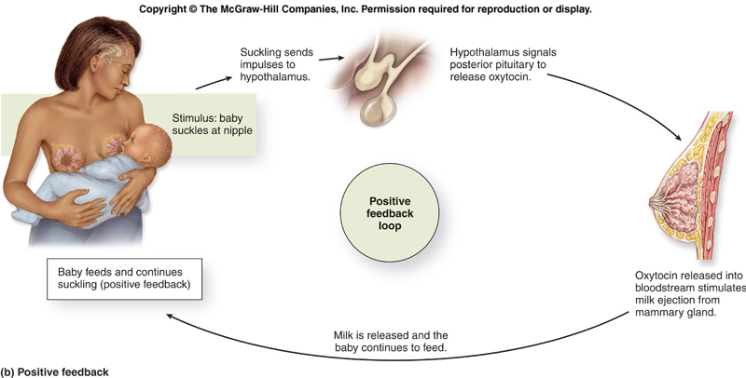
Cont.
Only in Females’ Slides
مشروحة عند الأولاد بشكل آخر
Negative feedback
Positive feedback
This man is eating, so for sure the blood glucose level will elevate, this will stimulate B cells in pancreas to release insulin → take the glucose inside the liver and stores it as glycogen. also other tissue will open the channels responsible for glucose transport take up more glucose, Then the glucose blood level drop, so I don’t need insulin any more → it will inhibited.
Baby sucking will stimulate the nipple receptors which send impulses to brain that stimulate the release of prolactin and oxytocin, oxytocin cause contraction so the milk released and the baby do more sucking and more positive feedback.
Also the operation of labor consider as positive feed back

Slide 19
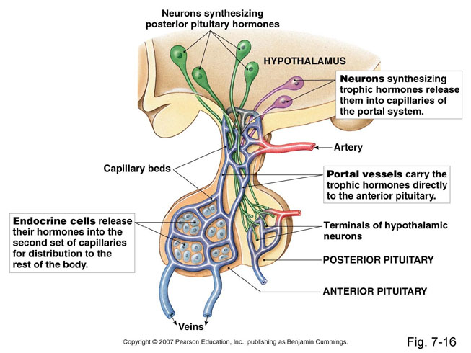
Summary
Anterior (Adenohypophysis):
originates from Rathke’s pouch (pharyngeal epithelium)
Anterior pituitary gland is connected to hypothalamus by portal system: hypothalamic-hypophysial portal vessels.
Anterior pituitary contains 5 cell types: (Somatotrops: GH 40%, Corticotrops: ACTH 20%, Thyrotropes: TSH, Gonadotropes: LH & FSH, Lactotrops: PRL )
Posterior (Neurohypophysis):
Originates from hypothalamus (glial-type cells)
Hormones synthesized in the supraoptic and paraventricular nuclei of the hypothalamus and released in posterior pituitary
Secrete oxytocin and vasopressin
Hypothalamic control of pituitary secretions
Hormonal | secretion of hypothalamus (The anterior pituitary)
Nervous | signals from hypothalamus (Posterior pituitary)

Slide 20
Summary
Hypothalamic releasing and inhibiting hormones
Growth hormone releasing hormone (GHRH) | Stimulates release of growth hormone
Growth hormone inhibiting hormone (GHIH) also called Somatostatin | Inhibits release of growth hormone
Thyrotropin-releasing hormone (TRH) | Stimulates release of thyroid stimulating hormone (TSH)
Corticotropin-releasing hormone (CRH) | Stimulates release of adrenocorticotropin hormone (ACTH)
Gonadotropin releasing hormone (GnRH) | causes release of the 2 gonadotropic hormones: Luteinizing (LH) follicle-stimulating hormone FSH
Prolactin inhibitory hormone (PIH) also known as Dopamine | Inhibits prolactin secretion
Feedback mechanism
Positive feedback | Negative feedback
-Release of hormone A stimulates the release of hormone B -Hormone B stimulates further release of hormone A | -Release of hormone A stimulates the release of hormone B -Hormone B inhibits the release of hormone A

Slide 21
Thank you for checking our work!
اعمل لترسم بسمة، اعمل لتمسح دمعة، اعمل و أنت تعلم أن الله لا يضيع أجر من أحسن عملا.
قادة الفريق:
ليــلـى مـذكور & مـحـمـد نـصـر
Please check our editing file to know if there are any additions, changes or corrections.
Examine yourself
خالص الشكر لأعضاء الفريق الكِرام:
2017-2018 Dr. Hanaa AlZamil’s Lecture & Notes.
2017-2018 Prof. Abdulmajeed Aldress’s Lecture& Notes.
Guyton & Hall of Medical Physiology 13th Edition.
Linda S. Costanzo 5th Edition.
ريـمـا الشايع
دعاء عبدالفتاح
شروق الصومالي
Helpful physiology bocks.
Give us your feedback ☺
اللهم اني استودعتك ما حفظت وما قرأت وما فهمت، فرده لي وقت حاجتي إليه إنّك على كل شيءٍ قدير.

