Slide 1
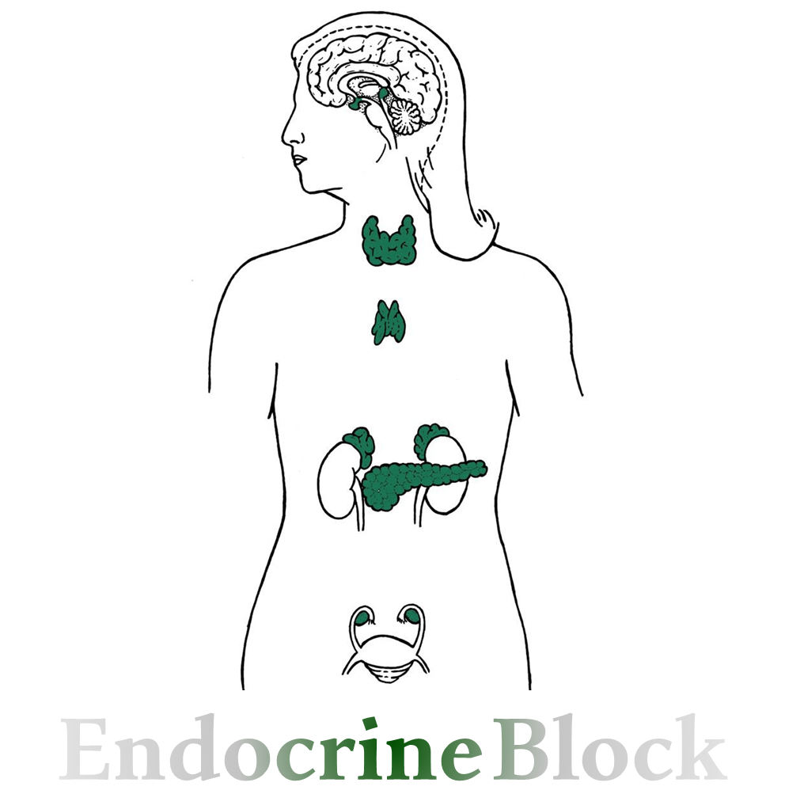
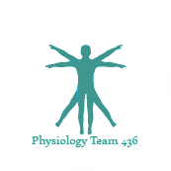
Text
Only in Females’ slide
Only in Males’ slides
Important
Numbers
Doctor notes
Extra Notes
You should study second lecture first!
المحاضرة مبنية على نوتز الدكتورز وقايتون ولندا نظرا لأن السلايدات اغلبها صور

Slide 2
Anterior & posterior Pituitary gland
By the end of this lecture, students should be able to describe:
Summarize the direct and indirect physiological actions of growth hormone.
Outline neuroendocrine control of growth hormone secretion.
List stimuli that increase and decrease growth hormone secretion.
Describe the role of prolactin in milk secretion.
Discuss regulation of prolactin secretion.
ADH: Physiological functions & Control of secretion.
Oxytocin: Physiological functions& Control of secretion.

Slide 3
Anterior Pituitary (Adenohypophysis¹)
تكرار للمحاضرة الثانية
The notes here are imp
Special neurons in the hypothalamus synthesize and secrete the hypothalamic releasing and inhibitory hormones that control secretion of anterior pituitary.
Neurons send their nerve fibers to the median eminence (extension of hypothalamic tissue into the pituitary stalk).
There is NO direct neural contact to anterior pituitary.
Hormones are secreted to the tissue fluids, absorbed into the hypothalamic-hypophysial portal system and transported to the sinuses of the anterior pituitary (Anterior pituitary gland is connected to hypothalamus by portal system: “hypothalamic-hypophysial portal vessels²”).
Adenohypophyseal Hormones³:
Growth hormone (GH).
Thyroid-stimulating hormone (TSH).
Adrenocorticotropic hormone (ACTH).
Follicle-stimulating hormone (FSH).
Luteinizing hormone (LH) also known as lutropin.
Prolactin (PRL).
These six hormones Secreted from 5 types of cells are called trophes Ex: somatotrphes & regulate the activity of
other endocrine glands.
In addition, pro-opiomelanocortin (POMC): Has been isolated from the pituitary. Is enzymatically split into ACTH,
opiates, and melanocyte-stimulating hormone (MSH).
¹= Adenohypophysis = Epithelial cells secret a lot of different secretions.
²= Connection between two capillaries.
³= Anterior pituitary gland usually secret 6 hormones:
4 of them is known to stimulate other endocrine gland like prolactin stimulate the mammary gland. The only hormone which is acting on all body cell is growth hormone.

Slide 4
Growth Hormone
Characteristic:
Growth hormone, also called somatotropic hormone or somatotropin.
Secreted in Somatotrophs (20%).
is a small protein molecule that contains 191 amino acids in a single chain.
has a molecular weight of 22,005KD.
Mechanism of action | 1. Direct effect | 2. Indirect effect
 | Growth hormone join its receptor directly. This receptor similar in shape with insulin one. (Tyrosine kinase) Find in: Skeletal muscles. Liver & adipose. | Growth hormone secretes from anterior pituitary gland and travel through the blood and reach the liver and stimulated, the liver secret insulin like growth factor(IGFs)(somatomedin) and insulin like growth factor binding protein(IGFBPs). Depends on somatomedin ‘insulin– like growth factor [IGF-I& II] secreted by the liver, which is responsible for effect of GH on bone & cartilage growth and increase the synthesis of protein in skeletal muscles. Growth hormone started with molecular weight of 20000 then it gets modified and ended with 4500 – 7500 MW. somatomedin C is the most potent type of somatomedin.

Slide 5
Secretion of Growth Hormone
During life:
Since birth, GH is secreted in low levels. During childhood, it shows a plateau. And then it is greatly secreted during puberty (highest peak).
Triggered by hormones which are testosterone(in male) and estrogen(in female).
Elderly people have low testosterone and estrogen hormones so they have low GH.
During the day:
Pulsatile every 2H.
During night:
The most profound one is after 1hr of sleep.
There is a variety in the growth hormone secretion (pulsatile secretion) to prevent adaptation or down regulation of the receptor.
3 types of loops:
short loop
ultra short loop
long loop

Slide 6
Regulation of Growth Hormone
Stimulate growth hormone release:
GHRH → receptor → Gs protein → Adenylyl cyclase and phospholipase C →cAMP and IP3/Ca → secretion + synthesis (of growth hormone).
Inhibit growth hormone release:
Somatostatin (SRIF) → receptor Gi → inhibit generation of cAMP → Decrease secretion (of growth hormone).
Growth hormone is secreted in response to GHRH which comes from the hypothalamus.
GHRH acts on anterior pituitary through 2nd messenger system.
Both mechanism are metabolized:
the 2nd messenger of adenylyl cyclase is CAMP.
the 2nd messenger of phospholipase C is IP3/Ca.

Slide 7
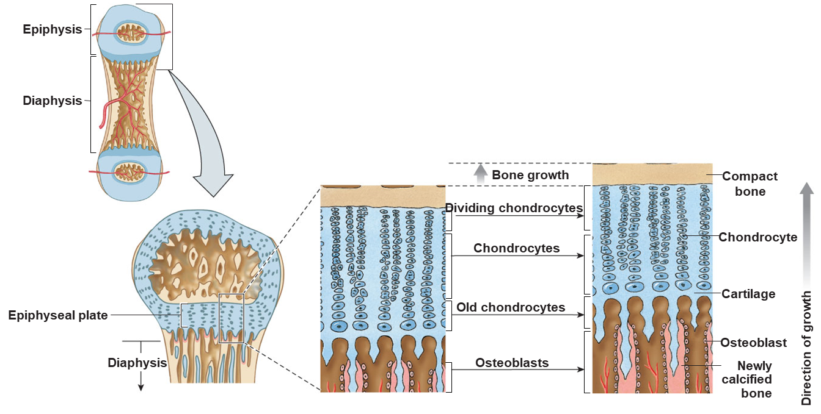
Function of Growth Hormone
Promotes Growth of Many Body tissues( ↑ cellular sizes, ↑ mitosis (Number), ↑tissue growth &↑ organ size) except the brain.
Growth actions are not direct, but they are indirectly mediated via the generation of polypeptides called somatomedins or insulin-like growth factors ( IGFs ).
Somatomedins are secreted by the liver.
Mechanisms of bone growth
Long term effect promotion of growth
Short term
(Metabolic effects)

Slide 8
Mechanisms of bone growth
Long term effect promotion of growth | Mechanisms of bone growth
 | Before epiphyseal closure in childhood → Promotion of linear growth. As femur and humors | After epiphyseal closure in late adolescence → increase bones thicken and total bone mass. *(Flat bone: scapula)
 | Increase metabolism in cartilage forming cells. Increase proliferation of chondrocytes. Increase linear growth & Widening of the epiphysial plate. To understand: Under the influence of GH, the chondrocytes in the epiphysial plate are stimulated → increases amino acids uptake by chondrocytes → stimulates protein synthesis by chondrocytes → stimulates mitosis of chondrocytes → this effect causes an increase in number of chondrocytes (i.E., Hyperplasia) → stimulates expansion in size of the chondrocytes (i.E., Hypertrophy). Thus, IGF-1 leads to elongation of the bones. Chondrocytes cultured outside the body fails to proliferate or enlarge in response to growth hormone. | Occurs in membranous bones, e.g. jaw, & skull bones. When there is no remaining epiphyseal cartilage and the shafts have fused with the epiphyses, GH can no longer cause lengthening of the long bones. Because GH also stimulates osteoblasts, which deposit new bone → bones thicken and total bone mass is increased by GH even after epiphyseal closure. This’s a continuous process not like the long bone which will stop after all cartilage calcified.
* No further bone lengthening after epiphysial plate fusion between shaft and epiphysis only thickening.

Slide 9
Important
Cont. Mechanisms of bone growth
Short term (Metabolic effects):
Promotion of protein deposition in tissues (Anabolic):
Enhancement of amino acid transport & uptake through the cell membrane.
Enhancement of RNA synthesis, Also translation to cause protein synthesis by the ribosomes.
Increased nuclear synthesis of DNA , Also transcription to form RNA
Decreased catabolism of protein and amino acids “protein sparer”.
Promotion of fat utilization for energy (Catabolic):
release of fatty acids from adipose tissue → increasing the FFA in the body fluids → conversion of FFA to acetyl coenzyme A → energy.
High GH levels might cause excessive fat mobilization leading to acetoacetic acid ( formation by the liver → causing ketosis → fatty liver.)

Slide 10
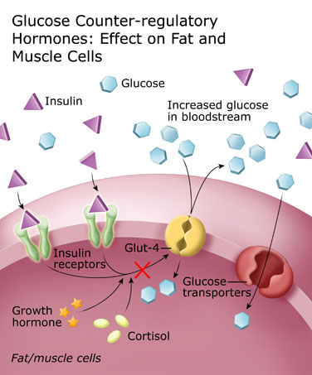
Cont. Short term
Important
Increased glucose → increased insulin→insulin binds to tyrosine kinase → phosphorylation → activate Glut (it’s receptor) → cells will take up glucose →growth hormone stops activation of Glut receptor → glucose and cortisone remain in blood.
3. Impairment of carbohydrate utilization for energy (Hyperglycemic):
GH decreases the uptake and utilization of glucose (Antagonize the insulin action) (such as muscle and adipose tissue ).
Also it increases the synthesis of glucose by the liver (diabetogenic) (increase gluconeogenesis: Producing glucose from other resources than carbohydrate)
As a result, blood glucose concentration tends to rise and insulin secretion increases to compensate for the GH-induced insulin resistance (this Mean if the GH exceed the normal range it may cause diabetes).
Excess secretion of growth hormone = metabolic disturbances very similar to patients with type II diabetes.
Why gh increase blood glucose?
The action of GH causes this effect that we don’t want. Basically when insulin binds to its receptor and demoralization happens. It goes and activate the Glut-4 receptor which is a receptor that takes in glucose inside the cell (responsible for the uptake of glucose).
This process help keep blood glucose level normal.
GH action is by blocking the Glut-4 receptor to inhibit the in take of glucose inside the cell which in turn increase blood glucose level. Cortisol has the same action so we must be cautious when prescribing to a diabetic patient.

Slide 11
Other Functions of Growth Hormone
Only in Females’ Slides
Increases calcium absorption from GIT.
Strengthens and increases the mineralization of bone (may be a reason for osteoporosis in elderly when growth hormone level drop).
Retention of Na+ and K+.
Increases muscle mass (protein anabolic).
Stimulates the growth of all internal organs excluding the brain.
Contributes to the maintenance and function of pancreatic islets (it’s true that growth hormone antagonize insulin action but it’s essential for the pancreatic islets which secret the insulin).
Stimulates the immune system.

Slide 12
Control of GH secretion
Important
The Dr talked about the red ones
Stimulate the secretion
inhibit the secretion
1. Growth hormone releasing hormone(GHRH).
2. Decrease blood glucose: hypoglycemia or fasting.
لأن هذا الهرمون یزید مستوى السكر بالدم، فعند نقص السكر يُفرز الهرمون.
3. Decrease Blood free fatty acid (FFAs).
لأن هذا الهرمون یزید مستوى الدهون بالدم، فعند نقص الدهون يُفرز الهرمون.
4. Intake of protein or amino acids (Arginine).
After a protein meal, increased plasma levels of GH would favor the utilization of amino acids for protein synthesis.
5. Starvationالجوع , especially with severe protein deficiency.
The increase in GH during fasting would be beneficial because GH enhances lipolysis and decreases peripheral utilization of glucose.
6. Ghrelin (stomach). هرمون الجوع
7. Stress conditions: e.g. trauma or emotions.
8. Muscular exercise
9. Puberty
10. Androgen & estrogens
11. during the first 2 hours of deep sleep (more in children).
12. Alpha – Adrenergic agonist
13. Sleep stage 3 and 4
1. Senescence الشيخوخة
2. like growth factors (IGF-1)
3. increase Blood free fatty acid
ارتفاع مستوى الدهون عند الأطفال يُعيق النمو
4. increase blood glucose: hyperglycemia
ارتفاع مستوى السكر عند الأطفال يُعيق النمو
5. Growth hormone Inhibitory hormone(GHIH) (somatostatin)
6. Beta – Adrenergic agonist
7. Pregnancy
8. Somatostatin & Somatomedins
9. Obesity

Slide 13
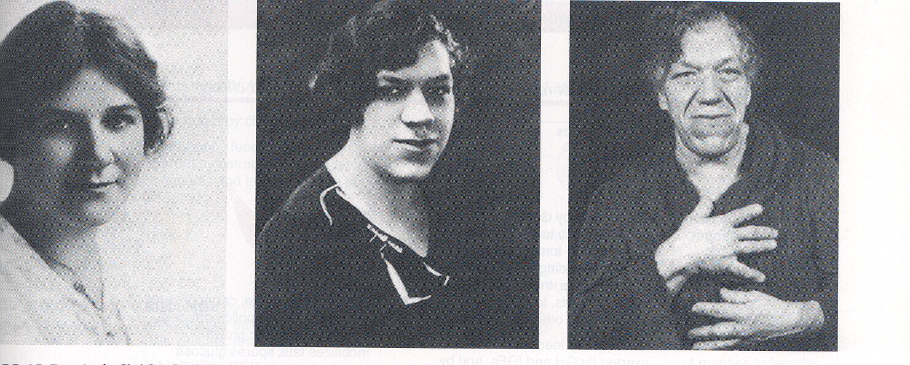
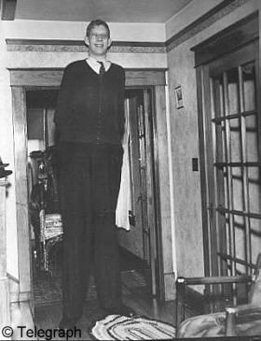
Important
Abnormalities of GH Secretion
In children “ Gigantism”العمقلة |  |  | In adult “Acromegaly” ضخامة الأطراف
Definition | As all body tissues grow rapidly, including bones. Height as it occurs before epiphyseal fusion of long bones with their shafts. The person will develop hyperglycemia (diabetes). |  | Definition | Person can’t grow taller, BUT soft tissue continue to grow in thickness (skin, tongue, liver, kidney).
Causes | Excessive production of GH from a GH-secreting pituitary tumour (somatotropes tumours) in childhood. |  | Causes | Excessive production of GH from a GH-secreting pituitary tumour (somatotropes tumours) in adulthood.
 |  |  | Clinical features: | Excessive soft tissue growth. Enlargement of bones of hands(spade like) & feet. Enlargement of membranous bones including cranium, nose, forehead bones, supraorbital ridges. Protrusion of lower jaw. Ride-spaced teeth (widening of incisor spaces) تباعد المسافة بين الأسنان Hunched back (kyphosis) (enlargement of vertebrae). Deepening voice. Macroglossia(ضخامة اللسان)
Treatment |  | Octreotide: is a drug that inhibit secretion of growth hormone (somatostatin analog).
Childhood = Before puberty
Adulthood = After puberty

Slide 14
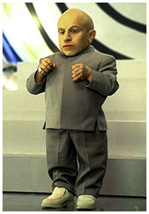
The notes here are imp
Cont.
Due to decrease GH secretion
pituitary dwarfismالتقزُّم
Definition | Dwarfism means failure in growth (i.e., growth retardation).
Causes | It is caused usually by defective GH axis (hypothalamic-anterior pituitary-liver-target organs axis)such as decreased secretion of: Growth hormone releasing hormone(GHRH). human growth hormone (HGH). Insulin. like growth factors (IGF-I). There may be a defect in the GH receptors.
You need to differentiate between:
1- if only the growth hormone drop in childhood this will cause dwarfism but with no mental retardation (normal brain).
2- if the thyroid hormone is the affected one and very low in the body it will cause dwarfism since the relation between the thyroid hormone and growth hormone is permissiveness but this time with mental retardation.

Slide 15
Prolactin Hormone
Prolactin
characteristic | Secreted in Lactotrophs.(15%) Is formed of 198 amino acids. Prolactin structurally is related to growth hormone.
Control of Secretion | Inhibition of PL secretion | Stimulation of PL secretion
 | By prolactin inhibitory hormone(PIH) (Dopamine) (Hypothalamic control of PL secretion is performed primarily by dopamine) Thus, pituitary stalk lesions cause hyperprolactinemia. Sources of dopamine: Dopaminergic neurons in the hypothalamus. Dopaminergic neurons in the posterior pituitary. Nonlactotrophs cells of the anterior pituitary. | Exercise, Surgical, psychological stress, Stimulation of the nipple (Suckling response inhibits PIH release), Sleep, Pregnancy and TRH.
Hormones are classified in to 3 families:
1- growth hormone + prolactin
2- LH + FSH + TSH

Slide 16
Regulation of Prolactin Hormone
Important
Hypothalamus will tonically inhibit the secretion of prolactin from anterior pituitary through dopamine.
Why is prolactin secreted in lactating women but not secreted in normal women?
Because normally dopamine is released in greater amount compared to TRH
Prolactin is secreted after pregnancy WHY?
b/c high levels of estrogen and progesterone will down regulate prolactin so that’s why its; not secreted during pregnancy.

Slide 17
Prolactin function & Abnormalities
The notes here are imp
Functions:
1- Breast development.
2- Major function is milk production (Lactogenesis*): (We need prolactin after delivery for lactating and milk synthesis).
Prolactin Increases mRNA which increase production of Lactose, lipid, casein.These proteins are commonly found in mammalian milk.
3- Inhibition of ovulation: عشان كذا المُرضِعة تنقطع عندها الدورة الشهرية ☺
By inhibiting GnRH (Prolactin inhibit GnRH → inhibition of LH & FSH → Inhibition of ovulation)
Other effects:
Stimulates the secretion of dopamine in median eminence (inhibits its own secretion).
In males, PL is involved in testicular function.
Only in Males’ Slides
Abnormalities:
1. Prolactin deficiency:
Failure to lactate.
2. Prolactin excess:
Galactorrhea
(a milky nipple discharge unrelated to the normal milk production of breast-feeding.), (a sign of underlying disease).
Infertility = no ovulation
Bromocriptine
(dopamine agonist-treatment).
*Action of Lactogenesis:
1- during puberty: prolactin + estrogen + progesterone = breast development (increase in channels number to increase the breast size).
2-During pregnancy: lactose + lipids + casein ( protein of milk ) = lactogenesis (synthesis of milk) (increase the alveoli for milk production). After pregnancy secretion of milk occur by oxytocin.
And breast development (increase the number of alveoli that synthesis and store milk)

Slide 18
FSH & LH
The notes here are imp
(FSH & LH)
Follicle-stimulating hormone & Luteinizing hormone
Characteristics: | Glycoproteins. Secreted in Gonadotrophs (15%). α and β. Related to TSH.
Negative feedback
Positive
Feedback- for the process of ovulation
Negative feedback
Estradiol stimulates anterior pituitary gland In the midcycle but inhibits it in the 2 other cycles.
The reason why it is +ve in the midcycle is to make ovulation.
Prolactin suppress ovulation by suppressing gonadocyte releasing hormone → no LH,FSH -→ no ovulation.

Slide 19
TSH
The notes here are imp
(TSH)
Thyroid-stimulating hormone
Characteristics | Action | Abnormalities
Secreted in Thyrotrophs (5%). Glycoproteins. α and β. Related to FSH & LH (structurally). | Increase synthesis and secretion of thyroid hormones. Trophic effect. Trophic effect: change of the size. If patient has hyperthyroidism (thyroid gland not secreting T3 and T4) messages through feedback go to hypothalamus: ”(we need thyroid hormone)” so it secrets TRH then anterior pituitary secrets TSH. TSH goes to thyroid in order to release T3 and T4. But there is no T3 so the cycle will start again and again which gives trophic effect known as goiter. | Hypothyroidism &hyperthyroidism
Not enough thyroid hormones will stimulate hypothalamus to secrete TRH which will secrete TSH that will go to the thyroid gland and stimulate the secretion of hormones.
If there was over stimulation on thyroid gland, this can cause a trophic effect (change in size)- goiter effect – abnormal enlargement of thyroid gland.

Slide 20
ACTH
The notes here are imp
Normal:
Hypothalamus →secrete CRH (corticotropin-releasing hormone) →stimulates anterior pituitary → release ACTH →stimulates adrenal cortex → release cortisol→ inhibits anterior pituitary and hypothalamus ((-ve feedback))
(ACTH)
Thyroid-stimulating hormone
Characteristics | Action
Cortictrophs (15%). ACTH, MSH, β-endorphin. Preproopiomelanocortin (POMC). | Stimulate synthesis and secretion of adrenal cortical hormones.
In case of Addison's disease which is adrenal insufficiency (no adrenal secretion) there is feedback but precisely no negative feedback b/c of absence of cortisol. So ACTH levels in the blood will increase. And other precursors such as MSH will disseminate in the skin and cause pigmentation which is one of the features of this disease.

Slide 21
Factors affecting ACTH
Only in Males’ Slides
Factors affecting ACTH
Stimulating factors | Inhibiting factors
Decreased blood cortisol level. Sleep – wake transition. Stress. Hypoglycemia. Surgery. Trauma. Psychiatric disturbance. ADH. Alpha- adrenergic agonists. Beta- adrenergic agonists. Serotonin. | Increased blood cortisol level. Opioids. Somatostatin.
Hyperthyroidism = excessive secretion of hormones stimulated by immunoglobulin instead of hormones (Autoimmune disease) Ig mimics TSH.

Slide 22
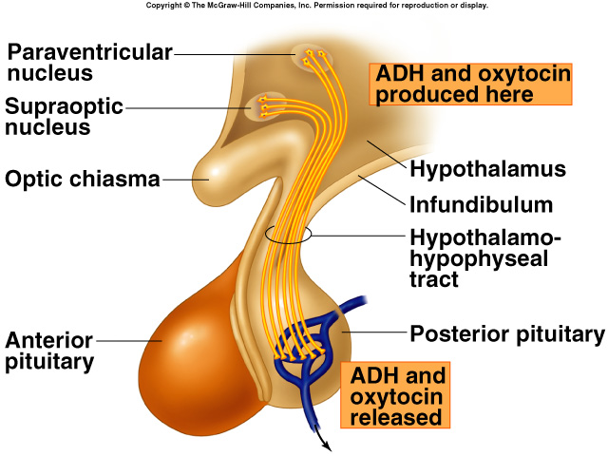
The Posterior Pituitary and Hypothalamic Hormones
posterior Pituitary is very simple, just we have two hormones:
ADH which is involved in water retention.
Oxytocin which mostly involve in reproduction.
The posterior lobe is a downgrowth of hypothalamic neural tissue While the Anterior from the tissue of the mouth (the upper part).
Has a neural connection with the hypothalamus (hypothalamic-hypophyseal tract).
Posterior pituitary Does not synthesize hormones & Consists of axon terminals of hypothalamic neurons.
Magnocellular neurons in paraventricular and supraoptic nuclei of the hypothalamus secrete oxytocin and ADH also known as Vasopressin ,They are then transported in secretion granules down axons to nerve terminals in the posterior pituitary gland.These endings lie on the surfaces of capillaries.

Slide 23
Doctors’ notes
Posterior pituitary itself does NOT synthesize hormones (it is only composed of supporting cells that do NOT produce hormones).
Hormones of posterior pituitary are synthesized in hypothalamus (in the supraoptic and paraventricular nuclei the hormones are synthesized and packaged in vacuoles) then the vacuoles travel along the axon until they reach to the end of the axon at the substance of posterior pituitary (and become stored at the end of the axon; ready to be released once needed).
When we need these hormones, the hypothalamus is stimulated and رسالات عصبية will transmit along the axon and cause change in the nerve endings so the vacuole fuse with the membrane and open and release its contents by exocytosis then the hormone is transmitted through the blood to the body parts to produce its actions.
Nervous signals from hypothalamus Stimulation of each part of pituitary gland:
Posterior pituitary → stimulated by totally nervous stimulation.
While Anterior pituitary → stimulated by hormonal stimulation.

Slide 24
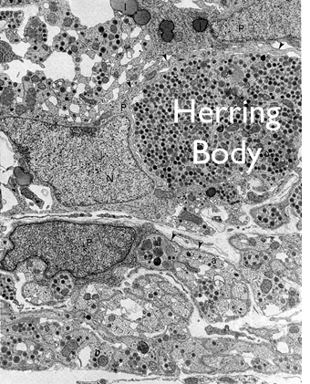
Cont.
Only in Females’ Slides
Pituicytes function:
It forms physical and chemical barrier between nerve terminal and blood vessels.
Amplify auto receptor negative feedback.
Pituicytes are the supporting cells (glial cells) forming the substance (matter) of superior pituitary.
Pituicytes support the nerve endings and help them to secrete the stored hormones.
Some studies stated that Pituicytes prevent the axons of being stimulated when its not the time of need for the hormone… and when there is stimulation (at times of need for hormones) the Pituicytes (which has pods).
أرجل تبعد شوي عن الأكسون وتخليه يطلع الهرمونات للدم، فهذا المقصود بقولنا أنها تشكل barrier

Slide 25
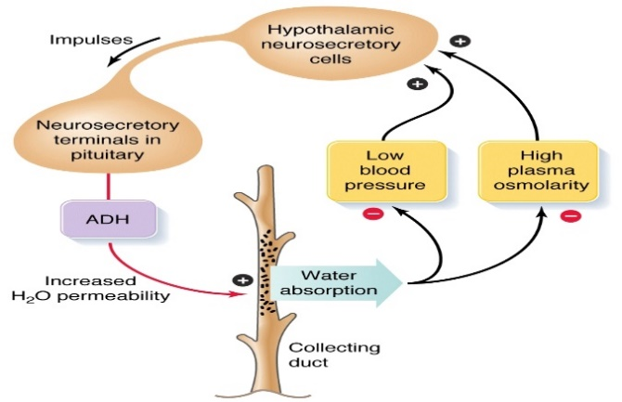
Antidiuretic hormone(Vasopressin)
The receptor are imp
Antidiuretic hormone(Vasopressin)
Synthesis of ADH | Receptors of ADH Receptors are for the hormones to produce the action and the letter V may denote the other name of the hormone (vasopressin) |  | Regulation of ADH
It is synthesized as pre-prohormone and processed into a nonapeptide (9 amino acids) (Also oxytocin produced at the beginning as nonapeptide). ADH synthesized in the cell bodies of hypothalamic neurons (supraoptic nucleus). ADH is stored in the posterior pituitary. | V1A | Mediate vasoconstriction (Involved in blood vessels). Found in the liver glycogenolysis. Present on blood vessels and liver. | Hypothalamus receives feedback from: Osmoreceptors. Aortic arch baroreceptors. Carotid baroreceptors. Atrial stretch receptors. Any increase in osmolality or decrease in blood volume will stimulate ADH secretion from posterior pituitary.
 | V1B | Are unique to anterior pituitary & mediate increased adrenocorticotropic hormone(acth) secretion.
 | V2 | are located in the principle cells in distal convoluted tubule & collecting ducts in the kidneys (Involved in formation of aqua-pores which are water channels). لقوا أن فيه علاقة بينADH و ACTH Patients who have tumor producing too much ADH will also have increase secretion of ACTH

Slide 26
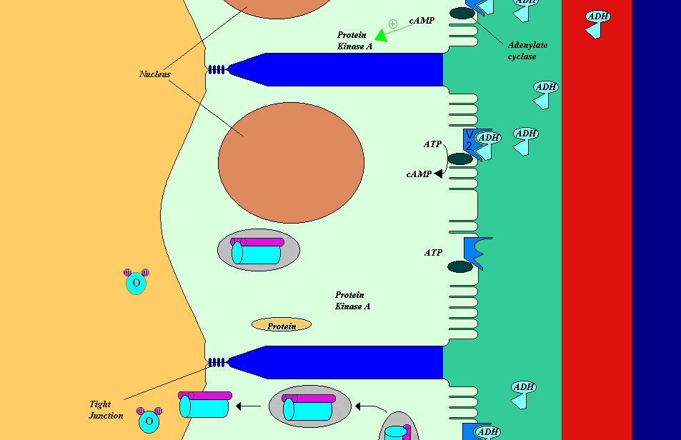
Mechanism of action of ADH
Important
Animation
ADH binds to V2 receptors on the principle cells of the distal convoluted tubules and collecting ducts→Via adenylate cyclase/cAMP induces production and insertion of aquaporin2 into the luminal membrane and enhances permeability of cell to water → Increased membrane permeability to water permits back diffusion of free water, resulting in increased urine osmolality (concentrates urine).
Only in Females’ Slides
In the image you see the blood vessel and the principle cell… hormones come via blood through capillaries then pass from capillaries to interstitial fluid then attach to receptors of the cells causing stimulation that convert ATP to cAMP … then cAMP causes phosphorylation to some protein kinase … this phosphorylation lead to the movement of the vesicles containing aquaporins until it reaches cell membrane and opens there…
So the water enter from the tubule into the cell and later absorbs into blood.
ATP is transformed into cAMP (the second messenger) that makes the aquaporins (inside vacuoles) move and attach to membrane of the cell allowing the passage of water.
Both hormones are G protein coupled receptors which involved in smooth muscles contraction. There are six types of G protein coupled receptors & don't worry we will not ask you about them.

Slide 27
Cont.
The Sum up are Important
Control of ADH Release:
Osmotic pressure(Osmoreceptor mediated) | Blood volume (baroreceptors mediated (vagus nerve)) | Other stimuli that affect ADH secretion (only in females’ slides)
Osmoreceptors located in the hypothalamus. If plasma osmolality is directly increased by administration of solutes, only those solutes that don't freely or rapidly penetrate cell membranes, such as sodium, cause ADH release. Conversely, substances that enter cells rapidly, such as urea, don't change osmotic equilibrium and thus don't stimulate ADH release. ADH secretion is very sensitive to changes in osmolality thus Changes of 1-2% result in increased ADH secretion. To sum up: ↑ osmolality → ↑ ADH secretion ↓ osmolality → ↓ ADH secretion | Hypovolemia is perceived by “pressure receptors” (carotid and aortic baroreceptors, & stretch receptors in left atrium & pulmonary veins). Normally, pressure receptors tonically inhibit ADH release. Decrease in blood pressure induces ADH secretion by reducing input from pressure receptors → The reduced neural input to baroreceptors relieves the source of tonic inhibition on hypothalamic cells that secrete ADH. Sensitivity to baroreceptors is less than osmoreceptors senses 5 to 10% change in volume. To sum up: ↑ blood pressure → ↓ ADH secretion ↓ blood pressure → ↑ ADH secretion | Stimuli that increase ADH secretion | Pain. Nausea. Surgical stress. Emotional stress.
 |  | Stimuli that decrease ADH secretion | Alcohol intake. That is why alcoholic people may urinate on their self because they have diuresis and they loose consciousness when they are drunk (not too much ADH is secreted in there case because of alcohol intake so not too much water is reabsorbed and they have bigger amounts of urine because urine is not concentrated as usual)

Slide 28
Oxytocin
Oxytocin
Synthesis of Oxytocin | Functions |  | Other stimuli (only in females’ slides) | Autism (only in females’ slides)
Oxytocin is synthesized in the cell bodies of hypothalamic neurons( paraventricular nucleus) → stored in the posterior pituitary. | Suckling during breast-feeding | Contracts the myoepithelial cells that lie outside the alveoli of the mammary glands. | In humans, oxytocin is thought to be released during (hugging, touching, and orgasm in both sexes) that’s why it called LOVE hormone. Release increased during stress. Release inhibited by alcohol. In males secretion increases at time of ejaculation (contraction of smooth muscle of vas deferens). | Autistic group had significantly lower plasma oxytocin levels than in the non-autism group. Elevated oxytocin was associated with higher scores on social and developmental measures for the non-autistic children*. Since oxytocin has a relation to social bonding. That’s why autistic children have less levels of oxytocin compared to healthy children. Sometimes autistic children sitting inside narrow places to feel as if they were hugged.
 | Childbirth (Parturition) | In late pregnancy, uterine smooth muscle (myometrium) becomes sensitive to oxytocin (positive feedback ) .
* Social people who like to make a lot of relations with many people, have more levels of oxytocin.

Slide 29
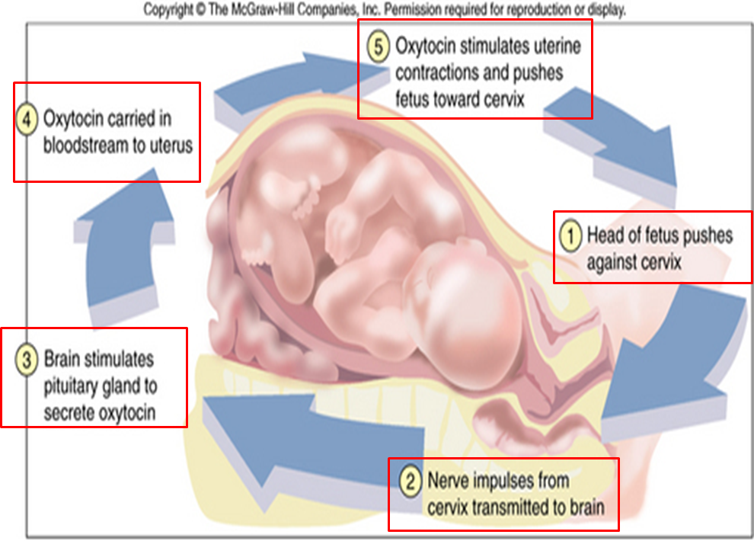
Childbirth
Only in Females’ Slides
Contractions induced by oxytocin.
The head of the baby cause pressure against cervix so impulses (nervous) goes to brain and stimulate more oxytocin contraction that will further cause more contraction (positive feed back).
In labor room, as soon as the head of the baby starts to get out they give the mother IM injection of oxytocin … they call it “active management of third stage of labor)
The aim is that they want the placenta to get out because if didn’t they are afraid of the “over use” and contractions of the uterus leading to uterus relaxation… so oxytocin injection is for prophylaxis of hemorrhage (because post mortem hemorrhage is the most common cause of death)

Slide 30
Diabetes Insipidus
 | Definition | Causes | Clinical futures | Treatment
Neurogenic (central) | failure of neurohypophysis to synthesize or secrete ADH. Deficiency of anti-diuretic hormone (ADH) or its action and is characterized by the passage of copious amounts of dilute urine. It must be differentiated from other polyuric states such as primary polydipsia & osmotic duiresis. Central DI is due to failure of the pituitary gland to secrete adequate ADH. | IDIOPATHIC (30% OF CASES). Benign or malignant tumors 25%. Infections (Encephalitis, TB, etc). Skull surgery. Trauma. Autoimmune associated with thyroiditis. Familial: 2 TYPES AD & X-linked inheritance Wolfram syndrome (also known as didmoad syndrome) characterized by di, dm, nerve deafness and optic atrophy. | Polyuria, polydipsia & thirst. Nocturia or nocturnal enuresis. Hypernatremic dehydration. Anorexia, constipation. Hyperthermia & lack of sweating. | Desmopressin (ddavp) a synthetic analog is superior to native avp because: It has longer duration of action (8-10 h vs 2-3 h). More potent. Its antidiuretic activity is 3000 times greater than its pressor activity. Provision of adequate fluids & calorie Low sodium diet Diuretics High dose of ddavp Correction of underlying cause
Nephrogenic | failure of the kidney to respond appropriately to ADH. when the renal tubules of the kidneys fail to respond to circulating ADH. The resulting renal concentration defect leads to the loss of large volumes of dilute urine. This causes cellular and extracellular dehydration and hypernatremia. | Primary familial: x-linked recessive that is severe in boys & mild in girls Secondary to: Chronic pyelonephritis Hypokalemia Hypercalcemia Sickle cell disease Protein deprivation
هذه الجزئية فقط عند الأولاد ومو موجودة بالأوجكتف، عند الرجوع للدكتور قال مو معكم☺

Slide 31
Question's asked by doctor
1. If the stalk connecting pituitary and hypothalamus was cut, and the hypothalamus was intact, Will after that ADH and oxytocin be secreted into blood?
NO, they wont be secreted.
They will be secreted because they nerves up there in hypothalamus are intact.
They will be secreted but after a period of time (not immediately).
The answer: is C
Because hormones that are already synthesized and stored in posterior pituitary can NOT be stimulated to be released, and the production of new hormones need time.
remember that these hormones are proteins so it needs time to be produced, so the cell bodies are intact in the hypothalamus so they can make hormones but the axons need time to regenerate.
2. If we don't have ADH, what will happen ?
The formation of urine is high & it has low osmolality, but in the blood the osmolality is low.
How about thirst ? always you will be drinking a lot and you have both polydipsia & polyuria.
3. What will the hypothalamus does if the osmolality is increased ?
Secretion of ADH.
If it was not enough it will stimulate the thirst center.
4. What are the situation which might cause un-functioning ADH?
Not producing by hypothalamus (due to trauma, tumor, infection.
It produces by hypothalamus but the receptors are defect (due to mutation).

Slide 32
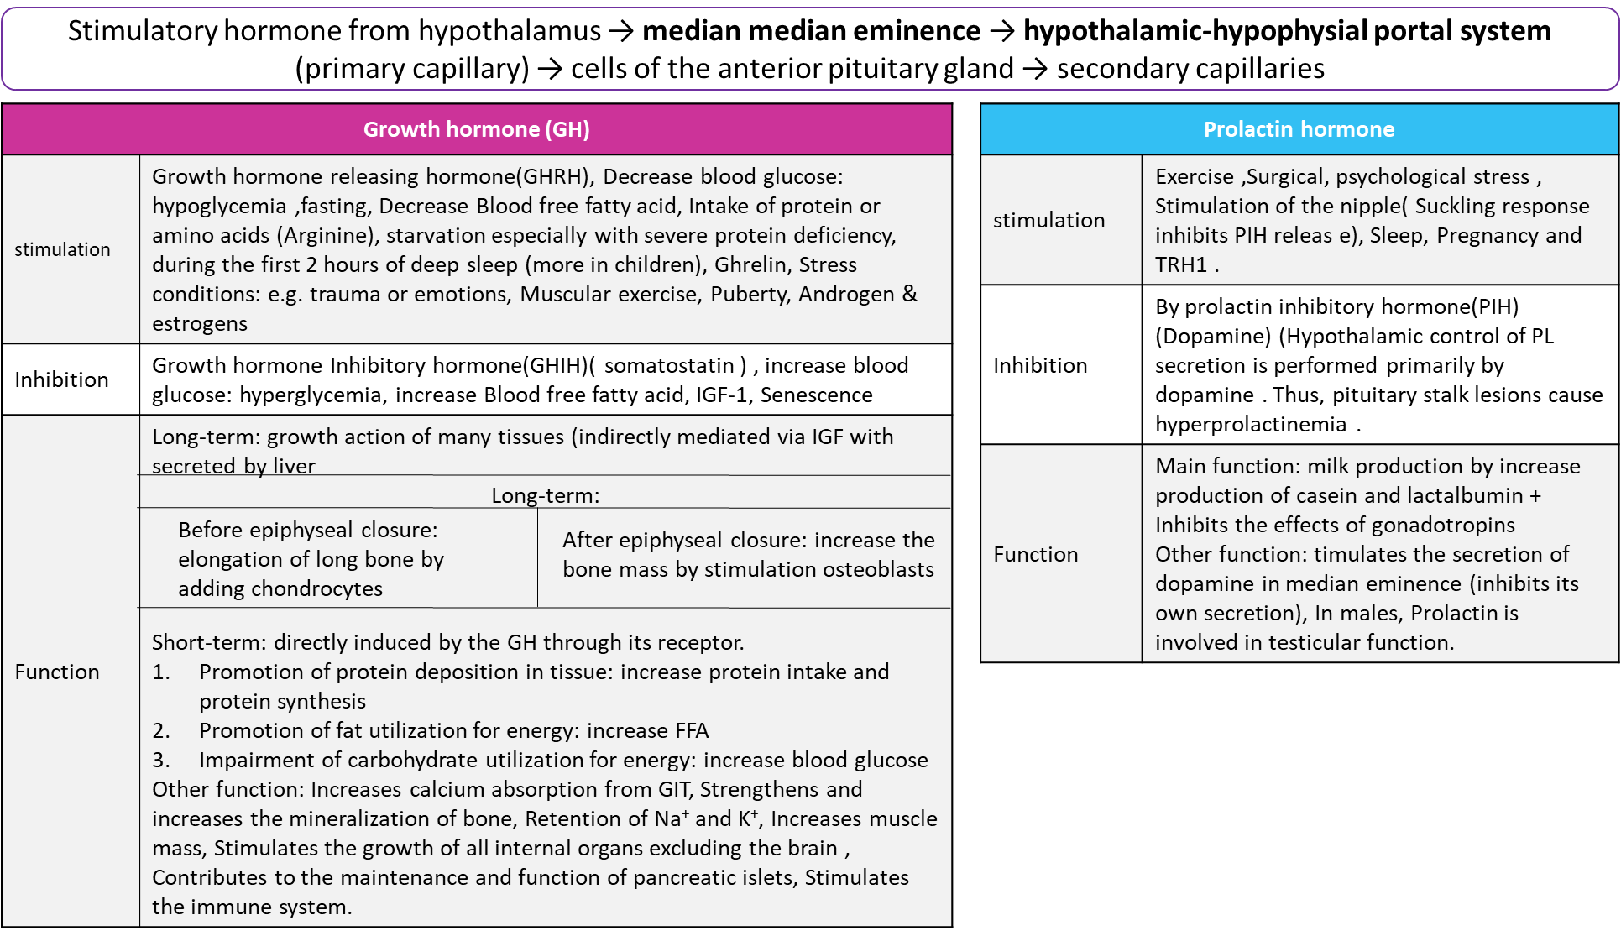
Summary

Slide 33
Summary

Slide 34
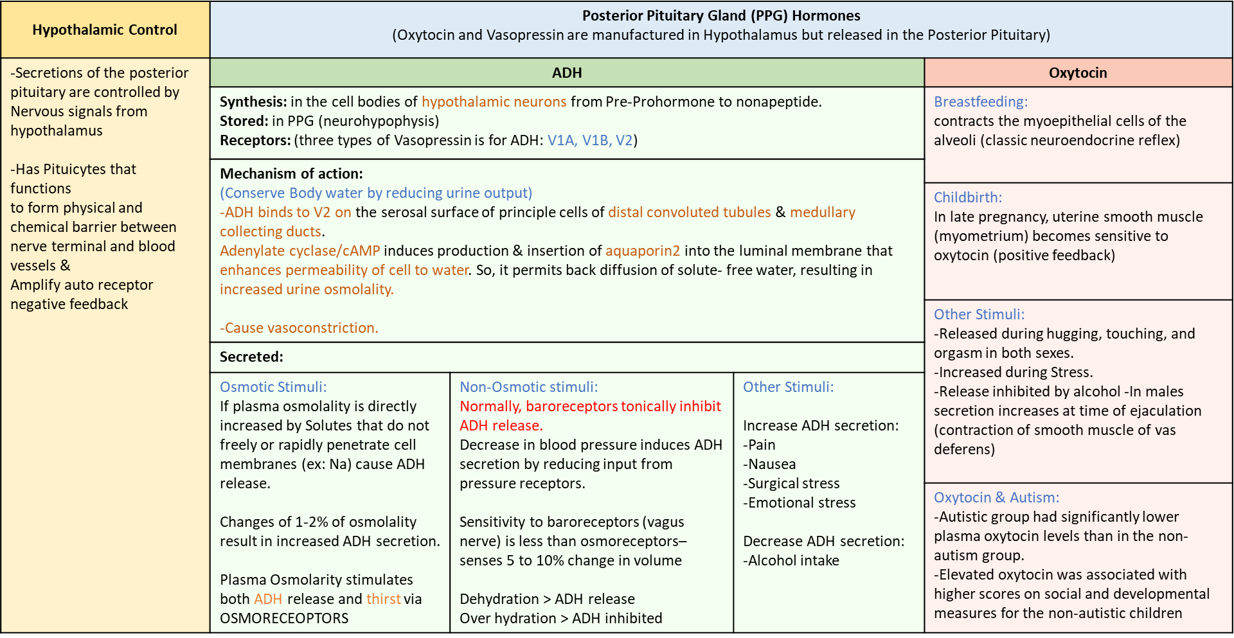
Summary

Slide 35
Thank you for checking our work!
اعمل لترسم بسمة، اعمل لتمسح دمعة، اعمل و أنت تعلم أن الله لا يضيع أجر من أحسن عملا.
قادة الفريق:
ليــلـى مـذكور & مـحـمـد نـصـر
Please check our editing file to know if there are any additions, changes or corrections.
Examine yourself
خالص الشكر لأعضاء الفريق الكِرام:
روان القحطاني
آمال الشـيـبـي
طلال الحقيل
حسان الشمري
حمد الخضيري
ريـما الشايع
دعاء ماهر
دانية الكلابي
شذا الغيهب
اللولو الصليهم
2017-2018 Dr. Hanaa AlZamil’s Lecture & Notes.
2017-2018 Prof. Abdulmajeed Aldress’s Lecture& Notes.
2017-2018 Dr. Dr. Khalid Al Regaiey’s Lecture & Notes.
Guyton & Hall of Medical Physiology 13th Edition.
Linda S. Costanzo 5th Edition.
Helpful physiology bocks.
Give us your feedback ☺
اللهم اني استودعتك ما حفظت وما قرأت وما فهمت، فرده لي وقت حاجتي إليه إنّك على كل شيءٍ قدير.

