Slide 1
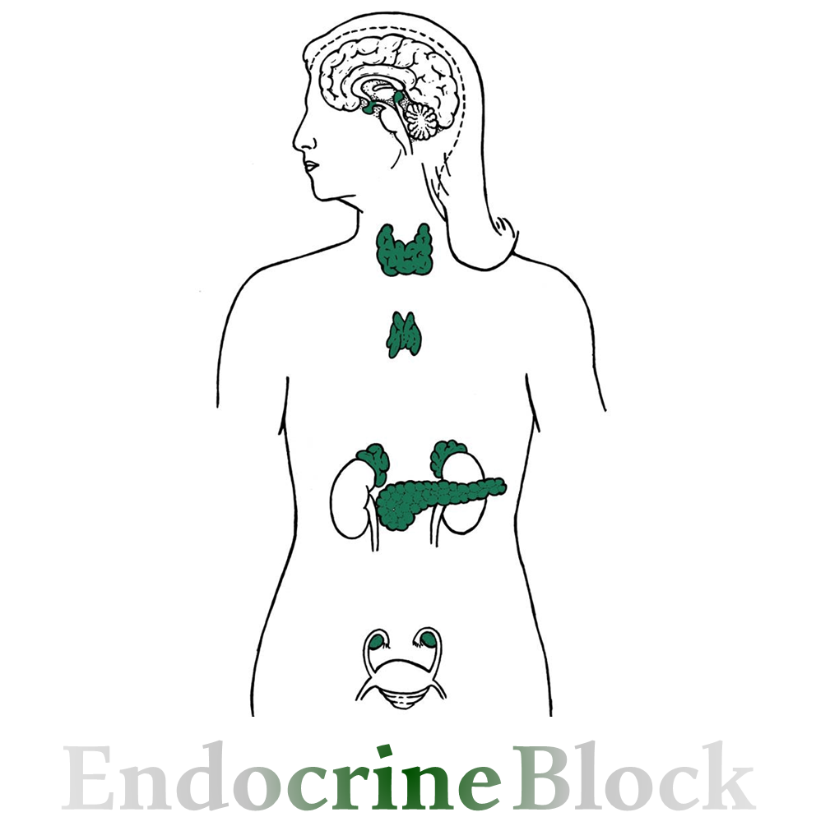
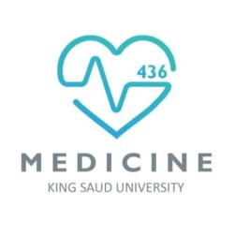
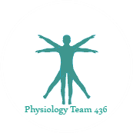

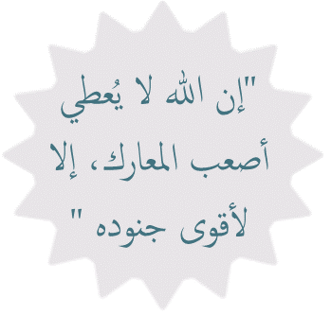
Text
Only in Females’ slide
Only in Males’ slides
Important
Numbers
Doctor notes
Extra Notes

Slide 2
Physiology & Diseases of the thyriod gland
By the end of this lecture, students should be able to describe:
List thyroid gland hormones.
Describe the synthesis of the thyroid hormones.
Describe the release and actions of thyroid hormones.
Describe the negative feedback mechanism (control).
Describe pathophysiology behind the causes of hyper-hypothyroidism.
Describe pathophysiology behind the signs and symptoms of hyper-hypothyroidism.
List the treatment.

Slide 3
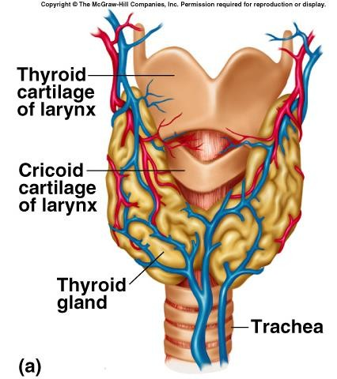
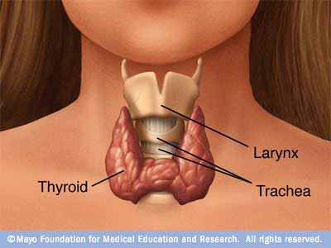
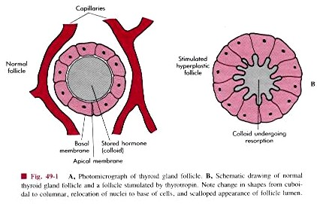
Thyroid Gland
It is located below the larynx on either sides & anterior to the trachea (It is not attached to larynx, its only lies above it)
The first recognized endocrine gland, but the master one is pituitary gland.
20g in adult.
Highly vascularized
Thyroid gland hormones الكمية عكس الactivity، يعني كلما زادت الكمية قل نشاط الهرمون (أقلهم كمية أكثرهم نشاطا)
Hormones | T3 (Triiodothyronine) | T4 Thyroxine (Tetraiodothyronine) | Calcitonin Hormone important in Ca metabolism. | Reverse T3 (not important) Biologically inactive, but it appears in chemical reactions
Amount | 10% | 90% | - | -
Site of synthesis | Apical and basal membrane in follicular cells |  | Parafollicular cells C-cell | -
Site of stores | In colloid |  |  | -
Thyroid gland is made of follicles.
Follicles are lined by follicular cells.
The surrounded pinkish material is colloid

Slide 4
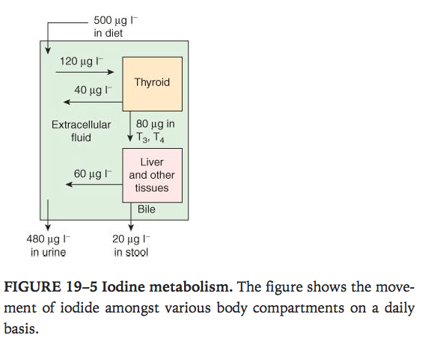
Unique features of thyroid gland
The notes here are imp
1. Contains a large amount of iodine:
supplied in diet موجود في ملح الطعام
1mg/week.
2. Synthesis is partially intracellular & partially extracellular (One special thing in thyroid hormones is that part is synthesized inside the cells and some outside the cells).
3. T4 is the major product (But less active).
Pic is Only in Females’ Slides
Excreted in stool
500Mg iodine is uptake by diet enters the circulation.
120Mg (large amount) is taken up by thyroid gland for thyroid hormones synthesis (T3 ,T4).
Some is taken by liver and other tissues:
20% of the Iodide is taken by the thyroid gland.
while remaining 80% will be excreted in urine.
Uptake by tissues
To thyroid
(T3,T4)
Function on the tissues
Iodine in Extracellular fluid
Excreted in urine
Excreted directly in urine

Slide 5
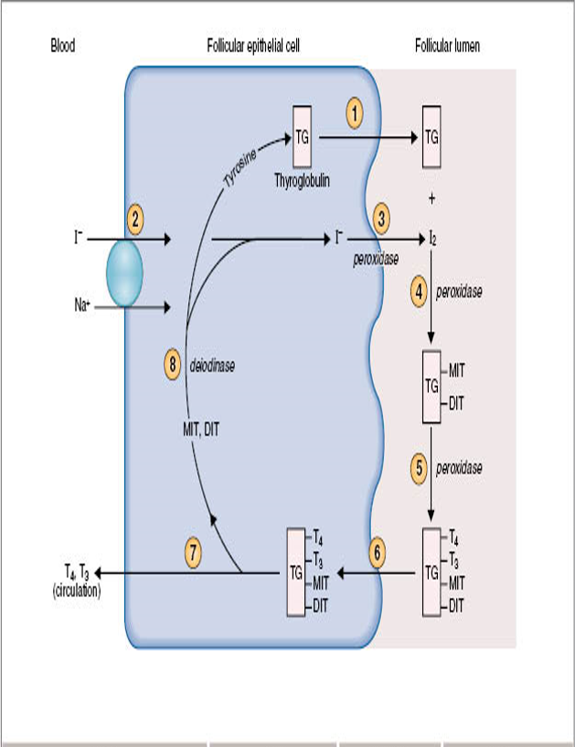
Steps in Biosynthesis of Thyroid Hormones
مشروحة بالسلايدات الجاية
There are 10 steps in biosynthesis of thyroid hormones done by the follicular cells:
1. Thyroglobulin formation & transport.
2. Iodide pump or iodide trap.
3. Oxidation of iodide to iodine.
4. Organification of thyroglobulin.
5. Coupling reaction.
6. Endocytosis of thyroglobulin.
7. Fusion of lysosomes immediately with the vesicles.
8. Hydrolysis of the peptide bond to release DIT + MIT+ T4 + T3 from the thyroglobulin.
9. Delivery of T4 and T3 to the systemic circulation.
10. Deiodination of DIT and MIT by thyroid deiodinase.
(Recycling).
MIT= Monoiodothyrosine.
DIT= Diodothyroine.
When T4 & T3 are released we are left with TG attached to (DIT,MIT).
We need to have TG alone to start new hormonal synthesis, that's why (DIT,MIT) will be removed by the action of deiodinase to have TG to start synthesizing new thyroid hormones.
Other picture
Another Picture

Slide 6
Cont.
الإنزيمات مهمة بارك الله فيكم ☺
1. Thyroglobulin Formation & Transport:
Thyroglobulin is formed of 140 tyrosine (main amino acid) + glycoprotein. (glycoprotien = protien +caebohydrate)
It is formed in Rough endoplasmic reticulum & Golgi apparatus.
2. Iodide Pump Or Iodide Trap:
Iodide is very essential component for thyroid hormones, T4 contains 4 iodine & T3 contains 3.
Active transport (Which is sodium iodide co-transporter).
Wolff-chaikoff effect*.
(A reduction in thyroid hormone levels caused by administration of a large amount of iodine).
تطبيق لنظرية العرض والطلب: الحين لما الناس تسمع عن سلعة بتخلص لأنهم يراكضون عشان يشترونها٬ نفس الشي لما يوصل اليود للدم يكون قليل، هذا بيأثر على نشاط الPump يزيده ويأخذ كل اليود الموجود والعكس صحيح.
في السابق كانوا يستخدمون هذه الطريقة للعلاج (Nagative feedback) (وداوِها باللتي كانت هي الداء)
Ratio of concentration from 30-250 times (in the gland compared to the blood).
It is stimulated by TSH (The pump number & activity will be increased in response to TSH).
3. Oxidation Of Iodide To Iodine:
Catalyzed by Thyroid Peroxidase (Thyroid Peroxidase = converts iodide to iodine (oxidation) so it can bind to thyroglobulin).
It is located in or attached to the apical membrane.
Wolff-chaikoff effect: Read it
when Iodide in blood is increased, the number & activity of Iodide pump will be decreased because there is abundant Iodide in blood.
While when Iodide in blood is decreased, the number & the activity of this pump will be increased to uptake this small quantity of Iodide in blood.

Slide 7
Cont.
الإنزيمات مهمة بارك الله فيكم ☺
4. Organification Of Thyroglobulin:
Binding of iodine with Thyroglobulin.
Catalyzed by thyroid peroxidase to formation of MIT & DIT.
Remain attached to thyroglobulinuntil the gland stimulated to secret.
MIT= Monoiodothyrosine & DIT= Diodothyroine.
1 Tyrosine of Thyroglobulin + 1 Iodine = MIT.
1 Tyrosine of Thyroglobulin + 2 Iodine = DIT.
Thyroglobulin is formed from tyrosine, this thyrosin can attach to one iodine (MIT) or 2 iodine (DIT).
5. Coupling Reaction:
DIT + DIT = T4 (faster), while DIT + MIT = T3
Catalyzed by thyroid peroxidase.
It is stored as colloid.
عندنا follicular cell وفي النص الهرمون as a colloid واذا احتجته اسوي endocytosis، هل ينفع يطلع للدم؟ لا ، اكسره واطلع t3 و t4.
Is sufficient for 2-3 months (That’s why hypo/ hyper thyroidism symptoms will appear late)
6. Endocytosis of Thyroglobulin.
After formation & entering the colloid endocytosis of thyroglobulin starts.
7. Fusion Of Lysosomes Immediately With The Vesicles.
If it enters follicular cells the lysosomes bind with vesicles and hydrolysis occurs.
8. Hydrolysis (proteolysis) Of The Peptide Bond To Release DIT + MIT+ T4 + T3 From The Thyroglobulin.
MIT=Monoiodothyrosine.
DIT= Diodothyroine.
9. Delivery Of T4 and T3 to The Systemic Circulation.
By concentration gradient → target cells → action.
10. Deiodination of DIT And MIT By Thyroid Deiodinase (recycling).
(Deiodination is a process of separating the Iodine and Tyrosine in DIT & MIT to use Tyrosine again in synthesis of Thyroglobulin & also to reuse the Iodine).

Slide 8
Thyroid Hormones in The Circulation
The notes here are imp
1. Unbound (free): Found in small amounts.
0.03% of T4.
0.3% of T3 (more, because it’s the needed form, Free hormone it’s the only type that triggers negative Feedback and it is the active form).
2. Bound: 70-80% is bound to thyroxine-binding globulin (TBG) which is synthesized in the liver, the reminder is bound to albumin.
Bound hormones inactive → type of storage.
Unbound hormones active → less amount.
Effect of Liver diseases (Hepatic failure) on thyroid hormones:
Effect of pregnancy on thyroid hormones:
Increase in estrogen levels
Increase in TBG
Does it mean every pregnant have hyperthyroidism?
No but it means that her thyroid hormone level will be physiologically increased into the upper normal limit.
Decrease TBG
Increase of Free levels of T3 & T4 in the blood
Inhibition of thyroid secretion.
Decrease in free levels of T3 & T4 in the blood
Stimulation of thyroid secretion.
pregnant women feels hot due to increase T3 & T4.

Slide 9
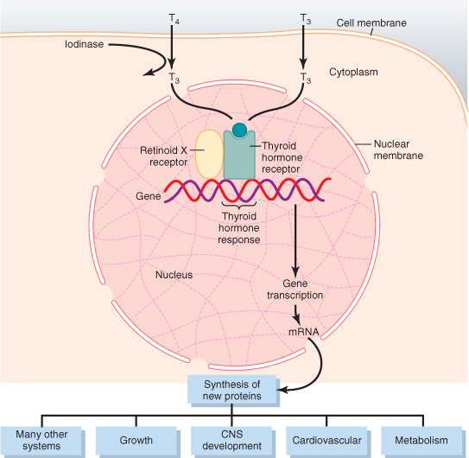
Release of T4 & T3 Into The Tissues
The Enzyme here is important
1. The release is slow because of the high affinity if the plasma binding proteins.
½ of T4 in the blood is released every 6 days & ½ of T3 in the blood is released every one day.
2. T4 & T3 readily diffuse through the cell membrane.
3. It is stored in the targeted tissues (days to weeks).
4. Most of T4 is deionized to T3 by 5- iodinase enzyme (Before binding to the nuclear receptors 90% of T4 is converted to T3)
5. In the nucleus, T3 mainly binds to “thyroid hormone receptor” & influence transcription of genes.
T3 ,T4 can easily inter cell membrane → to cytoplasm → iodinase converts T3 to T4 → T3 enters the nuclear membrane → nucleus → bound to thyroid hormone receptor → manipulated DNA synthesis and mRNA → gives protein that has affect on target cells. it enters the Cell membrane , Nuclear membrane & stimulates the synthesis of certain proteins.
T3 binds to the nuclear receptor forming a T3-receptor complex
Activation of thyroid regulating element on the DNA
DNA transcription → formation of mRNA
Translation of mRNA → specific protein synthesis (target tissue specific).

Slide 10
Action of thyroid hormones
Thyroid hormones affect many systems because they affect the metabolism and all cells have metabolism
Action of thyroid hormones
Effect on Autonomic nervous system | Effect on CNS These effects are age dependent: |  | Effect on Respiration
Thyroid hormone interact with the sympathetic nervous system. Produced the same action as catecholamine's via β adrenergic receptors including increase: BMR. Heat production. Heart rate. Stroke volume. .i.e. β-blocker (propranolol) is used in treatment of hyperthyroidism. | fetal and postnatal life | Thyroid hormones are essential for maturation of the CNS. perinatal decrease of hormones secretion (hypothyroidism) causes irreversible mental retardation. For this reason, screening is necessary to introduce hormone replacement. If it is detected in the new born, hormone replacement can reverse the CNS effect. If the baby isn't responsive, inactive, sleeps a lot = thyroid hormone deficiency. | Increase ventilation rate. Increase dissociation of oxygen from Hb by increasing red cells 2,3-DPG (2,3diphosphoglycerate). 2,3-DPG will decrease the affinity of the RBC, & increase the loading to the tissues.
 | In adult | Increase in thyroid hormone secretion: (Hyperthyroidism = tremor) Hyperexcitability. Irritability. Decrease in thyroid hormones secretion:عكس الهايبر Slow movement. Impaired memory. Decrease Mental capacity.

Slide 11
Cont.
Action of thyroid hormones
Basal metabolic rate (BMR) = The amount of energy the body needs to maintain basal functions. بعدما الجسم خلاص هضّم وتخلص من الجلوكوز BMR هو كمية الطاقة الاساسية الموجودة. | Effect on Metabolism
 | Affect on carbohydrate metabolism | Effects on fat metabolism | Effect on protein metabolism
It is the energy requirement under basal or resting condition (state of mental & physical rest 12-18 hours after a meal). Complete lack of the thyroid hormones → decreases BMR 40% - 50%. (If there is no thyroid hormones energy amount decrease to half) Extreme increase of the thyroid hormones → increases BMR 60-100% (If there is thyroid hormone excess the amount of energy is doubled, Because it affects O2 consumption in cells). الخلايا لها سرعة حركة معينة ممكن تزيد وممكن تقل، عشان تستمر الحركة نحتاج طاقة، لما تقعد مريّح ١٣-١٦ ساعة بعد الوجبة الجسم بيحتاج هالمصدر من الطاقة. | Increase: Glucose uptake by the cells. Glycogenolysis. Gluconeogenesis. Absorption from the GIT. | Increase lipolysis. Decrease plasma cholesterol by increase loss in feces. Increase oxidation of free fatty acids. الثايرود يحرق الدهون، عشان كذا بعض الستَّات ياخذون الثايركسون عشان يخسِّوا (ينحفوا) بس أوعكم تعملوها لأن اللعب بالهرمونات زي اللعب بالنار، هتنبسطوا أول يومين وبعدها تعيَّطوا. | Overall effect is catabolic leading to decrease in muscle mass. هذي المرحلة يكون الجسم اكل الجلوكوز و اكل الدهون بقى العضلات.
 | The metabolic effects are due to the induction of metabolic enzymes: Cytochrome oxidase. NAPDH cytochromeC reductase. Alpha-glycerophosphate dehydrogenase. Malic enzymes. Several proteolytic enzymes.
الدكتورة قالت مو مهم، والدكتور ما شرحها

Slide 12
Cont.
Action of thyroid hormones
Effects on the cardiovascular system | Effect on GIT | Bone (growth hormone)
Increase heart rate & stroke volume ​(increased contractility) Which lead to raises the Cardiac out put up to 60% → increase delivery of oxygenated blood to the tissues. Decrease peripheral resistance → increase delivery of oxygenated blood to the tissues. Why there is peripheral resistance? ​Increased metabolism in the tissues causes more rapid decrease utilization of oxygen than normal & release of greater than normal quantities of metabolic end products from the tissues. These effects cause vasodilation in most body tissues, thus increasing blood flow​. How do the thyroid hormones perform their effects on CVS? The increased contractility is partly direct and partly indirect: 1. Indirect: Thyroid hormones potentiate the effect of catecholamine in the circulation → activation of β-adrenergic receptors. 2. Direct induction of: Myocardial β-adrenergic receptors. Sarcoplasmic reticulum. Ca+2 ATPase. Myosine. | Increase: Appetite and food intake. Digestive juices secretion. G.I tract motility: excess secretion causes diarrhea →hyperthyroidism. lack of secretion causes constipation → hypothyroidism. Hyperthyroidism = increase appetite and loss of weight. Hypothyroidism = decrease appetite and gain weight. | Promote: 1. Bone formation & maturation. 2. Ossification. 3. Fusion of bone plate. We said promote because the action is done by growth hormone.
Summary of Action of thyroid hormones

Slide 13
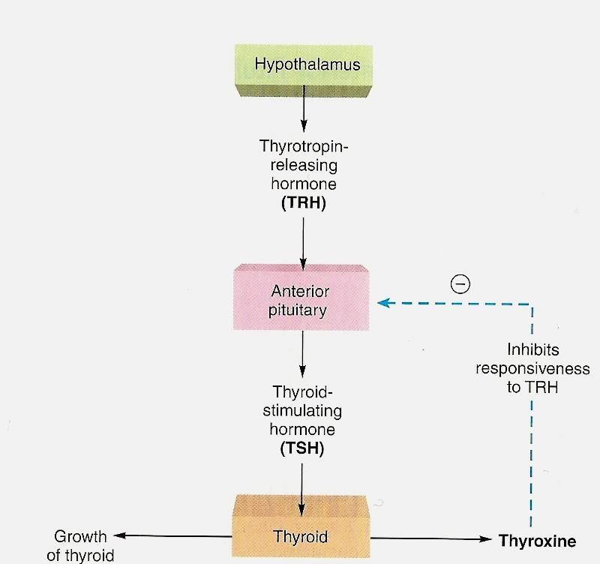
Regulation of Hormones secretion
Regulation of Hormones secretion:
It is regulated by the hypothalamic-pituitary axis.
1. Thyrotropin-releasing hormone (TRH):
It’s a tripeptide, released from the paraventricular nuclei of the hypothalamus.
It acts on the thyrotrophs of the anterior pituitary.
Its function is transcription & secretion of TSH.
Phospholipid second messenger system.
2. Thyroid-stimulating hormone (TSH):
It’s a glycoprotein, released from the anterior pituitary.
It regulates the metabolism, secretion & growth of the thyroid gland (Trophic effect).
Hypothalamus releases TRH which stimulates the anterior pituitary gland to release TSH which stimulates the release of T3 and T4 from the thyroid gland.
T3 and T4 have a negative feedback effect on the anterior pituitary.
Some factors like environmental influence (temperature) affect the release of hypothalamic hormone TRH.
The hypothalamus secretes TRH to the Anterior pituitary glands which stimulates it into secreting TSH into the thyroid gland which leads to release of T3 & T4.
Once there is enough amounts of T3 and T4 it will inhibit the responsiveness of the anterior pituitary to TRH, thus stopping it from releasing TSH.

Slide 14
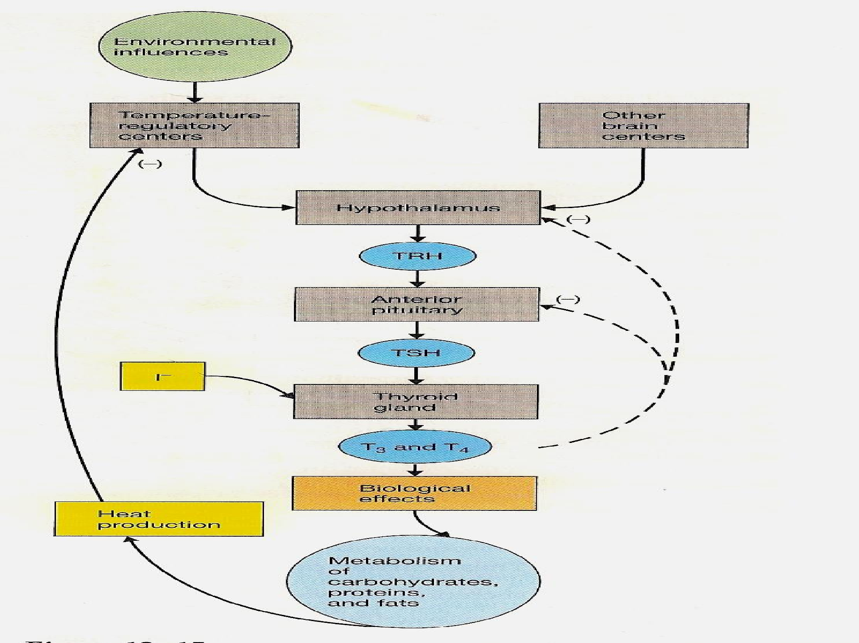
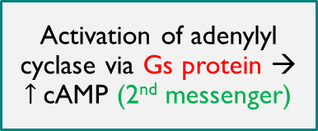
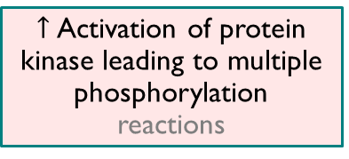
Action of TSH
TSH secretion started at 11-13 of gestational weeks.
Action of TSH
It increases proteolysis of thyroglobulin.
Increases pump activity to increases iodide entering the cell.
Increases iodination of tyrosine.
Increases coupling reaction.
Trophic effect.
لاحظوا ان الناس اللي يعيشون عند البحر ما عندهم مشاكل بالغدة الدرقية بينما البعيدين عن البحر عندهم تضخم Goiter بسبب زيادة TSH.
TSH binds to receptor
Activation of adenylyl cyclase via Gs protein → $↑$cAMP (2nd messenger)
$↑$Activation of protein kinase leading to multiple phosphorylation reactions
Secretion and thyroid growth.

Slide 15
Factors affecting thyroid hormones secretion
Factors affecting thyroid hormone secretion
Stimulating factors | Inhibiting factors
TSH. Thyroid stimulating immunoglobulin (TSI) → it functions as TSH. Increase TBG levels (like pregnancy). | Iodide (I⁻) deficiency. Deiodinase deficiency (No iodine no thyroid hormone). Excessive iodide intake (wolff-chaikoff effect). Perchlorate, thiocyanate (inhibits the Na+, I⁻ Cotransport). Propylthiouracil (inhibits peroxidase enzyme). Decreased TBG levels (like liver disease).
Hyperthyroidism = excessive secretion of hormones stimulated by immunoglobulin instead of hormones (Autoimmune disease) Ig mimics TSH.

Slide 16
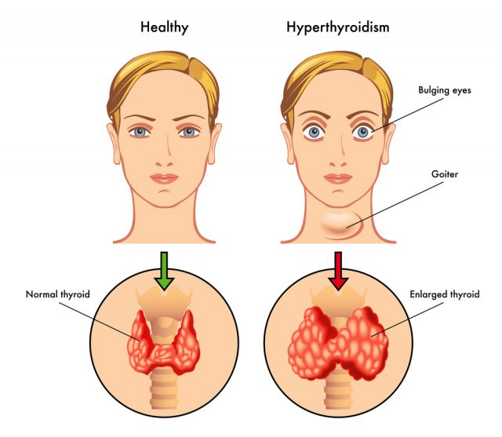

Hyperthyroidism
Definition: Over activity of the thyroid gland.
More common in Women, Women: men ratio (8:1).
Increase activity of the gland, what does it mean?
5- 10 times increase in secretion because of TSH.
2-3 times increase in size because of trophic effect.
Causes
1. Graves’ disease
2. Thyroid gland tumor
3. Exogenous T3 and T4
4. Excess TSH secretion
The most common cause.
An autoimmune disorder.
Increased circulating level of thyroid stimulating immunoglobulins (TSI).
95% (Of all causes of hyperthyroidism).
4 – 8 times more common in women than men.
The tumor may be in the pituitary or hypothalamus.
95% is benign & 5% is malignant.
History of head & neck irradiation & family history.
rarely cause.
eg. in case of hypothyroidism treatment.
بعض الناس یأخذونھم كحبوب لنقص الوزن.
Diseases of the hypothalamus ( TRH).
Diseases of the pituitary (TSH).

Slide 17
  Diagnosis (Signs and symptoms )
تجیك وحده، خففت ملابسھا، رایحه جایه على دورة المياه و نحیفه.
Size | Goiter (is an abnormal enlargement of thyroid gland) in 95%. | Cardiovascular | Increase heart rate & stroke volume. Arrhythmias (all the above are Because thyroid hormone potentiate catecholamines). Hypertension.
skin | Smooth, warm & moist رطب (Moist Because of the increase of metabolism & sweating). Heat intolerance & night sweating. (Because the metabolic rate is high, so the body is burning everything & that produces heat). ایش یعني؟ یعني مایتحمل الحراره. يكون الشخص في مكان حرارته معتدله، لكنه حرّان لیش؟ لأن الجسم یحرق كل شيء یدخله. | G.I tract | Increase in appetite & weight loss caused by ↑ BMR “basal metabolic rate”. Malabsorption lead to Diarrhea.
 |  | Renal function | Increase glomerular filtration rate.

Slide 18
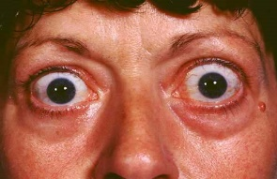
  Cont.
The notes here are imp
Musculoskeletal | Muscle atrophy (caused by ↑ protein catabolic). | Exophthalmos جحوظ العين | Anxious staring expression. protrusion of eye balls (mostly caused by accumulation of polysaccharides which attract water with it behind the eye balls). Graves’ disease نشوفھا في حالات Why & how? Polysaccharides accumulates behind the eye & it starts to attract water with it, so they push the eye forward. TSI will also stimulate the accumulation of these polysaccharides. یعني تتجمع بولیساكرایدز وراء العين وتسحب معاھا مويه، تراكمھم راح يدف العین على قدام فیصیر جحوظ.
Neurological | Tremor. Enhanced reflexes. Irritability Because of hyper excitability of the whole body. | Others | Menstrual cycle disturbance. (In both hypo &hyper)
Summary of symptoms of hyperthyroidism

Slide 19
Investigation & Treatment
The notes here are imp
Investigation:
The diagnosis of hyperthyroidism is based on the measurement of T3, T4 and TSH levels.
A. In primary hyperthyroidism:
The disorder is in the thyroid gland.
There will be high level of T4 and T3, while TSH level will be low by negative feedback of the high level of T3 and T4 on the anterior pituitary.
B. In secondary hyperthyroidism:
The disorder is in the hypothalamus or anterior pituitary.
There will be high level of T4, T3 & TSH.
Treatment:
1. Medical therapy:
By administration of drugs e.g. propylthiouracil, which inhibit the synthesis of thyroid hormones. usually for 12-18 months course with 3-4 monthly monitorin (because it we’re working according to the feedback mechanism).
2. Surgery: subtotal thyroidectomy.
Indication for surgery:
Relapse after medical treatment.
Drug intolerance.
Cosmetic.
Suspected malignancy.
Also radioactive iodine is another treatment.
It destructs the cells which leads to decrease is synthesis of the hormones.

Slide 20
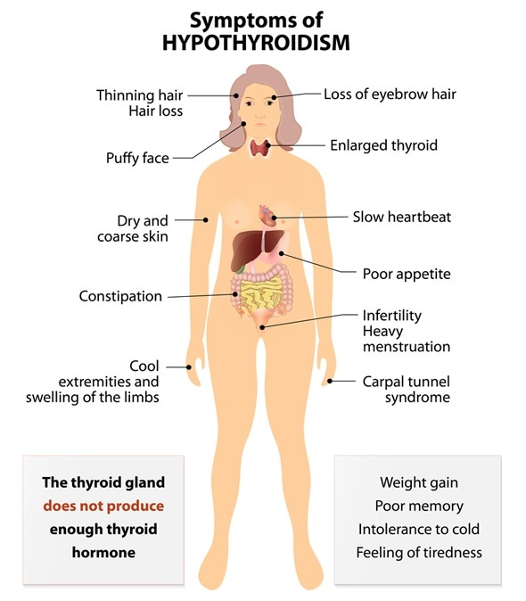
Hypothyroidism
The notes here are imp
المقطع يحتوي على موسيقى، اكتموا الصوت من فضلكم
فيه سؤال من هنا !
Under activity of the thyroid gland.
More in women (30-60 years).
More common than Hyperthyroidism & very common in Saudi Arabia.
Hypothyroidism diagnose is frequently confused with depression.
How does she look?
تعبانة، نعسانة، خاملة أغلب الوقت، مكتئبة ومالها خلق شيء
So hypothyroidism & depression have similar signs that's why we must do thyroid function tests (TFT) to differentiate between them.
A deferential diagnosis of hypothyroidism is depression.
مهمة هالصورة لا تنسونها

Slide 21
Causes
The notes here are imp
1. Inherited abnormalities of thyroid hormone synthesis
Peroxidase defect.
Iodide trapping defect.
Thyroglobulin defect.
2. Endemic Colloid Goiter يعني محصور في منطقة معينة
Before table salt.
Low iodide → low hormone formation → increased TSH → Thyroglobulin → increased size > 10 times.
كانت هذي الحالة منتشرة بشكل كبير قبل وجود ملح الطعام (فيه كمية كبيرة من اليود) اللي عندهم هذا المرض يكون الثايرويد كبير جدا بس ليش حجم الثايرويد كبير جدا؟
Because there is No Iodine means no thyroid hormones. No thyroid hormones will result through feedback mechanisms in the increase of TSH.
As we know, TSH has two effects, which are increase in secretion and increase in size (trophic effect)
In this case, there is no Iodine, thus secretion can’t be increased so the only action of TSH will be trophic effect. The body will produce more TSH (because there isn’t any thyroid hormones) and all of that TSH will increase the gland’s size massively
3. Idiopathic Nontoxic Colloid Goiter
Iodine intake is normal.
Thyroiditis (one of the theories).
Inflammation (thyroiditis) → increased cell damage → decreased hormone secretion → increased TSH → increased activity of normal cells → increased size.
Idiopathic, one of the theories is inflammation of thyroid (thyroiditis).
Inflamed cells won’t secrete hormones. If thyroid hormones are deficient, body will synthesize more TSH and will result in increased activity of normal cells and an increase in size.
4. Gland destruction (surgery)
مثلًا كان عند المریض هايبر، وسووا له عملية والجراح شال من الغدة أكثر من اللازم
سووا عمليه والجراح شال من الغدة أكثر من اللازم، راح يصير عنده هايبو.
5. Pituitary diseases or tumor
No TSH
6. Hypothalamus diseases or tumor
No TRH.

Slide 22
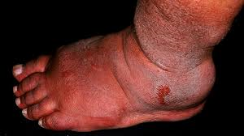
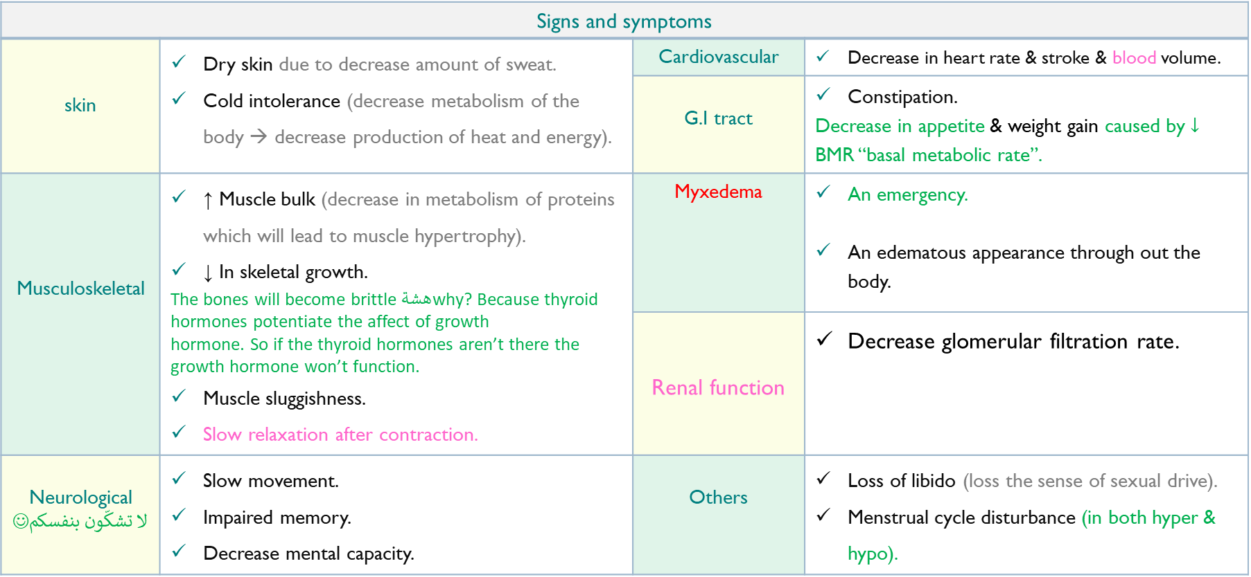
Diagnosis
تجيك وحده متلحفه بكل الدولاب، خاملة اغلب الوقت، ماتأكل، مالھا خلق شيء وسمینه.
Signs and symptoms
skin | Dry skin due to decrease amount of sweat. Cold intolerance (decrease metabolism of the body → decrease production of heat and energy). | Cardiovascular | Decrease in heart rate & stroke & blood volume.
 |  | G.I tract | Constipation. Decrease in appetite & weight gain caused by $↓$ BMR “basal metabolic rate”.
Musculoskeletal | ↑ Muscle bulk (decrease in metabolism of proteins which will lead to muscle hypertrophy). ↓ In skeletal growth. The bones will become brittle هشةwhy? Because thyroid hormones potentiate the affect of growth hormone. So if the thyroid hormones aren’t there the growth hormone won’t function. Muscle sluggishness. Slow relaxation after contraction. | Myxedema | An emergency. An edematous appearance through out the body.
 |  | Renal function | Decrease glomerular filtration rate.
Neurological لا تشكّون بنفسكم☺ | Slow movement. Impaired memory. Decrease mental capacity. | Others | Loss of libido (loss the sense of sexual drive). Menstrual cycle disturbance (in both hyper & hypo).
Summary of symptoms of hypothyroidism

Slide 23
Investigation & Treatment
The notes here are imp
Investigation:
The diagnosis of hyperthyroidism is based on the measurement Serum T3,T4, (low).
A. TSH is elevated in primary:
The disorder is in the thyroid gland.
There is low amount of T3 and T4 secreted, so the pituitary thinks that its not secreting enough TSH, so it will increase the secretion of TSH.
B. TSH is low in secondary hypothyroidism:
The disorder is in the hypothalamus or anterior pituitary.
There will be low TSH, so there will be low T3 & T4 also.
Treatment:
L-thyroxine (Hormone replacement therapy, MUST monitor & adjust dose).
Starting dose is 25-50 μg.
Increase to 200 µg.
At 2-4 weeks period.
The first response seen is the weight loss.

Slide 24
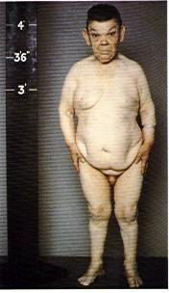
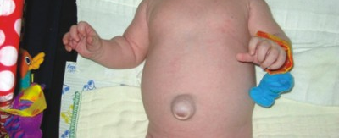
Cretinism
Cretinism التقزم
Definition | Causes | Symptoms | Treatment
Extreme hypothyroidisim during infancy and childhood (failure of growth). (Inability to secrete the thyroid hormone. Thyroid hormone isn’t there). | 1. Congenital lack of thyroid gland. (Congenital Cretinism). 2. Genetic deficiency leading to failure in production of hormone. 3. Iodine lack in the diet. (Endemic Cretinism). | Infant appears normal at birth but abnormality appears within weeks. Protruding tongue (tongue sticks out). Dwarf with short limbs. Mental retardation. Often the infant is present with Umbilical Hernia. Delayed eruption of teeth. | Changes are irreversible unless if treatment is given early.
Umbilical Hernia
Protruding tongue

Slide 25
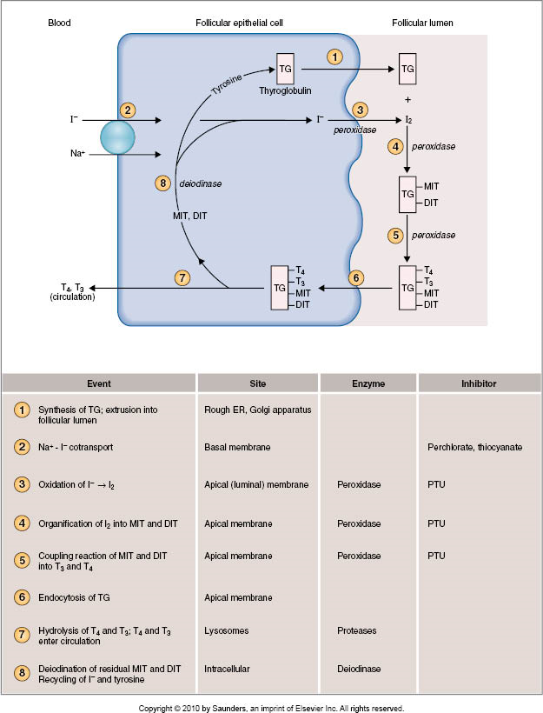
Summary of steps in biosynthesis of thyroid hormones (From slides)
1. Iodide pump.
2. Thyroglobulin synthesis.
3. Oxidation of iodide to iodine.
4. Iodination of tyrosine, to form mono-iodotyrosine (MIT) & di-iodotyrosine.
5. Coupling.
MIT + DIT = Tri-iodothyronine, (T3).
DIT + DIT = Tetra-iodothyronine, (T4)/ Thyroxine.
6. Release.

Slide 26
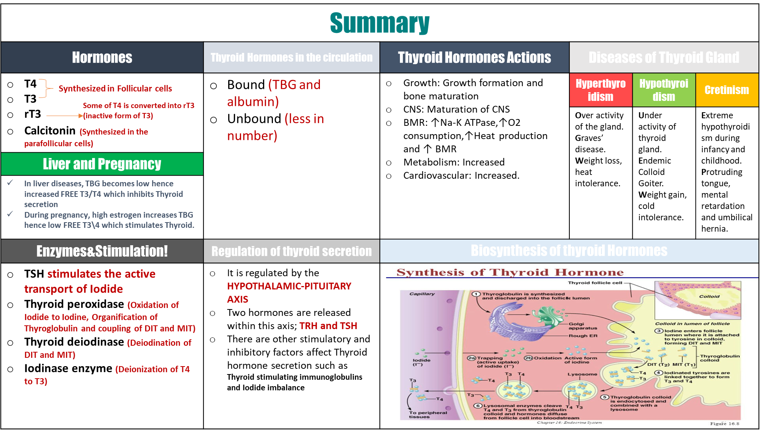

Slide 27
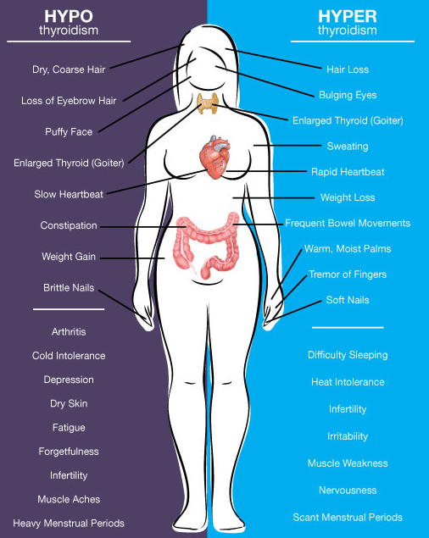
Summary of hypo-hyperthyroidism
Another summary

Slide 28







Thank you for checking our work!
اعمل لترسم بسمة، اعمل لتمسح دمعة، اعمل و أنت تعلم أن الله لا يضيع أجر من أحسن عملا.
قادة الفريق:
ليــلـى مـذكور & مـحـمـد نـصـر
Please check our editing file to know if there are any additions, changes or corrections.
خالص الشكر لأعضاء الفريق الكِرام:
Examine yourself
أسيل بادخن
حنين باشيخ
دعاء عبدالفتاح
دعاء ماهر
زينة الكاف
نوف العماري
عبدالرحمن الراشد
عبدالعزيز العنقري
عبداللطيف العبداللطيف
فارس الجعفر
قيس المهيدب
نواف الخضيري
باسل المفلح
حسان الشمري
حمد الخضيري
خالد القحطاني
طلال الحقيل
عبدالله السعيد
2017-2018 Dr. Nervana Bayumi’s Lecture & Notes.
2017-2018 Prof. Abdulmajeed Aldress’s Lecture& Notes.
Guyton & Hall of Medical Physiology 13th Edition.
Linda S. Costanzo 5th Edition.
Helpful physiology bocks.
Give us your feedback ☺
اللهم اني استودعتك ما حفظت وما قرأت وما فهمت، فرده لي وقت حاجتي إليه إنّك على كل شيءٍ قدير.

