Slide 1
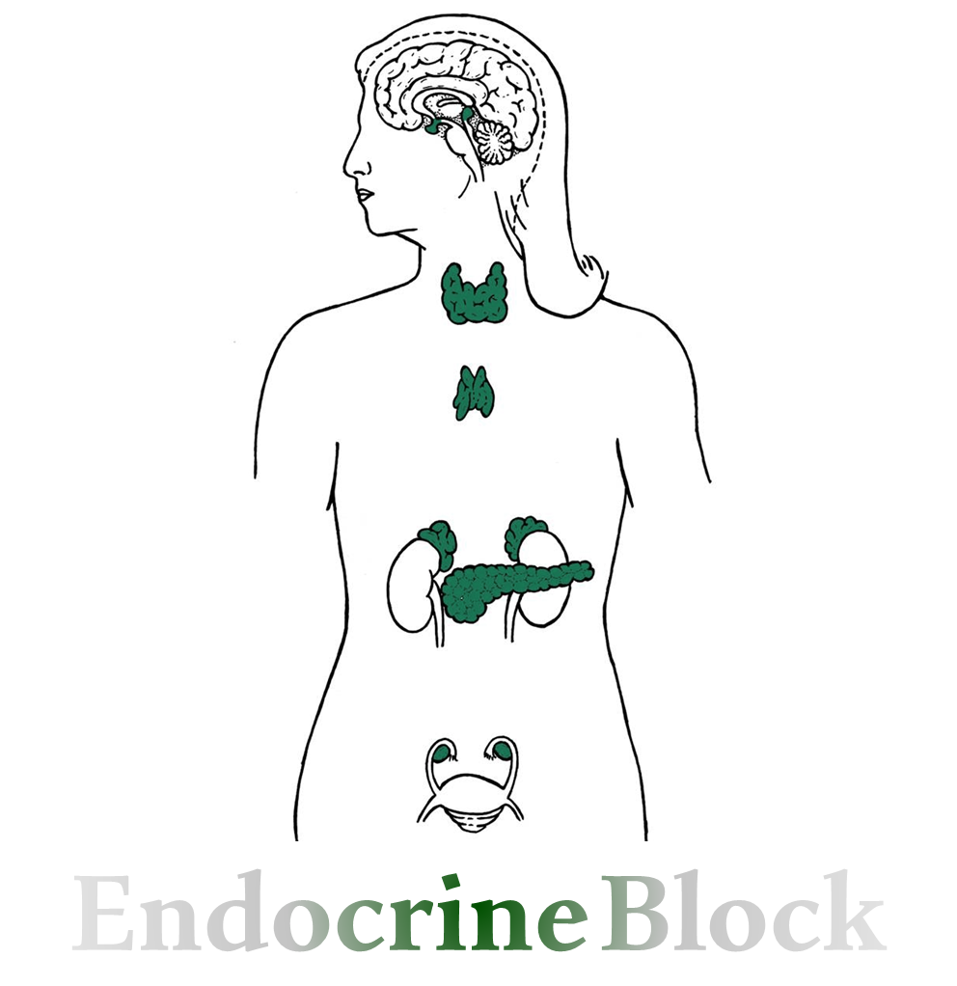
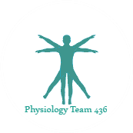
Text
Only in Females’ slide
Only in Males’ slides
Important
Numbers
Doctor notes
Extra Notes
كل محتويات المحاضرة سواء كانت عند البنات فقط أو الأولاد فقط، هي ضمن الأوبجكتف.
حاولوا تدرسون كل المحاضرة، المحاضرة جداً سهلة وبسيطة ☺

Slide 2
Hypo and hyper-parathyroidism
By the end of this lecture, students should be able to describe:
1. List the functions of calcium.
2. Describe calcium metabolism.
3. Describe physiology of bone.
4. Understand and explain hormonal regulation of calcium metabolism:
Parathyroid hormone
Calcitonin
Vitamine D3
5. Understand hypo and hyper-parathyroidism.

Slide 3
Hypercalcemia
Only in Males’ Slides
PTH mediated: Primary hyperparathyroidism.
Non-PTH mediated:
Parathyroid hormone–related peptide (PTHrP): certain tumors secrete high levels of PTHrP, which causes hypercalcemia of malignancy.
Vitamin D intoxication, granulomatous disorders, osteolytic bone metastases, malignancy.
Medications: Thiazide diuretics
NS (normal saline) bolus to restore volume; then 100 – 200 ml/hours.
Bisphosphonates (onset 24 - 48 hours).
Calcitonin 4 – 8 IU q6-8 hrs (onset immediate, resistance develops in 24 - 48 hours).
Surgery for adenoma.
Medications of severe hypercalcemia:
Indications for therapy: Symptoms of hypercalcemia & Plasma [Ca] >14 mg/dl.
Principles of therapy:
Expand ECF volume.
Increase urinary calcium excretion.
Decrease bone resorption.
Clinical Manifestation:
Nausea, vomiting.
Anorexia (decrease apatite), weight loss.
Constipation.
Lethargy (tiredness )and Fatigue.
Confusion, stupor (lack of critical mental function), coma.
Impaired concentration and memory.
Depression.
Reduced neuromuscular excitability & muscle weakness (calcium blocks sodium channels and inhibits depolarization).
Easy fatigability & muscle weakness more common in hyperparathyroidism than other hypercalcemic conditions.
Proximal muscle weakness
Shortened QT interval on electrocardiogram.
Cardiac arrhythmias.
Vascular calcification.

Slide 4
Wolff’s Law
Only in Males’ Slides
States that bone in a healthy person or animal will adapt to the loads under which it is placed. If loading on a particular bone increases, the bone will remodel itself over time to become stronger to resist that sort of loading.
The remodeling of bone in response to loading is achieved via mechanical stress.
Prolonged immobilization might lead to bone resorption and increased calcium plasma levels.

Slide 5
Hypocalcemia
Only in Males’ Slides
Causes:
Hypoparathyroidism:
Surgical (thyroid, parathyroid surgery).
Autoimmune
Magnesium deficiency
PTH resistance (pseudohypoparathyroism): Normal PTH levels but deficient receptors
Vitamin D deficiency
Vitamin D resistance
Lack of 1α hydroxylase → no vit D3 activation.
Other: renal failure, pancreatitis and tumor lysis.
Clinical Signs:
Neuromuscular excitability.
Paranesthesia (tingling sensation) around mouth, fingers and toes.
Muscle cramps, carpopedal spasms (a spasmodic contraction of the muscles of the hands, feet, and especially the wrists and ankles).
Tetany (is a medical sign consisting of the involuntary contraction of muscles).
Seizures (focal or generalized).
Laryngospasm (an involuntary muscular contraction (spasm) of the vocal folds), stridor (is a high-pitched breath sound) and apneas (suspension of breathing) → this signs appears in neonates.
Cardiac rhythm disturbances (prolonged QT interval).
Chvostek’s and Trousseau’s signs – latent hypocalcemia (explained next slide).

Slide 6
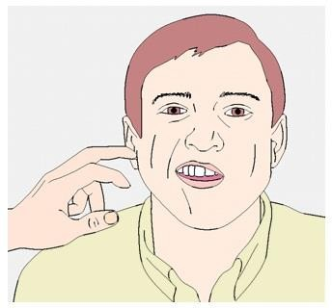
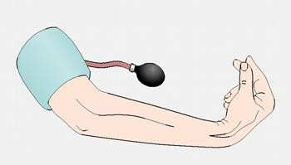
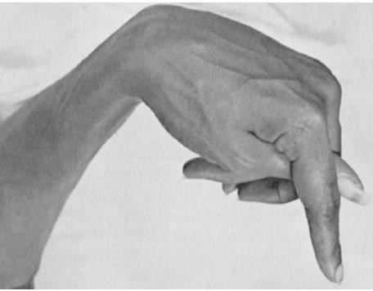
Chvostek’s & Trousseau’s sign
Very important
فيه سؤال من هنا
Chvostek’s Sign
It refers to an abnormal reaction to the stimulation of the facial nerve.
When the facial nerve is tapped at the angle of the jaw (i.E. Masseter muscle), the facial muscles on the same side of the face will contract momentarily.
Typically a twitch of the nose or lips because of hypocalcemia.
Trousseau’s Sign
To elicit the sign, a blood pressure cuff (sphygmomanometer) is placed around the arm and inflated to a pressure greater than the systolic blood pressure and held in place for 3 minutes.
This will occlude the brachial artery.
In the absence of blood flow, the patient's hypocalcemia and subsequent neuromuscular irritability will induce spasm of the muscles of the hand and forearm.
The wrist, thumb and metacarpophalangeal joints are flex, and fingers are adducted. This is due to enhanced neuromuscular excitability.

Slide 7
Hyperparathyroidism
Only in Males’ Slides
The disorder is characterized by:
hypercalcemia, hypercalciuria, hypophosphatemia, and hyperphosphaturia.
Parathyroid hormone causes phosphaturia and a decrease in serum phosphate.
Calcium rises and it is also secreted in the urine.
Most common complication are renal stones made of calcium phosphate.
Stone chemistries: calcium, phosphate, urate.
Most serious complication is the deposition of calcium in the kidney tubules resulting in impaired renal function.
Causes:
Primary
Adenoma (90%).
Multiple gland enlargement (10%).
Familial hyperparathyroidism.
Carcinoma (<1%).
Familial benign hypercalcemia (FBH).
Secondary (normo - or hypocalcemic):
Renal failure.
Vitamin D deficiency.

Slide 8
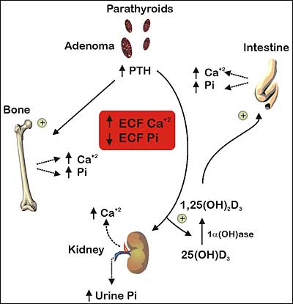
Cont.
Here the diagram explains the parathyroid hormone functions:
1st on bones: increase Ca⁺⁺ and Phosphate resorption.
2nd on kidneys: Increase Ca⁺⁺ reabsorption, However it increases phosphate excretion.
Also it stimulate (enhance) the action of 1- α-dihydroxycholecalciferol enzyme which will increase the production of 1,25(OH)₂D3 the active form of vit D.
Ultimately this will lead to increase Extracellular fluid Ca⁺⁺ and decreasing Phosphate.

Slide 9
Primary Hyperparathyroidism
Only in Males’ Slides
Only in Females’ Slides
Manifestation:
Hypercalcemia, Hypercalciuria.
Hypophosphemia (↓PO-4)
↑ Alkaline phosphatase (steoclastic resorption of bone can lead to weakened bones and secondary stimulation of the​ ​osteoblasts When the osteoblasts become active, they secrete large quantities of alkaline phosphatase.Therefore, one of the important diagnostic findings in hyperparathyroidism is a high level of plasma alkaline phosphatase).
Demineralization of bone multiple bone cysts (osteitis fibrosa cystic).
Broken bones.
CNS depressed, peripheral nervous system depressed (because of high Ca in ECF will decrease Na permeability at NMJ)
Muscle weakness.
Constipation, abdominal pain, peptic ulcer & decrease appetite.
Depressed relaxation of the heart during systole.
Calcium containing stones in kidney.
Parathyroid poisoning: Precipitation of calcium in soft tissues occur when Ca⁺² → >17mg/dl → lead to death.
Just read it
Affects approximately 100,000 patients a year (in the US).
Prevalence: 0.1 to 0.3% of the general population.
More common in women (1:500) than in men (1:2000).
Patients with single adenoma ~90% : minimally invasive surgery.
العظم يفضى من المنيرالز الي فيه فيطلع العظم فارغ وكأنه يحتوي على أكياس
The bone becomes weak and easily broken.
If we measured the level of the enzyme alkaline phosphatase in blood it will be high.

Slide 10
Secondary Hyperparathyroidism
Only in Females’ Slides
Due to ↓ Ca⁺² in ECF.
Causes:
Low calcium diet.
Pregnancy.
Lactation.
Rickets or Osteomalcia.
Chronic renal failure → ↓ 1,25(OH) – D3 synthesis

Slide 11
Hypoparathyroidism (Rare)
Important
Cause:
Injury to the parathyroid glands (surgery).
Autoimmune.
Symptoms: (due to hypocalcaemia)
Tingling in the lips, fingers, and toes (Due to neural hyperexcitability).
Dry hair, brittle nails, and dry, coarse skin.
Muscle cramps and pain in the face, hands, legs, and feet.
Cataracts on the eyes (​No one knows why).
Malformations of the teeth, including weakened tooth enamel.
Loss of memory.
Headaches.
Signs:
Positive Chvostek’s sign (facial muscle twitch).
Positive Trousseau’s sign (carpal spasm) metacarpophalangeal and wrist joints are flexed, fingers are adducted.
Delayed cardiac repolarization with prolongation of the QT interval.
Paresthesia.
Tetany: can be overt or latent.
Treatment:
Calcium carbonate and vitamin D supplements (We can’t treat the patient with parathyroid hormone since its effect is transient and very expensive)
Case:
27 years old man present to his physician 3 weeks after his thyroid surgically removed because of thyroid cancer, he noticed after discharge that he has involuntary painful muscular cramps, numbness around his mouth, head and feet, his parents said that he was irritable for the the last 2 weeks and he is on levothyroxine medication.
Diagnosis:
Hypoparathyroidism due to injury of the gland during the surgery

Slide 12
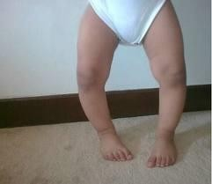
Vitamin D deficiency Diseases
Important
1. Rickets: (in children)
Cause: lack of vitamin D leading to calcium/phosphate deficiency in ECF, so there is normal formation of the
collagen matrix but Incomplete mineralization (poor calcification) → Soft Bones (Clinically: Bone Deformity).
(Either due to low VitD. intake or insufficient sun exposure → ↓calcium & ↓ phosphate in ECF → no bones calcification
→ soft weak bones → the weight of the body will cause the bones to bend)
Season: Occur in the spring. Why? due to depletion of VitD stores during the winter so symptoms appear in spring.
ليه يبين بالربيع مو الشتاء ؟ لأن بالصيف كان يتعرض للشمس فصار عنده فيتامين دال، ولما جا الشتاء صار مافي شمس، بس كان لسا عنده مخزون، بس لما جا الربيع خلص المخزون وبدأت تطلع عنده الأعراض.
Features:
Low plasma calcium & phosphate.
Weak bones
Tetany
Treatment of Rickets:
Supplying adequate calcium and phosphate in the diet.
Administering large amounts of vitamin D.
Tetany in Rickets (only in females’ slides)
Early stages | No tetany. PTH stimulate osteoclastic absorption of bone. ECF Calcium level is normal.
When the bones finally become exhausted of calcium | Calcium level falls rapidly
Blood level of calcium falls below 7 mg/dl | Signs of tetany: positive Chvostek's sign. Death: tetanic respiratory spasm.
ﻟﻮ ﺻﺮﺗوا دﻛاترة اﻃﻔﺎل وﺟﺎكم ﻣﺮﯾﺾ وﺷﻜﯿﺘوا ان عنده Rickets وﺳﺄﻟﺘوه ﻋﻨﺪك ﺗﯿﺘﺎﻧﻲ وقالكم ﻻ، وش تسوون؟ تقولون ﻟﻪ ارﺟﻊ اﻟﺒﯿﺖ ﻣﺎﻓﯿﻚ ﺷﻲء؟ لا طبعا لأن الدكتور الشاطر بيتذكر الفيسيولوجي، ويتذكر أن PTH قاعد يشتغل as compensatory mechanism، فـ إنخفاض مستوى الكالسيوم راح يتعوض، لكن العظام لسا ضعيفة.

Slide 13
Cont.
2. Osteomalacia: (Rickets in adult)
Demineralization (poor calcification) of preexisting bones which leads to more susceptibility to Fracture.
Serious deficiencies of both vitamin D and calcium occasionally occur as a result of steatorrhea (failure to absorb fat) (Since vitD is fat soluble it can be deficient in cases of steatorrhea).
Poor absorption of vitamin D and calcium.
Almost never proceeds to the stage of tetany but often is a cause of severe bone disability.
Renal Rickets: (The kidneys synthesize the active form of VitD since it contains the enzyme α1-hydroxlase)
It is a type of osteomalacia due to prolonged kidney disease.
Failure of the damaged kidney.
Only in Females’ Slides
3. Osteoporosis
Typically silent without symptoms until late stages → fractures with minimum trauma.
Inadequate bone matrix and minerals.
Osteoporosis is the most common of all bone diseases in adults, especially in old age.
Results from equal loss of both organic bone matrix and minerals resulting in loss of total bone mass and strength.
The cause of the diminished bone:
The osteoblastic activity in the bone is usually less than normal so the rate of bone osteoid deposition is depressed.
Excess osteoclastic activity.
Lack of physical stress.
Malnutrition (lack of vitamin C) → collagen decrease.
Postmenopausal lack of estrogen (Estrogen inhibit the activity of osteoclast and decrease the number of osteoclast. So, when estrogen gone the osteoclast will start to do it’s function)
Old age.
Cushing’s syndrome (because massive quantities of glucocorticoids secreted in this disease cause decreased deposition of protein throughout the body and increased catabolism of protein and have the specific effect of depressing osteoblastic activity).
Only in Females’ Slides

Slide 14
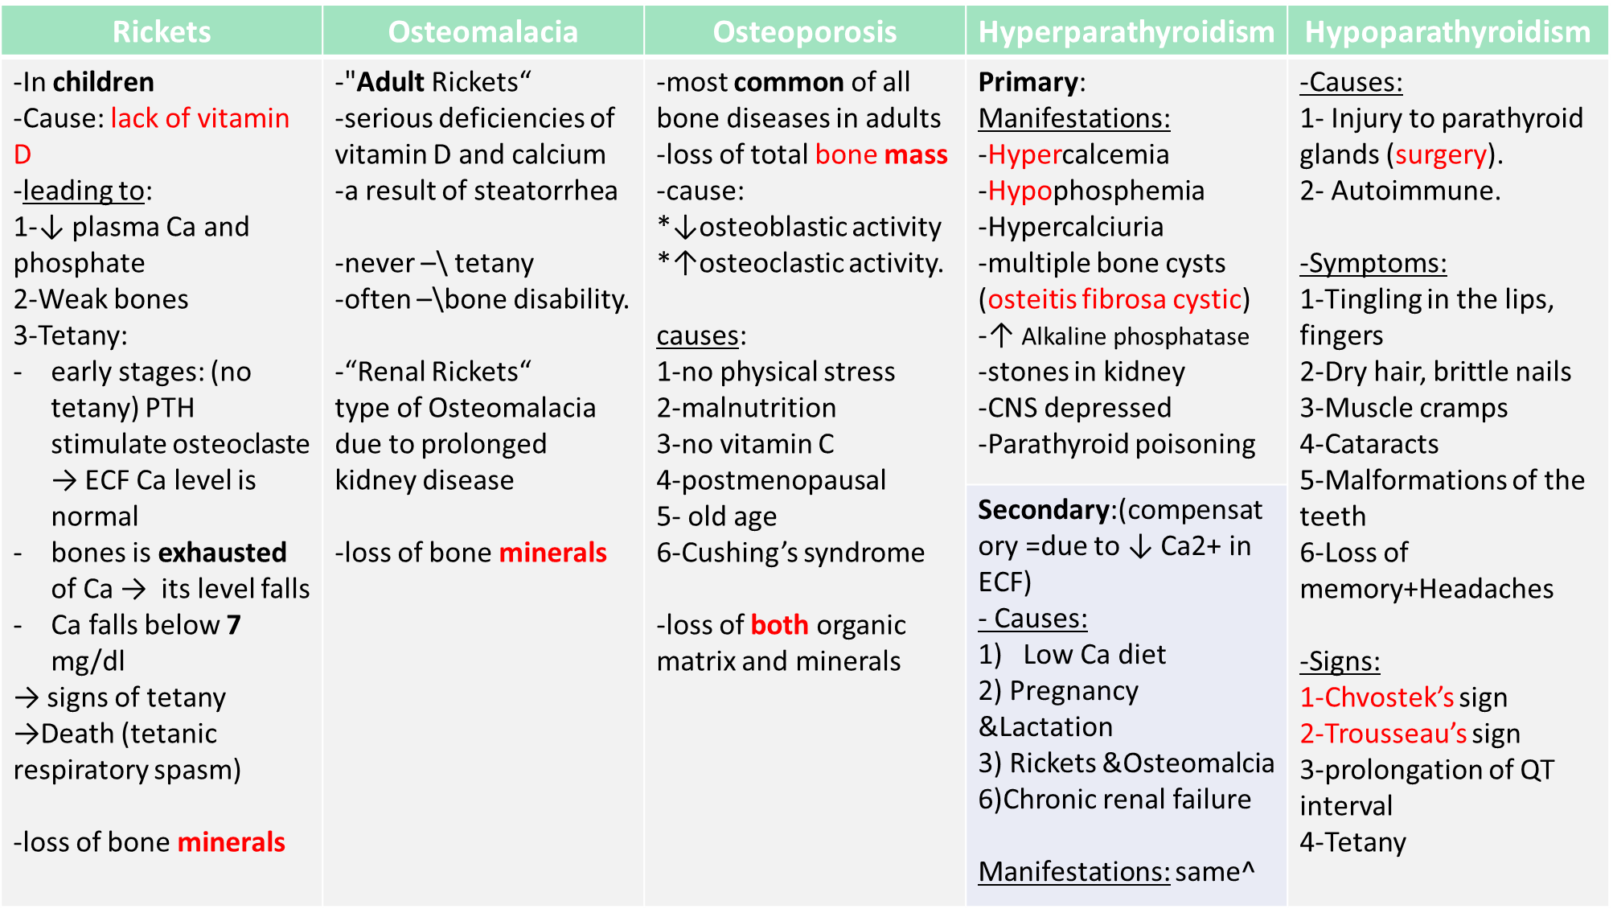
Summary

Slide 15
Thank you for checking our work!
اعمل لترسم بسمة، اعمل لتمسح دمعة، اعمل و أنت تعلم أن الله لا يضيع أجر من أحسن عملا.
قادة الفريق:
ليــلـى مـذكور & مـحـمـد نـصـر
Please check our editing file to know if there are any additions, changes or corrections.
Examine yourself
خالص الشكر لأعضاء الفريق الكِرام:
فؤاد فتحي
ماجد الزين
لـمـى الـتـمـيـمـي
دعاء عبدالفتاح
غادة المزروع
2017-2018 Dr. Abeer AlGhumlas’s Lecture & Notes.
2017-2018 Dr. Khalid Al Regaiey’s Lecture& Notes.
Guyton & Hall of Medical Physiology 13th Edition.
Linda S. Costanzo 5th Edition.
Helpful physiology bocks.
Give us your feedback ☺
اللهم اني استودعتك ما حفظت وما قرأت وما فهمت، فرده لي وقت حاجتي إليه إنّك على كل شيءٍ قدير.

