Slide 1
Med436
Editing File
Coping with Diabetes Mellitus in Adolescence
Notes
Important
Extra

Slide 2
Objectives:
Types of Diabetes and treatment
Types of coping
Difficulties among adolescent with DM type 1
Sources of stressors
How to help

Slide 3
Overview Of Diabetes Mellitus
What is Diabetes Mellitus?
Introduction video
It is a group of metabolic disorders in which there are high blood sugar levels over a prolonged period. (Extra)
Types of DM:
Type I | Type II | Gestational
Insulin-dependent diabetes mellitus(IDDM) 5% - 10% Childhood | Non-insulin dependent diabetes mellitus(NIDDM) Increased about 4 folds (Last 30 years) 8.5% Age usually more than 18 | During pregnancy
Family history (specially history of autoimmune diseases) is important in T1DM while obesity is an important risk factor to T2DM. (Important)
The older, the higher risk of developing DM. <30 years old
Glucose impairment → Pre-diabetes

Slide 4
Overview Of Diabetes Mellitus
Treatment of Diabetes Mellitus:
Lifestyle
Active
Weight control
Drugs
Early diagnosis
Insulin Vs. Oral hypoglycemic
Blood pressure control
Blood lipid control
Renal function
Must be tightly controlled
Facts about Type I patients:
80%, Unhygienic administer (ما ينظفون المكان قبل الحقنة )
58% , Wrong dose
77%, Glucose level (Test/interpret)(ما يعرفون يقرؤون النتائج)
75% , Foods ( type / regular ) (ما يعرفون نوع الأكل اللي ينفعلهم)
Early diagnosis is important to detect early stages (or pre-diabetes) of DM so complications will not progress earlier in life.
Delayed diagnosis → intense symptoms

Slide 5
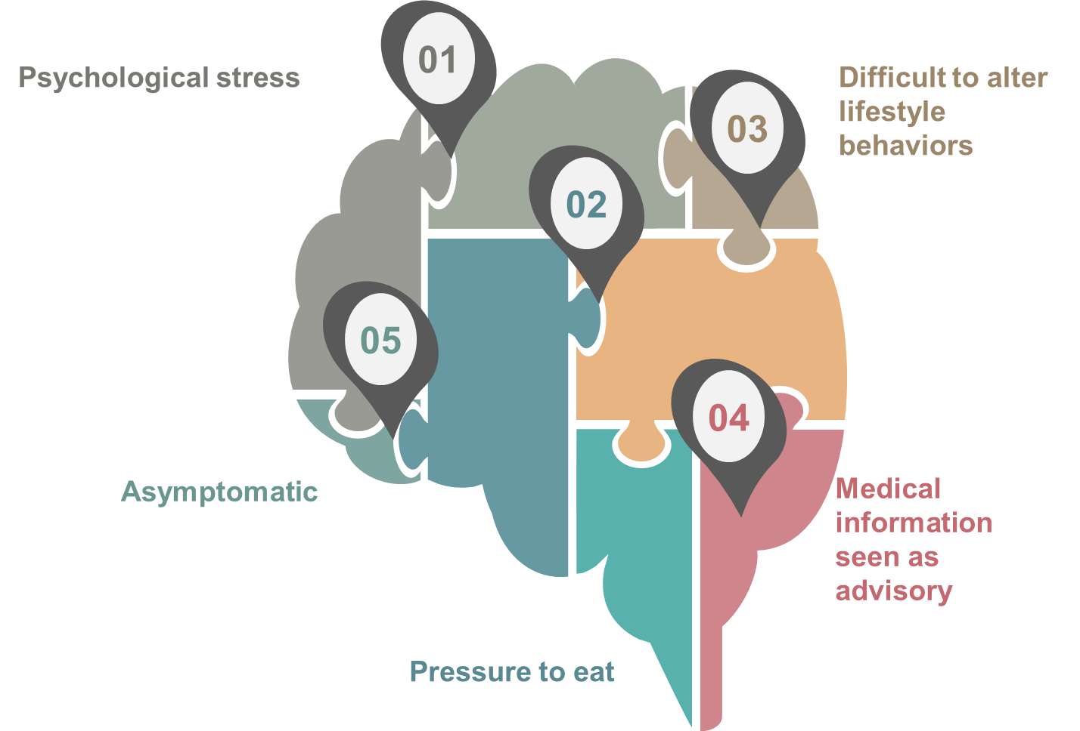
Stressors
What is a stressor?
It is a chemical or biological agent, environmental condition, external stimulus or an event that causes stress to an organism. (Extra)
Sources for stressors for them (Adolescents and children):
أي شي ممكن يأثر على نفسية الطفل, مثلا نظره اصدقائه له ,فكرة انه بيأخذ الدواء طول حياته...
بيغير طريقة اكله وجرعات الادوية اللي لازم ياخذها
كثير منهم ما يعرف انه عنده الا بوقت متأخر ليش ؟
Threshold for Type 1 Diabetes is very high
ما تقدر تبسط المعلومات عن المرض اللي عنده لدرجة يفهمها و ممكن يفهم المريض أن هذا نوع من التحكم و فرض السيطرة. كون الإنسان خلال هذه الفترة العمرية يفكر بالاستقرارية و هذا النوع من النصائح ممكن يشعره بأنه غير مستقل و غير قادر على اتخاذ قرار بنفسه.
منعه من بعض انواع الاكل والحلويات , اللي هي متعته في الحياة!!

Slide 6
Stages of grief
Anger
Bargaining
المساومة
Denial
الإنكار
Depression*
(irritability)
Acceptance
Stages of grief
So, Now you told them that they have diabetes , what will they do ?
شرح الخطوات :
يعني اول ما تعلم المريض انه عنده دايابيتس (الاطفال والمراهقين ) يبدأ اول شي ينكر الموضوع ويقول لا مافيني شي , بعدها مع اصرار اهله على العلاج يبدأ المريض يغضب ويعصب , بعدها يتعود على الموضوع شوي ويبدأ يساوم الدكتور أو أهله (طيب لو عدلت اكلي؟ لو بطلت التشوكليت ارجع طبيعي ؟ ), طبعا بعد فترة بيستوعب انه ما يقدر يسوي شي ويدخل في الاكتئاب , واخر شي بيوصل مرحل يتقبل فيها المرض.
To diagnose a diabetic (or any chronic) patient with depression, diagnostic criteria must be followed*. (Do you remember CNS block?)
Those stages are not necessary to be in the same sequence. It depends on person’s behavior.

Slide 7
Coping
What is Coping (Adapting) ?
After accepting the fact of being ill, coping starts.
The process of managing stressors (internal and external).
Coping of adolescents with chronic illness focus on coping with illness it self. ( مرة مهمة واذا جاكم سؤال فهو غالبا عنها)
Adolescence stages
Early adolescence (11-14 years)
Mid-adolescence (14-16 years)
Late adolescence (17-older years)
Am I normal ?
Independence
self image
Future oriented
Intimacy (رأي الجنس الاخر فيه)
career goals
More common with females

Slide 8
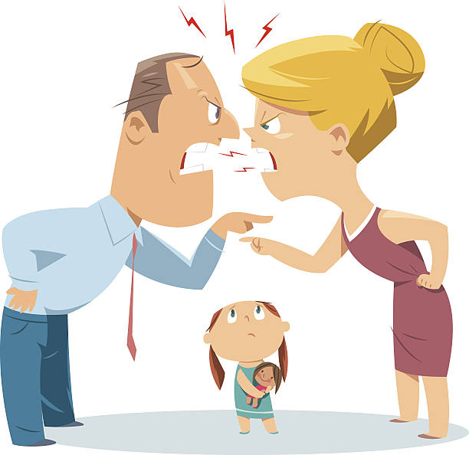
Coping
Family conflict :
Dr. Mohammed explained this part. It is not extra, don’t skip it.
one study found that diabetes-specific family conflict had a stronger negative impact on quality of life than the intensity of treatment.
negative and critical parenting, has been related to poor metabolic control and poorer quality of life in youth
Why family conflict has negative impact? Because it puts the child under stress all the time and that will increase CORTISOL in the body which in return will increase glucose and decreases the uptake.

Slide 9
Difficulties among adolescents
Developmental complications
Dependency on family
(developing independence)
تلاقي أمه وأبوه وراه دائما
Relationship with peers
Body image issues
Morbidity
Psychological morbidity appears to be from 10 – 30 % with chronic illnesses.
Depression
Diabetes mellitus is co-morbid with :
مهمة مرة , اذا جاكم سؤال وش اكثر
(psychiatric disorder ) يرتبط مع الدايابيتس ؟
Anxiety disorders (most common)

Slide 10
Psychosocial factors and Diabetes
Psychosocial Factors and Diabetes (Extra)
THIS SLIDE IS EXTRA
Stress sometimes changes a latent case of diabetes into an active one.
Psychological factors may precipitate the onset of diabetes and influence the timing of symptoms presentation.
It has been established that there is an excess of life events in the few months preceding the onset of the condition particularly in older children & adolescents.
Life experience and emotional factors can have an important bearing on the course of diabetes.
كل الذكريات و الأحداث التي نمر بها، يتم تخزينها في العقل الباطن، فعندما يمر الإنسان بموقف معين، يقوم العقل الباطن باستحضار الذكريات المرتبطة بذلك الموقف فيبني الإنسان مخاوفه و موقفه على حسب الذكرى. مثلًا شخص معين علِم بوفاة أحدهم بسبب مرض السكري ، العقل الباطن يحفظ هذه الحادثة دون ان يعي ثم حينما شُخِص ذلك الشخص بمرض السكري، تلقائيًا يسترجع ذكرى وفاة ذلك الشخص فيبني خوفه من المرض.
Diabetes mellitus is not the only chronic disorder that leads to psychological symptoms. All chronic diseases do.

Slide 11
Other co-morbid problems
Other co-morbid behavioral & psychological problems:
Learning problems
Acute organic brain syndrome
e.g.; delirium
(DM can lower mental capacity and ability)
Adjustment disorders
Behavioral problems
School absence
Anger
Low self esteem
Social withdrawal
Eating disorders
Diabetic patients commonly have Bulimia nervosa because of guilt feeling
Because of low self esteem

Slide 12
How to Help?
DM patients don’t ask for help, why?
Dependent behavior
Parental involvement
Immaturity (ما يقدر المريض حالته و سوؤها و تعتبر أشد معضلة للأطباء النفسيين)
Lack of support system
Severe illness or disability
Psychopathology (Depression and Anxiety)
Obstacles with family / caregivers (يعني كيف تتغير طريقة تعامل الاهل مع الطفل)
Emotional Dependency
Parenting styles
Excessive need of control
Heightened perception of disease severity
Lack of trust in caregivers

Slide 13
How to Help?
How to help? (Treatment)
Parent support
Coping with depression and anxiety.
Cognitive coping:
Understand how the insulin helps to grow stronger.
Behavioral coping:
Minimize the experience of being deprived from popular food .
The easiest thing you can change with a child is behavior.
Psychosocial Aspects of Management:
Education.
School and Family Counseling.
Managing psychiatric Disorders.
Individual psychotherapy.
عشان نعالج الأعراض النفسية لمريض السكري، لازم نعالج كل شيء مع بعض و ممكن إننا نركز على شيء أكثر من غيره لكن أهم شيء إننا ما نترك حاجة بدون علاج.

Slide 14
Important Message
Important Slide
Psychological factors
Anxiety disorder
Dependency
Coping with disease itself
Course of illness
Psychiatric Disorder
Difficulties,
Most important
Best way of coping

Slide 15
Test your self!
Q1.What is the most common psychiatric disorder associated with Type 1 diabetes ?
A. Depression
B. Anxiety
C. Schizophrenia
D. Delirium
Q5.A 15 years old diabetic patient’s mother had noticed her child to ask frequent questions about the possibility of not getting the disease if she kept her diet well controlled. Which stage of grief is the patient at?
Depression
Bargaining
anger
none
Q2. what is the best way of coping in a child with type 1 diabetes ?
Diet restriction
Bargaining
Parent counseling
Coping with illness itself
Q6. Which of the following can be associated with diabetes mellitus?
Low self esteem
Psychosis
Increase mental ability
Memory loss
Q3.which one the following is considered one of the stressors for an adolescent with diabetes ?
A. Pressure to eat
B. Difficult to alter lifestyle behaviors
C. Medical information seen as advisory
D. All of them
Q4.Adolescent patients with diabetes don’t usually ask for help. Why?
Fear of the treatment
Psychopathology
Immaturity
B and C
Answer key:
1:B 2:D 3:D 4:D 5:B 6:A

Slide 16
Summary | Stressors | Stages of Grief
 | In Diabetic patients, stressors sources vary and each stressor has a different effect on the disease course (Psychological factors can change the course of disease).
 | Coping | Difficulties they face
 | Coping is : the process of managing the stressors (internal and external). Family conflict and over caring has a very negative impact on the coping process which leads to DEPENDENCY. | Diet restriction Dependency on family (Independency is essential in the treatment to an extent) Physical limitations and body image issues Frequent blood testing and injection Isolation from peers
 | How to help?
 | Important to know!!
Denial → Anger → Bargaining → Depression → Acceptance
Those sources are:
Psychological stress (most common is ANXIETY)
Pressure to eat (can develop anxiety)
Asymptomatic (patient can deny the fact that they have DM)
Difficult to alter lifestyle behaviors (Peer influence cause more difficulty)
Medical information seen as advisory (This age group hate to be guided)
Parent support
Coping with depression and anxiety
Cognitive coping
Behavioral coping
BEST WAY OF COPING : COPING WITH THE ILLNES ITSELF
MOST COMMON PSYCHIATRIC DISORDER WITH TYPE 1 DIABETES in ADOLSCENTS AND CHLDREN IS : ANXIETY

Slide 17
@Psychiatry436
436psychiatry@gmail.com
Your suggestions matter
“Don’t stop until you’re Proud”
Team Leaders:
Mohammed Habib & Aseel Badukhon
References:
Doctors’ notes and slides

