Slide 1



PRE-MARITAL
COUNSELING AND TESTS
Marwah Hassounah MPH-HCOM, MBBS
Community Medicine Unit Faculty
Family and Community Medicine Department- King Saud University Reproductive System Block- 2nd year Medical Students
April 4th, 2018 11-12 p.m.
1

Slide 2

Learning Objectives
By the end of this lecture the student should be able to:
Recognize the Saudi Healthy Marriage program
Recall the program’s areas of pre-marital counseling
List diseases included in the Saudi pre-marital screening program
Identify the fate of tested individuals (case, carrier, clear)
Recognize cultural considerations for pre-marital counseling in Saudi Arabia
2

Slide 3

Lecture Outline
The Saudi Scene
Brief on the Saudi pre-marital screening program
Pre-marital counseling and its application in KSA
The program’s objectives Overview video
Cultural considerations
3 minutes in-class stretching break
Scenario application for fates of tested couples Infectious disease scenarios
Inherited blood disorders
Closing remarks
3

Slide 4
The scene
The middle East is one of the regions known for high rates of sickle cell
disease and beta-thalassemia.(1)
In the 80s Saudi Arabia was hyper-endemic with Hep B Virus. (2)
In Saudi Arabia, Hepatitis C persists as a problem in hemodialysis patients and IV drug users. In KKUH, Hep C prevalence was 0.58 % in 1996 and decreased to 0.08% in 2006. (2)
From the year 2000 to 2009, there were 2,956 reported Saudi cases of
HIV. A rate of 1.5 cases per 100,000 Saudis.
Marked regional variations in the prevalence of sickle cell disease and b-thalassemia in Saudi Arabia: Findings form the pre-marital screening and geentic counseling program. Journal of Epidemiology
and Global Health. December 2011. Ziad A. Memish Mohamad Y. Saeedi.
Epidemiology of viral Hepatitis in Saudi Arabia: Are We Off the Hook?. Saudi Journal of Gastroenterology. Nov-Dec 2012. Ayman Abdo, Faisal M. Sanai, Faleh Z. Al-Faleh.
HIV Case Notification Rates in the Kingdom of Saudi Arabia over the Past Decade (2000-2009). PLoS ONE. Sep 2012. Mohammed A. A. I. Mazroa et al
4

Slide 5

5

Slide 6
Healthy Marriage Program
Program started in 2004. It included tests for hemoglobinopathies:
sickle cell and thalassemia.(1)
In 2008 the MOH added to the program testing for HIV, Hep B, Hep C.(2)
In 2013, the program changed its name from pre-marital screening جاوزلا لبق ام صحف to healthy marriage program جمانرب يحصلا جاوزلا, and started electronic integration. (3)
Alsaeed ES, Farhat GN, Assiri AM, Memish Z, Ahmed EM, Saeedi MY, Al-Dossary MF, Bashawri H. Distribution of hemoglobinopathy disorders in Saudi Arabia based on data from the premarital screening and genetic counseling program, 2011–2015. Journal of Epidemiology and Global Health. 2017 Dec 15.
Alswaidi FM, O'Brien SS. Is there a need to include HIV, HBV and HCV viruses in the Saudi premarital screening programme on the basis of their prevalence and transmission risk factors?. Journal of Epidemiology & Community Health. 2009 Jan 1:jech-2009.
MOH releases healthy marriage program instead of pre-marital screening [online news article]. Akhbar 24. URL: https://akhbaar24.argaam.com/article/detail/143471. Published: July 25th, 2013. Accessed: April 3rd, 2018.
6

Slide 7
Healthy Marriage Program cnt’
Centers
List of MOH centers accredited to give the healthy marriage certificate:
https://www.moh.gov.sa/en/HealthAwareness/Beforemarriage/Pa ges/002.aspx
There are others in non-MOH institutes. Ex: PCC1 here in KKUH for
KSU staff
7

Slide 8
Lecture Outline
The Saudi Scene
Brief on the Saudi pre-marital screening program
Pre-marital counseling and its application in KSA
The program’s objectives Overview video
Cultural considerations
3 minutes in-class stretching break
Scenario application for fates of tested couples Infectious disease scenarios
Inherited blood disorders
Closing remarks
8

Slide 9
Pre-marital counseling
Pre-marital: before marriage
Counseling: “professional guidance of the individual by utilizing psychological methods……” (1)
Definition of Counseling [online webpage]. Merriam- Webster Dictionary. URL: https://www.merriam-webster.com/dictionary/counseling. Accesed: April 2nd, 2018.
9

Slide 10
Pre-marital Counseling in KSA
The Saudi pre-marital screening program, tests for genetic blood disorders (hemoglobinopathies) and infectious diseases. Then according to the results, it provides counseling on:
The odds of transferring this disease to their prospective marriage partner
The odds of transferring this disease to their future children
Solutions and how to move forward
Premarital Screening [online webpage]. Ministry of Health. URL: https://www.moh.gov.sa/en/HealthAwareness/Beforemarriage/Pages/default.aspx. Last Update: July 1st, 2017. Accessed: April 2nd, 2018.
10

Slide 11
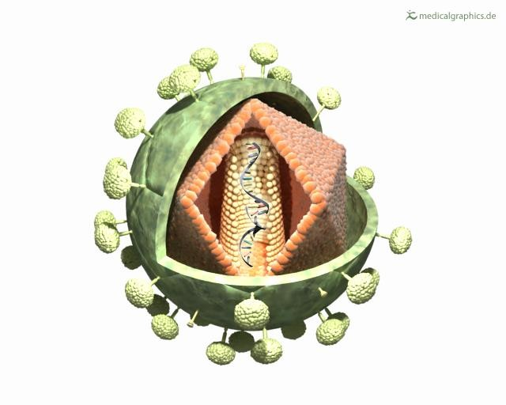


The program’s objectives
Anatomie HIV-Virus illustration by www.medicalgraphics.de, distributed under creative commons CC BY-ND 3.0. URL: http://www.medicalgraphics.de/en/free- pictures/erkrankungen/hiv-virus-offen.html. Accessed: April 2nd, 2018
Emoji image by Ebrahim, distributed under the Creative Commons Attribution-Share Alike 4.0 International license. URL: https://commons.wikimedia.org/wiki/File:Emojione_1F613.svg. Accessed: April 2nd, 2018

Slide 12
The program’s objectives
To make it easier for people who want to make the test to ask for it
To raise awareness about the concept of a comprehensive healthy marriage
Premarital Screening [online webpage]. Ministry of Health. URL: https://www.moh.gov.sa/en/HealthAwareness/Beforemarriage/Pages/default.aspx. Last Update: July 1st, 2017. Accessed: April 2nd, 2018.

Slide 13
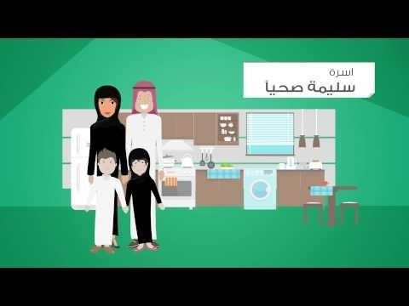

Slide 14
Certificate of healthy marriage
The certificate is issued after the test results have been done and counseling has been performed in the counseling clinic for cases that mandate it.
Examples of such cases: Having Hep C, hemoglobinopathy with chance of having diseased children

Slide 15
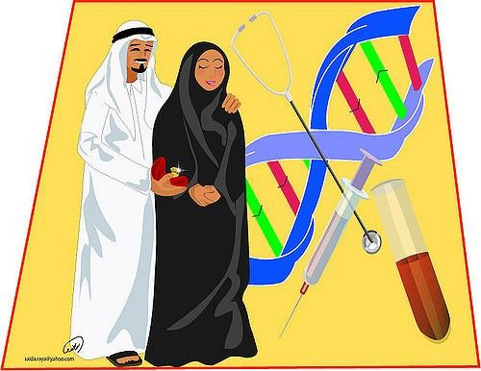
Cultural considerations
Consanguineous marriage (56% in 1995, 57.7% in 2007 in KSA)*
Respect the couple’s decisions. The test is mandatory but the
results are not mandatory.
Family and tribal pressure
Taboo of certain diseases/ stigma
Privacy and confidentiality
El-Hazmi MA, Al-Swailem AR, Warsy AS, Al-Swailem AM, Sulaimani R, Al-Meshari AA. Consanguinity among the Saudi Arabian population. Journal of medical genetics. 1995 Aug 1;32(8):623-6. El-Mouzan MI, Al-Salloum AA, Al-Herbish AS, Qurachi MM, Al-Omar AA. Regional variations in the prevalence of consanguinity in Saudi Arabia. Saudi Medical Journal. 2007;28(12):1881-4.
15

Slide 16
Lecture Outline
The Saudi Scene
Brief on the Saudi pre-marital screening program
Pre-marital counseling and its application in KSA
The program’s objectives Overview video
Cultural considerations
3 minutes in-class stretching break
Scenario application for fates of tested couples Infectious disease scenarios
Inherited blood disorders
Closing remarks

Slide 17


Slide 18
Lecture Outline
The Saudi Scene
Brief on the Saudi pre-marital screening program
Pre-marital counseling and its application in KSA
The program’s objectives Overview video
Cultural considerations
3 minutes in-class stretching break
Scenario application for fates of tested couples Infectious disease scenarios
Inherited blood disorders
Closing remarks

Slide 19

Scenario #1
Mohammed and Fatima presented to the primary care clinic for pre-marital screening. You performed the following blood tests: complete blood count, sickle cell test, hemoglobin electrophoresis, and virology tests for HIV, Hep C, and Hep B. Both were clear from any abnormalities.
1. Is counseling required in this situation?

Slide 20

Scenario #2
Amal and Tareq performed pre-marital screening tests and it was found that Tareq is a Hep B carrier. Repeat the tests to confirm. To issue them a health marriage certificate it is mandatory that they go to the counseling clinic.
what will you counsel them about?
Transmission to wife- Hep B vaccine
Transmission to future children – Hep B vaccine
Solutions: refer to specialty clinic as needed.

Slide 21
What if it was Hep C or HIV?
Repeat the tests to confirm.
Counseling is mandatory as well.
  Transmission to wife- no vaccines, health education
  Transmission to future children
  Solutions: refer to specialty clinic as needed. (antiviral therapy)
The marriage
  Hep C: if decided to proceed, sign that they received counseling
and they are going ahead with the marriage despite counseling
  HIV: Medical record goes to MOI. Only allowed to marry from other HIV affected individuals.

Slide 22
Lecture Outline
The Saudi Scene
Brief on the Saudi pre-marital screening program
Pre-marital counseling and its application in KSA
The program’s objectives Overview video
Cultural considerations
3 minutes in-class stretching break
Scenario application for fates of tested couples Infectious disease scenarios
Inherited blood disorders
Closing remarks

Slide 23

Scenario #3
Ali, from the Eastern region, presented to your clinic for pre- marital screening as he intends to marry his cousin. His prospective wife did the test and was clear from any abnormalities. Ali’s hemoglobin electrophoresis shows Hb A : 60
% , Hb SS :40% , Hb F : 2 % , meaning he is a carrier of sickle cell trait.
What would you tell them about the
odds of inheritance for their future children?

Slide 24
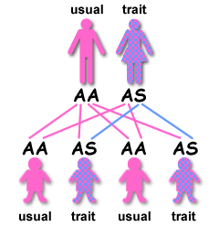
Scenario #3 cnt’
Inheritance of Sickle Cell Anemia [ online webpage]. Sickle Cell Society. URL: http://www.sicklecellsociety.org/resources/inheritance-of-sickle-cell-anaemia/. Published: July 13th, 2014. Accessed: April 3rd, 2018

Slide 25
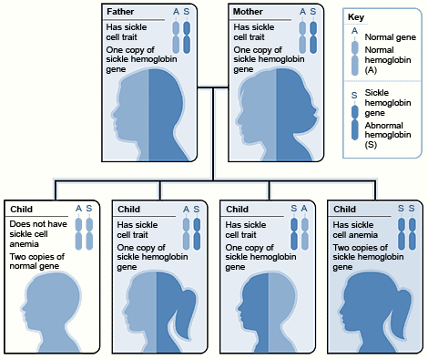
What if Ali’s fiancé Sara was also a sickle cell trait carrier?
Counseling:
Transmission to future children?
Solutions/alternatives?
  Find another partner for marriage who doesn’t have sickle cell trait or anemia
Certificate of healthy marriage will be given after they go to the counseling clinic.
Inheritance of Sickle Cell Anemia [ online webpage]. Sickle Cell Society. URL: http://www.sicklecellsociety.org/resources/inheritance-of-sickle-cell-anaemia/. Published: July 13th, 2014. Accessed: April 3rd, 2018

Slide 26
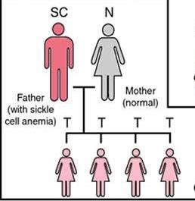
What if Ali had sickle cell anemia and Sara was clear?
Odds of transmission to future children?
Is an appointment at the counseling clinic mandatory to issue the certificate?
Image by NigeriaGalleria. Used without permission. [online webpage]. URL: https://www.nigeriagalleria.com/Community-Health/Sickle-Cell.html. Accessed: April 3rd, 2018.
26

Slide 27
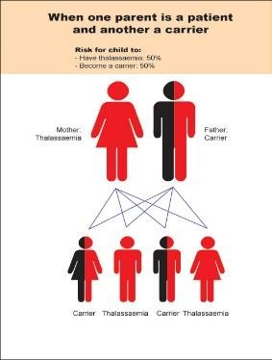
What if Ali is a carrier and Sara has sickle cell anemia?
Counseling:
Odds of transmission to future children?
Alternatives/solutions?
  Find another partner for marriage who doesn’t have sickle cell trait or anemia
Certificate of healthy marriage will be given after they go to the counseling clinic.
Image from markgadogbe. Wordpress without permission. Love and Sickle Cell [online blogpost]. URL: https://markgadogbe.wordpress.com/tag/heartbreak/. Posted:May 4th, 2015. Accessed April 3rd, 2018.
27

Slide 28
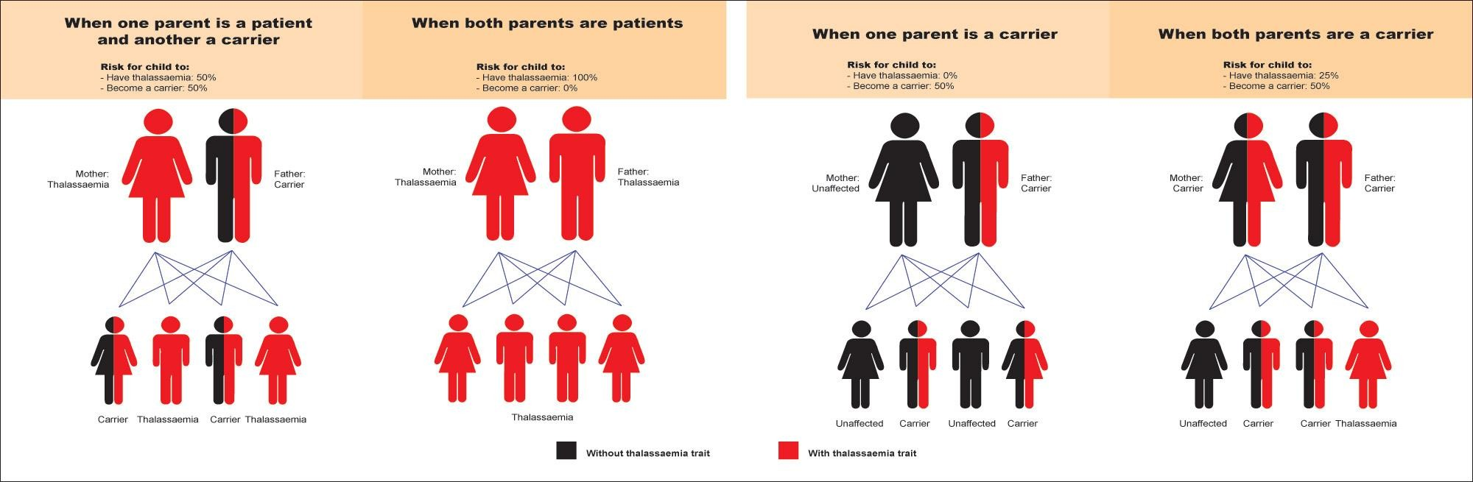
Image from markgadogbe. Wordpress without permission. Love and Sickle Cell [online blogpost]. URL: https://markgadogbe.wordpress.com/tag/heartbreak/.
Posted:May 4th, 2015. Accessed April 3rd, 2018.
28

Slide 29
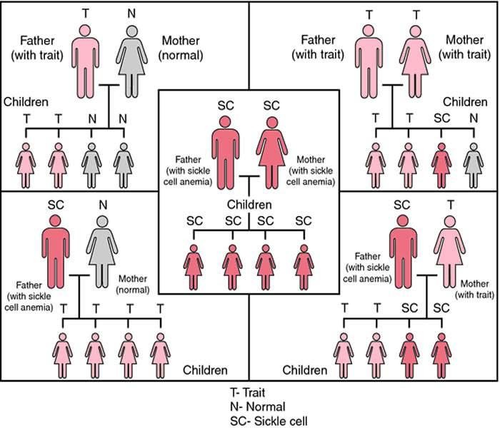
Image by NigeriaGalleria. Used without permission. [online webpage]. URL: https://www.nigeriagalleria.com/Community-Health/Sickle-Cell.html. Accessed: April 3rd, 2018.
29

Slide 30
Lecture Outline
The Saudi Scene
Brief on the Saudi pre-marital screening program
Pre-marital counseling and its application in KSA
The program’s objectives Overview video
Cultural considerations
3 minutes in-class stretching break
Scenario application for fates of tested couples Infectious disease scenarios
Inherited blood disorders
Closing remarks

Slide 31
Learning Objectives
By the end of this lecture the student should be able to:
Recognize the Saudi Healthy Marriage program
Recall the program’s areas of pre-marital counseling
List diseases included in the Saudi pre-marital screening program
Identify the fate of tested individuals (case, carrier, clear)
Recognize cultural considerations for pre-marital counseling in Saudi Arabia

Slide 32

THANK YOU
Marwah.m.i.h@gmail.com

