Slide 1
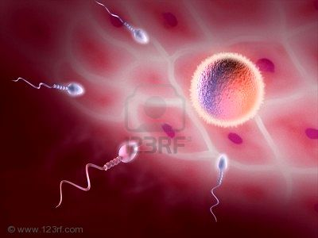
PHARMACOLOGY OF
CONTRACEPTION

Slide 2
CONTRACEPTION
PHARMACOLOGY
ILOs
By the end of this lecture you will be able to:
Perceive the different contraceptive utilities available
Classify them according to their site and mechanism of action
Justify the existing hormonal contraceptives present
Compare between the types of oral contraceptives pills with respect to mechanism of action, formulations, indications, adverse effects, contraindications and possible interactions
Hint on characteristics & efficacies of other hormonal modalities

Slide 3
IN CONCEPTION there is fusion of the sperm & ovum to produce a new organism.
?
IN CONTRACEPTION  we are preventing this fusion to occur
This achieved by interfering with
Normal process of ovulation
Preventing sperm from fertilizing the ovum
Implantation
IUD (copper T)
HORMONAL THERAPY
Killing the sperm
Interruption by a barrier
Oral Contraceptive pills
Contraceptive Patches
Vaginal rings
Injectable
IUD (with hormone)
Spermicidals
Jells
Foams
Condoms
Cervical caps Diaphragms
Thin films

Slide 4
HYPOTHALAMUS
1)GnRH
ANTERIOR PITUITARY
2)FSH
LH
OVARY
3)ESTROGENS (β-ESTRADIOL)
AND
PROGESTERONE

Slide 5
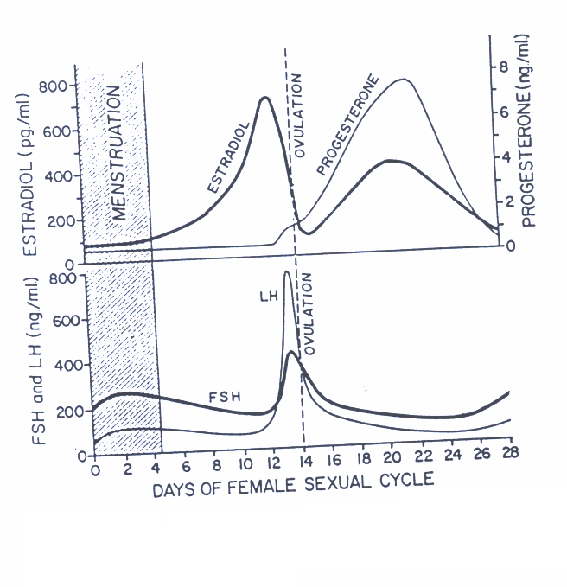
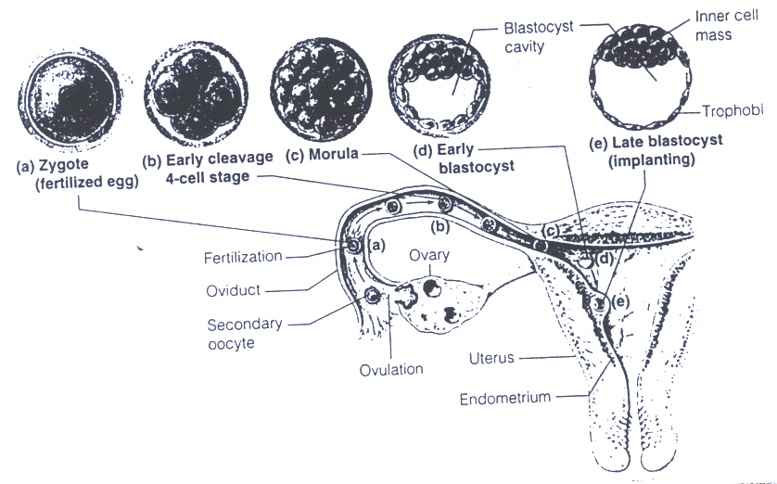
Plasma concentrations of the gonadotropins & ovarian hormones during the normal female sexual cycle

Slide 6
Types
ORAL CONTRACEPTIVE Pills
According to composition & intent of use; OC are divided into three types
COMBINED Pills(COC)
MINI Pills(POP)
MORNING-AFTER Pills
Contain estrogen & progestin(100% effective)
Contain only a progestin(97%effective)
Contain both hormones or
Each one alone (high dose) or Mifepristone + Misoprostol
ESTROGENS
Ethinyl estradiol or mestranol [a “prodrug” converted to ethinyl estradiol]
Currently concentration used now is very low to minimize estrogen hazards
PROGESTINS
Norethindrone
Levonorgestrel (Norgestrel)
Medroxyprogesterone acetate
Has systemic androgenic effect; acne, hirsutism, weight gain.
Currently
Norgestimate
Desogestrel
Drospirenone
Has no systemic androgenic effect
Notes:
Birth control pills

Slide 7
MECHANISM OF ACTION OF COC
INHIBIT OVULATION by SUPPRESSING THE RELEASE OF GONADOTROPHINS(FSH & LH)  no action on the ovary  ovulation is prevented.
Inhibit IMPLANTATION by causing abnormal contraction of the fallopian tubes & uterine musculatureovum will be expelled rather than implanted.
Increase viscosity of the cervical mucus making it so viscous  no sperm pass
Abnormal transport time through the fallopian tubes .

Slide 8
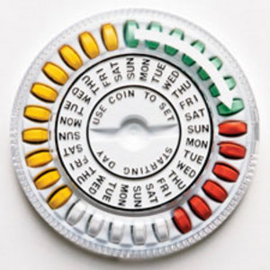
COMBINED Pills [COC] Continued
Methods of administration of monthly pills
Pills are better taken same time of day
For 21 days; starting on day 5 / ending at day 26.
This is followed by a 7 day pill free period
TO IMPROVE COMPLIANCE; a formulation of 28 pills
* The first 21 pills are of multiphasic formulation
* Followed by the last 7 pills are actually placebo

Slide 9
Seasonal Pills
COMBINED Pills [COC] Continued
COMBINED Pills [COC] Continued
Are known as Continuous / Extended cycle  Cover 91 days schedule
Taken continuously for 84 days, break for 7 days
Has very low doses of both estrogens and progestins
Benefit; It lessens menstrual periods to 4 times a year useful in those who have pre-menestrual or menestrual disorders, and in perimenopausal women with vasomotor symptoms.
Disadvantages; Higher incidence of breakthrough bleeding & spotting during early use.

Slide 10
COMBINED Pills [COC] Continued
Monthly Pills
Currently, their formulation is improved to mimic the natural on going changes in hormonal profile.
Accordingly we have now the phase formulations
Monophasic (a fixed amount of estrogen & progestin)
Biphasic (2 doses)(a fixed amount of estrogen, while amount of progestin increases stepwise in the second half of the cycle)
Triphasic (3 doses)(amount of estrogen; fixed or variable & amount of progestin increases stepwise in 3 phases).

Slide 11
COMBINED Pills [COC] Continued
 | Estrogen (mg) |  | Progestin (mg)
Monophasic combination tablets
Loestrin 21 1/20 | Ethinyl estradiol | 0.02 | Norethindrone acetate | 1.0
Desogen, Apri, Ortho-Cept | Ethinyl estradiol | 0.03 | Desogestrel | 0.15
Brevicon, Modicon, Necon 0.5/35 | Ethinyl estradiol | 0.035 | Norethindrone | 0.5
Demulen 1/35 | Ethinyl estradiol | 0.035 | Ethynodiol diacetate | 1.0
Nelova 1/35 E, Ortho-Novum 1/35 | Ethinyl estradiol | 0.035 | Norethindrone | 1.0
Ovcon 35 | Ethinyl estradiol | 0.035 | Norethindrone | 0.4
Demulen 1/50 | Ethinyl estradlol | 0.05 | Ethynodiol dlacetate | 1.0
Ovcon 50 | Ethinyl estradlol | 0.05 | Norethindrone | 1.0
Ovral-28 | Ethinyl estradiol | 0.05 | _{D,L}-Norgestrel | 0.5
Norinyl 1/50, Ortho-Novum 1/50 | Mestranol | 0.05 | Norethindrone | 1.0
Biphasic combination tablets
Jenest-28, Ortho-Novum 10/11, Necon 10/11, Nelova 10/11
Days 1—10 | Ethinyl estradiol | 0.035 | Norethindrone | 0.5
Days 11—21 | Ethinyl estradlol | 0.035 | Norethlndrone | 1.0

Slide 12
COMBINED Pills [COC] Continued
 | Estrogen (mg) |  | Progestin (mg)
Triphaslc combination tablets
Triphasil, Tri-Levlen, Trivora
Days 1—6 | Ethinyl estradlol | 0.03 | _{L}-Norgestrel | 0.05
Days 7—11 | Ethinyl estradiol | 0.04 | _{L}-Norgestrel | 0.075
Days 12—21 | Ethinyl estradiol | 0.03 | _{L}-Norgestrel | 0.125
Ortho-Novum 7/7/7, Necon 7/7/7
Days 1—7 | Ethiriyl estradiol | 0.035 | Norethindrone | 0.5
Days 8—14 | Ethinyl estradiol | 0.035 | Norethindrone | 0.75
Days 15—21 | Ethinyl estradiol | 0.035 | Norethindrone | 1.0
Ortho-TrI-Cyclen
Days 1—7 | Ethinyl estradiol | 0.035 | Norgestimate | 0.18
Days 8—14 | Ethinyl estradiol | 0.035 | Norgestlmate | 0.215
Days 15—21 | Ethinyl estradiol | 0.035 | Norgestimate | 0.25

Slide 13
COMBINED Pills [COC] Continued
ADRs
1. Nausea and breast tenderness 2. Headache 3. Skin Pigmentation 4. Impair glucose tolerance (hyperglycemia) 5.  incidence of breast, vaginal &
cervical cancer 6. Cardiovascular - major concern a. Thromboembolism b. Hypertension 7.  frequency of gall bladder disease
A. Estrogen Related
B. Progestin Related
1. Nausea, vomiting&headache 2. Slightly higher failure rate 3. Fatigue, depression of mood 4. Menstrual irregularities 5. Weight gain 6. Hirsutism 7. Masculinization (Norethindrone) 8. Ectopic pregnancy

Slide 14
COMBINED Pills [COC] Continued
Contraindications of estrogen containing pills
Thrombophlebitis / thromboembolic disorders
CHF or other causes of edema
Vaginal bleeding of undiagnosed etiology
Known or suspected pregnancy
Known or suspected breast cancer, or estrogen-dependent neoplasms
Impaired hepatic functions
Dyslipidemia, diabetes, hypertension, migraine…..
Lactating mothers – use progestin - only pills(mini pills)
N.B. Obese Females, smokers,
Females > 35 years
better given progestin only pills

Slide 15
COMBINED Pills [COC] Continued
Interactions
Medications that cause contraceptive failure
Medications that  COC toxicity
Medications that is altered in clearance by COC
Impairing absorption
CYT P450 Inhibitors
CYT P450 Inducers
Medications that cause contraceptive failure
Antibiotics that interfere with normal GI flora   absorption   its bioavailability
Microsomal Enzyme Inducers   catabolism of OC
e.g.: Phenytoin , Phenobarbitone, Rifampin
Medications that  COC toxicity
Microsomal Enzyme Inhibitors;  metabolism of OC   toxicity e.g.: Acetaminophen, Erythromycin
Medications altered in clearance () by COC;   in their toxicity
WARFARIN, Cyclosporine, Theophyline

Slide 16
Types
ORAL CONTRACEPTIVE Pills
COMBINED Pills
MINI Pills
MORNING-AFTER Pills
Progestin-Only Pills (POP)
Contains only a progestin as norethindrone or desogestrel….
Mechanism of action
The main effect is
○ increase cervical mucus, so no sperm penetration & therefore, no fertilization.

Slide 17
MINI Pills Continued
Indications
Are alternative when oestrogen is contraindicated (e.g.: during breast feeding, hypertension, cancer, smokers over the age of 35).
Contraceptives containing only a progestin
Should be taken every day, the same time, all year round
I.M injection e.g. medroxy progesterone acetate 150 mg every 3 months..
Notes:
estrogen in combined hormonal birth control may reduce milk supply.
Combination estrogen and progestin birth control should NOT be used in women over 35 years of age who smoke due to an increased risk of serious side effects, such as heart attack, blood clots, and stroke.

Slide 18
Types
ORAL CONTRACEPTIVE Pills
COMBINED Pills
MINI Pills
MORNING-AFTER Pills
Contraception on instantaneous demand, 2^{ndry} to unprotected sexual intercourse
Post Coital Contraception
Emergency Contraception
Composition | Method of Administration | Timing of 1st dose After Intercourse | Reported Efficacy
Ethinyl estadiol + Levonorgestrel | 2 tablets twice with 12 hrs in between | 0- 72hrs | 75%
High-dose only Ethinyl estadiol | Twice daily for 5 days | 0- 72hrs | 75 - 85%
High dose only levonorgestrel | Twice daily for 5 days | 0- 72hrs | 70 – 75%
Mifepristone ± Misoprostol | A single dose | 0- l20 hrs | 85 - 100%
Notes:
Mifepristone= a synthetic, steroidal antiprogestogen

Slide 19
MORNING-AFTER Pills Continued
Indications
When desirability for avoiding pregnancy is obvious :
-Unsuccessful withdrawal before ejaculation
-Torn, leaking condom
-Missed pills
-Exposure to teratogen e.g. Live vaccine
-Rape

Slide 20
