Slide 1
Female Perineum and External Genitalia
Dr. Saeed Vohra

Slide 2
OBJECTIVES
At the end of the lecture, the student should be able to describe the:
Boundaries of the perineum.
Division of perineum into two triangles.
Boundaries & Contents of anal & urogenital triangles.
Lower part of Anal canal.
Boundaries & contents of Ischiorectal fossa.
Innervation, Blood supply and lymphatic drainage of perineum.

Slide 3
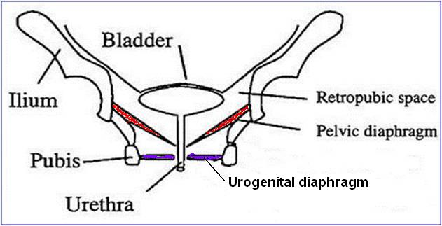
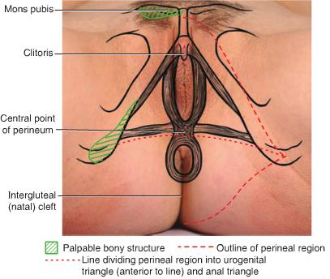
Perineum
Perineum is the region of the body below the pelvic diaphragm
It is a diamond shaped area between the thighs
Boundaries:
Anteriorly Mons pubis
Laterally Medial surfaces of the thighs
Posteriorly Intergluteal folds
Contents:
Lower ends of urethra, vagina & anal canal
External genitalia
Perineal body & Anococcygeal body

Slide 4
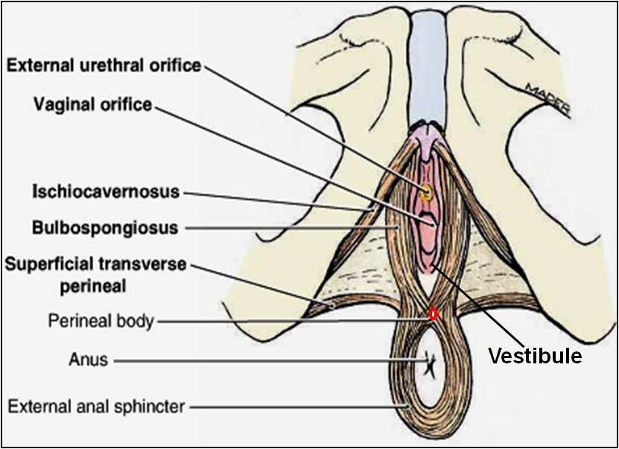
Perineal Body
Perineal body is an irregular fibromuscular mass of variable size and consistency, located at midpoint of the line between the ischial tuberosities
Lies in the subcutaneous tissue, posterior to vaginal vestibule and anterior to the anal canal & anus
Forms the central point of the perineum & blends anteriorly with the perineal membrane
Function:
Gives attachment to perineal muscles
Plays an important role in visceral support especially in female

Slide 5
Anococcygeal Body
The anococcygeal body is a complex musculotendinous structure
Situated between the anterior aspect of the coccyx and the posterior wall of the anorectal canal
Receives insertion of fibers of levator ani muscle

Slide 6
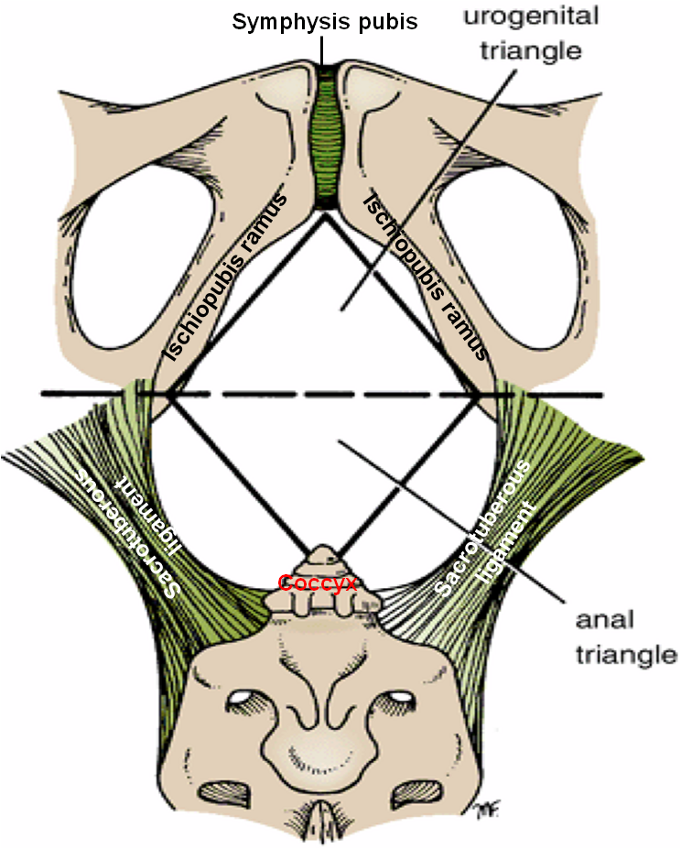
Boundaries & Division of Perineum
Boundaries:
Its bony boundaries are:
Anterior: Symphysis pubis.
Posterior: Coccyx.
Lateral: Ischiopubic rami, ischial tuberosities & sacrotuberous ligament.
Division:
By an imaginary line passing through two ischial tuberosities, it is divided into:
Urogenital triangle anteriorly.
Anal triangle posteriorly.

Slide 7
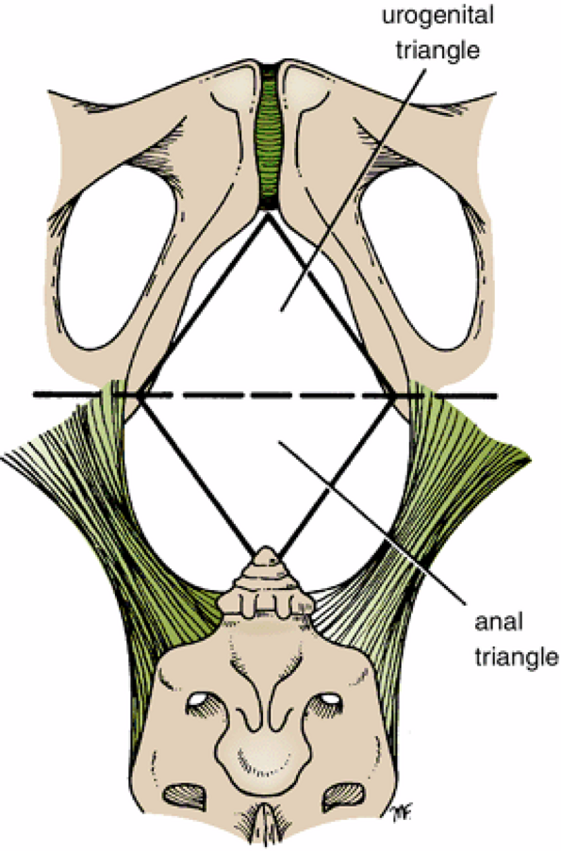
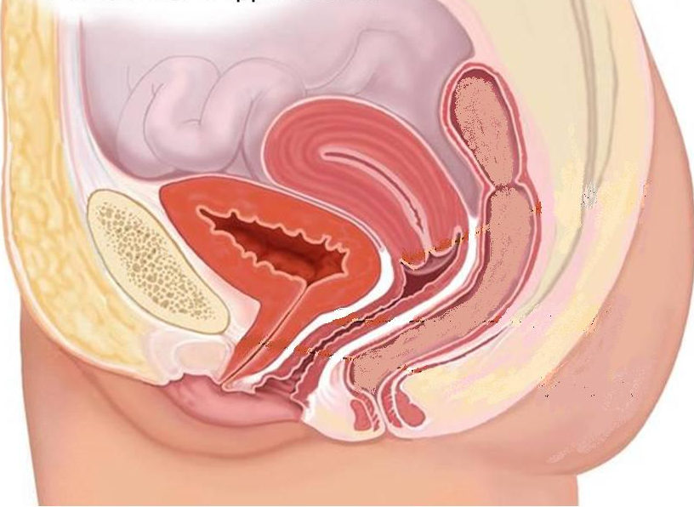
Urogenital Triangle
Boundaries :
Anteriorly : Symphysis pubis
Posteriorly : Transverse line passing through the 2 ischial tuberosities.
Laterally : Ischiopubic rami & ischial tuberosities.
Urethra
Contents :
Lower part of urethra & vagina.
External genitalia (vulva).
Vagina
Vulva

Slide 8
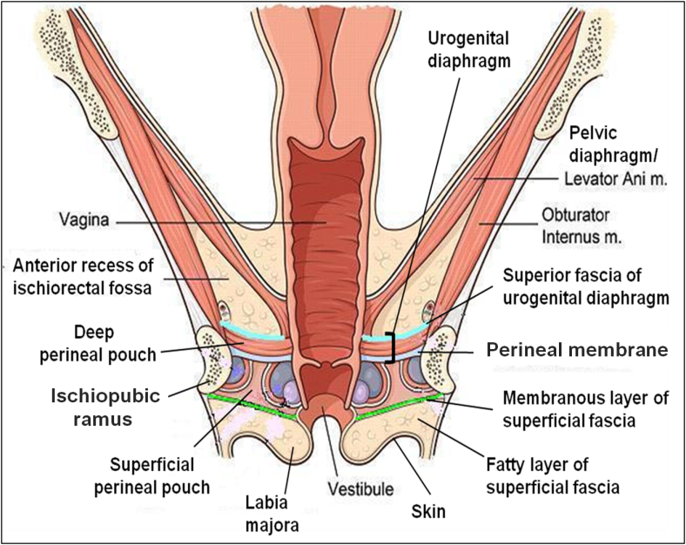
Urogenital Diaphragm
A triangular musculofascial diaphragm located in the anterior part of the perineum
Fills in the gap between the pubic arch
Composed of: Sphincter urethrae and the deep transverse perineal muscles enclosed within the superior and inferior layers of fascia of the urogenital diaphragm
The inferior layer of the fascia is formed by the perineal membrane

Slide 9
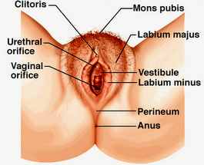
Female External Genitalia (Vulva)
Mons pubis : a collection of fat overlying the pubes.
Labia majora.
Labia minora.
Clitoris.
Vestibule of vagina: The interval between the two labia minora.
Vagina & urethra open into the vestibule through urethral orifice anteriorly and vaginal orifice posteriorly.

Slide 10
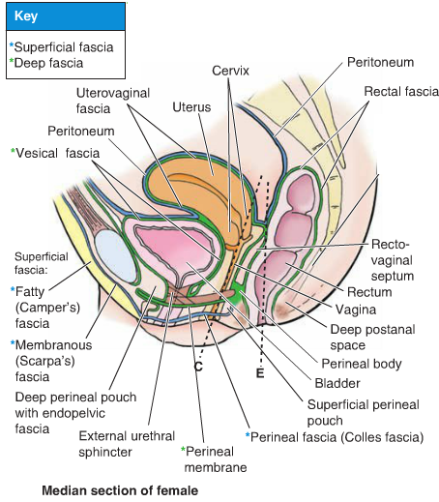
Fascia of Urogenital Triangle (Perineal Fascia)
The perineal fascia is continuous anteriorly with the fascia of abdomen and consists of superficial and deep layers
Superficial perineal fascia: consists of:
Superficial fatty layer (Camper’s fascia) makes up the substance of mons pubis & labia majora and extends into the anal region
Deep membranous layer (Colle’s fascia ): Does not extend to anal region. Becomes fused with the posterior margin of the perineal membrane
Deep perineal fascia invests the muscles in the superficial perineal pouch

Slide 11
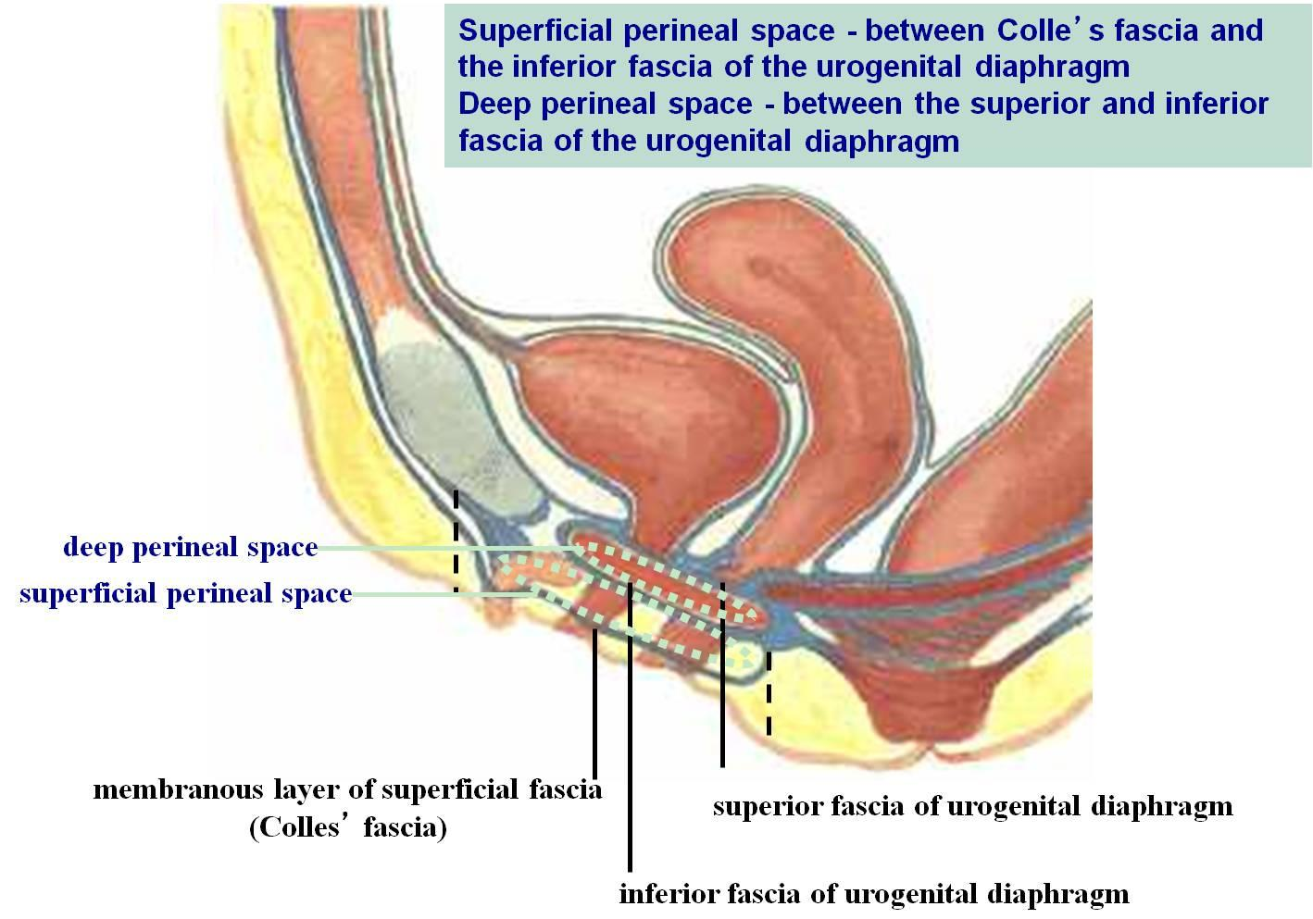
Perineal Pouches

Slide 12
Superficial Perineal Pouch
It is the space between the deep membranous layer of superficial fascia and the perineal membrane.
BOUNDARIES:
Inferiorly: membranous layer of superficial fascia.
Superiorly: perineal membrane.
Laterally: ischiopubic rami

Slide 13
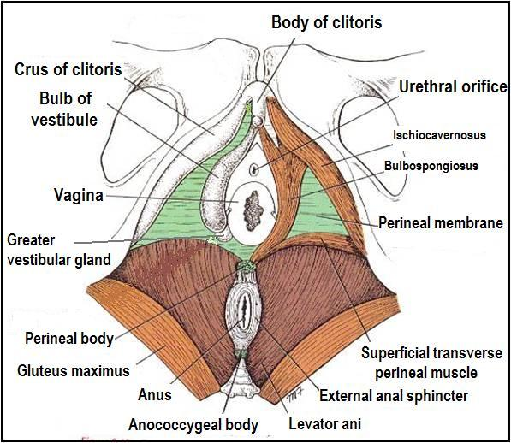
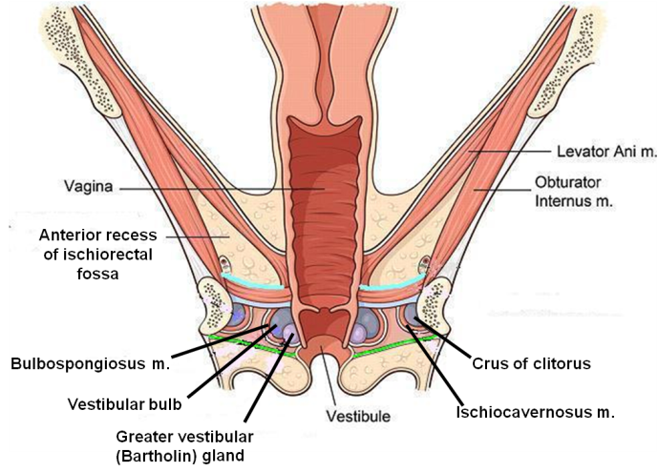
Contents of Superficial Perineal Pouch
Bulbs of vestibule: on each side of vaginal orifice.
Crura of clitoris.
Superficial perineal muscles:
Bulbospongiosus muscle, surrounds orifice of vagina and covers vestibular bulb.
Ischiocavernosus muscle, covers crus of clitoris on each side.
Superficial transverse perineal muscles.
Greater vestibular glands: on each side of vaginal orifice.
Perineal branch of pudendal nerve supplying muscles & skin.

Slide 14
Deep Perineal Pouch
It is a completely closed space deep to the perineal membrane
BOUNDARIES:
Inferiorly: Inferior fascia of the urogenital diaphragm (Perineal membrane)
Superiorly: Superior fascia of the urogenital diaphragm
Laterally: Inferior portion of obturator internus facia
Coronal section of pelvis

Slide 15
Contents of Deep Perineal Pouch
Part of urethra
Part of vagina
Sphincter urethrae muscle, which is pierced by urethra & vagina.
Deep transverse perineal muscles
Internal pudendal vessels
Dosal nerve of clitoris

Slide 16
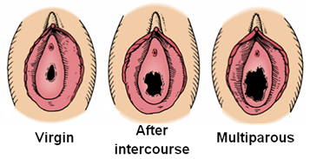
Vagina
The vagina is a muscular canal that leads from the uterus to the external orifice of the genital canal
It measures about 3 in. (8 cm) long.
It serves as the excretory duct for the menstrual flow & forms part of the birth canal.
The vaginal orifice in a virgin possesses a thin mucosal fold, called the hymen, which is perforated at its center.
Arteries:
Vaginal artery, a branch of the internal iliac artery
Vaginal branch of the uterine artery
Veins: drain into the internal iliac veins

Slide 17
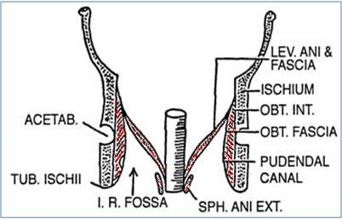
Anal Triangle
Boundaries:
Anteriorly: Transverse line passing through the 2 ischial tuberosities.
Posteriorly : coccyx.
Laterally : ischial tuberosity & sacrotuberous lig.
Contents:
Lower part of Anal canal
Ano-coccygeal body
Ischiorectal fossa on each side

Slide 18
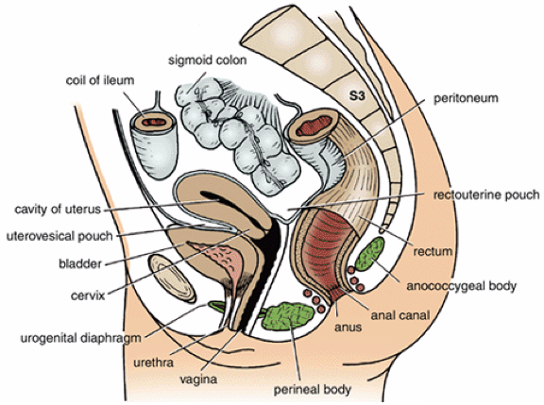
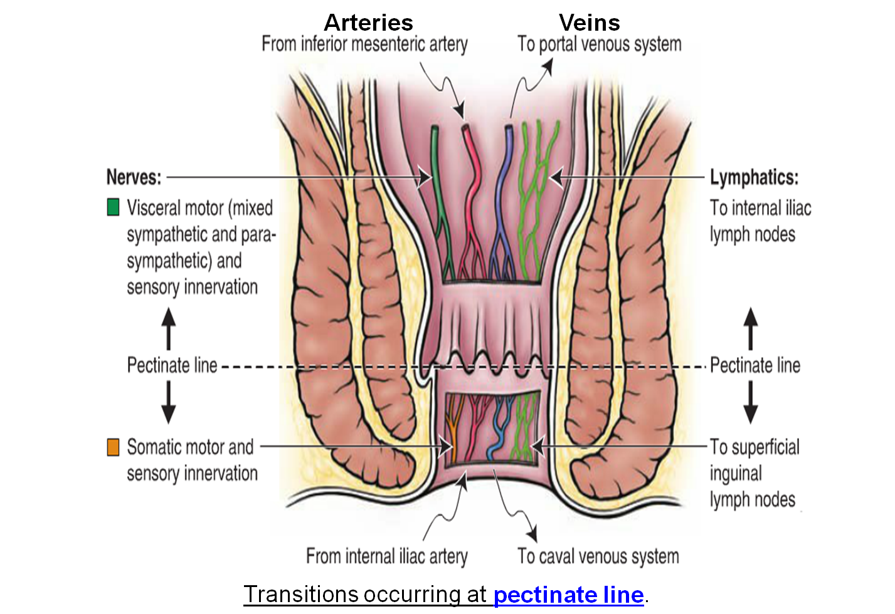
Anal Canal
It is about 1.5 in. long, descending from the rectal ampulla to the anus.
Relations (In female):
Anteriorly: Perineal body, urogenital diaphragm, and lower part of vagina
Posteriorly: Anococcygeal body.
Laterally: Ischiorectal fossae.
Division: Divided into:
Upper half: derived from hindgut (endoderm)
Lower half: derived from the proctodeum (ectoderm)
The two parts have different blood supply, nerve supply and lymphatic draiange.

Slide 19
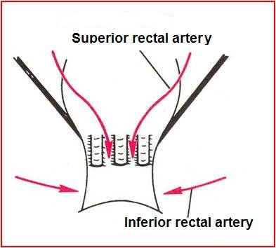
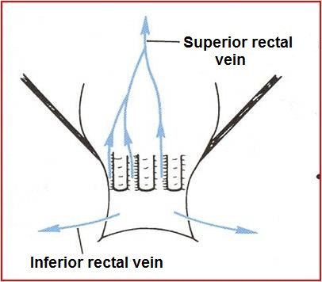
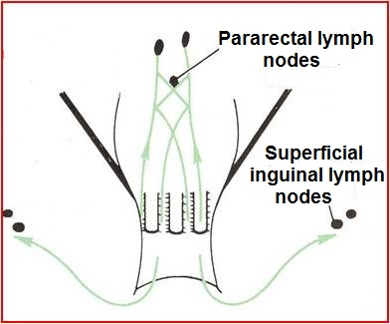
Anal canal | Arterial supply | Venous drainage | Lymphatic drainage | Nerves
Upper half | Superior rectal artery (continuation of the inferior mesenteric artery) | Superior rectal vein drained into the inferior mesenteric vein (portal circulation) | Para-rectal nodes drained into inferior mesenteric lymph nodes | Visceral motor (sympathetic & parasympathetic) & sensory nerves
Lower half | Inferior rectal a. (branch of internal pudendal artery) | Inferior rectal vein drained into the internal pudendal vein (Systemic circulation) (site of portal-systemic anastomosis) | Superficial inguinal lymph nodes | Somatic motor & sensory nerves

Slide 20
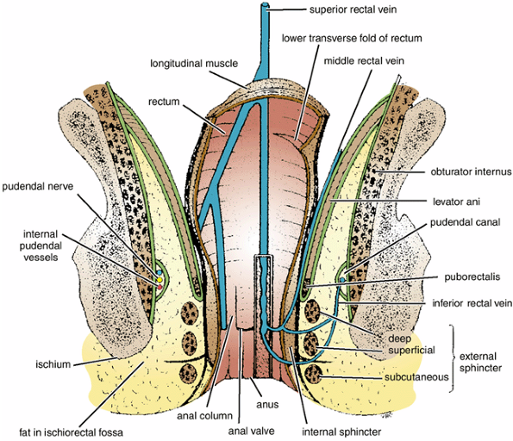
Ischiorectal Fossa
A fascial lined wedge-shaped space on each side of the anal canal.
Boundaries:
Base: Skin of the perineum.
Medial wall: Levator ani & anal canal.
Lateral wall: Obturator internus, covered with fascia.
Contents:
Dense fat.
Pudendal nerve & internal pudendal vessels within the pudendal canal
Inferior rectal nerve & vessels crossing the fossa to reach anal canal.

Slide 21
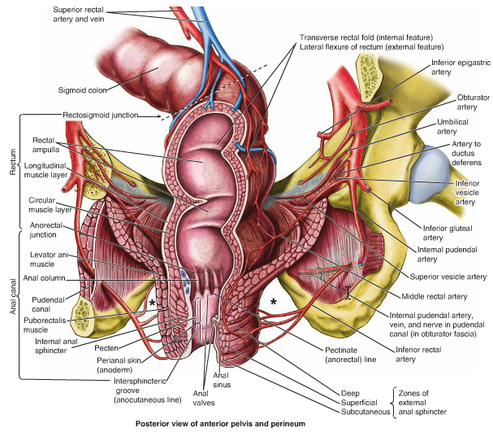
Pudendal Canal:
A fascial canal formed by obturator fascia, located on the lateral wall of the ischiorectal fossa
Contents:
Pudendal nerve
Internal pudendal vessels

Slide 22
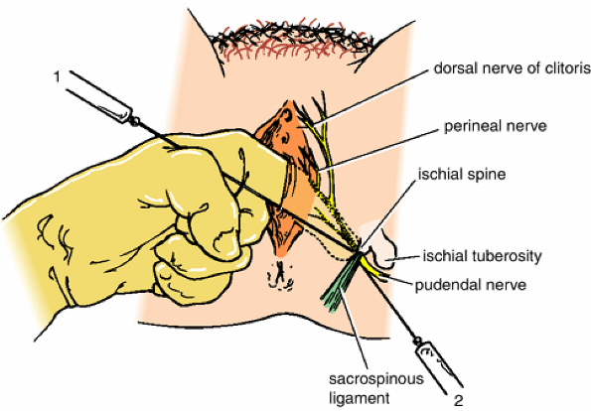
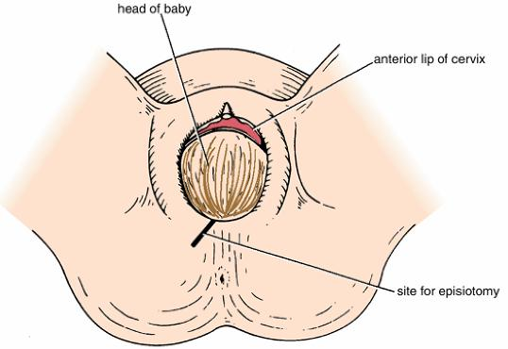
Pudendal Nerve Block
Pudendal nerve block is used in providing analgesia for the second stage of labour and to provide anesthesia of the perineum in order to create or repair an episiotomy. Can be done by transvaginally or through perineal approach.
Transvaginal method: The needle is passed through the vaginal mucous membrane toward the ischial spine. After the needle is passed through the sacrospinous ligament, the anesthetic solution is injected around the pudendal nerve
Perineal method: The ischial tuberosity is palpated subcutaneously through the buttock. The needle is inserted on the medial side of the ischial tuberosity to a depth of about 1 in. (2.5 cm) from the free surface of the tuberosity. The anesthetic is injected around the pudendal nerve.
An episiotomy is a surgically planned incision on the perineum and the posterior vaginal wall during second stage of labor to prevent perineal tear.

Slide 23
Thank You

