Slide 1
DRUGS AFFECTING
ERECTILE DYSFUNCTION

Slide 2
DRUGS AFFECTING
ERECTILE DYSFUNCTION
ILOs
By the end of this lecture you will be able to:
Revise the haemodynamic changes inducing normal erection
Interpret its different molecular control mechanisms
Define erectile dysfunction [ED] and enumerate its varied risks
List drugs inducing ED and reflect on some underlying mechanisms
Correlate drugs used in treatment of ED to the etiopathogenesis
Classify oral 1st line therapy relevent to; Mechanism / Utility / ADRs
Compare the pharmacological difference of PDE₅ inhibitors
Study the transurethral, intracavernous or topical 2nd line therapies; Mechanism / Utility / ADRs
Enumerate lines of treatment of priapism

Slide 3
Pathophysiology: Mechanism of an erection
A normal erection relies on the coordination:
Vascular
Neurological
Hormonal
Psychological
An erection can occur following direct genital stimulation or auditory or visual stimulation, aspects that contribute to the influx of blood to the penis

Slide 4
Pathophysiology: Mechanism of an erection
An erection occurs when the amount of blood rushing to the penis is greater than the amount of blood flowing from it
A massive influx of blood accumulates in the sinusoidal spaces due to relaxation of smooth muscle & dilatation of arteries → corpora cavernosa to swell (tumescence)
Tumescence compresses the veins that normally drain the penis → prevents blood outflow & maintains penile rigidity

Slide 5
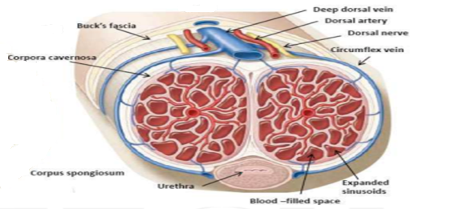
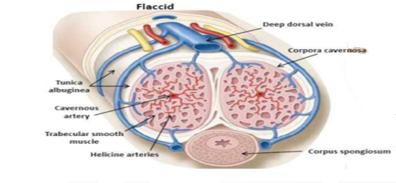
Peripheral HAEMODYNAMIC CHANGES inducing ERECTION
FLACCID State
ERECT State

Slide 6
ERECTILE DYSFUNCTION
Persistent or recurrent inability to attain (acquire) & maintain (sustain) an erection (rigidity) sufficient for satisfactory sexual performance
“Impotent" is reserved for those men who experience erectile failure during attempted intercourse more than 75 % of the time.
Prevalence
Endothelial Dysfunction → Commonest Cause

Slide 8
DRUGS ADVERSLY CAUSING ED
Centrally Acting Drugs
DA>NE promote arousal / 5HT action on 5HT₂ →↓DA release →↓ arousal
Most ADDs→ ↓ 5HT uptake;
non-selectively as TCAs
selectively as SSRIs
↑ 5HT in synapse act on 5HT₂
Delay ejaculation
Peripherally; ↓ genital sensation→
Treat Premature Ejaculation
Anti-psychotic drugs → DA antagonist + hyperprolactenemia
Anti-epileptic drugs (phenytoin) → have GABA effect →antagonize Exc. Amino acid. → ↑ sedation → ↓ arousal.
Centrally acting anti-hypertensives
Methyl dopa, Reserpine !!! → ↓ arousal
Clonidine → ↓ arousal centrally / Vasoconstriction peripherally !!!

Slide 9
Other anti-hypertensives
β₂ blockers → -ve vasodilating β₂ + potentiate α₁ effect
Thiazide diuretics → ↓ spinal reflex controlling erection + ↓ arousal
↓ Desire
Anti-androgens
Finasteride → α reductase inhibitor (prevent production of active testosterone → irreversible erectile dysfunction
Cyproterone acetate → synthetic steroidal antiandrogen
Cimetidine (high doses) / Ketoconazole /Spironolactone → hyper- prolactinemia + gynecomastia
Estrogen-containing medications
Habituating Agents
Cigarette smoking → vasoconstriction + penile venous leakage
Alcohol [small amounts]→↑ desire +↓ anxiety + vasodilatation
Alcohol [big amounts]→↑ sedation+ ↓ desire
Chronic alcoholism→ hypogonadism + polyneuropathy

Slide 10
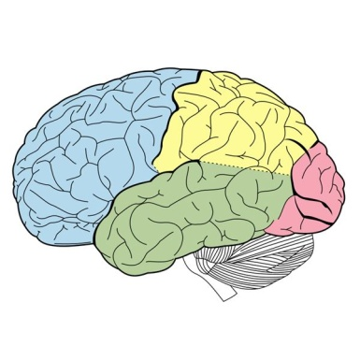
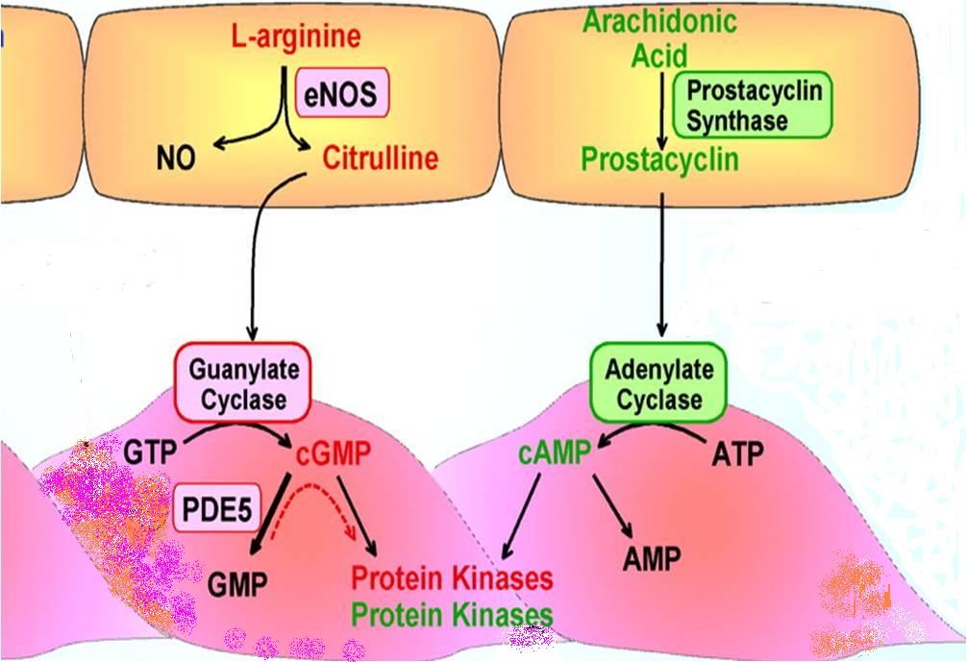
Desire
Androgens
DRUGS TREATING ED
CENTRALLY
Arousal
Apomorphine
PERIPHERALLY
ORAL
Transurethral
Intracavernosal Inj.
Nitrates !!!
+
Prostaglandin Analogues
+
+
Salbutamol !!!
PDE₅ Inhibitors
Sildenafil
Vardenafil
Tadalafil
Avanafil
cGMP
cAMP
-
PDE₅
-
Papaverine
PDE_{2,3,4}
α₁
AMP
-
Phentolamine

Slide 11
SELECTIVE PDE₅ Inhibitors
Mechanism
ORAL
Sildenafil
Vardenafil
Tadalafil
Avanafil
Inhibit PDE₅  prevent breakdown of cGMP  pertain vasodilatation  erection.
They do not affect the libido, so sexual stimulation is essential to a successful
Pharmacodynamic action relevant to PDE₅ inhibition ►
VSMCs of Erectile Tissue of Penis (vascular smooth muscle cells (VSMCs)
Other VSMCs ( lung, brain….) / heart
Other non-VSMCs (prostate, bladder, seminal vesicle, GIT….)
Platelets
Other tissues; testis, sk. muscles, liver, kidney, pancreas, …..
Indications
Erectile dysfunction; 1st line therapy. All types have similar efficacy
Pulmonary hypertension
BPH & premature ejaculation
 | Sildenafil | Vardenafil | Tadalafil
% Efficacy | 74-84 | 73-83 | 72-81

Slide 12
Selectivity on PDE₅ is not absolute and vary with each drug
Can partially act on PDE targeting cGMP (6, 11, 9, 1)
In higher doses it can act on PDE targeting cAMP (2,3,4, 10,…)
PDE
PDE
IHD / AMI
PDE
PDE
PDE
Headache/Flush nasal congestion
PDE
Altered VISION
PDE
PDE
lymphocyte
PDE
PDE
PDE
Back Pain
Sildenafil 10-fold selective
Vardenafil 16-fold selective
Tadalafil >200-fold selective
Give variability in ADRs

Slide 13
 | Sildenafil | Vardenafil | Tadalafil
Headache % | 14 | 10 | 15
Flushing % | 12 | 11 | 3
Nasal | Congestion | Rhinitis | Congestion
Dyspepsia % | 7 | 3 | 15
Abnormal vision % | > 4 | < 2 | -
Myalgia & Back pain % | - | - | 5
Sperm functions | - | - | ?
Q-T prolongation | - |  | -
ADRs
Common ADRs
Major less common ADRs
IHD & AMI > patients on big dose or on nirates
Hypotension > patients on α-blockers than other antihypertensives
Bleeding; epistaxsis…..etc.
Priapism; if erection lasts longer than 4 hours  emergency situation
Major rare ADRs
Ischemic Optic Neuropathy; can cause sudden loss of vision
Hearing loss

Slide 14
Pharmacokinetic profile difference of PDE5 inhibitors
Absorption; Fatty food interferes with Sildenafil & Vardenafil absorption
→ so taken on empty stomach / at least 2 hr.s after food
Tadalafil & [Avanafil] are not affected by food
Metabolism; All by hepatic CYT3A4; Tadalafil > the rest thus;
↑ADRs with enzyme inhibitors; erythro & clarithromycin, ketoconazole, cimetidine, tacrolimus, fluvoxamine, amiodarone…etc.
↓ efficacy with enzyme inducers; rifampicin, carbamazipine, phenytoin
Administration
All drugs are given only once a day | Sildenafil | Vardenafil | Tadalafil
Dosage (mg) | 50-100 | 10-20 | 10-20
Time of administration before intercourse (hrs.) | 1 | 1 | 1-12
Onset of action (min) | 30-60 | 30-60 | <30-45
Duration of action (hrs.) | 4 | 4-5 | 36
NB. Avanafil has the advantage of been given 30 min before intercourse
Tadalafil must be given every 72 hrs if used with enzyme inhibitors

Slide 15
Contraindications
Hypersensitivity to drug
Patients with history of AMI / stroke / fatal arrhythmias <6 month
Nitrates→ total contraindication / ? PDEIs in small dose + spacing at least 24hrs (48 hrs with Tadalafil) for fear of developing IHD/AMI due to severe hypotension (see detailed mechanism in antianginal drugs)
Precautions
With α blockers [except tamsulosin] →orthostatic hypotension
With hepato/renal insufficiency
With bleeding tendencies [leukemia's, hemophilia, Vit K deficiency, antiphospholipid syndrome,…etc]
With quinidine, procainamide, amiodarone (class I & III antiarhtmics) (Vardenafil)
Dose adjustment; when using drugs that have interaction on hepatic liver microsomal enzymes i.e inhibitors or inducers.
Retinitis pigmentosa

Slide 16
Testosterone
ORAL
Given to those with hypogonadism or hyperprolactenemia
Given for promotion of desire.
Apomorphine
A dopamine agonist on D₂ receptors.
Activates arousal centrally; Erectogenic + Little promotion of desire
Given sublingual / Acts quickly.
Not FDA approved / Weaker than PDE₅ Is
Given in mild-moderate cases / psychogenic / PDE₅ Is contraindication
ADRs: nausea, headache, and dizziness but safe with nitrate
Oral phentolamine → α₁ blocker / debatable efficacy
Yohimbine → Central and periphral α₂ agonist → Aphrodetic + Erectogenic but low efficacy and many CV side effects
Trazodone → Antidepressant, a 5HT reuptake inhibitor → priapism
Korean Ginseng → Questionable / may be a NO donner.

Slide 17
Alprostadil; PG E1 → ↑cAMP
Synthetic + more stable
(MUSE)
TRANSURETHRALORAL
Applied by a special applicator into penile urethra & acts on corpora cavernousa →Erection
Low - Intermediate Efficacy
Minimal systemic effects / Rarity of drug interactions.
ADRs
Variable penile pain
Urethral bleeding / Urethral tract infection
Hypotension
Priapism or Fibrosis →rare
Topical
20% Papaverine; ↑cAMP + cGMP
2% Minoxidil; NO donner + K channel opener
2% Nitroglycerine
+ a drug absorption enhancers
Low efficacy / No FDA approval
Female Partner can develop → hypotension, headache → vaginal absorption.

Slide 18
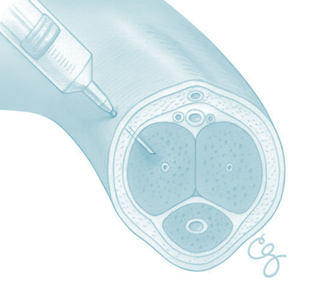
1. Alprostadil; PG E1 → ↑cAMP
Intracavernosal Inj.
Needs training → Erection → after 5-15 min
lasts according to dose injected
May develop fear of self injury / Discontinuation
ADRs
Pain or bleeding at injection site
Cavernosal fibrosis
Priapism
2. Papaverine; PG E1 → ↑cAMP + cGMP
3. Phentolamine; α₁ blocker
3 combined in severe cases
Treatment of Pripism
A medical emergency
Aspirate blood to decrease intracavernous pressure.
Intracavernous injection of Phenylephrine → α₁ agonist → detumescence

Slide 19
DRUGS AFFECTING
ERECTILE DYSFUNCTION
GOOD LUCK

