Slide 1
Physiology of Ovarian Cycle GUYTON & HALL, Chapter 81
Dr.Mohammed Alotaibi
Assistant Professor of Physiology
College of Medicine
King Saud University

Slide 2
Objectives
By the end of this lecture, you should be able to:
Recognize the hypothalamic- pituitary-ovarian-axis
Describe the physiological phases of ovarian cycles
Describe the changes that occur in the ovaries leading to ovulation
Describe the development and the fate of corpus luteum

Slide 3
Physiologic Anatomy of the Female Sexual Organs

Slide 4
Female Reproductive Physiology
Normal repr. Years of female → Monthly rhythmical changes in the rates of secretion of female hormones & corresponding physical changes in the ovaries & other sexual organs (menstrual/sexual cycle)
Duration of the cycle averages 28 days (20-45 days).
There are 2 results of the female sexual cycle:
Single ovum is released from the ovaries each month
Uterine endometrium is prepared for implantation of the fertilized ovum.

Slide 5
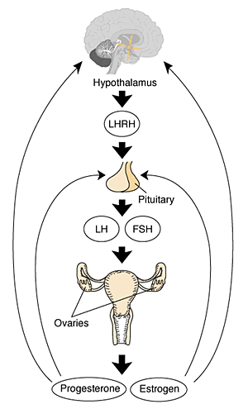
Gonadotropic hormones and their effects on the ovaries
The ovarian changes during the sexual cycle depend completely on FSH & LH secreted by AP.
Both FSH and LH stimulate their ovarian target cells by combining with highly specific receptors leading to an increase in the cells rates of secretion, growth & proliferation.
GnRH

Slide 6
Ovarian Cycle
Follicular Phase
(Preovulatory)
Luteal
Phase
(Postovulatory)
Ovulation

Slide 7
“Follicular” phase of the ovarian cycle:
(Ovarian follicle growth)

Slide 8
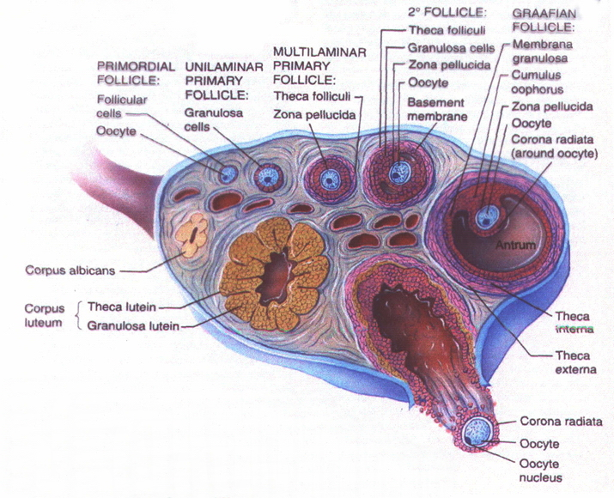
Female child
During the first few days of the monthly female sexual cycle there is an increase secretion of FSH, LH

Slide 9
aromatase

Slide 11
The early growth of the primary follicle up to the antral stage is under FSH stimulation only. Then there is accelerated growth of the follicle to larger follicle called vesicular follicle (Graffian) caused by:
Estrogen ↑ FSH receptors
(positive feedback effect).
2. Estrogen & FSH combine
to promote LH receptors on
the original granulosa cells
in addition to FSH stimulation.
Proliferation of the follicular theca cells & increase their secretion.

Slide 12
Ovarian follicle growth
- The antral follicles begin to grow. The ovum enlarges & remains embedded at one pole of the granulosa cells of the follicle
After a week or more of growth—but before ovulation occurs—one of the follicles begins to outgrow all the others, and the remaining 5 to 11 developing follicles involute (a process called atresia)

Slide 13
Ovulation
Ovulation in a woman who has a normal 28-day female sexual cycle occurs 14 days after the onset of menstruation.
Without LH hormone, ovulation will not occur
2 days before ovulation → rate of LH secretion ↑ to 6-16 fold & peaks about 16 hrs before ovulation.

Slide 14
Ovulation
LH surge is necessary for final follicular growth and ovulation:
- FSH also ↑ 2 to 3 fold & acts synergistically with LH to cause swelling of the follicle before ovulation.
- LH has specific effect on the granulosa cells & theca cells converting them to progesterone-secreting cells → rate of estrogen secretion ↓ about 1 day before ovulation while progesterone secretion begin to ↑

Slide 16
Initiation of ovulation
Large quantity of LH causes rapid secretion of progesterone from the follicle. Within a few hours 2 events occur which are necessary for ovulation:
1) the theca externa begins to secrete proteolytic enzymes & causes weakening of the wall resulting in swelling of the follicle & degeneration of the stigma
2) rapid growth of new blood vessels into the follicle wall & prostaglandins are secreted into the follicular tissue.

Slide 17
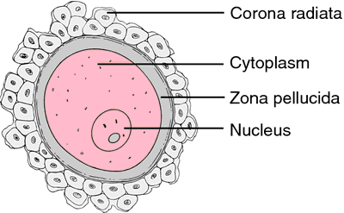
Ovulation
During ovulation, stigma protrudes & fluids ooze from the follicle & the stigma ruptures allowing more viscous fluid outward carrying with it the ovum surrounded by mass of granulosa cells called corona radiata

Slide 18
Corpus Luteum
corpus albicans
7-8 days after ovulation ~ 1.5 cm in diameter
The granulosa cells with the theca cells are called corpus luteum.

Slide 19
Corpus Luteum
‘’Luteal’’ phase of the ovarian cycle
- After expulsion of the ovum from the follicle, the remaining granulosa & theca interna cells change to lutein cells & become filled with lipid inclusions giving them yellowish appearance.
- The granulosa cells in corpus luteum form large amount of progesterone & estrogen. The theca cells form mainly androgens which are converted by granulosa cells into female hormones and small amount can appear in plasma.

Slide 20
Corpus Luteum
Function of LH:
1-Change of granulosa and theca interna cells into lutein cells.
2- Causes ovulation.
3- Maintains secretion of progesterone & estrogen from the corpus luteum.

Slide 21
Involution of the corpus luteum and onset of the next ovarian cycle
1- Estrogen & progesterone have strong negative feedback on AP and ↓ FSH & LH
2- The lutein cells secrete small amounts of inhibin
3- Around 26th days of normal sexual cycle & after involution of corpus luteum, sudden cessation of estrogen, progesterone & inhibin removes the negative feedback inhibition of the AP & allowing ↑ secretion of FSH & LH again.

Slide 22
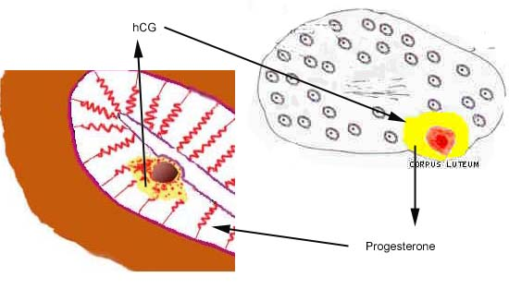
Corpus Luteum
- If pregnancy occurs, the hCG from the Trophoblast acts on the corpus luteum to prolong its life for 2 to 4 months of pregnancy

Slide 23
Corpus Luteum
FSH & LH initiate the growth of new follicles, beginning a new ovarian cycle.

Slide 24
Physiology of Uterine (Endometrial) Cycle GUYTON & HALL, Chapter 81
Dr.Mohammed Alotaibi
Assistant Professor of Physiology
College of Medicine
King Saud University

Slide 25
Objectives
By the end of this lecture, you should be able to:
Describe the normal phases of menstrual cycle
Discuss the structural changes that occur in the endometrium during the menstrual cycle and explain how these changes are hormonally controlled
List the hormones of female reproduction and describe their physiological functions
Describe the physiology of menopause and the disorders of menstruation

Slide 26
Monthly endometrial cycle and menstruation
It is associated with the monthly cyclical production of estrogens & progesterone by the ovaries in the lining of the uterus
GnRH

Slide 27
Uterine (endometrial) Cycle
Proliferative phase
(estrogen Phase)
(Preovulatory)
Secretory phase
(progestational phase)
(Postovulatory)
Ovulation

Slide 28
Proliferative phase (estrogen phase)
The endometrial surface re-epitheliazed within 4-7 days after the beginning of menstruation. The endometrium thickness increases, due to increase numbers of stromal cells &progressive growth of the glands & new blood vessels.
thin layer of endometrial stroma
stromal cells & epithelial cells proliferate rapidly by estrogen
At the time of ovulation, the endometrium is 3-5 mm thick. The endometrial glands, cervical region secrete a thin, stringy mucus which helps to guide sperm in the proper direction from the vagina into the uterus.

Slide 29
Secretory phase (progestational phase)
progesterone causes marked swelling & secretory development of the endometrium
The glands increase in tortuosity, blood supply ↑
Stromal cells cytoplasm increase lipid &glycogen deposits, 1 week after ovulation, endometrium thickness is 5-6 mm . Uterine secretions called “uterine milk” provide nutrition for the dividing ovum.

Slide 30
Menstruation
-If the ovum is not fertilized, about 2 days before the end of the monthly cycle, the corpus luteum in the ovary suddenly involutes and the ovarian hormones (estrogens and progesterone) decrease to low levels of secretion,
- Necrosis is initiated in the endometrial blood vessels, due to:
1) vasospasm
2) decrease nutrients to the endometrium
3) loss of the hormonal stimulation
- The mass of desquamated tissue & blood plus the contractile effects of prostaglandins all initiate contractions which expel the uterine contents.

Slide 31
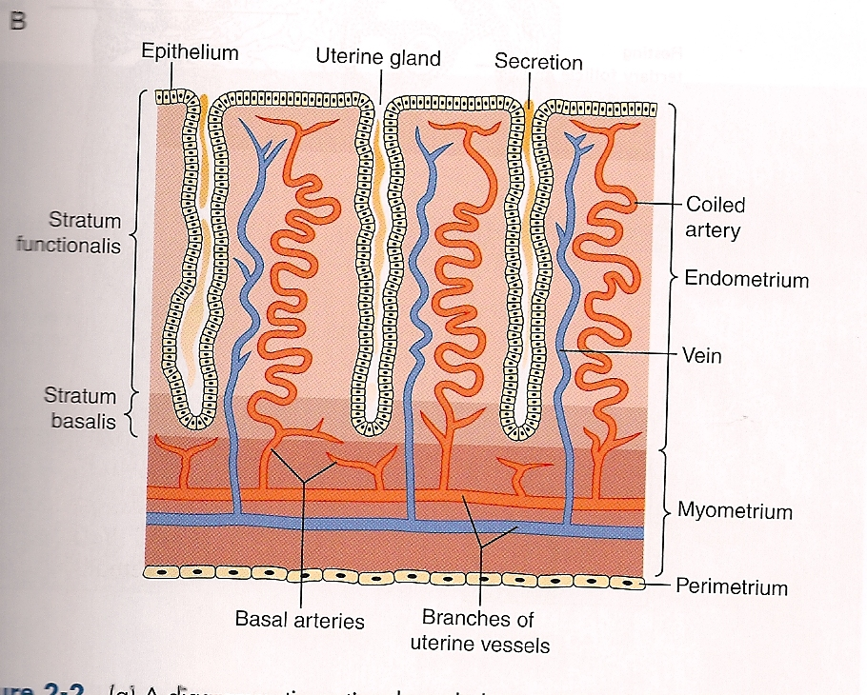
Uterine (endometrial) Cycle

Slide 32
Menstruation
- In normal menstruation, about 40 ml of blood + 35 ml of serous fluid are lost. The menstrual blood is normally non-clotting due to the presence of fibrinolysin.
-Within 4 to 7 days after menstruation, the loss of blood ceases & the endometrium become re-epithelialized.
Leukorrhea during menstruation:
During menstruation, leukocytes are released with the necrotic material & blood so the uterus is highly resistant to infection during menstruation as protective mechanism.

Slide 33
Summary

Slide 34
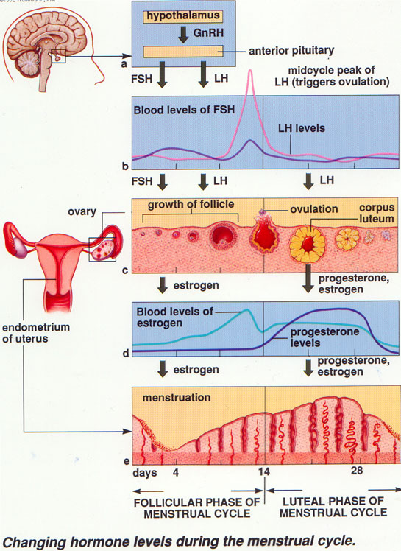

Slide 35
Functions of Estrogens
Estrogens increase the size of ovaries, fallopian tubes, uterus, and external genitalia.
Estrogens cause marked proliferation of the endometrial stroma and greatly increased development of the endometrial glands.
Estrogens cause (1) development of the stromal tissues of the breasts, (2) growth of an extensive ductile system, and (3) deposition of fat in the breasts.
Estrogens stimulate bone growth and slightly increase protein deposition.
Estrogens increase body metabolism and fat deposition.
Estrogens cause sodium and water retention by the kidney tubules.

Slide 36
Functions of progesterone
Progesterone promotes the secretory changes in the uterine endometrium.
Progesterone promotes increased secretion by the mucosal lining of the fallopian tubes.
Progesterone promotes development of the lobules and alveoli of the breasts, causing the alveolar cells to proliferate, enlarge, and become secretory.
Progesterone decreases the frequency and intensity of uterine contractions.

Slide 37
Menopause and the Disorders of Menstruation

Slide 38
Menopause
At the age of 40 to 50 years, the sexual cycle becomes irregular, ovulation fails to occur & the cycle ceases
The loss of estrogens causes marked physiological changes in the function of the body including:
“hot flushes” characterized by extreme flushing of the skin, psychic sensations and dyspnea, Irritability, fatigue, anxiety, occasionally various psychotic states, decreased strength and calcification of bones throughout the body.
GnRH

Slide 39
Disorders of Menstruation
Amenorrhea: Is absence of menstrual period either
Primary amenorrhea in which menstrual bleeding has never occurred.
Secondary amenorrhea cessation of cycles in a woman with previously normal periods, caused by:
Pregnancy (is the most common cause)
Emotional stimuli and changes in the environment.
Hypothalamic diseases (↓ GnRH pulses)
Pituitary disorders
Primary ovarian disorders and various systemic disease.
Menorrhagia: Refer to abnormally heavy or prolonged bleeding.
Hypomenorrhea: Refer to scanty flow.
Dysmenorrhea: Painful menstruation (cramps due to accumulation of prostaglandins in the uterus and treatment with inhibitors of prostaglandin synthesis).

Slide 40
The End
Thank You

