Slide 1
Reproductive Physiology Lecture 3 Puberty in males and females
Dr.Mohammed Alotaibi
Assistant Professor of Physiology
College of Medicine
King Saud University

Slide 2
Objectives
By the end of this lecture, you should be able to:
Define Puberty
Recognize the physiology of puberty related to changes in hypothalamic-pituitary-gonadal axis
Describe the physical changes that occur at puberty in males and females
Describe the pathophysiological conditions associated with puberty

Slide 3
PUBERTY
Definition: A stage of human development when sexual maturation and growth are completed and result in ability to reproduce..
(Physiological transition from childhood to reproductive maturity)

Slide 4
Puberty
ACCELERATED SOMATIC GROWTH
Maturation of primary sexual characteristics (gonads)
Appearance of secondary sexual characteristics (pubic and axillary hair, female breast development, male voice changes,...)
- Menstruation and spermatogenesis begin
Occurs between 8 and 14yrs in girls
Occurs between 9 and 14yrs in boys

Slide 5
Puberty – Terms & Events
Thelarche: development of breast
Puberache: development of pubic & axillary hair
Menarche: the first menstrual period
Adrenarche: the onset of an increase in the secretion of androgens; responsible for the development of pubic/axillary hair, body odour and acne.
Gonadarche: maturation of gonadal function

Slide 6
Puberty – hormonal changes
Hormonal changes precede physical changes
Increased stimulation of HPG axis:
gradual activation of the GnRH (LHRH)
increases frequency and amplitude of LH pulses.
gonadotropins stimulate secretion of sex steroids (estrogens and androgens)
extragonadal hormonal changes (elevation of IGF-I, and adrenal steroids)

Slide 7
Puberty – hormonal changes
In young children, LH and FSH levels are insufficient to initiate gonadal function
Between 9-12 yrs, blood levels of LH, FSH increase.
High levels of LH, FSH initiate gonadal development
Nocturnal GnRH pulsatility (LH secretion) precedes phenotypic changes by several years
First phenotypic changes:
breast development / testicular enlargement

Slide 8
Pulsatile secretion of GnRH
Increased sensitivity of the GnRH receptors in anterior pituitary
Pulsatile secretion of LH and FSH
Appearance of large nocturnal pulses of LH during REM sleep.
Secretion of gonadal steroid hormones testosterone and estradiol
Appearance of the secondary sex characteristics at puberty

Slide 9
In an early pubertal girl:
LH secretion is minimal during waking hours. Pubertal LH pulsations promptly begin with sleep onset and wane with sleep offset, followed several hours later by increased ovarian estradiol secretion that peaks mid-day.
In an early pubertal boy:
Daytime LH values are low, with minimal testosterone secretion. Pubertal LH pulsations begin promptly with sleep onset and cease with sleep offset; testosterone secretion occurs primarily during sleep, beginning about 2 hours after LH increases and waning on awakening.

Slide 10
Puberty – hormonal changes
GH secretion from anterior pituitary increases.
TSH (thyroid stimulating hormone) secretion from anterior pituitary increases in both sexes:
increases metabolic rate
promotes tissue growth

Slide 11
Puberty – hormonal changes
HYPOTHALAMUS
GnRH AND GHRH
ANTERIOR
PITUITARY
GROWTH
LH & FSH
HORMONE
LIVER
TESTIS/ OVARY
SEX STEROID SYNTHESIS
IGF-1
SEXUAL MATURATION
SOMATIC
GROWTH

Slide 12
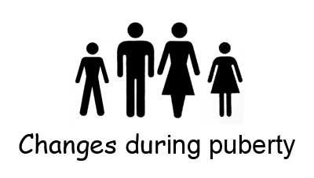
Physical

Slide 13
Physical Changes
5 stages from childhood to full maturity
Tanner Scale (P1 – P5)
Reflect progression in changes of the external genitalia and sexual hair
Secondary sexual characteristics
Mean age 10.5yrs in girls
Mean age 11.5 – 12yrs in boys

Slide 14
Puberty: Girls
Breast enlargement usually first sign (Thelarche)
Menarche usually 2-3 yrs after breast development
dependent on increased secretion of adrenal androgens (adrenarche).
and closure of the epiphyses typically begin and end earlier in girls than in boys.

Slide 15
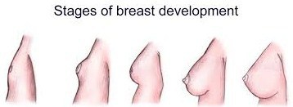
Pubertal Stages (Tanner) Girls
P1 Prepubertal
P2 Early development of subareolar breast bud +/- small amounts of pubic and axillary hair
P3 Increase in size of palpable breast tissue and areolae, increased pubic/axillary hair
P4 Breast tissue and areolae protrude above breast level. Further increased in pubic/axillary hair growth
P5 Mature adult breast. Complete pubic/axillary hair growth

Slide 16
Puberty – Boys
Puberty is associated with activation of the HPG axis.
Leydig cell proliferation in the testes, and increased synthesis and secretion of testosterone.
There is growth of the testes, largely because of an increased number of seminiferous tubules.
There is growth of the sex accessory organs such as the prostate.
There is a pronounced linear growth spurt.
As plasma levels of testosterone increase, facial, pubic, and axillary hair appears and there is growth of the penis, lowering of the voice, and initiation of spermatogenesis (spermarche).

Slide 17
Pubertal Stages (Tanner) Boys
P1 Prepubertal, testicular volume < 1.5 ml [9 yrs and younger]
P2 Testicular volume between 1.6 and 6 ml; skin on scrotum thins. Few pubic hair [9-11 yrs]
P3 Testicular volume between 6 and 12 ml, Lenghtening of penis. Further growth of testes and scrotum [11-12.5 yrs]
P4 Testicular volume between 12 and 20 ml; scrotum enlarges further and darkens. Incresed pubic/ axillary hair [12.5-14 yrs]
P5 Testicular volume greater than 20 ml. Genitalia adult in size and shape. Completed pubic/axillary hair growth [14+ yrs]

Slide 18
Timing of Puberty
Trend toward earlier puberty exists within Western Europe and USA
Puberty usually completed within 3 - 4 yrs of onset
Examination of lifestyle changes may give clues regarding mechanisms inducing onset

Slide 19
Influencing Factors
Genetic factors : 50-80% of variation in pubertal timing.
Environmental factors e.g. extreme stress.
Nutritional factors → e.g. Leptin hormone regulates appetite and metabolism through hypothalmus. Permissive role in regulating the timing of puberty.

Slide 20
Leptin accelerates the HPG axis
Hypothalamus
↓ Food intake
NPY
(-) /(+)
(-)
Kiss1 (Kisspeptin)
(+)
Peripheral circulation
GPR54
GnRH
(+)?
White Adipocyte
(fat cell)
Leptin
(+)
Anterior pituitary
↑ LH (direct)
↑ FSH
Notes:
NPY is a potent stimulator of food intake, has an inhibitory effect on GnRH secretion.

Slide 21
Nutrition
Critical body weight must be attained before activation of the reproductive system.
earlier puberty due to improvement of nutrition, living conditions, healthcare.
evidence supporting hypothesis:
obese girls go through early menarche
malnutrition is associated with delayed menarche
primary amenorrhea is common in lean female athletes

Slide 22
Disorders of Puberty

Slide 23
Types of puberty disorders?
Early or
Precocious Puberty
Delayed Puberty
More common in females
Uncommon in males

Slide 24
PRECOCIOUS PUBERTY
Precocious onset of puberty is defined as occurring younger than 2 yrs before the average age
Girls < 8 years old
Boys < 9 years old
Gonadotropin-dependent (central)
Gonadotropin-independent (peripheral)

Slide 25
Gonadotropin-dependent precocious puberty
Premature activation of the (HPG) axis.
Intra-cranial lesions: (tumours, hydrocephalus, CNS malformations).
Gonadotropin secreting tumours in anterior pituitary gland (v. rare).

Slide 26
Gonadotropin-independent precocious puberty
Precocious pseudopuberty.
No spermatogenesis or ovarian development.
FSH & LH suppressed.
Congenital adrenal hyperplasia (CAH).
Sex steroid secreting tumours:
adrenal or ovarian

Slide 27
Delayed puberty
Initial physical changes of puberty are not present
by age 13 years in girls (or primary amenorrhea at 15.5-16y)
by age 14 years in boys
Pubertal development is inappropriate
- The interval between first signs of puberty and menarche in girls, completion of genital growth in boys is > 5 years

Slide 28
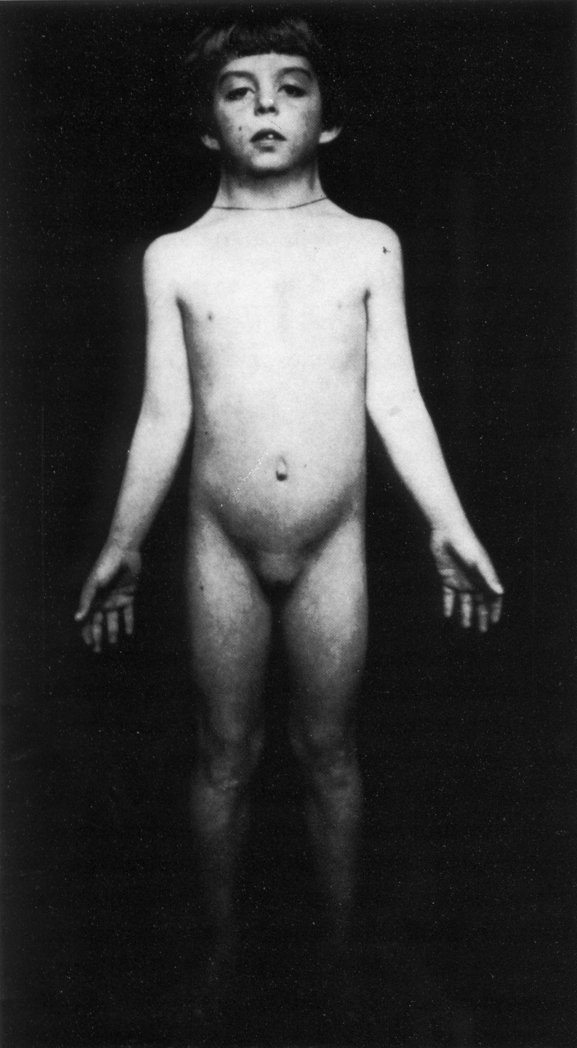
Causes of delayed puberty
Gonadal failure (Hypergonadotropin hypogonadism)
Post-malignancy chemo / radiotherapy / surgery (Acquired)
Polyglandular autoimmune syndromes
Turner’s Syndrome (Congenital)
Karyotype 45,X (structural abnormalities of X chromosome)
Short stature (final height 144-146 cm), Gonadal dysgenesis ,Skeletal abnormalities, Cardiac and kidney malformation, Dysmorphic face
No mental defect
Impairment of cognitive function
Therapy: growth hormone, sex hormone substitution

Slide 29
Causes of delayed puberty
Gonadal deficiency
Congenital hypogonadotropin hypogonadism
Hypothalamic/pituitary lesions (tumours, post-radiotherapy)
Rare gene mutations inactivating FSH/LH or their receptors

Slide 30
The End
Thank You

