Slide 1
HIV & AIDS
Dr. Abdulkarim Alhetheel
Assistant Professor in Microbiology Unit
College of Medicine & KKUH

Slide 2
Objectives
The students should be able to know:
HIV main structural components
Mode of transmission
Stages of HIV infection
Main clinical features of each stage of HIV infection
Serological profile during the stages of HIV infection
Diagnosis
Management & treatment

Slide 3
Outline
Introduction to HIV & AIDS
HIV main structural components & life cycle
Mode of transmission
HIV pathogenesis
Stages of HIV infection
Persistent generalized lymphadenopathy (PGL)
AIDS related complex (ARC)
Serological profile
Diagnosis
Management & treatment

Slide 4
Human immunodeficiency virus (HIV)
Is a retrovirus that causes human AIDS, and was initially identified in 1983.
HIV infects mainly CD4+ T cells, macrophages, and dendritic cells which express the surface receptor CD4.
Destroying CD4+ T cells leads to severe immunologic impairment and eventually death.
Acquired immunodeficiency syndrome (AIDS)
Is the end stage of the disease that is associated with CD4+ T cell depletion, multiple or recurrent opportunistic infections, and unusual cancer (Kaposi sarcoma).

Slide 5
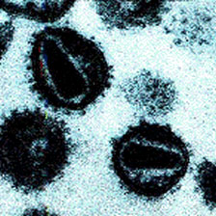
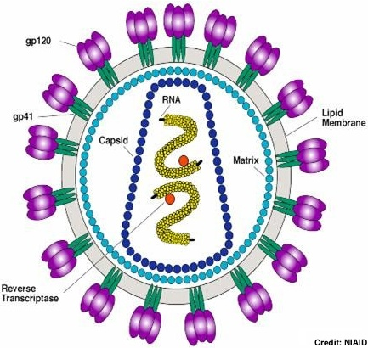
Characteristics of HIV
Family of Retroviridae.
Virion consist of:
Glycoprotein envelope (gp120, gp41).
Matrix layer (p17).
Capsid (p24).
Two copies of ss-RNA.
Enzymes:
Reverse transcriptase: converts viral RNA into DNA.
Integrase: integrates viral DNA with host DNA (provirus), persisting infection.
Protease: viral protein maturation.

Slide 6
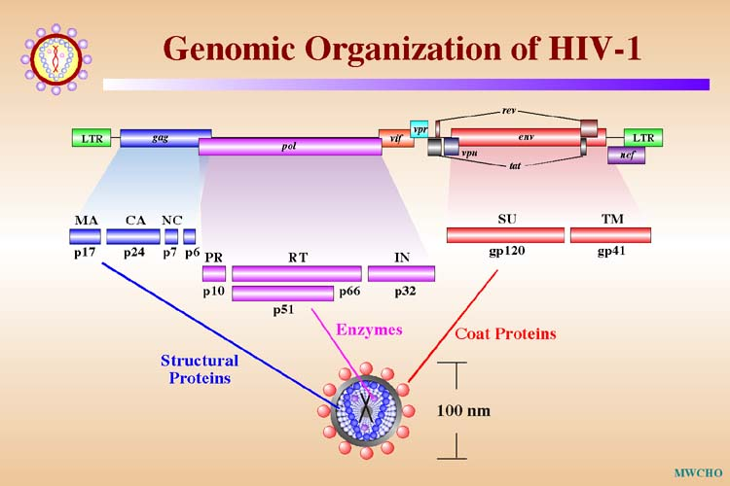
HIV genome
The genome consists of 9 genes:
3 structural genes (gag, pol, env)
6 non-structural genes (tat, nef, rev, vif, vpr, vpu)

Slide 7
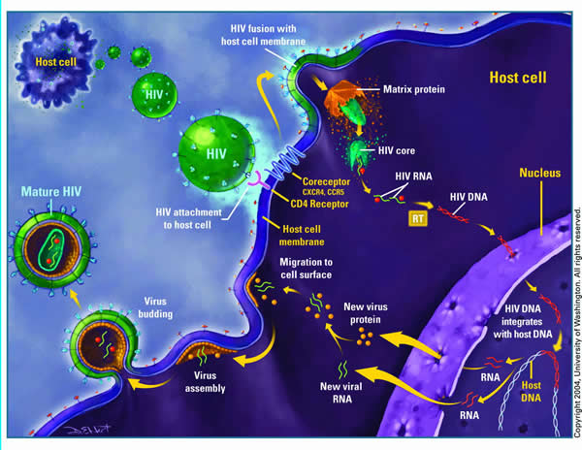
HIV life cycle

Slide 8
HIV species
There are two HIV species known to cause AIDS in humans HIV-1 and HIV-2, and the overall sequence homology between HIV-1 & HIV-2 is less than 50%.
HIV-1:
Causes HIV infection worldwide.
Highly virulent.
Highly susceptible to mutations.
HIV-2:
Causes the infection in specific regions e.g. West Africa.
Relatively less virulent.
Relatively less susceptible to mutations.

Slide 9
Transmission of HIV
1- Sexually (unprotected sex):
The virus is present in blood, semen and vaginal secretions.
2- Parenteraly:
Direct exposure to infected blood or body fluids (e.g. receiving blood from infected donor).
Using contaminated or not adequately sterilized tools in surgical or cosmetic practice (dental, tattooing, body piercing).
Sharing contaminated needles, razors, or tooth brushes.

Slide 10
Continued..
3- Perinatally (from mother to baby):
Infected mothers can transmit HIV to their babies transplacentally (25%), but Treatment of the mothers with the reverse transcriptase inhibitor (Zidovudine) during pregnancy can reduce transmission in most cases.
Virus spread to child perinatally mainly (50%) during delivery, but given the reverse transcriptase inhibitor (Nevirapine) as single dose during delivery can reduce the transmission.
Breastfeeding is also an important way of perinatal transmission (25%).

Slide 11
Virus Inactivation
HIV is easily inactivated by treatment for 10 min at 37ºC with any of the following:
10% House hold bleach, Sodium hypochlorite
50% Ethanol
35% Isopropanol
0.5% Paraformaldehyde
0.3% Hydrogen peroxide

Slide 12
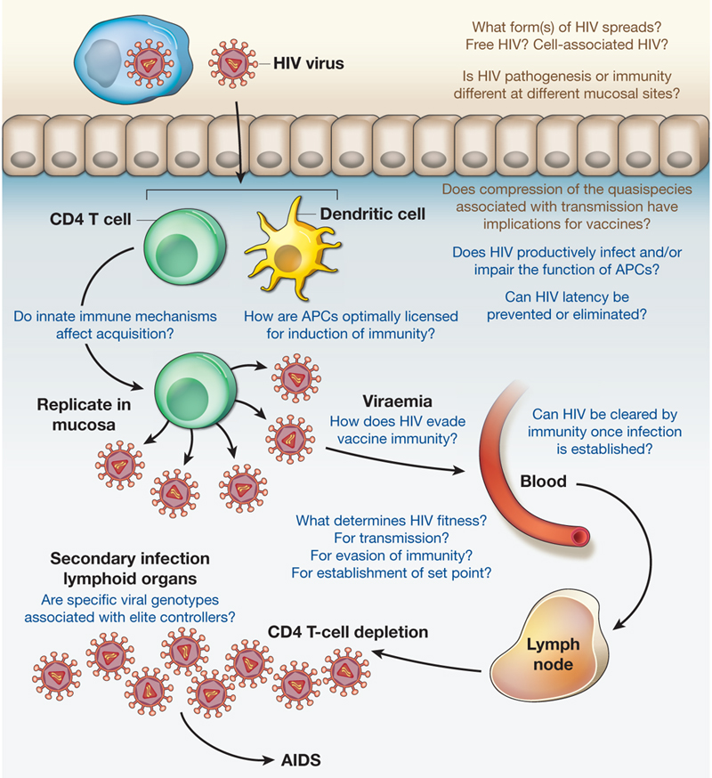
HIV pathogenesis

Slide 13
Stages of HIV infection
The course of HIV infection is divided into 3 stages based on CD4+ T cell count and presence of opportunistic infections:
The acute phase
The chronic phase 1- (PGL)
2- (ARC)
AIDS (the end stage of the disease)

Slide 14
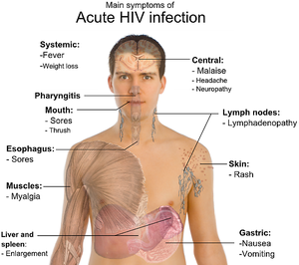
Acute phase:
Incubation period 2 weeks and lasts for about 12 weeks.
Mostly asymptomatic, but in about 25-65% of the cases, patients may develop symptoms resemble infectious mononucleosis or Flu (fever, headache, anorexia, fatigue, lymphadenopathy, skin rash) which resolved in 2 weeks.
Rapid viral replication (high viral load >10⁶ copies/mL).
Gradual decrease in CD4+ T cell count.

Slide 15
Blood markers in the acute stage:
Normal to slightly decrease no of CD4+ T cells.
Appearance of the viral RNA, and then the core antigen (p24 antigen) which indicate active viral replication.
Appearance of two antibodies, Anti-envelop (Anti-gp120) & Anti-core (Anti-p24).
The 1st choice marker for detection HIV in the acute phase is HIV RNA.

Slide 16
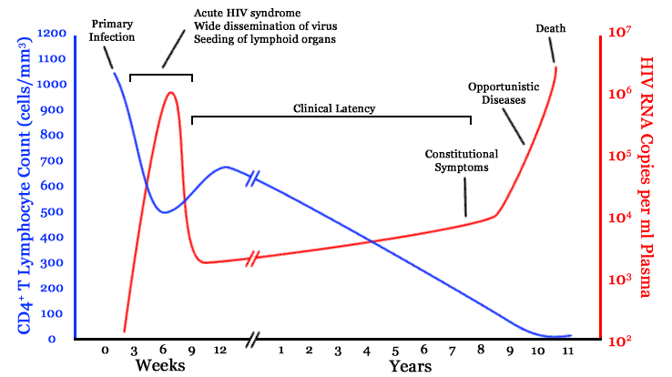
HIV RNA copies VS CD4+ T cell counts

Slide 17
Chronic phase:
Lasts for about 10 yrs in adults, and 5 yrs in children.
Totally asymptomatic but the patients is still contagious.
Relatively low viral load (<10⁴ copies/mL).
CD4+ T cell count > 500 cells/mm³.
At the end of this stage, two syndromes appear:
Persistent generalized lymphadenopathy (PGL).
AIDS-related complex (ARC).

Slide 18
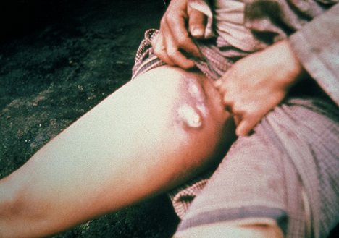
Persistent generalized lymphadenopathy (PGL)
Is defined as enlargement of lymph nodes for at least 1 cm in diameter in the absence of any illnesses or medications that known to cause PGL.
Clinical features:
In two or more lymph nodes out of the inguinal area.
Persists for at least 3 months.

Slide 19
AIDS-related complex (ARC)
Is a group of clinical symptoms that come before AIDS and may include the following:
Fever of unknown origin that persists > 1 month.
Chronic diarrhea, persisting > 1 month.
Weight loss > 10% of the original weight (slim disease).
Fatigue, night sweating, and malaise.
Neurological disease as myelopathy and peripheral neuropathy.

Slide 20
Slim disease

Slide 21
Blood markers in the chronic stage:
Viral load (HIV RNA) increases gradually, but HIV core antigen (p24) may not appear in blood.
Anti-envelop (Anti-gp120) & Anti-core (Anti-p24) are positive.
CD4+ T cell count gradually decreased but still more than 200 cells/mm³

Slide 22
HIV RNA copies VS CD4+ T cell counts

Slide 23
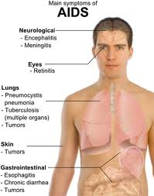
AIDS phase:
The end stage of the disease.
Continuous viral replication (high viral load).
Marked decrease in CD4+ T cell count < 200 cell/mm³.
Defects in cellular immunity.
Persistent or frequent multiple opportunistic infections.
Unusual cancer (Kaposi sarcoma).

Slide 24
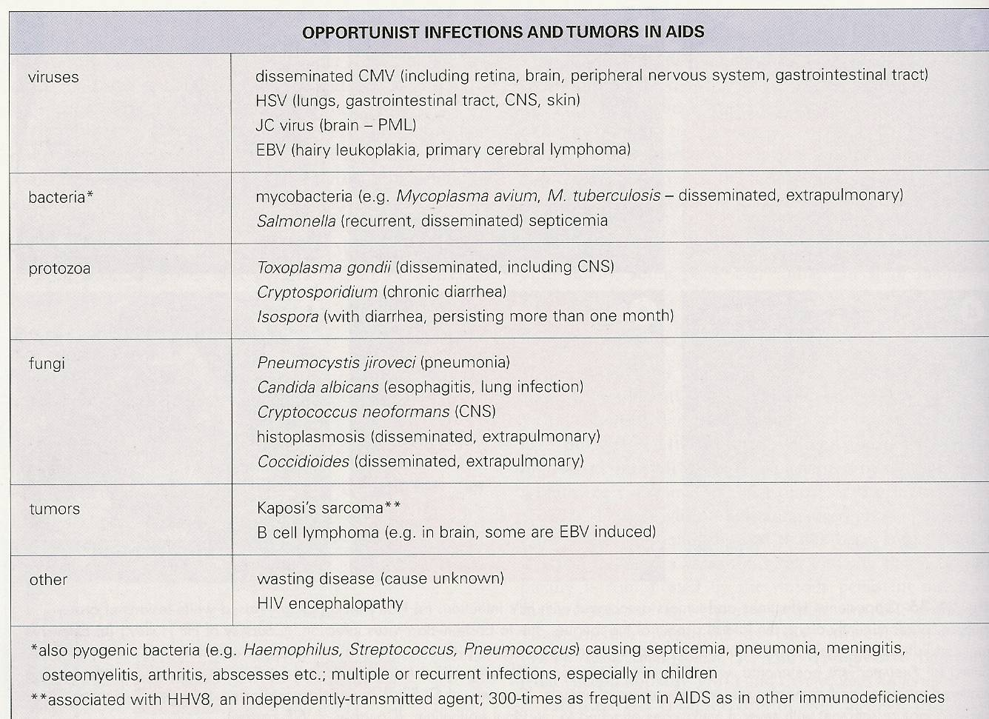
Continued..

Slide 25
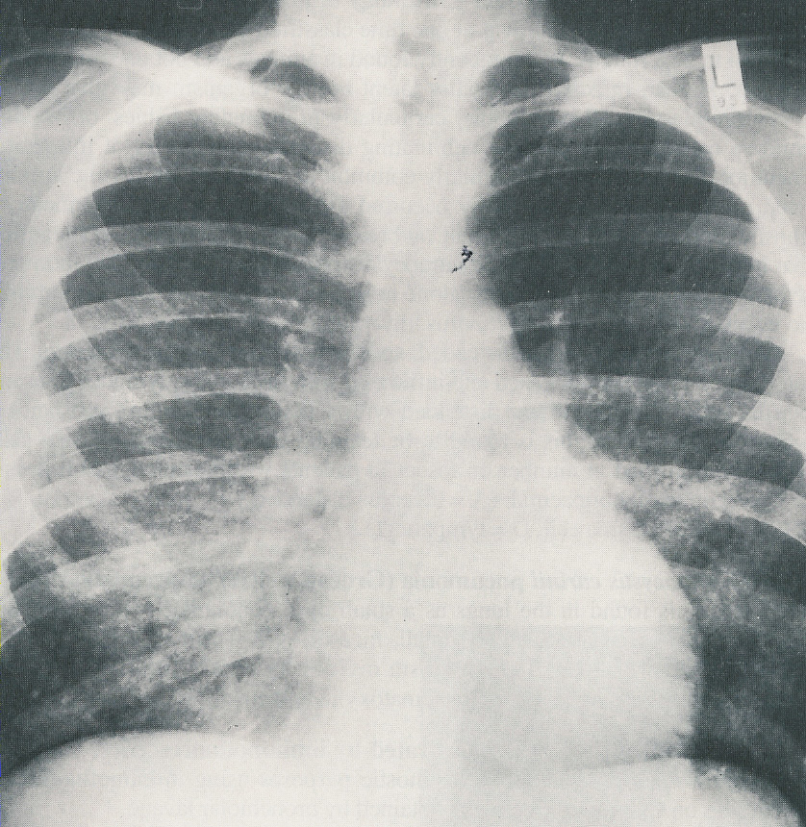
Pneumocystis pneumonia

Slide 26
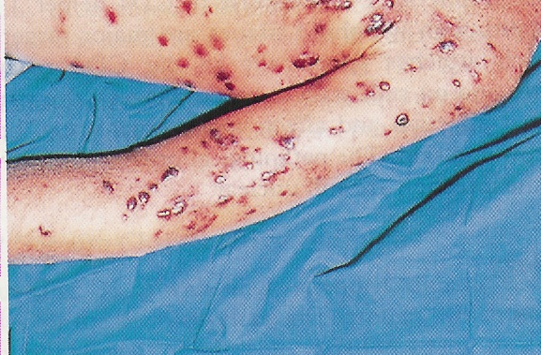
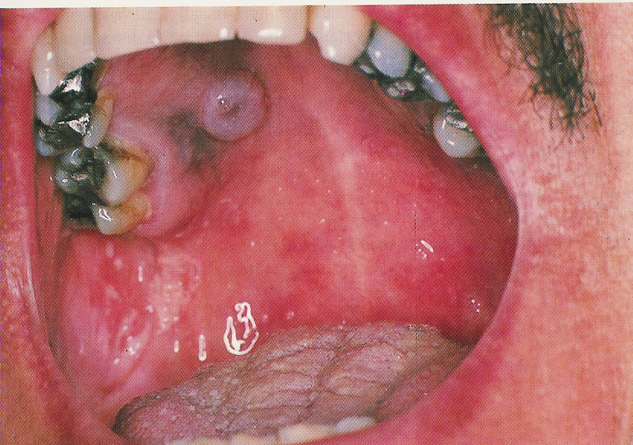
Kaposi sarcoma / Candida infection

Slide 27
Blood markers in AIDS stage:
High viral load (HIV RNA), and HIV core antigen (p24) appears in blood.
Detection of both HIV RNA & the antigen p24 indicative of active viral replication.
Anti-envelop (Anti-gp120) & Anti-core (Anti-p24) are positive.
CD4+ T cell count decreased to very low levels (<200 cells/mm³).

Slide 28
HIV RNA copies VS CD4+ T cell counts

Slide 29
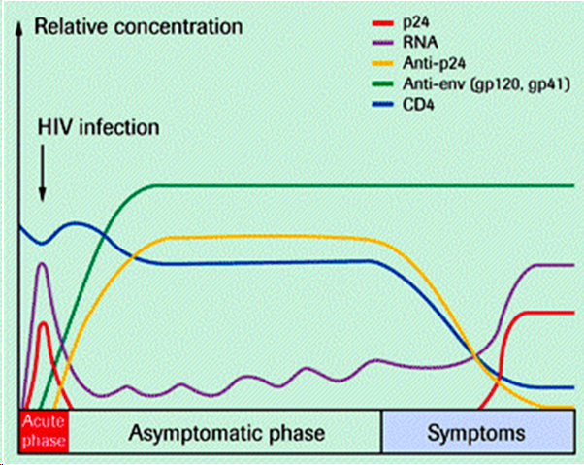
Serological profile of HIV infection

Slide 30
Diagnosis
Patients history with or without clinical symptoms provides hints for a physician whether the patient has ever exposed to HIV or not.
Detection of both HIV Ag & Ab in the patient serum by ELISA.
If result is positive, repeat the screening test in duplicate.
If repeatedly reactive (positive), do confirmatory tests (Western blot, recombinant immunoblot assay (RIBA), or PCR).
Blood viral load by PCR is also used to monitor HIV replication and follow up patients treatment.

Slide 31
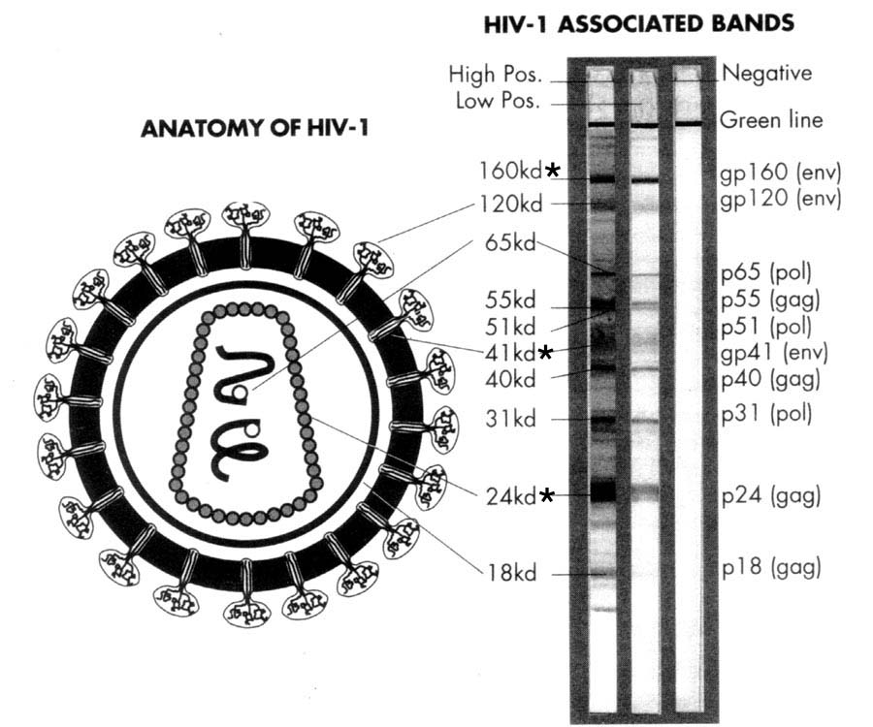
HIV western blot

Slide 32
Management & prevention
No vaccine is available to prevent HIV infection, and thus the best strategies to control the spread of HIV infection are the following:
Religious education (teaching the risk of making prohibited relations).
Public health education (teaching the risk of using shared materials).
Practice safer sex by having one sexual partner.
Advise of using condoms when is necessary.

Slide 33
Treatment
Is a combined therapy known as high active antiretroviral therapy (HAART).
NOTE: HAART does not clear (eradicate) the virus from the body, and should be taken all life.
NOTE: HAART treated patients are still contagious even if their blood viral load below detection level (< 50 copies/mL).
HAART is usually composed of two reverse transcriptase inhibitors and one protease inhibitor.

Slide 34
Continued..
There are two types of reverse transcriptase inhibitors:
Nucleoside analog RT inhibitors for HIV-1 & HIV-2:
- Zidovudine (AZT) - Zalcitabine (ddC)
- Stavudine (d4T) - Lamivudine (3TC)
Non-nucleoside analog RT inhibitors for HIV-1 only:
- Nevirapine - Delavirdine - Efavirenz
Proteases inhibitors include:
- Saquinavir - Indinavir
- Nelfinavir - Ritonavir

Slide 35
Goals of HIV treatment
To inhibit viral replication.
To control chronic immune activation and keep the immune system as close as possible to the normal state.
To prevent the development of opportunistic infections.
To minimize the chance of viral transmission especially from mother to neonate.

Slide 36
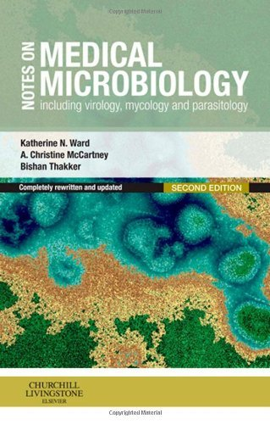
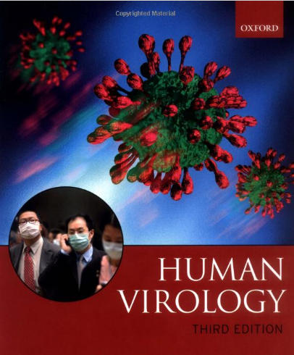
Reference books
Notes on Medical Microbiology
By; Katherine N. Ward, A. Christine McCartney, and Bishan Thakker.
(2009)
Human Virology
By; Leslie Collier and John Oxford.
(2006)

Slide 37
Thank you for your attention !
Questions ?

