Slide 1
Benign breast diseases

Slide 2
Objectives
Know the ways that benign breast conditions can present clinically .
Know the common inflammatory conditions of breast (mastitis and abscesses).
Understand the pathology of fibrocystic changes.
Know the common benign breast tumors with special emphasis on fibroadenoma and phyllodes tumor.
Know the risk of subsequent breast cancer in women with diagnosed benign breast tissue.

Slide 3
Introduction
The functional unit of the breast is the lobule, which is supported by a specialized intralobular stroma.
The inner luminal epithelial cells produce milk during lactation.
The basally located myoepithelial cells have contractile function to aid in milk ejection and also help support the basement membrane.
The ducts are conduits for milk to reach the nipple.
The size of the breast is determined primarily by interlobular stroma, which increases during puberty and involutes with age.
Each normal constituent is a source of both benign and malignant lesions

Slide 4
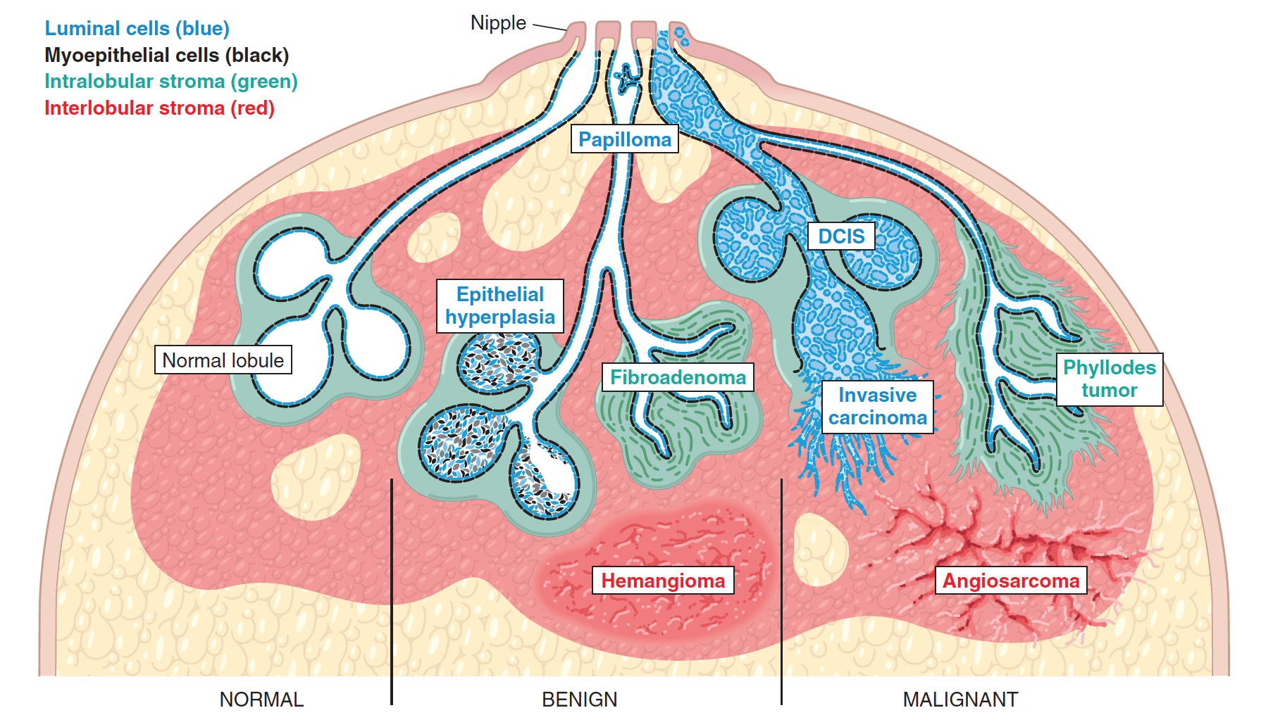

Slide 5
Clinical Presentation of Breast Diseases
Pain (mastalgia):
It is the most common breast symptom. May be cyclical (with menses) or noncyclical. Diffuse cyclical pain has no pathologic significance. Non-cyclical pain can be caused by ruptured cysts or areas of prior injury or infection, or no specific cause. Although the great majority of painful masses are benign, about 10% of breast cancers present with pain.
Palpable mass
Nipple discharge:
Milky discharge: not associated with malignancy.
Bloody or serous discharges: commonly associated with benign lesions but can rarely be due to a malignancy.

Slide 6
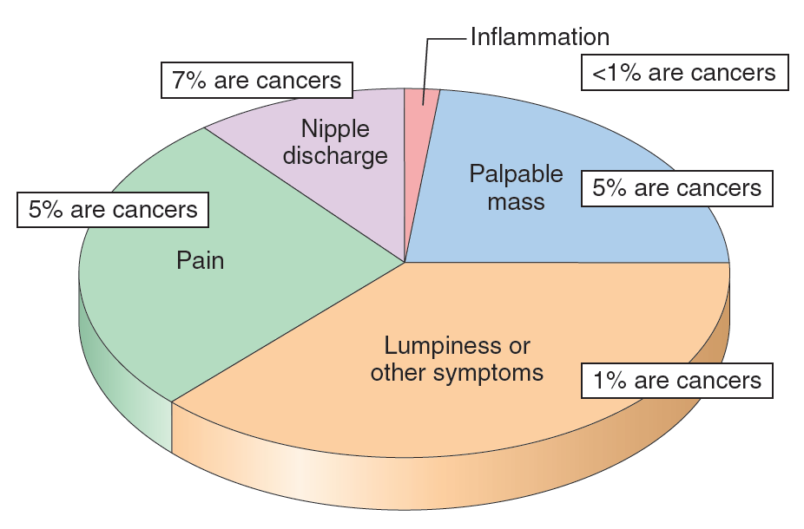
Clinical Presentation of Breast Diseases

Slide 7
Mammographic Screening
Mammographic screening was introduced in the 1980s as a means to detect small, non-palpable, asymptomatic breast carcinomas.
The principal mammographic findings of breast carcinoma are densities/masses and calcifications:
Densities (mass): Most tumors appear radiologically denser than the normal breast. Fibroadenomas and cysts can also present as densities.
Calcifications: Calcium gets deposited in secretions, necrotic debris, or hyalinized stroma. It can be seen in benign and malignant conditions
Calcifications in malignancy are usually small, irregular, numerous, and clustered.
Mammographic screening has increased the diagnosis of DCIS which usually present as mammographic calcifications
It is recommended to start mammographic screening at the age of 40 years.

Slide 8
Benign Breast Lesions
Inflammatory lesions
Acute mastitis: Staphylococcus aureus infection is the most common organism.
Periductal mastitis
Mammary duct ectasia → dilated ducts disease
Fat necrosis: It is usually due to a mechanical or surgical trauma.
Lymphocytic mastopathy (sclerosing lymphocytic lobulitis): It is seen in diabetic women.
Granulomatous mastitis: It can be idiopathic, due to sarcoidosis or TB.
Benign epithelial lesions
Non proliferative breast changes (fibrocystic changes)
Proliferative breast disease without atypia
Proliferative breast disease with atypia /Atypical hyperplasia
Benign stromal lesions
Fibroadenoma
Benign phyllodes tumors

Slide 9
Inflammatory Lesions

Slide 10
Mastitis
Acute mastitis: Almost all cases of acute mastitis occur during the first month of breastfeeding. Staphylococcus aureus is the most common causative organism. The breast is erythematous and painful. Fever is often present.
Periductal mastitis: This condition is not associated with lactation. However, there is a strong association with cigarette smoking.

Slide 11
Benign Epithelial Lesions

Slide 12
Non Proliferative Breast Changes (Fibrocystic Changes)
It is the most common disorder of the breast.
Age: 20 - 55 years, decreases progressively after menopause.
The cause is not known but it is thought to be hormonal imbalances.
It can produce palpable breast masses, mammographic densities orncalcifications, or nipple discharge. It may also present with cyclical pain.
It carries no increased risk for cancer.

Slide 13
Non Proliferative Breast Changes (Fibrocystic Changes)
Three histological patterns are seen:
Cysts with apocrine metaplasia: cysts are lined by benign flattened to columnar epithelium with focal apocrine metaplasia. In apocrine metaplasia the cells become large and have abundant eosinophilic cytoplasm. The cysts can rupture and cause inflammation.
Fibrosis: contribute to the palpable firmness of the breast.
Adenosis: It is defined as an increase in the number of acini per lobule (adenosis can also be seen in pregnancy).

Slide 14
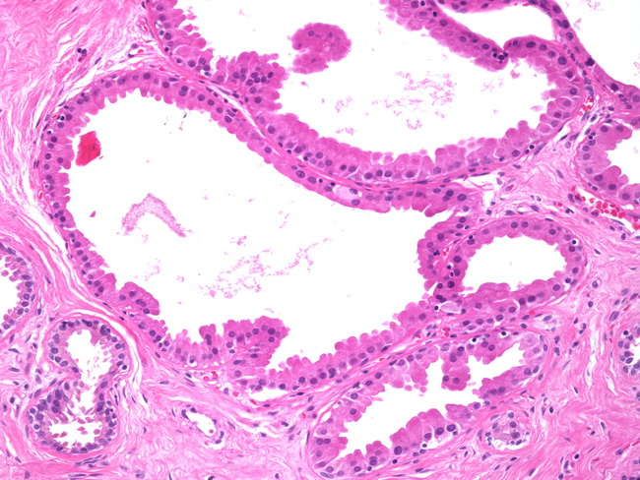
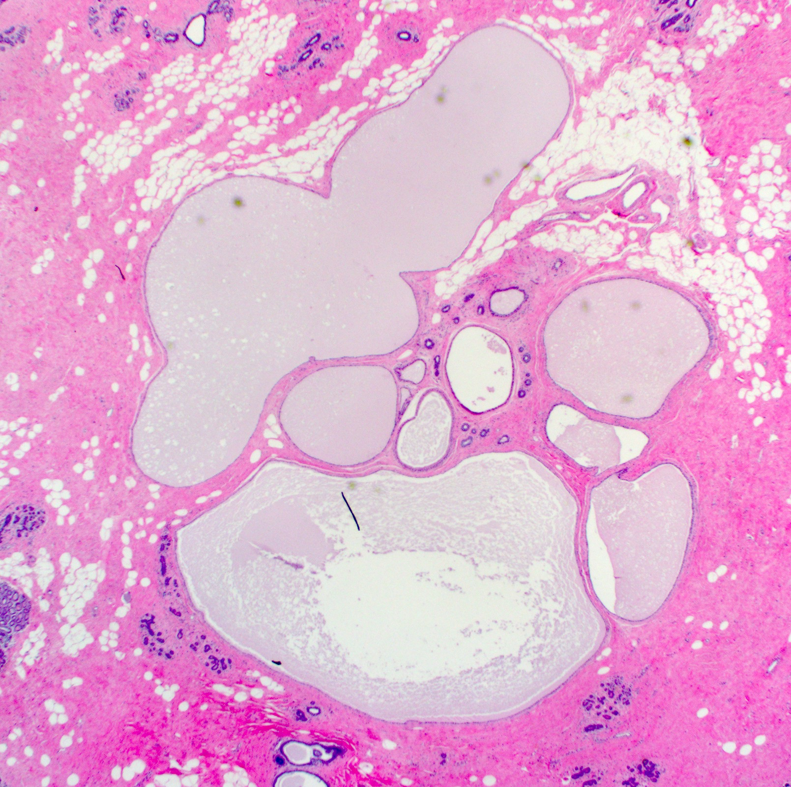
Cystic apocrine metaplasia
Cysts

Slide 15
Proliferative Disease Without Atypia
They are incidental findings and rarely form palpable masses.
They are detected as small mammographic densities.
Risk for cancer is 1.5 – 2 times normal.
The following entities are included in this category:
Epithelial hyperplasia
Sclerosing adenosis
Complex sclerosing lesions/radial scar
Papillomas
Proliferative variant of fibrocystic disease.

Slide 16
Epithelial Hyperplasia (usual ductal hyperplasia)
The normal breast has a 2 layers of cells (epithelial and myoepithelial cells). Thus, epithelial hyperplasia is defined as the presence of more than 2 layers.
Hyperplasia can range from mild, moderate and severe/florid.
Both epithelial and myoepithelial cells proliferate.
It can be seen in the ducts and the lobules.
When it is seen in fibrocystic disease: it is called as proliferative type/variant of fibrocystic disease.

Slide 17
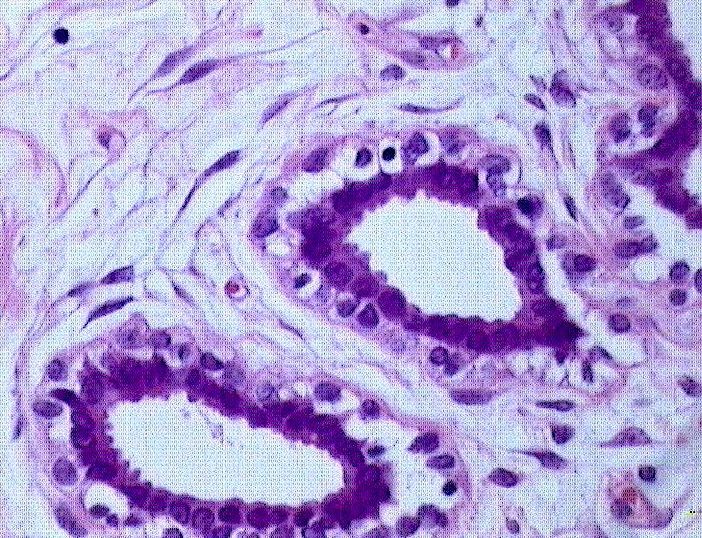
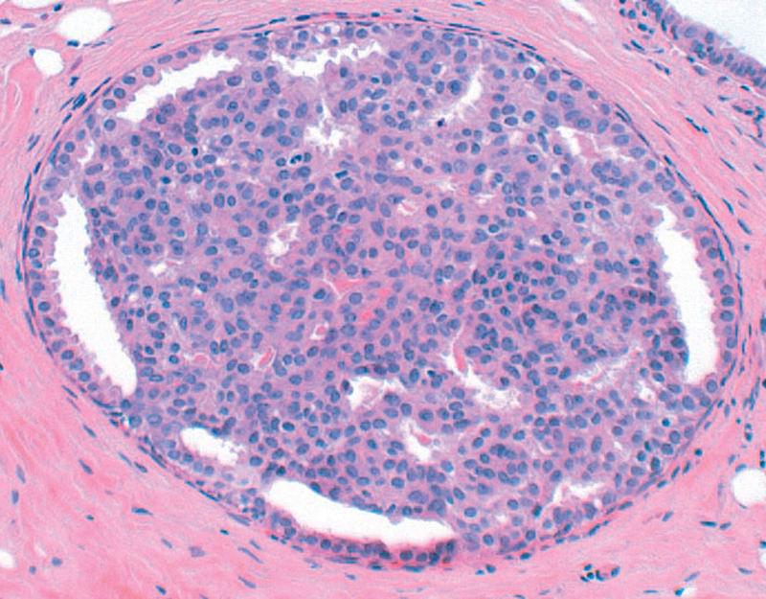
Normal acinus
Usual ductal hyperplasia

Slide 18
Sclerosing Adenosis
It is commonly seen as an incidental microscopic finding but may occasionally present as a palpable mass that is mistaken clinically for cancer.
Calcifications are commonly seen in the lesion, so even on mammography it can mimic cancer.
It is almost always associated with other forms of fibrocystic change.
Microscopically: adenosis and stromal fibrosis in the lobule which leads to compression and distortion of the lobule.

Slide 19
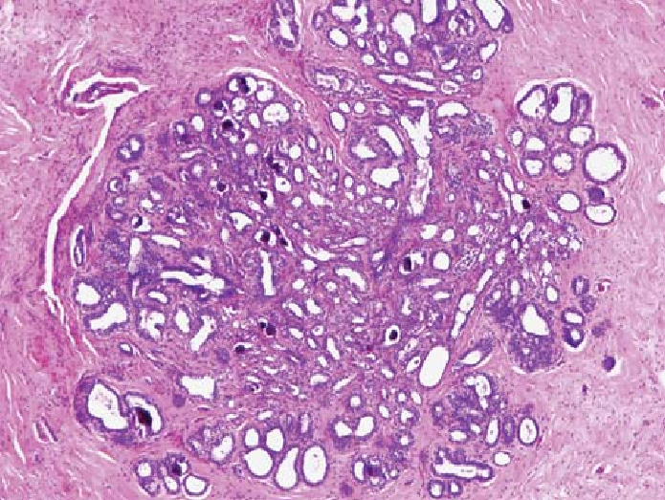
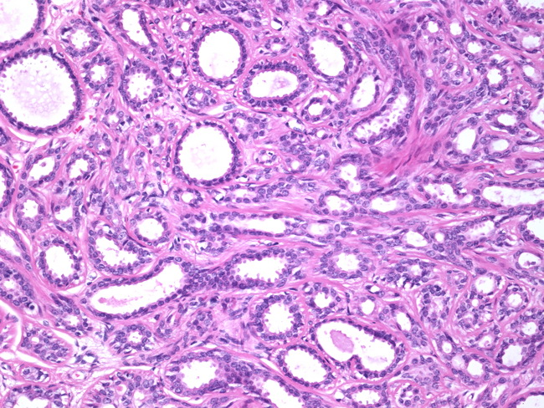
Sclerosing adenosis

Slide 20
Complex Sclerosing Lesion (Radial Scar).
Radial scars are stellate lesions characterized by a central nidus of entrapped glands in a dense fibrotic or hyalinized stroma. The nidus is surrounded by radiating arms of epithelium with varying degrees of cyst formation and hyperplasia.
They typically present as an irregular mammographic density and closely mimic an invasive carcinoma both mammographically and clinically.
The word "scar" refers to the morphologic appearance, and not a prior inflammation, trauma or surgery.

Slide 21
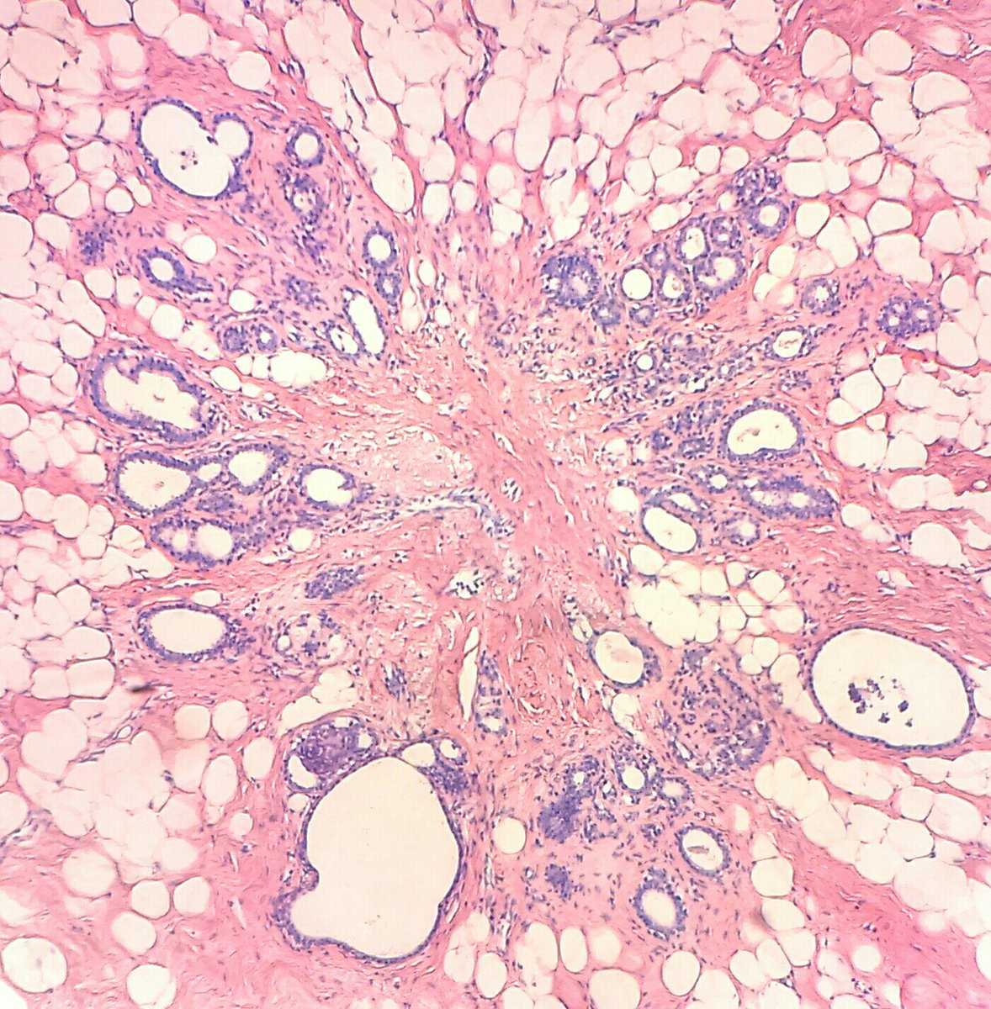
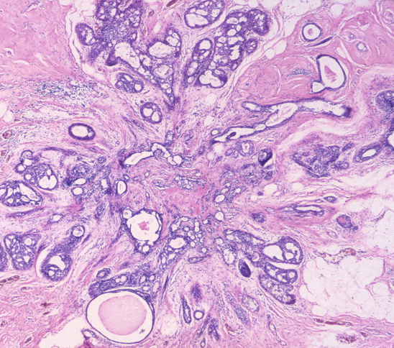
Radial scar (complex sclerosing lesion

Slide 22
Intraductal Papillomas
It is a papillary tumor that arises from the ductal epithelium. It is more common in the large lactiferous ducts (present in the central part of the breast at the nipple) but can also occur in the small ducts in any quadrant of the breast.
Large duct papillomas (central papillomas): usually solitary and situated in the lactiferous duct at the nipple. Patients present with bloody nipple discharge and sometimes a subareolar palpable mass.
Small duct papillomas: commonly multiple and located deeper within the ductal system. Small duct papillomas have been shown to increase the risk of subsequent carcinoma.

Slide 23
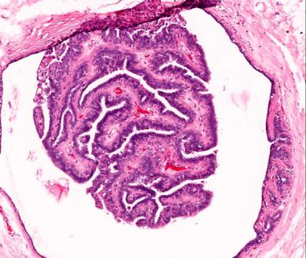
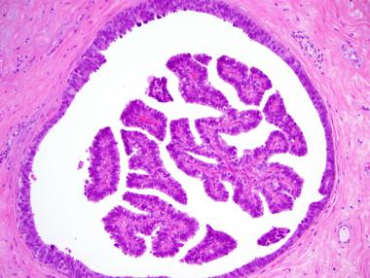
Intraductal papillomas

Slide 24
Proliferative breast disease with atypia (Atypical hyperplasia)
Risk for cancer is 4 - 5 times normal
Atypical hyperplasia is a cellular proliferation resembling ductal carcinoma in situ (DCIS) or lobular carcinoma in situ (LCIS) but lacking sufficient qualitative or quantitative features for a diagnosis of carcinoma in situ.
Include two entities
Atypical ductal hyperplasia
Atypical lobular hyperplasia
Atypical hyperplasia has some of the architectural and cytologic features of carcinoma in situ but lack the complete criteria for that diagnosis and is categorized as ductal or lobular in type

Slide 25
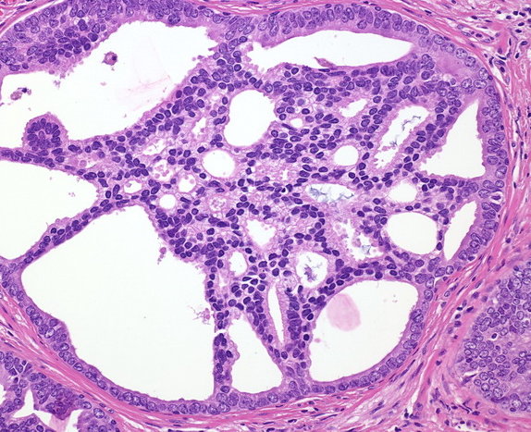
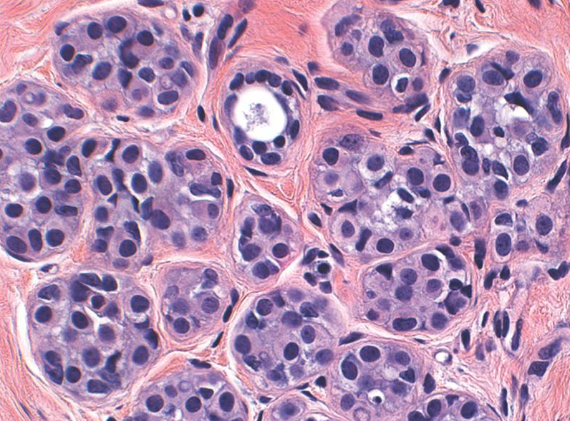
ADH
ALH

Slide 26
Pathologic lesion | Relative risk of development of invasive carcinoma | comments
Non-proliferative breast diseases (fibrocystic changes) | do not have an increased risk. | Fibrocystic disease
Proliferative disease without atypia | 1.5 to 2 times normal | Epithelial hyperplasia Sclerosing adenosis Complex sclerosing lesions/radial scar Papillomas Proliferative fibrocystic disease.
Proliferative disease with atypia | 4.0 to 5.0 times normal | ADH ALH
Carcinoma in situ | 8.0 to 10.0 times normal | DCIS LCIS

Slide 27
Stromal Lesions

Slide 28
Fibroadenoma
The most common benign tumor of the female breast.
It is composed of benign proliferation of both epithelial and stromal elements.
It can occur at any age, most common before the age of 30 years.
Clinical presentation: firm, mobile lump (“breast mouse”).
It may increase in size during pregnancy. It may stop growing and regress after menopause.
The tumor is usually solitary but may be multiple and involve both breasts.
The tumor is completely benign and they are almost never malignant.
Treatment: lumpectomy (only the lump is removed)

Slide 29
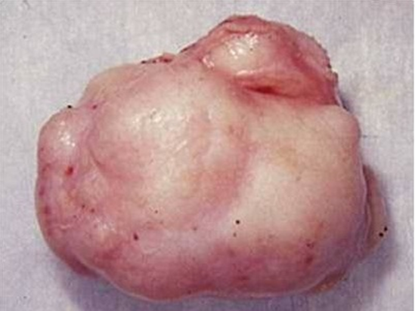
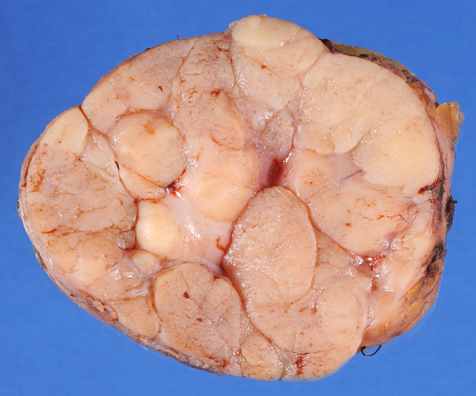
Fibroadenoma
Grossly: spherical nodules, sharply demarcated and circumscribed from the surrounding breast tissue and freely movable so it can be shelled out. The size varies between 1 cm to 10 cm in diameter. The cut surface is pearl-white and whorled.

Slide 30
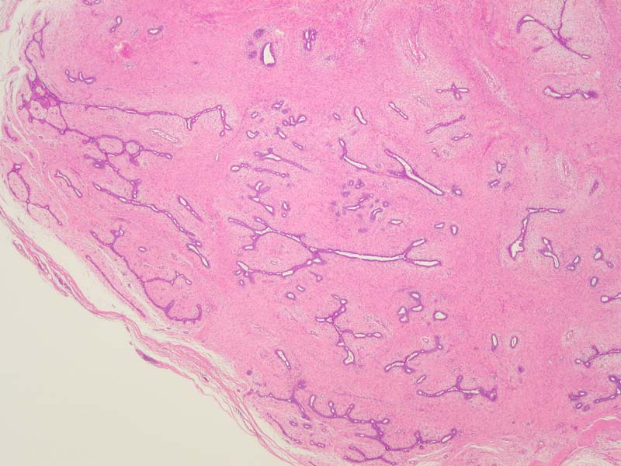
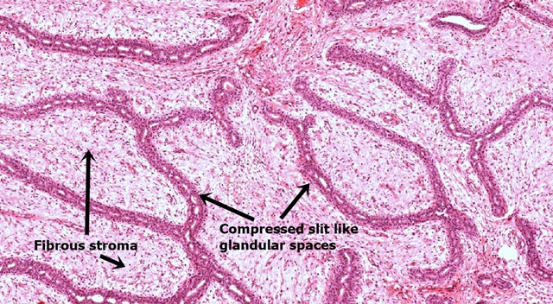
Fibroadenoma
Histology: tumor is composed of a mixture of ducts and fibrous connective tissue.
The lesion consists of a proliferation of intralobular stroma surrounding and often pushing and distorting the associated epithelium. The border is sharply delimited.

Slide 31
Phyllodes Tumors
Phyllodes tumors can occur at any age, but most present in the 40s and 50s, that is 10 to 20 years later than the average presentation of a fibroadenoma.
These tumors are much less common than fibroadenomas.
Most present as large palpable masses (usually 3 to 4 cm in diameter).
Phyllodes tumors are classified as:
Benign phyllodes tumors: most (75%) phyllodes tumors are benign.
Low-grade phyllodes tumors: they tend to recur locally and rarely metastasize.
High-grade phyllodes tumors: they are uncommon and they behave aggressively with frequent local recurrences and can have distant metastases to lung, bone and brain. They have better a prognosis than invasive ductal carcinoma.

Slide 32
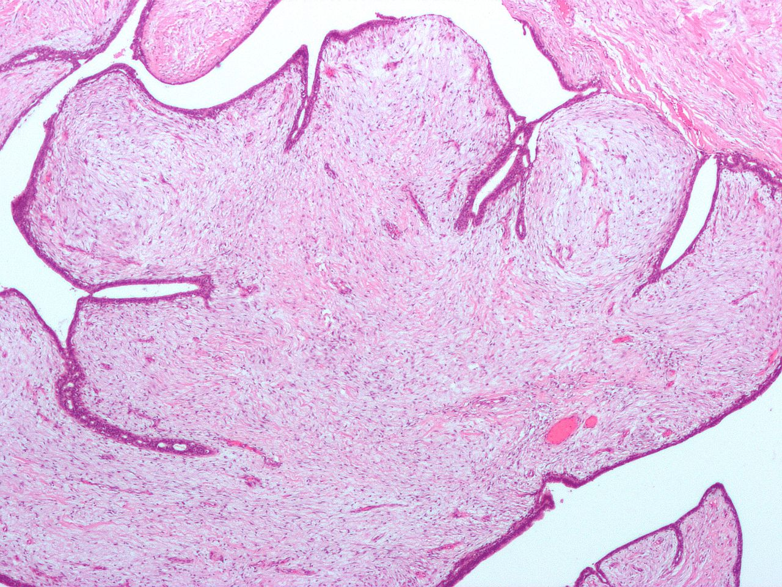
Benign Phyllodes Tumor
Benign phyllodes tumors are fibro-epithelial tumors that have a leaf-like pattern and a cellular stroma.

Slide 33
References
Kumar V, Abbas AK, Aster JC. Robbins Basic Pathology. 10th ed. Elsevier; 2018. Philadelphia, PA.

Slide 34
End of lecture
Thank You

