Slide 1

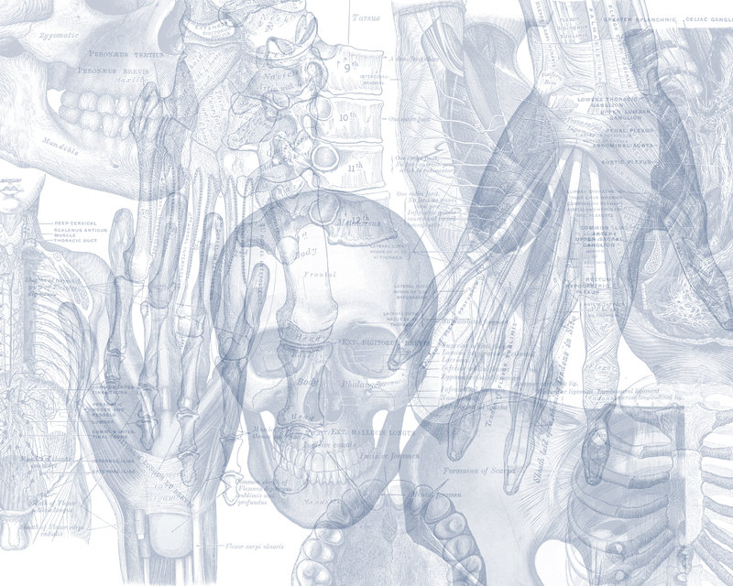


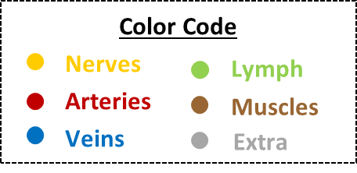
OSPE
REPRODUCTIVE BLOCK

Slide 2
اللهم لا سهل إلا ما جعلته سهل وأنت تجعل الحزن إذا شئت سهل
Important Points
Read the questions carefully.
Make sure your write the FULL name of the structures with the correct spelling.
Example: IVC ✕→ Inferior Vena Cava ✓
Aorta ✕→ Abdominal aorta ✓
3. There is NO guarantee whether or not the exam will go out of this file.
Good luck!

Slide 3
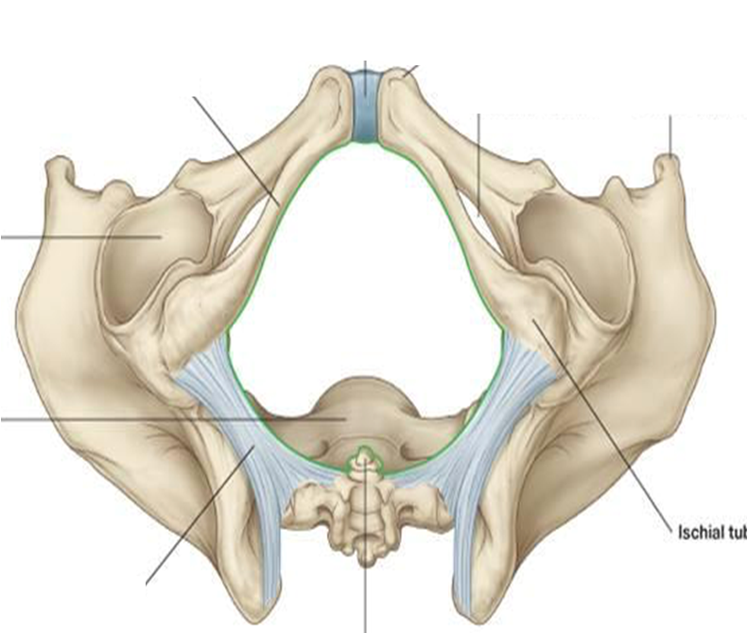
Question: 1
5
1
Identify:
Ischiopubic arch
Ischial tuberosity
Coccyx
Sacrotuberous ligament
Symphysis pubis
2
4
3

Slide 4
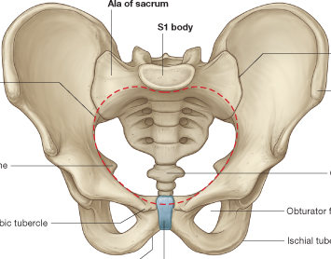
Question: 2
2
1
Identify the structures of the pelvic inlet:
Promontory of sacrum.
Ala of sacrum
Iliopectineal line (arcuate line).
Symphysis pubis
3
4

Slide 5
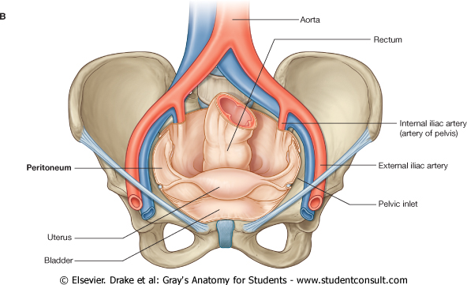
Question: 3
4
Identify the labeled structures:
Uterus.
Urinary bladder.
External iliac artery.
Rectum.
Broad ligament.
5
3
1
2

Slide 6
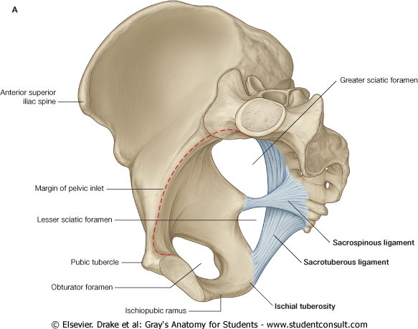
Question: 4
Identify the labeled structures:
Lesser sciatic foramen
Obturator foramen
Greater sciatic foramen.
Sacrospinous ligament
Sacrotuberous ligament.
3
1
4
5
2

Slide 7
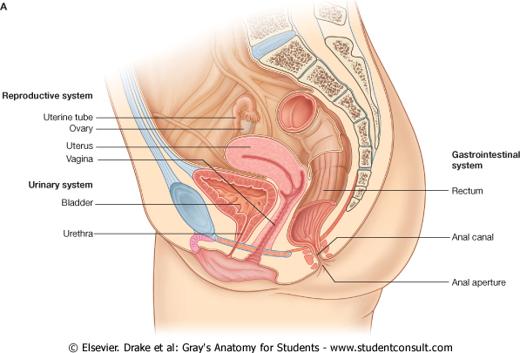
Question: 5
3
Identify the labeled structures:
Fallopian tube
Vagina.
Rectouterine* or Douglas pouch.
Posterior vaginal fornix.
Urethra
Vulva
1
4
2
5
6
*also called rectovaginal pouch

Slide 8
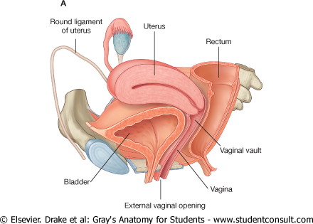
Question: 6
1
5
4
Identify the labeled structures:
Fallopian tube.
Urinary bladder.
Vagina.
Rectum.
Uterus.
2
3

Slide 9
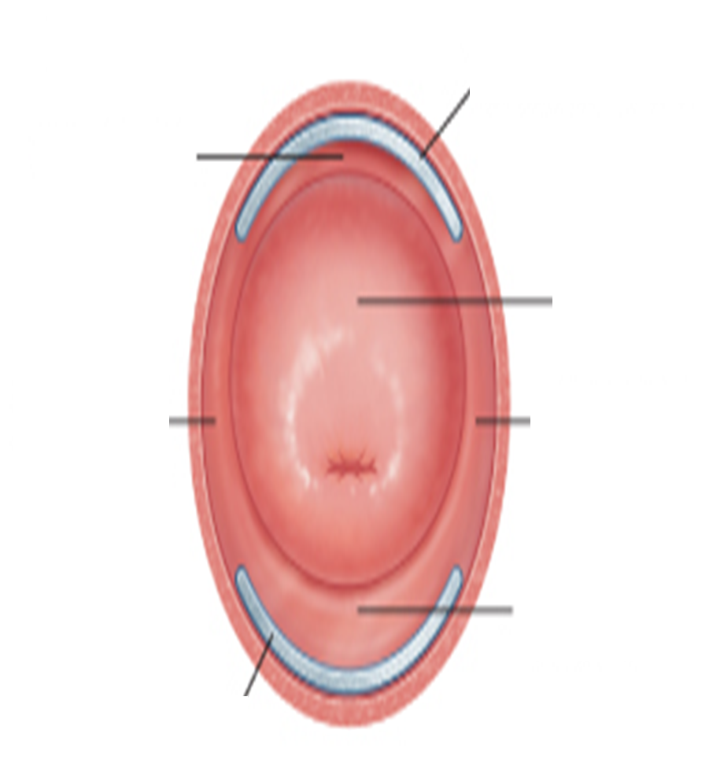
Question: 7
Identify the labeled structures:
Anterior vaginal fornix
Cervix.
External os.
According to pregnancy, what description would you give to this female?
Multiparous (has anterior and posterior lips).
1
2
3

Slide 10
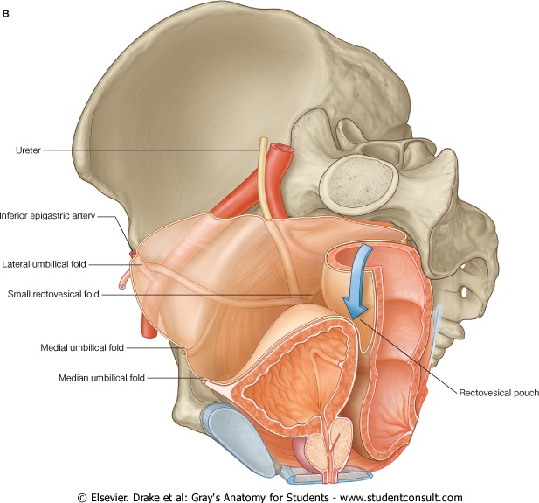
Question: 8
Identify the labeled structures:
Ureter.
Rectovesical pouch.
Prostate gland.
Vas deferens.
1
4
2
3

Slide 11
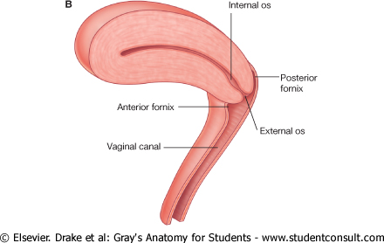
Question: 9
1
Identify the labeled structures:
Cervical canal.
Posterior fornix.
External os.
Vagina.
Anterior fornix.
2
5
3
4

Slide 12
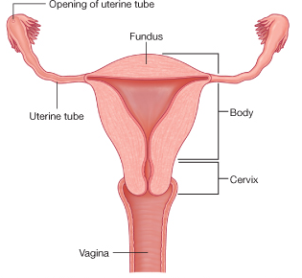
Question: 10
1
Identify the labeled structures:
Fundus.
Body.
Cervix.
Vagina.
Fallopian tube.
2
5
3
4

Slide 13
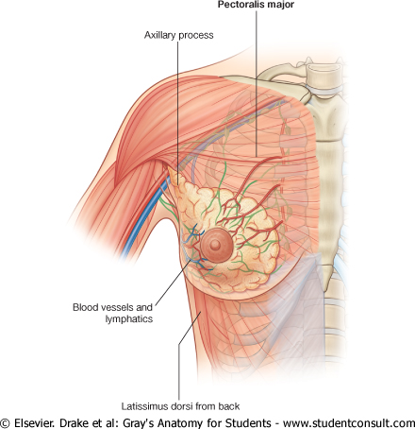
1
Question: 11
2
Identify the labelled structures:
Pectoralis major
Axillary (tail) process
Nipple
Areola
4
3

Slide 14
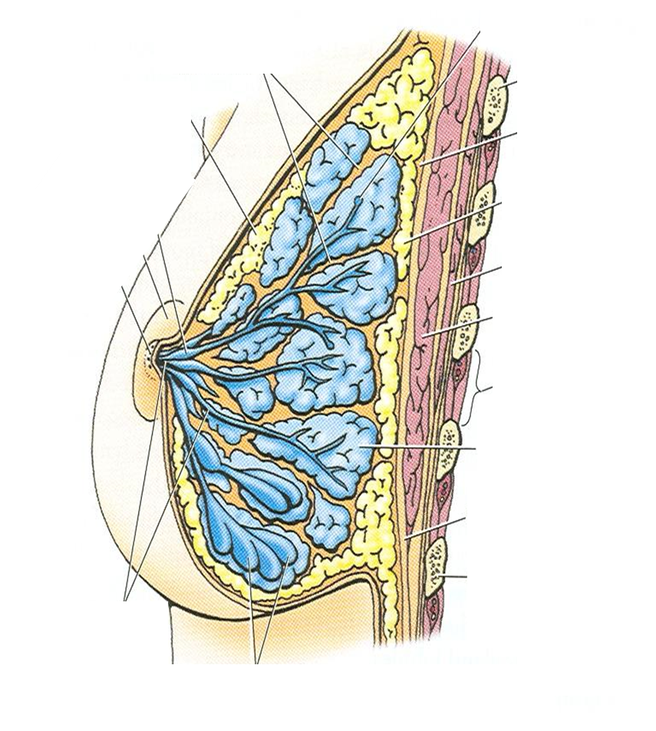
1
Question: 12
Identify the labelled structures:
Suspensory ligaments (coopers ligaments)
Lactiferous sinus
Areola
Nipple
Lactiferous ducts
Mammary gland lobules
Retromammary space
7
3
2
4
5
6

Slide 15
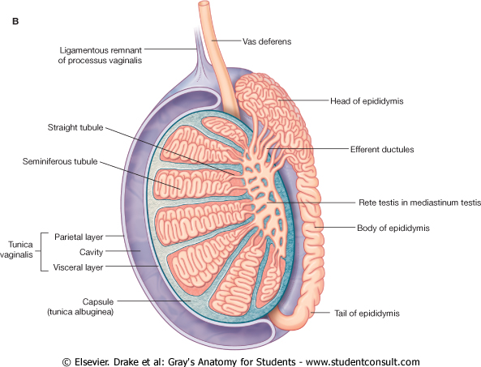
Question: 13
3
Identify the labeled structures:
Tunica vaginalis.
Tunica albuginea.
Vas deferens.
Head of the epididymis.
Efferent ductules or vasa efferentia.
Rete testis
4
5
6
1
2

Slide 16
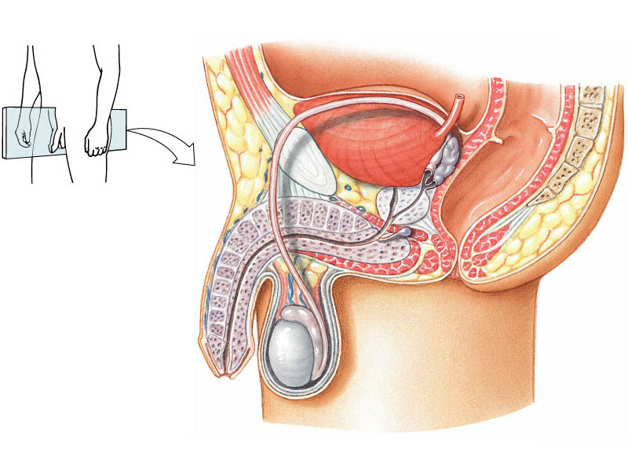
Question: 14
Head of epididymis
Urinary bladder
Body of epididymis
Vas deferens
Vas deferens
Seminal vesicle
Tail of epididymis

Slide 17
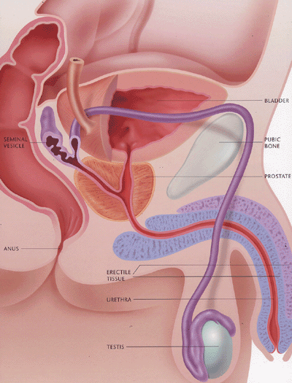

Question: 15
Seminal vesicle
Prostate gland
Bulbourethral gland
Theory
Relations of Prostate
Base (superior) | Neck of urinary bladder
Apex (Inferior) | Urogenital diaphragm
Anterior | Symphysis pubis
Posterior | Rectum
Lateral | Medial margin of levator ani muscles (levator prostate)

Slide 18
Question: 16
1
2
Identify the labeled structures:
Base of urinary bladder
Vas deferens
Seminal vesicle
3

Slide 19
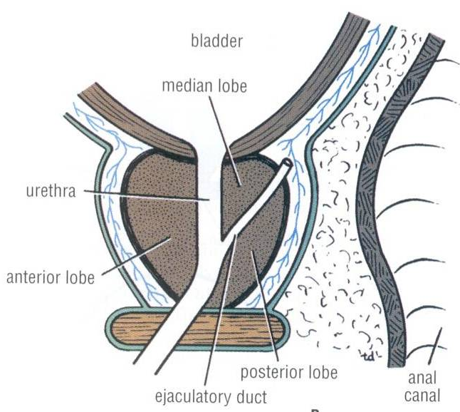
Question: 17
Identify the structure:
Ejaculatory duct
Theory
Supply
Arteries | Inferior vesical artery
Veins | Prostatic venous plexus (lies between the prostatic fibrous capsule and the prostatic sheath) It drains into the Internal iliac veins: It is continuous superiorly with the vesical venous plexus and posteriorly to the internal vertebral venous plexus.
Lymphatics | Internal iliac lymph nodes

Slide 20
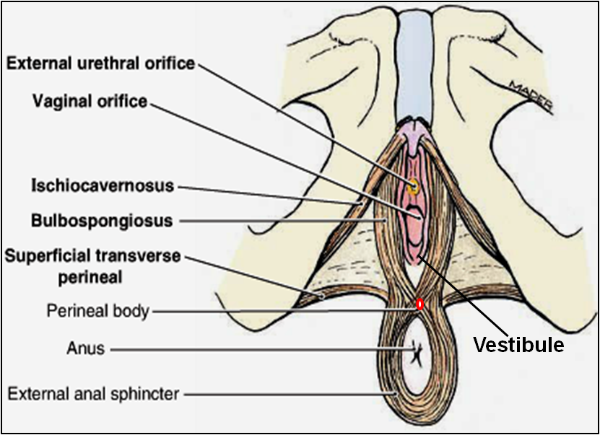
Question: 18
Prof. Abuelmakarem told us to add all the pictures from the perineum lecture:
Identify the labeled structures:
External urethral orifice
Vaginal orifice
Ischiocavernosus
Bublospongiosus
Superficial transverse perineal
Perineal body
Anus
External anal sphincter
Vestibule
Perineal membrane
1
2
10
3
4
5
6
7
9
8

Slide 21
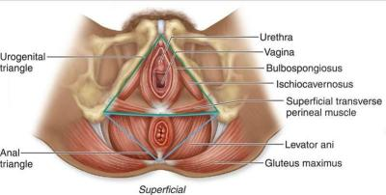
Question: 19
Prof. Abuelmakarem told us to add all the pictures from the perineum lecture:
Identify the labeled structures:
Urogenital triangle
Anal triangle
Gluteus maximus
Levator ani
Superficial transverse perineal muscle
Ischiocavernosus
Bulbospongiosus
Vagina
Urethra
9
8
1
7
6
5
4
2
3

Slide 22
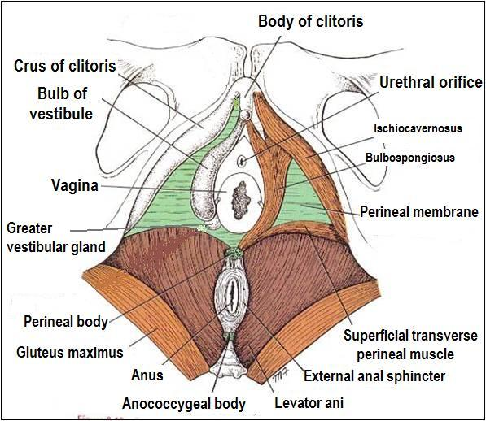
Question: 20
Prof. Abuelmakarem told us to add all the pictures from the perineum lecture:
Identify the labeled structures:
Body of clitoris
Crus of clitoris
Bulb of vestibule
Vagina
Greater vestibular gland
Perineal body
Anus
Anococcygeal body
Levator ani
Perineal membrane
Urethra
1
2
3
11
4
10
5
6
7
8
9

Slide 23
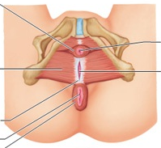
Question: 21
Prof. Abuelmakarem told us to add all the pictures from the perineum lecture:
Identify the labeled structures:
External urethral sphincter
Deep transverse perineal muscle
Central tendon
Anus
External anal sphincter
Vaginal opening
Urethral opening
1
7
2
6
3
4
5

Slide 24
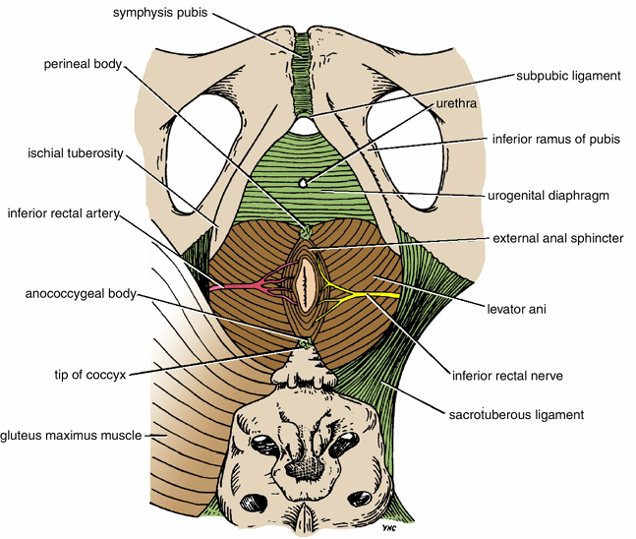
Question: 22
Prof. Abuelmakarem told us to add all the pictures from the perineum lecture:
Identify the labeled structures:
Symphysis pubis
Perineal body
Ischial tuberosity
Anococcygeal body
Tip of coccyx
Sacrotuberous ligament
Levator ani
External anal sphincter
Urogenital diaphragm
Inferior ramus of pubis
Urethra
1
2
11
10
3
9
8
4
7
5
6

Slide 25
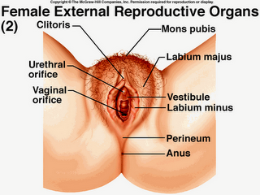
Question: 23
Prof. Abuelmakarem told us to add all the pictures from the perineum lecture:
Identify the labeled structures:
Clitoris
Urethral orifice
Vaginal orifice
Anus
Perineum
Labium minus
Vestibule
Labium majus
Mons pubis
1
9
2
8
3
7
6
5
4

Slide 26
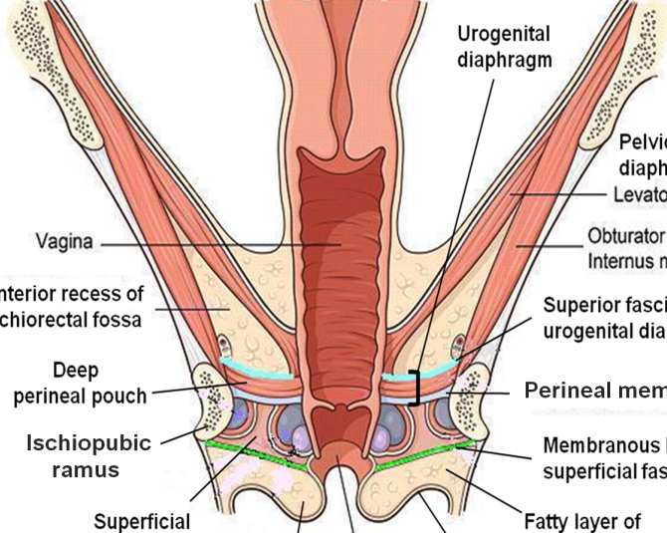
Question: 24
Prof. Abuelmakarem told us to add all the pictures from the perineum lecture:
Identify the labeled structures:
Urogenital diaphragm
Vagina
Deep perineal pouch
Ischiopubic ramus
Levator ani
Obturator internus
Superior fascia of urogenital diaphragm
Perineal membrane
Membranous layer of superficial fascia (colle’s fascia)
Fatty layer of superficial fascia (camper’s fascia)
Superficial perineal pouch
1
5
2
6
7
3
8
4
9
11
10

Slide 27





And we’re done! Thank You!
الحمدلله تم!
Done by:
Jawaher Abanumy
Khalid Aleedan
Mohammed Alyousef
Mohammed Ghandour
Practice Test
Extra Pictures
Feedback
Editing File
anatomyteam436@gmail.com
References:
1- Team 435
2- Greys Anatomy for Students
@anatomy436

