Slide 1
Anatomy of Female Reproductive System
Color Code
Important
Doctors Notes
Notes/Extra explanation
Please view our Editing File before studying this lecture to check for any changes.

Slide 2
Objectives
At the end of the lecture, students should:
List the organs of female reproductive system.
Describe the pelvic peritoneum in female.
Describe the position and relations of the ovaries.
List the parts of the uterine tube.
Describe the anatomy of uterus regarding: subdivisions, cavity, relations, ligaments & main support.
Describe the anatomy of vagina regarding: structure, extent, length & relations.
Describe the supply (arteries, veins, lymph, nerves) of female reproductive system.

Slide 3
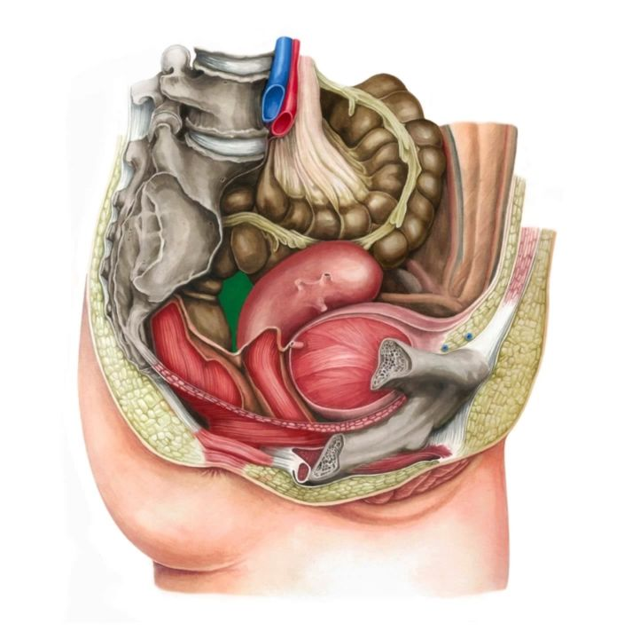
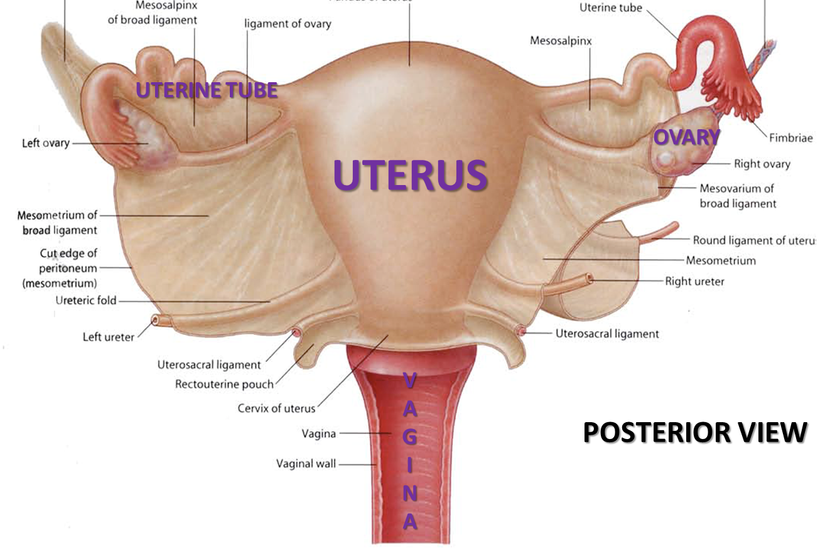
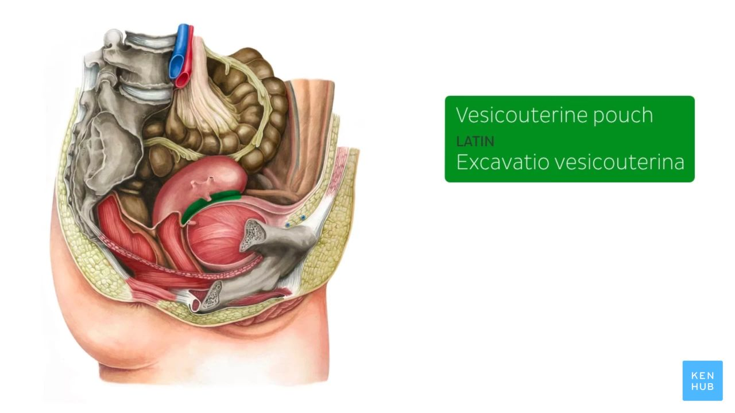
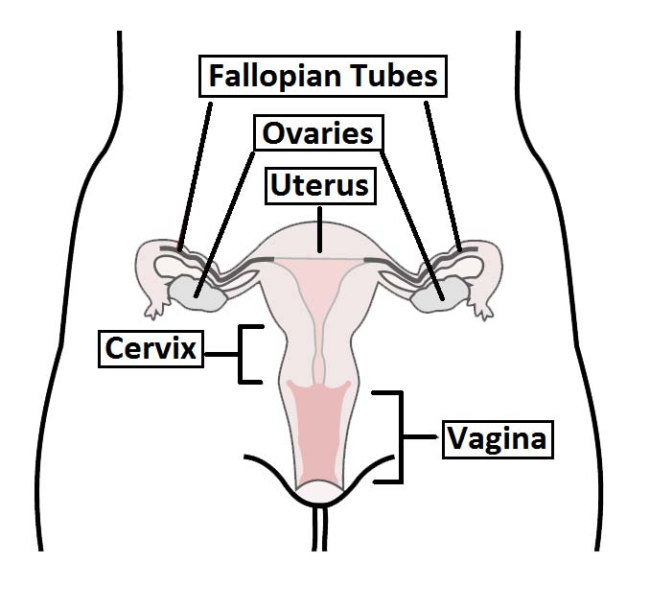
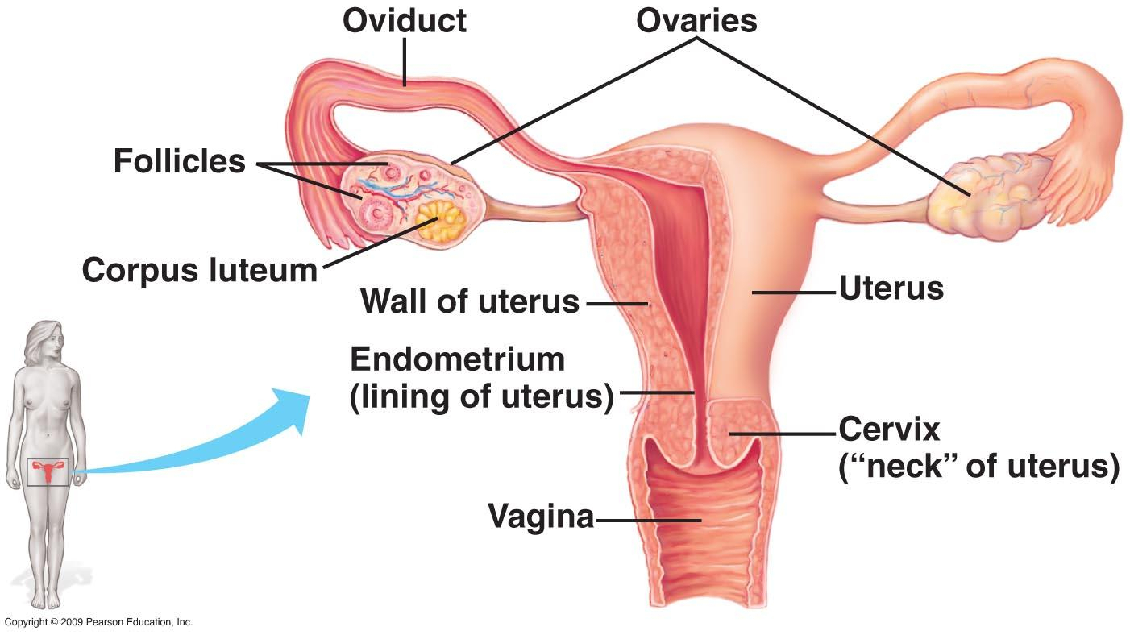
Introduction
09:58
15:12
The female reproductive system has 4 main organs:
Ovaries
Fallopian tube
Uterus
Vagina
Rectouterine pouch (the green part)
Extra
Uterovesical pouch (the green part)
Extra
Extra

Slide 4
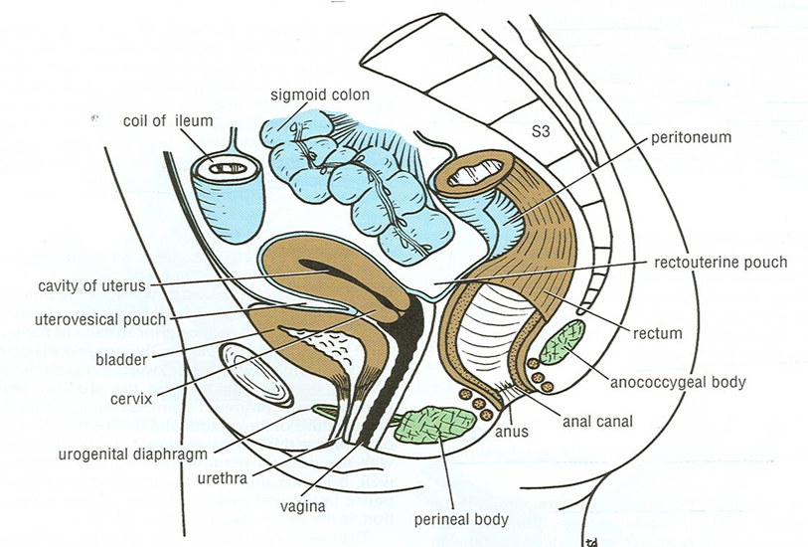
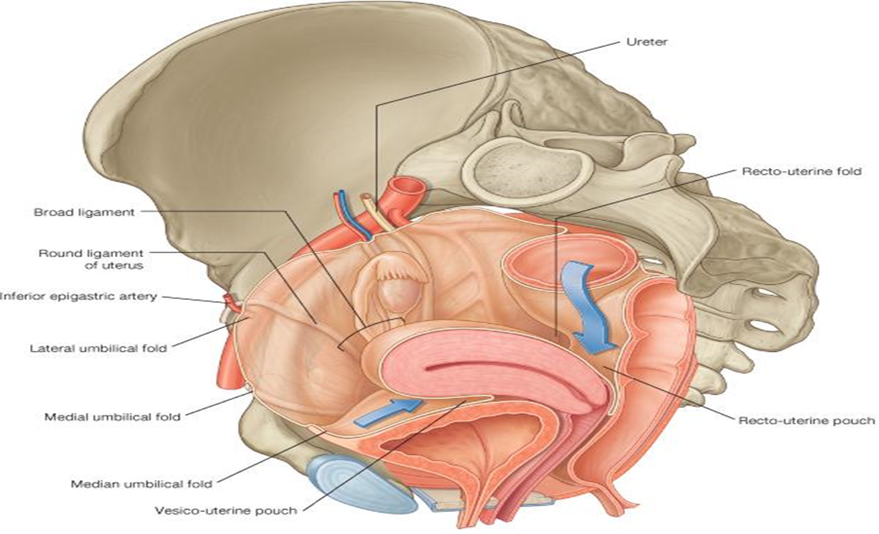
More pictures in the slide before
Pelvic Peritoneum in Female
02:50
02:54
Rectouterine (Douglas) pouch
Reflection of peritoneum from rectum to upper part of posterior surface of vagina.
Uterovesical (vesicouterine) pouch
Reflection of peritoneum from uterus to upper surface of urinary bladder.
Broad ligament of uterus
Extension of peritoneum from lateral wall of uterus to lateral wall of pelvis.
encloses the uterine tubes.
Broad ligament
Extra: pus can accumulate in the rectouterine pouch
Posterior view

Slide 5
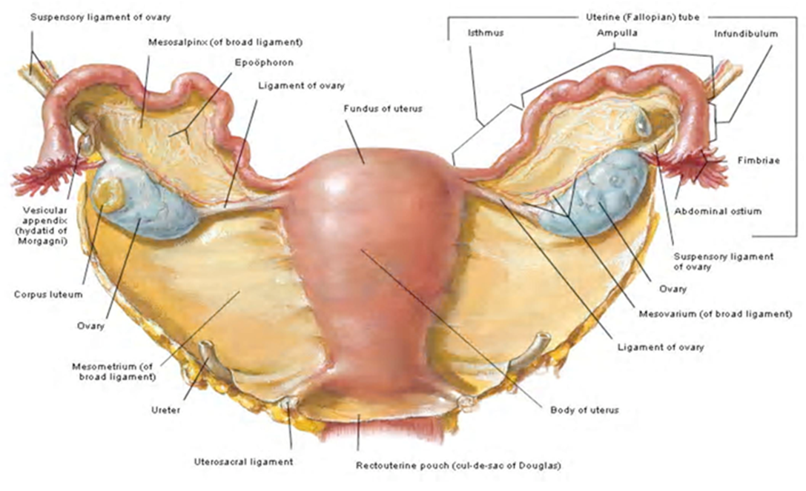
1. Ovaries
Shape: | almond-shaped organ.
It is attached to the back of the broad ligament by a peritoneal fold (mesovarium).
Medial end: | attached to uterus by ligament of ovary*.
Lateral end: | related to the fimbriae of the uterine tube.
Function: | Primary sex organs in female. Production of female germ cells Secretion of female sex hormones
fimbria
ovary
mesovarium
Ligament of ovary
Extra:
The fimbriae catch the oocyte.
*other names: ovarian ligament, round ligament of the ovary
Suspensory ligament of the ovary: a fold of peritoneum that contains the ovarian vessels, nerves and lymphatics.

Slide 6
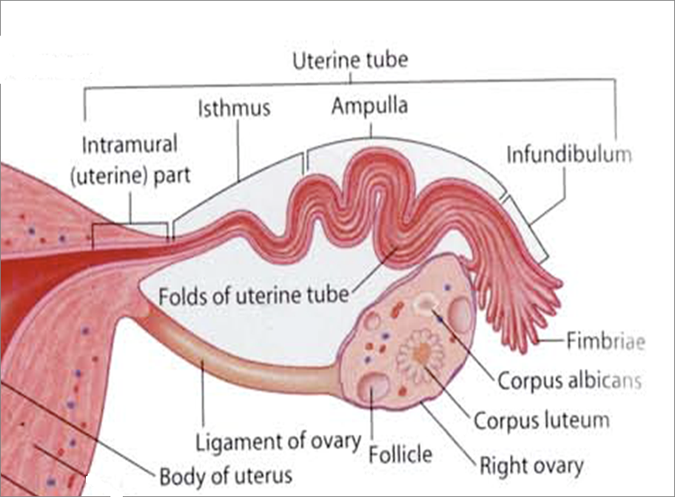
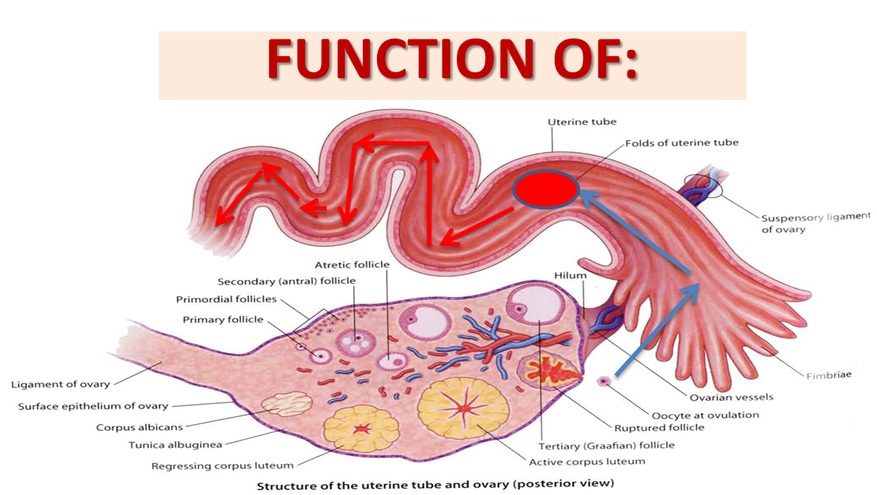
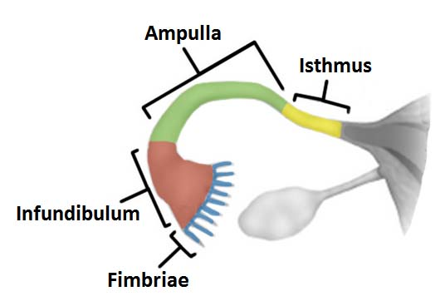
2. Uterine (fallopian) Tube
It is 10 cm long.
It is enclosed in the broad ligament of uterus.
Function:
Site of fertilization.
Transport of fertilized ovum into the uterus.
Parts
Intramural part: | opening into the uterine wall.
Isthmus: | narrowest part.
Ampulla: | widest part (it is the site of fertilization)
Infundibulum: | funnel-shaped end. has finger-like processes (fimbriae) related to ovary

Slide 7
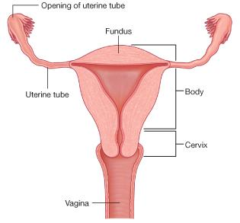
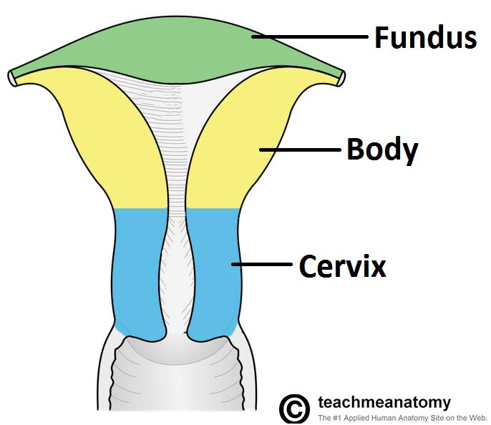
3. Uterus
The uterus is a hollow (أجوف), pear shaped muscular organ divided into:
03:57
1- Fundus
no cavity
The part of uterus above the level of uterine tubes
3- Cervix
cavity is fusiform
The part of the uterus below the level of the isthmus of the uterus
divided into:
Supravaginal part
Vaginal part
Isthmus
2- Body
cavity is triangular
The part of uterus from the level of uterine tube to the level of the isthmus of uterus
2’
3’
1’
Extra
These measurements are in a women who never got pregnant ‘‘nulligravida’’

Slide 8
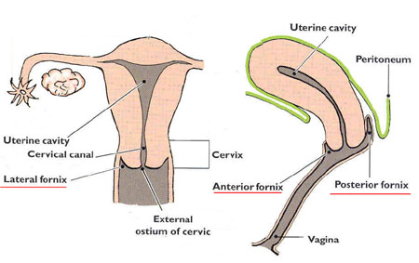
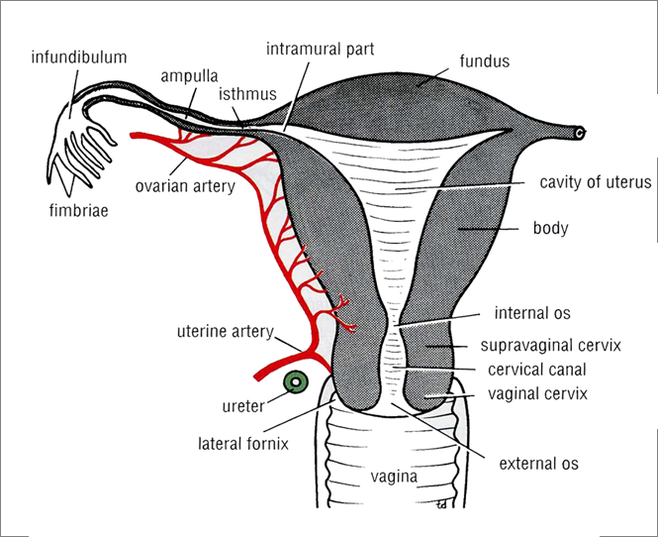
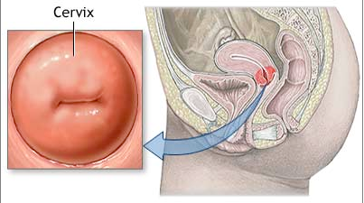
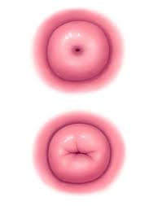
3. Uterus
Cervical Canal
05:32
Extra
Relations of Uterus: Important!
Fundus + Body + Supravaginal Part of Cervix:
Anterior | Superior surface of urinary bladder
Posterior | Sigmoid colon
Lateral | Uterine artery
Vaginal part of Cervix (surrounded by vaginal fornices)
Anterior | Anterior fornix of vagina
Posterior | Posterior fornix of vagina
Lateral | Lateral fornices of vagina
From inside to outside:
Uterus (body)
Internal os
Cervical canal
External os
Vagina
INTERNAL OS: opening between cavity of body of uterus & cavity of cervix (cervical canal)
EXTERNAL OS: opening between cervical canal & cavity of vagina
In a nulliparous woman: external os appears circular.
In a multiparous woman: external os appears as a transverse slit with an anterior & a posterior lip.
Nulliparous: never gave birth
Multiparous: gave birth

Slide 9
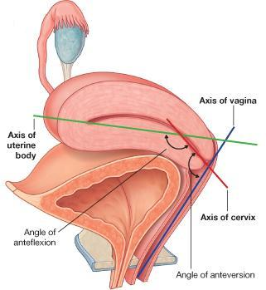
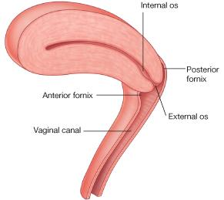
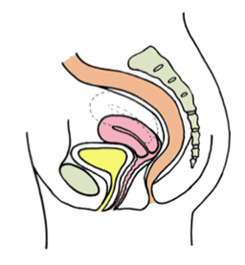
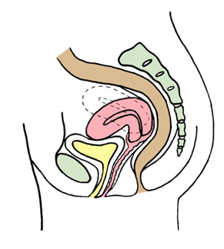
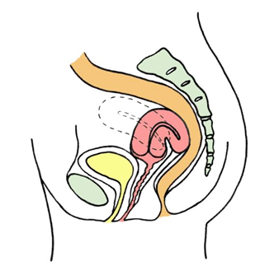
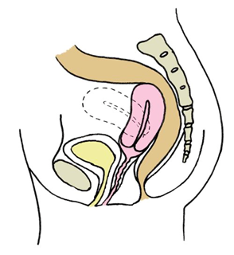
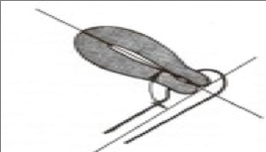
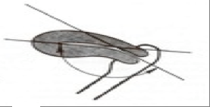
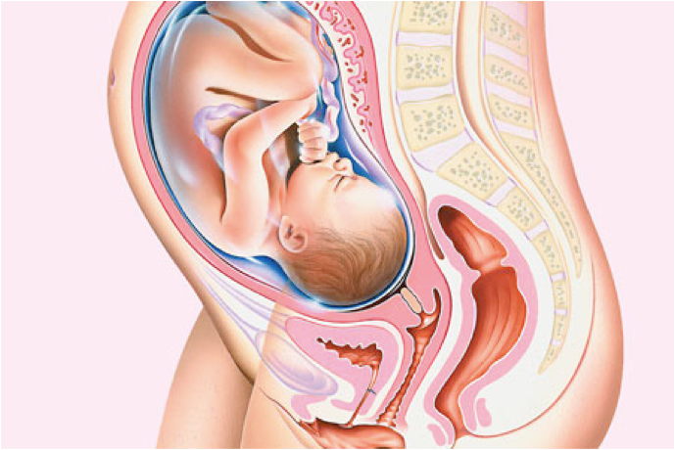
3. Uterus
Positions of the Uterus
We have 2 normal positions for the uterus. The more common one is anteverted-anteflexed.
Usual position of uterus
1. Anteverted-anteflexed |  | 2. Retroverted-retroflexed
ANTEVERTED UTERUS | ANTEFLEXED UTERUS | RETROVERTED UTERUS | RETROFLEXED UTERUS
Long axis of whole uterus is bent forward on long axis of vagina | Long axis of body of uterus is bent forward on long axis of cervix | Fundus & body of uterus are bent backward on the vagina and lie in rectouterine pouch | Long axis of body of uterus is bent backward on long axis of cervix
Function of uterus
Verted ---> Vagina Flexed ---> Cervix

Slide 10
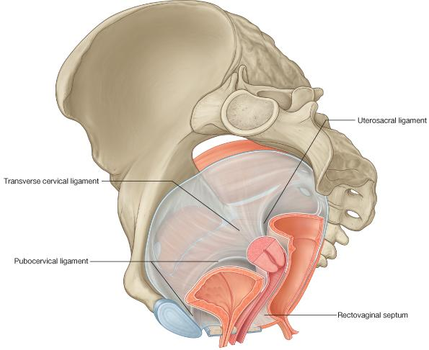
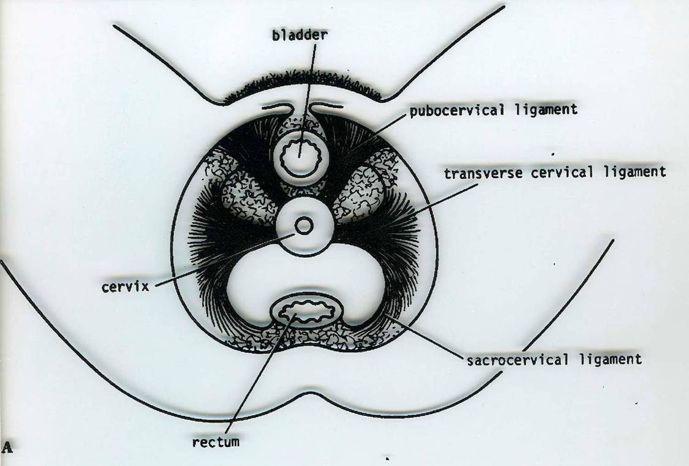
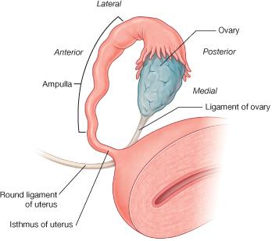
3. Uterus
Ligaments of the Uterus (keep the uterus in its correct position)
08:14
I. Ligaments at junction between fundus & body of uterus (At the level of uterine tube) :
Round ligament of uterus (Extends through inguinal canal to labium majus)
Ligament of ovary
II. Ligaments of cervix: Extend from cervix to :
Anterior pelvic wall (pubocervical)
Lateral pelvic wall (transverse cervical or cardinal)
Posterior pelvic wall (uterosacral or sacrocervical).
Uterosacral ligament
transverse cervical
Pubocervical

Slide 11
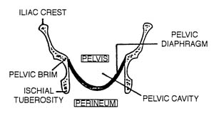
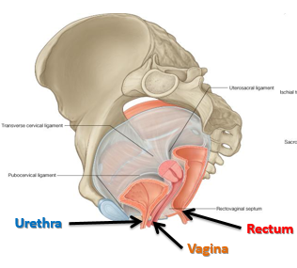
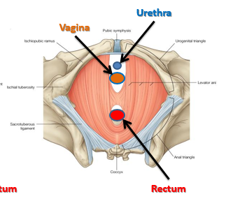
Levator Ani Muscles
Form the pelvic floor: separate pelvis from perineum
Form pelvic diaphragm: traversed by urethra, vagina & rectum (they pass through it)
Support pelvic organs
urethra
vagina
urethra
rectum
vagina
rectum

Slide 12
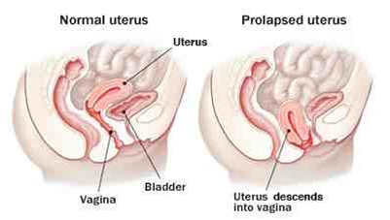
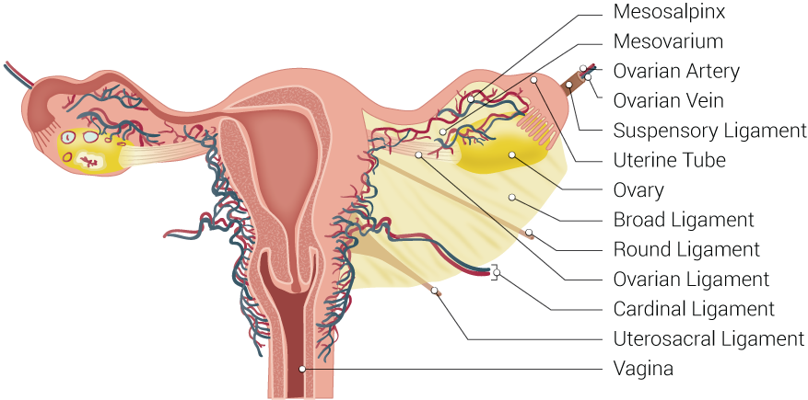
3. Uterus
Support of Uterus:
Round ligament of uterus (maintains anteverted anteflexed position)
Ligaments of cervix (especially transverse cervical)
Levator ani muscles
Uterine prolapse
Downward displacement of uterus due to damage of:
Ligaments of uterus
Levator ani muscles

Slide 13
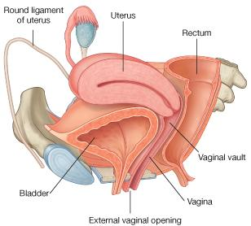
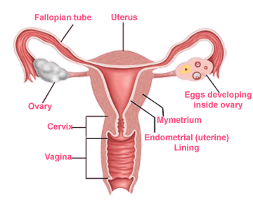
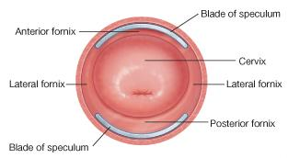
4. Vagina
Structure | fibro-muscular tube
Extent | from external os, along pelvis & perineum, to open in the vulva (female external genitalia), behind urethral opening
Length | its anterior wall (7.5 cm) is shorter than its posterior wall (9 cm)
Function | 1. copulatory organ (organ involved in sexual reproduction) 2. birth canal

Slide 14
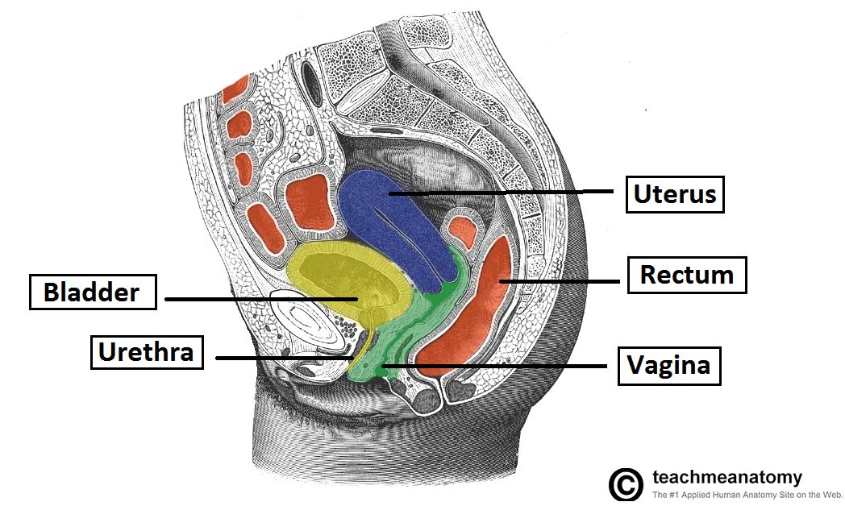
4. Vagina Relations of Vagina
Relations of Vagina: Important
 | In Pelvis | In Perineum
Anterior | urinary bladder | urethra
Posterior | rectum | anal canal
Lateral | ureters | -
Extra

Slide 15
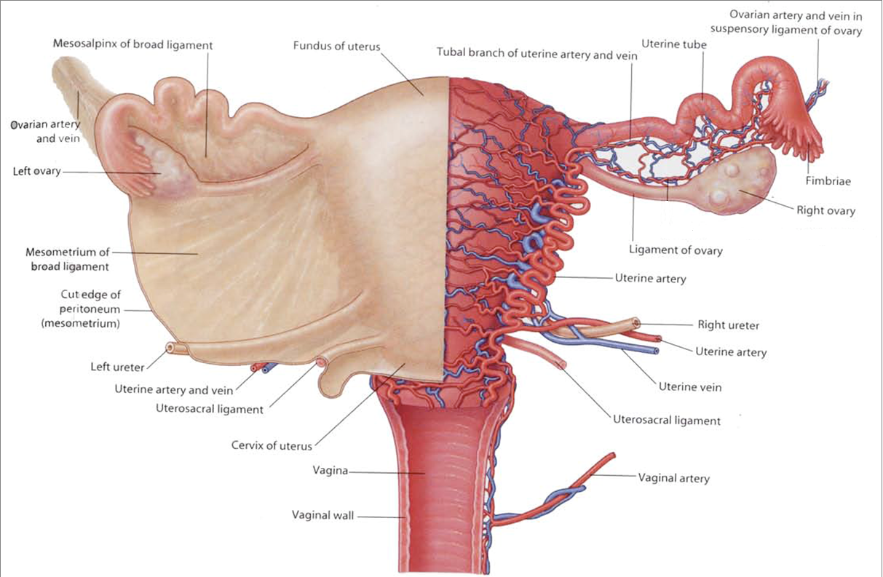
Supply
The arterial supply of the female reproductive system is from:
Abdominal aorta → ovarian artery
Internal iliac artery (artery of pelvis) → vaginal & uterine artery
Organ | Arteries | Veins | Lymphatics | Nerves (autonomic)
1. Ovaries | Ovarian (from the abdominal aorta) | Ovarian (drain in the inferior vena cava and left renal vein) | To paraaortic lymph nodes (in abdomen) | Ovarian plexus (in abdomen)
2. Uterine tubes | -Ovarian -Uterine | -Ovarian -Uterine | -Paraaortic -internal iliac | -Ovarian -Inferior hypogastric
3. Uterus | Uterine (from internal iliac artery in pelvis) | Uterine plexus (to internal iliac vein) | To internal iliac lymph nodes (in pelvis) | Inferior hypogastric plexus (in pelvis)
4. Vagina | Vaginal (from internal iliac artery in pelvis) | Vaginal plexus (to internal iliac vein) | To internal iliac lymph nodes (in pelvis) | Inferior hypogastric plexus (in pelvis)
abdomen
both
pelvis

Slide 16
Summary
Organ | Function | Parts | Relations
 |  |  | Anterior | Posterior | Lateral
1. Ovaries | Primary sex organs in female. | Medial end → uterus by ligament of ovary. Lateral → fimbriae of the uterine tube. | - | - | -
2. Uterine tubes | Site of fertilization (ampulla) | Intramural Isthmus Ampulla Infundibulum | - | - | -
3. Uterus | Pregnancy (maintenance of fetus) | Fundus Body Cervix (between internal and external os) | Superior surface of urinary bladder | Sigmoid colon | Uterine artery
 |  |  | Anterior fornix of vagina | Posterior fornix of vagina | Lateral fornices of vagina
4. Vagina | copulatory organ and birth canal | - | Urinary bladder (in pelvis) & urethra (in perineum) | Rectum (in pelvis) & anal canal (in perineum) | ureters (in pelvis)
Fundus + Body + Supravaginal Part of Cervix
Vaginal Part of Cervix

Slide 17
MCQs
Q1) A reflection of the peritoneum from the uterus to upper part of urinary bladder:
Broad ligament of the uterus
Rectouterine pouch
Douglas pouch
Uterovesical pouch
Q2) In which part of the uterine tube does fertilization take place?
Isthmus
Ampulla
Intramural
Infundibulum
Q3) Which one of the following consider as posterior relation of vagina in perineum ?
a) ureter
b) rectum
c) uterus
d) anal canal
Q4) Which one of the following is the origin of uterine artery ?
a) aorta
b) abdominal aorta
c) internal iliac
d) external iliac
Q5) What muscle that separate pelvis from perineum?
Levator ani
Obturator internus
Psoas major
Piriformes
Q6) Which of the following ligaments support the uterus and prevent prolapse?
Round ligament
Ovarian ligament
Cardinal ligament
Broad ligament
Answers: 1. D, 2. B, 3. D, 4. C, 5. A, 6. A

Slide 18
Leaders:
Nawaf AlKhudairy
Jawaher Abanumy
Members:
Abdulmalik alhadlaq
Abdullah jammah
Abdullah hashim
Abdulrahman alrajhi
Abdulmohsen alghannam
Feedback
References:
1- Girls’ & Boys’ Slides
2- Greys Anatomy for Students
3- TeachMeAnatomy.com
anatomyteam436@gmail.com
@anatomy436

