Slide 1
Female Perineum
Color Code
Important
Doctors Notes
Notes/Extra explanation
Please view our Editing File before studying this lecture to check for any changes.

Slide 2
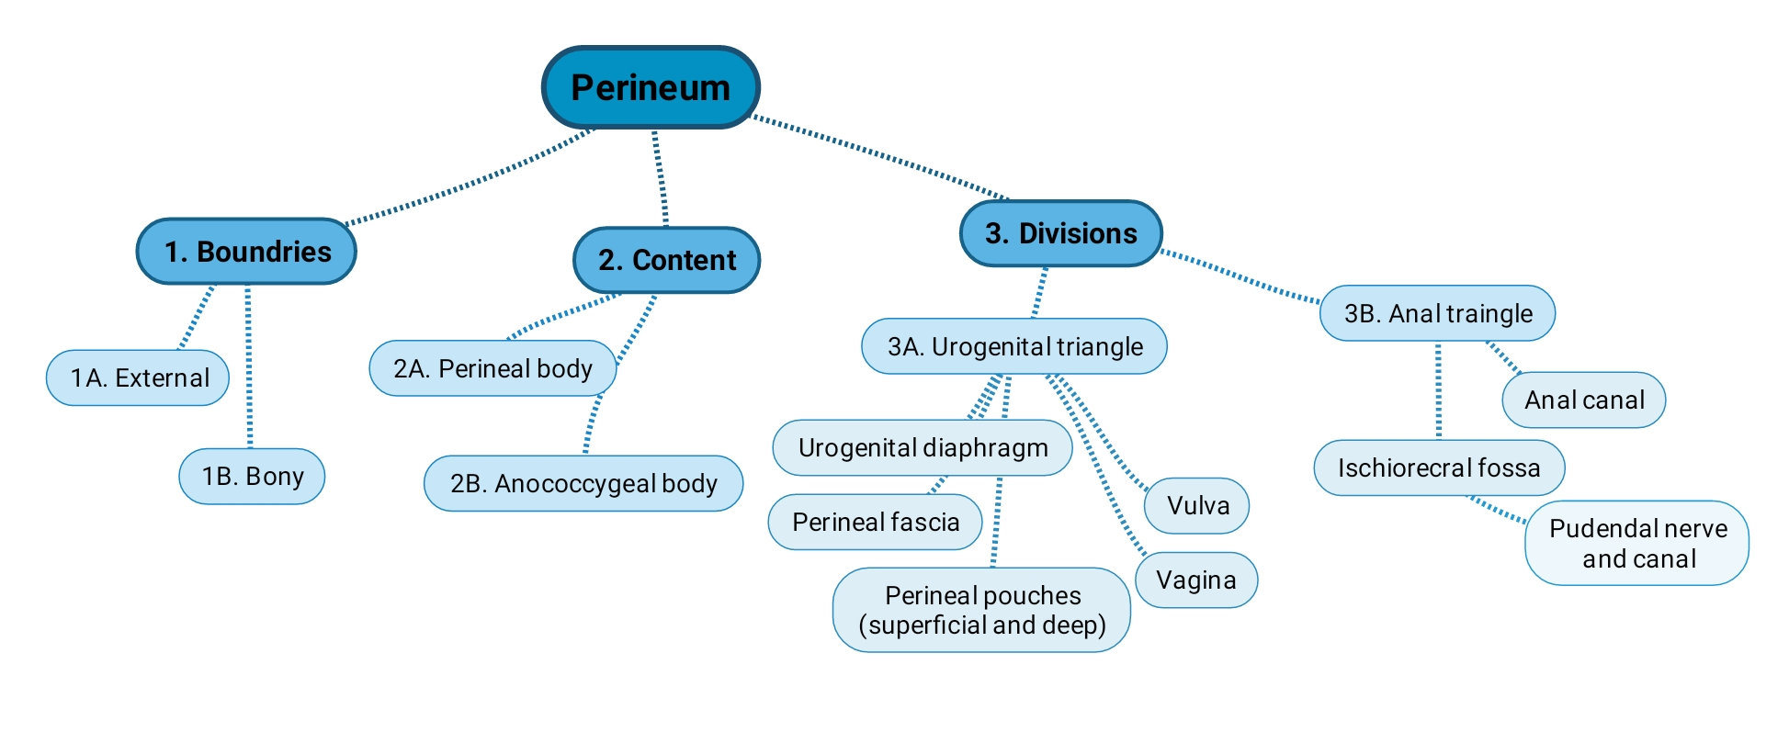
Objectives
At the end of the lecture, the student should be able to describe the:
Boundaries of the perineum.
Division of perineum into two triangles.
Boundaries & Contents of anal & urogenital triangles.
Lower part of Anal canal.
Boundaries & contents of Ischiorectal fossa.
Innervation, Blood supply and lymphatic drainage of perineum.
Lecture Outline →

Slide 3
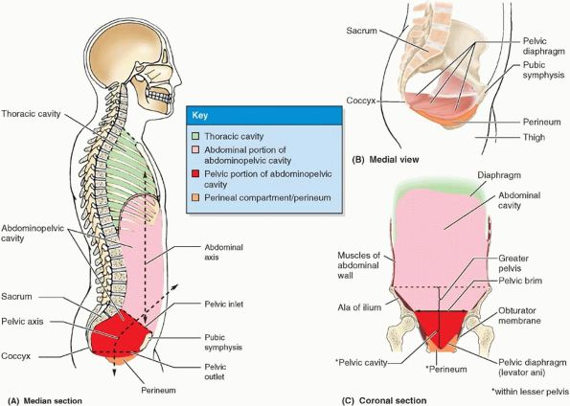
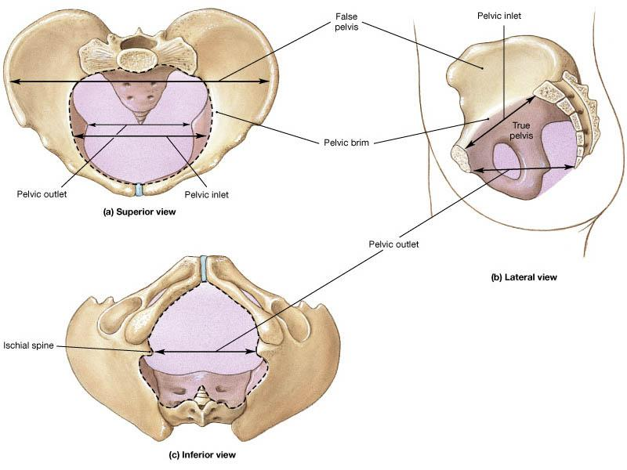
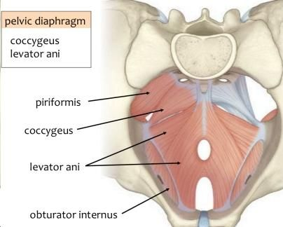
Introduction:
The trunk is divided into 4 main cavities: thoracic, abdominal, pelvic, and perineal. (see image 1)
The pelvis has an inlet and an outlet. (see image 2) The lowest part of the pelvic outlet is the perineum.
The perineum is separated from the pelvic cavity superiorly by the pelvic floor.
The pelvic floor or pelvic diaphragm is composed of muscle fibers of the levator ani, the coccygeus muscle, and associated connective tissue. (see image 3) We will talk about them more in the next lecture.
Image (1)
Image (2)
Image (3)
Note: this image is seen from ABOVE

Slide 4
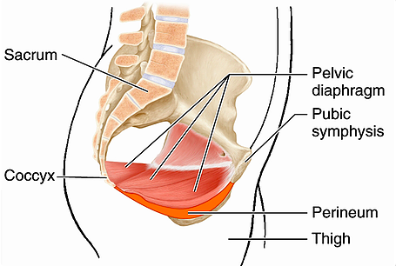
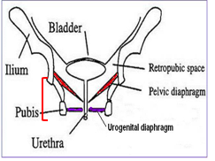
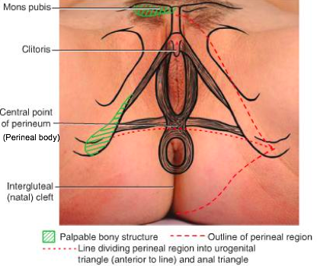
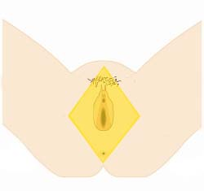
Perineum
(In this lecture the boundaries and relations are important)
Perineum is the region of the body below the pelvic diaphragm (The outlet of the pelvis)
It is a diamond shaped area between the thighs.
Boundaries: (these are the external or surface boundaries)
Contents:
Lower ends of urethra, vagina & anal canal
External genitalia
Perineal body & Anococcygeal body
(we will now talk about these in the next slides)
Anteriorly | Laterally | Posteriorly
Mons pubis | Medial surfaces of the thighs | Intergluteal folds or cleft
Extra

Slide 5
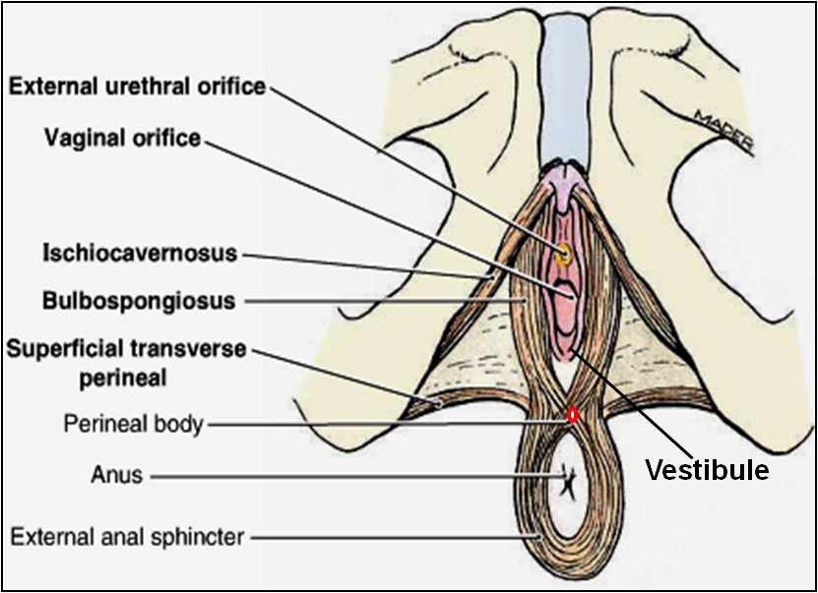
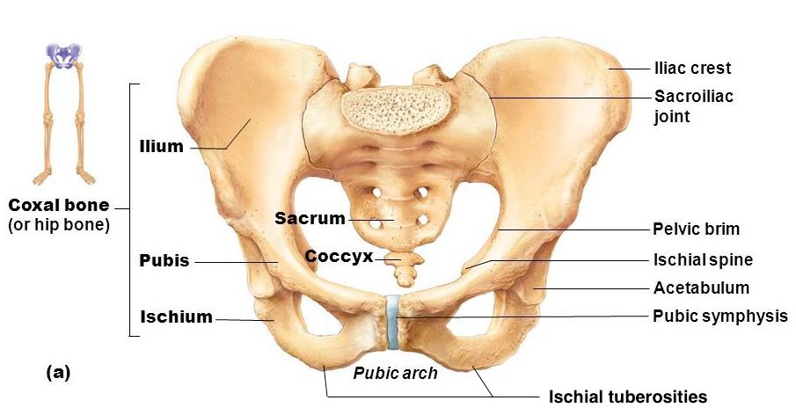
Perineum
Perineal body
Extra explanation:
The perineal body is an irregular fibromuscular mass. It is located at the junction of the urogenital and anal triangles – the central point of the perineum. This structure contains skeletal muscle, smooth muscle and collagenous and elastic fibres.
Anatomically, the perineal body lies just deep to the skin. It acts as a point of attachment for muscle fibres from the pelvic floor and the perineum itself
Perineal body is an irregular fibromuscular mass of variable size and consistency, located at midpoint of the line between the ischial tuberosities.
Lies in the subcutaneous tissue, posterior to vaginal vestibule and anterior to the anal canal & anus
Forms the central point of the perineum & blends anteriorly with the perineal membrane
Function:
Gives attachment to perineal muscles
Plays an important role in visceral support especially in female
Perineal membrane
Extra

Slide 6
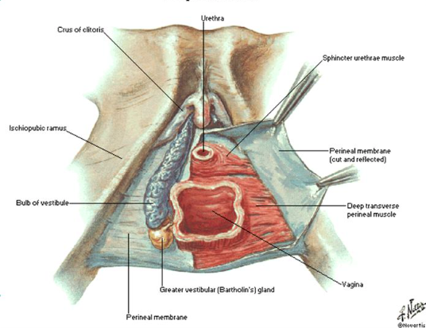
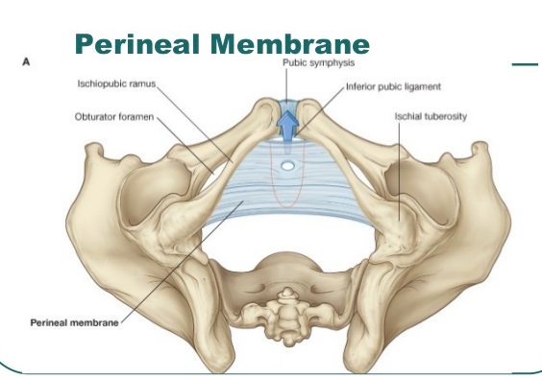
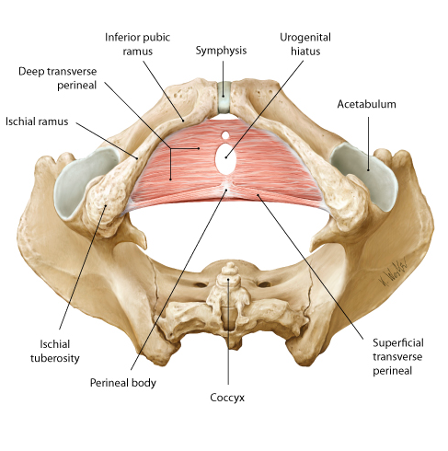
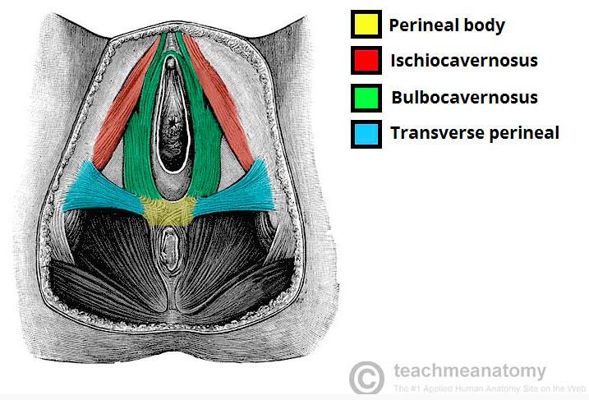
These pictures are extra.

Slide 7
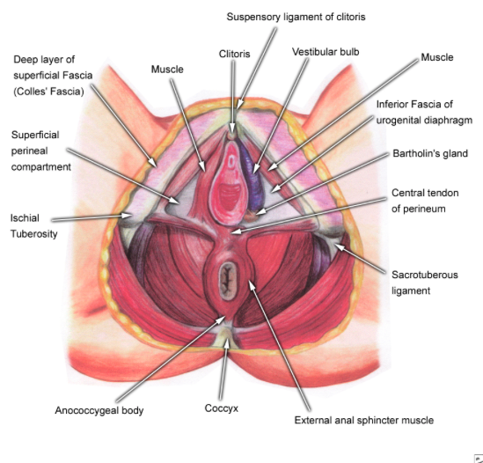
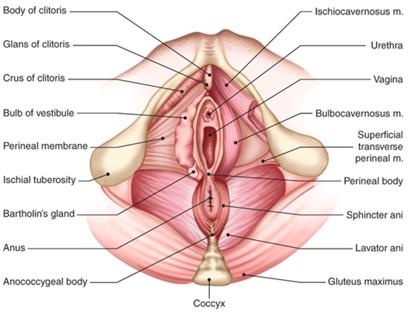
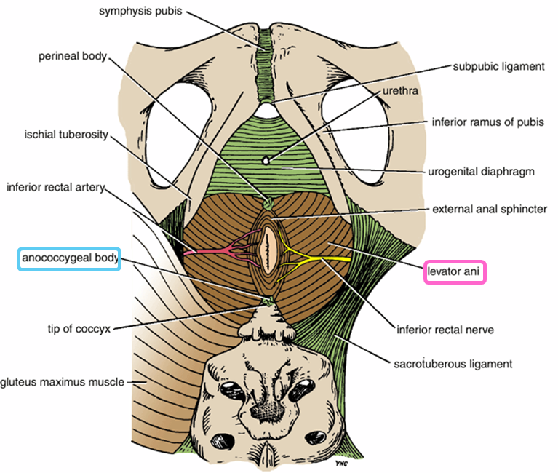
Perineum
Anococcygeal Body
The anococcygeal body is a complex musculotendinous structure (more tendinous).
Situated between the anterior aspect of the coccyx and the posterior wall of the anorectal canal
Receives insertion of fibers of levator ani muscle (gives attachment of levator ani muscles).
يعني بالترتيب يكون:
Vaginal vestibule
Perineal body
Anal canal
Anococcygeal body
Coccyx
Extra
Extra

Slide 8
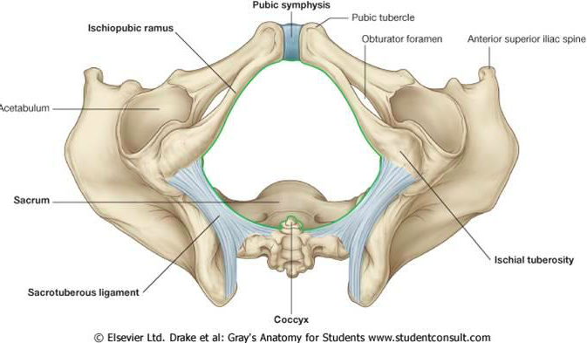
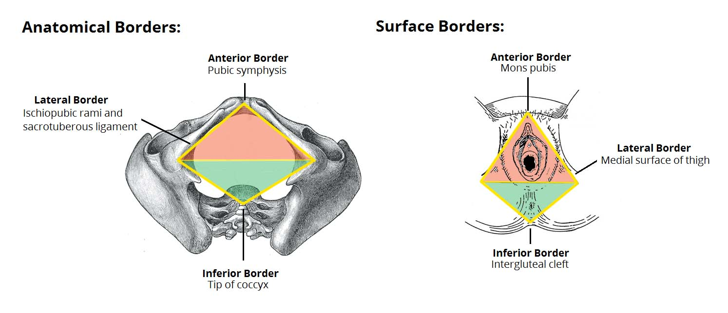
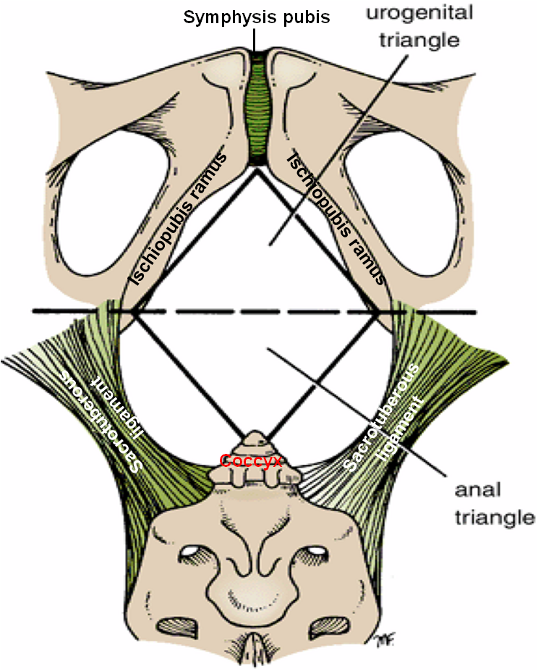
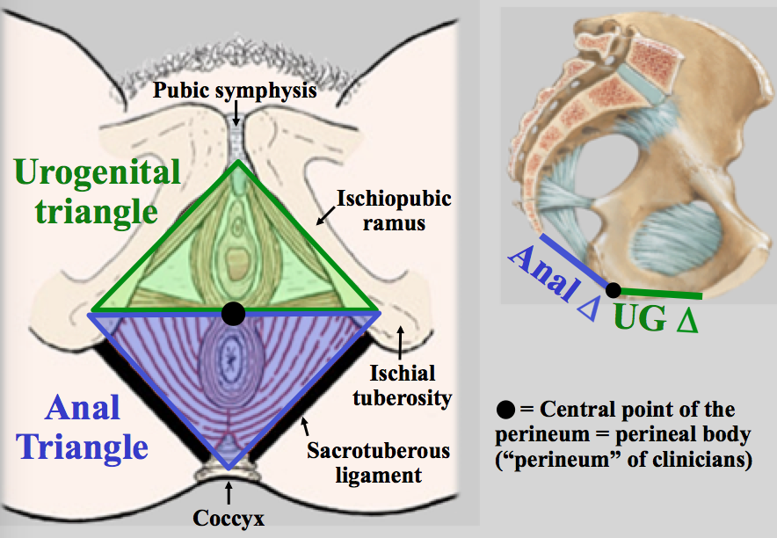
Perineum
Divisions
Boundaries:
Its bony boundaries are:
Division:
By an imaginary line** passing through two ischial tuberosities, it is divided into:
Urogenital triangle anteriorly.
Anal triangle posteriorly.
Anteriorly | Laterally | Posteriorly
Symphysis pubis | Ischiopubic rami, ischial tuberosities & sacrotuberous ligaments* | Coccyx
Note the perineum has bony boundaries and surface or external boundaries: →
* ligament between sacrum and ischial tuberosity
** this is the same line that passes through the perineal body
Extra
In the next slides we will talk about the urogenital triangle in detail.
Extra
Sacrum

Slide 9
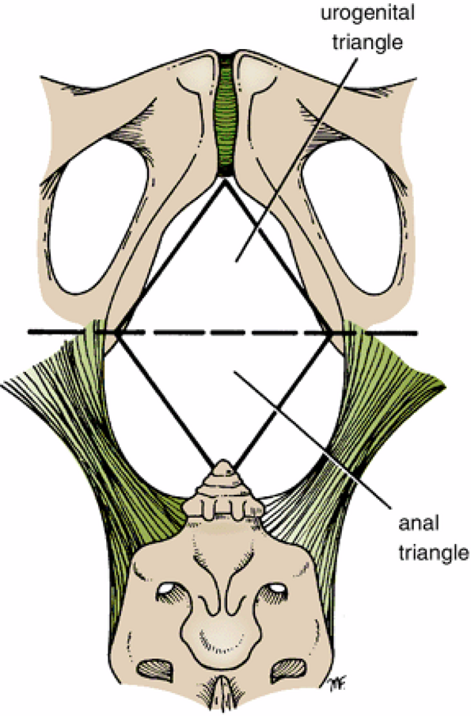
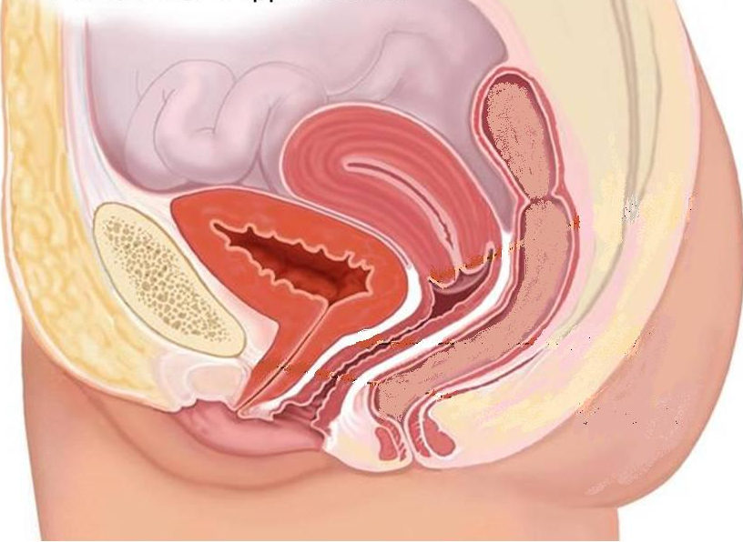
I. Urogenital Triangle
Extra
Boundaries:
Contents:
Lower part of urethra & vagina.
External genitalia (vulva).
Urogenital diaphragm
The urogenital triangle : is associated with the structures of the urogenital system – the external genitalia (genital part) and urethra (urinary part).
Anteriorly | Laterally | Posteriorly
Symphysis pubis | Ischiopubic rami & ischial tuberosities | Transverse line passing through the 2 ischial tuberosities
Urethra
Vagina
Vulva

Slide 10
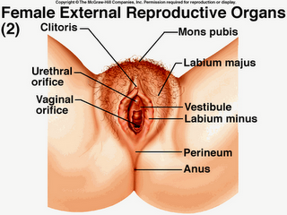
I. Urogenital Triangle
Female External Genitalia (Vulva)
04:24
The external genital organs of the female are collectively known as the vulva (also called the pudendum). The vulva is comprised of many different structures:
Mons pubis: a collection of fat overlying the pubes
Labia majora (labia means lips or flaps).
Labia minora.
Clitoris (the two labia minora meet at a point anteriorly and make the clitoris).
Vestibule of vagina: The interval or area between the two labia minora and has 2 openings:
Vagina & urethra open into the vestibule through urethral orifice anteriorly and vaginal orifice posteriorly.
Extra

Slide 11
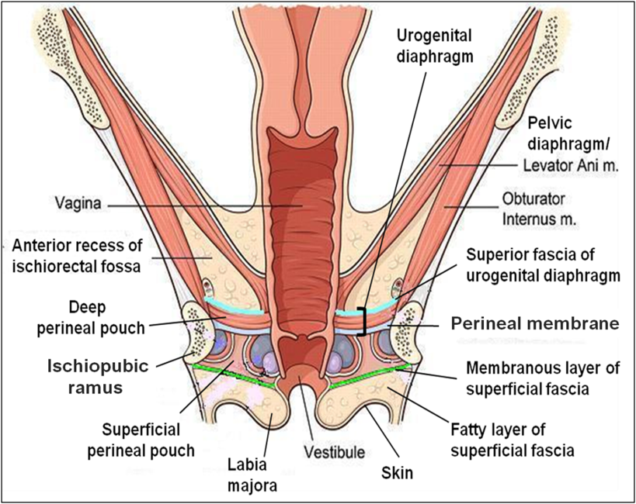
Extra Explanation
There are many layers in the urogenital triangle
The first component is the urogenital diaphragm which is composed of:
Superior layer of fascia of urogenital diaphragm
Deep transvers muscle + sphincter urethrae
Inferior layer of fascia of urogenital diaphragm: this layer is also called perineal membrane.
The urogenital triangle extends downwards until the skin. Below the skin we have the perineal fascia which is divided into:
Superficial perineal fascia: further divided into deep membranous layer and superficial fatty layer .
Deep perineal fascia
NOTE: Remember that the superficial layer is the one closer to the skin.
Next we have the pouches which are above and below the perineal membrane:
The deep pouch is basically the same as the urogenital diaphragm (above perineal membrane).
The superficial pouch extends below the perineal membrane to the deep membranous layer.
Deep pouch
Superior layer of fascia of urogenital diaphragm
Muscles (deep transverse & sphincter diaphragm)
perineal membrane
Superficial pouch
Superficial fascia: deep membranous layer
Superficial fascia: superficial fatty layer
Skin

Slide 12
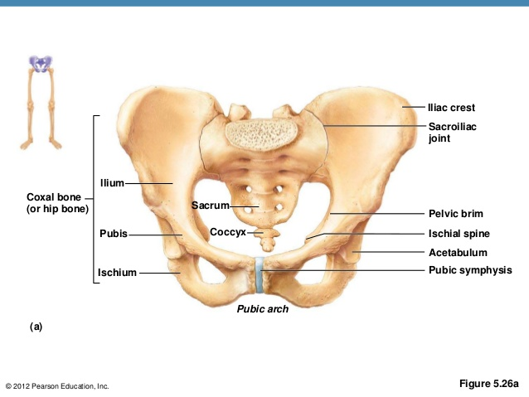
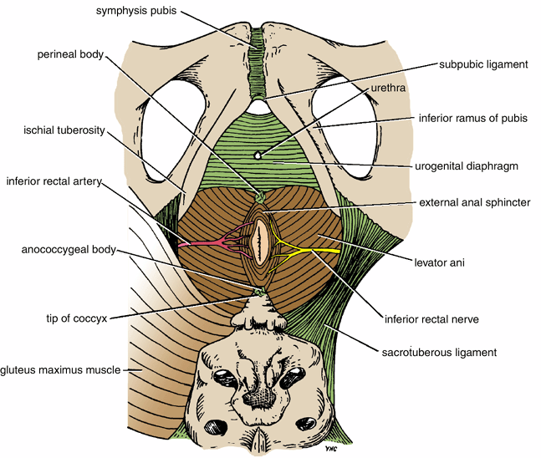
I. Urogenital Triangle
Urogenital Diaphragm
A triangular musculofascial diaphragm located in the anterior part of the perineum (in the urogenital triangle).
Fills in the gap between the pubic arch.
Composed of: musculo-fascial so it has muscles and fascia
Sphincter urethrae and
the deep transverse perineal muscles enclosed within
the superior and (4) inferior layers of fascia of the urogenital diaphragm (The inferior layer of the fascia is formed by the perineal membrane)
Extra
muscle
fascia
Extra
The fascia cover the muscle from above and below
Note: we have 2 fascia: perineal fascia (superficial and deep) and fascia of urogenital diaphragm (superior and inferior)

Slide 13
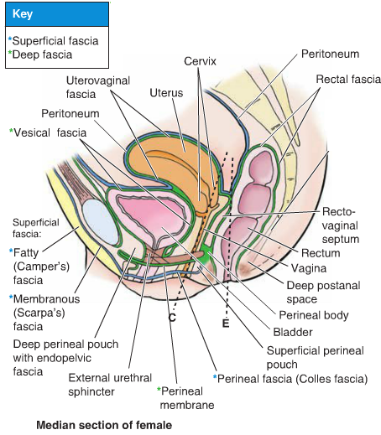
I. Urogenital Triangle
Perineal Fascia
Perineal Fascia Fascia of Urogenital Triangle (Perineal Fascia) is continuous anteriorly with the fascia of abdomen and consists of 2 layers: superficial and deep layers
Superficial perineal fascia Consists of: | Deep perineal fascia invests the muscles in the superficial perineal pouch (the muscles will be mentioned later)
1. Superficial fatty layer (Camper’s fascia ) makes up the substance of mons pubis & labia majora and extends into the anal region.
2. Deep membranous layer (Colle’s fascia ): Does not extend to anal region. Becomes fused with the posterior margin of the perineal membrane

Slide 14
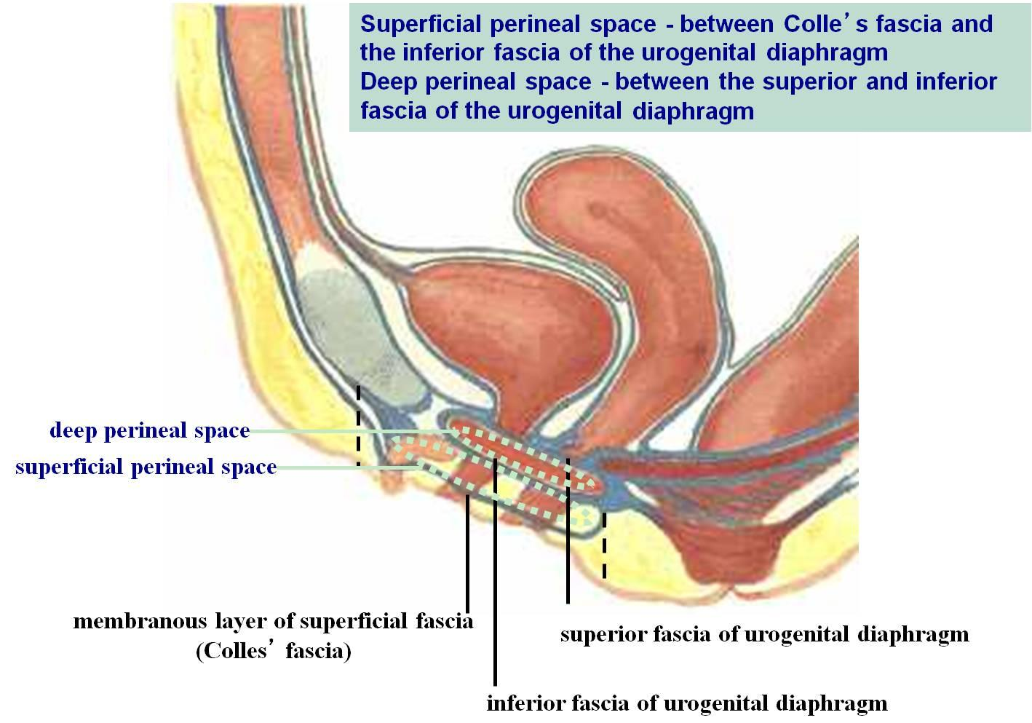
I. Urogenital Triangle
Perineal Pouches
Structurally, the urogenital triangle is complex, with a number of fascial layers and pouches. Unlike the anal triangle, the urogenital triangle has an additional layer of strong deep fascia; the perineal membrane. This membrane has pouches on its superior and inferior surfaces: the superficial and deep pouches.

Slide 15
Perineal Pouches Superficial Perineal Pouch
It is the potential space between the deep membranous layer of superficial fascia and the perineal membrane (inferior fascia of urogenital diaphragm).
Boundaries:
Superiorly | Laterally | Inferiorly
Perineal membrane | Ischiopubic rami | Membranous layer of superficial fascia (colles fascia)

Slide 16
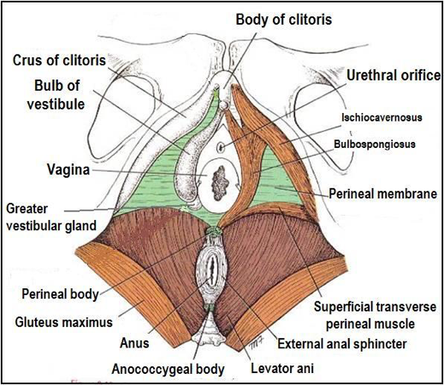
Perineal Pouches Contents of Superficial Perineal Pouch
The contents are important.
(2)
(1)
1. Bulbs of vestibule: on each side of vaginal orifice.
2. Crura of clitoris (crura: plural of “crus”)
3. Superficial perineal muscles: (see slide 6 for a picture of the muscles) | a) Ischiocavernosus muscle: covers crus of clitoris on each side.
 | b) Bulbospongiosus muscle: surrounds orifice of vagina and covers vestibular bulb.
 | c) Superficial transverse perineal muscles
4. Greater vestibular glands: on each side of vaginal orifice.
5. Perineal branch of pudendal nerve: supplying muscles & skin.
(3-a)
(3-b)
(4)
(3-c)

Slide 17
Perineal Pouches Deep Perineal Pouch
It is a completely closed space deep to the perineal membrane.
It is the same as the urogenital diaphragm.
Boundaries:
Superiorly | Laterally | Inferiorly
Superior fascia of the urogenital diaphragm | Inferior portion of obturator internus fascia | Inferior fascia of the urogenital diaphragm (perineal membrane)

Slide 18
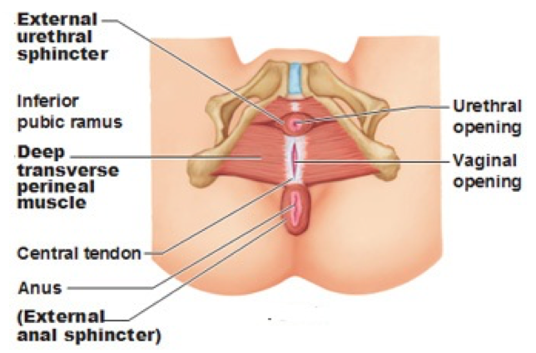
Perineal Pouches Contents of Deep Perineal Pouch
(1)
1. Part of urethra
2. Part of vagina
3. Sphincter urethrae and Sphincter vaginae muscles; which is pierced by urethra & vagina.
4. Deep transverse perineal muscles
5. Internal pudendal vessels
6. Dorsal nerve of clitoris
(1)
(4)
(2)

Slide 19
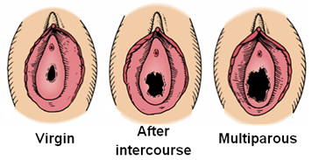
Vagina
The vagina is a muscular canal that leads from the uterus to the external orifice of the genital canal
It measures about 3 in. (8 cm) long.
It serves as the excretory duct for the menstrual flow & forms part of the birth canal.
The vaginal orifice in a virgin possesses a thin mucosal fold, called the hymen (غشاء العذرية), which is normally perforated at its center to allow the menstrual blood to flow out.
Arteries:
Vaginal artery, a branch of the internal iliac artery
Vaginal branch of the uterine artery
Veins:
drain into the internal iliac veins.
بعد عدة ولادات

Slide 20
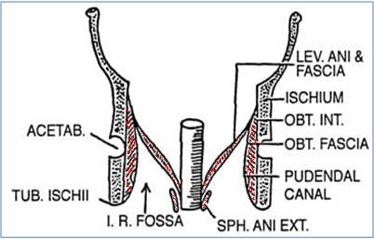
II. Anal Triangle
Boundaries:
Contents:
Lower part of Anal canal
Ano-coccygeal body
Ischiorectal fossa on each side (will be discussed later)
Anteriorly | Laterally | Posteriorly
Transverse line passing through the 2 ischial tuberosities | ischial tuberosity & sacrotuberous ligament. | Coccyx

Slide 21
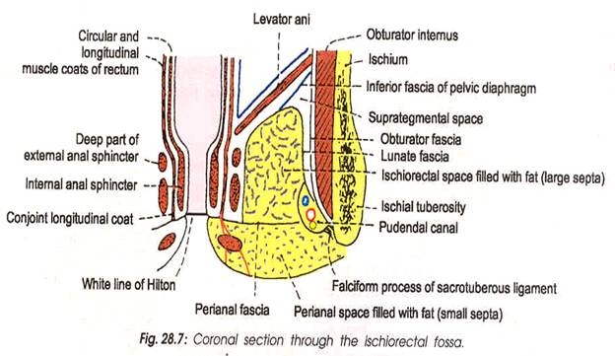
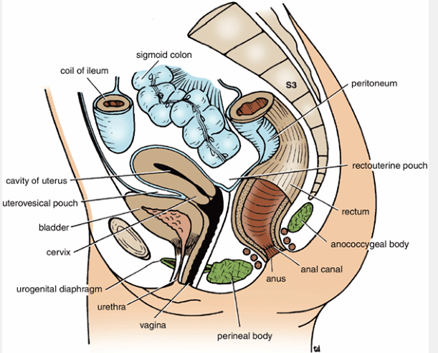
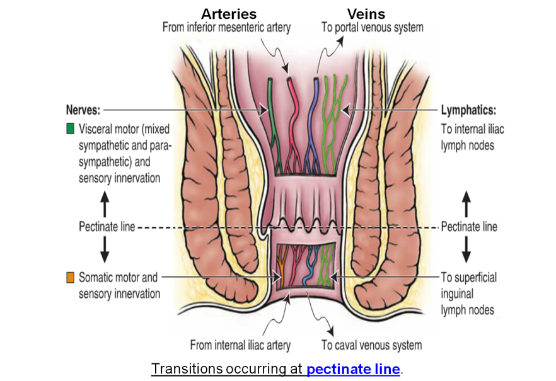
II. Anal Triangle
Anal Canal
It is about 1.5 in. long, descending from the rectal ampulla to the anus.
Relations (In female):
Division: Divided by pectinate line into:
Upper half: derived from hindgut* (endoderm)
Lower half: derived from the proctodeum (ectoderm)
The two parts have different blood supply, nerve supply and lymphatic drainage.
Anteriorly | Posteriorly | Laterally
Perineal body, urogenital diaphragm, lower part of vagina | Anococcygeal body | Ischiorectal fossae
Extra
*remember from GIT block: the artery of the hindgut is the inferior mesenteric artery

Slide 22
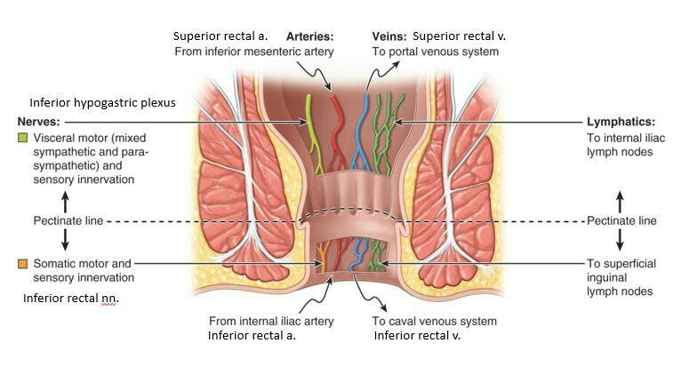
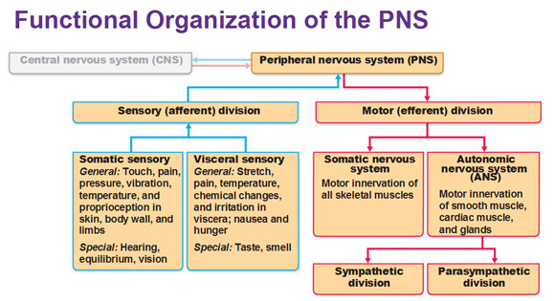
This slide is important.
Anal canal | Arterial supply | Venous drainage | Lymphatic drainage | Nerves
Upper half (endoderm) | Superior rectal artery (continuation of the inferior mesenteric artery) | Superior rectal vein drained into the inferior mesenteric vein (portal circulation). | Para-rectal nodes drained into inferior mesenteric lymph nodes | (sensitive to stretch) Visceral^ sensory & motor (Inferior Hypogastric Plexus) (sympathetic & parasympathetic).
Lower half (ectoderm) | Inferior rectal artery (branch of internal pudendal artery) | Inferior rectal vein drained into the internal pudendal vein (Systemic circulation*) site of portal-systemic anastomosis**. | Superficial inguinal lymph nodes | (sensitive to pain) Somatic^ motor & sensory nerves (Inferior rectal N. branch of pudendal N.) supplies: external sphincter muscle of the anus and the skin of the anal region.
The name of the nerves are only mentioned on the girls slides.
*Clinical importance:
in children we give medication in the form of suppository (تحميله) We insert it in the lower half of the anal canal but we shouldn’t push it in too deeply because then it will go to the portal instead of the systemic circulation.
**In cases of portal hypertension this will lead to hemorrhoids (بواسير)
^to review the difference between visceral and somatic look at this picture:

Slide 23
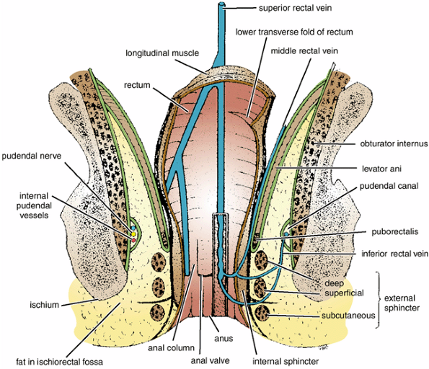
II. Anal Triangle
Ischiorectal Fossa
A fascial lined wedge-shaped space on each side of the anal canal.
Boundaries:
Contents:
Dense fat.
Pudendal nerve & internal pudendal vessels within the pudendal canal.
Inferior rectal nerve & vessels crossing the fossa to reach anal canal.
Base | Medial Wall | Lateral Wall
Skin of the perineum. | Levator ani & anal canal. | Obturator internus, covered with fascia.

Slide 24
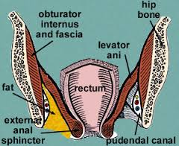
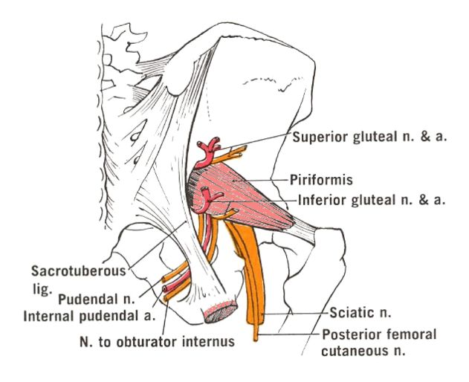
II. Anal Triangle
Pudendal Canal
The pudendal canal is a fascial canal formed by obturator fascia, located on the lateral wall of the ischiorectal fossa.
Contents:
Pudendal nerve.
Internal pudendal vessels (artery and vein).
Mnemonic:
VAN
Vein
Artery
Nerve
Extra

Slide 25
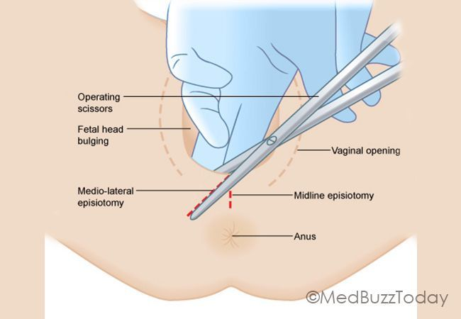
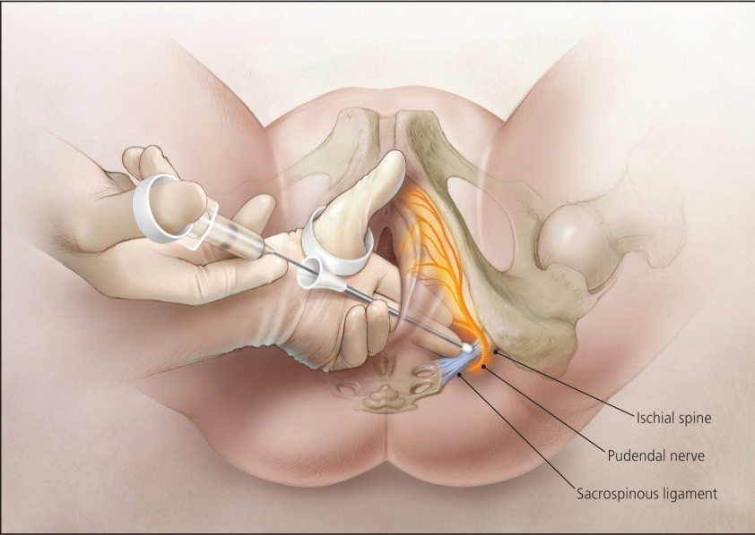
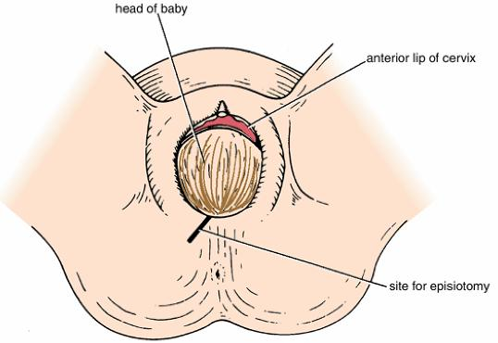
II. Anal Triangle
Pudendal Nerve Block Important!
Pudendal nerve block is used in providing analgesia for the second stage of labour (الولادة) to provide anesthesia of the perineum in order to create or repair an episiotomy (An episiotomy is a surgically planned incision on the perineum and the posterior vaginal wall during second stage of labor to prevent perineal tear).
Method: can be done by transvaginally or through perineal approach.
Extra
Transvaginal method:
The needle is passed through the vaginal mucous membrane toward the ischial spine.
After the needle is passed through the sacrospinous ligament, the anesthetic solution is injected around the pudendal nerve
Perineal method:
The ischial tuberosity is palpated subcutaneously through the buttock. (needs experience)
The needle is inserted on the medial side of the ischial tuberosity to a depth of about 1 in. (2.5 cm) from the free surface of the tuberosity.
The anesthetic is injected around the pudendal nerve.
الفرق بين الاثنين انه الاول يكون من جوى لازم الدكتور يدخل من المهبل.
بينما الطريقة الثانية تكون من برا الدكتور يحس العظم بعدين يدخل الإبرة على طول.
The cut is made in an oblique line so we don’t cut the perineal body

Slide 26
Perineum: region of the body below the pelvic diaphragm Contents: 1\Lower ends of urethra, vagina & anal canal- 2\ External genitalia- 3\ Perineal body & Anococcygeal body
The anococcygeal body is a complex musculotendinous structure, located between the anterior aspect of the coccyx and the posterior wall of the anorectal canal. Receives insertion of fibers of levator ani muscle |  | Perineal body is an irregular fibromuscular mass, located at the midpoint of the line between the ischial tuberosities Function: 1-Gives attachment to perineal muscles. 2-Plays an important role in visceral support especially in female.
Anteriorly Mons pubis \ Laterally Medial surfaces of the thighs \Posteriorly Intergluteal folds. |  |  | Boundaries of perineum:
Anal triangle posteriorly: Boundaries: Anteriorly: Transverse line passing through the 2 ischial tuberosities. Posteriorly : coccyx. Laterally : ischial tuberosity & sacrotuberous ligament. Contents: - Lower part of Anal canal. - Ano-coccygeal body. - Ischiorectal fossa on each side. | Urogenital triangle anteriorly: Boundaries: Anteriorly : Symphysis pubis. Posteriorly : Transverse line passing through the 2 ischial tuberosities. Laterally : Ischiopubic rami & ischial tuberosities. Content: -Lower part of urethra & vagina. -External genitalia (vulva). |  | Division of perineum:
Contents: - Dense fat. - Pudendal nerve & internal pudendal vessels within the pudendal canal. - Inferior rectal nerve & vessels crossing the fossa to reach anal canal. | Boundaries: -Base: Skin of the perineum. -Medial wall: Levator ani & anal canal. -Lateral wall: Obturator internus, covered with fascia. |  | Ischiorectal fossa:

Slide 27
Pudendal Canal: | Anal Canal | Vagina | Perineal Pouches | Perineal Fascia | Female External Genitalia (Vulva) | Urogenital Diaphragm
-A fascial canal formed by obturator fascia, located on the lateral wall of the ischiorectal fossa Contents: 1-Pudendal nerve. 2-Internal pudendal vessels. | - 1.5 in. long, descending from the rectal ampulla to the anus. Relations (In female): Anteriorly: Perineal body, urogenital diaphragm, and lower part of vagina Posteriorly: Anococcygeal body. Laterally: Ischiorectal fossae. Division: Upper half: derived from hindgut (endoderm) Lower half: derived from the proctodeum (ectoderm) *The two parts have different blood supply, nerve supply and lymphatic drainage. | -muscular canal that leads from the uterus to the external orifice of the genital canal. - 3 in. (8 cm) long. -It is the excretory duct for the menstrual flow & forms part of the birth canal. Arteries: -Vaginal artery, a branch of the internal iliac artery -Vaginal branch of the uterine artery Veins: internal iliac veins | Superficial: It is the space between the deep membranous layer of superficial fascia and the perineal membrane. Deep: It is a completely closed space deep to the perineal membrane | continuous anteriorly with the fascia of abdomen. consists of: Superficial perineal fascia: -Superficial fatty layer (Camper’s fascia). - Deep membranous layer (Colle’s fascia ). Deep perineal fascia: invests the muscles in the superficial perineal pouch. | Mons pubis. Labia majora. Labia minora. Clitoris. Vestibule of vagina. urethral orifice & vaginal orifice. | A triangular musculofascial diaphragm located in in the urogenital triangle. Fills in the gap between the pubic arch. Composed of: Sphincter urethrae deep transverse perineal muscles. Superior layer of urogenital fascia Inferior layer of urogenital fascia (perineal membrane)

Slide 28
MCQs
Q1: All the following are contents of urogenital tringle except :
A) Urethra B) Vagina
C) Valva D) Anus
Q2:Which one of the following structures forms the center point of perineum?
A) Perineal body B) Ischial tuberosities
C) Anococcygeal body D) Coccyx
Q3: Which one of the following structures lie anterior to Urogenital Triangle?
A) Ischiopubic rami B) Ischial tuberosities.
C) External genitalia D) Symphysis pubis
Q4: Which of the following is a content of superficial perineal pouch ?
A) Dosal nerve of clitoris B) Pudendal artery
C) Pudendal vein D) Perineal branch of pudendal nerve
Q5: Which of the following is a lateral boundary to deep perineal pouch?
A) Inferior portion of obturator internus fascia
B) Superior portion of obturator internus fascia
C) Ischiopubic rami
D) Superior fascia of the urogenital diaphragm
Q6: Vaginal branch originates from which of the following arteries?
A) Internal iliac artery B) Ovarian artery
C) Uterine artery D) Inferior mesenteric artery
Q7: Which of the following vein drain the inferior rectal vein?
A) Uterine vein B) Internal pudendal vein
C) Superior mesenteric vein D) Inferior mesenteric vein
Q8: The fascia canal of pudendal canal formed by which of the following?
A) Deep perineal fascia B) Superficial perineal fascia
C) Obturator fascia D) Superior fascia of urogenital
diaphragm
Answers: 1. D, 2. A, 3. D, 4. D, 5. A, 6. C, 7. B 8. C

Slide 29
SAQ
Q1: Regarding the relation of the anal canal in female ?
1-Anteriorly: perineal body, urogenital diaphragm, lower part of vagina
2- Posteriorly: anococcygeal body
3- Laterally: ischiorectal fossae
Q2: What’s the divisions of the anal canal and from where it’s derived ?
Upper half: Derived from hindgut (endoderm)
Lower half: Derived from proctodeum (ectoderm)
Q3: What are the contents of the superficial pouch?
1. Bulbs of vestibule.
2. Crura of clitoris
3. Superficial perineal muscles:
a) Ischiocavernosus muscle.
b) Bulbospongiosus muscle.
c) Superficial transverse perineal muscles
4. Greater vestibular glands.
5. Perineal branch of pudendal nerve.
Q4: What are the bony boundaries of the perineum?
1-Anteriorly: Symphysis pubis
2- Posteriorly: Coccyx
3- Laterally: Ischiopubic rami, ischial tuberosities & sacrotuberous ligaments
Q5: What are the contents of the urogenital triangle?
Lower part of urethra & vagina.
External genitalia (vulva).
Q6: What are the contents of the anal triangle?
Lower part of Anal canal
Ano-coccygeal body
Ischiorectal fossa on each side
Q6: What are the contents of the pudendal canal?
Pudendal nerve.
Internal pudendal vessels

Slide 30
Leaders:
Nawaf AlKhudairy
Jawaher Abanumy
Members:
Alanoud Abuhaimed
Anwar Alajmi
Ghaida Alsaeed
Lama Alfawzan
Lama AlTamimi
Rawan AlWadee
Safa Al-Osaimi
Shatha Alghaihb
Wejdan alzaid
Feedback
References:
1- Girls’ & Boys’ Slides
2- Greys Anatomy for Students
3- TeachMeAnatomy.com
anatomyteam436@gmail.com
@anatomy436

